Slide 1
The H2 VLE Beam
Status report
N.Charitonidis and Y.Karyotakis
October 5th 2016

Slide 2
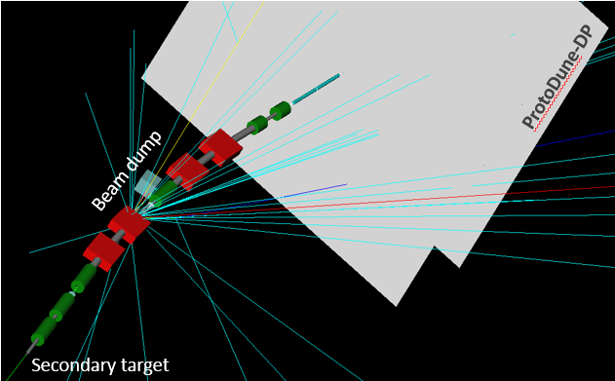
Simulation studies
GEANT4 based package (G4BeamLine)
  Full simulation of H2 beam line transport + sec. target + VLE extension
  All material included until the cryo membrane
  We request a particle to cross all our detectors
  Target W for 0.4 to 3. GeV/c and Cu for p > 3 GeV/c
We generate 6M events per energy
CERN-ACC-NOTE-2016-0052

Slide 3

Beam Composition and rates

Slide 4
Beam Instrumentation

Slide 5
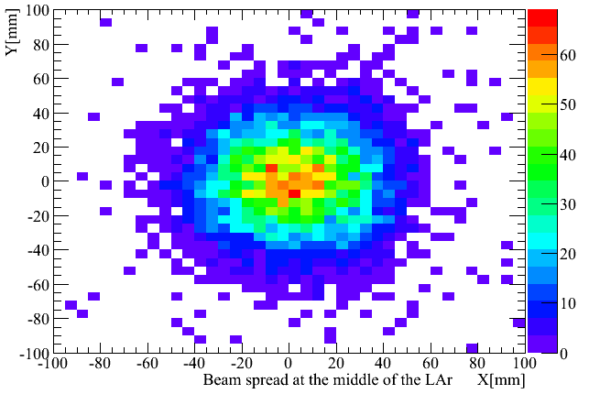
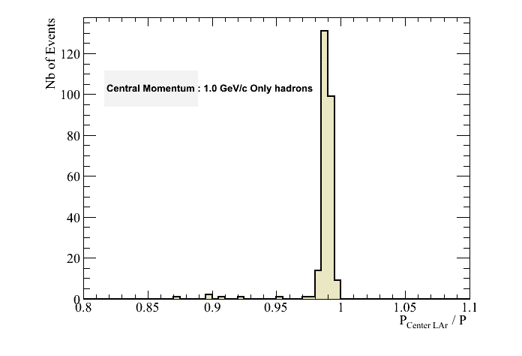
Beam size and momentum @ LAr center

Slide 6
Beam Detectors
Trigger
  3 scintillator tiles 10x10 cm2, S1,2,3
Tracking devices
  4 fiber layers ( 3 in vacuum and the 4th in front of LAr entrance) BPROF1,2,3,4
    1mm diameter one layer per coordinate, ~92% acceptance
Cherenkovs
  Two, 2m long threshold Cherenkovs
TOF
  Two layers of fibers, distant of 32m
  All detectors in vacuum, but BPROF4, and S3.

Slide 7
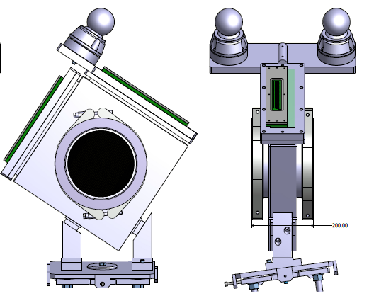
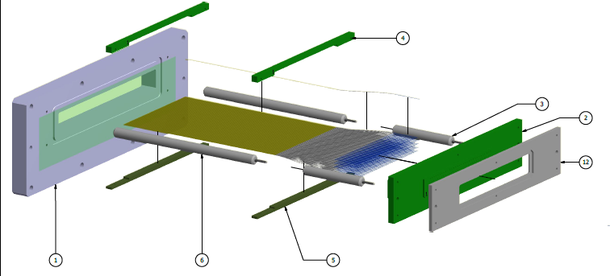
CERN Fiber Beam Profile Monitors and trigger tiles, TOF
→ Integrated in both beam lines
Tilt Flexibility: ~3 degrees from the nominal position
Support Flexibility: ~3 degrees from the nominal position
1mm fibers pitch
Trigger tile of 2mm scintillator
Final design and production for H2 under way by BE/BI group @ CERN
Courtesy: S. Girod, W.Devauchelle, I. Ortega-Ruiz [CERN]

Slide 8
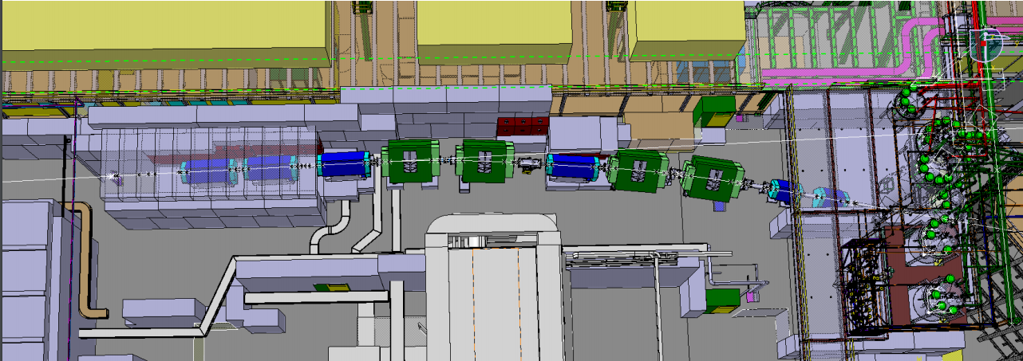
H2: Integration
Courtesy: S. Girod & V. Clerc
All vacuum elements and instrumentation (Cherenkovs, BPROF’s…) integrated.

Slide 9
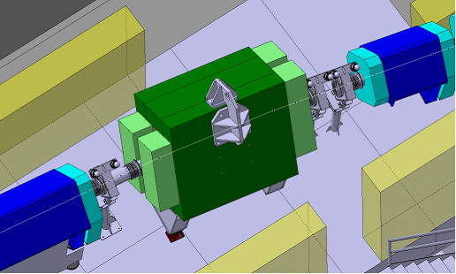
Beam profile monitors, tracker, scintillator tiles
Couresy: S. Girod, V. Clerc

Slide 10
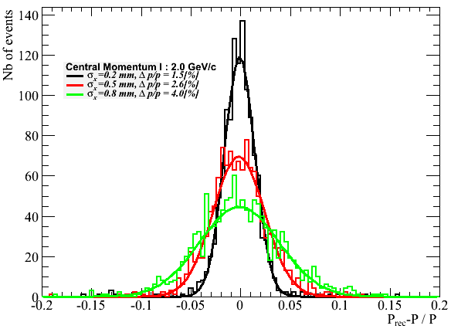
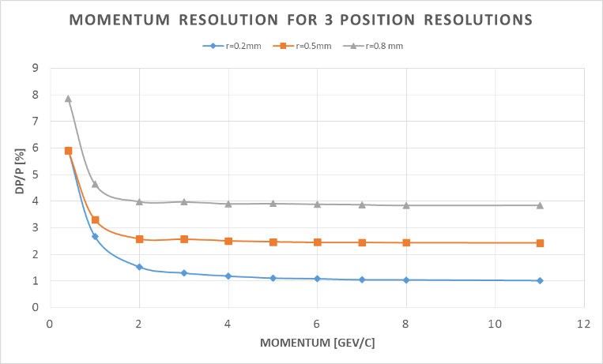
Momentum reconstruction
3 Fiber monitors around the last bend (both lines)
H2
Beam lines include a momentum selection collimator to be used in redundancy if necessary.

Slide 11
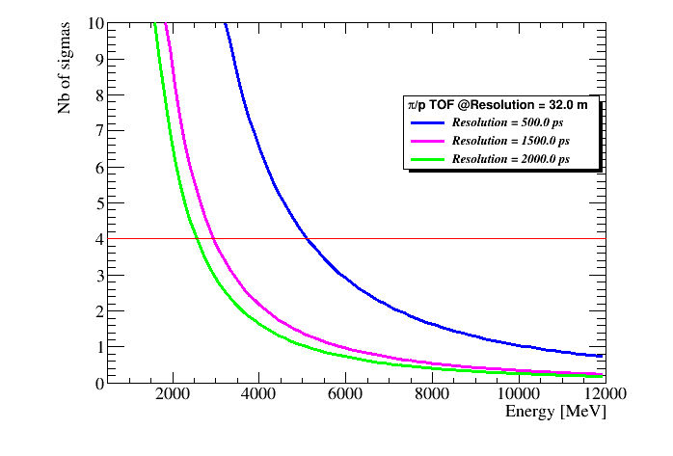
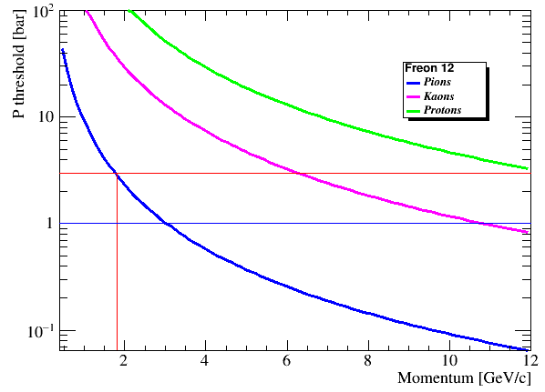
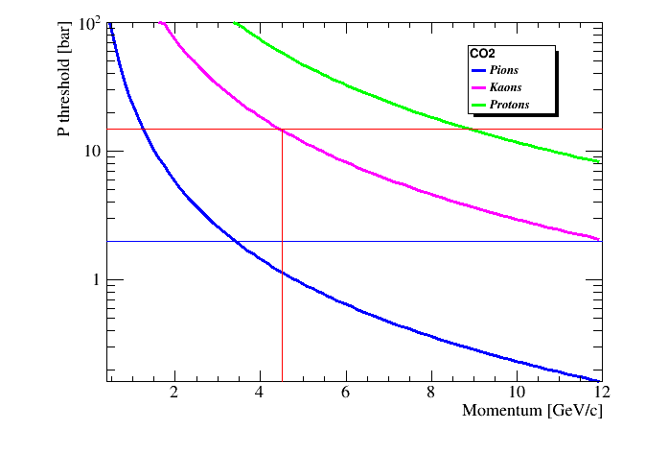
Particle ID
C1
C2

Slide 12
For 3.0 to 4.5 GeV/c
  Beam ++ : We identify pions and (K⁺[0.64% - 1.64%]+p[7.6%]), therefore we call them all p contaminated by K [8%-18%]
  Beam +- : We identify pions and (anti-p[0.3%-0.65%]+K-[0.36%-0.65%])

Slide 13
Freon 12
This gas may be available at CERN but needs a lot of effort
Replaced by R134a
  The refractive index is ‘unknown’. However for the R134 (n – 1) = 3200 10⁻⁶ ( J. Phys. Chem., 1990, 94 (25), pp 8840–8845 ) which would be perfect. Many weeks to get R134 !
  Use parasitically a beam at PS (1-5 GeV, e, π, p) and make pressure scans. Experiment to be done next week in principle.

Slide 14
DAQ
CERN is responsible for the beam data DAQ
  VME crate and dedicated standard modules
Beam Data
  x,y from the 4 beam profile monitors
  Two Cherenkov counters firing
  Time stamp
  TOF (?)
Beam Data buffer available between bursts
Time Stamp via White Rabbit
  Extra VME module to be added

Slide 15
Muon Shielding Studies

Slide 16
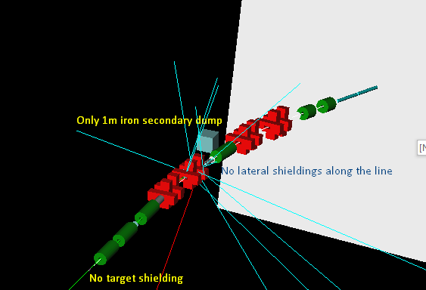
v. 1 : No Shielding

Slide 17
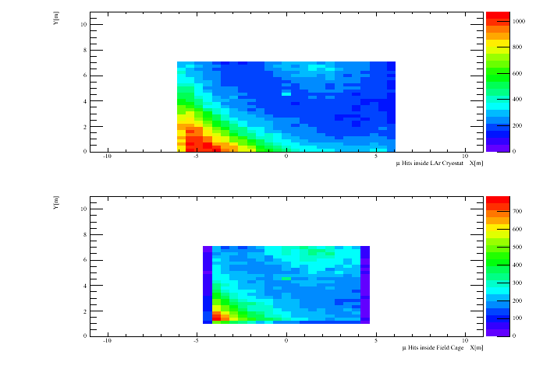
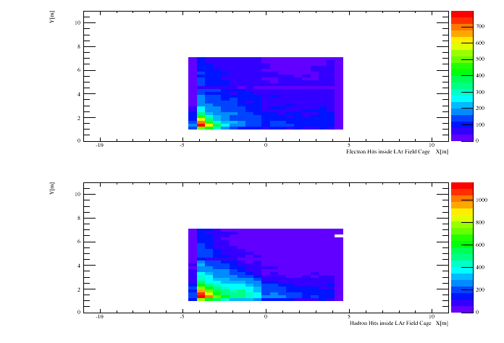
No Shielding Results
Number of muons in cryostat LAr 12GeV 229881
Number of muons in FC 12GeV 105162
Number of hadrons in FC 12GeV 63779
Number of electrons in FC 12GeV 41518

Slide 18
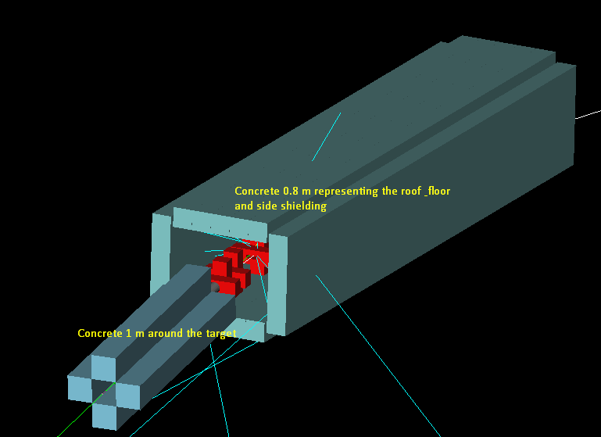
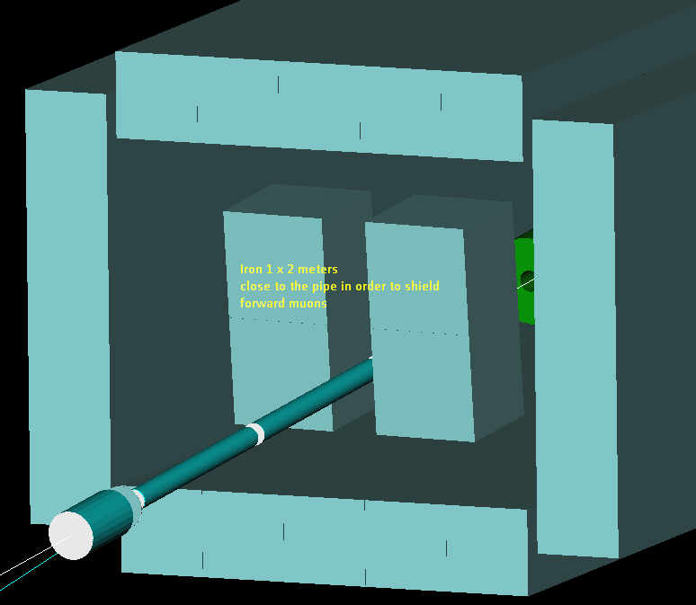
Shielding v1

Slide 19
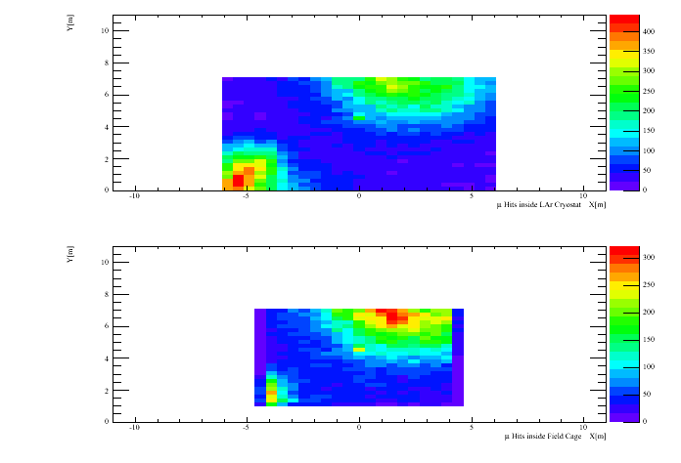
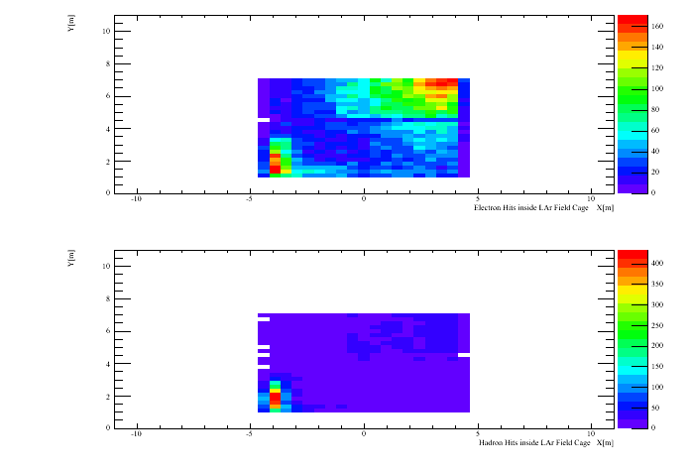
Shielding v1
Number of muons in cryostat LAr 12GeV 67523
Number of muons in FC 12GeV 39996
Number of hadrons in FC 12GeV 9685
Number of electrons in FC 12GeV 21171

Slide 20
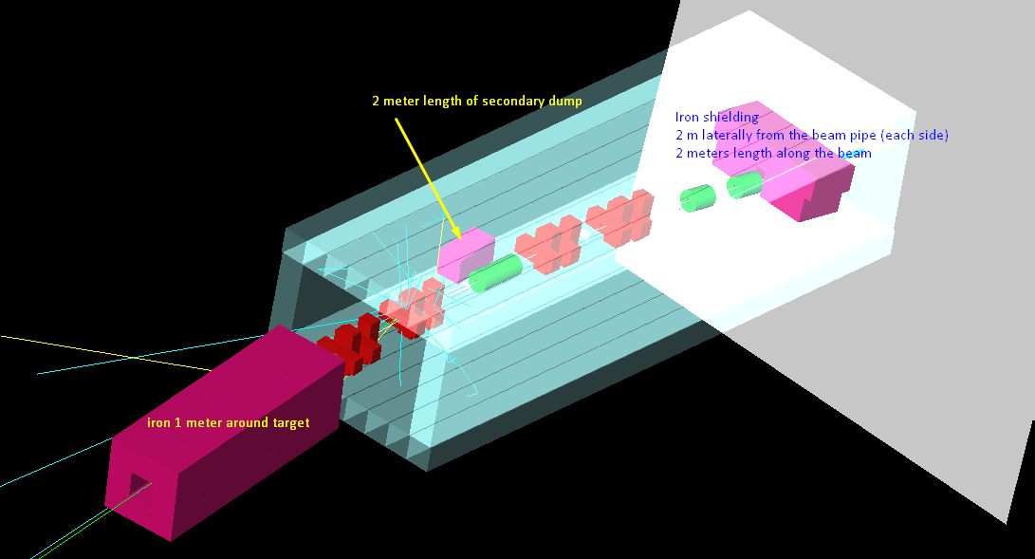
Shielding v2

Slide 21
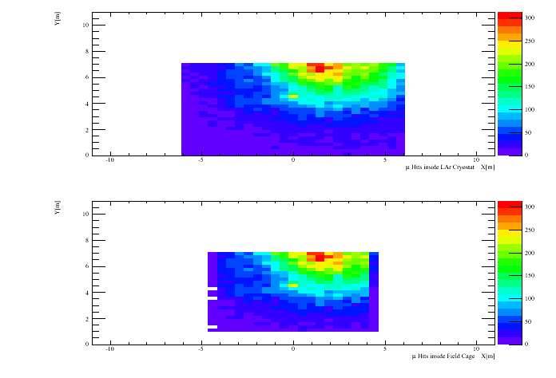
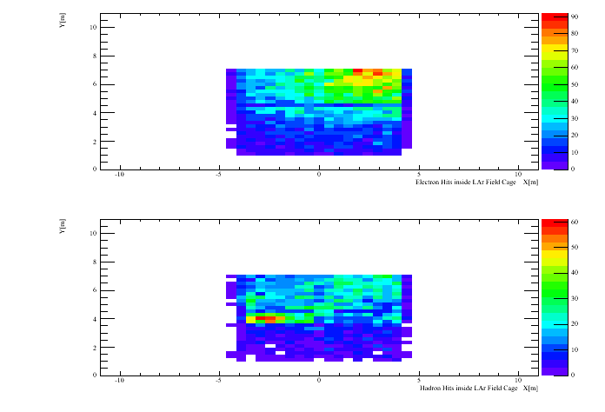
Shielding v2
Number of muons in cryostat LAr 12GeV 42824
Number of muons in FC 12GeV 33471
Number of hadrons in FC 12GeV 5537
Number of electrons in FC 12GeV 11367

Slide 22
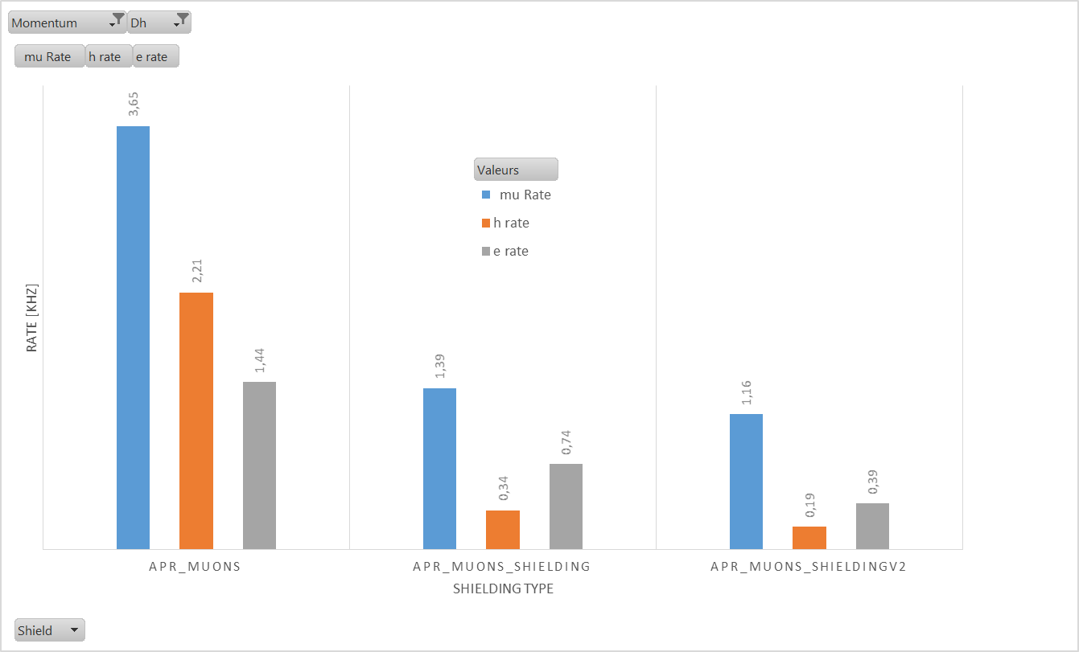

Slide 23
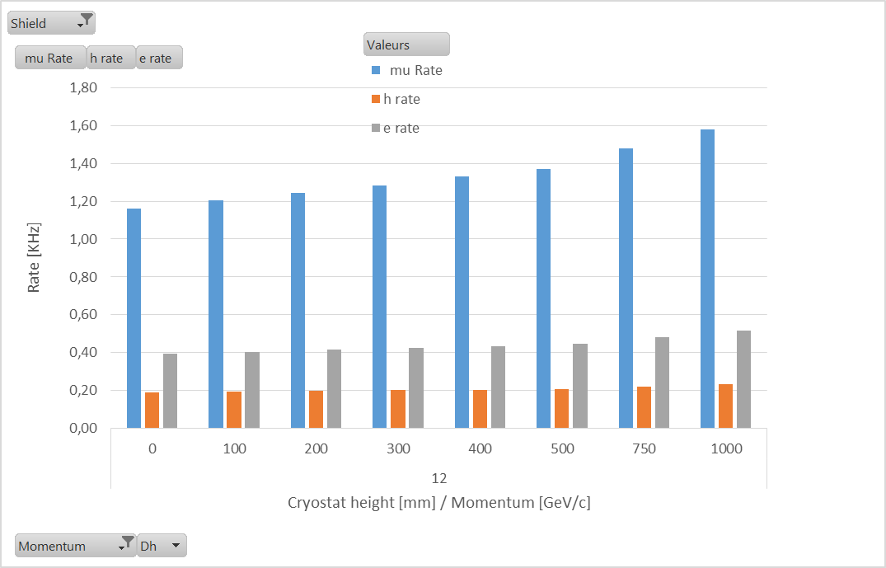
More shielding

Slide 24
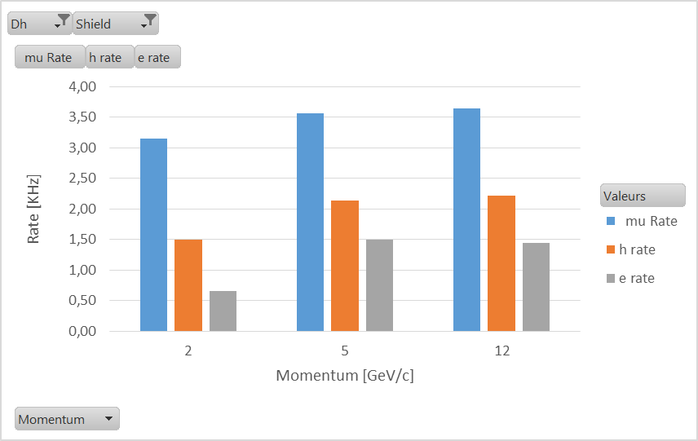
No shielding

Slide 25
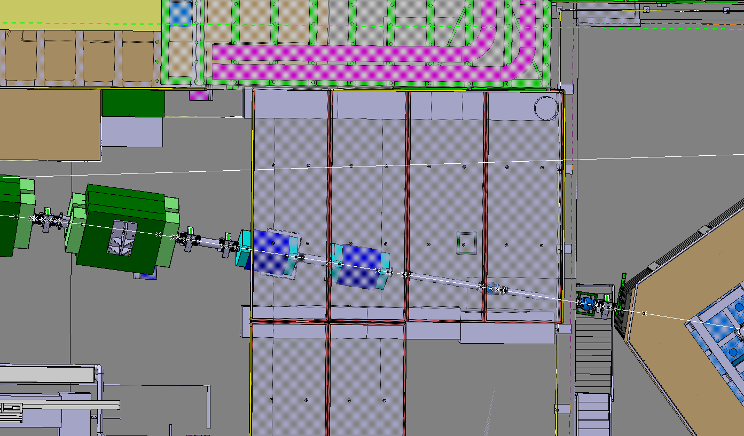
Shielding upstream NP02 top view
Passage 1250
H 3.9m
H 3.9m
1250
XCET
XCET

Slide 26
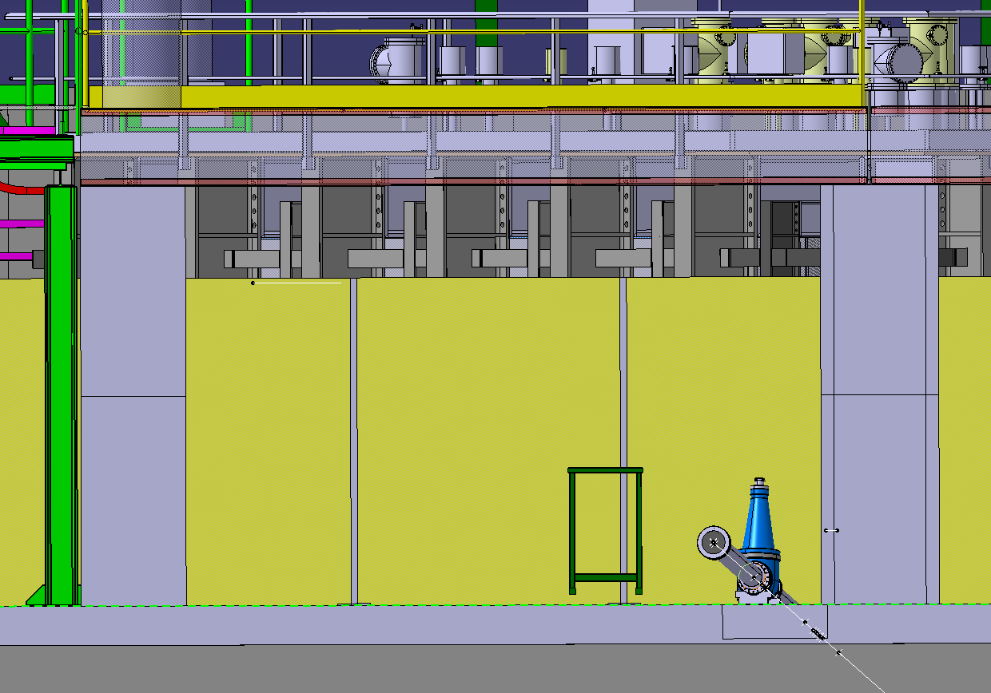
1688
1688
1600 mm
23168
1200 mm
XCET

Slide 27
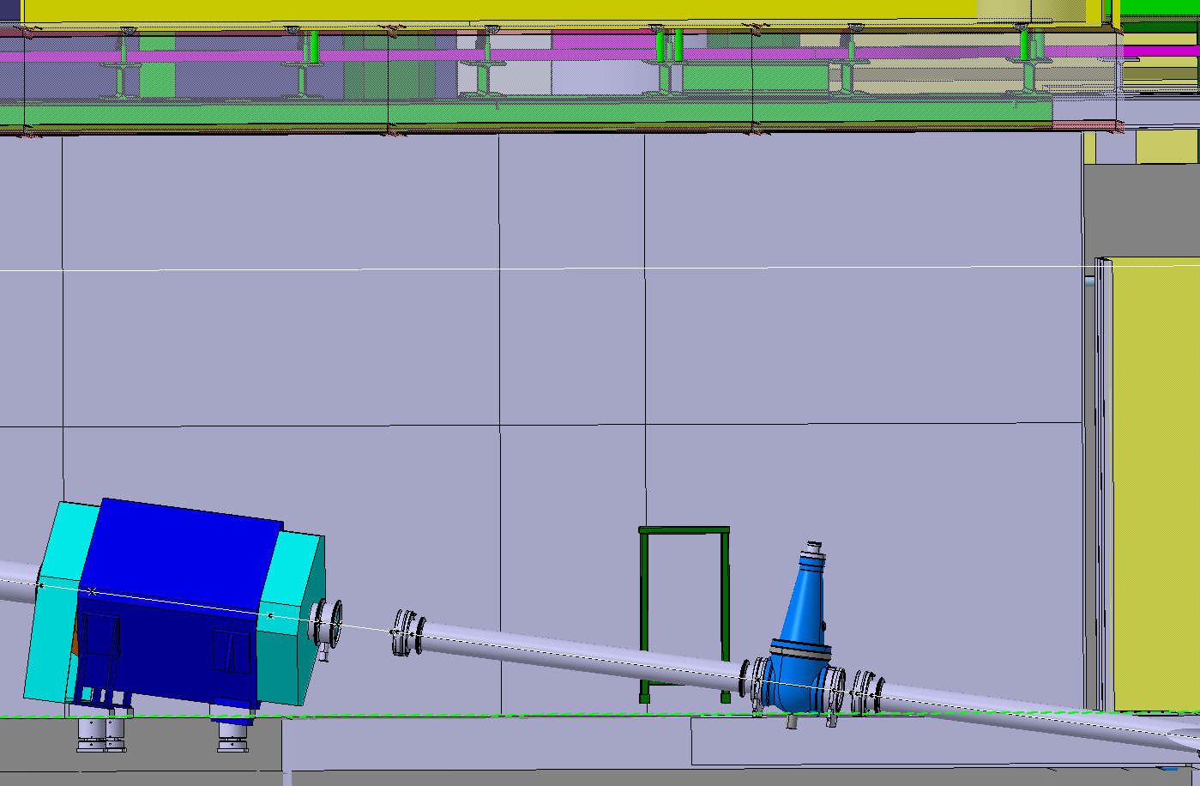
800mm Concrete; Fe; Al; feta?

Slide 28
Summary
Extensive simulations finished for H2, data available on eos
  Physics list study
  Target optimization
  Background (muons) in progress
  Momentum measurement
Material budget optimization
Detailed technical note submitted end of july 2016
Measure R134a refractive index
Detector production in progress
  Build 1/10th of TOF and test it on SPS this autumn

