Slide 1
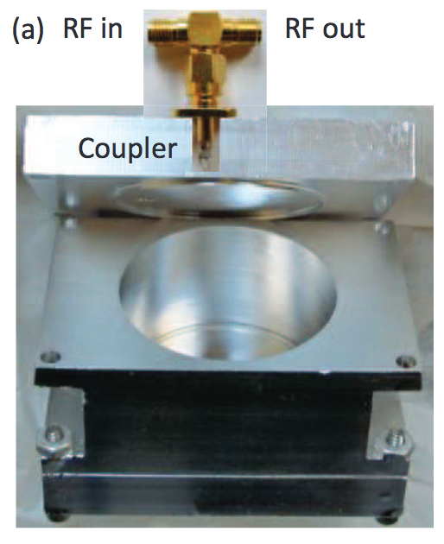
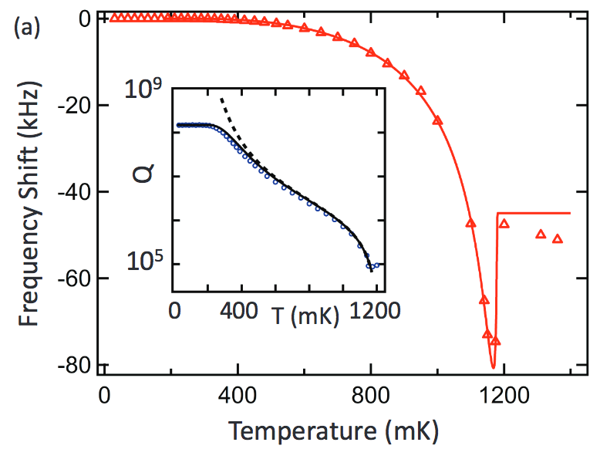
Study cavity wall material
Conductivity theory predicts the anomalous skin effect
Copper is the simplest conductor to demonstrate the effect
How about Aluminum?
The prediction is made for the BCS theory and it is more complicate than Cu (e.g. anisotropy of the scattering of conducting electrons)
Presently, high-purity Aluminum is one of the most popular materials to make a quantum computer (QC)
M. Reagor et al., arXiv:1302.4408v2 (2013)
The test used a 11.442 GHz Al Cavity
Purity: 99.999 %
Critical temperature of Al: 1.2 K
Q = 3 10⁸ in Super Conducting RF (SRF)
Q = 10⁵ in Normal Conducting RF (NRF)
Dashed curve is a prediction
Is Al better than Cu
for ADMX?

Slide 2
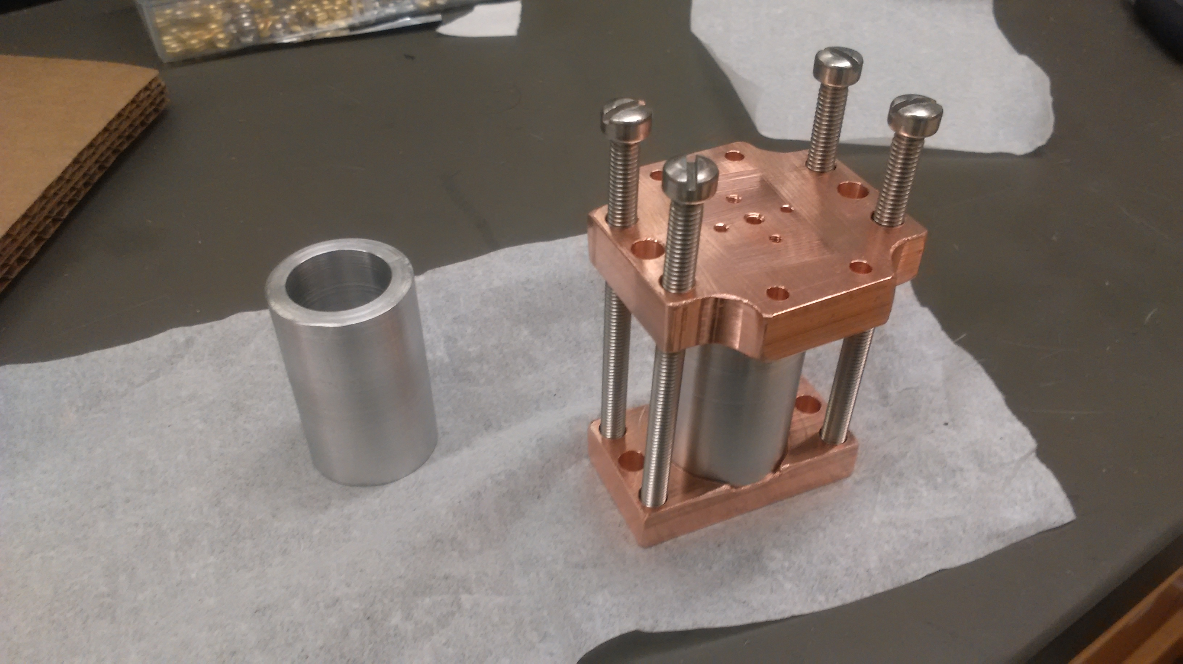
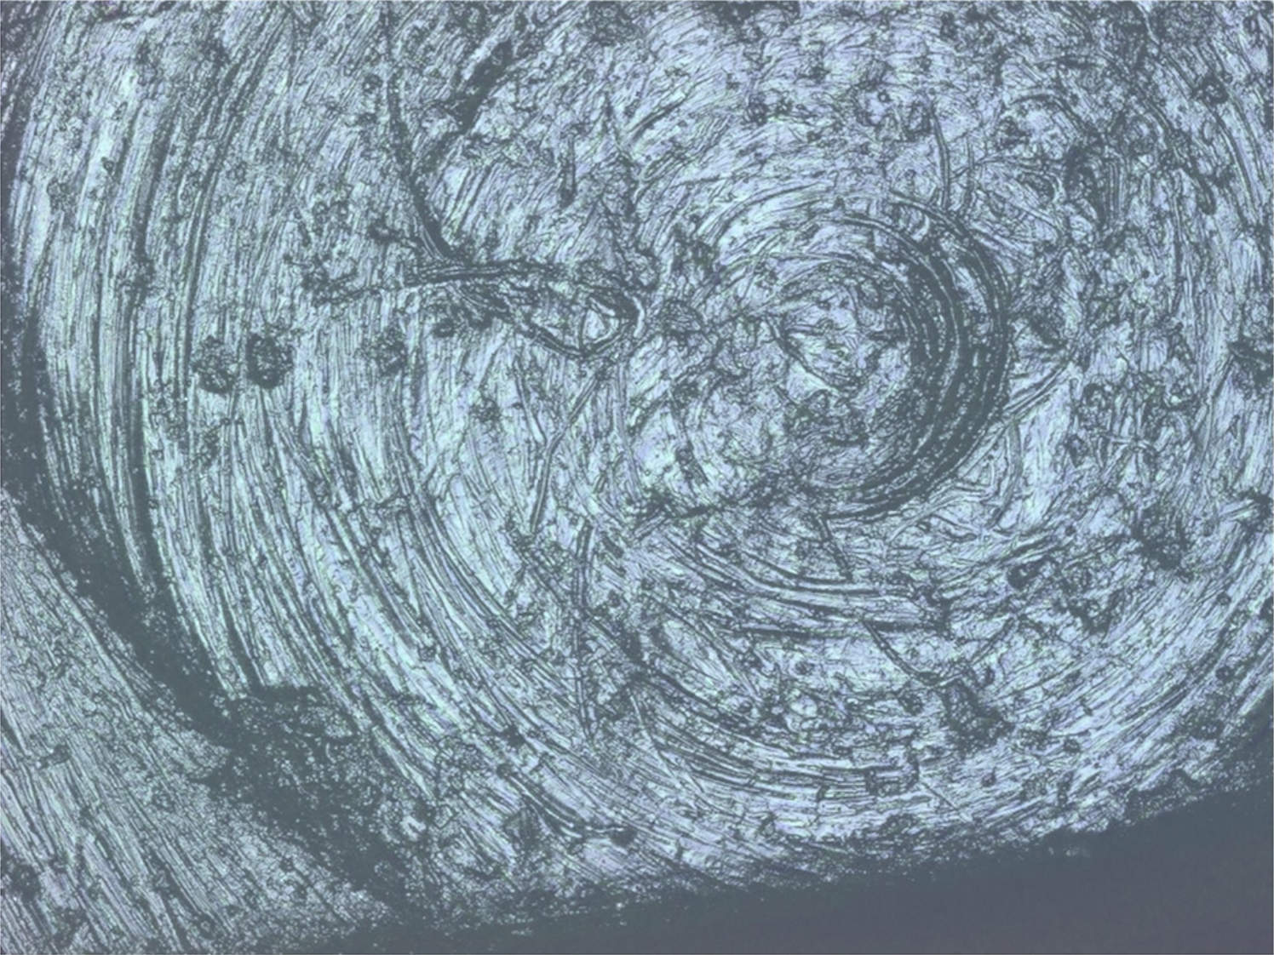
Work progress
Made several high purity Aluminum cavities
99.99% (4N), 99.999% (5N), and 99.9999% (6N)
Sumitomo Material provided a sample
Collaborate with the QC group at U of Chicago
UC is interested in a high-Q SRF
Observe a Q-factor for various SRF materials
Utilize Fermilab SRF facility to prepare an SRF cavity
Study a surface roughness vs a Q-factor
First 4N Al cavity reaches 1.7 10⁸ (Preliminary)
ADMX is interested in a high-Q NRF
Measure the Q-factor of a high-purity Al cavity
in a multi-Tesla magnetic field
Find a fridge + a multi-tesla magnet
Looking for more collaborator and funding support
Task is halted because of short money
Clamp
Resonator
Microscopic picture of
the first FNAL Al cavity

