Slide 1


CASPEr: the Cosmic Axion Spin Precession Experiment
Derek F. Jackson Kimball
California State University – East Bay

Slide 2

Collaboration

Slide 3
Collaboration

Slide 4



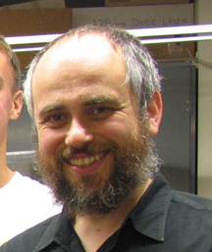






Collaboration
Dmitry Budker,
Arne Wickenbrock,
John Blanchard,
Samer Afach,
Marina Gil Sendra,
Martin Engler,
Gary Centers,
Nataniel Figueroa (Mainz)

Slide 5
Collaboration

Slide 6
Collaboration

Slide 7



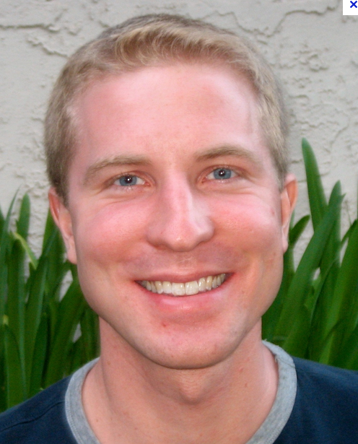


Collaboration
Surjeet Rajendran,
Tao Wang,
Dmitry Budker (UCB),
Peter Graham (Stanford),
Derek Kimball (CSUEB)

Slide 8
Collaboration

Slide 9
Collaboration

Slide 10



Collaboration
?
Alex Sushkov,
Deniz Aybas (Boston University)

Slide 11
Collaboration
Alex Sushkov,
Deniz Aybas (Boston University)

Slide 12
Outline
Motivation and theory;
CASPEr Electric;
CASPEr Wind;
New idea: a precessing ferromagnetic needle;
Conclusions.

Slide 13
Cosmic Axion Spin Precession Experiment
(CASPEr)

Slide 14
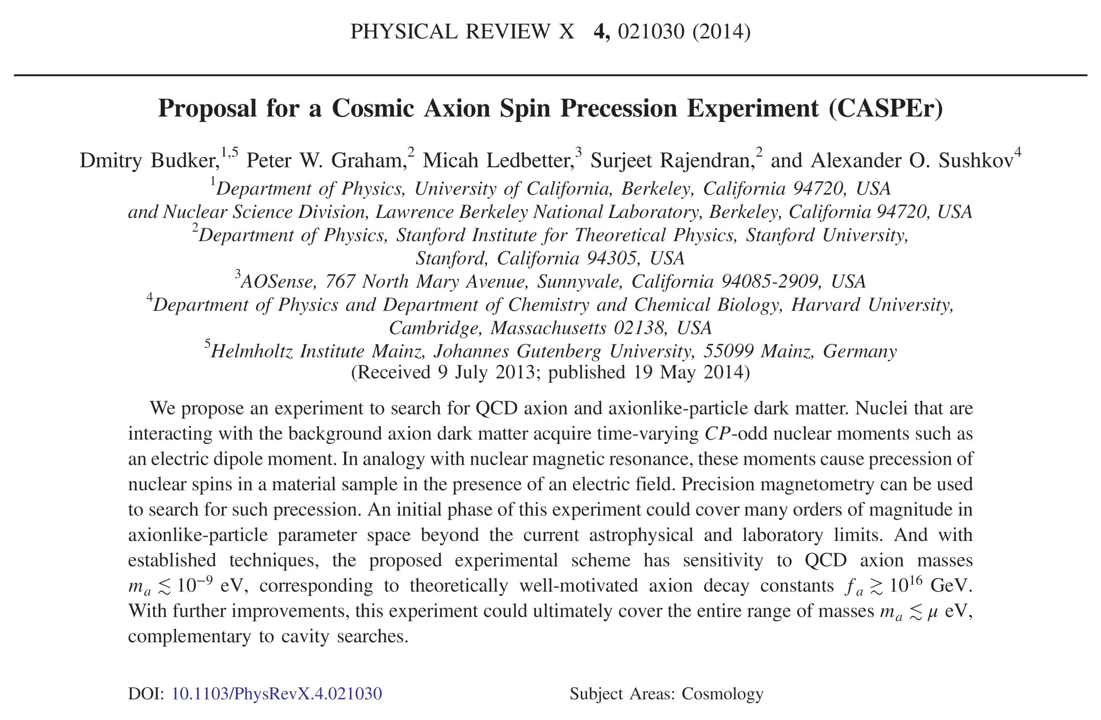
D. Budker et al., Phys. Rev. X 4, 021030 (2014).

Slide 15
Motivation and theory

Slide 16
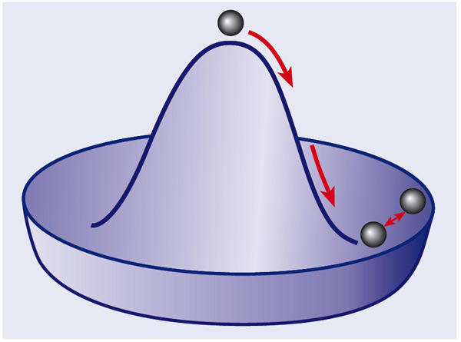
Axions
Axions and axion-like particles (ALPs) are pseudo-Goldstone bosons of global symmetries broken at an energy scale f_{a}.

Slide 17
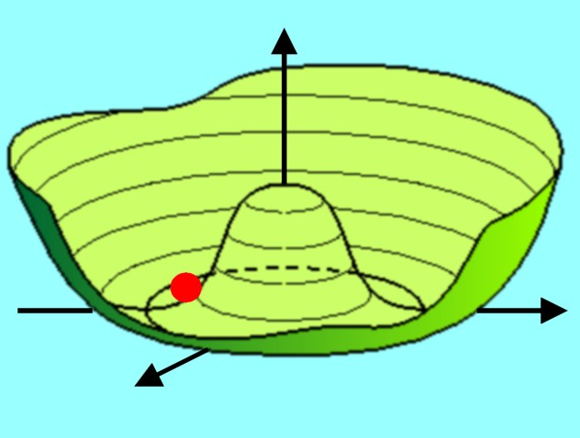


Axions: misalignment
When axions are produced after the Big Bang upon the breaking of the global symmetry, they are initially massless and can take on any initial field value a₀.

Slide 18
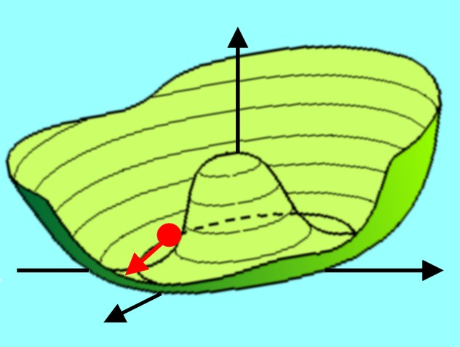
Axions: misalignment
However, when non-perturbative effects due to, for example, QCD become important, a potential develops for the axion.

Slide 19
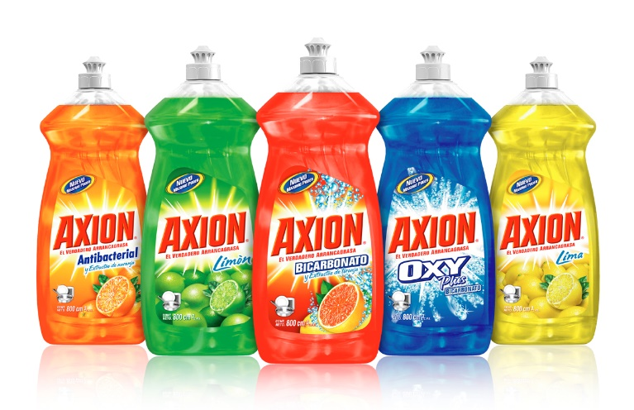
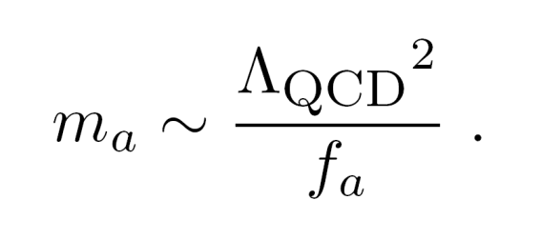
Axion mass
The QCD axion mass is given by:
Λ_{QCD} ~ 200 MeV is the QCD confinement scale.
ALPs may have different Λ and f.

Slide 20
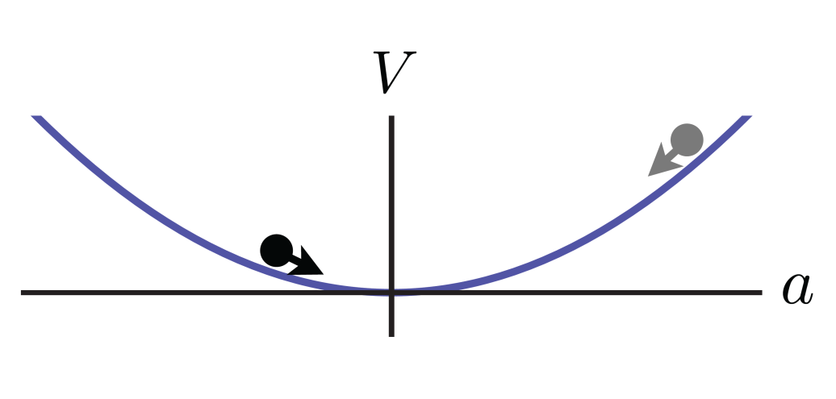
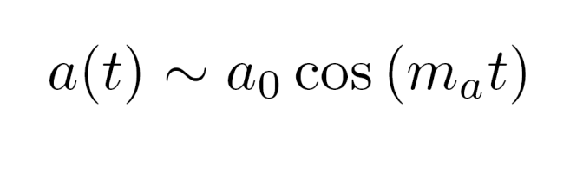
Axion oscillations
Because of the random misalignment between the axion field a₀ and the potential minimum, the axion field oscillates at the Compton frequency.

Slide 21
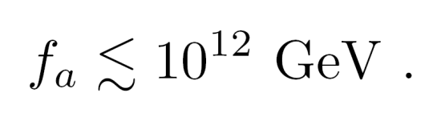
Inflation and axion cosmology
If the initial misalignment angle ∼ 1 in the early universe, then for the QCD axion:
The “anthropic” window.
However, if the inflation scale is lower than f_{a} the universe before inflation can have an inhomogeneous distribution of a₀.
Any local patch can inflate into our visible universe with a uniform value of a₀, and, of course, our visible universe has a dark matter density small enough to avoid overclosure.

Slide 22
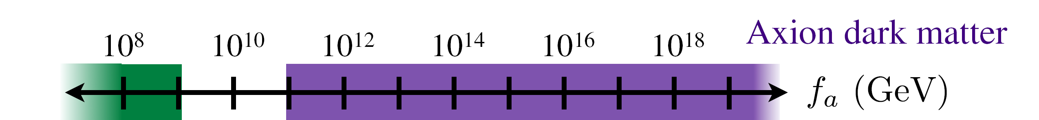
Inflation and axion cosmology
CASPEr
Astrophysical
constraints
ADMX
GUT scale
Planck scale

Slide 23
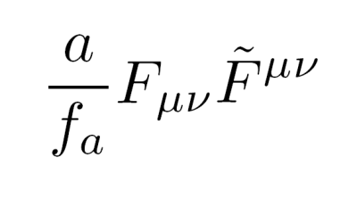
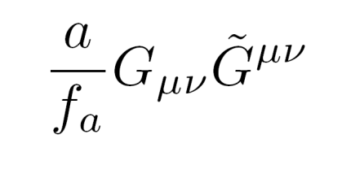
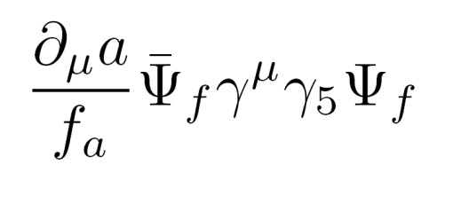
Axion couplings
Coupling to electromagnetic field
Coupling to gluon field
CASPEr Electric
Coupling to fermions
CASPEr Wind

Slide 24
CASPEr Electric

Slide 25
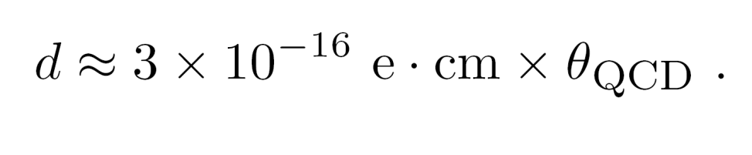
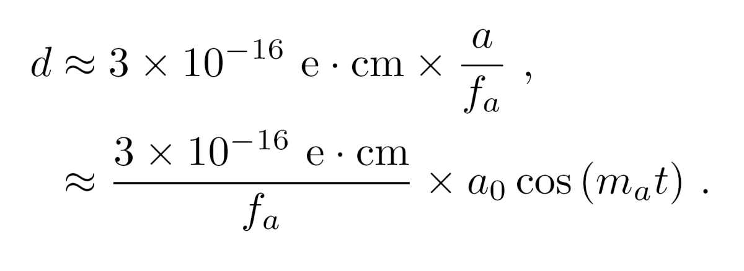
Axion-induced electric dipole moments (EDMs)
Nuclear EDM from the strong interaction (strong CP problem):
Nuclear EDM from axion field:
Can be thought of as
an oscillating θ_{QCD}.

Slide 26
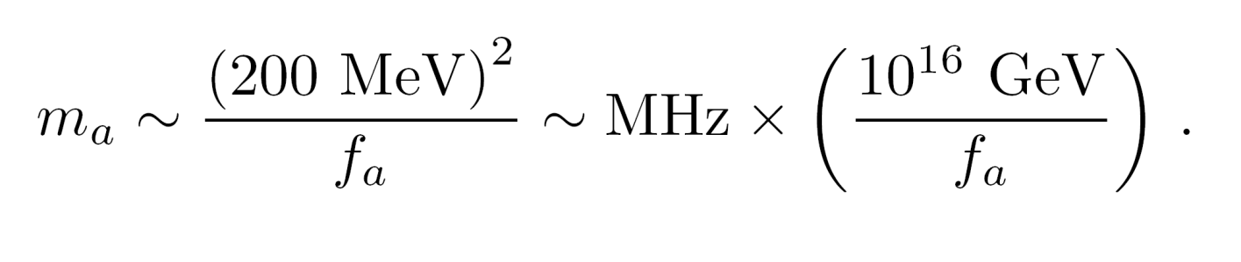
Axion oscillation frequency
Determined by the axion mass, related to the global symmetry breaking scale f_{a} :
f_{a} at GUT scale → MHz frequencies,
f_{a} at Planck scale → kHz frequencies.

Slide 27
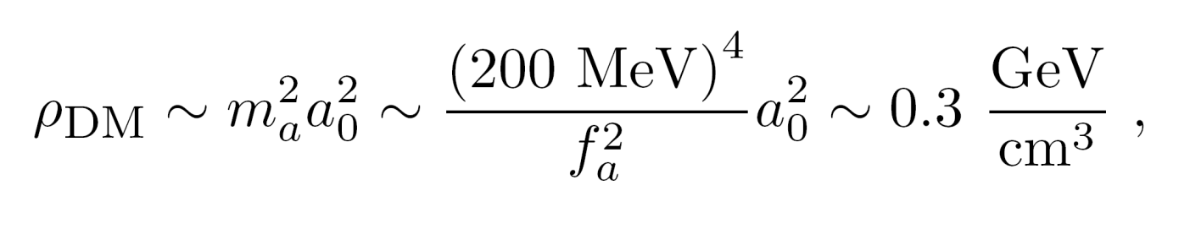
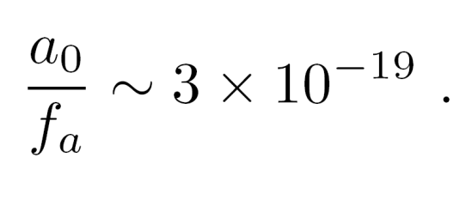
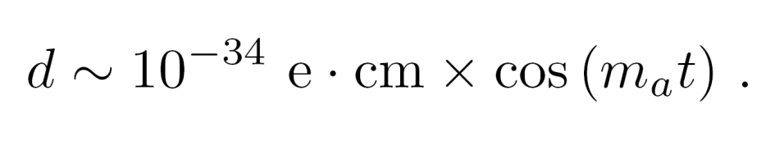
Axion-induced oscillating EDM
Assuming axions are the dark matter, the dark matter density fixes the ratio a₀/f_{a}:
This generates an oscillating EDM:

Slide 28
Nuclear Magnetic Resonance (NMR)
NMR resonant spin flip when Larmor frequency

Slide 29
EDM coupling to axion plays role of oscillating transverse magnetic field
SQUID
pickup
loop
Larmor frequency = axion Compton frequency
➔ resonant enhancement.

Slide 30
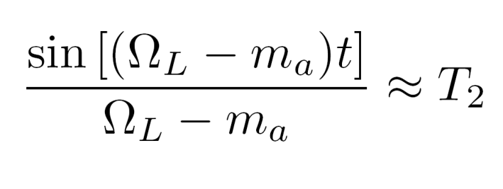
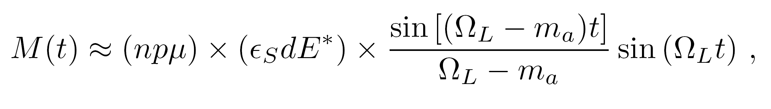
Signal estimate
n = atomic density;
p = nuclear polarization;
μ = magnetic moment;
E* = effective electric field;
ε_{S} = Schiff suppression;
Ω_{L} = Larmor frequency.

Slide 31
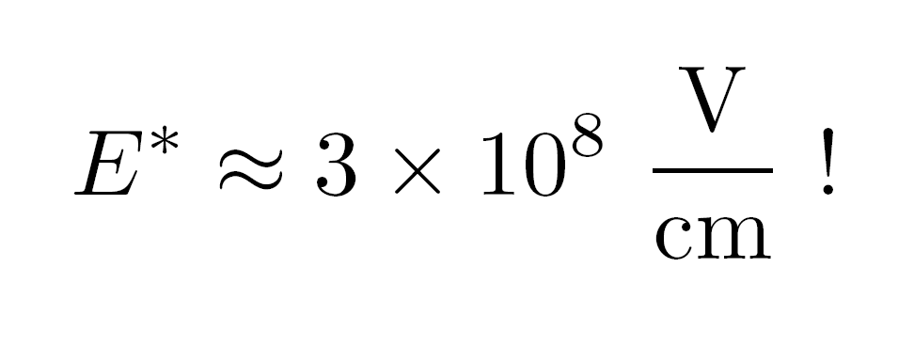
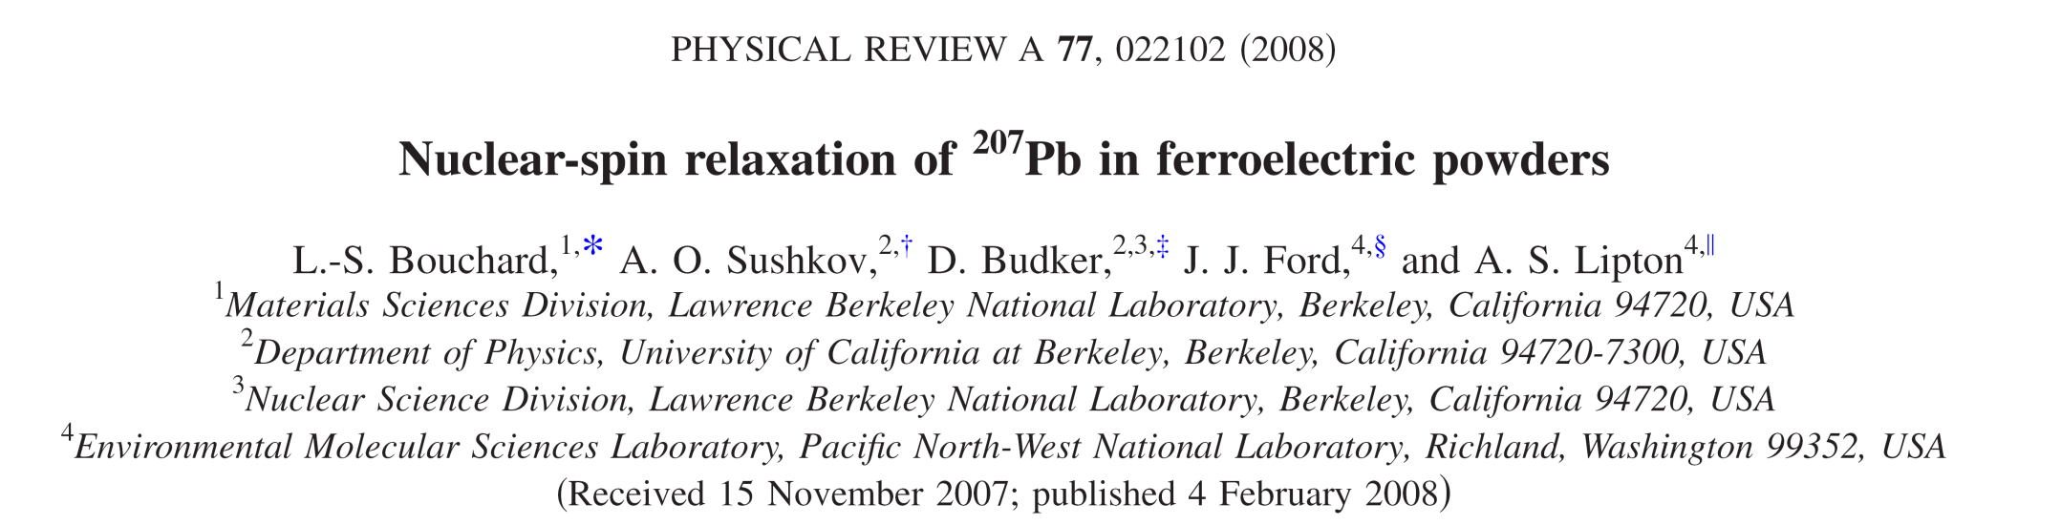
Sample choice
Need maximum n, p, E*, and ε_{S}, and long T₂.
For the first generation CASPEr-Electric experiment, we plan to use a ferroelectric crystal, likely PbTiO₃.

Slide 32
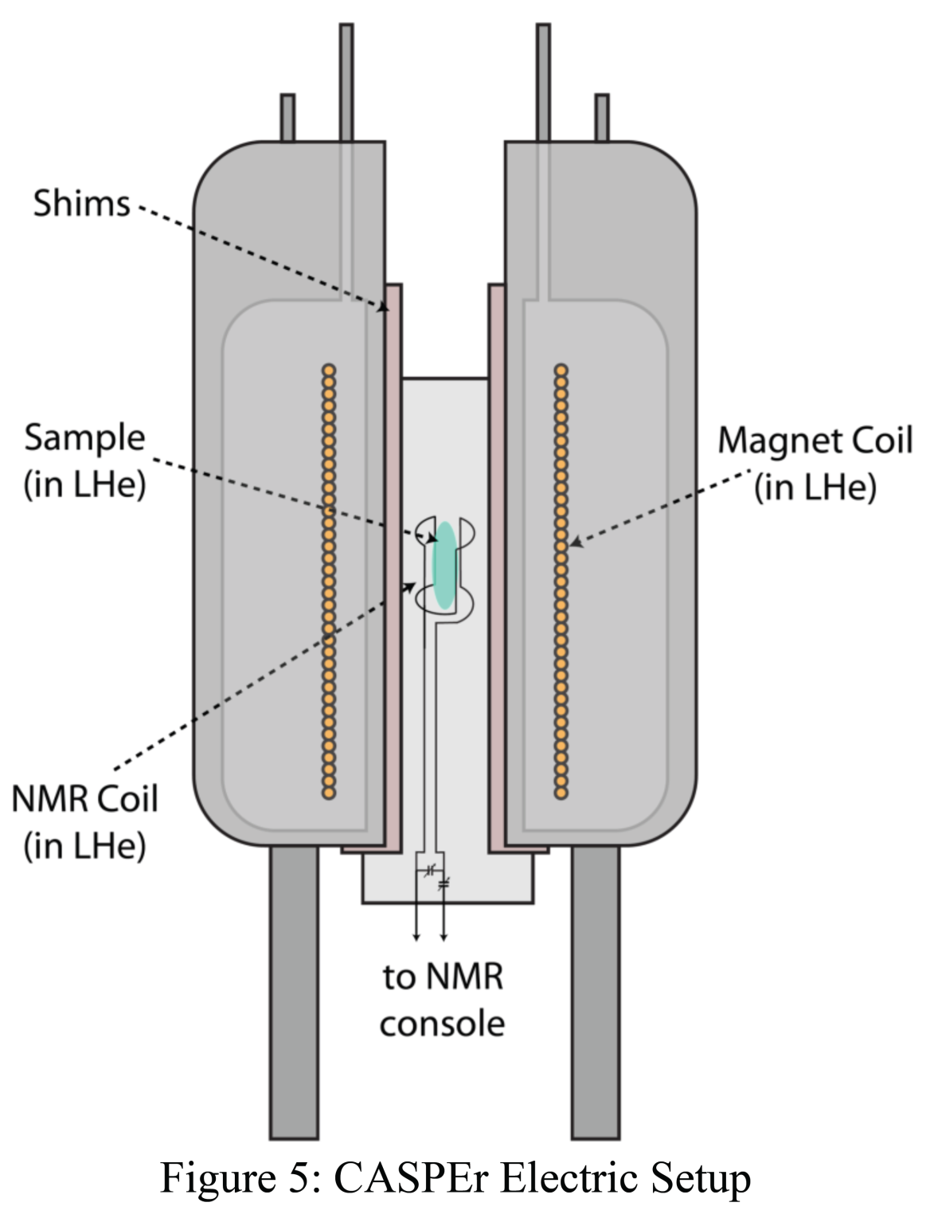
Experimental strategy
(1) Thermally polarize spins in a cryogenic environment at high magnetic field (~ 10 T);
(2) Scan magnetic field down from 10 T -- Larmor frequency decreases from ~ 50 MHz;
(3) Integrate for ~ 10 ms at each frequency, complete scan takes around 1000 s ≈ T₁ to complete.

Slide 33
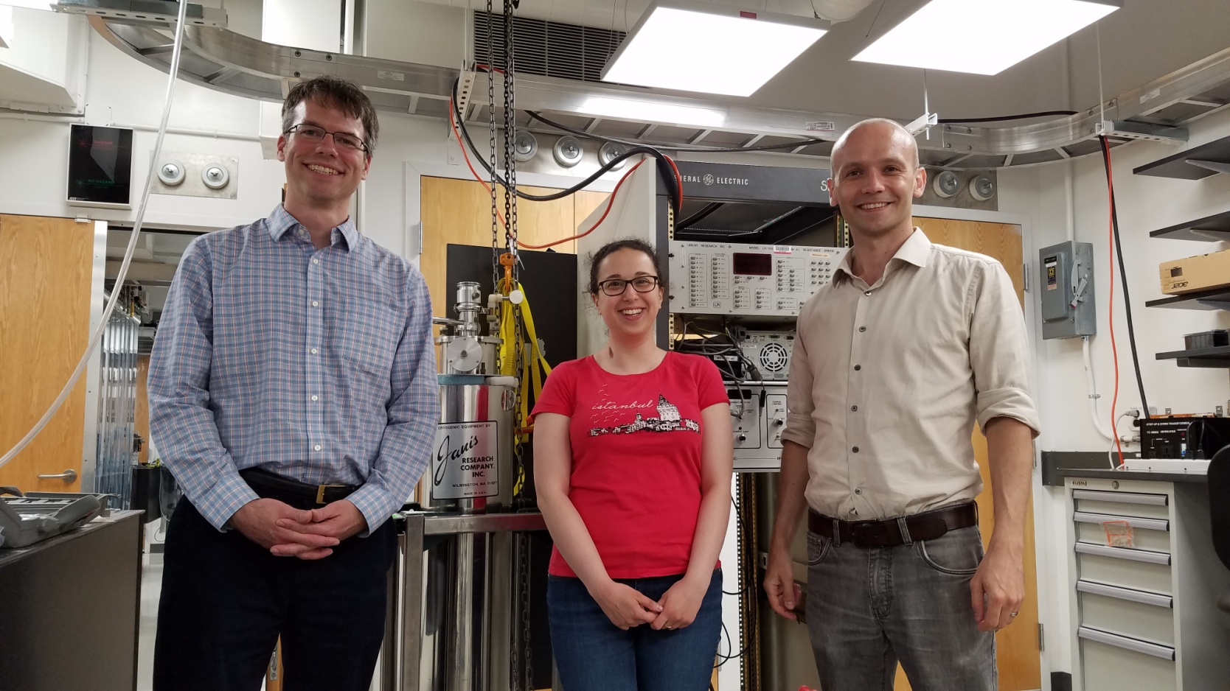
Experiments beginning!

Slide 34
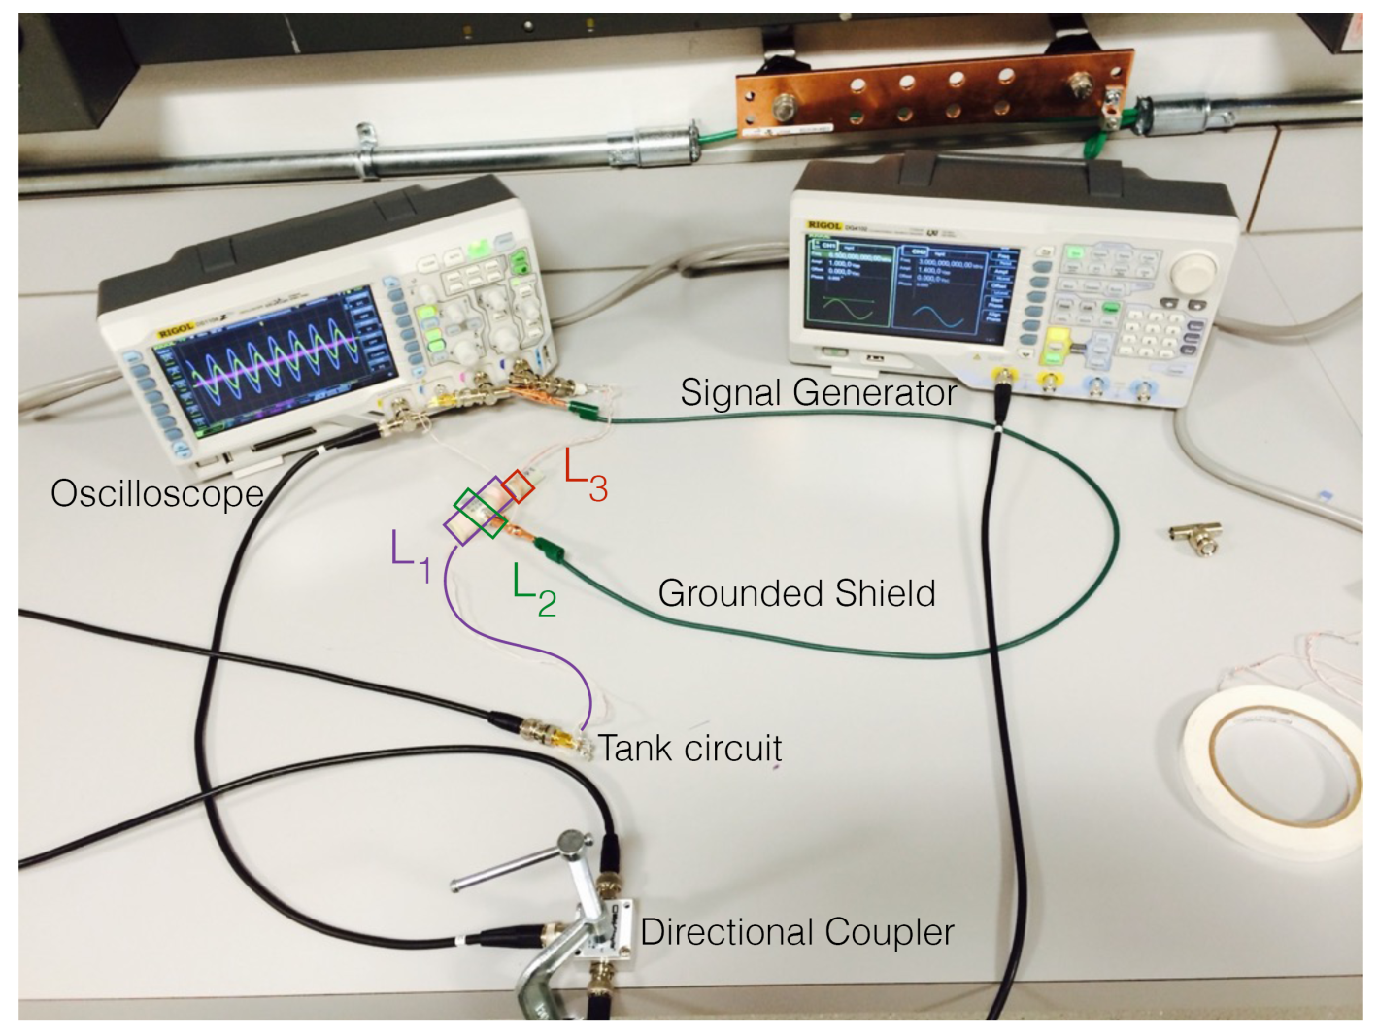
Experiments beginning!

Slide 35
Challenges
(1) T₁ acquires field dependence due to paramagnetic impurities – long T₁ at high fields, short T₁ at low fields:
this is a problem for duty cycle and maintaining polarization at low fields.
(2) The chemical shift anisotropy (CSA) can broaden the resonance.
(3) Vibrations can be an issue for low frequencies/fields.
Estimates of thermal drifts and magnetic field fluctuations indicate that they shouldn’t be a major problem.

Slide 36
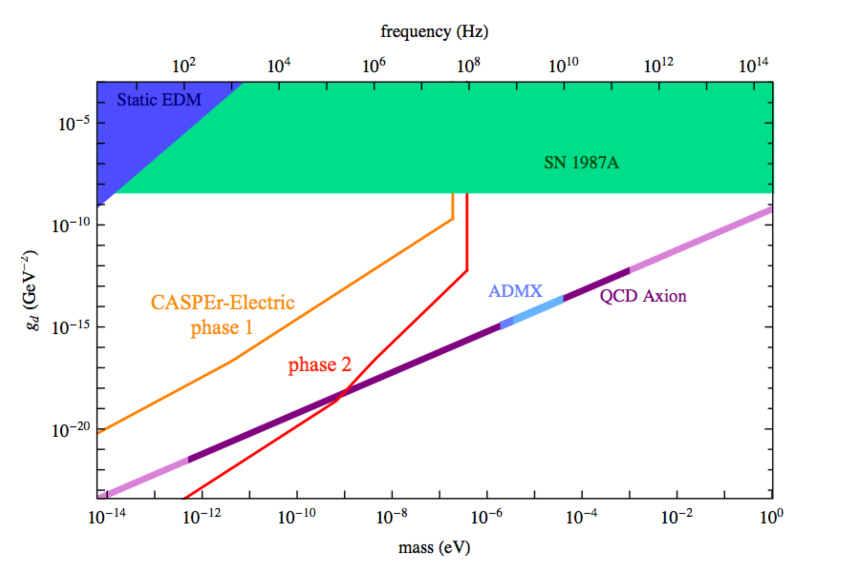
Experimental strategy
Experimental sensitivity

Slide 37
Phase 2 requirements
(1) Longer coherence time: T₂ ≈ 1 s.
(2) Hyperpolarization: p ≈ 1.
(3) Larger sample size: V ≈ 100-1000 cm³.
R&D required!

Slide 38
CASPEr Wind

Slide 39
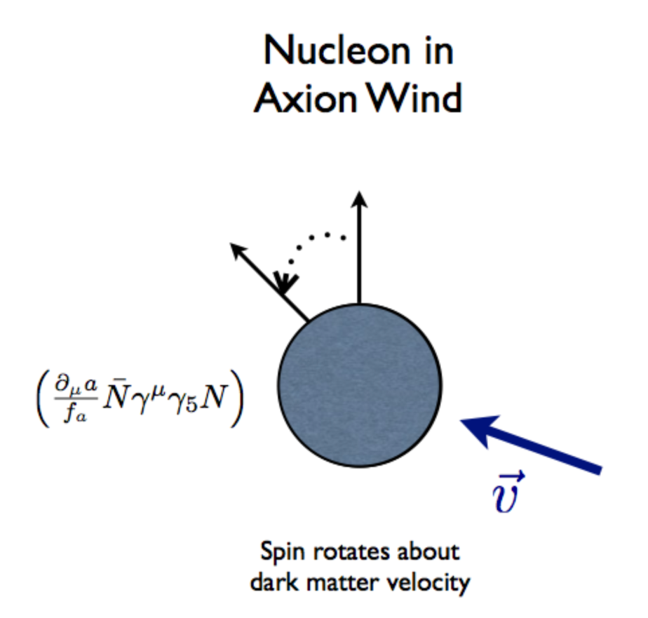
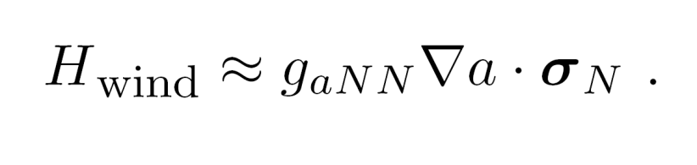
Axion/ALP-induced spin precession (axion wind)
Nonrelativistic limit of the axion-fermion coupling yields a Hamiltonian:

Slide 40
Axion wind detection
SQUID
pickup
loop
axion “wind”
Larmor frequency = axion Compton frequency
➔ resonant enhancement.

Slide 41
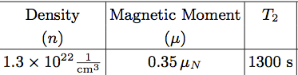
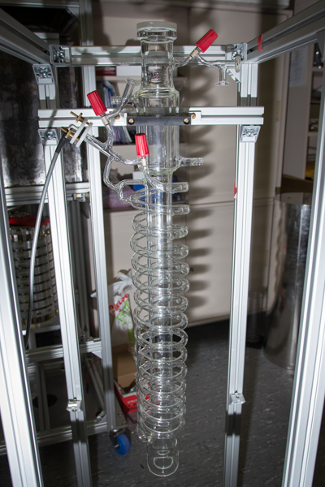
Sample choice: liquid Xenon
Relatively large sample can be hyperpolarized.
The enhancement factor can be on the order of 10⁶.

Slide 42
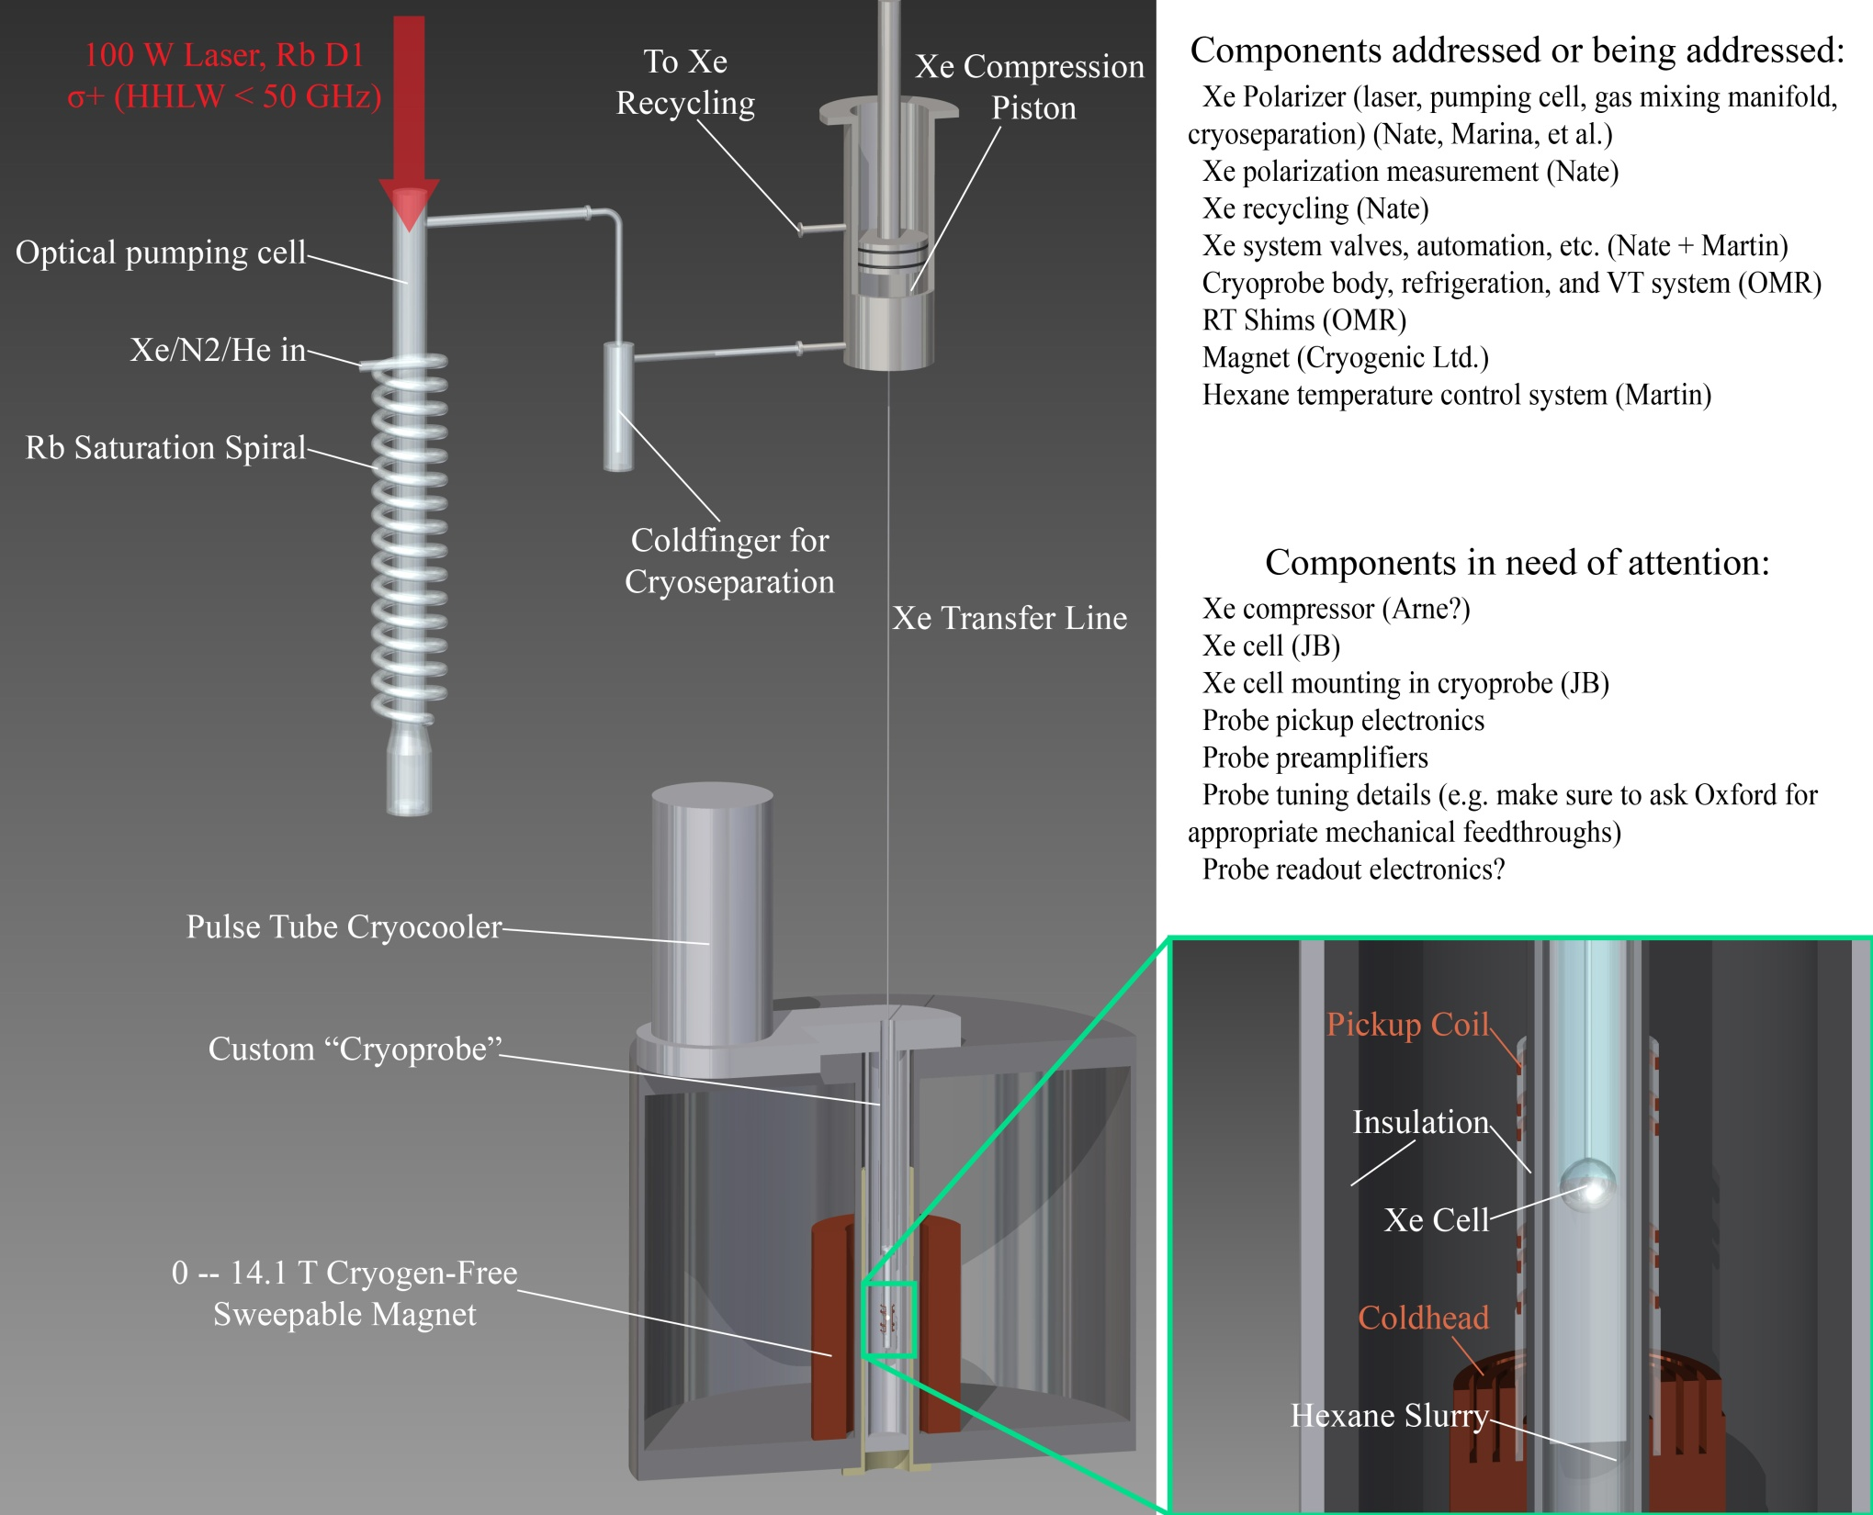
Experimental
setup

Slide 43
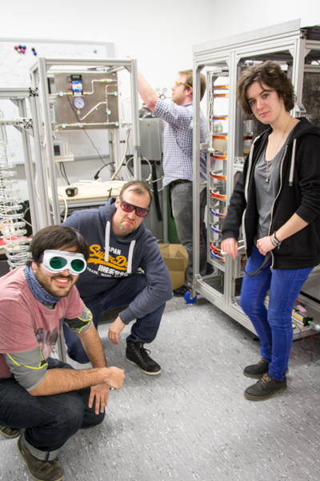
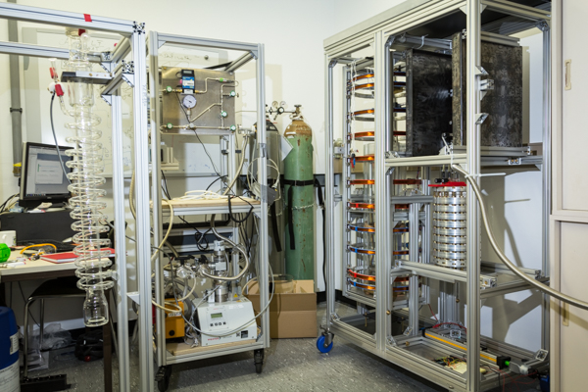
Experiments beginning!

Slide 44
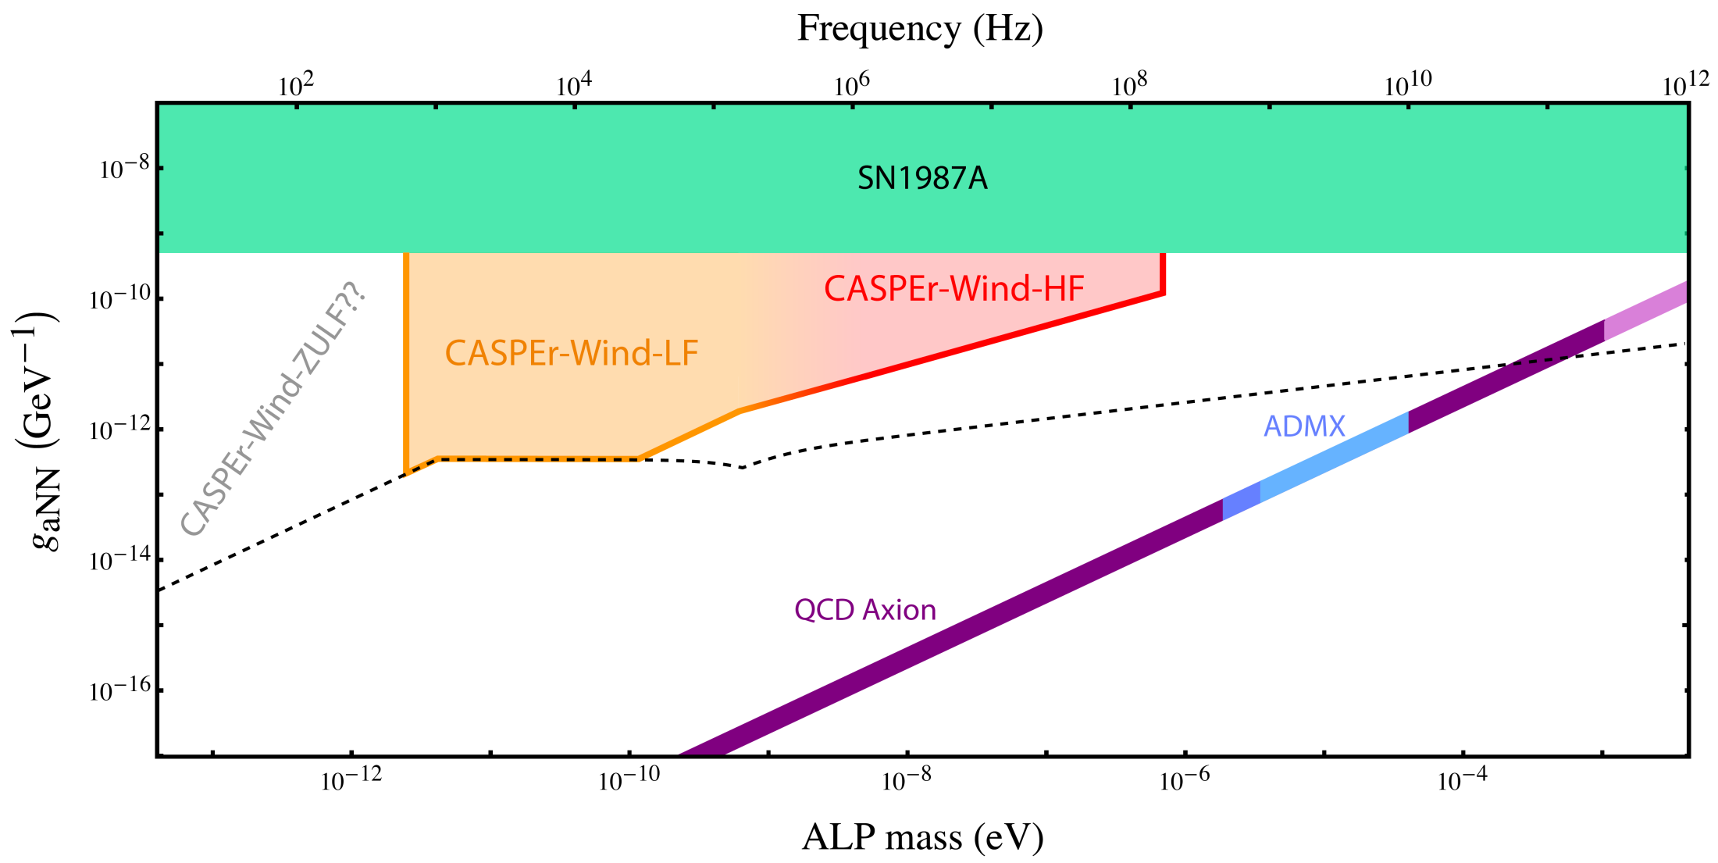
Experimental sensitivity

Slide 45
New idea: a precessing ferromagnetic needle

Slide 46
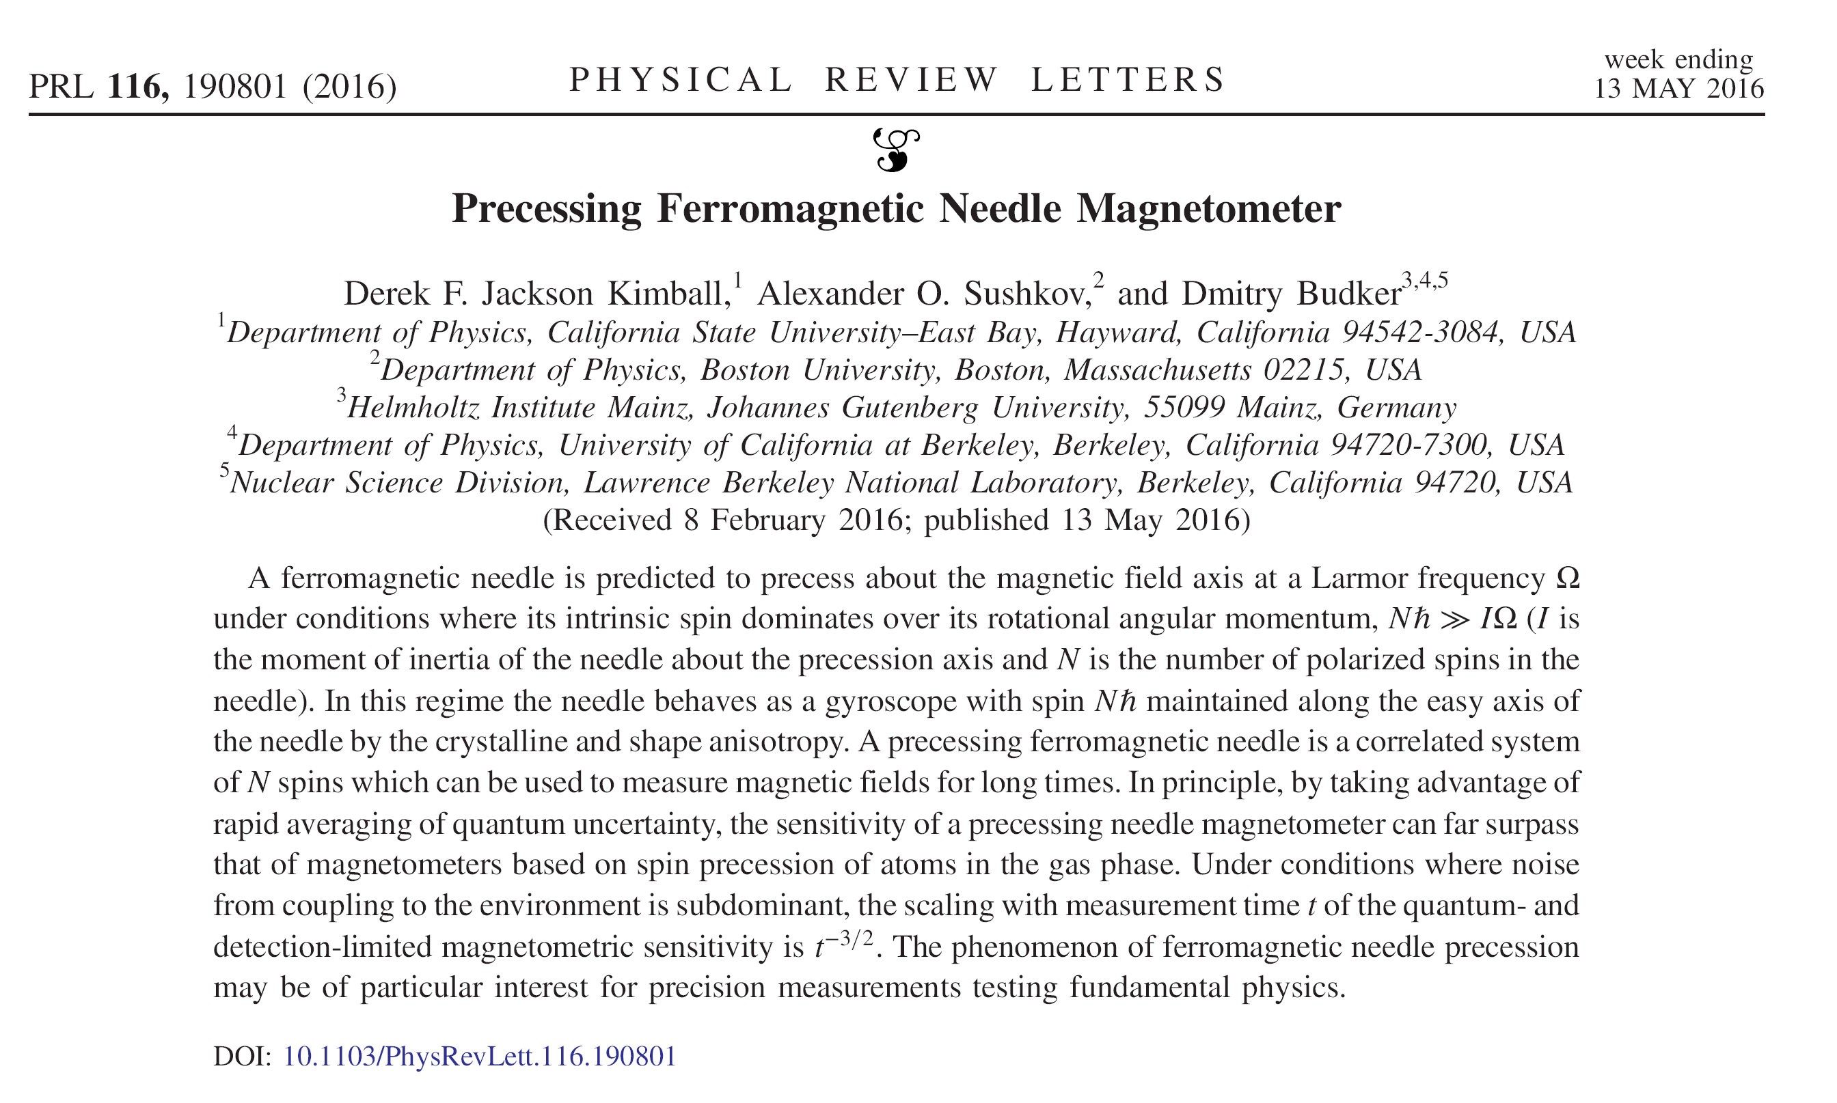
D. F. Jackson Kimball, A. O. Sushkov, and D. Budker, Phys. Rev. Lett. 116, 190801 (2016).

Slide 47
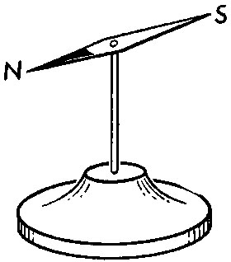
Ferromagnetic needles
Why do compass needles orient themselves along the ambient magnetic field, while atomic and nuclear spins precess about the field?

Slide 48
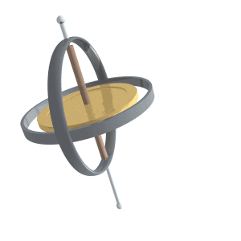
Ferromagnetic needles
Why do compass needles orient themselves along the ambient magnetic field, while atomic and nuclear spins precess about the field?

Slide 49
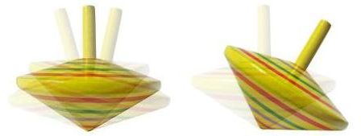
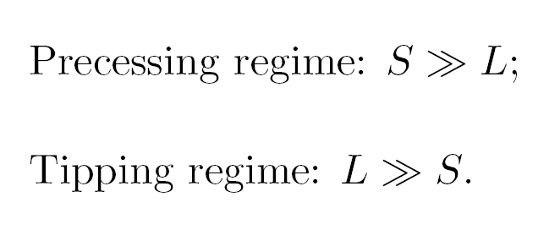
Two regimes: tipping & precessing

Slide 50
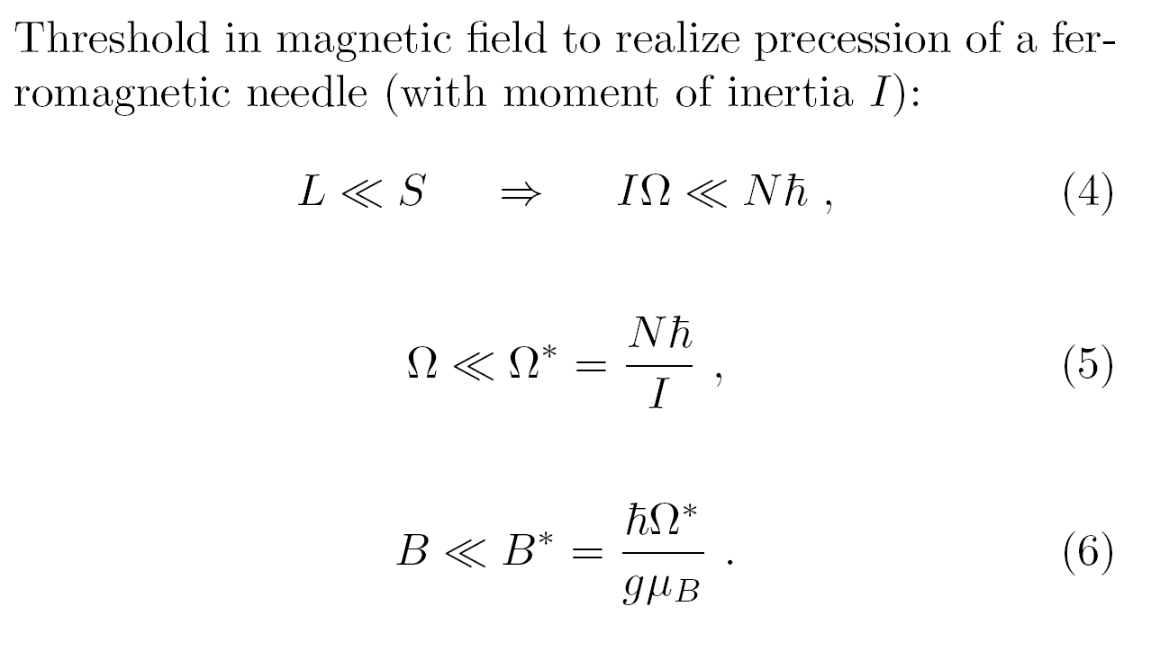
Threshold for precession

Slide 51
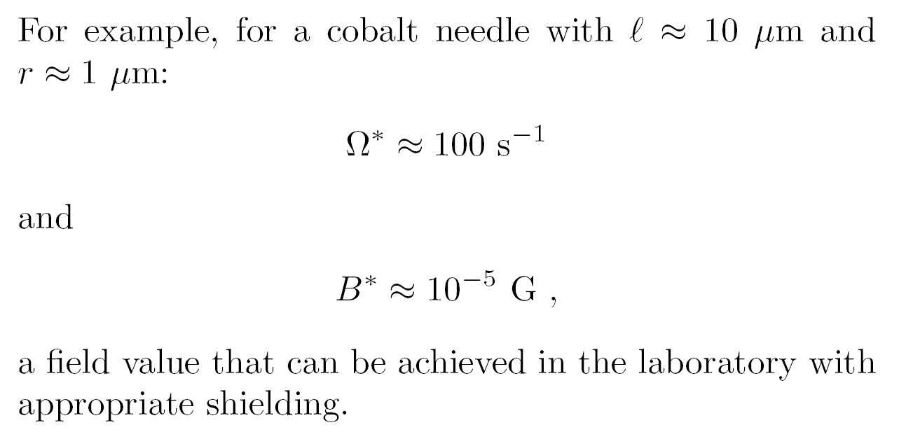
Threshold for precession

Slide 52
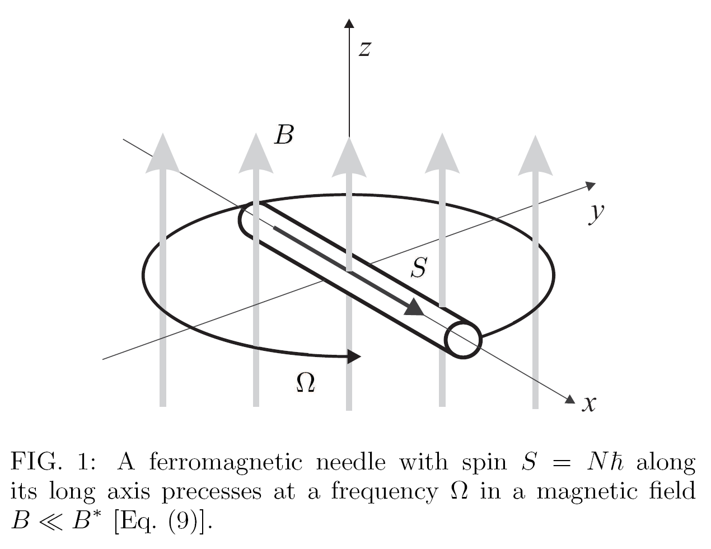

Slide 53
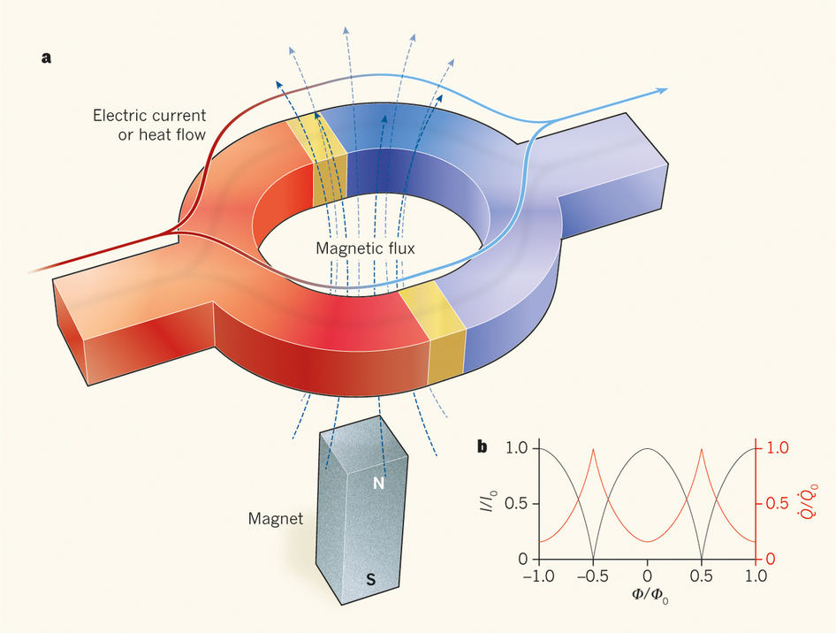
Idealized experiment

Slide 54
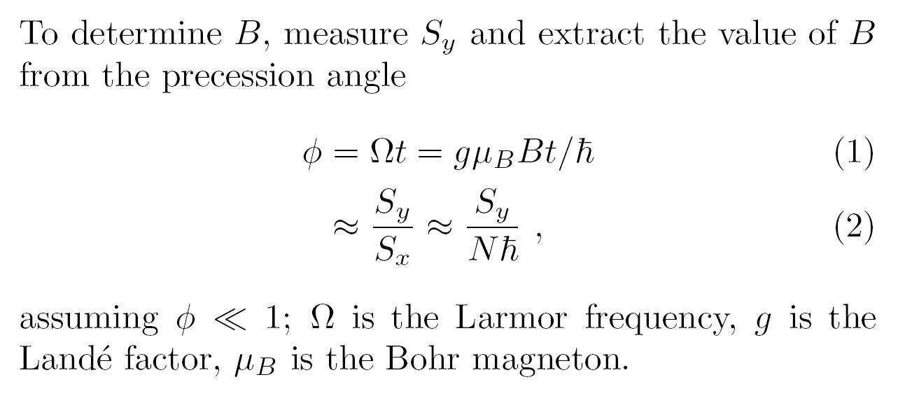
Magnetic field measurement

Slide 55
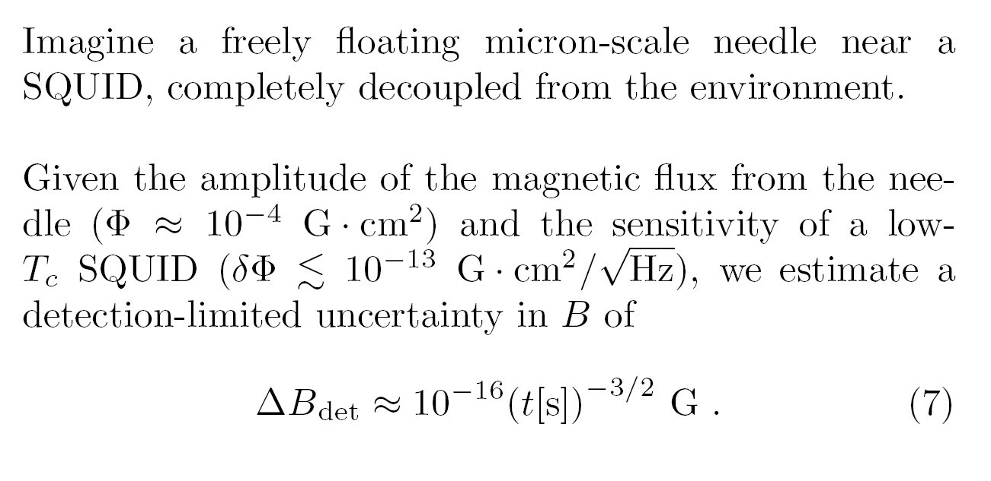
Sensitivity

Slide 56
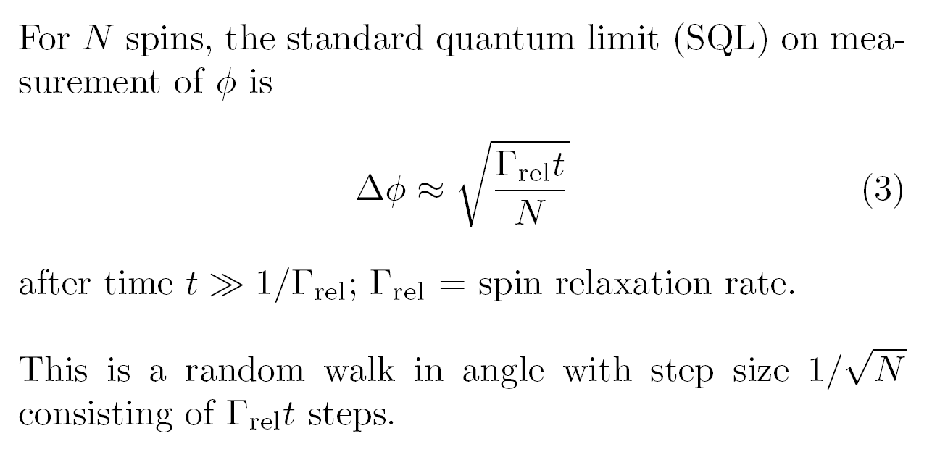
What about the Uncertainty Principle?

Slide 57
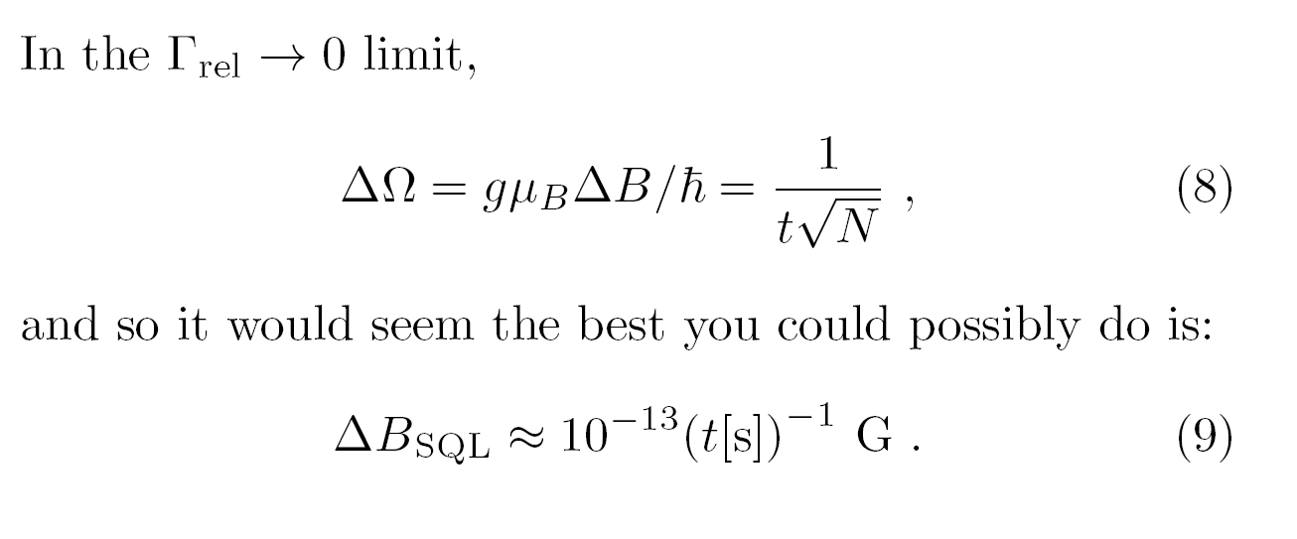
What about the Uncertainty Principle?

Slide 58

Averaging away the uncertainty?

Slide 59

Averaging away the uncertainty?

Slide 60

Fluctuation-dissipation

Slide 61
Spectral density of quantum fluctuations
Quantum fluctuations are spread over a
broad frequency band:
integration acts as a low-pass filter
( δS )² / Δf
f

Slide 62

(Needle floating in cryogenic vacuum, T ≈ 0.1K.)

Slide 63
Noise
Magnons,
Phonons,
Thermal currents (Johnson-Nyquist noise),
Collisions with residual gas molecules,
Black-body radiation.

Slide 64

Suspension?
Seemingly cannot use light or mechanical support
to reach ultimate sensitivity… still thinking…

Slide 65
Conclusions
New searches for oscillating moments induced by coherent oscillations of the axion/ALP field offer the possibility to investigate a significant fraction of unexplored parameter space!
If research and development of new samples and new hyperpolarization techniques succeed, we may be able to search for the QCD axion with f_{a} near the GUT and Planck scale!
New sensors based on precessing ferromagnetic needles could open new possibilities for precision measurements.

