Slide 1


Status of J-PARC Beam Monitor
Takeshi Toyama
Nov. 10, 2016
@FNAL
US-Japan Workshop on Accelerators and Beam Equipment for High- Intensity Neutrino Beams

Slide 2

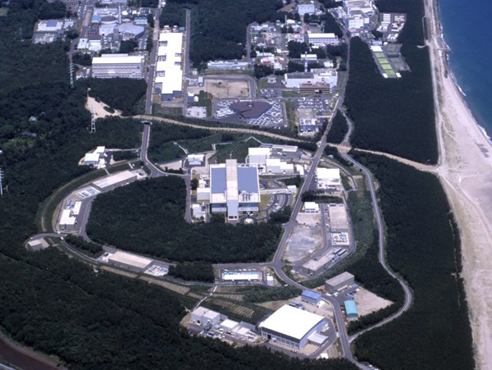
Japan Proton Accelerator Research Complex
Tokai, Ibaraki
LINAC
40mA
(50mA)
3 GeV RCS
500 kW
(1MW)
← operation
← one shot
ν detector
Kamioka
MLF
30 GeV MR
415kW
(750kW) ← goal
Hadron hall

Slide 3
Recent issues (1)
MR
As the beam power gets higher, the following issues appear:
  Beam loss diagnostics and controls
  DCCT: better accuracy and precision @ ~0.1 %
  Beam loss measurement: more robust
  Aperture: widen the beam ducts at downstream of the collimator
  Beam stability
  Beam size, profile and halo measurement
  Tapered-coupler BPM for transverse feedback: wider frequency bandwidth, flatter frequency response, and better balance between electrodes

Slide 4
Monitors in J-PARC
RCS
Blue: MR monitors added/modified
in FY 2015-FY2016
54 BPM(COD)
3 BPM (RF)
4 BPM (fast)
1 BPM (tune)
2 DCCT / SCT
8 MCT, FCT, WCM
2 +1 IPM
7 MWPM
90 BLM (proportional)
24 BLM (ionization)
20 BLM (scintillator)
2 Exciter
Abort dump line
2 BPM rotated 45 degree
1 SEEM
BLM
1 FCT
3Ν BT
1 FCT
2 BPM
32 BLM
2 Halo
monitor
Exciter 2 for intra-bunch Feedback
ν BT
1 FCT
2 DCCT
7 FCT
1+1 WCM
BPM (COD, turn-by-turn)
1 16-electrode monitor
2+1 BPM (tapered-coupler)
238 BLM (proportional)
36 BLM (ionization)
2 BLM (scintillator)
1 SEEM/MRPM (for SX)
5 Luminescence screen
3 IPM
2 Flying wire
2+2 Exciter
MR
MEBT
DTL/SDTL
A0BT
L3BT & dumps
8 BPM
6 SCT
5 FCT
4 WS/BSM
4 BLM
29 BPM
18 SCT
47 FCT
4 WS/BSM
53 BLM
17 BPM
3 SCT
4 FCT
4 WS/BSM
30 BLM
48 BPM
11 SCT
5 FCT
24 WS/BSM
38 BLM
3-50BT
5 FCT
14 BPM
5 SEEM
50 BLM (proportional)
4 BLM (ionization)
1 OTR / Fluorescent screen
Hadron BT
1 SEEM
RFQ
Exciter 1 for BXB Feedback
ACS
42 BPM
21 SCT
41 FCT
4 WS
3 BSM
21 BLM
*Monitors not counted for beam transport lines to the utilities,
3N BT, Hadron BT, ν BT

Slide 5
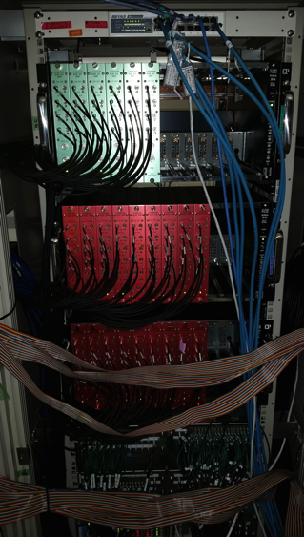
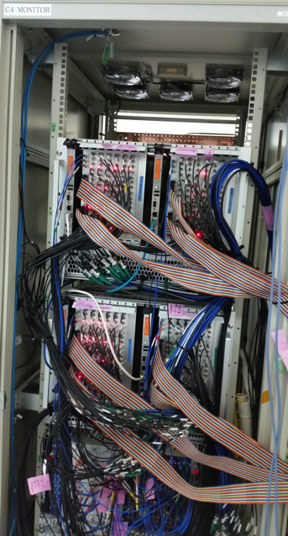
Recent issues (2)
MR
DCCTs are used for evaluating beam losses, as well as the beam intensity itself. Although digital signal processing to correct the imperfect circuit response of the order of 0.1 % was once applied successfully, strange behavior is recognized recently.
Signal processing circuits of the BLMs have been replaced with new one: modular, higher dynamic range and faster ADC. Sufficient channels for Proportional- and Ionization-chambers.
IPM in the MR: gathering ions (+); electron with a magnet is under study
→ covered by Ken'ichirou Satou
New signal
processing circuits
for BLMs
Analog Processing
Digital Processing

Slide 6
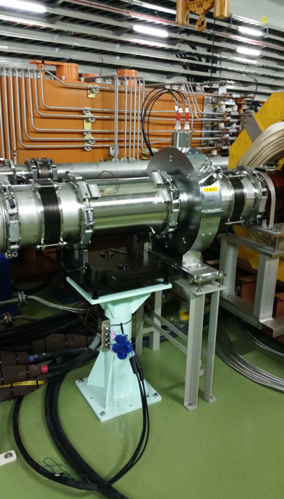
Recent issues (3)
MR
One of the Wall Current Monitor has been replaced,
from I.D. φ134 to I.D. φ165
to widen the beam aperture.
Fast Current Transformer is added
in the abort line.
To guarantee that the aborted beam power
is under the allowable limit of the beam dump.
→ covered by Hironori Kuboki
45-degree rotated BPM
FCT

Slide 7
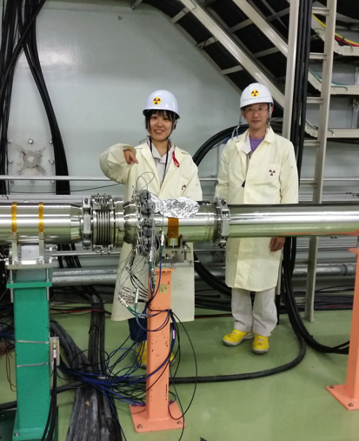
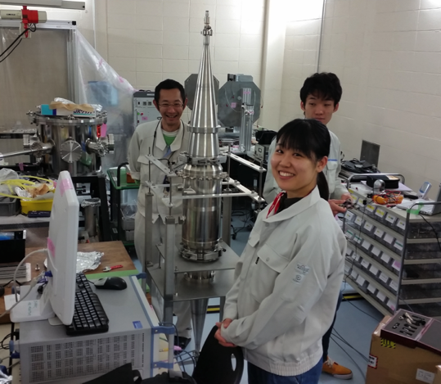
Recent issues (4)
MR
A 16 electrode beam monitor is developed and installed. Expecting better accuracy of quadrupole modes and higher multipoles. Evaluation with the beam has just started.
→ covered by me (for Nakanishi)
Installed at the address #15
Frequency response measurement

Slide 8
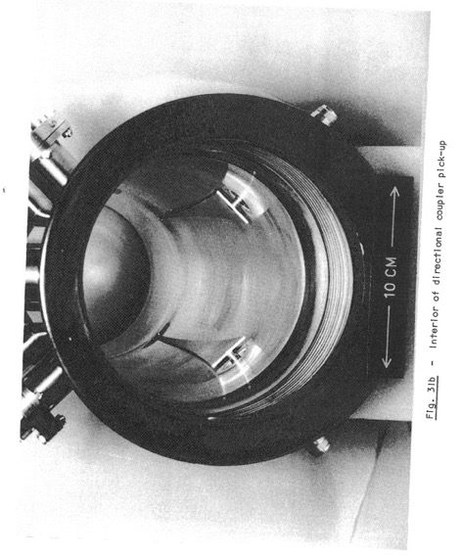
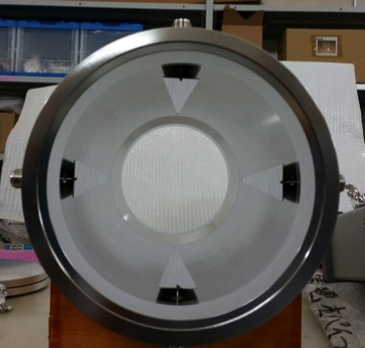
Recent issues (5)
MR
Pursue a better tapered-coupler BPM for the intra-bunch feedback system: wider and flat frequency response and more accurate response.
  Especially better balance between electrodes.
→ Followed by Wataru Uno
Exponential tapered-coupler
Linnecar, CERN-SPS-ARF-SPS/78/17
Linear tapered-coupler of the J-PARC MR
Cross section of monitor

Slide 9
Future plan
Upgrade of the processing circuit of the "regular" BPMs
Resolve mechanical relay troubles
Obtain higher position accuracy and precision
Beam tail and halo measurement with OTR/FL monitor in the MR
Study injected beam and initial few turns
Intra-bunch feedback improvement: CLK~100 MHz → ~200 MHz

