Slide 1
Booster operation and beam studies
Kiyomi Seiya
10 November 2016

Slide 2
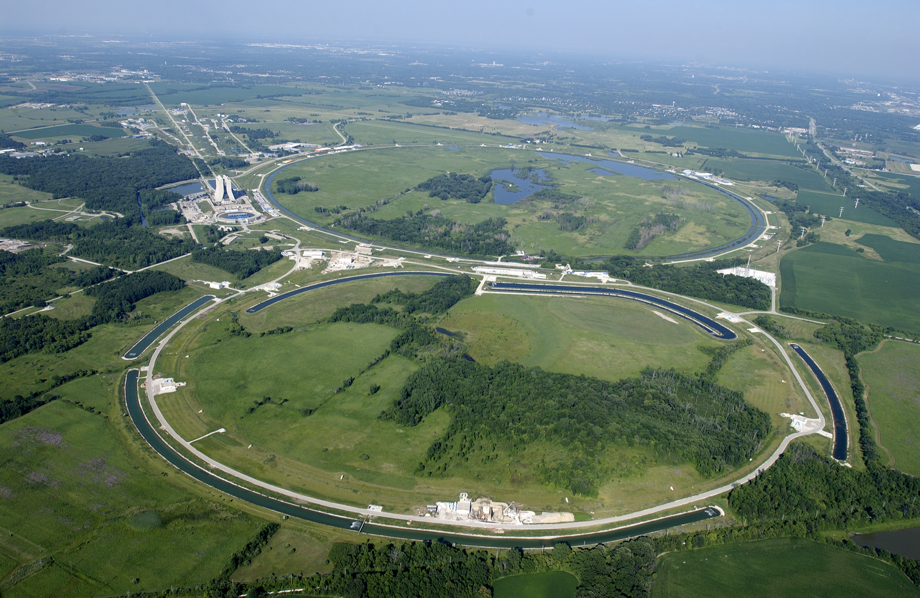
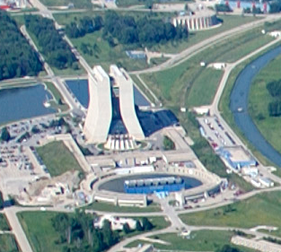
700kW operation at Fermilab
Numi 400kW → 700kW (4.3E12 ppp at 9Hz)
Booster repetition rate: 7.5Hz → 15Hz
Booster
Proton Improvement Plan (PIP):
Booster upgrade for 15Hz operation

Slide 3
Outline
Booster at Fermilab
PIP goals and requirements for the 15Hz Booster operation
Beam studies in the Booster
Summary and Plan

Slide 4
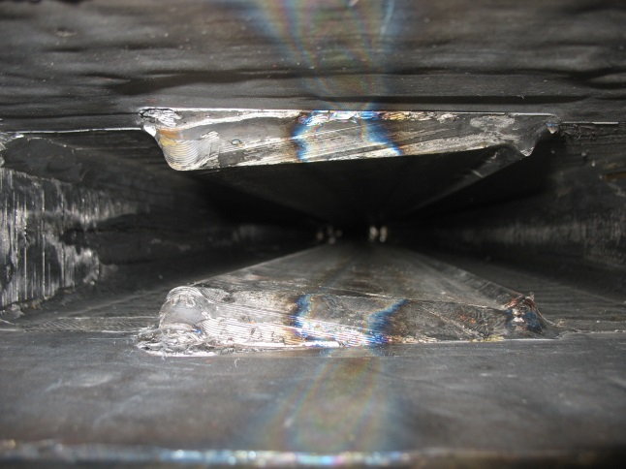
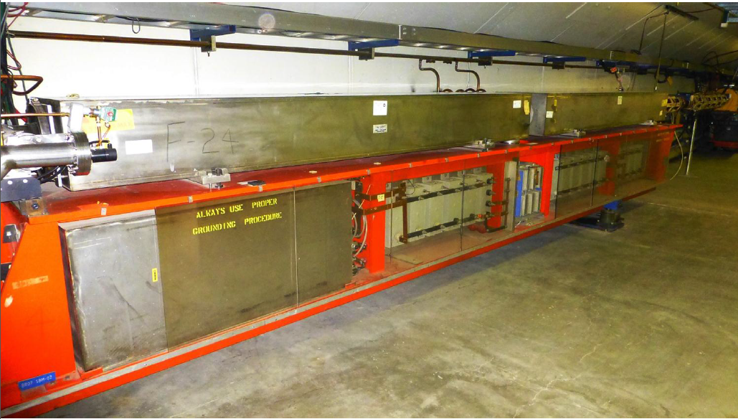
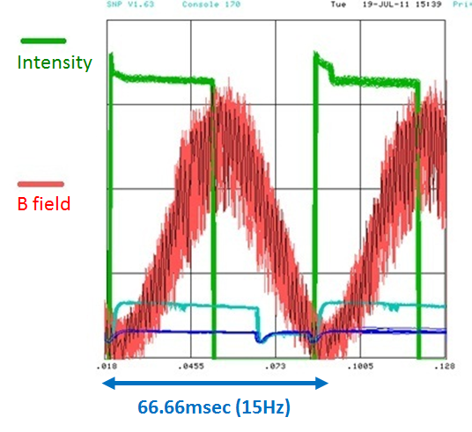
15 Hz Resonant Circuit Synchrotron
D-Magnet
F-Magnet
Resonant Capacitor
Choke
Proton Kinetic Energy
@ Injection → @ Extraction
400MeV 8GeV in 33.33msec

Slide 5
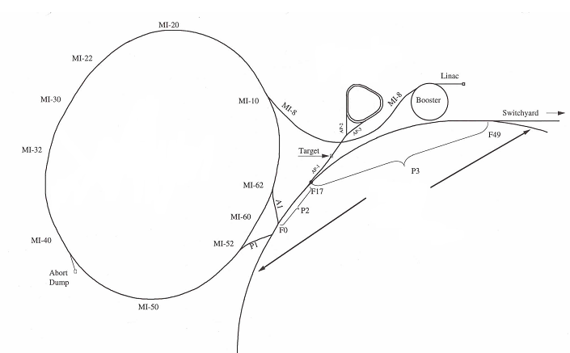
Beam to Neutrino experiments
ΒΝΒ (8GeV)
Numi (120GeV)
LINAC
Booster (h=84)
Recycler(RR)
Main Injector (MI)
(h=588)
Booster send beam to Booster neutrino experiment and MI/RR

Slide 6
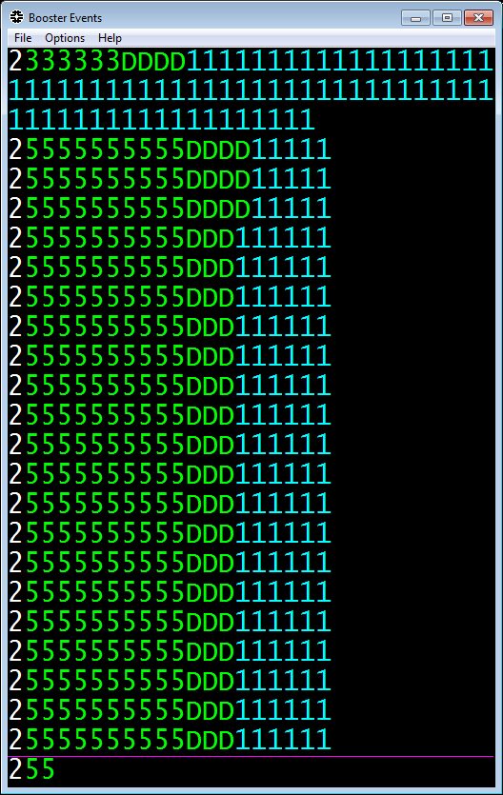
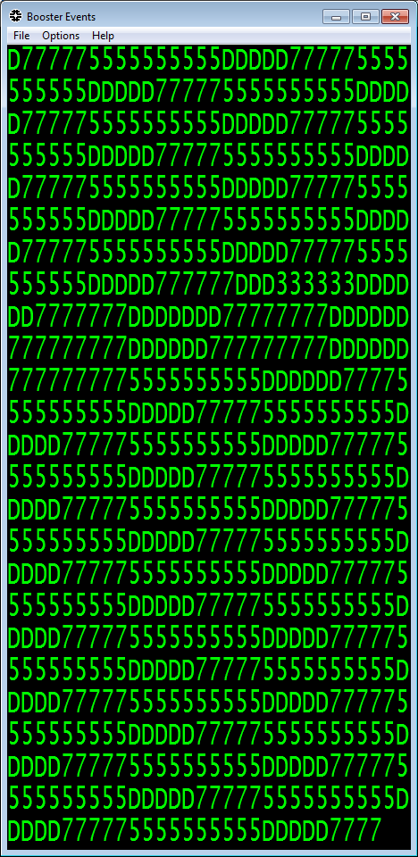
Booster 15Hz operation on Fri Apr 08 2016
11Hz
15Hz
BOOSTER EVENTS
D: BNB
5: Numi
3: SWITCHYARD
7: BSTR DUMP
2: PRE PULSE
1: NO PULSE PS

Slide 7
Status of Beam Power loss
4.3E12 ppp with 81 bunches to Recycler
FULL 15Hz operation for entire Fermilab exp. program.
Delivering 2.3E17 protons/hour (at 15 Hz) in FY2017
625 W
Administrative Limit
allows workers to work on components without being exposed to excessive radiation
Beam Power Loss [W]
15 Hz and 4.3e12/cycle is 232e15/hour
2.3E17
Delivering protons per hour

Slide 8
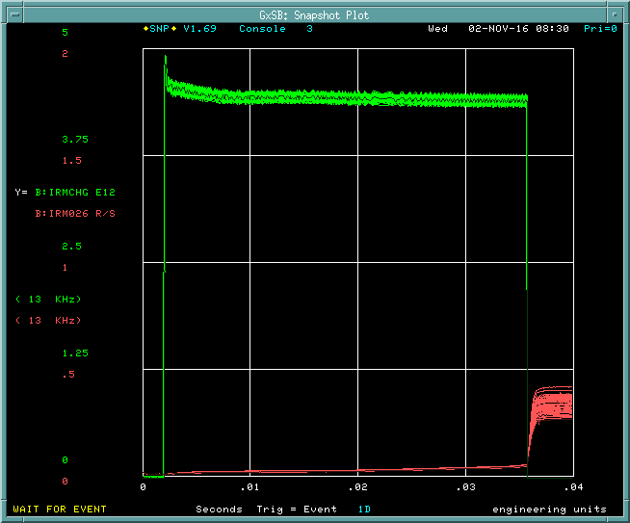
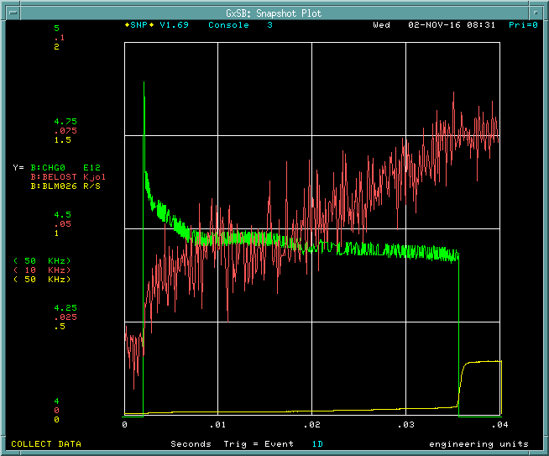
Intensity and beam loss in November 2016
Beam Energy Loss
Notch creation
Transition
Extraction
Intensity
Int. at Injection: 4.8E12 ppp
Int. at Extraction: 4.4E12 ppp
Efficiency: 92%
Slow loss
Slow loss
Beam energy loss/cycle = 0.055 kJ → 825W@15Hz
(625 W Administrative Limit)

Slide 9
Current beam studies
Collimator
Optics correction
Absorber
Laser notch
Injection capture and timing
Transition

Slide 10
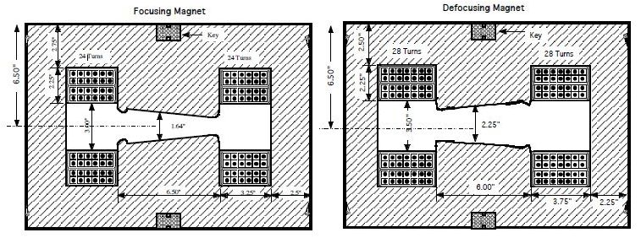
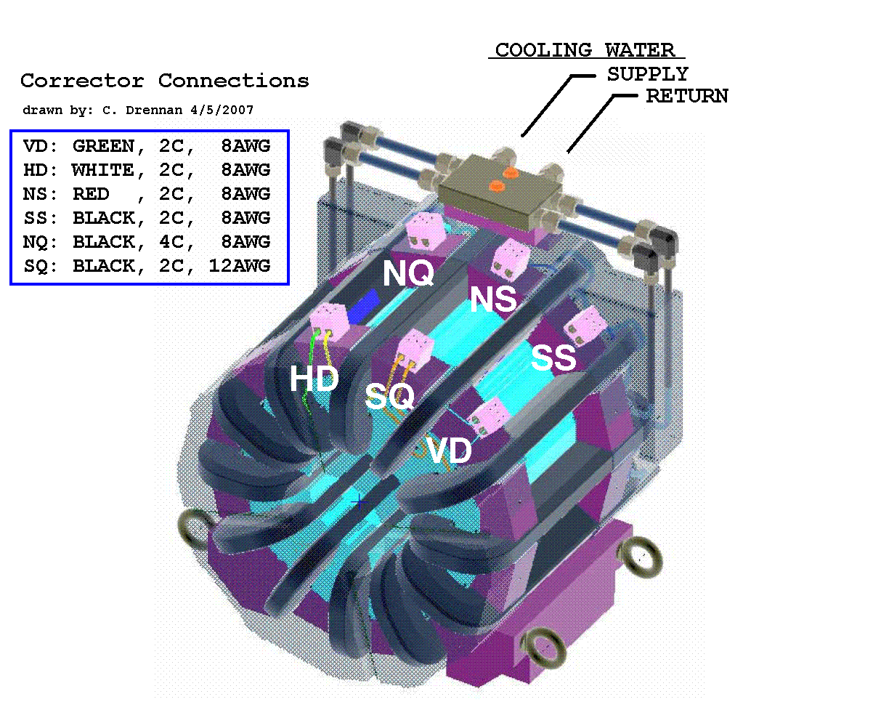
Booster FDOODF lattice
F Magnet
D Magnet
Combined function magnets: F, D
FDOODF x 24 periods
Corrector packages at short and long
Corrector package (12 poles) includes
H & V dipoles, quad, skew quad, sextupole, skew sextupole
and H & V BPMs.
Corrector Package

Slide 11
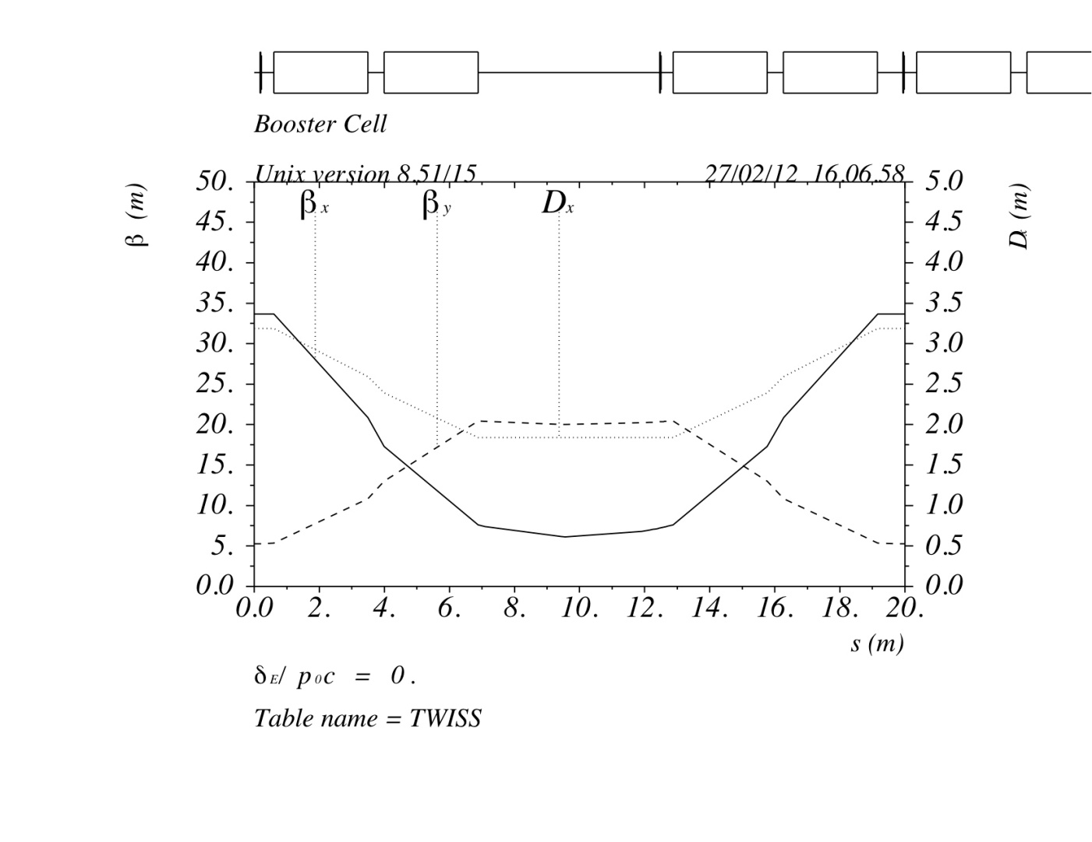
Booster Lattice and H/V beam size at short and long straight sections
LONG straight
SHORT straight
βx @short = 33.7
βx @long = 6.1
βy @short = 5.3
βy @long = 20.4
@ SHORT straight
@ LONG straight
beam size
+/-17.9mm
H_emittance(95%) = 14π mm-mrad
V_emittance(95%) = 16 π mm-mrad
+/-21.5 mm
+/-9.15mm
+/-9.12 mm

Slide 12
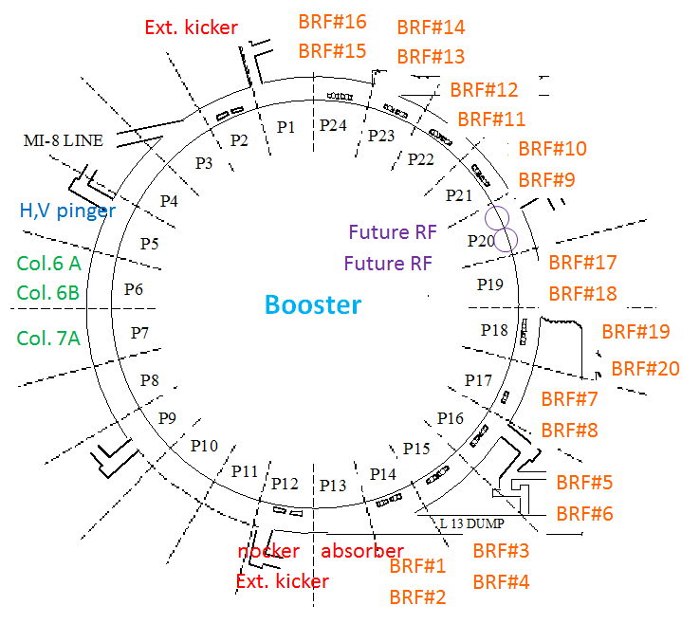
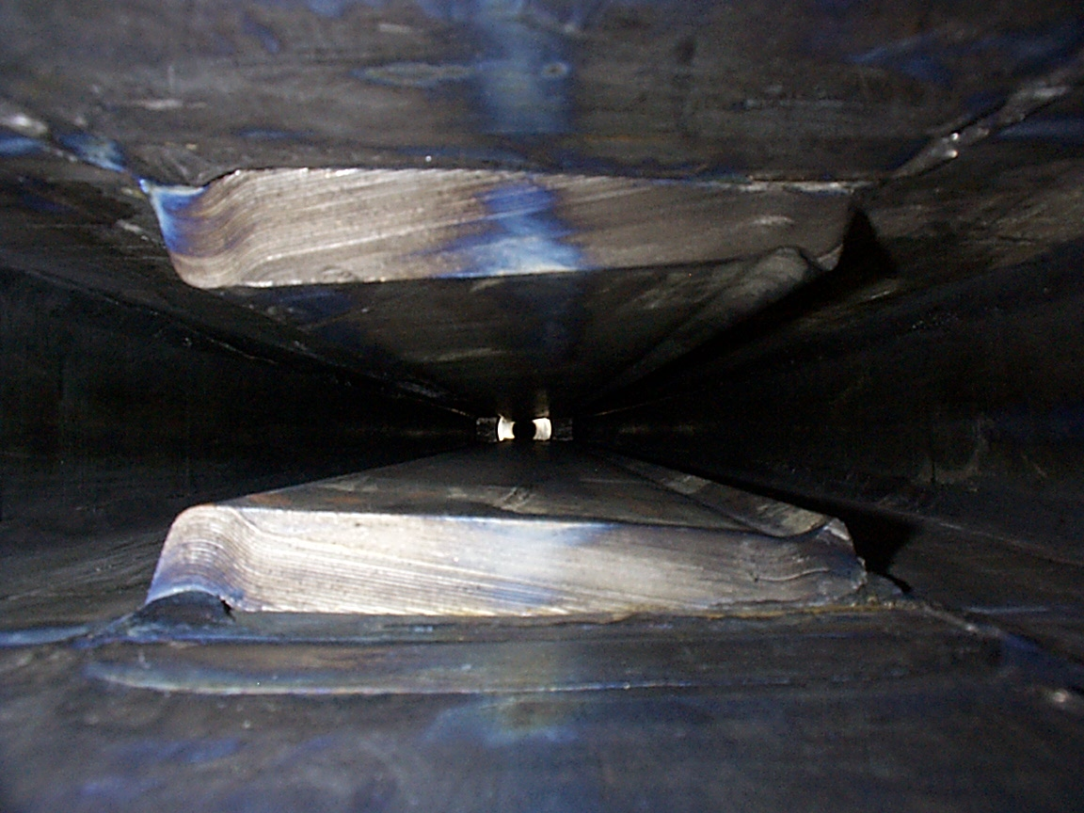
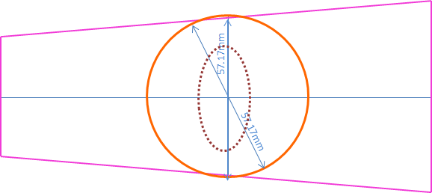
Components at long straight section in the Booster
Energy | 400 MeV – 8GeV
RF frequency | 37.9 – 52.8MHz
Harmonic number | 84
Radius | 75.75 m
Cycle Rate | 15Hz

Slide 13
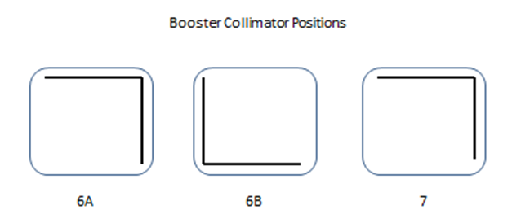
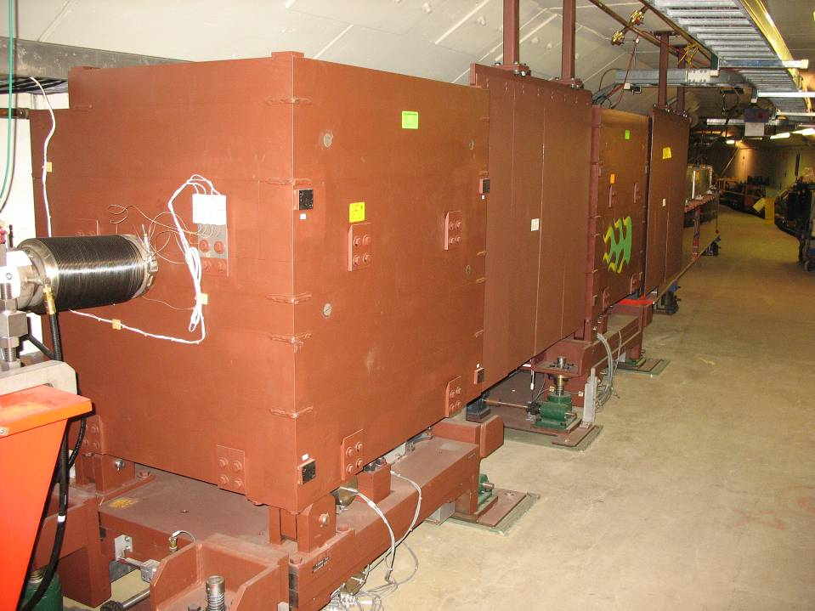
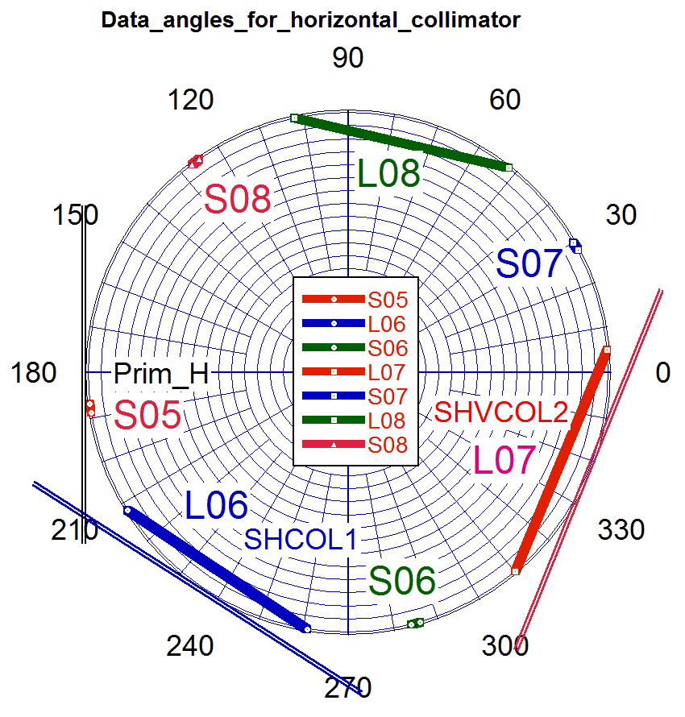
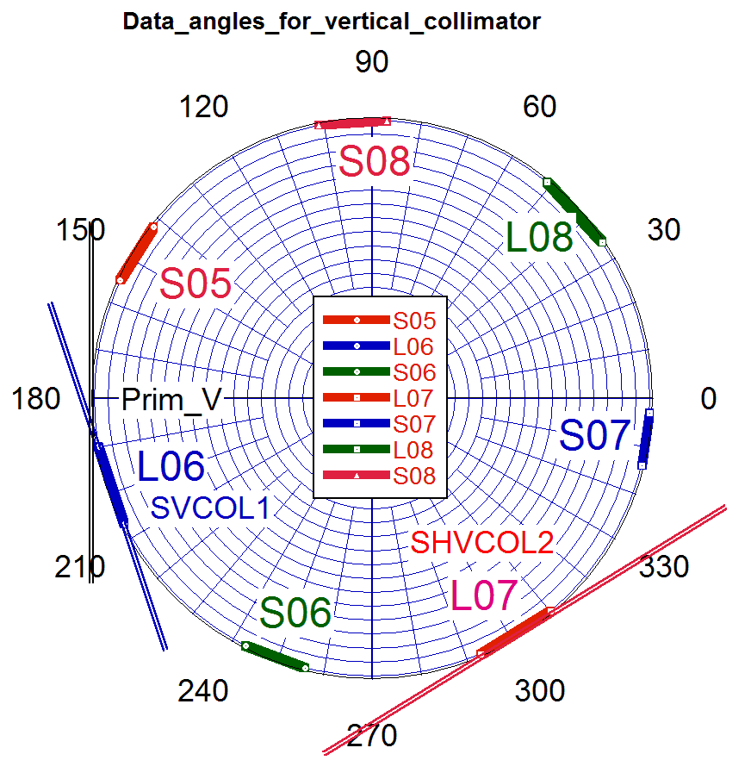
Booster collimation studies - V. Kapin Single stage collimation to two stage collimation
1SC (operation)
2SC
S5
H
V
L7
L6
The phase advance is not optimal for the secondary collimators.
There are aperture restrictions at bending magnets and RF cavities.

Slide 14
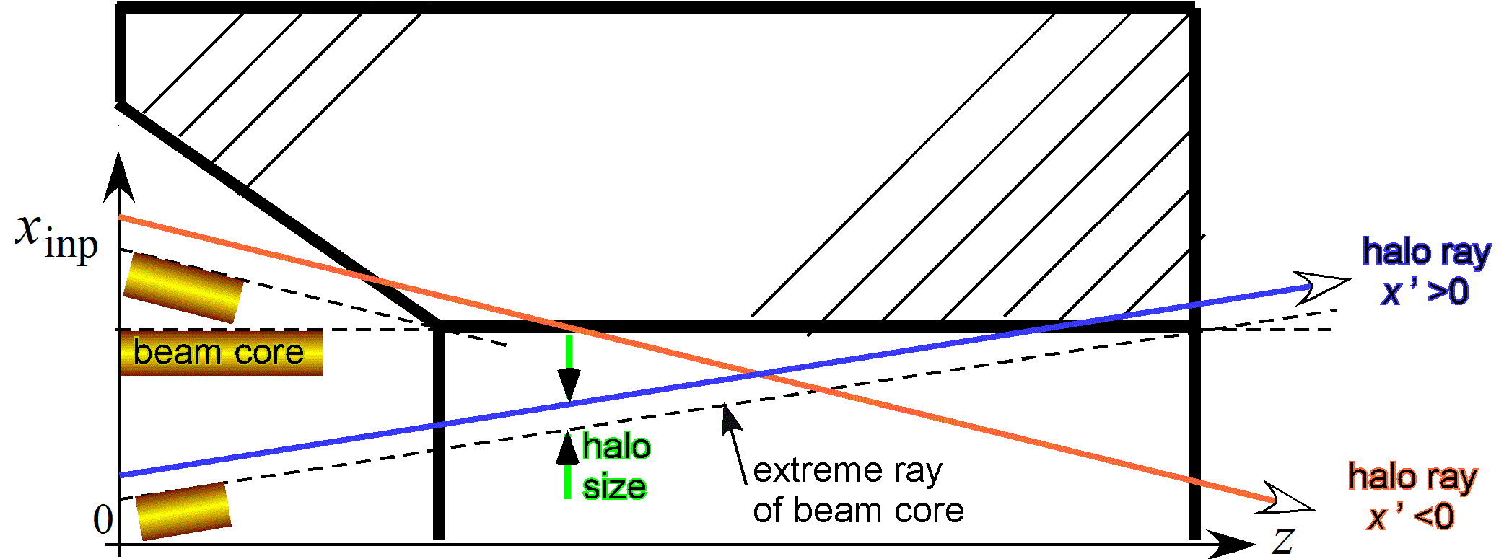
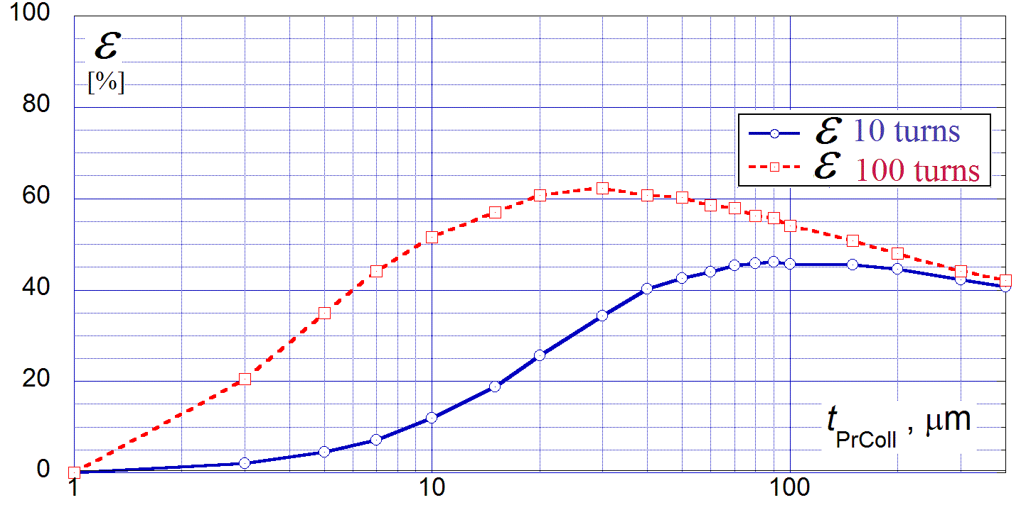
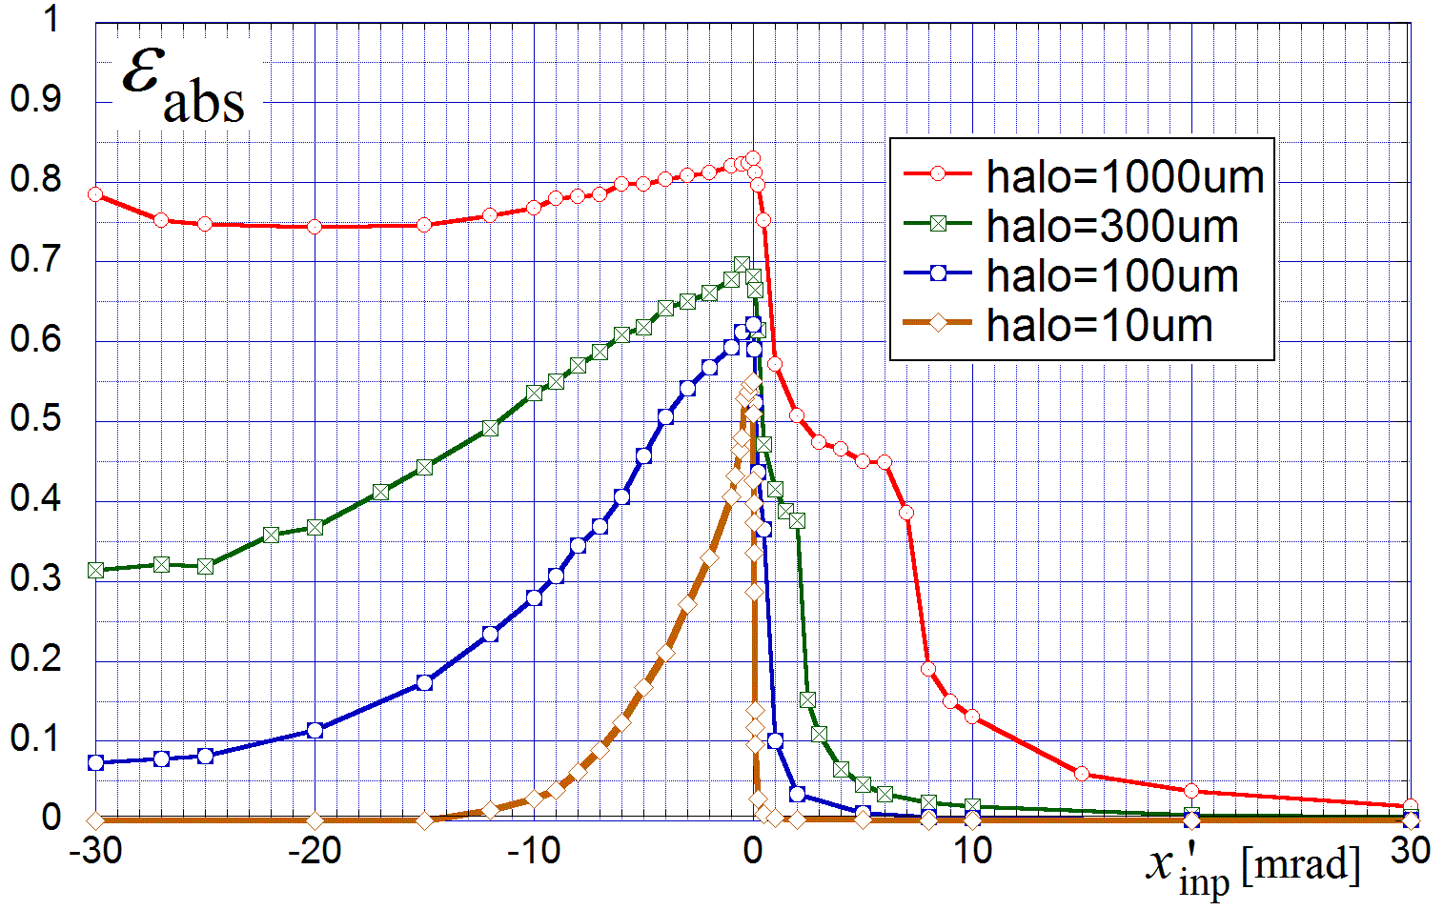
Simulation and beam studies for collimators
Simulation with 1SC
Simulation with 2SC
Eff. after 100 turns
Eff. after 10 turns
Foil thickness
Simulation:
Under optimal conditions the 2SC system could be more effective than the 1SC system by 5%.
Beam study in the vertical plane:
Two stage collimator is less effective by a factor of ~2.

Slide 15
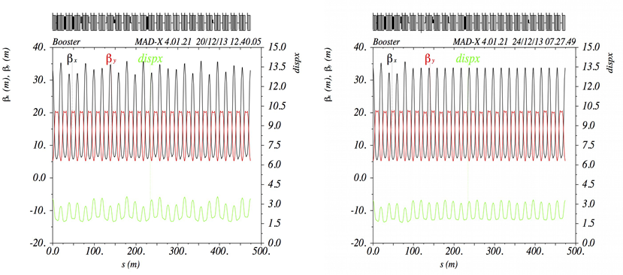
Optics correction - C. Y. Tan with LOCO (Linear Optics from Closed Orbit)
Extraction bump at Long3
Beta beating with extraction bump
corrected lattice
Beta beating can be corrected by using a few quads around the ring.

Slide 16
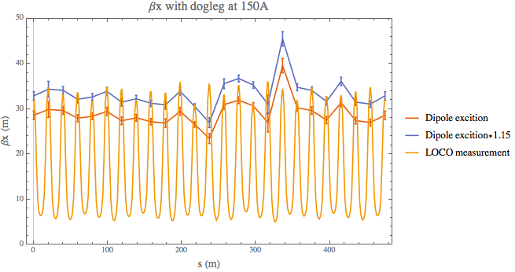
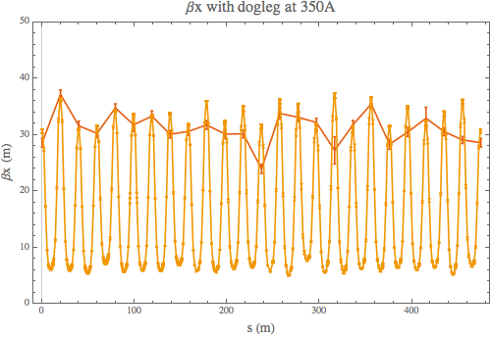
Beam optics measurement at DC magnetic field
LOCO:
Uses measurements all of the BPM positions at each location and calculate dx/dθ.
Calculates quad and skew quad strengths for the beta beating correction using the error between measurements and the model including the rolls and calibrations of every BPM and dipole corrector.
Dipole measurement:
$\frac{dx_{i}}{dθ_{j}}=\frac{\sqrt{β_{i}β_{j}}}{2sin({πν}_{x}\text{) }}cos⁡(\left|φ_{i}\text{−}φ_{j}\right|−{πν}_{x}$)
$\frac{dx_{j}}{dθ_{j}}=β_{j}\frac{cos({πν}_{x}\text{)}}{2sin({πν}_{x}\text{) }} → β_{j}$ = $\frac{cos({πν}_{x}\text{)}}{2sin({πν}_{x}\text{) }}$ / $\frac{dx_{i}}{dθ_{j}}$
B:DOGL3 = 150A
B:DOGL3 = 350A
Comparison of LOCO and dipole measurements.

Slide 17
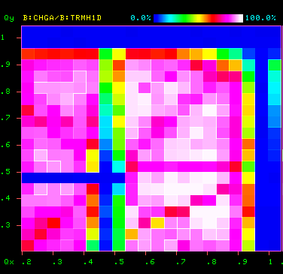
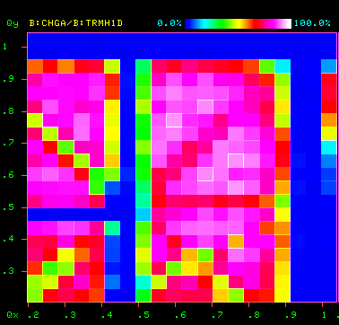
Tune scans at DC studies
B:DOGL3 = 150A
B:DOGL3 = 350A
$$v_{V}$$
$$v_{H}$$
This clearly shows that higher dogleg current increases the width of the Qx = 0.5 resonance.
Currently debugging the code for the correction.

Slide 18
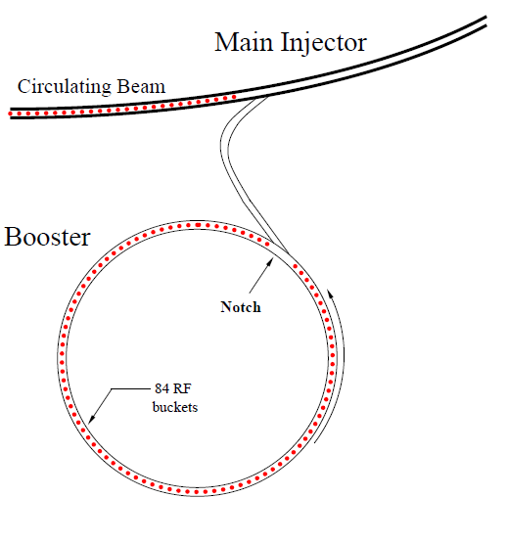
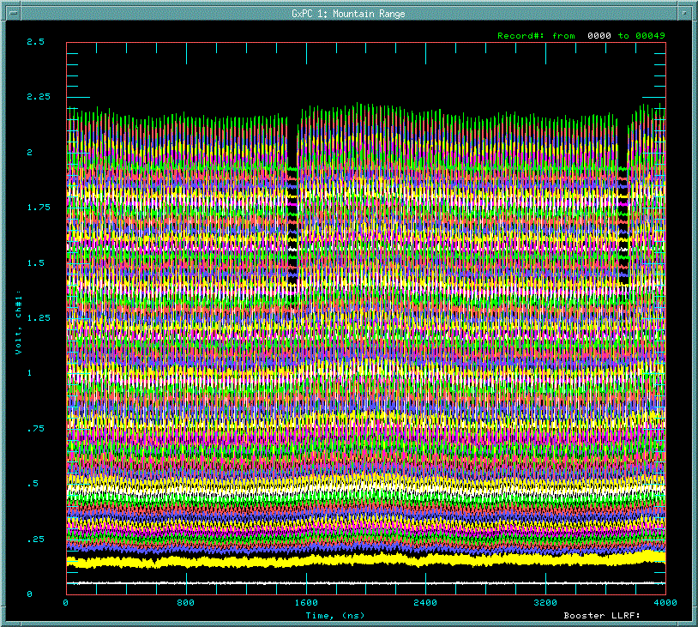
Notch and beam at injection
Longitudinal profile monitor
@ Booster injection
h=588
Main Injector / Recycler
1 Booster revolution
Notch
81 bunches
+ 3 empty bkts
Gap
for the extraction kicker
capture with
37MHz RF
→ 84 bunches
h=84
Time
Injection
200MHz
81 bunches + 3 empty buckets
Notch(extraction kicker gap) – Booster extraction kicker –MI/RR injection kicker
Notch has to be created at LOW energy

Slide 19
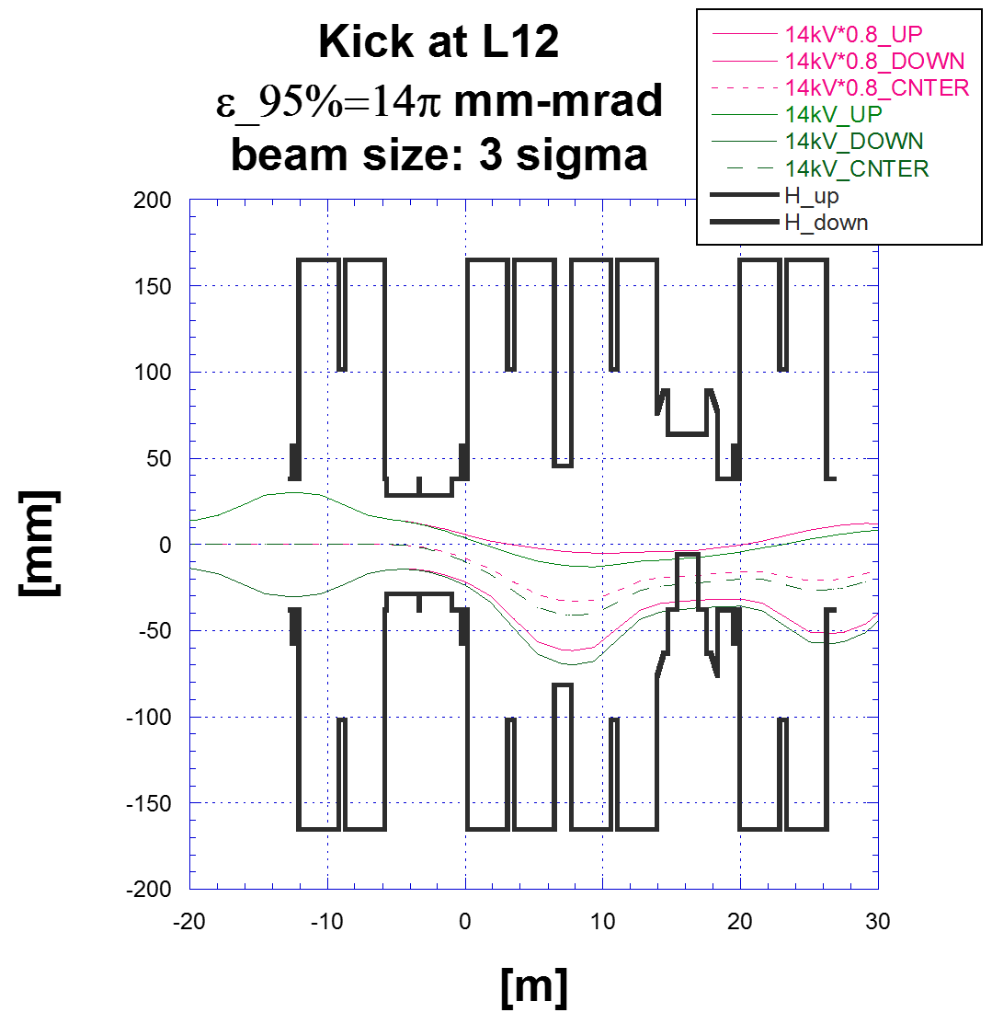
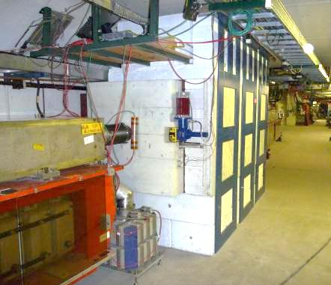
Notch creation at 400MeV –S. Chaurize
Notcher at L12
L12
L13
Absorber at L13
Top view of vacuum chambers

Slide 20
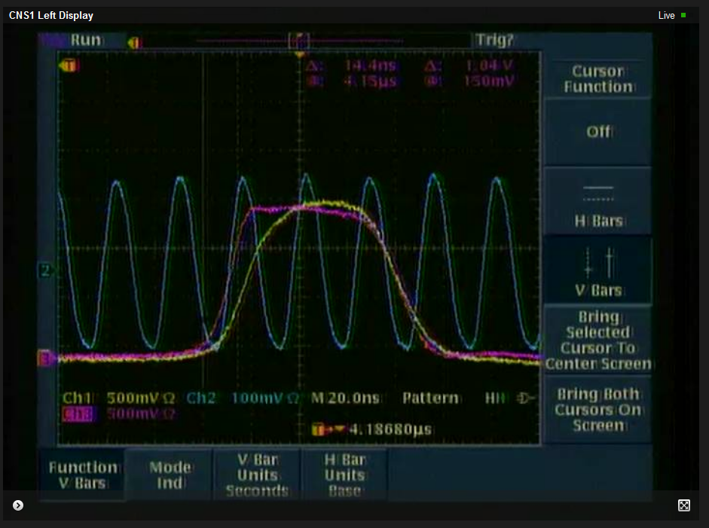
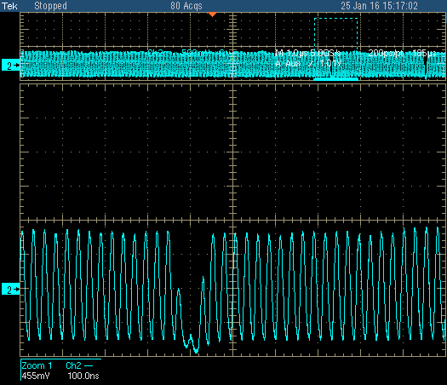
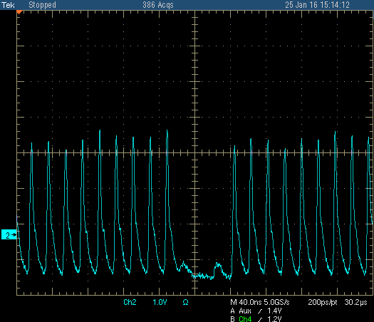
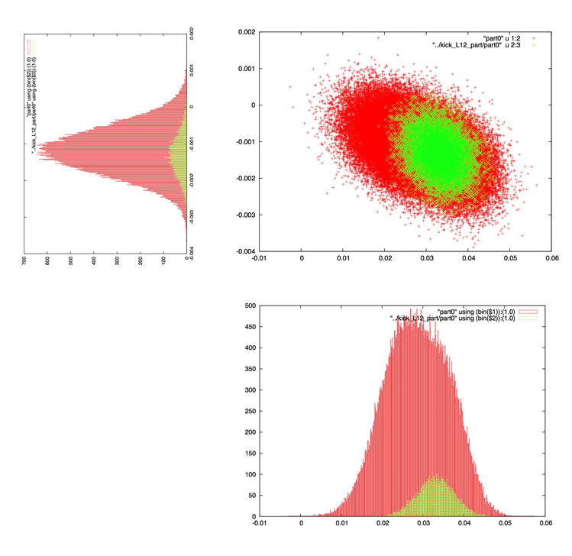
Voltage on the Notcher
RWM signal
at extraction
(8GeV)
at notch creation
(400MeV)
Notcher voltage
X’
Voltage, pulse length and absorber length have to be optimized to reduce losses
X
Absorber edge: 19.93 mm (set to 590 mils)

Slide 21
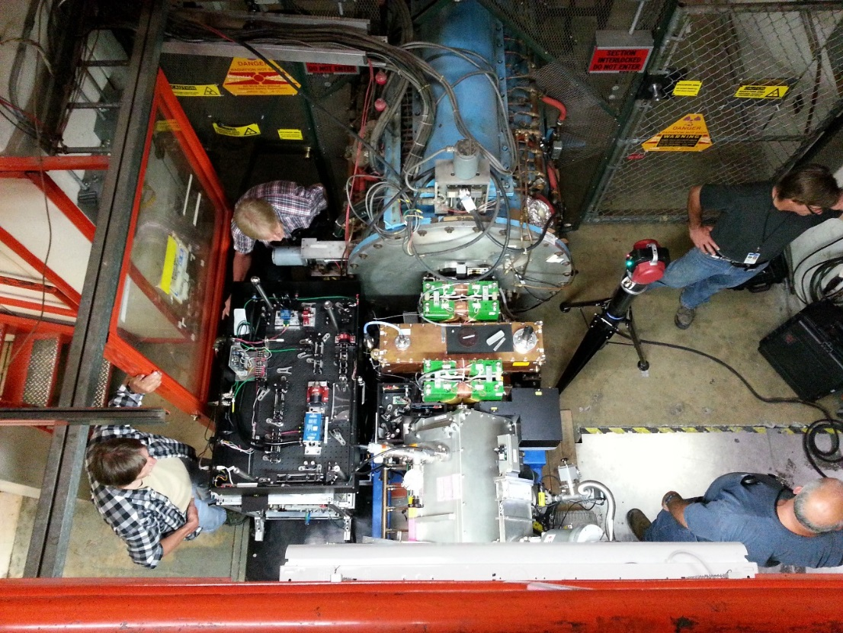
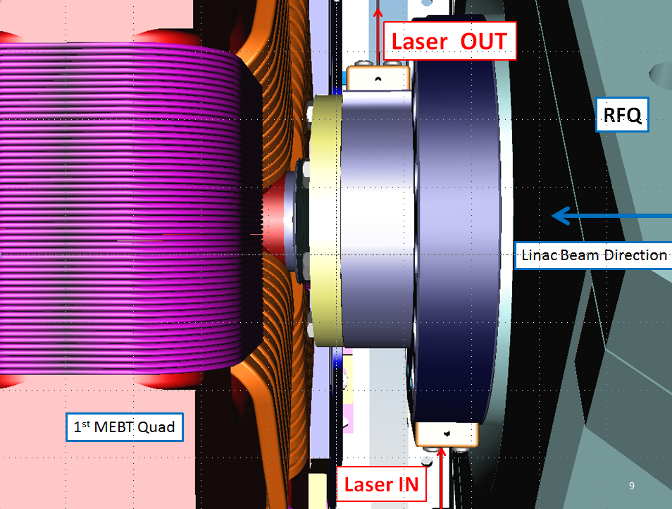
LINAC Notch –D. Johnson
Laser notching cavity installed on the downstream RFQ flange.
No more beam energy loss from Notch creation in the Booster.

Slide 22
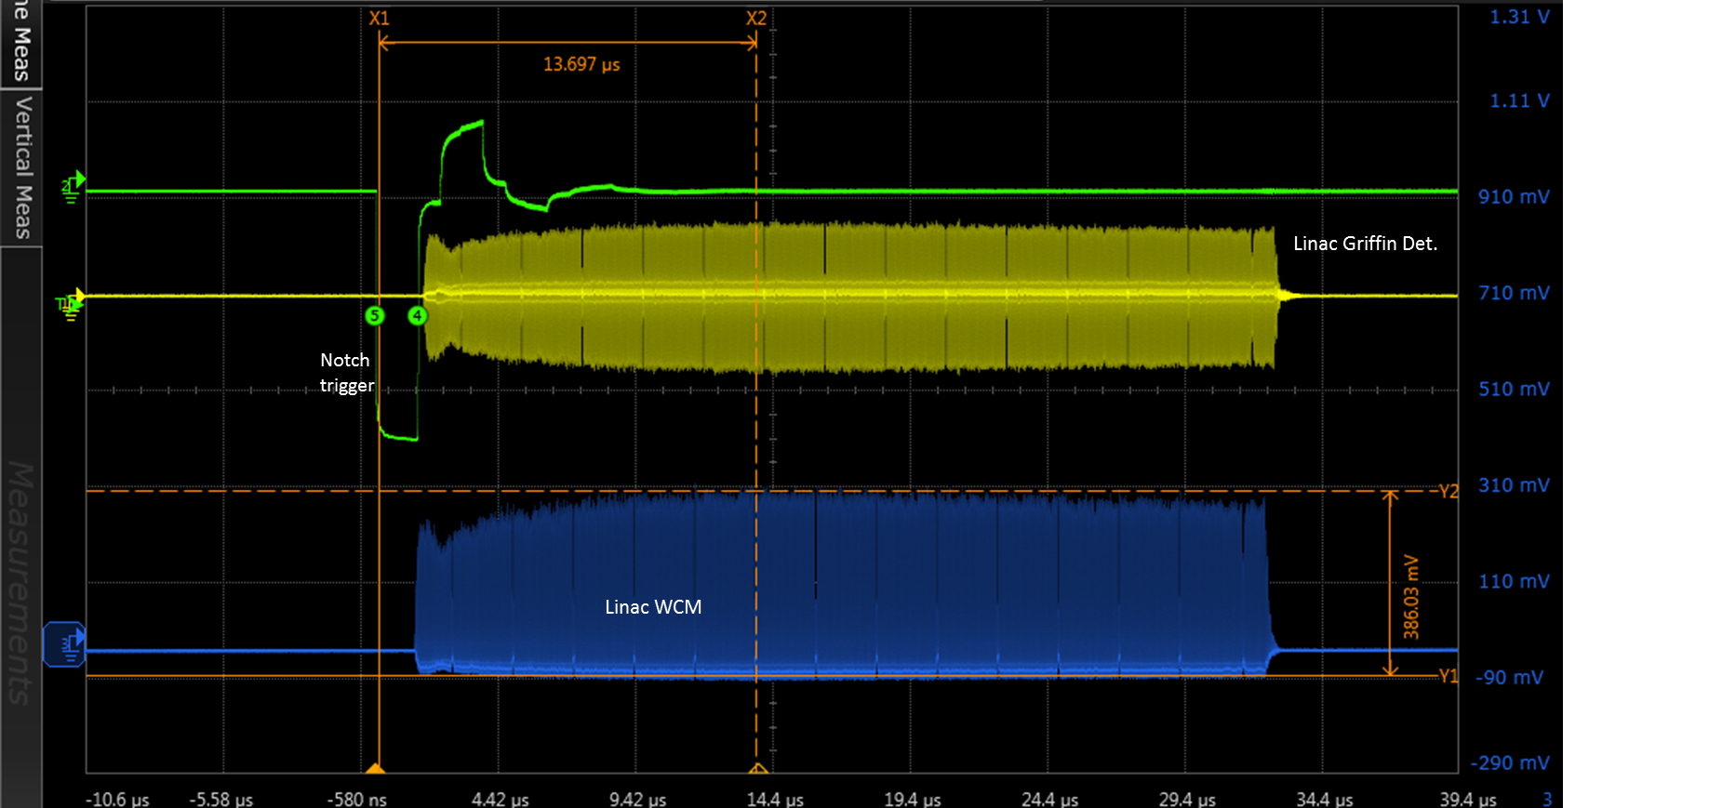
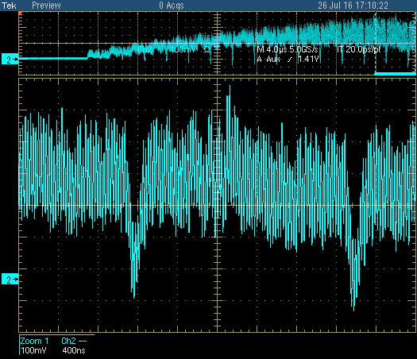
Beam sent to the Booster with Laser Notch in July 2016
WCM signal at LINAC
WCM signal in Booster
32 μsec
70 nsec
Commissioning will start at the end of November 2016.

Slide 23
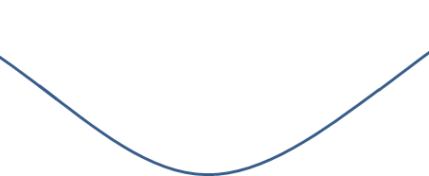
Injection rf capture – C. Bhat
New Scheme
Start End
Booster bending field
Booster B-curve
Bmin
RF feedback on
(adjusted)
New Scheme:
40μs
injection
260μs
rf capture
150μs
Original Scheme:
60μs
debunching
360μs
rf capture
[time]
We can put more beam to the Booster and reduce momentum spread.

Slide 24
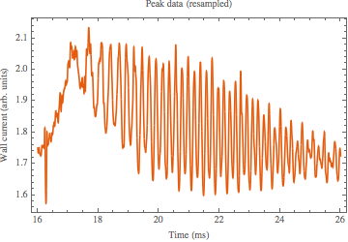
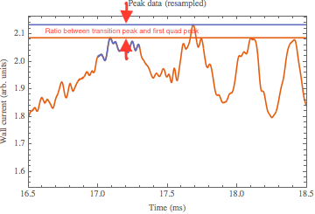
Longitudinal emittance blowup after transition – C. Bhat
Possible source of the oscillation
Beam current dependence (space charge)
Bucket mismatch (timing, voltage and phase)
Measured ratio of the first quadrupole peak to the transition peak.

Slide 25
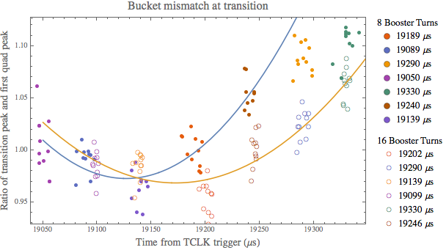
Comparison of 8 BT and 16 BT
Simulation and measurements showed that the quad peak ratio did not change at different intensity after the timing for the transition jump was optimized.
No blowup due to the space charge effect at the intensity of 5E12 ppp.
→ Need to improve timing and phases control

Slide 26
Plan and Summary
Plan
Add two more cavities – reliability and losses
Collimator and absorber upgrade – control beam loss location.
Laser notch – no more notch loss in Booster
Harmonic cavity – increase injection capture efficiency by flatting bucket
Tune and lattice studies – fix beta beating and reduce losses at injection
Summary
The goal is to achieve a Booster operation cycle rate of 15 Hz and an average of 4.3E12 protons per pulse for 2017, as users come on line.
A successful completion of the PIP effort is a laboratory priority and essential for reaching the HEP proton delivery goals.

