Slide 1
RF upgrade for MW beam
Chihiro Ohmori
KEK/J-PARC

Slide 2
Contents
Status of RF upgrade
FT3L Cavities for Acceleration
Beam Loading Issues
2nd Harmonic Cavities
Mid-Term Plan
Very Long Term Plan for Multi-MW

Slide 3
Status of RF upgrade
In 2014-2016, all (9) cavities were replaced.
Available voltage : 280 kV => 504 kV for 1.28 sec. cycle (540 kV for 1.16 s cycle).
For 2.48 sec cycle,
5 cavities for acceleration
2 cavities for 2nd H
2 reserved
123 4 567 8 9

Slide 4
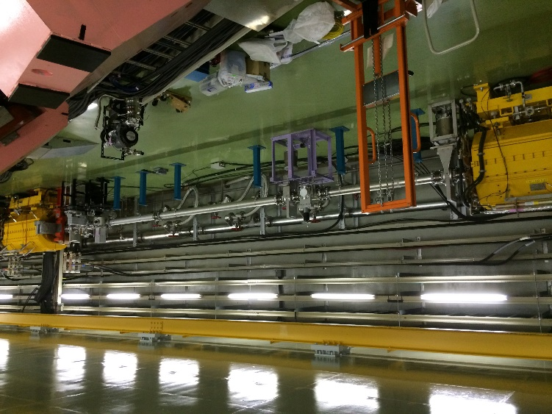
Status (Reuse of old cavities)
Ins C
Ins C
Space between Kickers
4 cavities/Long Straight, 27 cells
3 cavities/ long straight, 43 cells
2014 Before Replacement
2016 After Replacement
Installation in 2018
Old cavities are stored in tunnel for 2nd H cavity use in another straight section (INS-A)

Slide 5
=====Consolidation of power supplies=➔
Old Cav.
2 new Cav.
Reuse of Old Cav.
Air-cooled Cav.
Kinsho@IPAC16

Slide 6
New FT3L Cavity
Development takes 10 yrs. 9 cavities were replaced to new FT3L cavities.
FT3L ring cores were loaded in the new cavities.
“Finemet® FT3L” is the name of nano-crystalline material which was annealed under transverse magnetic field. It has two times higher impedance than ordinary nano-crystalline material-Finemet® FT3M.
FT3L and FT3M cores were made of thin ribbons. Especially, 13μm-thick ribbon is used FT3L for accelerator uses.

Slide 7
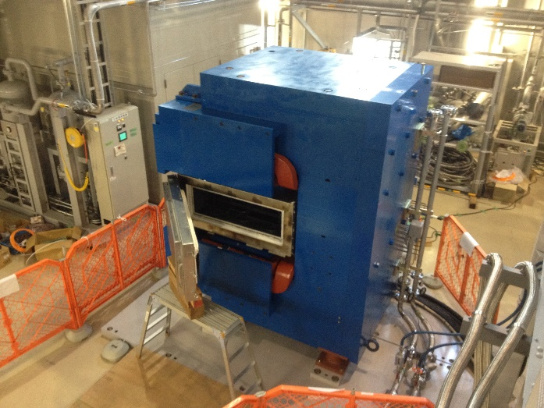
Magnetic Annealing
Direction of easy-mag. axis
RF RF RF
OFF ON ON
Nano-Crystalline is formed during annealing from amorphous.
Crystalline has “easy-magnetized axis”. It affects magnetic domain.
Magnetic annealing controls directions of magnetism of crystalline. It is perpendicular in FT3L.
Major RF loss in magnetic alloy is “domain wall” displacement. FT3L has less displacement motion than others.
FT3L has a half power loss than FT3M which was used in old MR cavities.
FT3M
Annealing
FT3L
Mag. Annealing
Magnetic annealing oven was tested in NU1 building of J-PARC

Slide 8
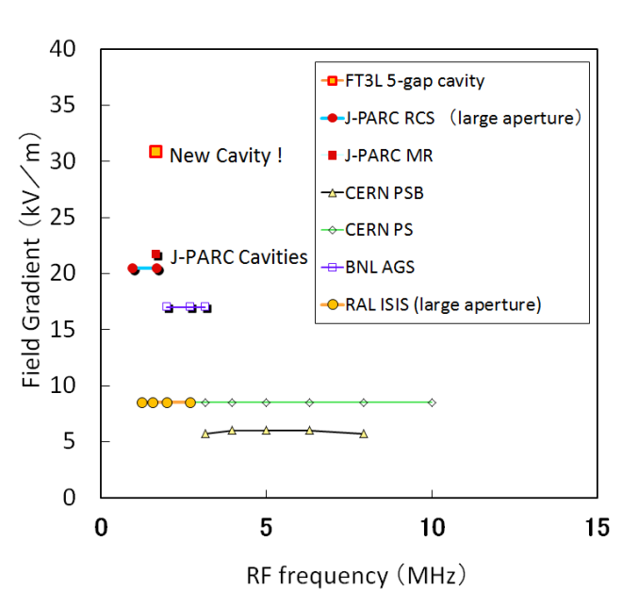
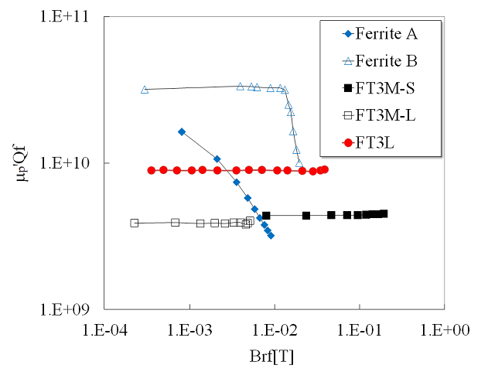
Higher Field Gradient
By the FT3L cavities, available voltage and field gradient are improved !
Comparison of Field Gradient
Characteristics of materials.
First FT3L cavity in FY2014
=> 5 FT3L cavities in FY15
=> 9 FT3L cavities in FY16.
Because of high saturation field, characteristics are stable.

Slide 9
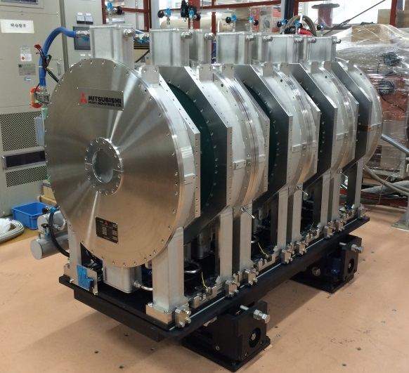
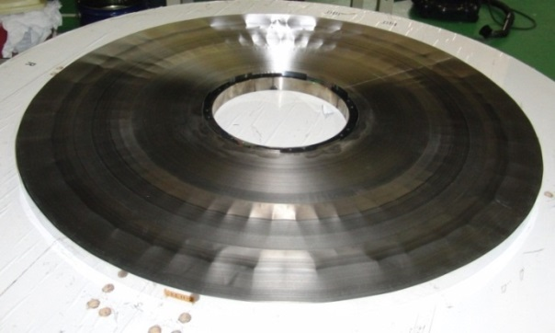
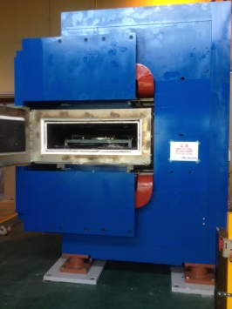
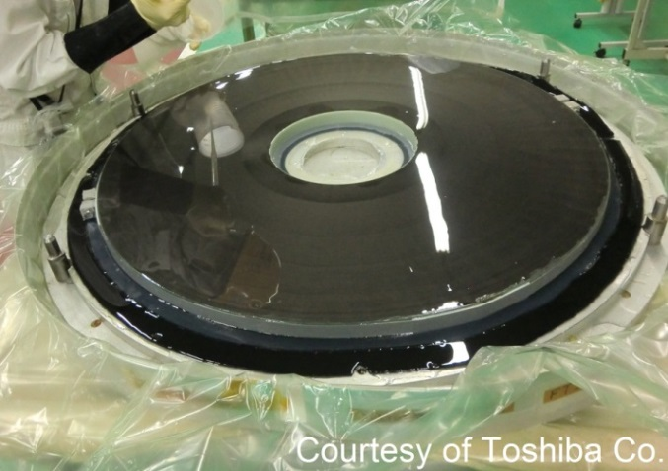
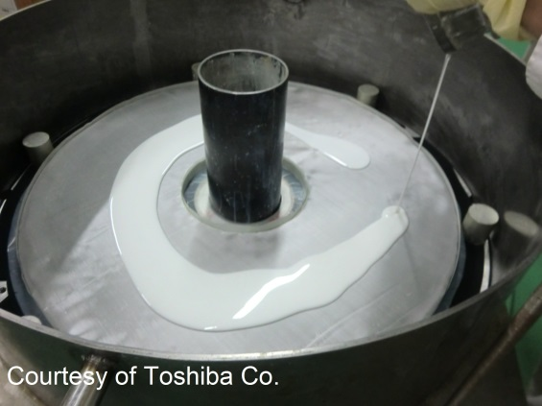
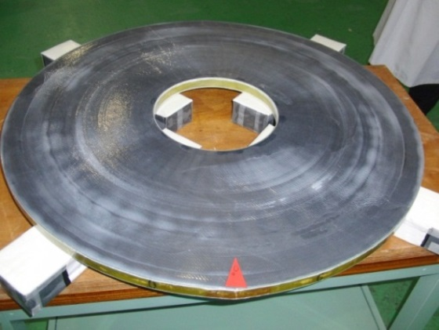
Assembly of FT3L cavity
Cavity assembling
KEK-made
oven
FT3L core
Installation into water tank
Molding with low viscosity resin
Water-proof coating
Cutting & Polishing

Slide 10
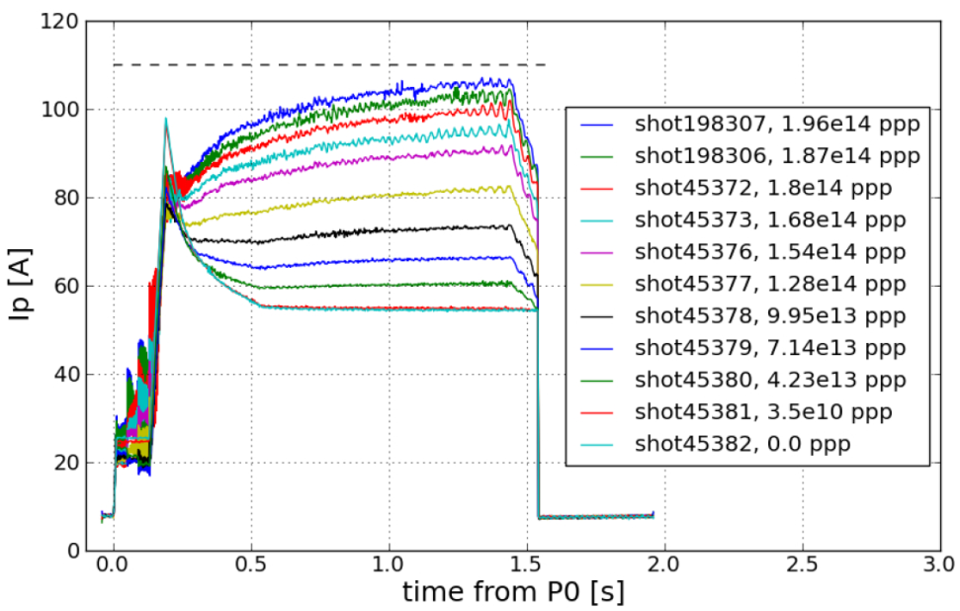
Beam Loading on FT3L cavity
2E14 protons
Anode current during acc.
Less power
Inductive
tuning
No beam
More RF power & Inductive tuning of cavity
Inductive cavity tuning fits high intensity operation.
Original FT3L cavity design: 5 gaps for 70 kV/cav for 1Hz.
Modified: 4 gaps operation for higher intensity with 56-60kV/cav for 1.16 s cycle.

Slide 11
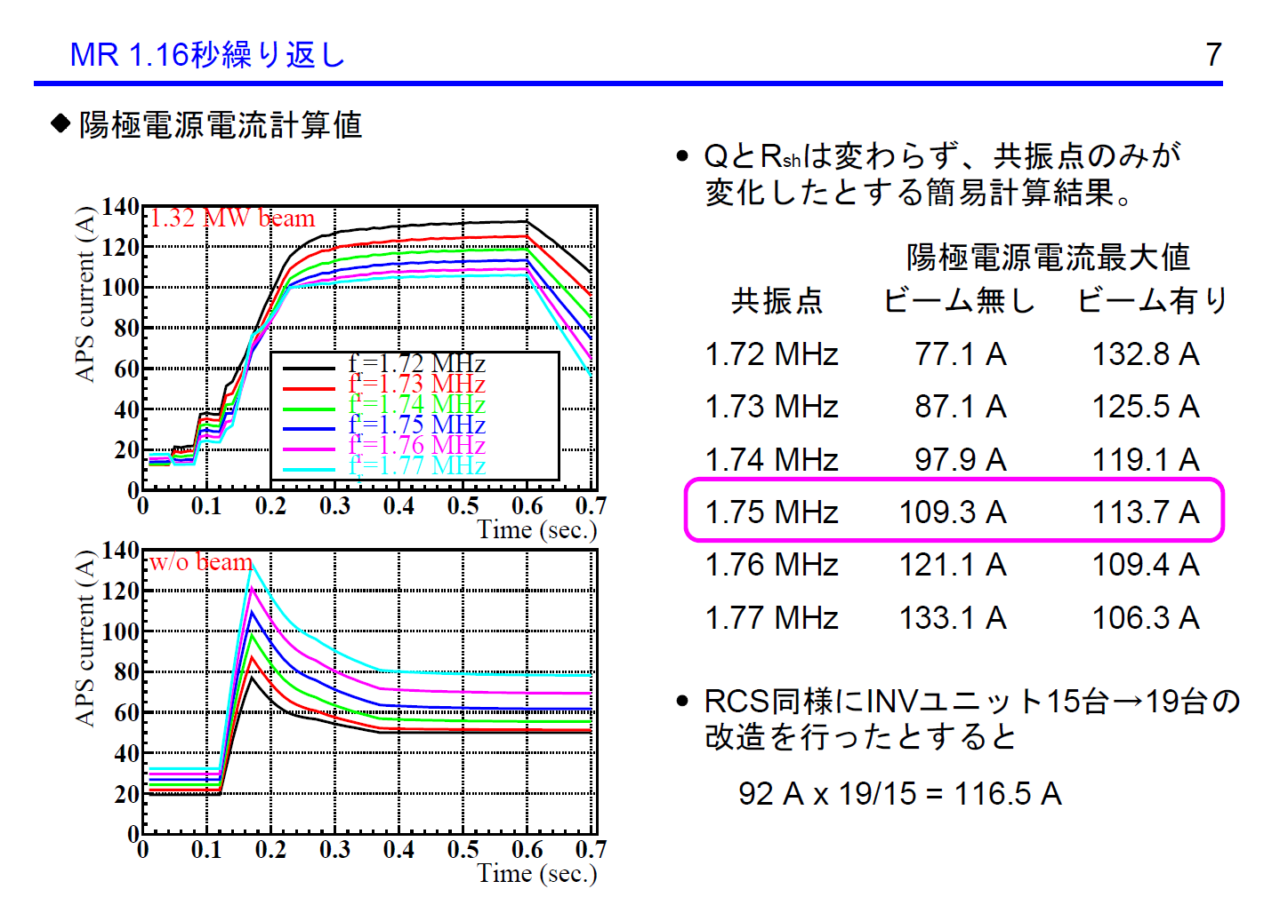
1.16 sec cycle
Calculation by Yamamoto
RFG山本さんによる計算結果
Estimation of Anode Current
Required Anode Current from a simle model
Max. Anode Current
Res. Freq. w/0 Beam with Beam
Adding 4 Inverter units to APS, max current
becomes
=> 1.32MW can be handled!

Slide 12
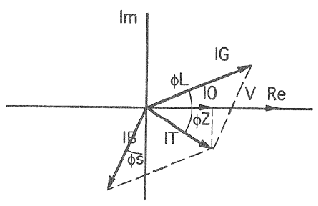
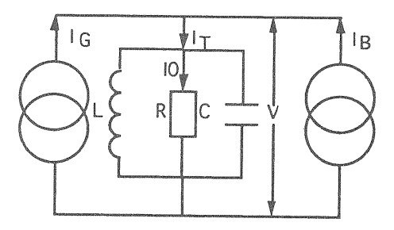
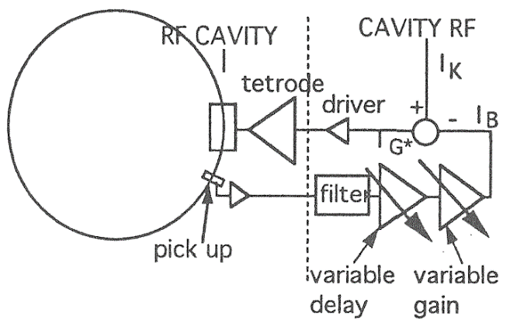
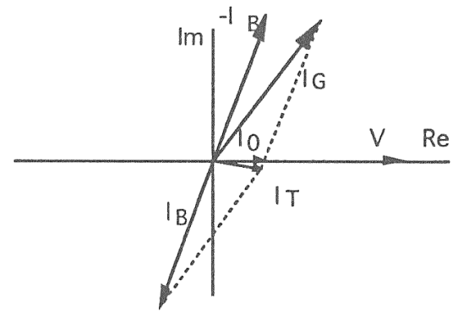
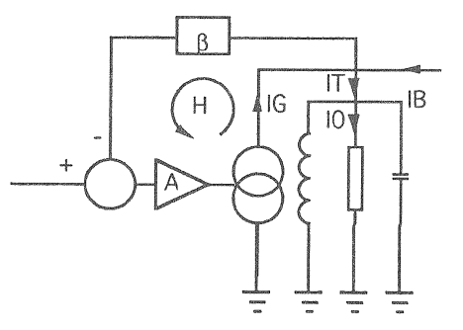
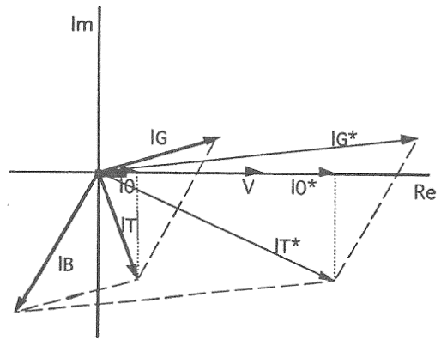
Compensation scheme
If IB ~ I0 or larger,
Feed Forward
ISIS
J-PARC
Fast Feedback
CERN PS
AGS
No work in Tunnel.
Need fine tuning for different conditions
Fast Feedback AMP in Tunnel.

Slide 13
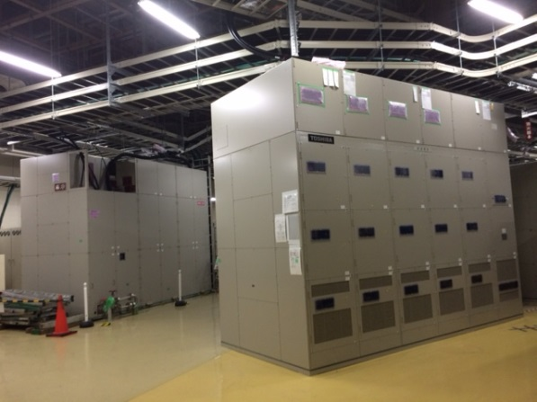
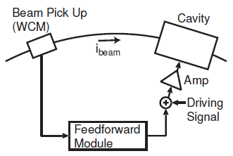
Feed Forward
Feed Forward Compensation for Wideband cavity
J-PARC adopts wide band cavities. Q=2 for RCS and Q>20 for MR.
J-PARC adopts feed forward beam loading compensation because
RCS system may not have enough gain (~20dB) by fast feedback.
Feed forward does not need extra work in tunnel.
J-PARC Feed Forward system works properly up to 1 MW-eq. for RCS and 380 kW for MR
F. Tamura, J-PARC
Feedforward module can handle 3 harmonics.
RCS: 2,4,6 (or 1-6 for single bunch)
MR:8,9,10

Slide 14
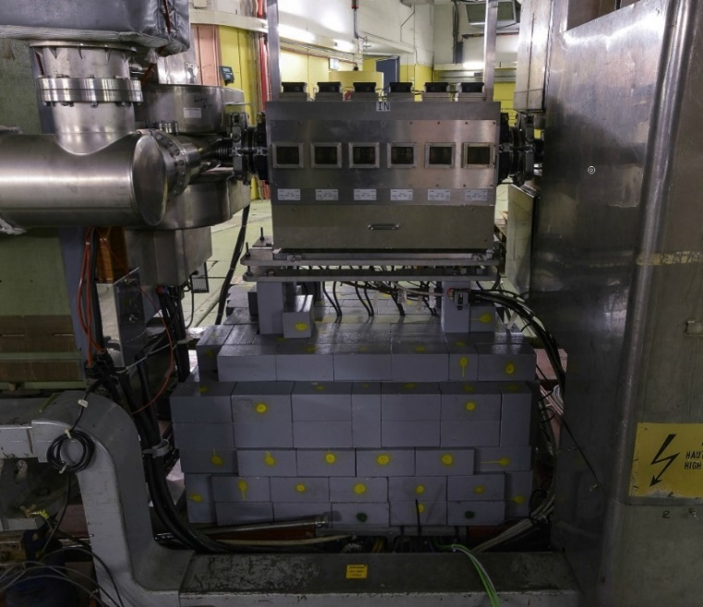
Feedback AMP from LIU Collaboration
KEK contributes LIU (LHC Injector Upgrade)-PS&PSB RF.
FT3L cavities will be used to replace all PSB cavities and damper cavities in PS.
These cavities are driven by Solid State AMP. The solid state AMP may fit to FB AMP at J-PARC.
Advantage: More beam & shorter tuning time
PSB
PS

Slide 15
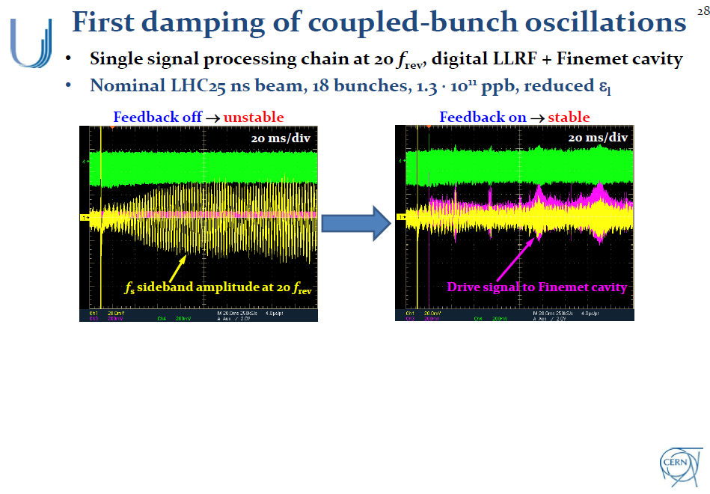
Recent Progress for Damper
2 !
H. Damerau@Finemet Review
H. Damerau@Finemet Review
Damper works remarkably!

Slide 16
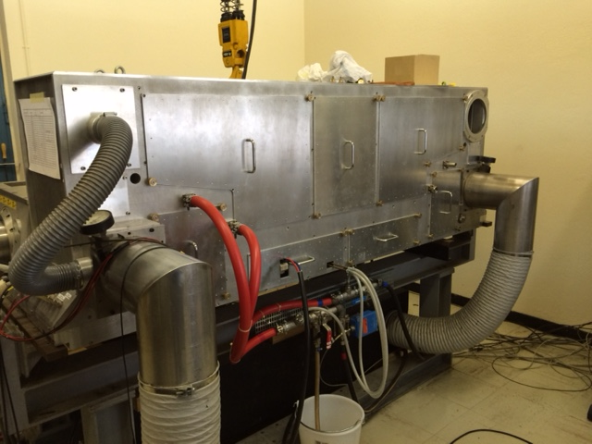
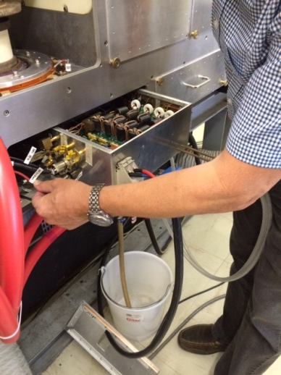
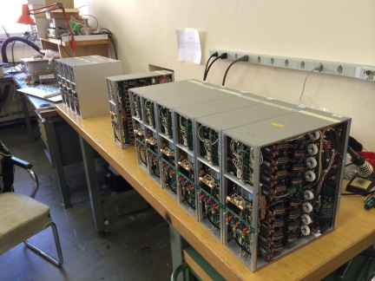
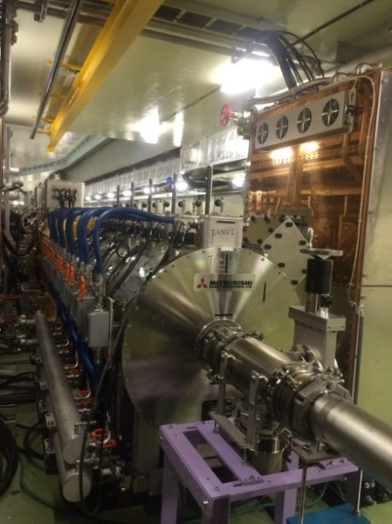
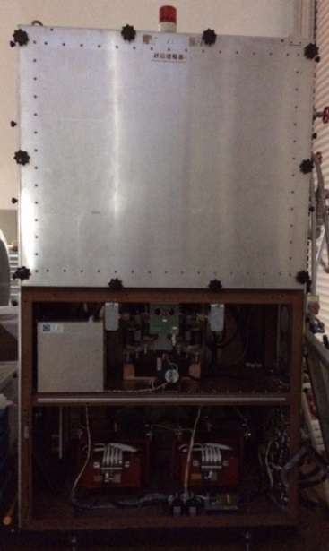
Feedback amplifier from LIU collaboration
Feedback amplifier for PSB back-up scenario
A half size of SSA
SSA for PSB FT3L system
A full size of SSA
AMP
J-PARC RF Cavity & AMP

Slide 17
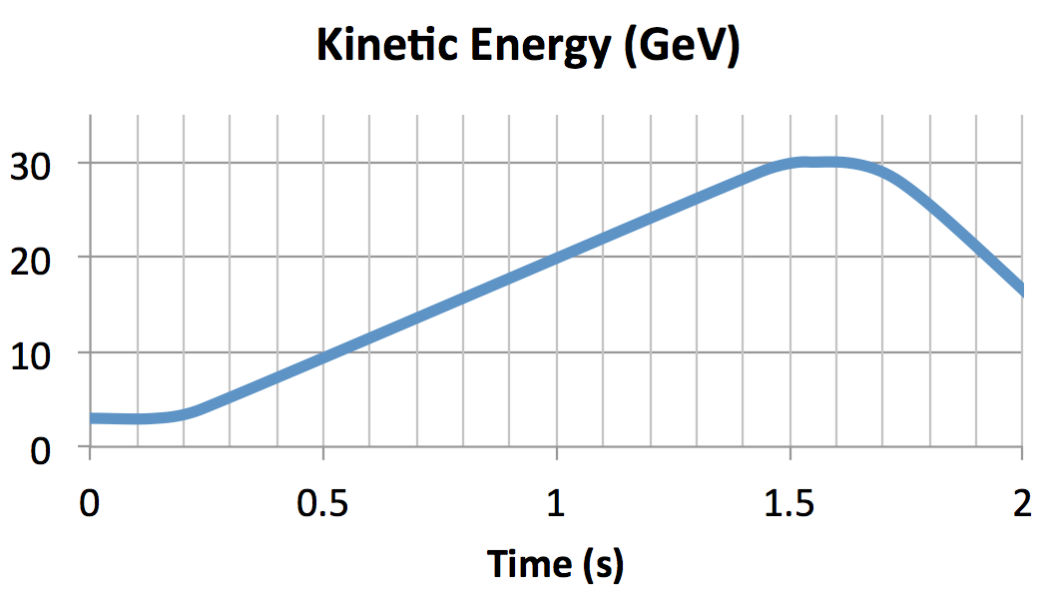
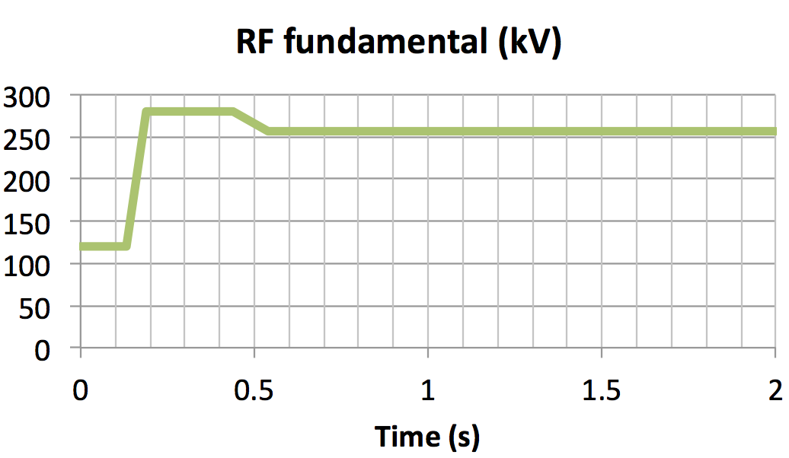
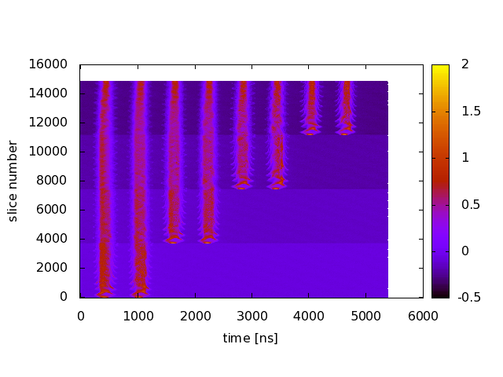
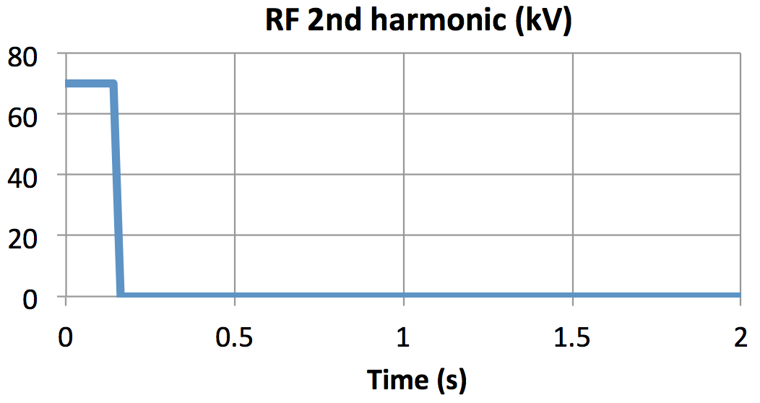
2 nd Haromonic RF Pattern
RF pattern :
Injection : 120 kV (fundamental), 70 kV (2nd harmmonic)
Acceleration : 280 kV → 256 kV (fundamental)
Beam loading compensation effectively works to damp the synchrotron oscillation.
Bunching factor was measured to be 0.3 during injection.
160 kV 85 kV
Longitudinal wave forms during injection
with wall current monitor
K4
K3
K2
K1

Slide 18
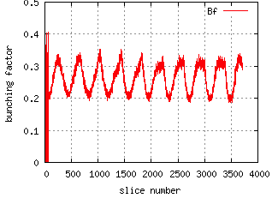
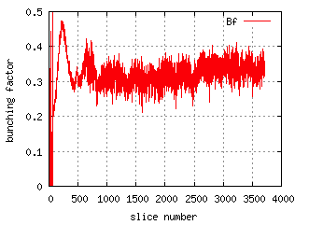
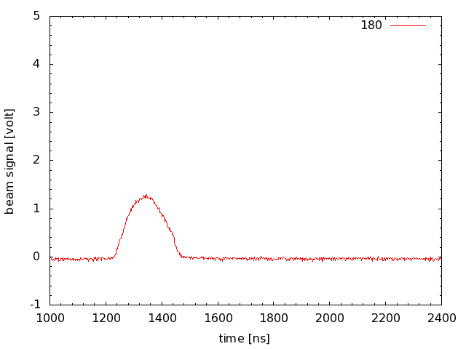
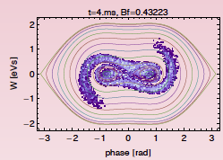
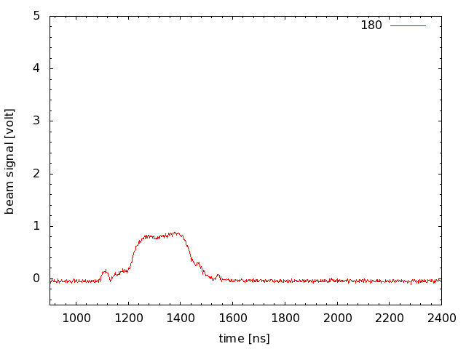
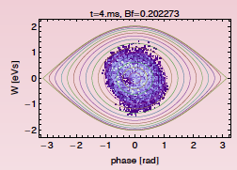
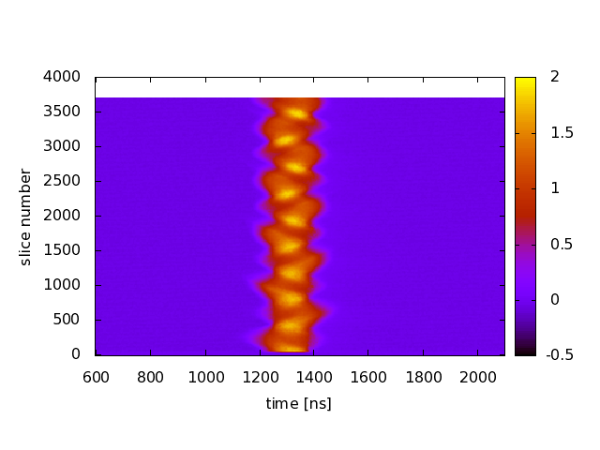
Longitudinal Profiles with High Intensity Beam of 500 kW equivalent
Tamura
(100 kV, 0 kV)
Bunching factor
0.2 ~ 0.3
Bunch length
~200 ns
(100 kV, 70 kV)
Bunching factor
0.3 ~ 0.4
Bunch length
~400 ns
Simulation
(100 kV, 0 kV)
Simulation
(100 kV, 70 kV)

Slide 19
Mid Term Plan Voltage Requirements
 | Present |  | Upgrade 1 |  | Upgrade 2
Cycle Time (s) | 2.48 |  | 1.28 |  | 1.16
# of protons | 2.2E+14 |  | 2.00E+14 |  | 3.20E+14
Beam Power (kW) | 425 |  | 756 |  | 1334
Acc. Time (s) | 1.4 |  | 0.62 |  | 0.57
Smoothing (s) | 0.1 |  | 0.1 |  | 0.1
RF Voltage (kV) | 280 |  | 504 |  | 540
Max/Extraction | 280 | 255.92 | 504 | 453.6 | 540 | 486
Synch. Phase | 21.85 | 24.03 | 31.13 | 35.06 | 32.27 | 36.38
Ratio of RF bucket | 1 | 1 | 1.10 | 1.03 | 1.11 | 1.03
Duty 58％ 48% 49％
Upgrade １：504kV = 14 kV/cell X 36 cells
Upgrade 2：540kV = 15kV/cell X 36 cells *Bench test with 16 kV/cell&60%Duty
Two issues;
1) 2nd H RF system (PS, AMP, DAMP, LLRF) when 1.28 s cycle starts.
2) Consolidation of Anode PS for MW beam & #10 Cavity system

Slide 20
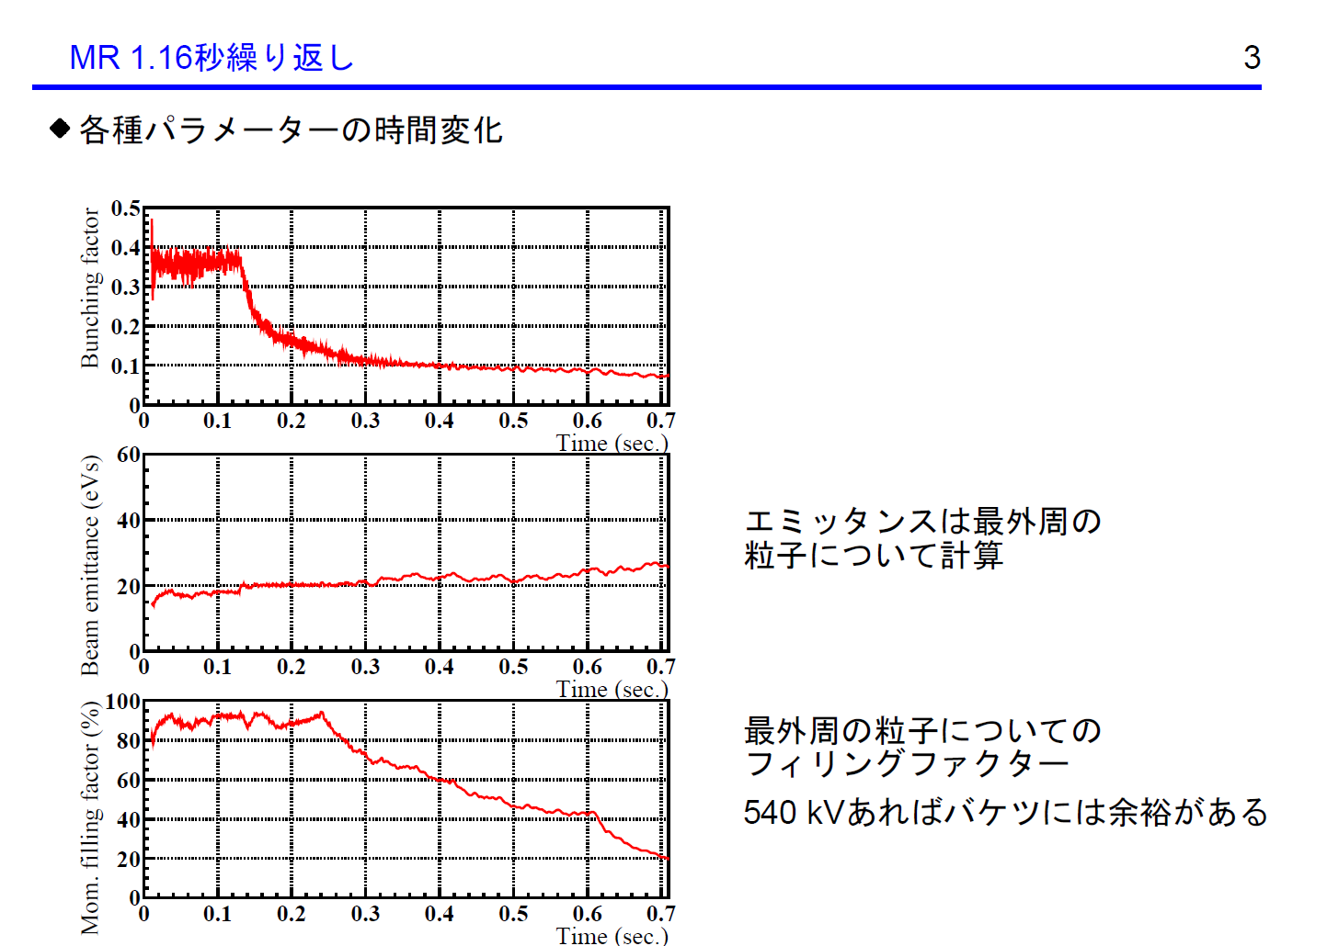
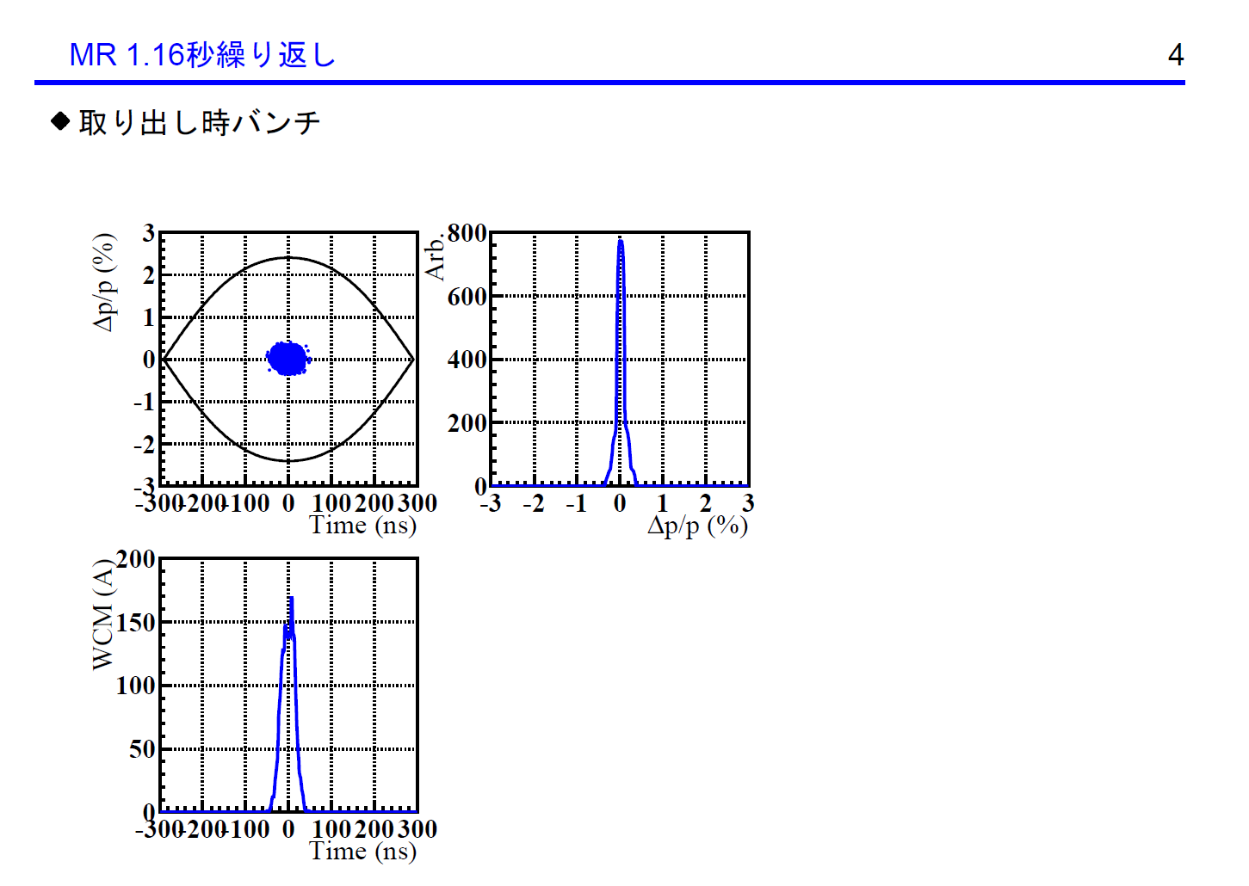
Simulation Results for 1.32 MW with 1.16 s cycle M. Yamamoto
Beam parameters &
Beam Loading compensations
3.19 E14 ppp
RF parameters
Injection
B
V
φ
0.57s acceleration
Loading compensation on more
Harmonics is needed.
Bunching factor, emittance, filling factor
Extraction
Bf
εL
pf
100% emittance
Acceleration by 540 kV 1st RF + 75 kV 2nd RF!

Slide 21
An idea for long term: Multi-MW by Batch Compression
RCS achieved 1MW. RCS study suggests 1.6 MW (133 TP) is reasonable.
FT3L cavities & consolidation of power supplies
But,3GeV injection seems difficult to inject to MR.
One of future (Long-Term) plans of J-PARC is 6-8 GeV Booster to reduce the space charge effects.
More beam can be accepted.
Bunch Manipulation by batch compression was studied to achieved Multi-MW beam for T2K with reasonable (achievable) technologies.
w/o “super-fast” kicker magnets, w/o faster cycling than 1 sec.

Slide 22
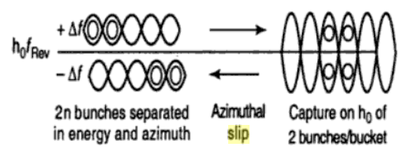
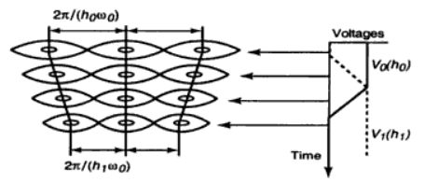
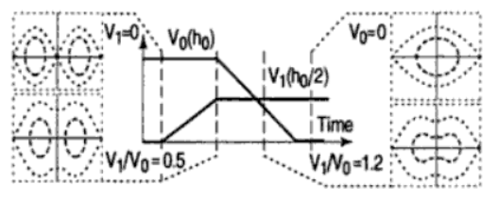
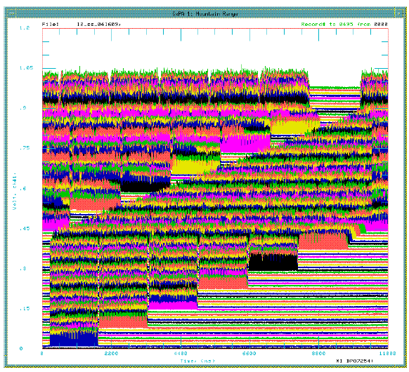
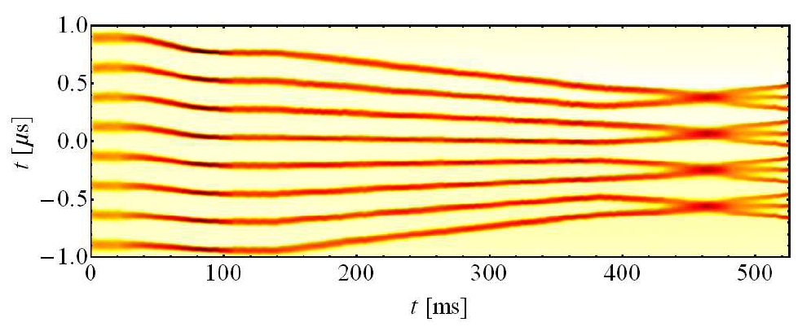
Bunch Manipulation
Slip Stacking at FNAL
Batch compression at CERN
Merging and splitting at CERN
No manipulation at J-PARC!
“Handbook of Accelerator Physics and Engineering” World Scientific
K. Seiya, PAC07
H. Damerau, HB2014

Slide 23
MR Injection Energy and Beam Loss
Simulation of beam survival in the injection period of the MR
for the RCS 1MW eq. beam (4e13 ppb)
Y. Sato
6.0 GeV
1.0
3.6 GeV Inj: Ave Inj loss 0.38%
(Total loss ~ Inj loss x1.5: 0.92 kW
for MR 1.2 MW @1.2 s cycle)
3.6 GeV
3.4 GeV
0.98
3.4 GeV Inj: Ave Inj loss 0.75%
(Total loss ~ Inj loss x1.5: 1.7 kW
for MR 1.2 MW @1.2 s cycle)
3.2 GeV
Survival ratio
3.0 GeV
3.2 GeV Inj: Ave Inj loss 1.5%
(Total loss ~ Inj loss x1.5: 3 kW
for MR 1.2 MW @1.2 s cycle)
0.96
3.0 GeV Inj: Ave Inj loss 3.2%
(Total loss ~ Inj loss x1.5: 6 kW
for MR 1.2 MW @1.2 s cycle)
0.94
0 0.04 0.08 0.12
Time [s]
3-50BT: 60π cut 2.4% loss (3.2 kW loss for 3GeV injection MR 1.2 MW @1.2 s cycle)

Slide 24
Batch Compression at J-PARC MR using 6-8 GeV Booster
BR
MR
H=9
H=9
H=9
H=9
H=11
H=13
H=13
H=13
K1
K2
K3
K4
K5
K6
K7
K8
2 empty buckets -> 1μs for Extraction Kicker
Narrow injection bunch w/o 2nd H
->200 ns for injection kicker

Slide 25
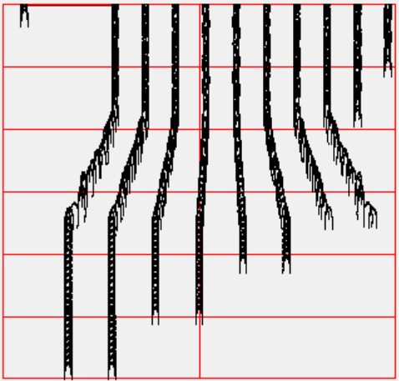
Batch Compression at J-PARC
H=13
H=12
H=11
H=10
H=9
0V VH
K4-K5:80 ms for H=9 to H=13
H=9: V=60 kV
H=13: V=87 kV
Total Injection time 120 ms to 280 ms
Increasing injection energy, MR can store more beam.
Recent simulation suggests RCS has a capability to handle 1.6 MW beam.
Batch Compression fits 6 (8) GeV booster scenario to achieve ~3 MW beam power.
Need cavities for compression & consolidation of RF power supplies

Slide 26
Summary
All cavities are replaced by new FT3L cavities.
504 (540) kV is available for 1.28 (1.16) sec. cycle.
Before 2018, need new RF AMP and APS for 2nd H
For MW beam, need consolidation of APS.
Batch Compression fits to 6 GeV booster scenario for 3 MW beam.

