Slide 1
2nd harmonic cavity for Booster
C.Y. Tan
US-J Mini Workshop
9 −10 Nov 2016

Slide 2
People involved
C.Y. Tan, W. Pellico (Proton source)
R. Madrak, J. Dey, D. Sun, J. Reid (RF dept)
G. Romanov, I. Tereckhine, A. Makarov (Tech Division)
K. Duel, M. Slabaugh (Mechanical support)
M. Kufer (EE support)
J. Kuharik (Grad student)

Slide 3
Introduction
Perpendicular biased cavities were proposed in the 1980s as a way to achieve higher Q’s and thus higher voltages compared to parallel biased cavities.
  TRIUMF for the Kaon program and SSC for LEB.
    None of the above cavities became operational.
  From literature, the most successful cavity to date has been the TRIUMF cavity that reached its design voltage of 65 kV.
    However, cavity developed a problem and did not see beam.
FNAL Recycler 53 MHz cavities are perpendicular biased but has a small sweep frequency of 10 kHz.
If successful, the FNAL cavity will be the first perpendicular cavity that has a large frequency sweep range of about 30 MHz.

Slide 4
Goals
The 2nd harmonic cavity will be used at injection, either at transition (requires 2 cavities) or at extraction.
  Reduced the duty factor so that the power loss in the garnet is kept under control! Previous cavities failed from localized losses in the garnet.
The cavity will operate at twice the fundamental frequency
  2×37.865 = 75.73 MHz at injection
  2×52.25 = 104.5 MHz at transition
  2×53.18 = 105.63 MHz at extraction
The peak RF voltage required is 100 kV in the cavity
  Theoretical requirement at injection is 100 kV minimum
  Transition is ~200 kV for focus free transition crossing.
  Extraction is ~50kV for voltage linearization for bunch rotation.

Slide 5
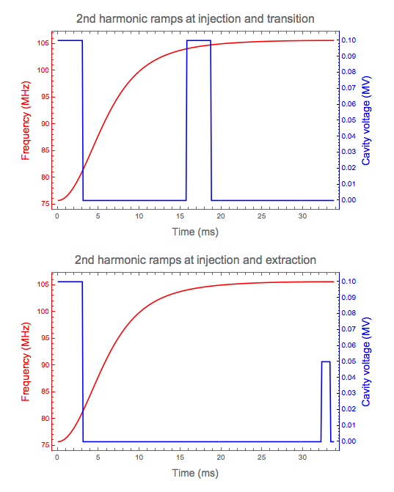
Ramps
In order to circumvent heating losses in the garnet, the duty factor of the cavity has been reduced to <10%.
Cavity is on for 3 ms at injection and transition. Or at injection for 3 ms and extraction for 1 ms.

Slide 6
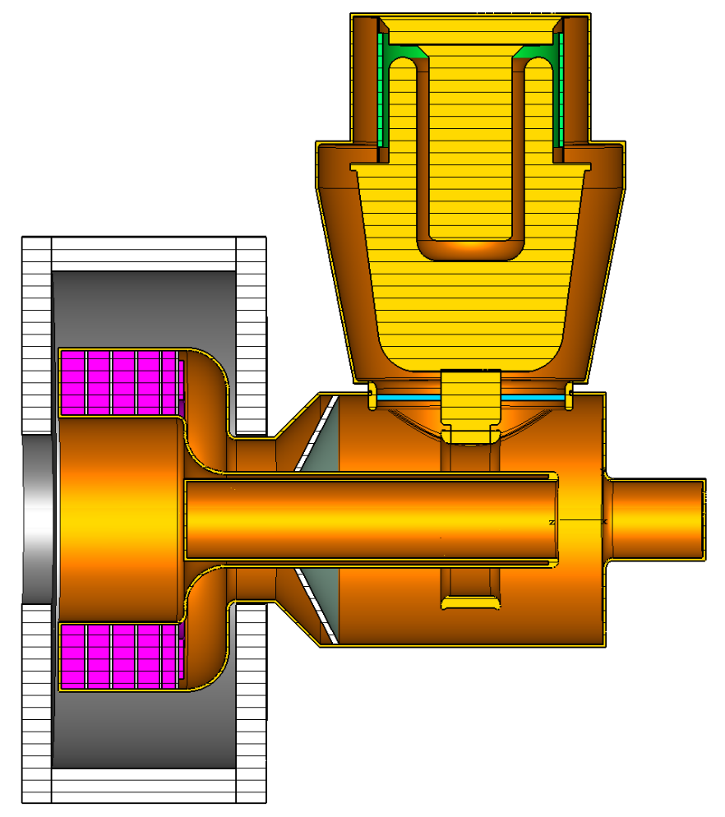
2nd harmonic cavity
All dimensions in mm.
HOM cavity is not shown.
The PA and the cavity is strongly coupled and is very sensitive to the dimensions of the PA transmission line.
The PA (Y567) has evolved into a detailed model so that step up ratios and anode impedances can be calculated correctly.
246
382
312
570
204
90
256
45
552

Slide 7
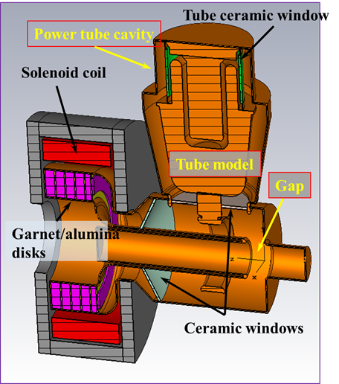
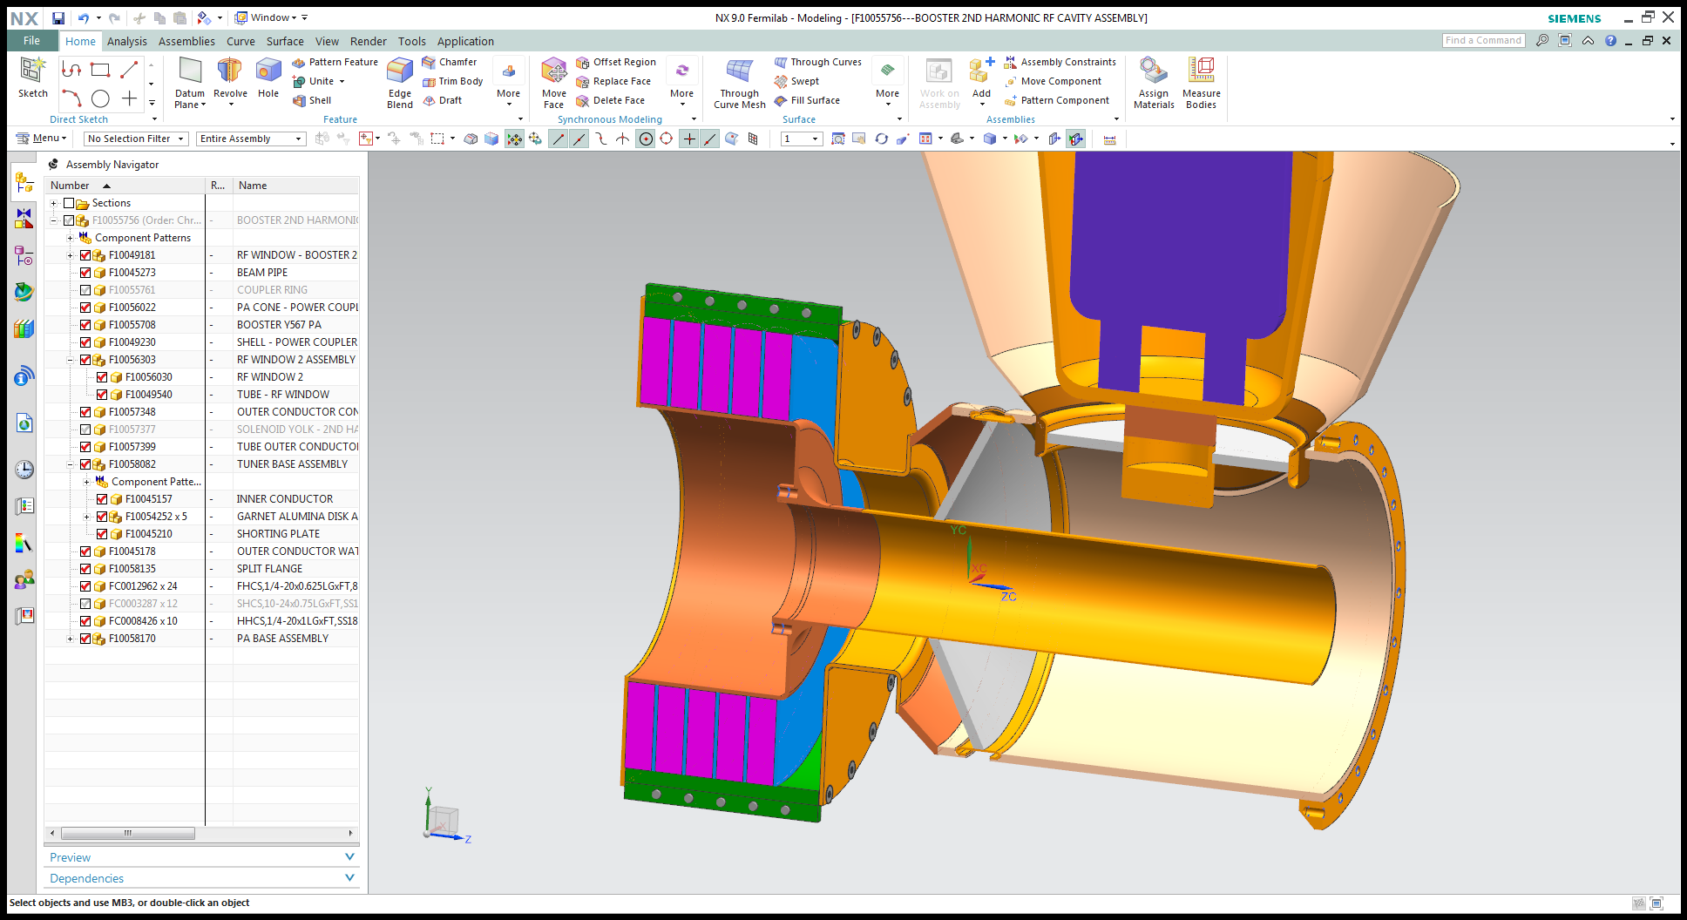
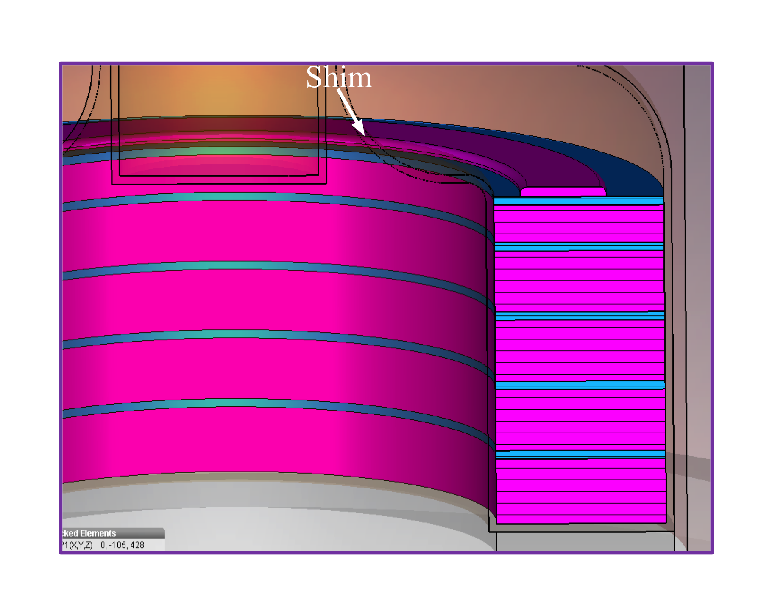
2nd harmonic cavity (cont’d)
Mechanical design and assembly sequencing
addition of shim makes H field more uniform and thus lowers losses in garnet.
Latest CST model. HOM cavity is not shown here.

Slide 8
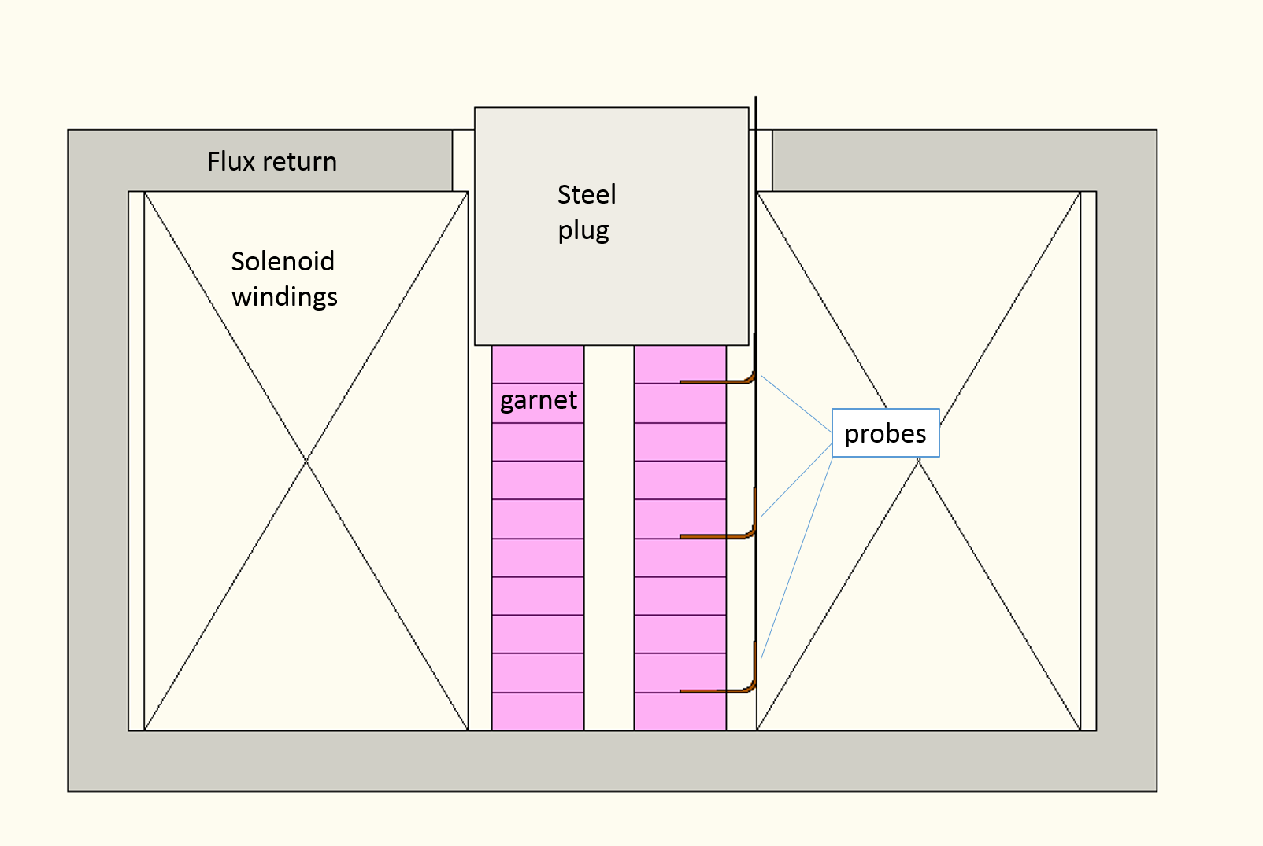
Garnet properties (static μ)
It is important to measure the real and imaginary parts of the magnetic permeability because the cavity model depends critically on the garnet properties.
  Uniform field in the garnet for measuring static magnetization is critical!
    Any local non-uniformity of the field can greatly affect the result.
10 stacked rings were placed inside the solenoid. A flux return on the bottom and sides were made from CMD-10 and G4 ferrite.
Dimensions of solenoid: ID = 177.8 mm, OD = 305 mm. Number of turns =112.
Steel plug inserted on top to improve field uniformity.
3 Hall probes were inserted between garnet rings.

Slide 9
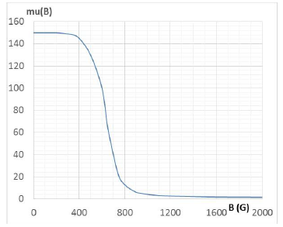
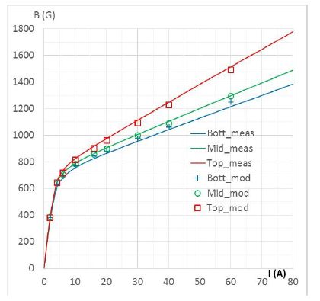
Garnet properties (cont’d)
The curve on m vs B curve was iteratively found using a model of the setup to match the measurements.
The curves on the right show the comparison of the model and measured B fields.

Slide 10
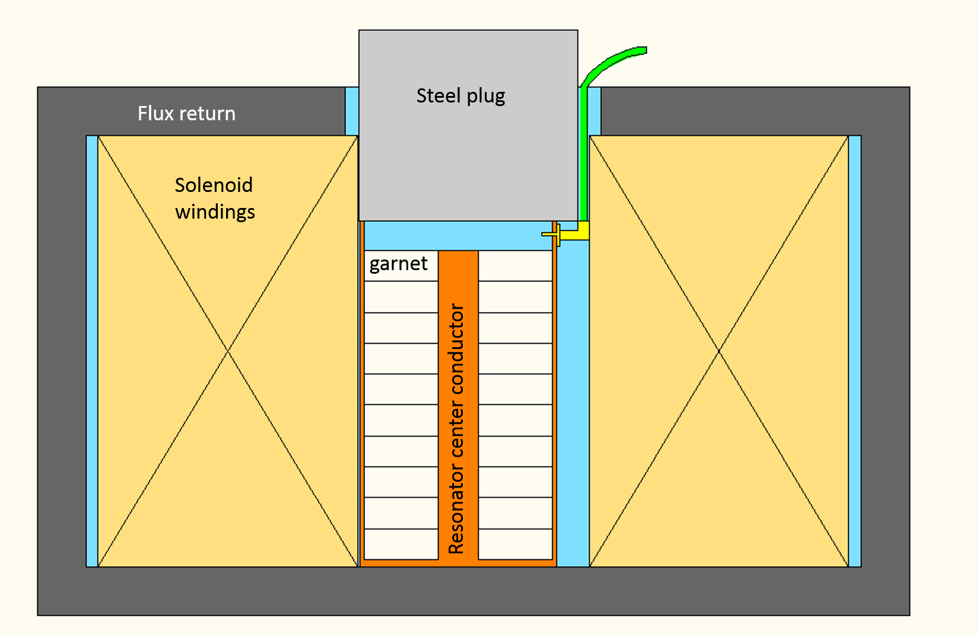
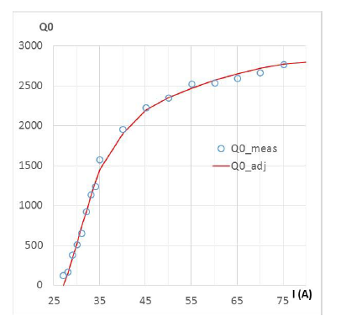
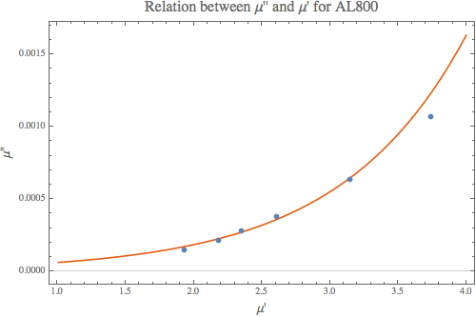
Garnet properties (RF)
A coax cavity was made with the garnet. It is critical to make the bottom shorting plate as thin as possible. Any localized non uniformity in B dominates Q measurements!

Slide 11
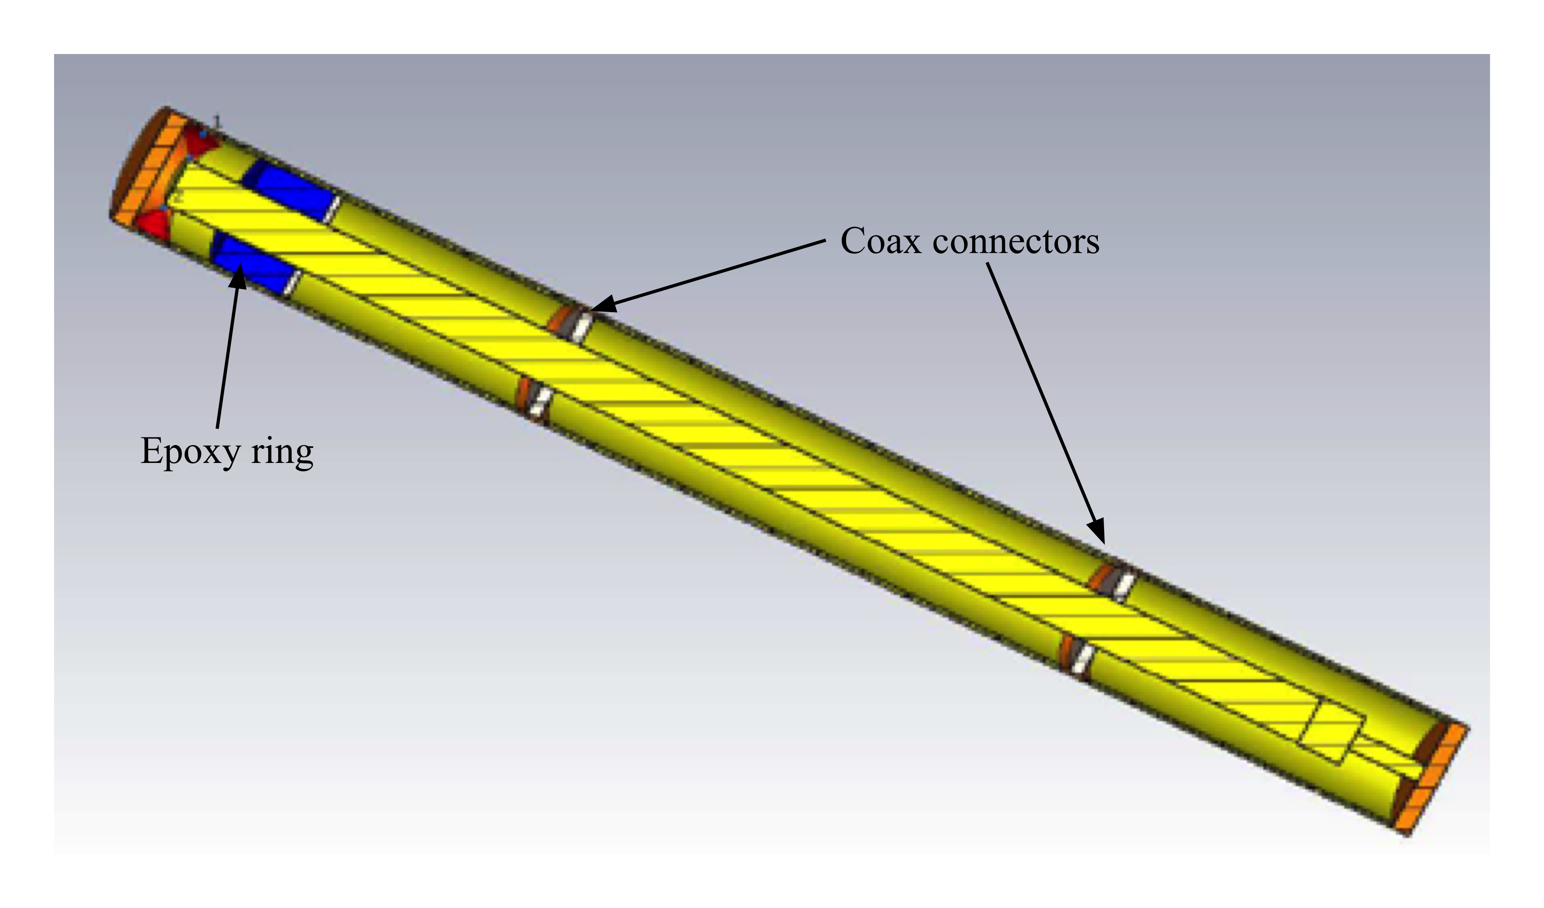
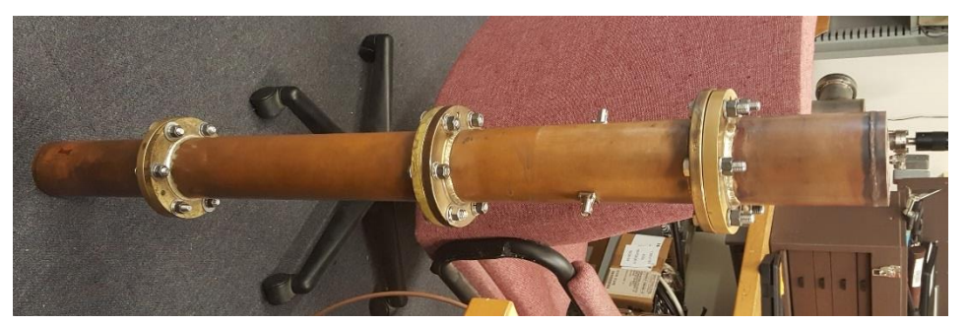
Stycast measurements
It is also important to know the RF properties of the glue that is used to glue the garnet sectors together and to the alumina cooling disk.
A 76 MHz quarter wave resonator was made from standard 3-1/8” transmission line. A 2” thick ring of epoxy with an OD/ID of ~3”/1.375” was made to fit into the end of the resonator.
The measured tanδe_{e} = 0.017 at 76 MHz, substantially smaller than the vendor’s value of 0.028 at 1 MHz (mHz?).
More measurements with a ½ wave resonator shows that that with four 0.5" thick AlN rings (total thickness = 2”) and three thin layers of Stycast (total thickness 0.0081”) does not change the Q. We are at the limits of measurement for thin layers. Must rely on simulations to get detailed heating profiles.

Slide 12
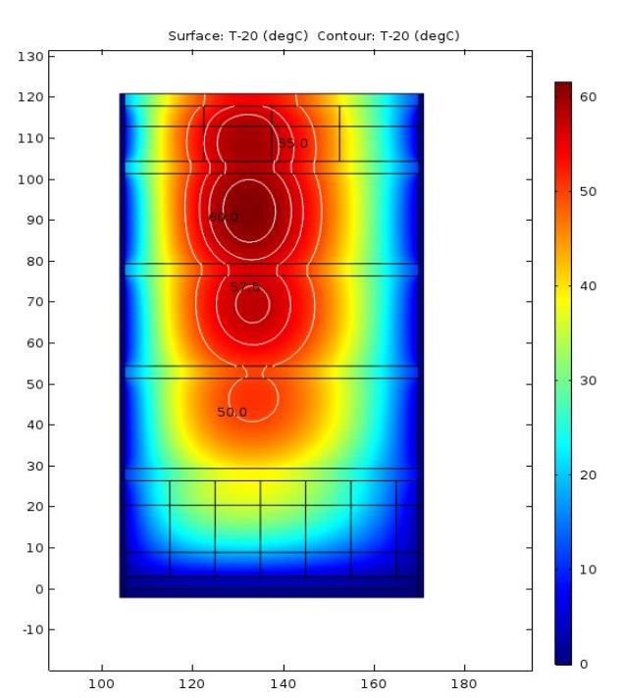
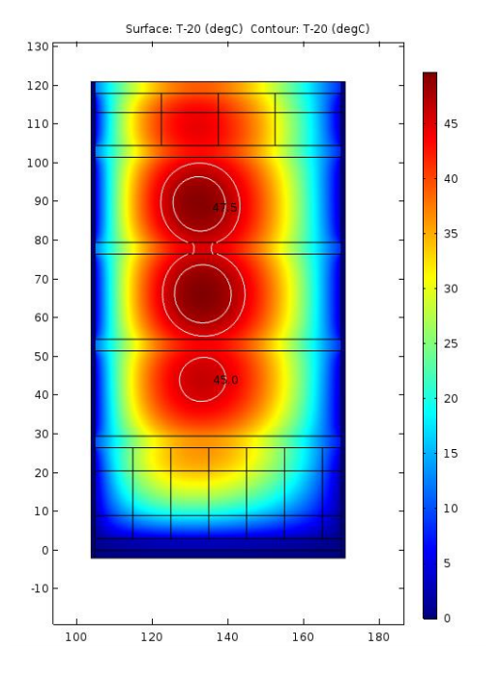
Temperature profile of garnet stack
Temperature delta’s for the garnet stack with tanδe = 0.02. Temperature rise is 60 degC. This sim was done with 0.1mm glue layers and the sides, 10% duty factor.
This is with no losses in the glue. Max delta temp is 47.5 degC.

Slide 13
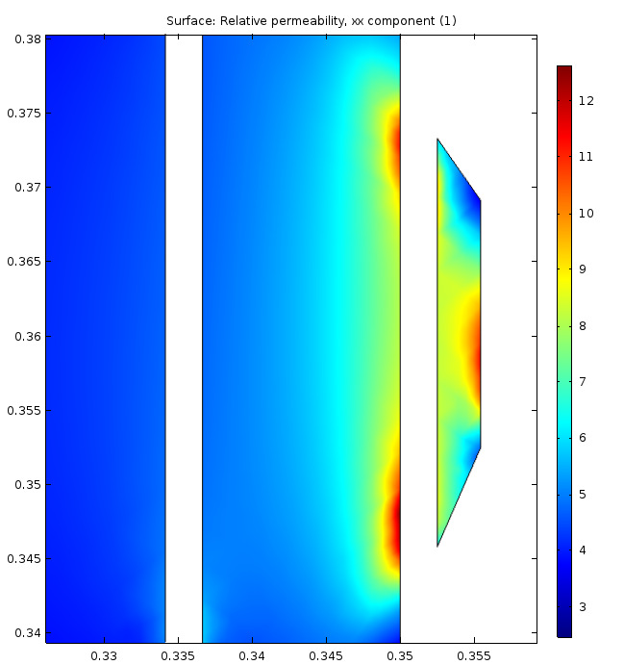
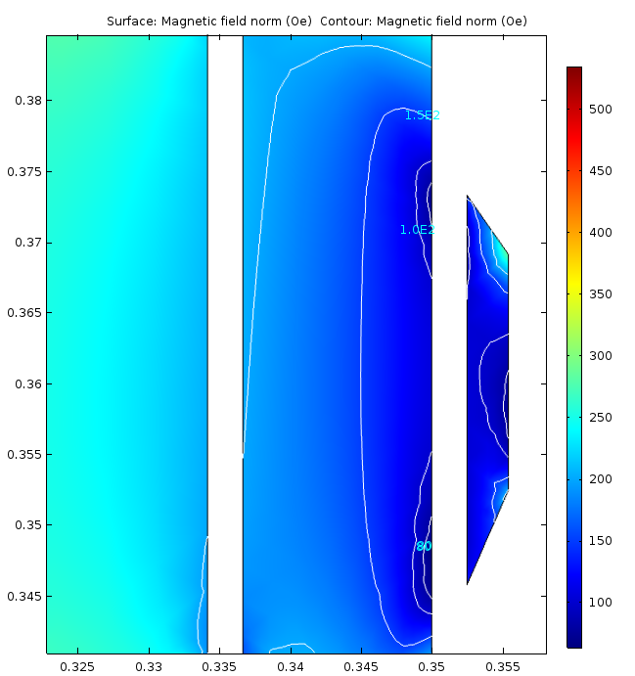
Adding shim to tuner makes field more uniform
Permeability in the garnet
Gyromagnetic resonance field at 75 MHz (32 Oe) → the field seems sufficiently far from the resonance.
Non uniform fields create hot spots in the garnet. This creates problems with localized heating if not taken care of.

Slide 14
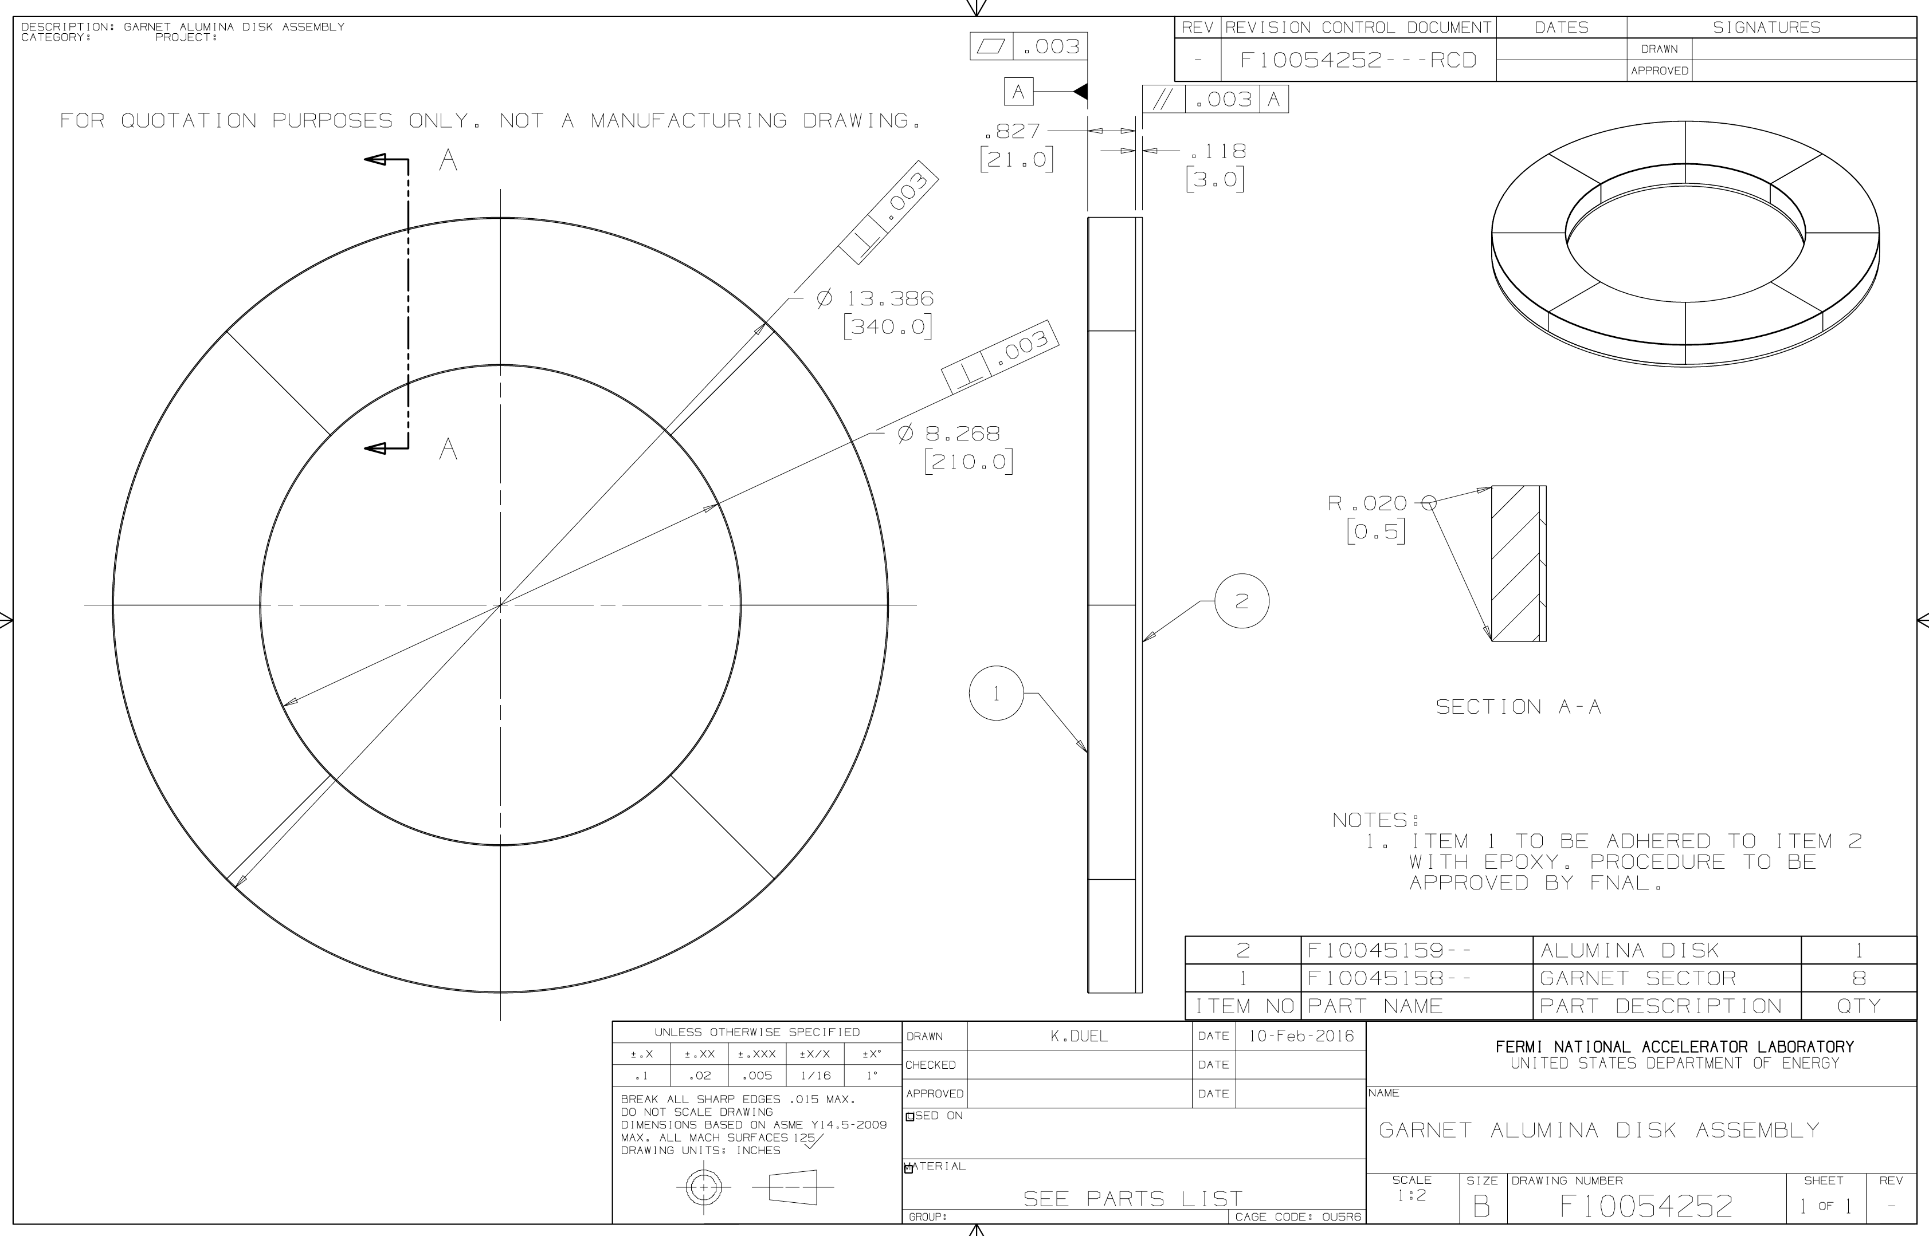
Construction of garnet ring with alumina cooling ring

Slide 15
Cavity simulations
In the early days, a transmission line (TL) model was used in parallel with the CST model
  The TL model was used to double check the CST model results.
  The TL model was very useful for understanding that strong coupling made the dimensions of the PA coupler very critical.
    Impacts the frequency range of the cavity.
    Impacts the impedance seen by the Y567.
  TL model was used to calculate
    Resonant frequencies as a function of μ.
    Shunt impedance (Engineer’s definition P = V_{p}²/(2 R_{s}))
    R/Q
    Q
    Stepup ratio
However, as the CST model matured, it is used for the final design.

Slide 16
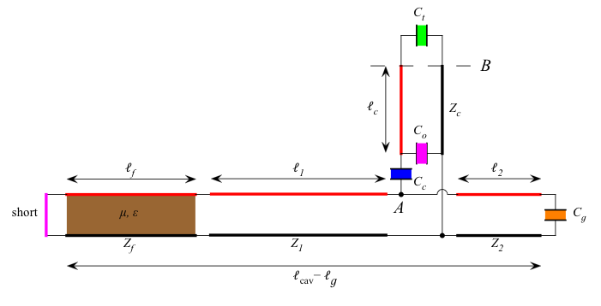
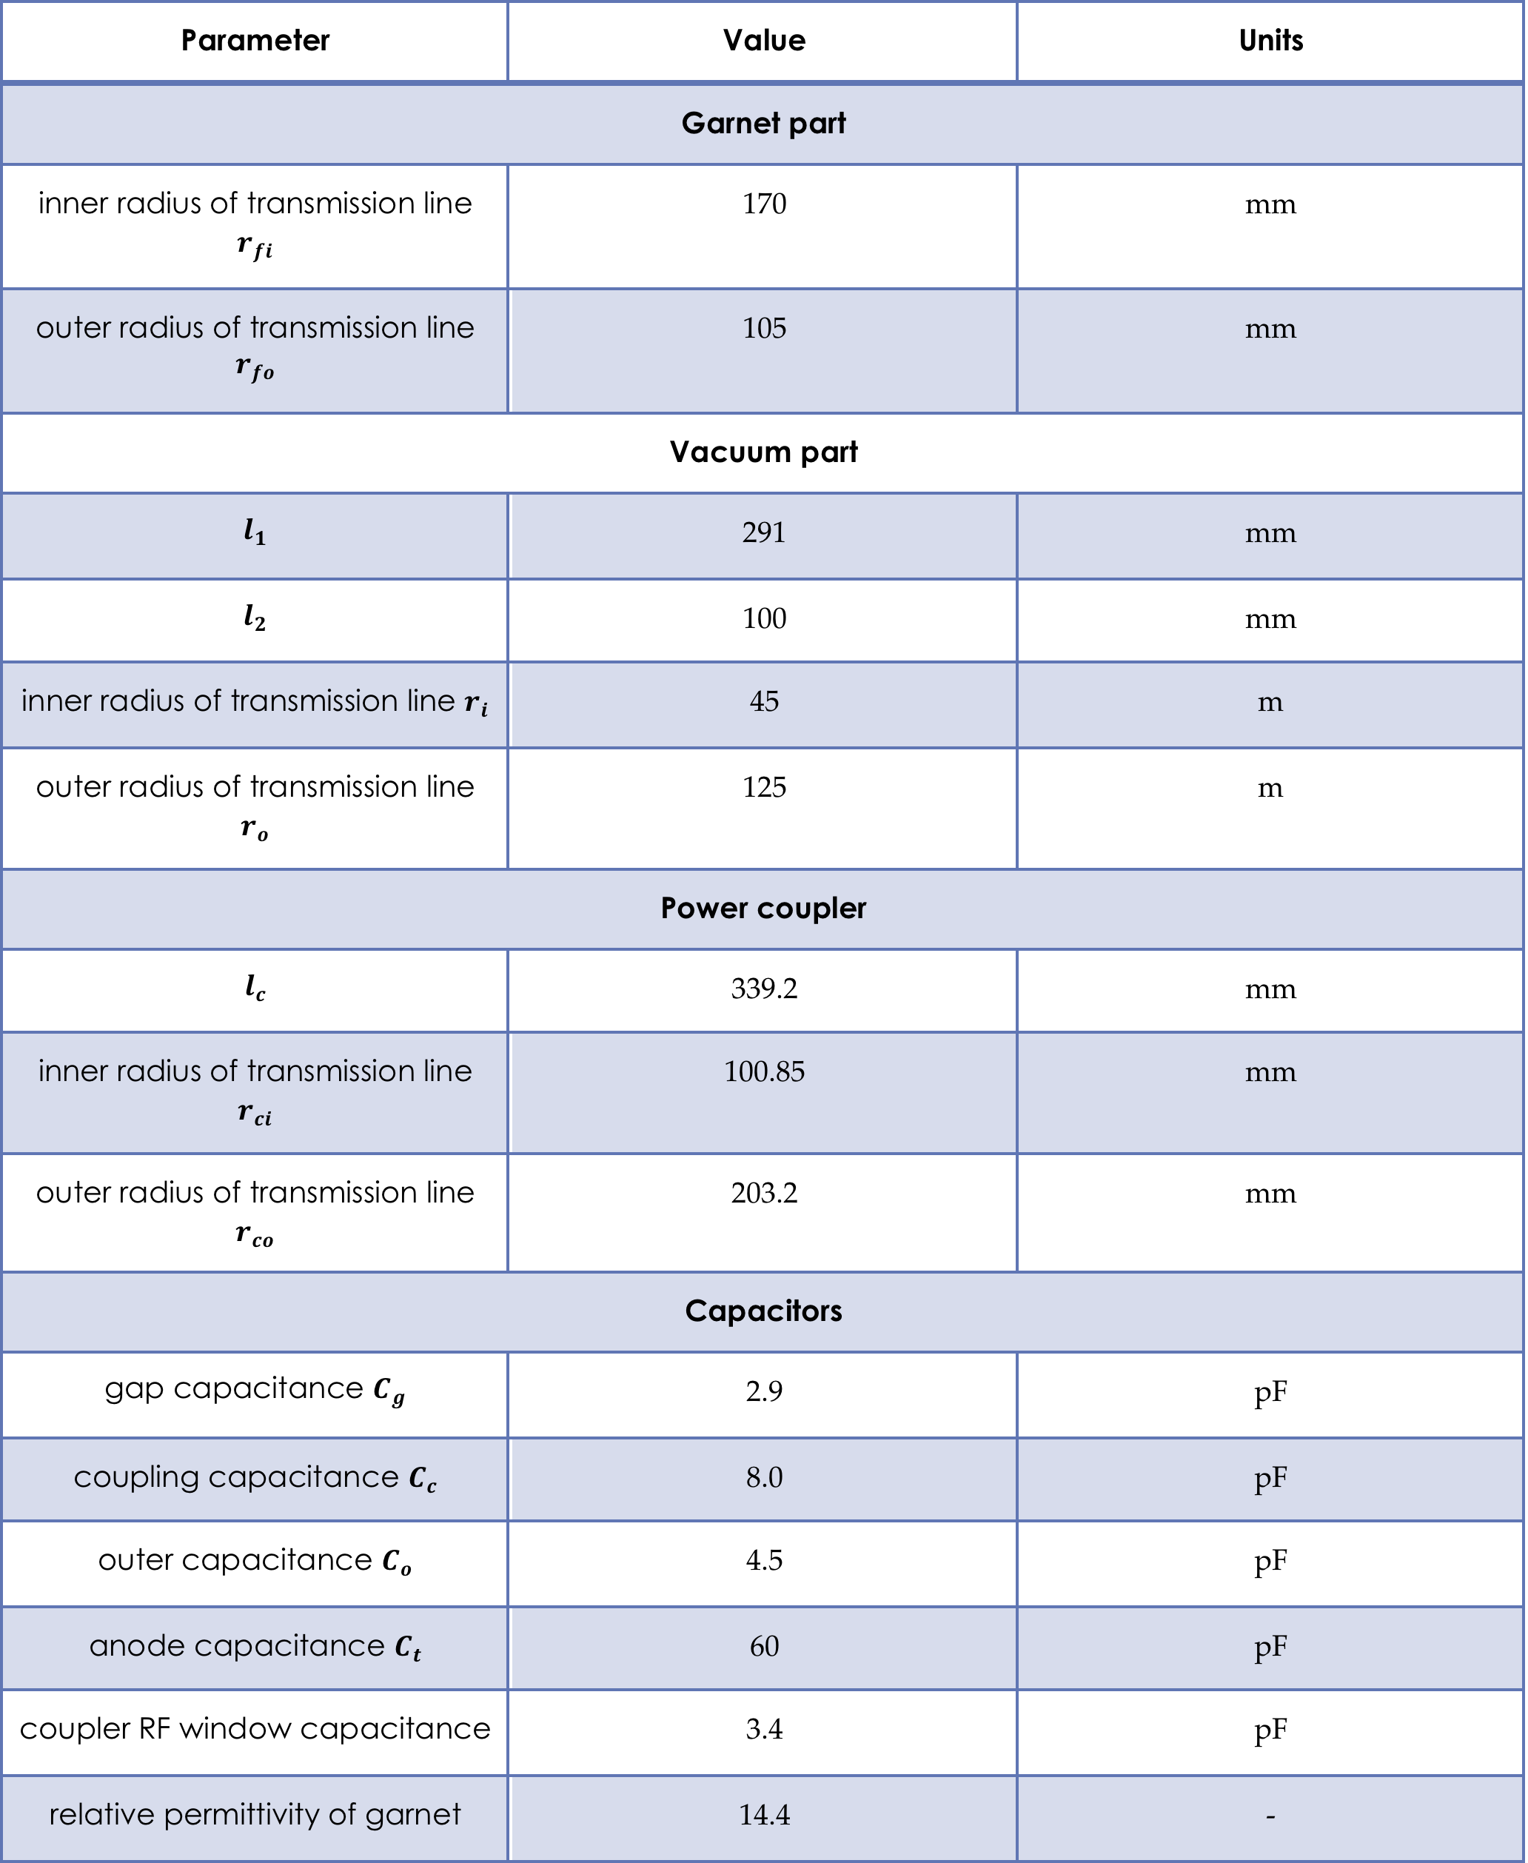
TL model
Ignored Alumina cooling disks
Ignored bend in the neck.
Models Y567 as a 60 pF capacitor.

Slide 17
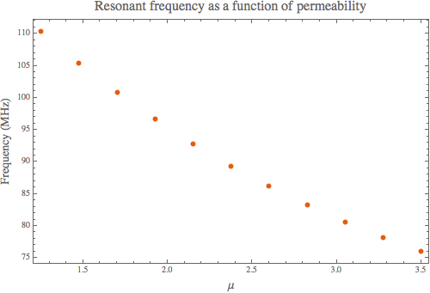
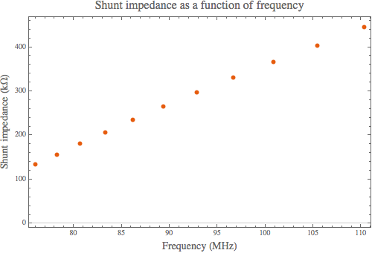
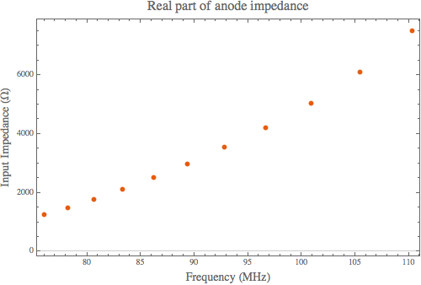
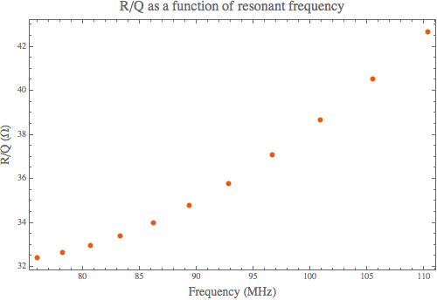
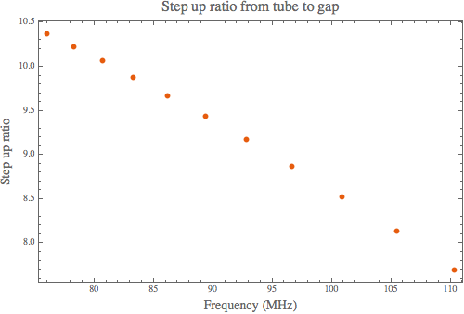
TL model results
The TL model allowed to calculate the effect of changes made to the cavity quickly. Also became a guide to the CST model, especially for making the coupling between the PA and the cavity work.

Slide 18
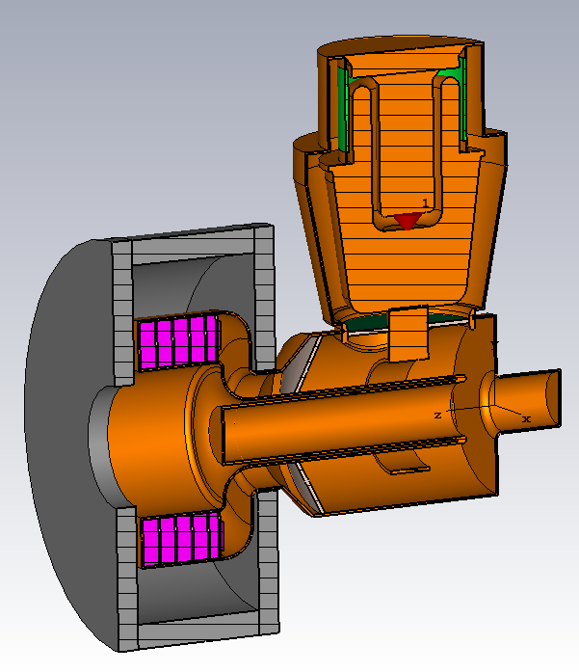
CST model results
Engineer’s definition P = V²/2R

Slide 19
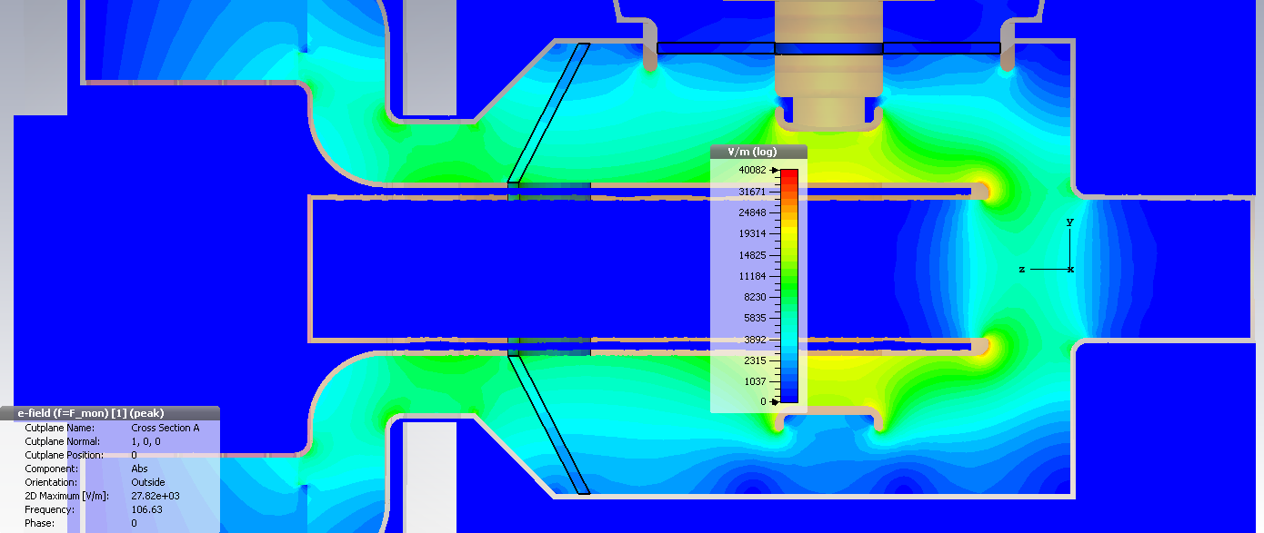
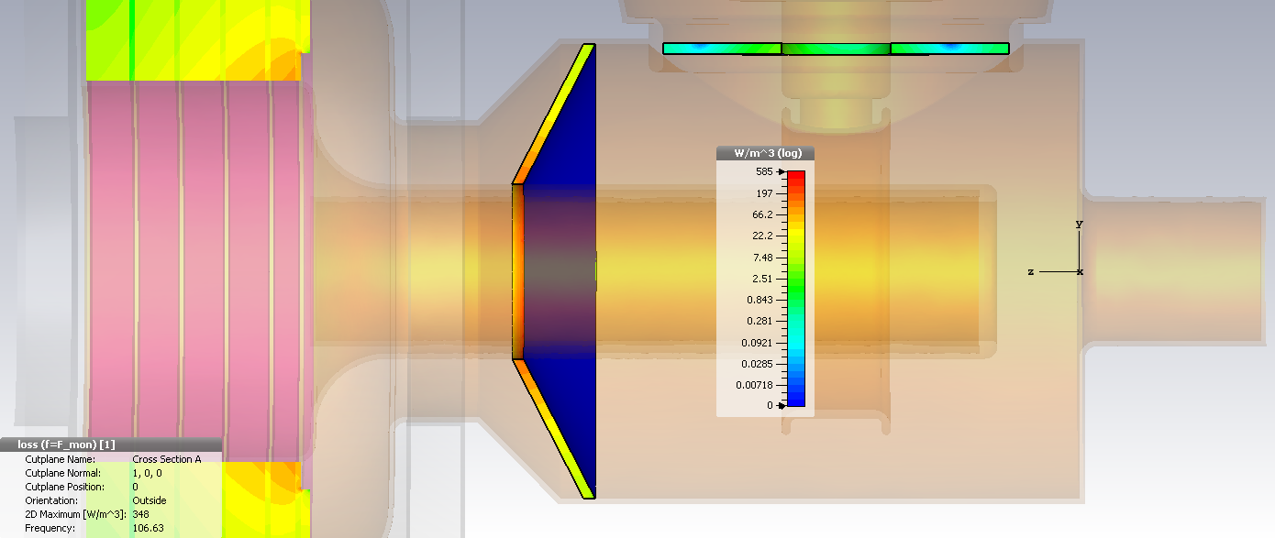
Thermal losses at windows
Assumptions:
Acc. Voltage = 100 kV
3 ms injection: I=140 A, F= 75.96 MHz, constant losses
+ 3 ms extraction: I=700, F=106.63 MHz, constant losses
tanδ_{E} = 0.0001
Repetition rate 15 Hz
Thermal losses:
Flat window: thermal losses of 0.25 W
Conical window: thermal losses 46.5 W
More simulations will be done to add the brazing lips.
RF electric field
Distributions at coil I = 700 A, F = 106.63 MHz
RF dielectric losses

Slide 20
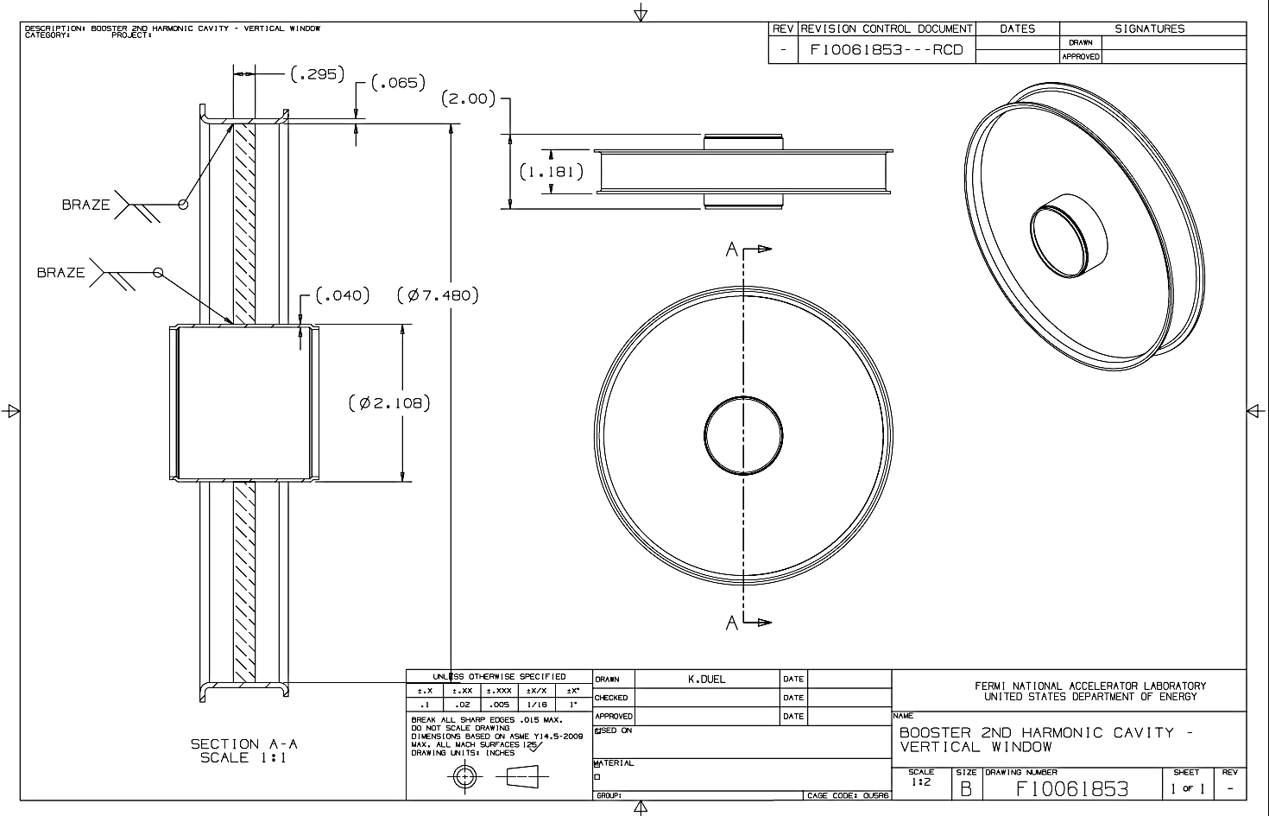
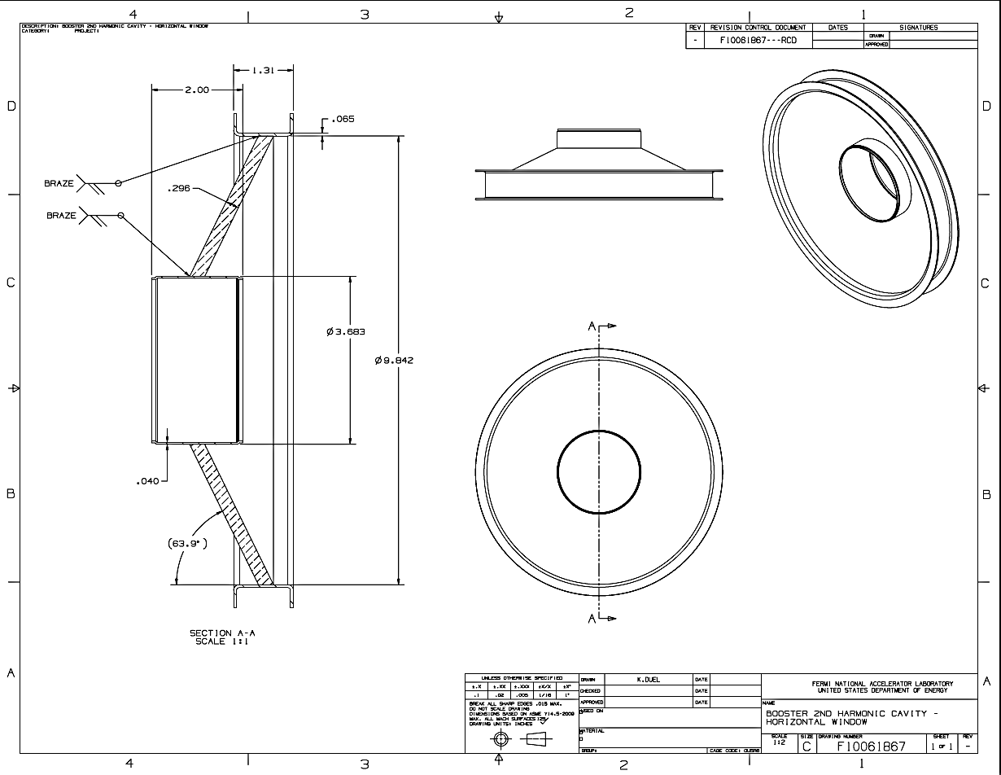
RF windows
RF windows have sent to manufacturer.
  Technically challenging to make sure that we can actually braze the windows to the cavity.

Slide 21
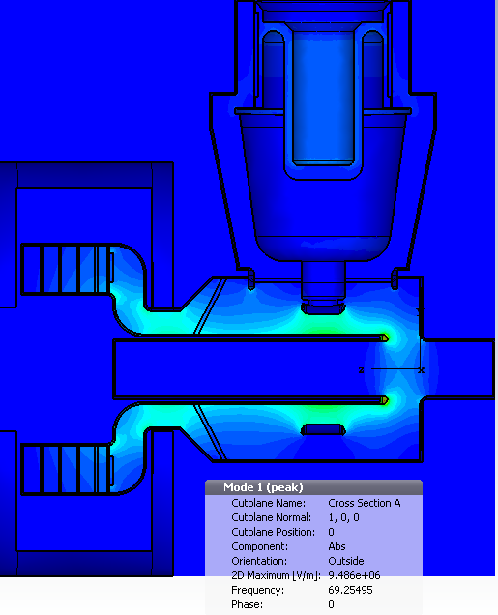
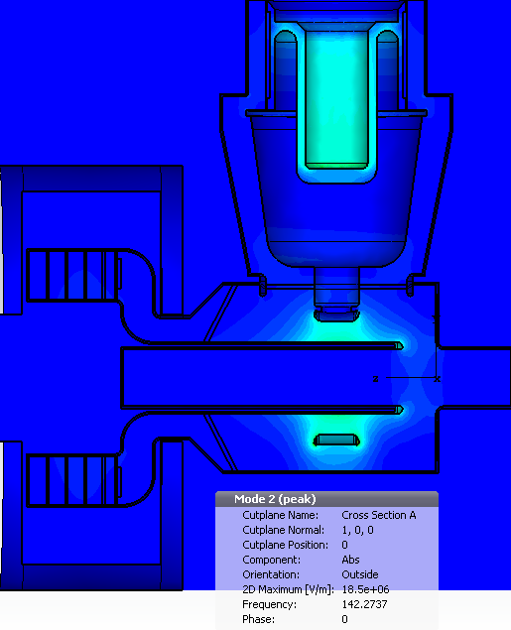
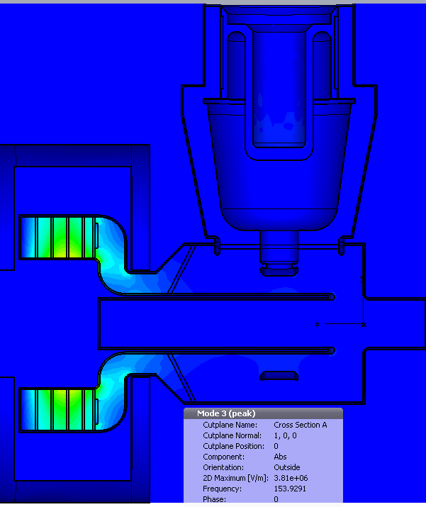
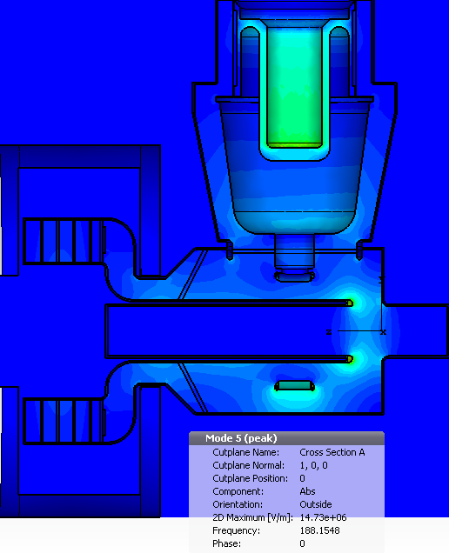
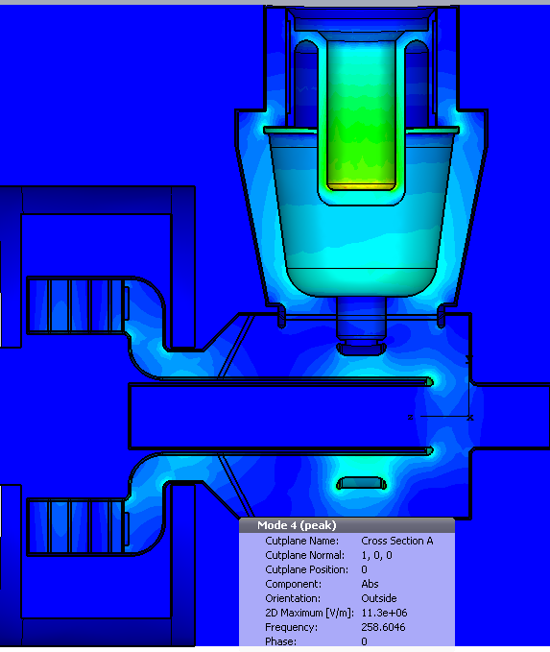
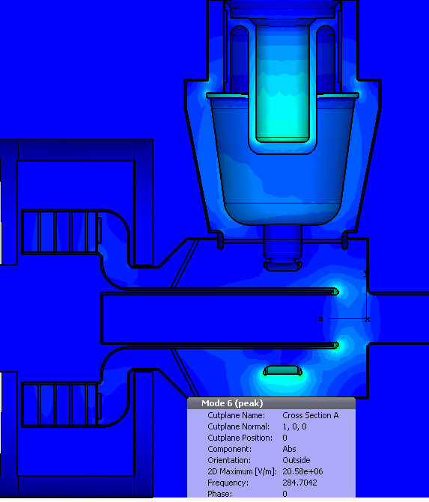
HOM modes
Operating mode,
F = 69.25 MHz
F = 142.26 MHz
F = 154 MHz
R/Q for operating mode is almost the same in all three models.
HOMs associated with the tuner are almost the same.
HOMs associated with the tube cavity got higher frequency.
The tube cavity provides additional damping for HOMs.
F = 188.14 MHz
F = 258.42 MHz
F = 284.7 MHz

Slide 22
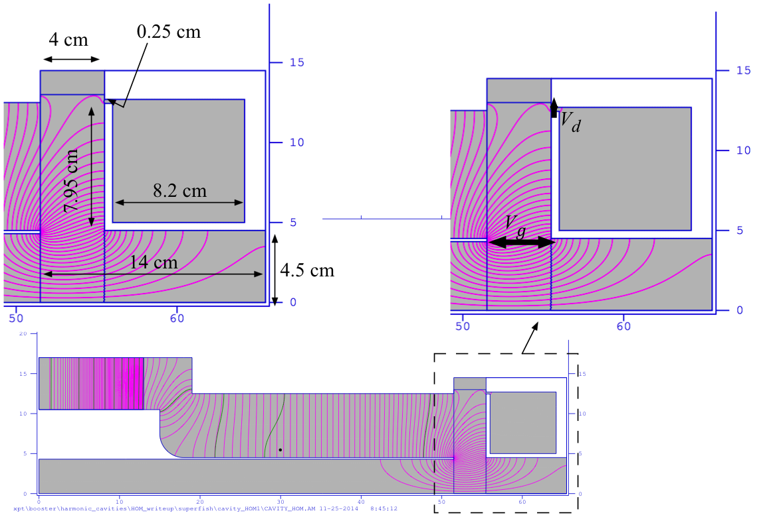
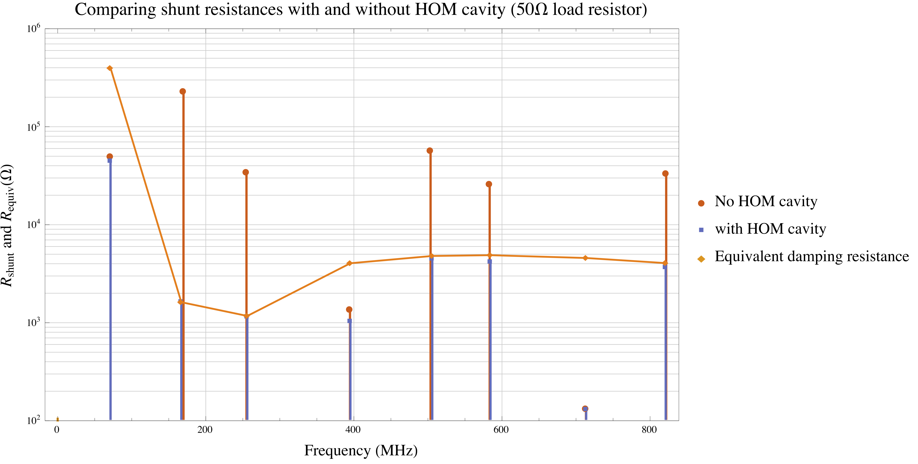
HOM damper
Semi analytic model uses both analytic calculation and Superfish.
Uses Smythe style broadband damper cavity.
CST model will have HOM damper

Slide 23
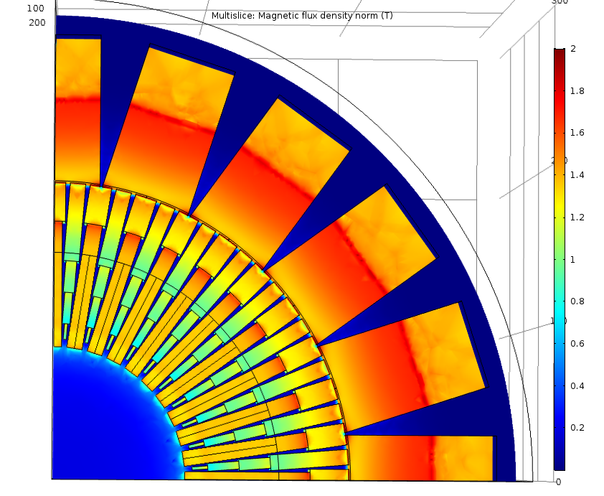
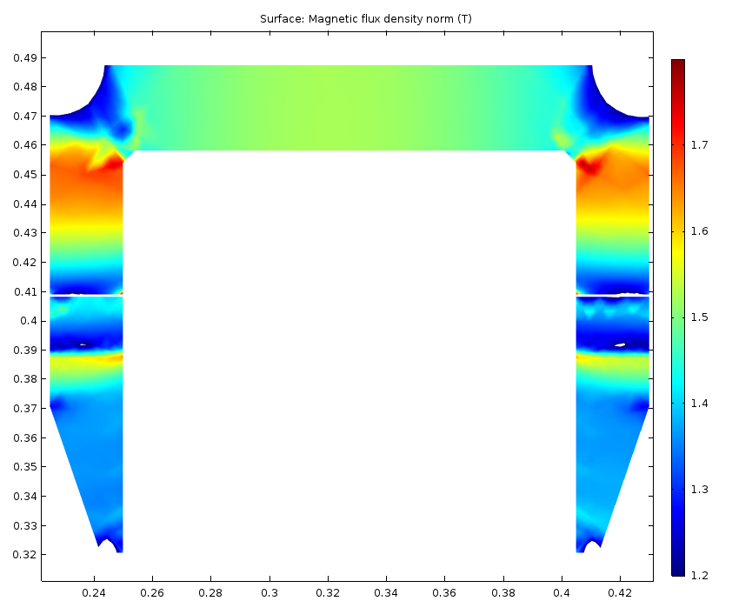
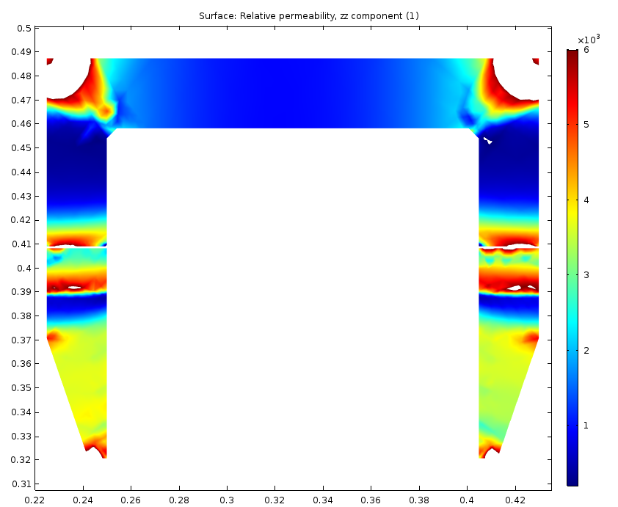
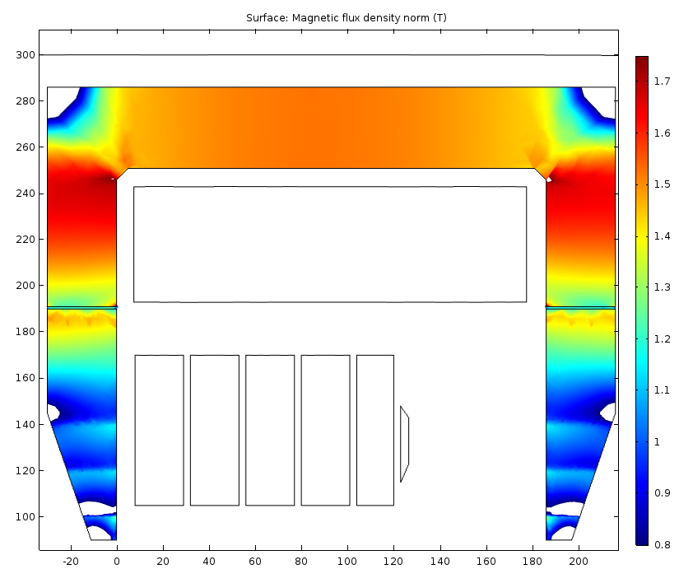
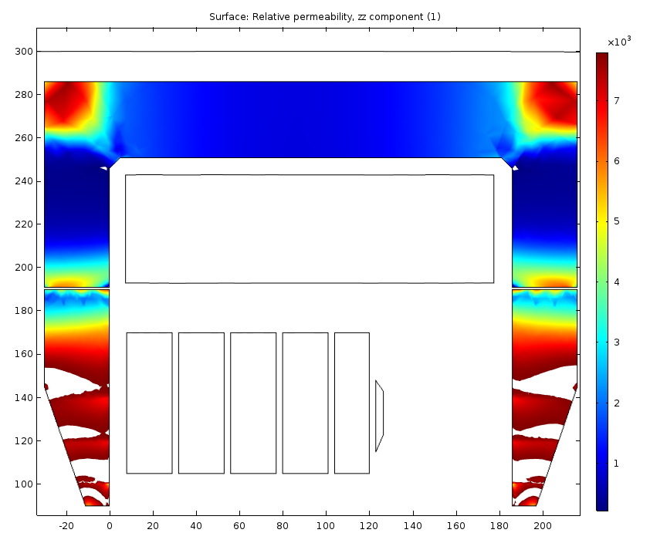
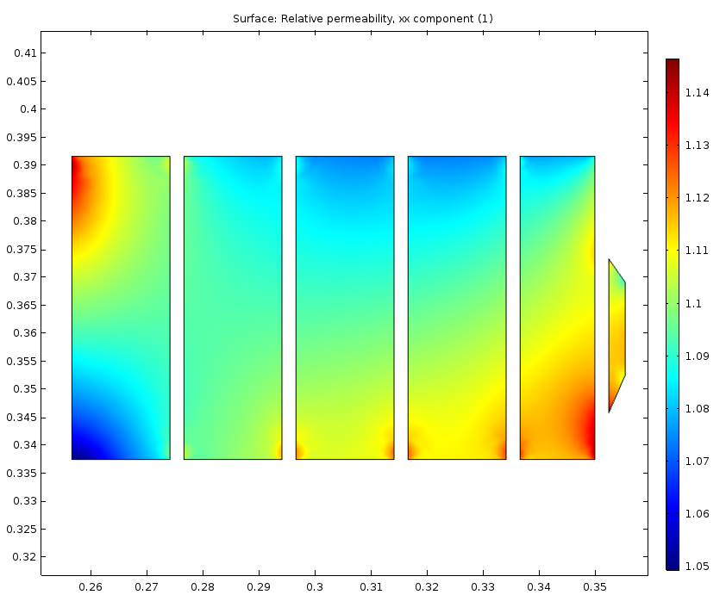
Solenoid
Gap between the pole and the FR is almost uniform (1 mm)
Thickness of the FR is 35 mm.
Material of the FR is M15
0⁰ plane: B → 1.2 – 1.8 T; μ → 200 - 6000
4.5⁰ plane: B → range 0.8 – 1.75 T; μ → 220 - 7800
Garnet permeability

Slide 24
PA test at 71.7 MHz
The Y567 although rated up to 108 MHz was never tested between 76 MHz to 106 MHz at FNAL.
  We have to make sure that the Y567 works in the frequency range.
  The test cavity did not get to 76 MHz.
    Redesign should get it to 76 MHz. Testing will be performed soon.
  Got to ~100 kW at 71.7 MHz, had to stop and investigate, some problems with drive amplifier. (Used AR amplifier. TOMCO will be used in subsequent tests).
  Drive amplifier only puts out its full power for a few ms, drops off later
  We were able to get to ~150 kW for a 6 ms pulse width (more than enough for our purposes. Again limited only by the drive amp on hand.

Slide 25
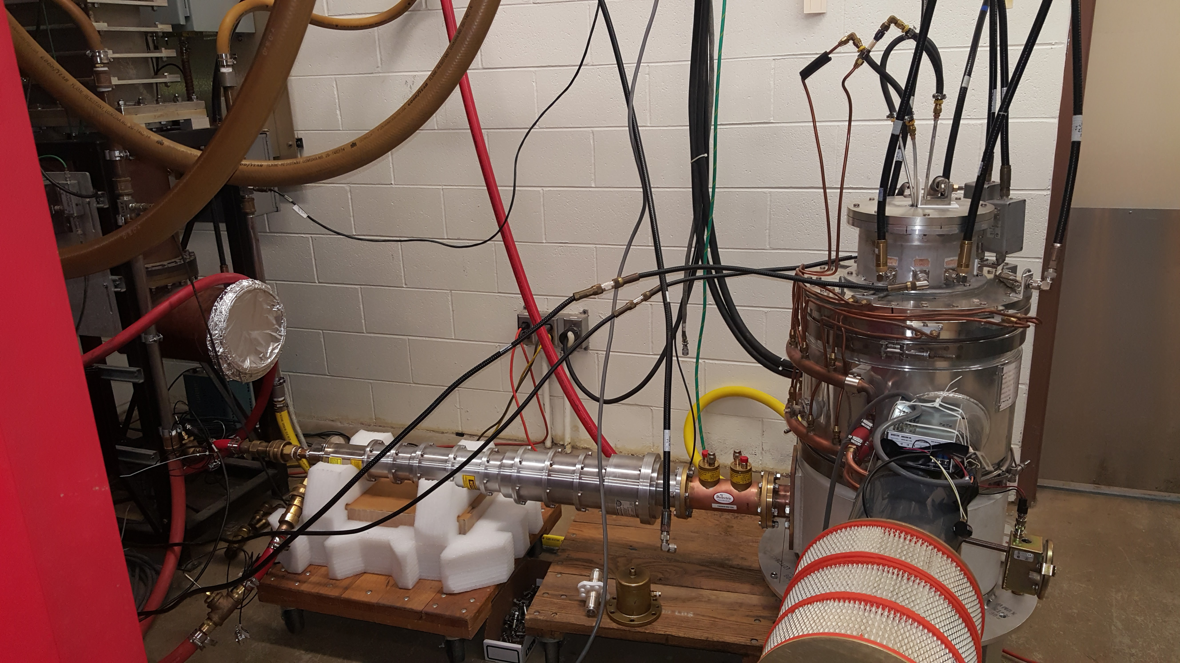
PA test set up
Cathode drive circuit, 76-106 MHz
PA power module
(from Booster standard cavities)
Water load
(position sets anode impedance)
resonator

Slide 26
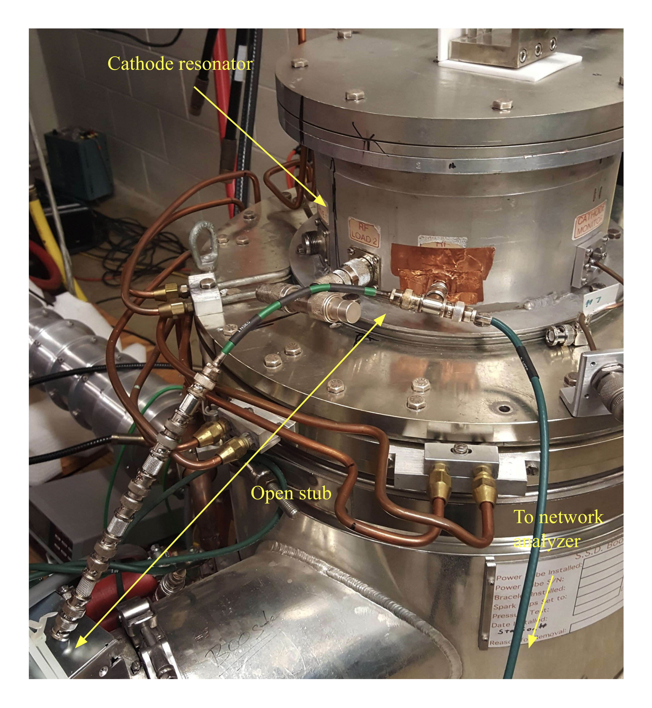
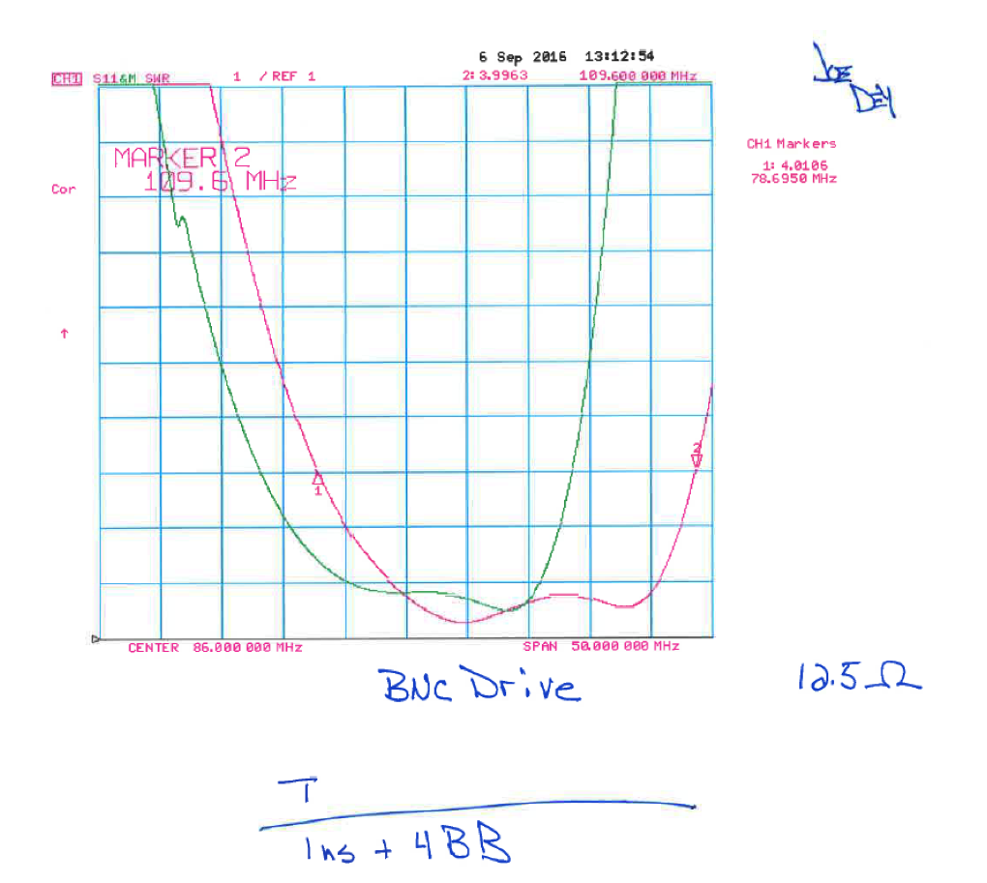
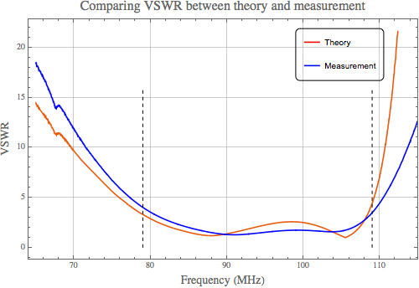
Driving the cathode resonator
We have to be able to couple in the drive from the solid state amplifier into a cathode resonator to drive the Y567.
The large frequency swing of 30 MHz becomes a matching problem.
  Too much reflected power derates the SSA from 8 kW. Must have VSWR < 4.
Low power open stub antenna works. High power stub being made.

Slide 27
Status and conclusion
8 kW solid state driver for the PA (Y567) has been bought from Tomco and has been tested.
Y567 has been tested at 71.7 MHz. Test at 76 MHz will be done soon (Nov 2017)
  106 MHz test will be done by the end of the year, 2016, or early next year, 2017.
Ceramic windows have been ordered in Sep 2016.
2 garnet rings have been ordered. Expected arrival at end of November 2016.
  Test stand for witness pieces will arrive end of the week.
  Mechanics and programs for doing the tests are ready.
Solenoid for biasing the garnet tuner is being mechanically designed. Simulations are done.
  Solenoid PS will be modified from existing PS. Design in progress.
HOM cavity design is in progress.
Goal is to have a cavity ready for testing by end of 2017.
  Regular meetings summarize all the work that has been done so far. Always available on http://beamdocs.fnal.gov. Search for 2nd harmonic.

