Slide 1
Wall Current Monitor (WCM) and Fast Current Transformer (FCT)
at J-PARC Main Ring
Hironori Kuboki
MR Monitor Gr.
Takeshi Toyama, Dai Arakawa (PF), Koutoku Hanamura,
Yoshinori Hashimoto, Masashi Okada, Ken-ichiro Satou,
Bruce Yee Rendon, Masaki Tejima

Slide 2
Wall Current Monitor (WCM) and Fast Current Transformer (FCT)
at J-PARC Main Ring
WCMs and FCTs at J-PARC Main Ring
WCM for feedforward (2015)
FCT for abort beam line (2016)
Summary & prospects

Slide 3
Main Ring (MR)
WCMs | 1 (measurement) 2 (feedforward)
FCTs | 3-50BT | 5
 | MR | 6+1(Abort)
Total length | 1567.5 m
Energy | 3 - 30 GeV
β | 0.9715 - 0.9995
Lorentz γ | 4.22 - 33.21
Harmonic | 9
No. Bunches | 8
Revolution periods | 5.38 - 5.23 μsec
RF freq. | 1.67 - 1.72 MHz
Bunch length (time) | 70～200 nsec
Bunch length (space) | 20～60 m
Tune | FX: ν_{x}=22.40, ν_{y}=20.75 SX: ν_{x}=22.30, ν_{y}=20.78
Abort
Fast extraction (FX)
Injection
from RCS
Neutrino
RF cavity
Hadron
3-50BT
Slow extraction
(SX)
500 m

Slide 4
Main Ring (MR)
WCMs | 1 (measurement) 2 (feedforward)
FCTs | 3-50BT | 5
 | MR | 6+1(Abort)
Total length | 1567.5 m
Energy | 3 - 30 GeV
β | 0.9715 - 0.9995
Lorentz γ | 4.22 - 33.21
Harmonic | 9
No. Bunches | 8
Revolution periods | 5.38 - 5.23 μsec
RF freq. | 1.67 - 1.72 MHz
Bunch length (time) | 70～200 nsec
Bunch length (space) | 20～60 m
Tune | FX: ν_{x}=22.40, ν_{y}=20.75 SX: ν_{x}=22.30, ν_{y}=20.78
Abort
Fast extraction (FX)
Injection
from RCS
Neutrino
RF cavity
Hadron
3-50BT
Slow extraction
(SX)
500 m

Slide 5
Main Ring (MR)
WCMs | 1 (measurement) 2 (feedforward)
FCTs | 3-50BT | 5
 | MR | 6+1(Abort)
Total length | 1567.5 m
Energy | 3 - 30 GeV
β | 0.9715 - 0.9995
Lorentz γ | 4.22 - 33.21
Harmonic | 9
No. Bunches | 8
Revolution periods | 5.38 - 5.23 μsec
RF freq. | 1.67 - 1.72 MHz
Bunch length (time) | 70～200 nsec
Bunch length (space) | 20～60 m
Tune | FX: ν_{x}=22.40, ν_{y}=20.75 SX: ν_{x}=22.30, ν_{y}=20.78
Abort
Fast extraction (FX)
Injection
from RCS
Neutrino
RF cavity
Hadron
3-50BT
Slow extraction
(SX)
500 m

Slide 6
Main Ring (MR)
WCMs | 1 (measurement) 2 (feedforward)
FCTs | 3-50BT | 5
 | MR | 6+1(Abort)
Total length | 1567.5 m
Energy | 3 - 30 GeV
β | 0.9715 - 0.9995
Lorentz γ | 4.22 - 33.21
Harmonic | 9
No. Bunches | 8
Revolution periods | 5.38 - 5.23 μsec
RF freq. | 1.67 - 1.72 MHz
Bunch length (time) | 70～200 nsec
Bunch length (space) | 20～60 m
Tune | FX: ν_{x}=22.40, ν_{y}=20.75 SX: ν_{x}=22.30, ν_{y}=20.78
Abort
Fast extraction (FX)
Injection
from RCS
Neutrino
RF cavity
Hadron
3-50BT
Slow extraction
(SX)
500 m

Slide 7
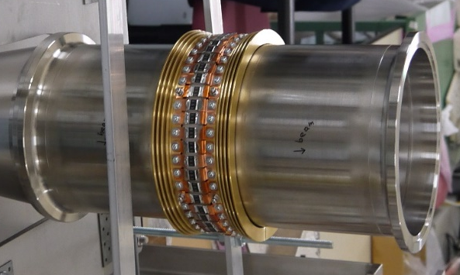
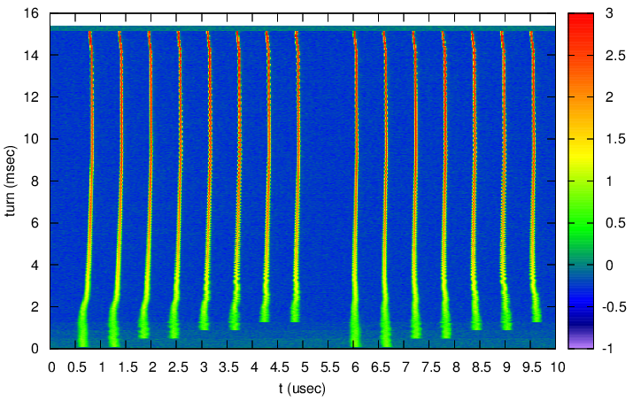
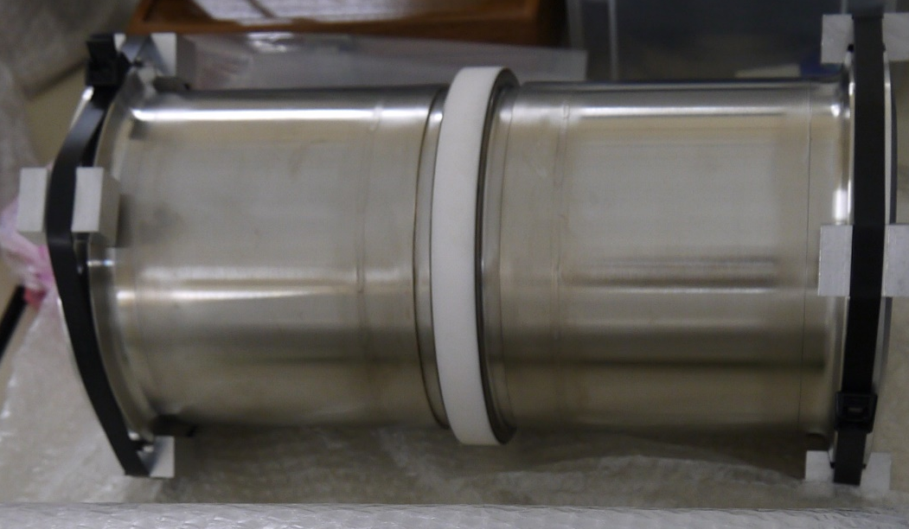
Wall Current Monitor (WCM)
Voltage
Time structure of the beam
Beam load compensation (feedforward)
Wall current (-)
Induced charge (+)
Beam (+)
Resistance
Ceramic insulator
Output signals from WCM (#019)

Slide 8
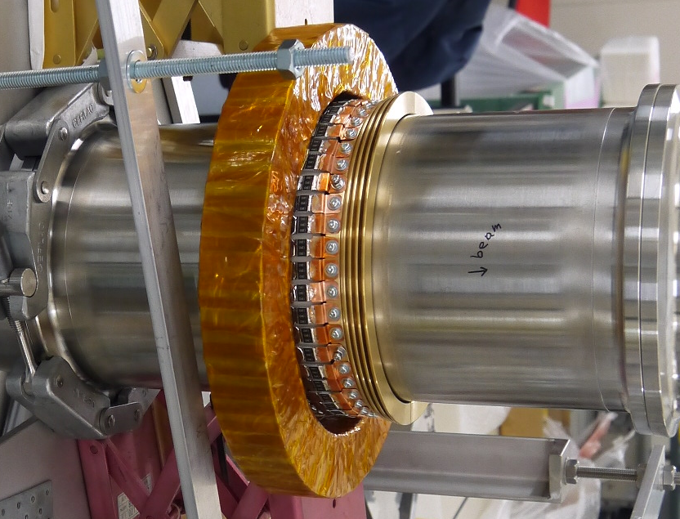
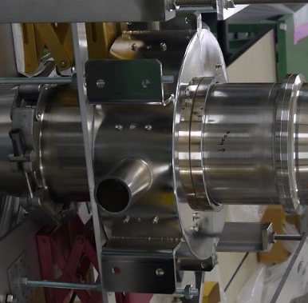
Voltage
Core
Wall current (-)
Induced charge (+)
Beam (+)
Resistance
Shield
Ceramic insulator

Slide 9
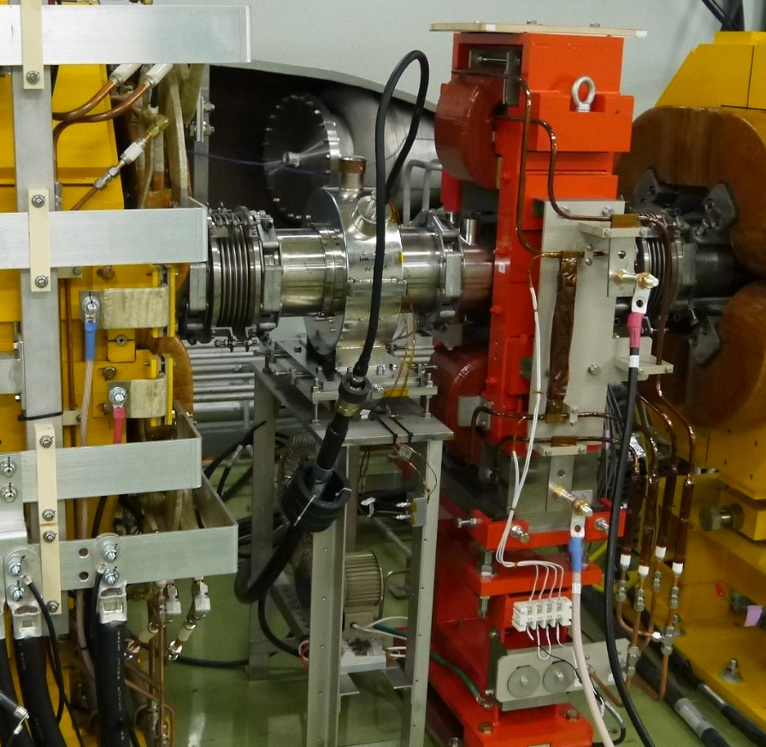
New WCM for feedforward
at the 1st straight line
Replacement due to the size enlargement of the pipe
Pipe ID | 165 mm (before 130 mm)
Resistance | 104 mΩ (13 Ω×130)
Core | Finemet core FT-3M ID: 207.4 mm, OD: 285.8 Thick: 35.3
Abort
Fast extraction (FX)
Injection
from RCS
Neutrino
RF cavity
Hadron
3-50BT
Slow extraction
(SX)
500 m

Slide 10
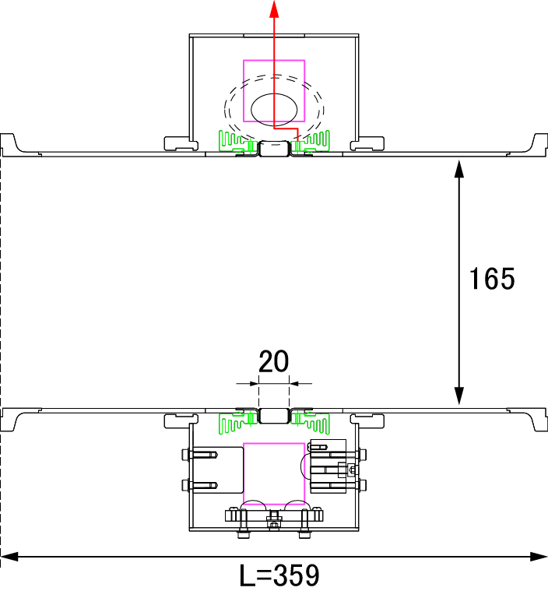
New WCM for feedforward
at the 1st straight line
Replacement due to the size enlargement of the pipe
Signal
Pipe ID | 165 mm (before 130 mm)
Resistance | 104 mΩ (13 Ω×130)
Core | Finemet core FT-3M ID: 207.4 mm, OD: 285.8 Thick: 35.3
Shield
Finemet core (FT-3M)
Heat sink
Insulation ceramic

Slide 11
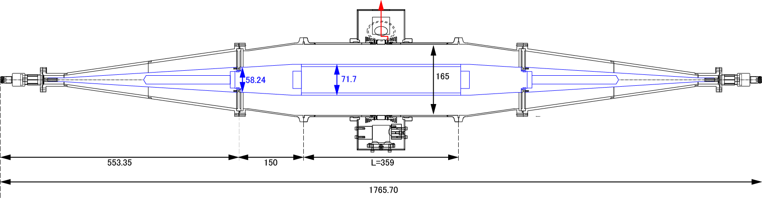
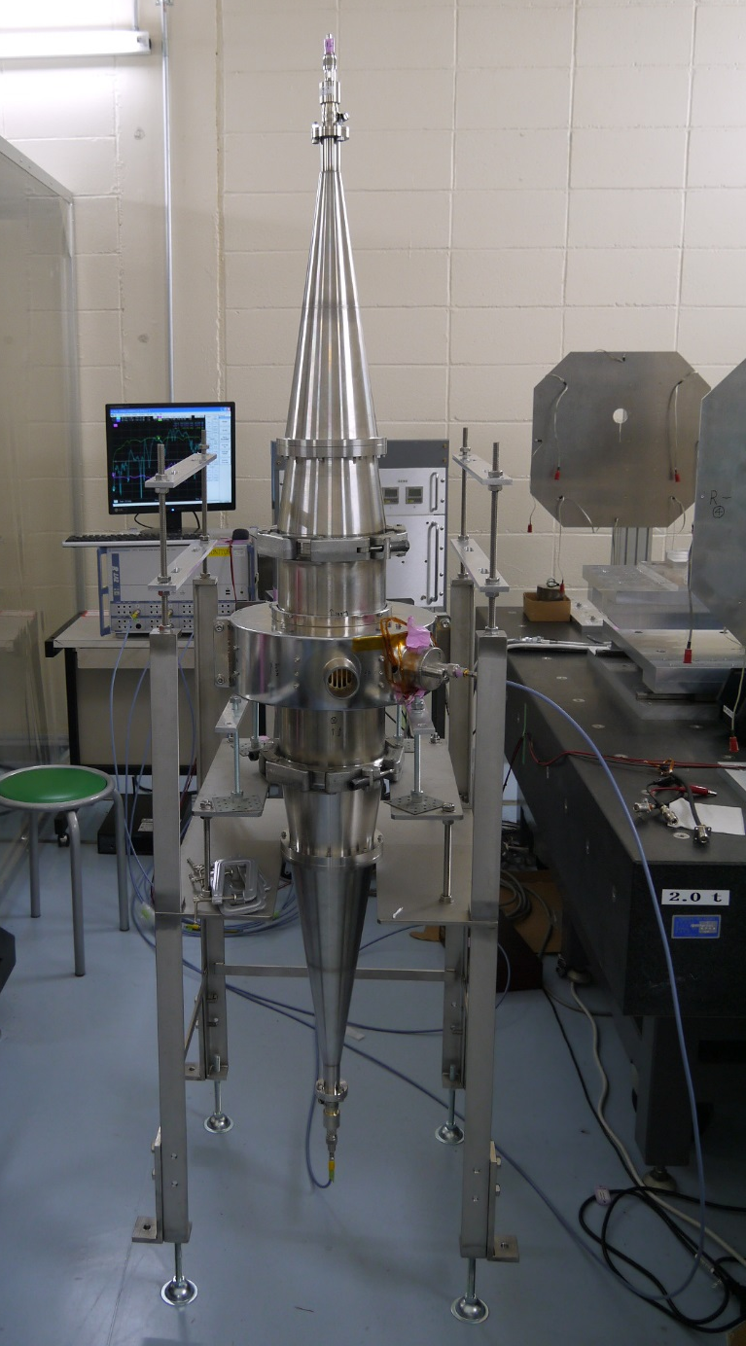
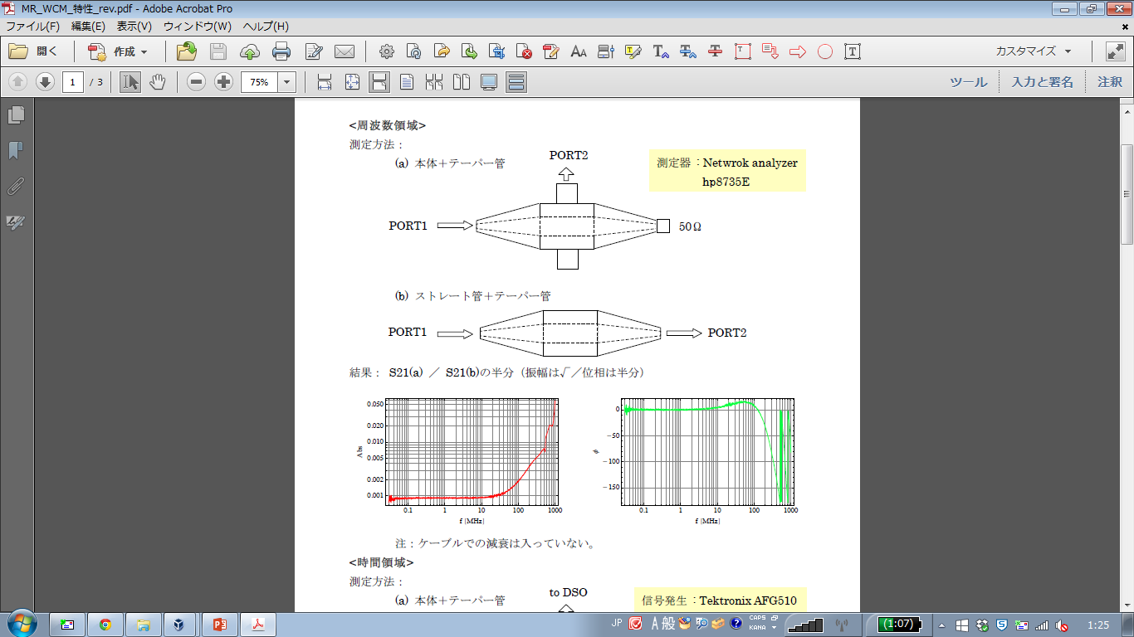
Frequency characteristic measurement
Signal
Inner pipe (conductor)
Network Analyzer
ROHDE & SCHWARZ
ZVT 8
(a) WCM
Measured:
scattering matrix components
S₁₁, S₁₂, S₂₁, S₂₂
300 kHz～2 GHz
(b) Reference pipe

Slide 12
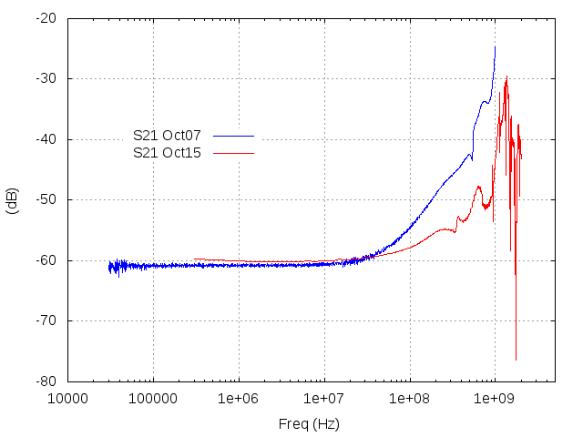
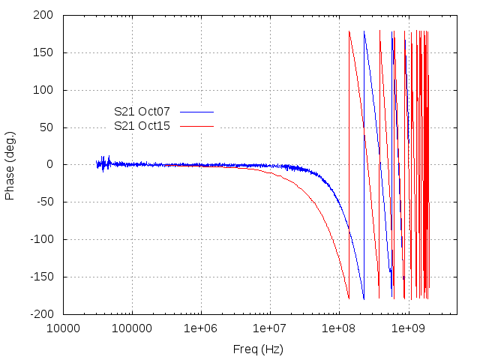
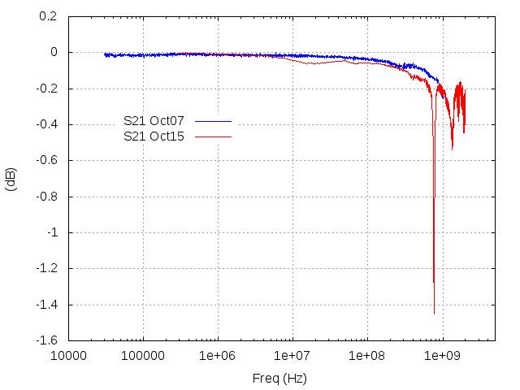
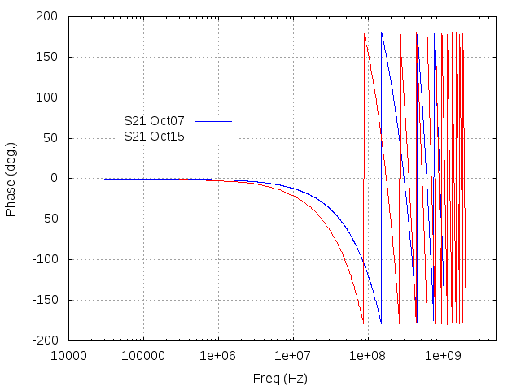
S₂₁
New (Oct15)
Before (Oct07)
S₂₁ amplitude
S₂₁ phase
(a) WCM
(b) Reference
Straight pipe (L=359)

Slide 13
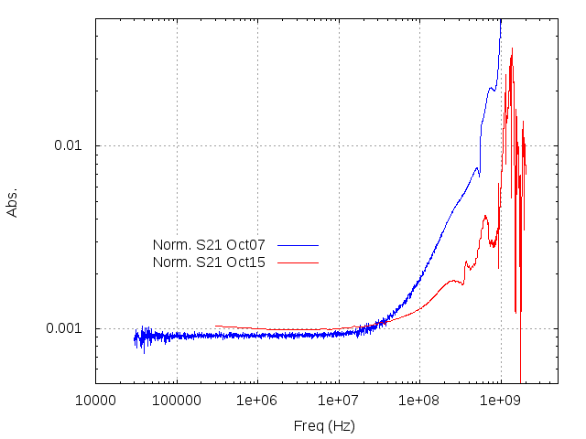
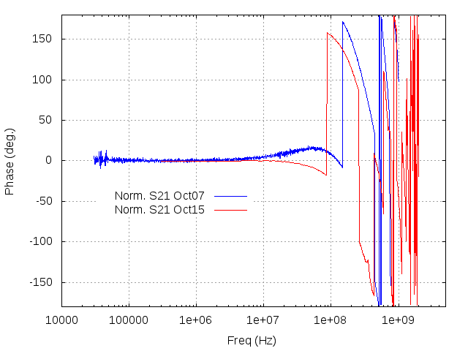
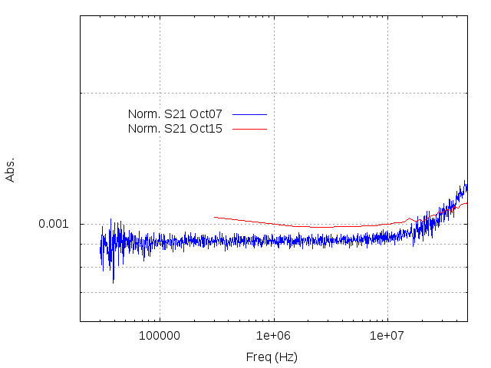
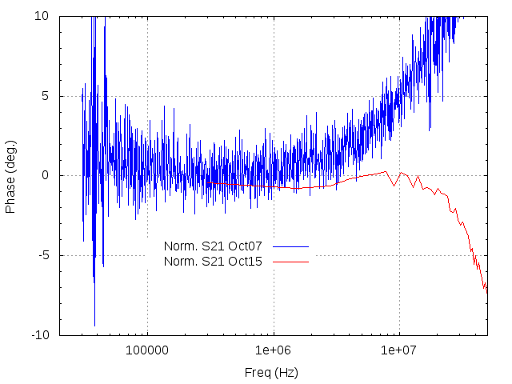
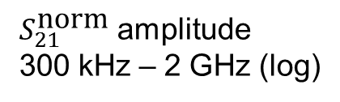
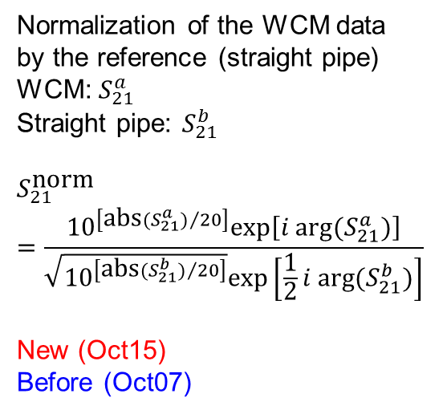

Normalization of the WCM data
by the reference (straight pipe)
WCM: $S_{21}^{a}$
Straight pipe: $S_{21}^{b}$
$$S_{21}^{\text{norm}}$$
$$=\frac{{10}^{\left[{\text{abs}(S_{21}^{a})}/{20}\right]}\text{exp}\left[i arg⁡(S_{21}^{a})\right]}{\sqrt{{10}^{\left[{\text{abs}(S_{21}^{b})}/{20}\right]}}\text{exp}\left[\frac{1}{2}i arg⁡(S_{21}^{b})\right]}$$
New (Oct15)
Before (Oct07)
$S_{21}^{\text{norm}}$ amplitude
300 kHz – 2 GHz (log)
$S_{21}^{\text{norm}}$ phase
(enlarged)
300 kHz – 50 MHz
(enlarged)
300 kHz – 50 MHz
This WCM has been used for
feedforward (beam loading
compensation) without problem
(for now)

Slide 14
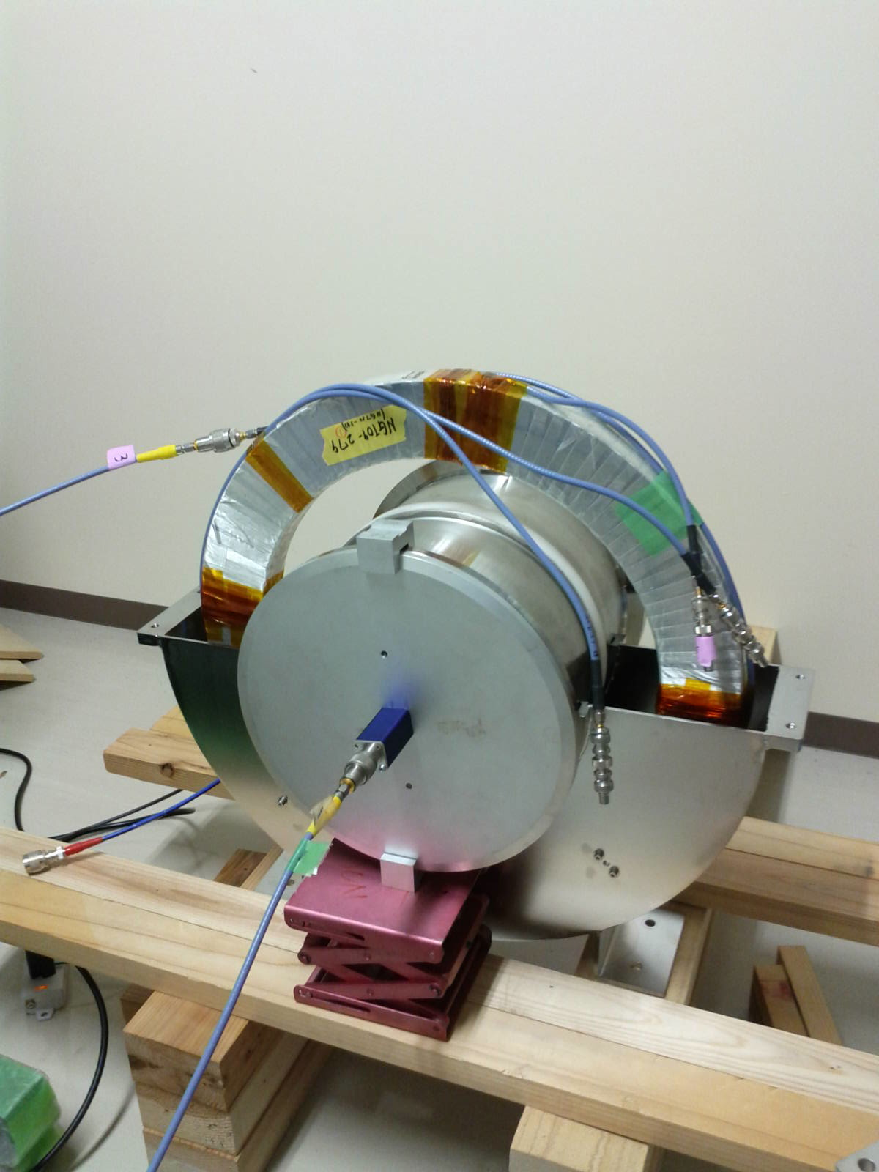
Coil (N turns)
Fast Current Transformer (FCT)
Signal
 | 3-50BT | MR | Abort (New)
Inner diameter | 200 mm 230 mm | 134 | 250
Finemet core FT-3M dimension | ID: 390 OD: 490 Thick 50 (25×2) | ID: 216 OD: ～310 Thick: 25 | ID: 375 OD: 500 Thick: 35
Turn Num. of coil | 25 | 50 | 10 × 4 = 40 turns
Finemet core
(FT-3M)
Shield
Beam
Insulation ceramic
Time structure of the beam
Beam phase measurement, feedback
Get timing for FX/Abort kicker

Slide 15
New FCT for abort line
Abort
Fast extraction (FX)
Injection
from RCS
 | 3-50BT | MR | Abort (New)
Inner diameter | 200 mm 230 mm | 134 | 250
Finemet core FT-3M dimension | ID: 390 OD: 490 Thick 50 (25×2) | ID: 216 OD: ～310 Thick: 25 | ID: 375 OD: 500 Thick: 35
Turn Num. of coil | 25 | 50 | 10 × 4 = 40 turns
Neutrino
RF cavity
3-50BT
Slow extraction
(SX)
Time structure of the beam
Beam phase measurement, feedback
Get timing for FX/Abort kicker
500 m

Slide 16
New FCT for abort line
Abort
Fast extraction (FX)
Injection
from RCS
 | 3-50BT | MR | Abort (New)
Inner diameter | 200 mm 230 mm | 134 | 250
Finemet core FT-3M dimension | ID: 390 OD: 490 Thick 50 (25×2) | ID: 216 OD: ～310 Thick: 25 | ID: 375 OD: 500 Thick: 35
Turn Num. of coil | 25 | 50 | 10 × 4 = 40 turns
Neutrino
RF cavity
3-50BT
Slow extraction
(SX)
Time structure of the beam
Beam phase measurement, feedback
Get timing for FX/Abort kicker
Particle counting for abort line
500 m

Slide 17
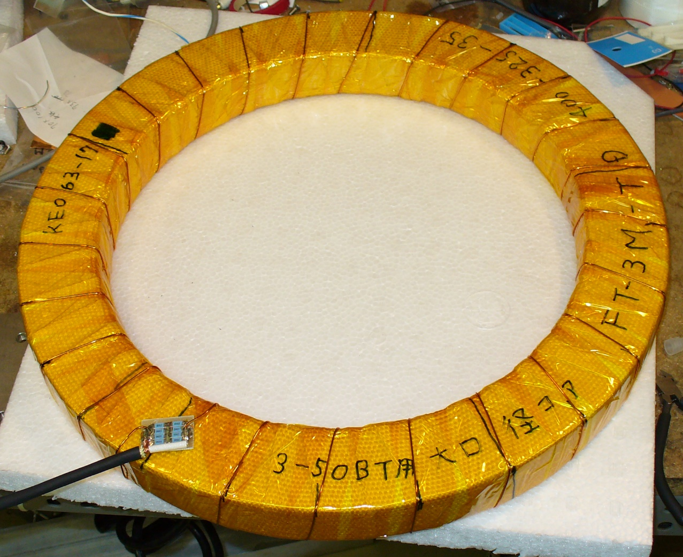
10-turn×4
Uniform 40-turn
Actually, the photo is not for 40 turns.

Slide 18
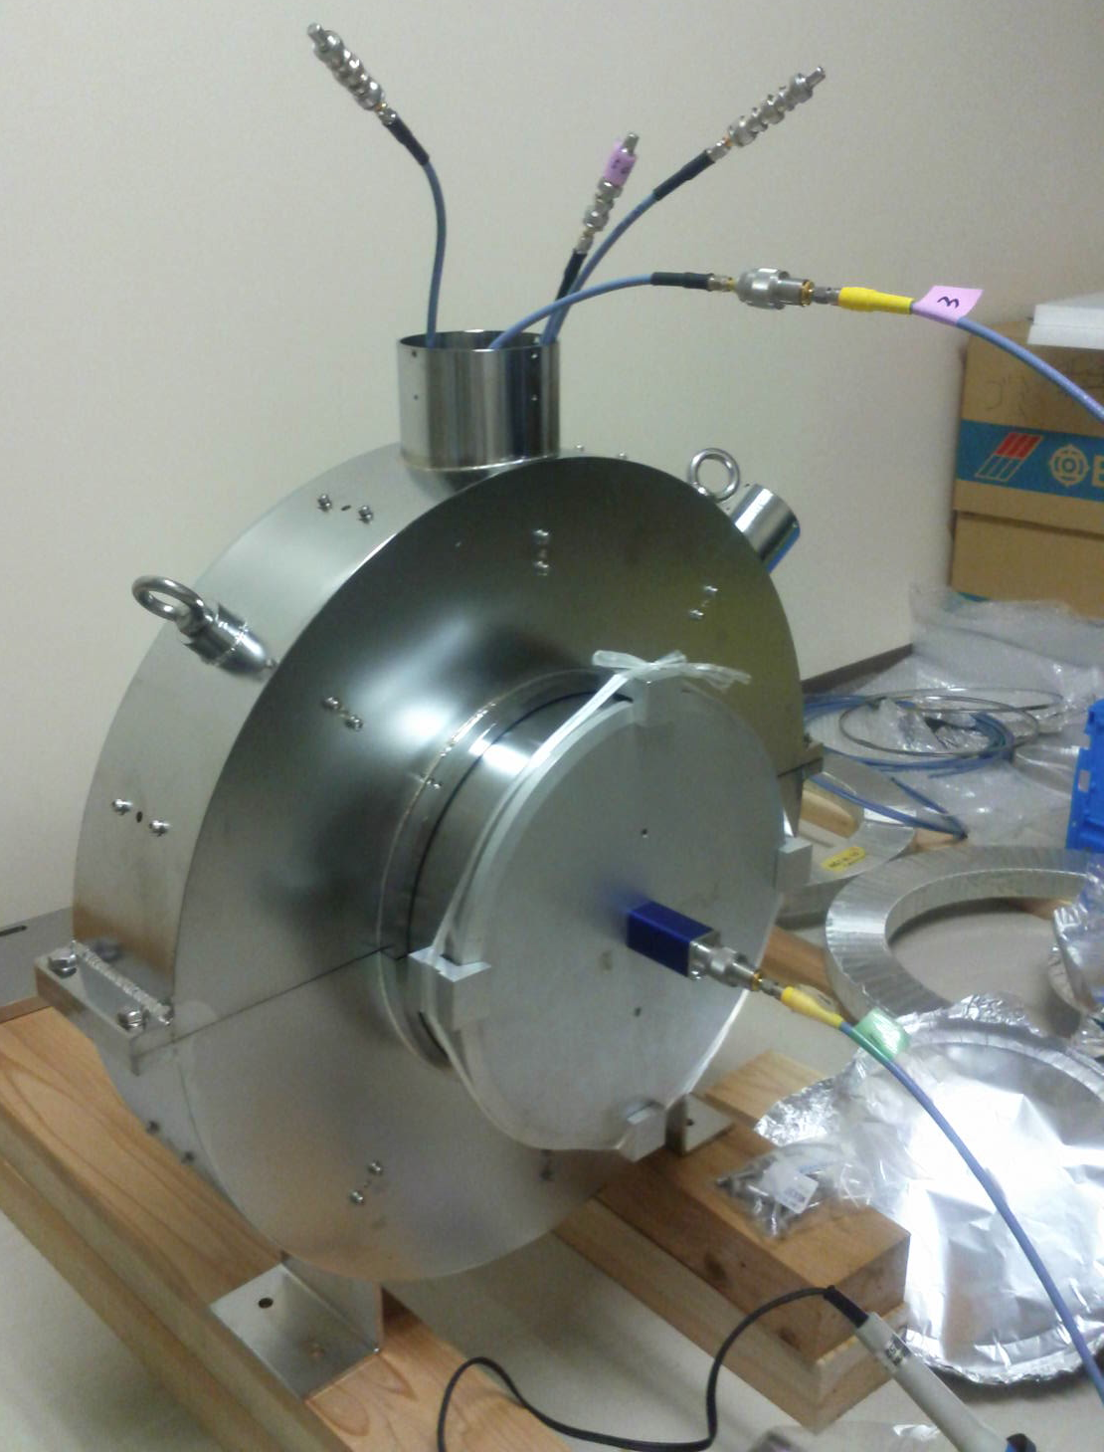
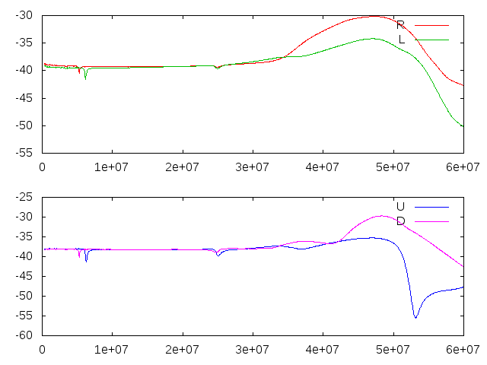

Frequency characteristic measurement
Network Analyzer (Agilent E5071)
Measured: S₁₁, S₁₂, S₂₁, S₂₂
300 kHz～1 GHz
$S_{21}$ amplitude
usable

Slide 19
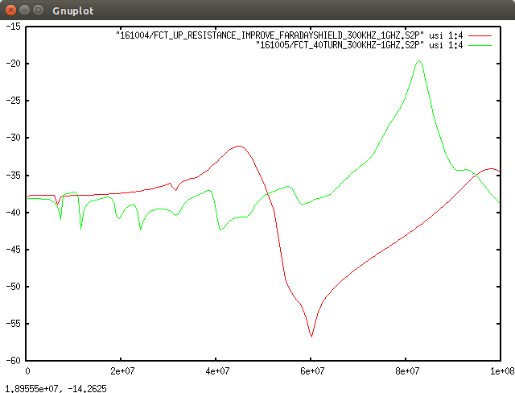
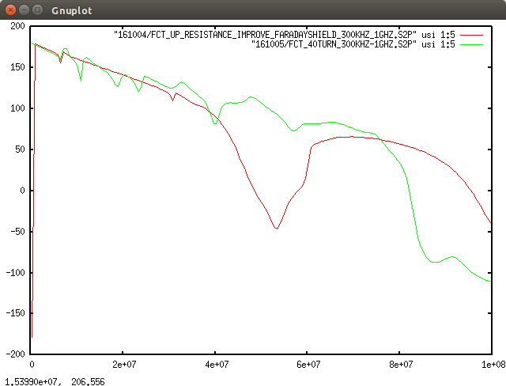


40-turn winding uniformly
4 × 10 turns locally
300kHz-100MHz
$S_{21}$ amplitude
$S_{21}$ phase

Slide 20
40-turn winding uniformly
4 × 10 turns locally
300kHz-100MHz
$S_{21}$ amplitude
$S_{21}$ phase
4×10-turn type has been adopted

Slide 21
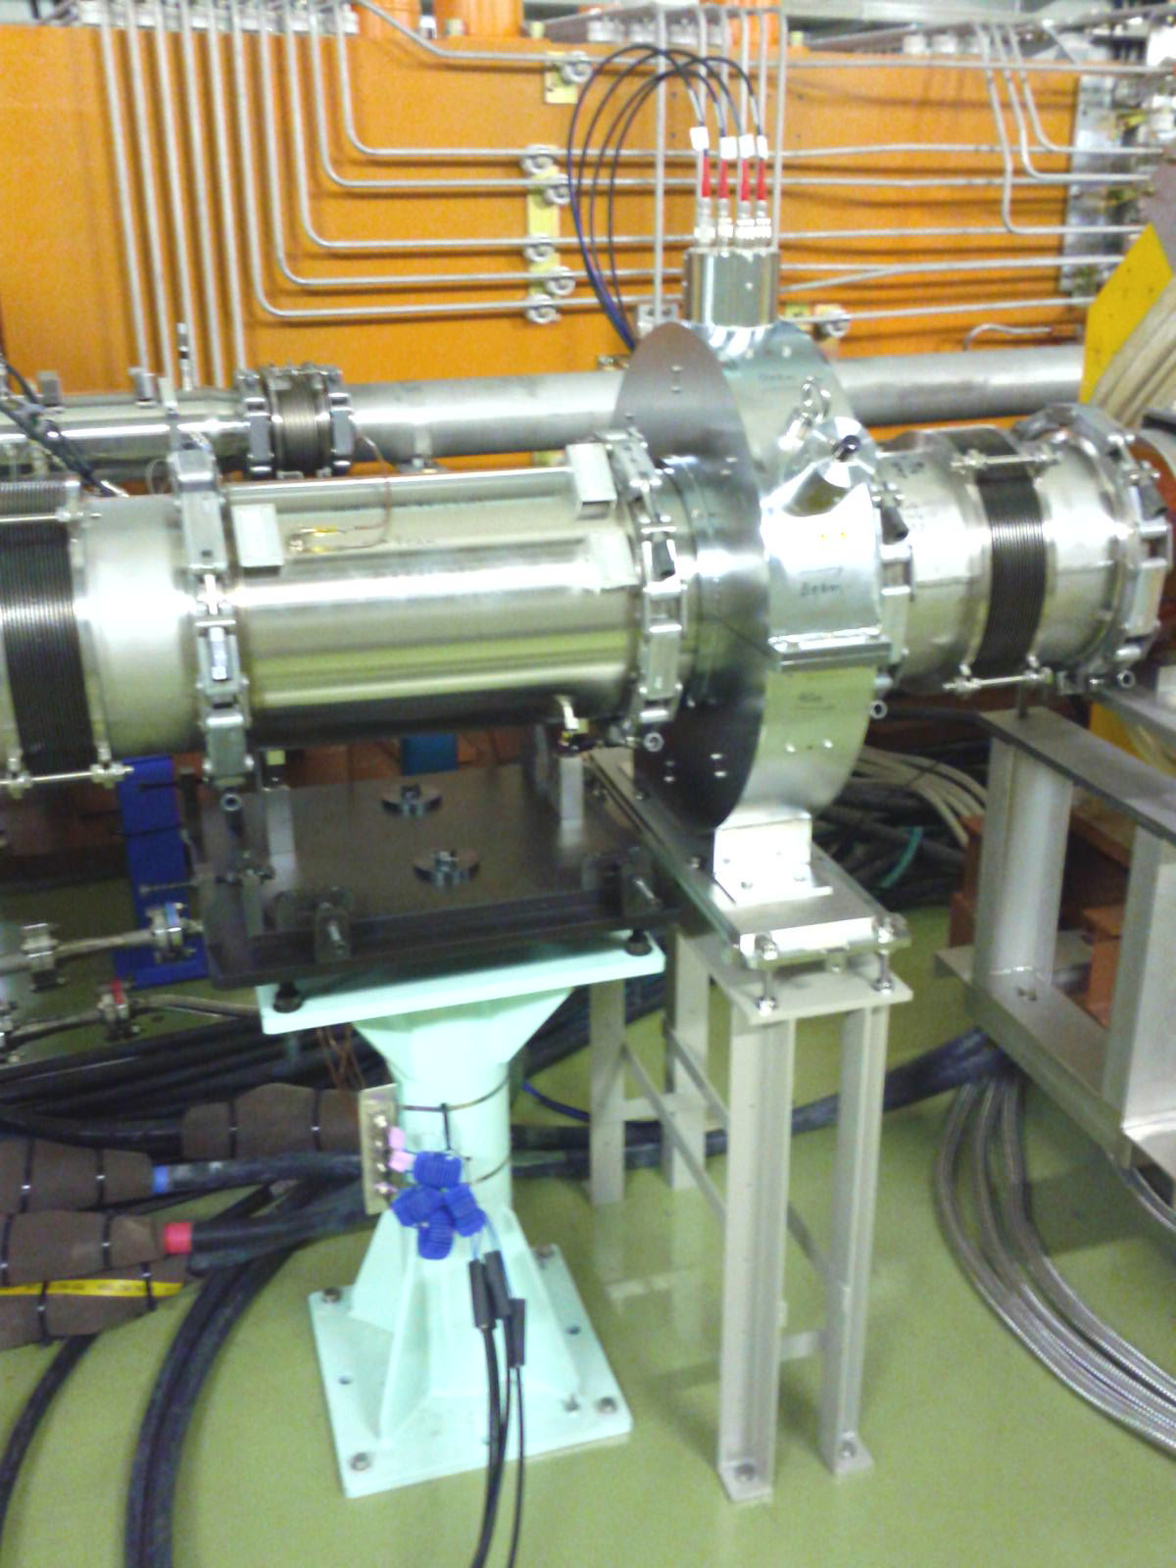
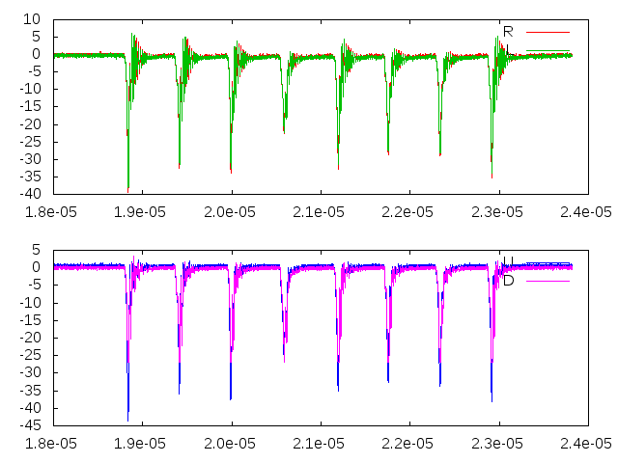
Beam signal
(V)
(sec)
(V)
(sec)

Slide 22
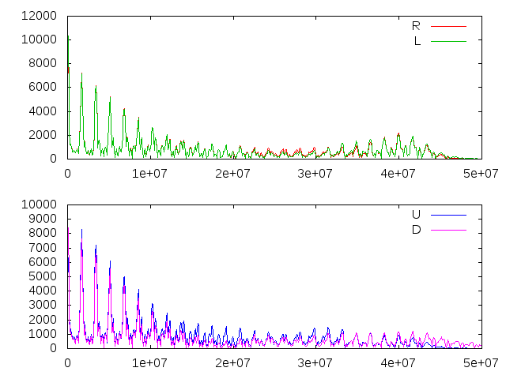
FFT Beam signal
Raw beam signal
Δf=1.7 MHz (RF fundamental)
(V)
(Hz)
(sec)
(V)
(Hz)
(sec)
Further data measurement and analysis will be planned.
Data acquisition and interlock system will be prepared for operation.

Slide 23
Summary & prospects
WCMs and FCTs are used to obtain beam bunch and timing information.
Upgraded year by year for higher beam intensity operation.
New WCM for feedforward was installed in the summer 2015.
Localization of resistance: not yet understood.
New FCT for MR abort line was installed in Oct. 2016.
Optimization with data measurement and analysis are going from now.
Data acquisition and interlock system will be also prepared for beam operation.

Slide 24
Additional

Slide 25
WCM: 014, 163 (feedforward),
019 (observe)
FCT: 070, 086, 091, 142, 158, 214
Main Ring (MR)
WCMs | 1 (measurement) 2 (feedforward)
FCTs | 3-50BT | 5
 | MR | 6+1(Abort)
Total length | 1567.5 m
Energy | 3 - 30 GeV
β | 0.9715 - 0.9995
Lorentz γ | 4.22 - 33.21
Harmonic | 9
No. Bunches | 8
Revolution periods | 5.38 - 5.23 μsec
RF freq. | 1.67 - 1.72 MHz
Bunch length (time) | 70～200 nsec
Bunch length (space) | 20～60 m
Tune | FX: ν_{x}=22.40, ν_{y}=20.75 SX: ν_{x}=22.30, ν_{y}=20.78
Abort
Fast extraction (FX)
Injection
from RCS
Neutrino
RF cavity
Hadron
3-50BT
Slow extraction
(SX)
500 m

Slide 26
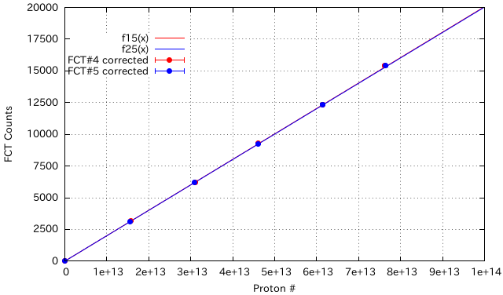
FCT for proton counting
15/09/07
Calibration coefficients
(Proton#)=(A/1000*(Counts)+B)*5e+9
 | FCT#4 | FCT#5
A | 981 | 1007
B | 3 | 4
Input
voltage
500 V
400 V
Area
=V×t
300 V
t (μsec)
200 V
Input: 100 V
 | FCT#4 | FCT#5
a(slope) 0-500 V | 2.00594e-10 | 2.00283e-10
b(const.) 0-500 V | 0.66261 | 0.12221

Slide 27
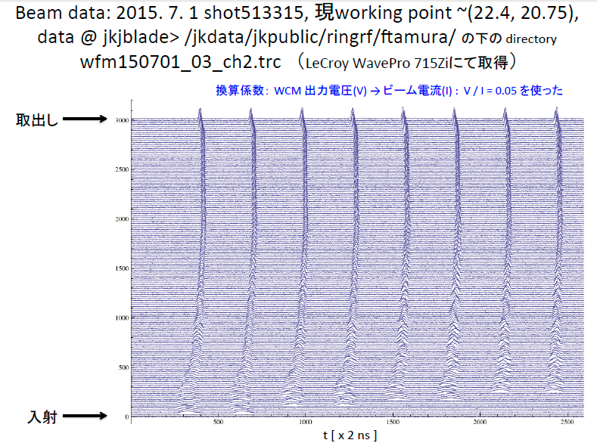
wfm150701_03_ch2.trc

Slide 28
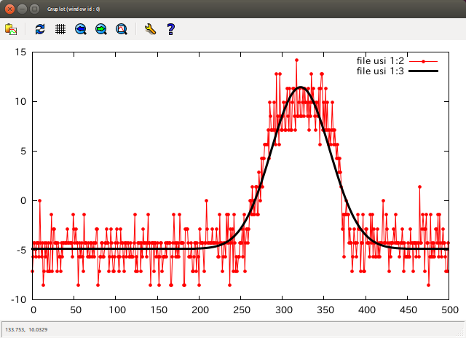
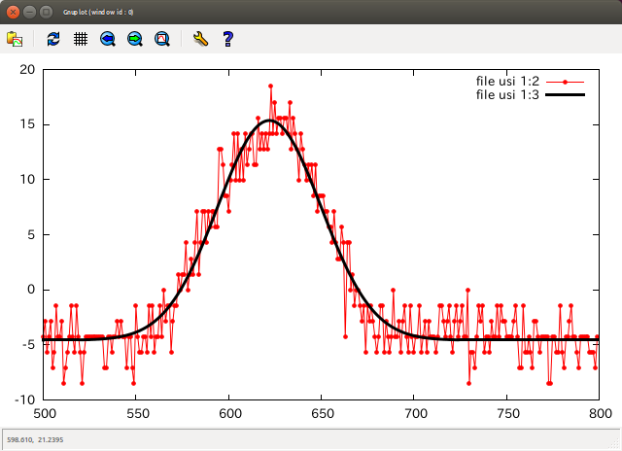
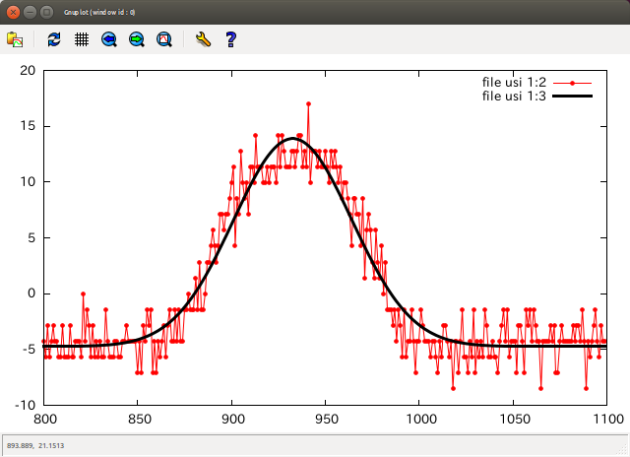
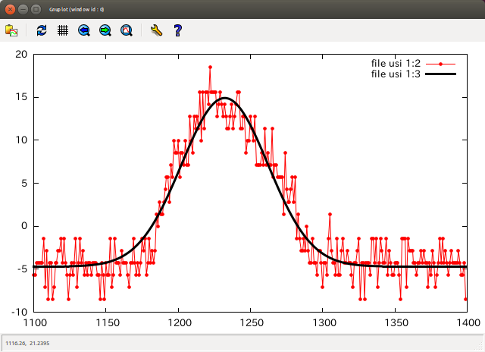
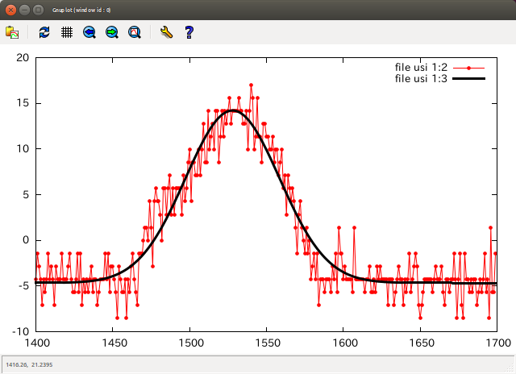
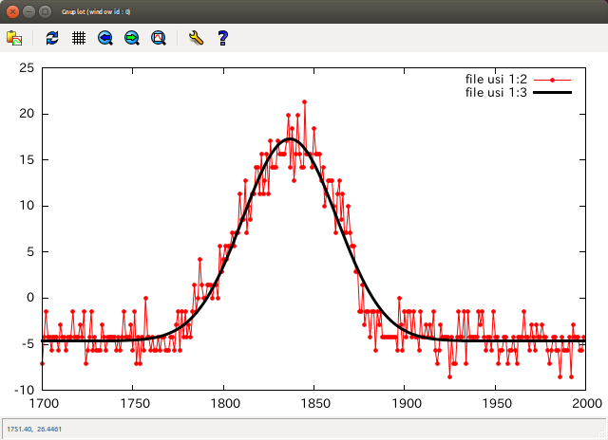
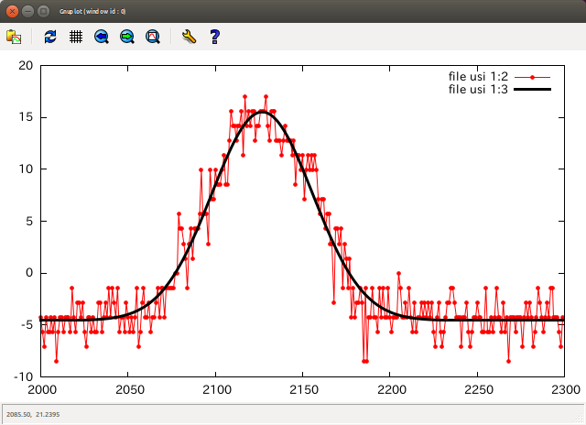
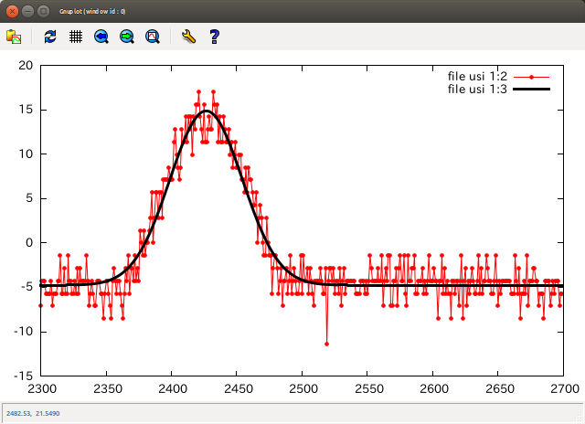
Current (A) vs time (ch)
Turn 130 (8 bunches are injected)
Baseline offset is determined for each plot range by Gaussian+const. fitting

Slide 29
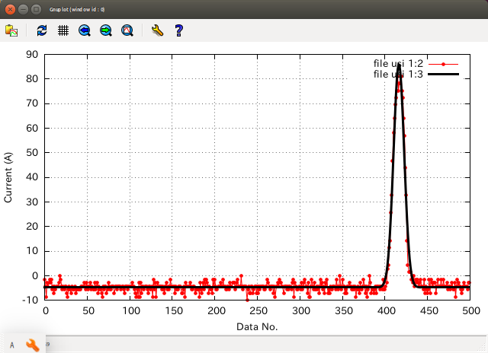
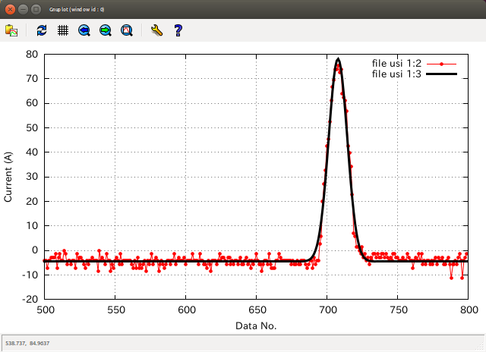
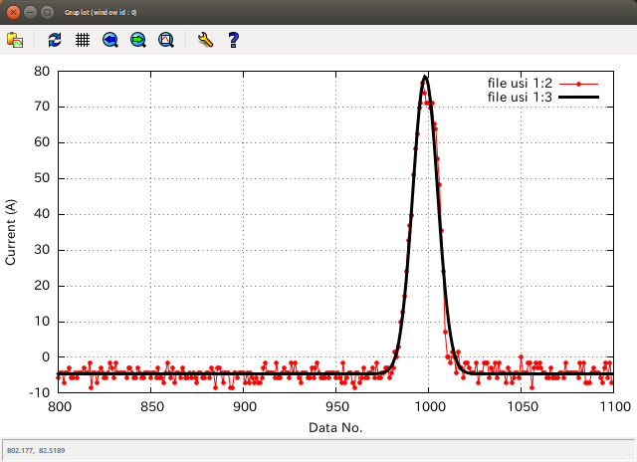
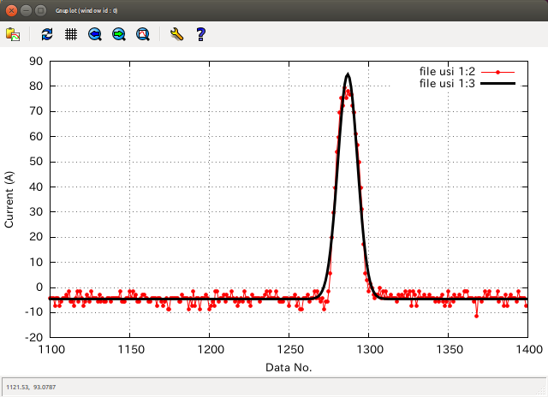
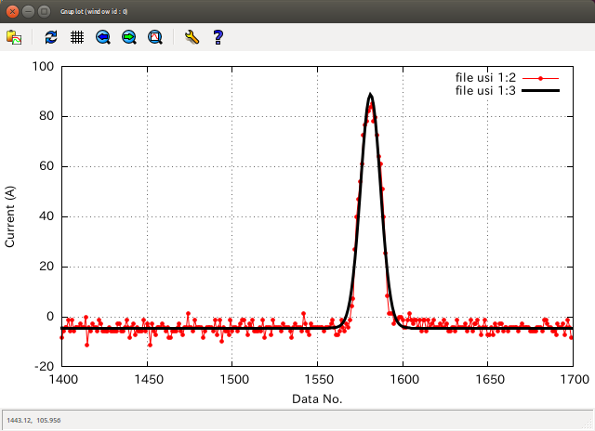
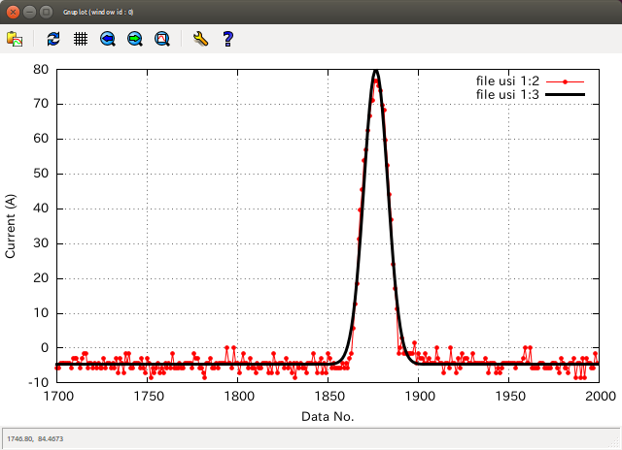
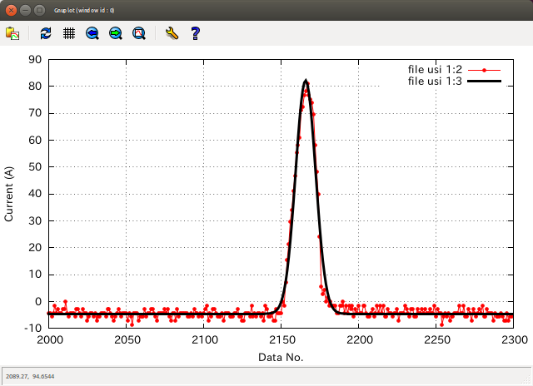
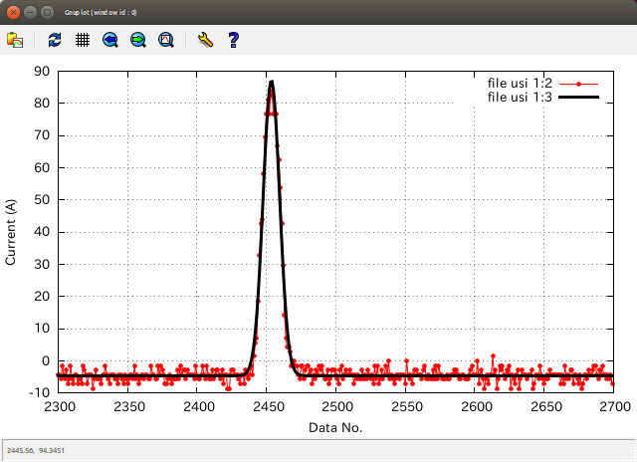
Turn 1000

Slide 30
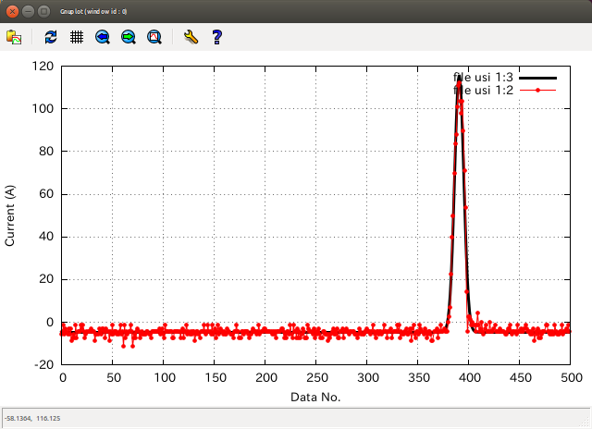
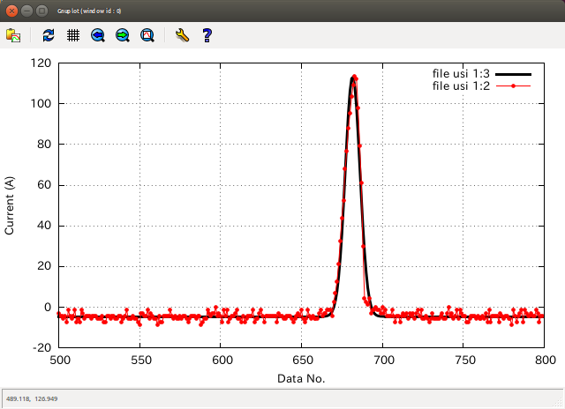
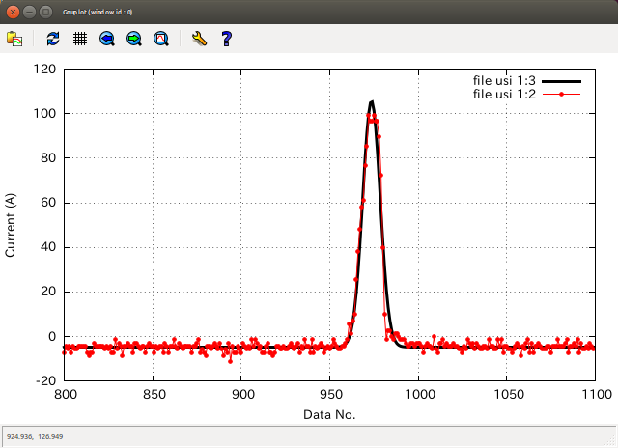





Turn 1500

Slide 31


15/10/01
締め締め部材を買いに行く前に、もしかすると信号読み出しの場所によってスペクトルが変わるかもしれない、
と思い調べてみた。
① スタート: 9/30のベスト

Slide 32


⑥ 一番初めの位置
明らかに値が大きい

Slide 33




15/10/01
WCM lower frequency cut off
$$τ=8.9368×{10}^{−4}$$
$$f=\frac{1}{τ}=1118.97$$
$$V\left(ω\right)=\frac{{jω}/{ω_{L}}}{1+{jω}/{ω_{L}}}RI_{B}$$
Cut off frequency
$f_{cutoff}={ω_{L}}/{2π}=\frac{1}{2×3.14159×8.9368×{10}^{−4}}=$178.08 Hz
Amplitude (abs(V(ω)))
Freq (Hz)

