Slide 1
The Fermilab Accelerator Complex and
PIP-II upgrades
Sergei Nagaitsev
9 November 2016

Slide 2
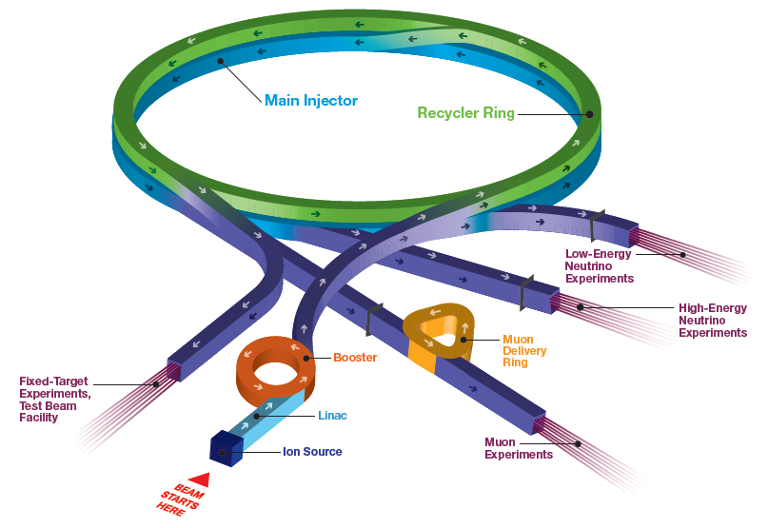
Fermilab Accelerator Complex
Short Baseline Neutrino:
MicroBooNE (ICARUS, SBND)
SwitchYard 120:
SeaQuest, LArIAT, test beam
Long Baseline Neutrino:
NOvA, MINERvA (LBNF/DUNE)
Muon Campus:
(g-2, Mu2e)

Slide 3
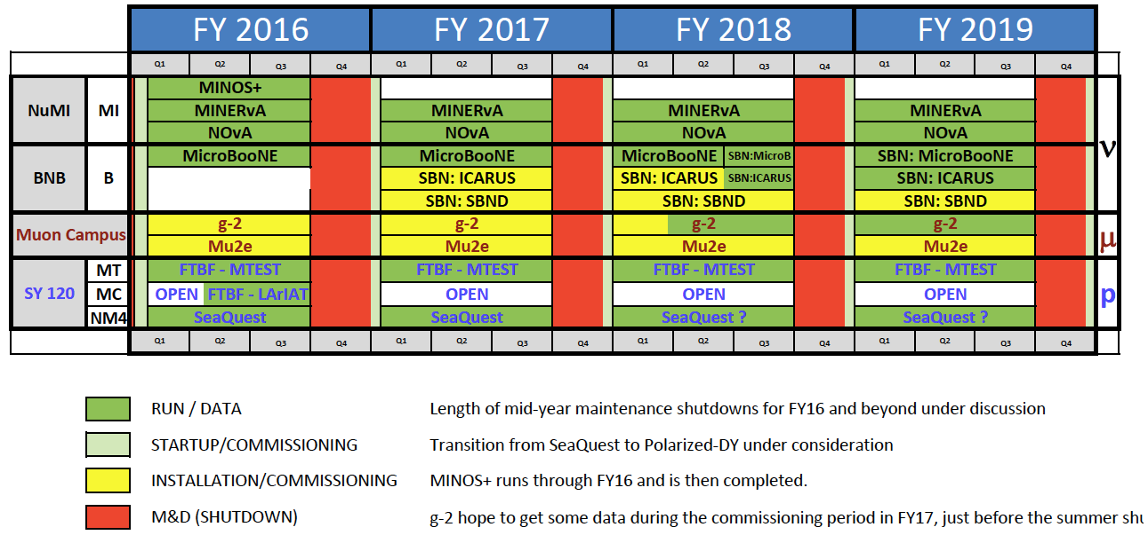
Fermilab Experiments’ Run Schedule

Slide 4
Accelerator Operations Goals
700 kW beam power to NOvA (world record for ν production)
Higher proton flux in the Booster (>2x10¹⁷ protons/hour) to support full experimental program
Complete the Muon Campus construction in 2017, then start to commission and operate beam to the g-2 experiment
Build an upgraded horn and power supply in the Booster Neutrino Beam target station for Short Baseline Neutrino

Slide 5
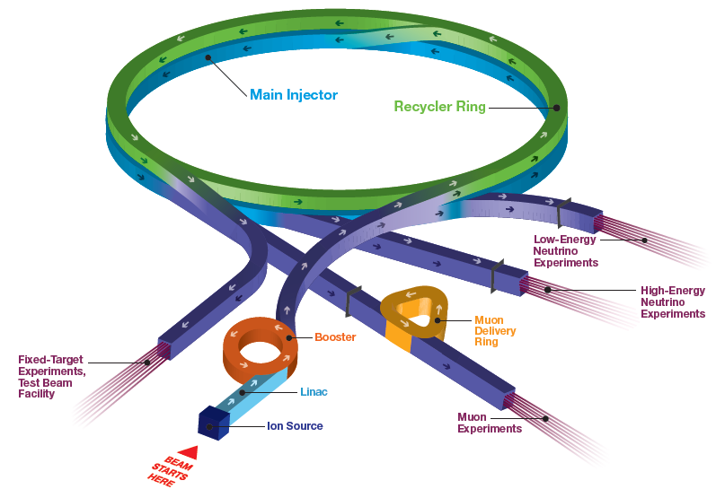
Neutrino Beam from Main Injector (NuMI)
Previous operation (320 kW):
  11 batches into Main Injector with RF slip-stacking
  Ramp to 120 GeV at 204 GeV/s and extract to NuMI target
  3.7e13 / 2.2 s cycle → 323 kW
  Recycler used for storing antiprotons for the Tevatron
Main Injector:
  Accelerates 8 → 120 GeV (150 GeV for Tevatron)
Recycler:
  Fixed 8 GeV KE ring
intensity
energy

Slide 6
Increasing Beam Power to 700 kW
Moved slip-stacking to Recycler
Increased number of batches 11→12
Increased Main Injector ramp rate
  204 GeV/s → 240 GeV/s
1.33s cycle
Can reach 700 kW with only ~10% increase in per-pulse intensity
intensity
energy

Slide 7
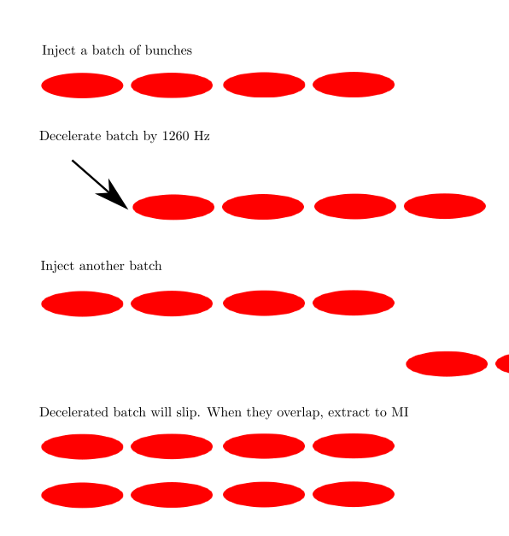
Slip-stacking
Double intensity of bunches using RF slip-stacking
10/10/2016
M Convery | Recent Progress in High Intensity Operation of the Fermilab Accelerator Complex

Slide 8
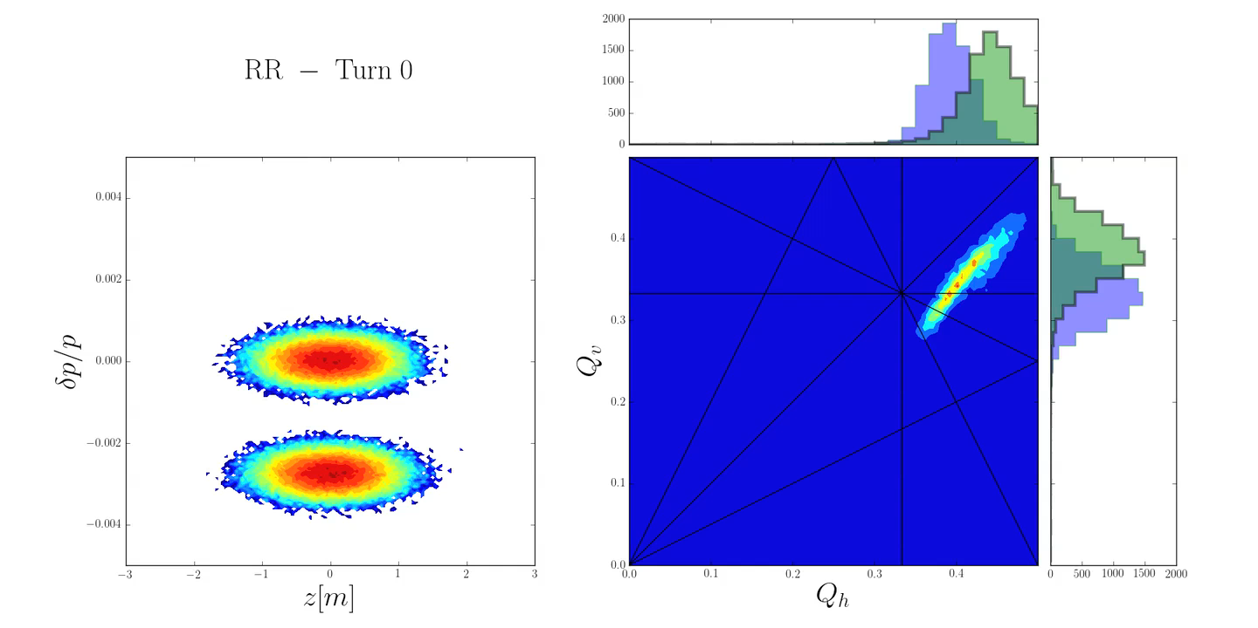
Challenges at High Intensity
Space charge tune shift when bunches overlap
Run at high chromaticity to avoid resistive wall instability
  Leads to tune shift between decelerated bunches and those on the central RF frequency
Robert Ainsworth, et al

Slide 9
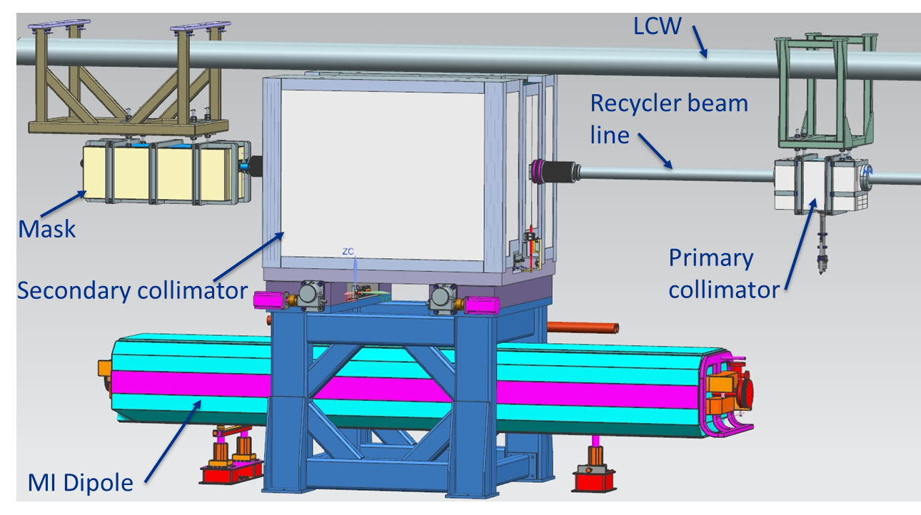
Other Requirements for 700 kW Beam to NuMI
Beam from Booster at 9 Hz (15 Hz to support full program)
Reliability improvements
  Recycler vacuum upgrade: replacing depleted titanium sublimation pumps with ion pumps – better suited for new mode
  Corrosion resistant beampipe in high radiation areas
Maintain high efficiency and control losses
  Collimators in Recycler to capture losses that would otherwise irradiate limited-aperture injection and extraction magnets

Slide 10
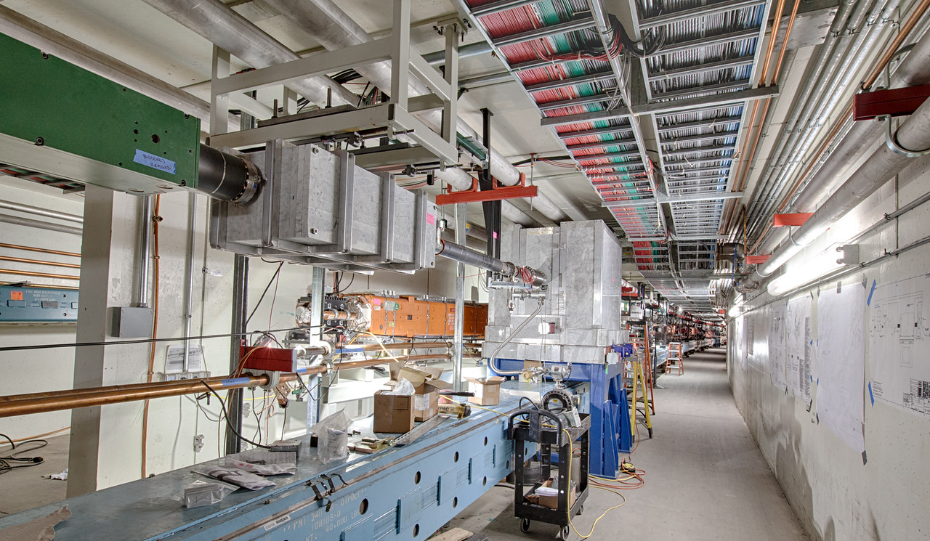
Collimators Installed during Shutdown

Slide 11
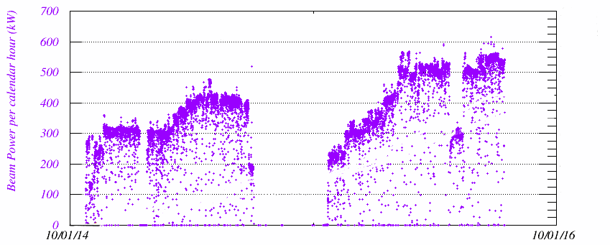
Ramping up Beam Power to 700 kW for NOvA
(Note that SY120 takes 10% of timeline, 700 kW → 630 kW)
Increase number of batches slip-stacked in Recycler in steps
At each step, increase intensity while tuning for efficiency, losses
Successfully demonstrated 700 kW for one cycle
Regular 700 kW operation after this shutdown
521kW
4+6 mode
575kW
4+6 mode
613kW
6+6 mode
460kW
2+6 mode
460kW
4+6 mode
No slip-stacking
360kW
2+6 mode
transformer failure

Slide 12
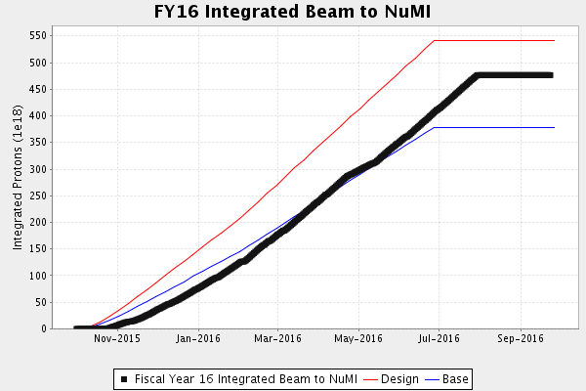
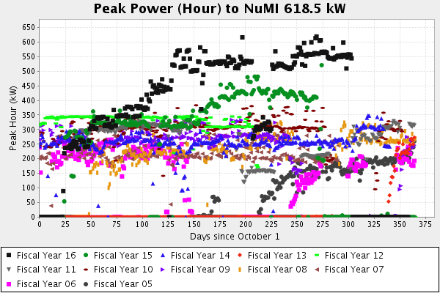
Achieved FY16 Goals for Beam to NuMI
Based on milestones for achieving 700 kW beam power
Ran consistently at 550 kW (w/ SY120) prior to shutdown, make last ~10% push once collimators installed

Slide 13
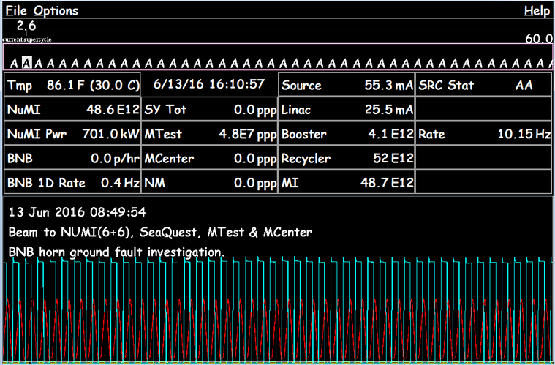
700 kW Beam to NuMI

Slide 14
Proton Improvement Plan
Multi-year campaign funded through accelerator operations
Includes RF upgrades, instrumentation and beam physics improvements, utilities…
Initiated in 2011; ~60% complete
Goals:
  Increase the beam repetition rate from ~7 Hz to 15 Hz
  Increase the proton source throughput, with a goal of reaching > 2x10¹⁷ protons/hour (from 1.1x10¹⁷)
  Eliminate major vulnerabilities and maintain reliability (>85%) at the increased repetition rate / flux
  Ensure a useful operating life of the proton source through at least 2025 – later changed to 2030

Slide 15
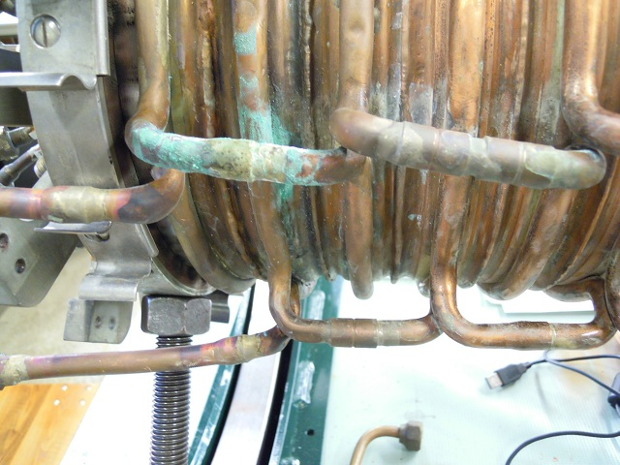
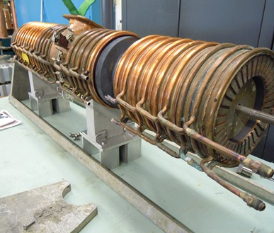
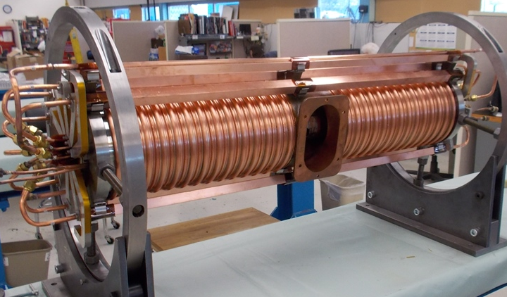
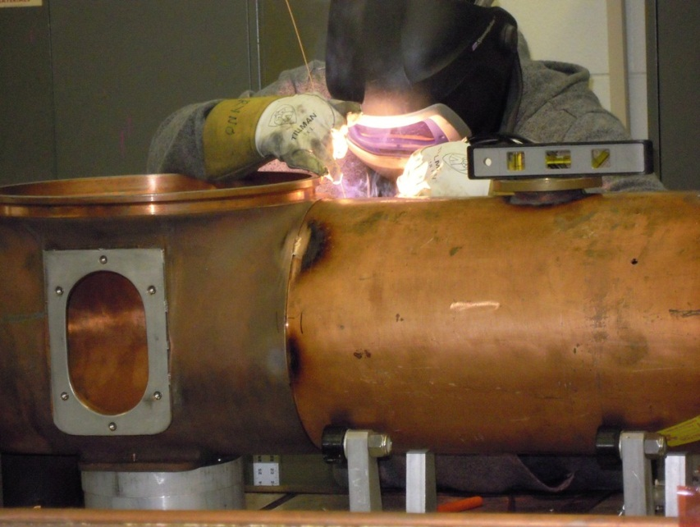
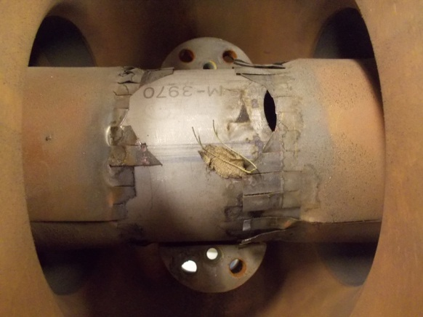
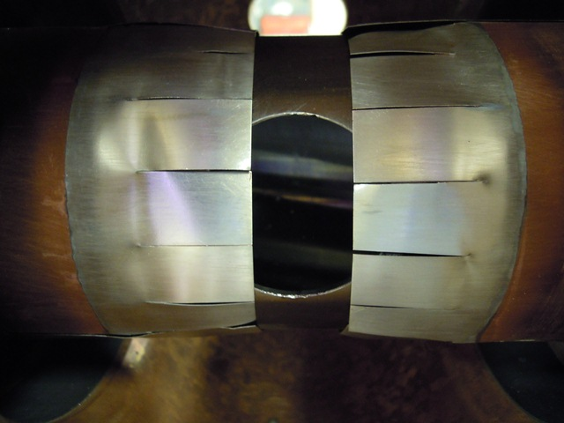
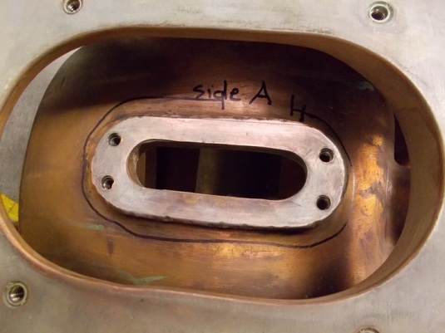
PIP Highlights – RF Cavity Refurbishment and New Tuners
Spent 4 years refurbishing water, vacuum, electrical and mechanical connections of 19 cavities to run at 15 Hz
Also built new tuners to allow quick repairs
Rebuilding 3 additional older cavities (one already installed)

Slide 16
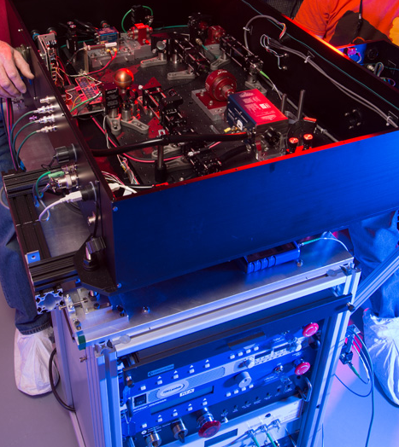
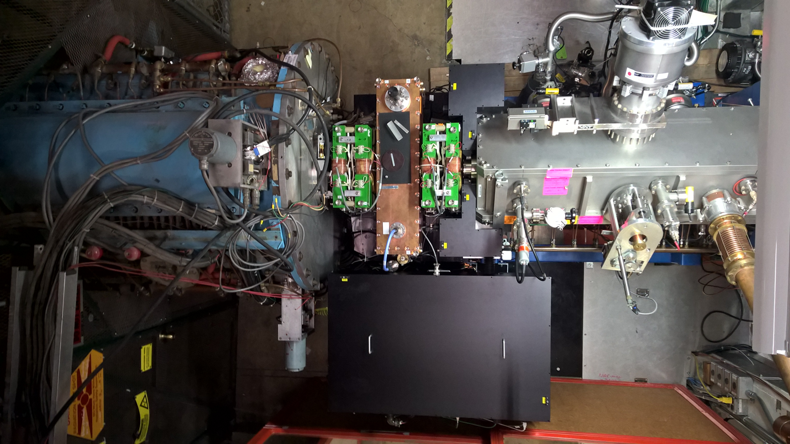
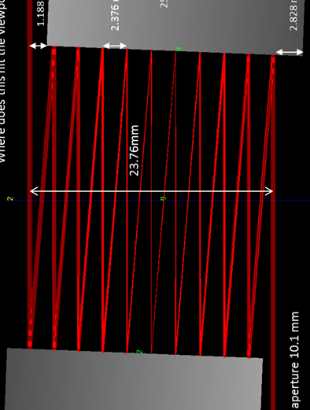
PIP Highlights – Laser Notcher
Currently use collimator system in Booster to notch out beam where Booster extraction kicker fires
Significantly reduce Booster losses by notching beam upstream in the PreAcc (750 keV)
Burst mode fiber/solid state MOPA laser transported to optical zig-zag cavity (20x less laser energy required) in vacuum flange of RFQ, neutralizes the H- beam

Slide 17
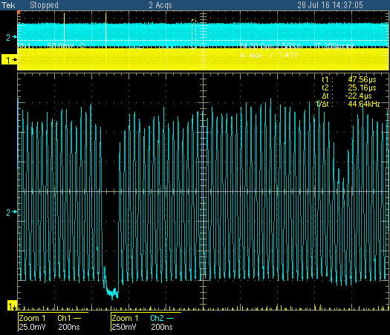
PIP Highlights – Laser Notcher (cont.)
  New accelerator development – never been done before!
Installed and tested just prior to summer shutdown
Achieved 70% neutralization, notch survived at 40% level in Booster
Finish commissioning and start routine operation after shutdown
Booster notch
Laser notch

Slide 18
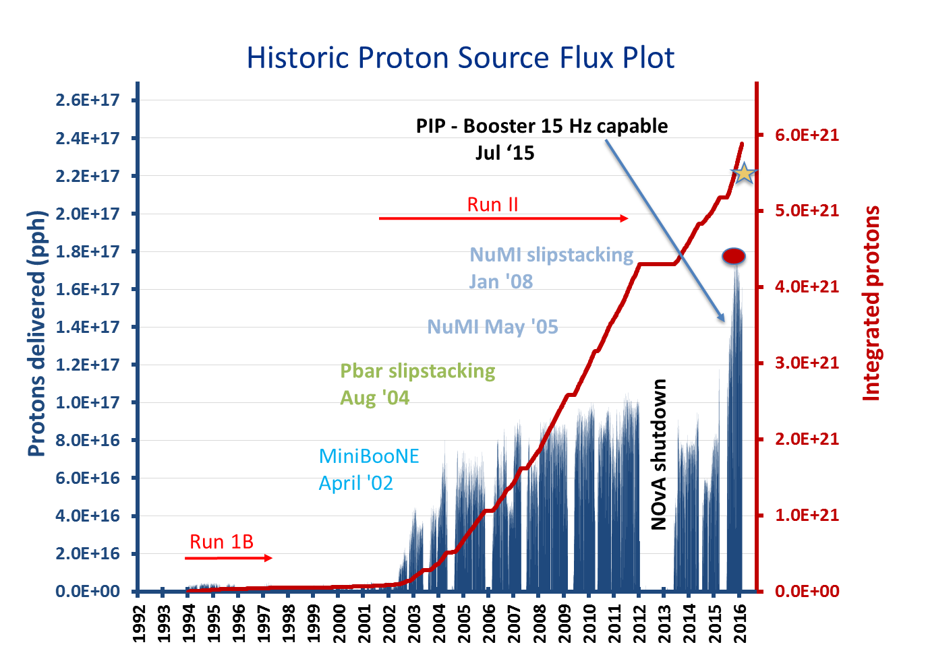
Booster 15 Hz Running
Capable of 15 Hz Booster beam since June 2015
Delivering record proton flux!
Enables us to supply beam to NuMI (at 700 kW), BNB, and the future Muon Campus
Currently limited by Booster shielding assessment – new assessment taking into account use of Total Loss Monitors to allow 2.5x10¹⁷ pph
under review

Slide 19
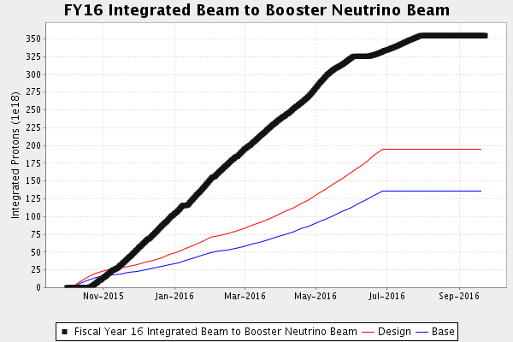
Surpassed FY16 Goals for Beam to BNB
Booster ramp-up in flux (15 Hz and intensity) much faster than assumed

Slide 20
BNB Upgrade for Short Baseline Neutrino Program
Optimized horn design can increase neutrino yield by up to 70%
  Inner conductor shape optimized for given length and current for efficient focusing
  Longer horn
Upgrade power supply to allow running at higher current and/or repetition rate
Fabrication and installation planned for 2018-2020
longer horn + higher current
longer horn
existing horn

Slide 21
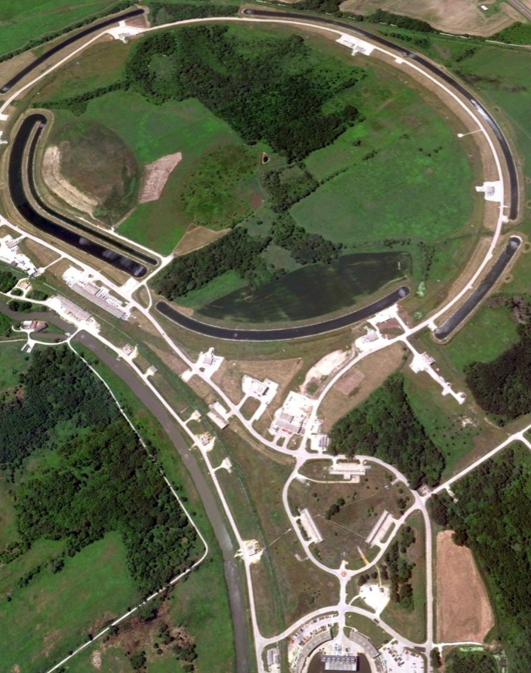
Muon Campus – Recycler Modifications
Recycler Ring
New 2.5 MHz RF in Recycler for re-bunching primary 8 GeV protons from Booster
  Bunch of 4x10¹² protons re-bunched into 4 bunches of 10¹² protons with needed bunch length for g-2/Mu2e
New connection from Recycler to Muon Campus
  Protons to Antiproton Source came from Main Injector (120 GeV)
  Protons extracted from Recycler to Muon Campus in 100 Hz bursts
New RF cavities
New connection from Recycler to Muon Campus
g-2 Target Station
Beam Transport and Delivery Ring
Muon Campus

Slide 22
Muon Campus – Conversion of Antiproton Source
Recycler Ring
Re-use Pbar target station for g-2 with new pulsed power supplies (100 Hz burst rate)
Pbar Debuncher ring converted to Delivery Ring
  Beamline (4 turns) for π decay and μ capture for g-2
  Resonant extraction of primary protons to Mu2e
New beamlines from Delivery Ring to g-2 storage ring and to Mu2e target
  Using magnets from Pbar Accumulator as well as from BNL g-2 beamline
g-2 Target Station
Beam Transport and Delivery Ring
Muon Campus

Slide 23
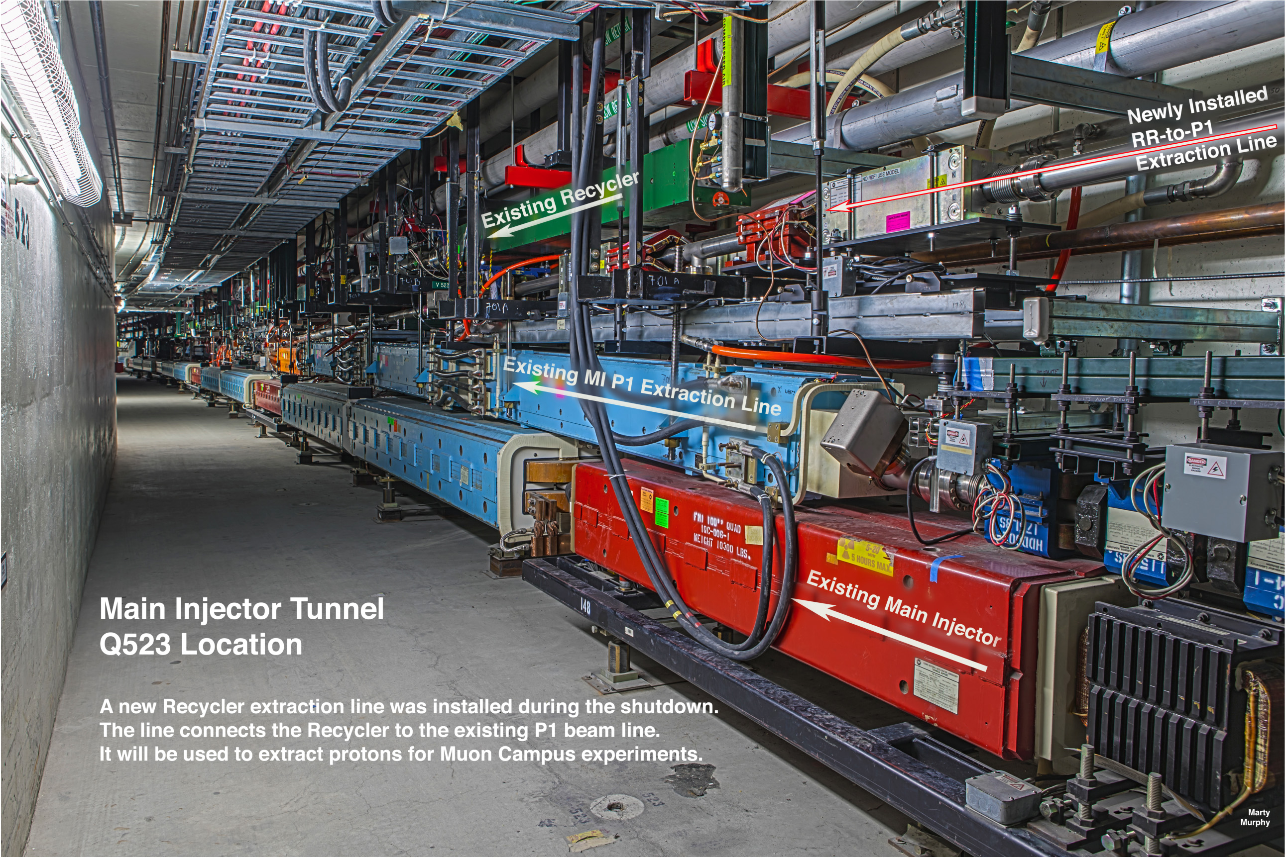
New Connection from Recycler to Muon Campus

Slide 24
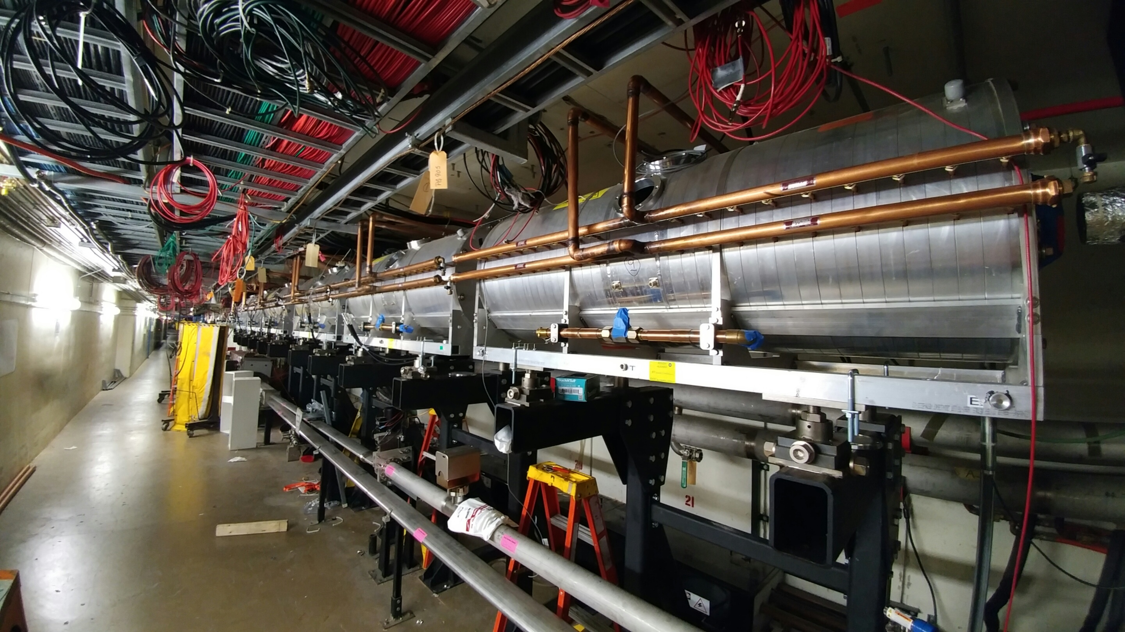
New Recycler 2.5 Mz RF for Muon Campus

Slide 25
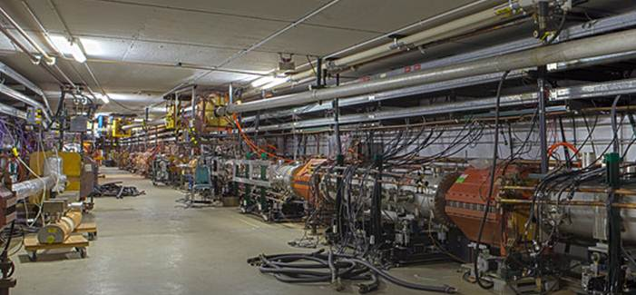
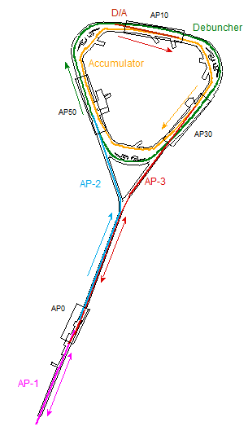
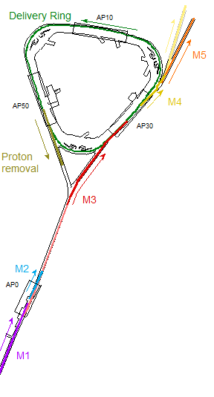
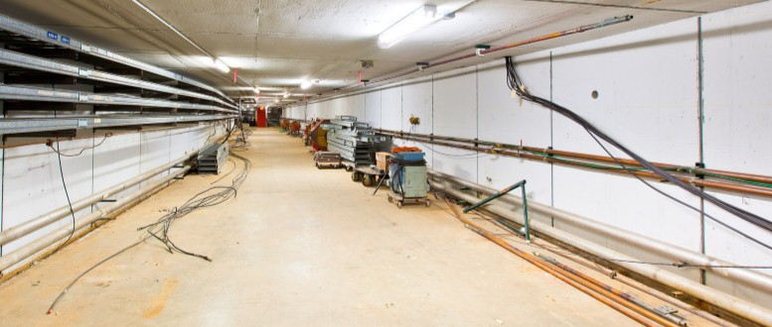
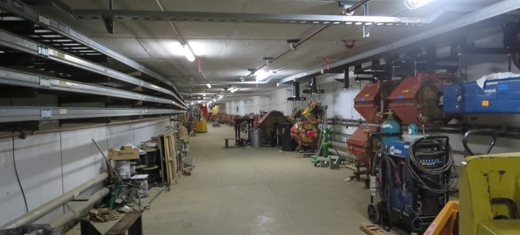
Muon Campus Beamline Construction
installing beamline in new tunnel
Pbar
Muon
5/8/14 start of decommissioning
new injection / extraction region reconfigured and installing magnets
3/23/15
beamline from target station to Delivery Ring installed and ready for commissioning
beamlines to target installed and ready for commissioning
2/26/16

Slide 26
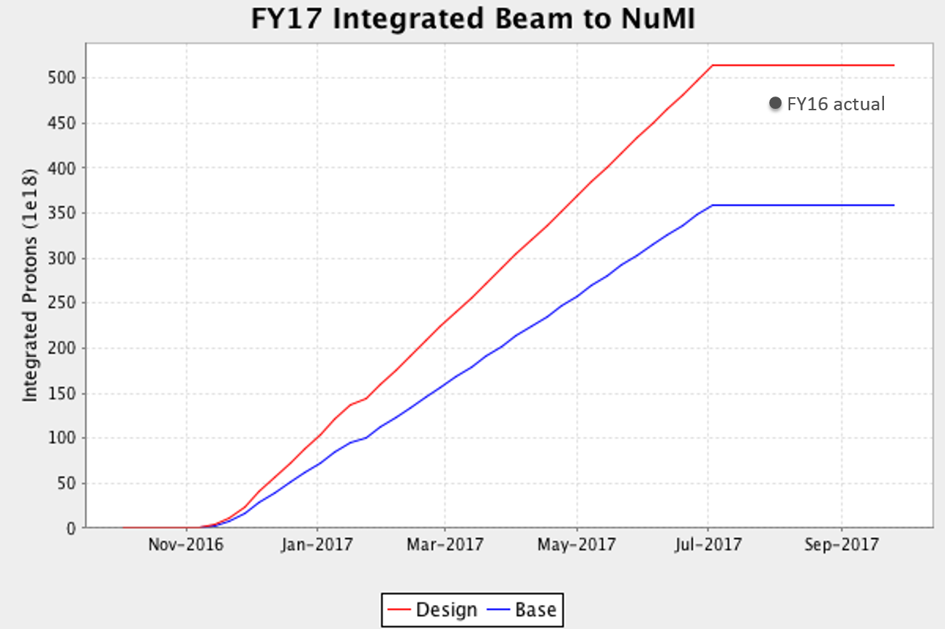
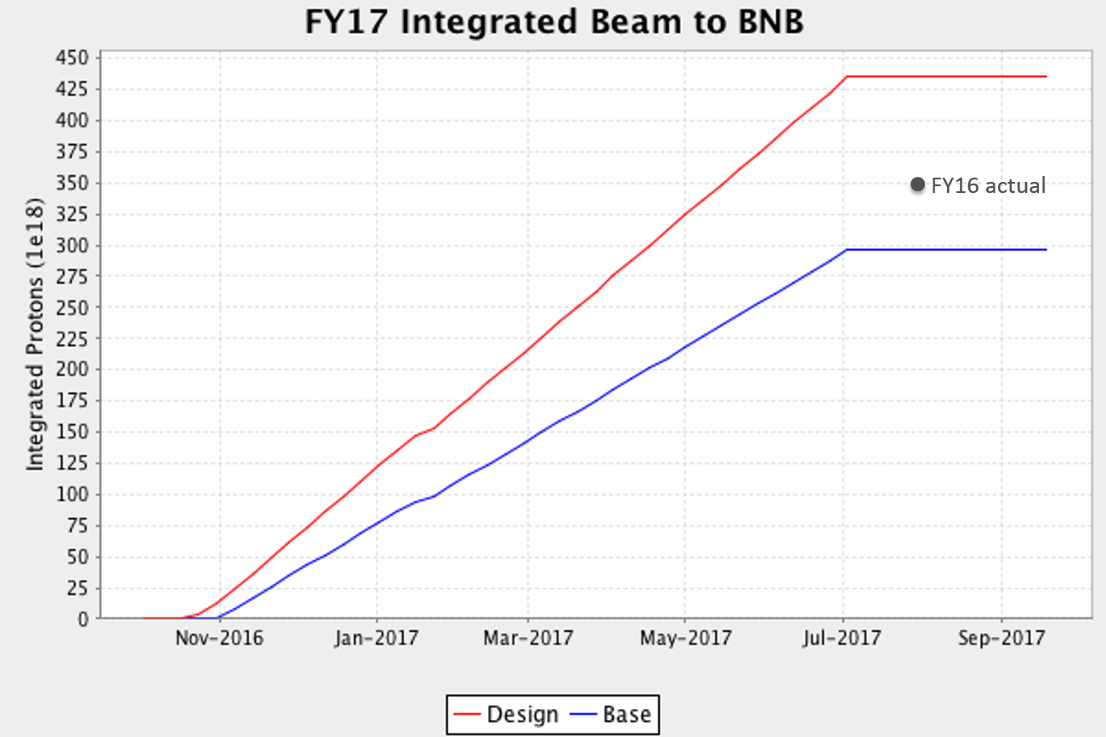
Accelerator Operations Goals for FY17
Accelerator shutdown planned to end early November
Expect similar integrated beam to NuMI and BNB as FY16
Establish muons to the g-2 storage ring

Slide 27
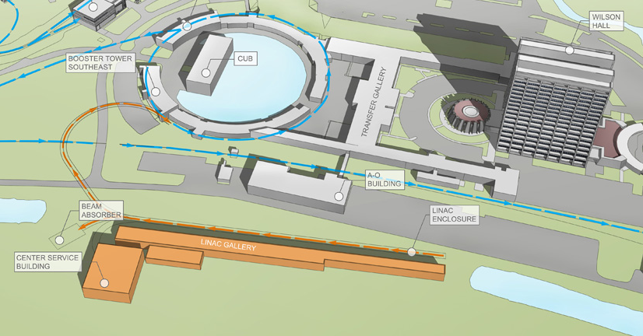
Beyond 700 kW
Plan for the next year is to run reliably at 700 kW
PIP-II Project aims to provide >1 MW starting in 2025 with new 800-MeV cw-capable superconducting Linac

Slide 28
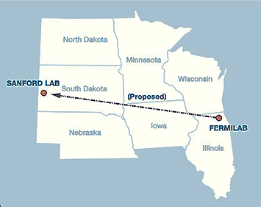
PIP-II and Fermilab Program Goals
Fermilab’s goal is to construct & operate the foremost facility in the world for particle physics research utilizing intense beams.
Neutrinos
  MINOS+, NOvA @700 kW: at present
  LBNF @ multi-MW
  SBN @ 10’s kW
Muons
  Muon g-2 @ 17-25 kW
  Mu2e @ 8-100 kW
Longer term opportunities
This requires more protons!
(and this statement tends to be time invariant)
“Upgrade the Fermilab Proton Accelerator Complex to produce higher intensity beams. R&D for the Proton Improvement Plan II (PIP-II) should proceed immediately, followed by construction, to provide proton beams of > 1 MW by the time of the first operation of the new long-baseline neutrino facility” – Recommendation 14, P5 report
PIP-II : Mission Need (Critical Decision 0) November 2015

Slide 29
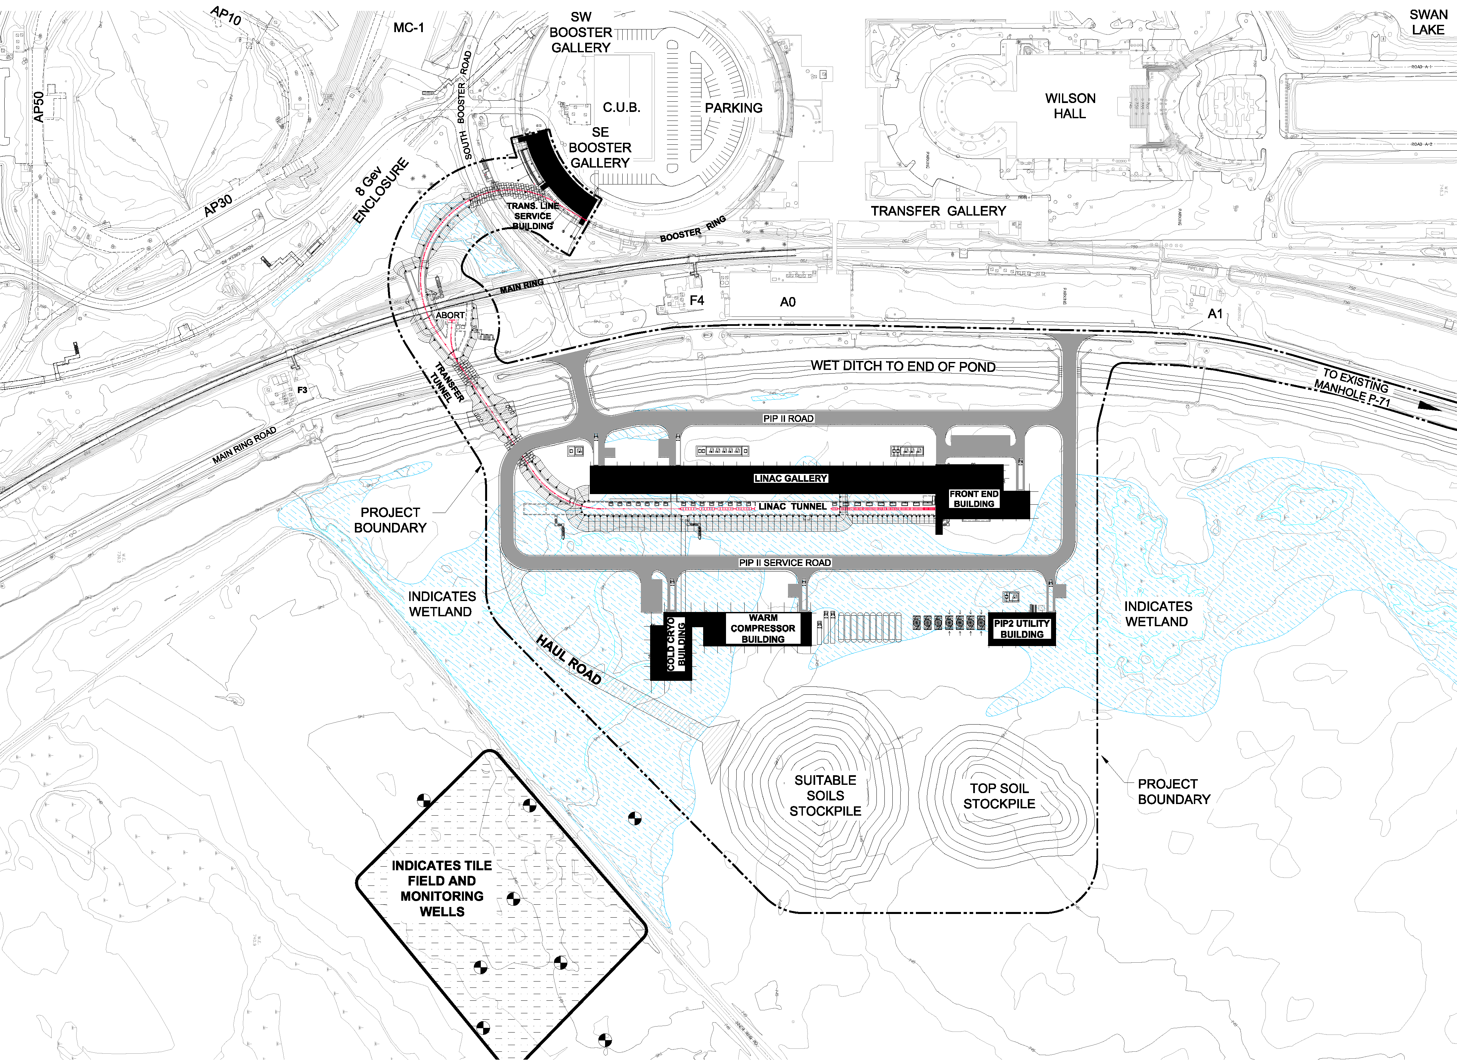
Proposed Technical Approach/Site Layout

Slide 30
Performance Goals
Performance Parameter | PIP | PIP-II
Linac Beam Energy | 400 | 800 | MeV
Linac Beam Current | 25 | 2 | mA
Linac Beam Pulse Length | 0.03 | 0.54 | msec
Linac Pulse Repetition Rate | 15 | 20 | Hz
Linac Beam Power to Booster | 4 | 17 | kW
Linac Beam Power Capability (@>10% Duty Factor) | 4 | ~200 | kW
Mu2e Upgrade Potential (800 MeV) | NA | >100 | kW
Booster Protons per Pulse | 4.3×10¹² | 6.5×10¹²
Booster Pulse Repetition Rate | 15 | 20 | Hz
Booster Beam Power @ 8 GeV | 80 | 166 | kW
Beam Power to 8 GeV Program (max) | 32 | 83 | kW
Main Injector Protons per Pulse | 4.9×10¹³ | 7.5×10¹³
Main Injector Cycle Time @ 60-120 GeV | 1.33* | 0.7-1.2 | sec
LBNF Beam Power @ 60-120 GeV | 0.7* | 1.0-1.2 | MW
LBNF Upgrade Potential @ 60-120 GeV | NA | >2 | MW
*NOvA operations at 120 GeV

Slide 31
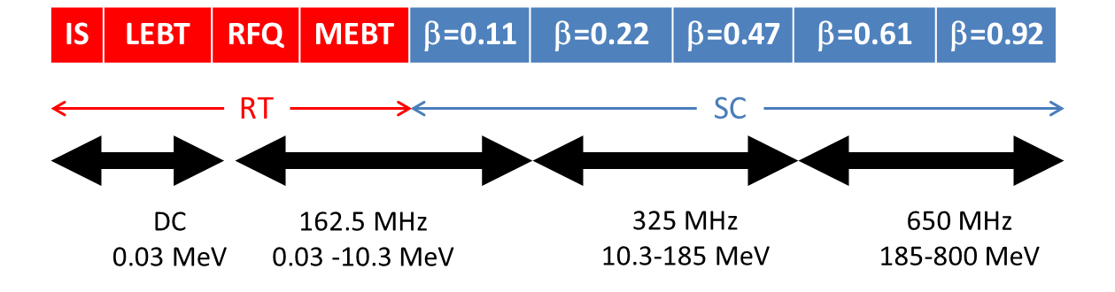
Scope/Technology Map
Section | Freq | Energy (MeV) | Cav/mag/CM | Type
RFQ | 162.5 | 0.03-2.1
HWR (β_{opt}=0.11) | 162.5 | 2.1-10.3 | 8/8/1 | HWR, solenoid
SSR1 (β_{opt}=0.22) | 325 | 10.3-35 | 16/8/ 2 | SSR, solenoid
SSR2 (β_{opt}=0.47) | 325 | 35-185 | 35/21/7 | SSR, solenoid
LB 650 (β_{g}=0.61) | 650 | 185-500 | 33/22/11 | 5-cell elliptical, doublet*
HB 650 (β_{g}=0.92) | 650 | 500-800 | 24/8/4 | 5-cell elliptical, doublet*
*Warm doublets external to cryomodules All components CW-capable

Slide 32
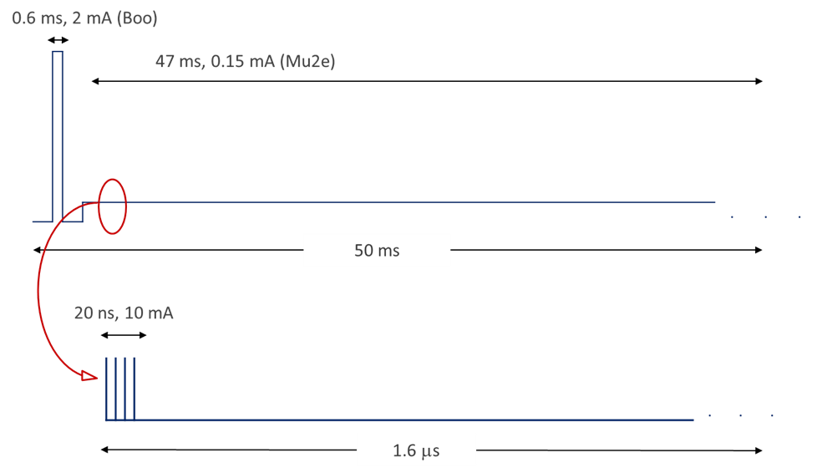
PIP-II and Next Generation Mu2e
Possible beam structure:
  Beam pulse length: ~20 nsec
  Pulse repetition period: 1.6 μsec
  Beam power: 100 kW

Slide 33
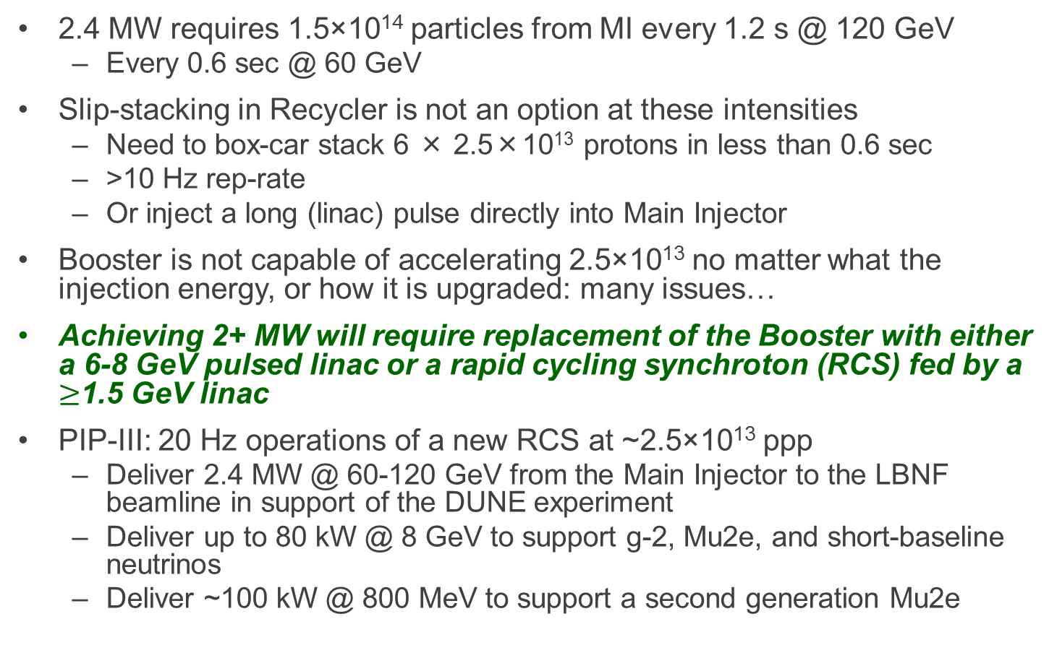
PIP-III (~2030)
2.4 MW requires 1.5×10¹⁴ particles from MI every 1.2 s @ 120 GeV
  Every 0.6 sec @ 60 GeV
Slip-stacking in Recycler is not an option at these intensities
  Need to box-car stack 6 × 2.5×10¹³ protons in less than 0.6 sec
  >10 Hz rep-rate
  Or inject a long (linac) pulse directly into Main Injector
Booster is not capable of accelerating 2.5×10¹³ no matter what the injection energy, or how it is upgraded: many issues…
Achieving 2+ MW will require replacement of the Booster with either a 6-8 GeV pulsed linac or a rapid cycling synchroton (RCS) fed by a $≥$1.5 GeV linac
PIP-III: 20 Hz operations of a new RCS at ~2.5×10¹³ ppp
  Deliver 2.4 MW @ 60-120 GeV from the Main Injector to the LBNF beamline in support of the DUNE experiment
  Deliver up to 80 kW @ 8 GeV to support g-2, Mu2e, and short-baseline neutrinos
  Deliver ~100 kW @ 800 MeV to support a second generation Mu2e

Slide 34
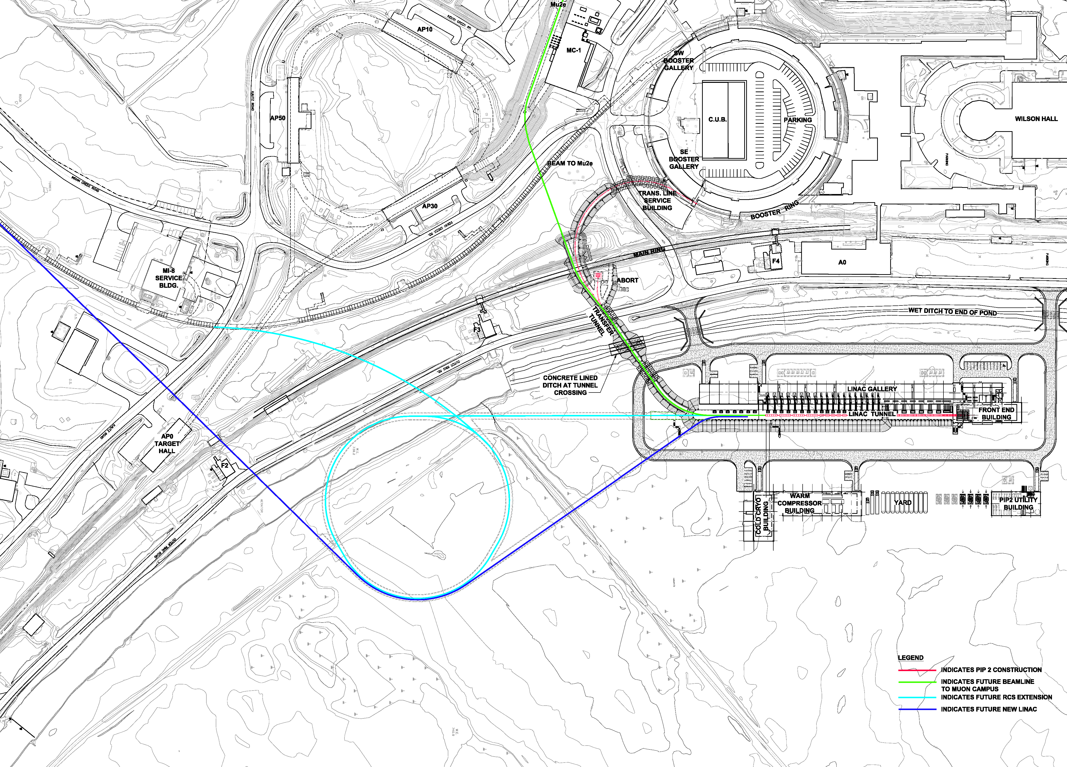
PIP-III (~2030)

Slide 35
Conclusions
Ready to run at world record 700 kW beam power for NOvA after summer shutdown
Many of the PIP improvements in beam delivery have been realized already; work to ensure reliability remains
Optimizations for the SBN program of building an upgraded horn and power supply could increase neutrino yield by up to 70%
Muon Campus construction is on track and will be ready to commission and operate beam to g-2 starting this spring
We have a well-developed PIP-II project plan
An experienced team is in place that can be expected to successfully execute the PIP-II project.

