Slide 1
Fermilab Low Mass Multiwires
Gianni Tassotto
11/9/2016

Slide 2
AGENDA
SEM/MULTIWIRE R&D AND OPERATION FOR NUMI
SIMULATIONS
FERMILAB MULTIWIRE IMPROVEMENTS
BEAM LOSSES
SUMMARY

Slide 3
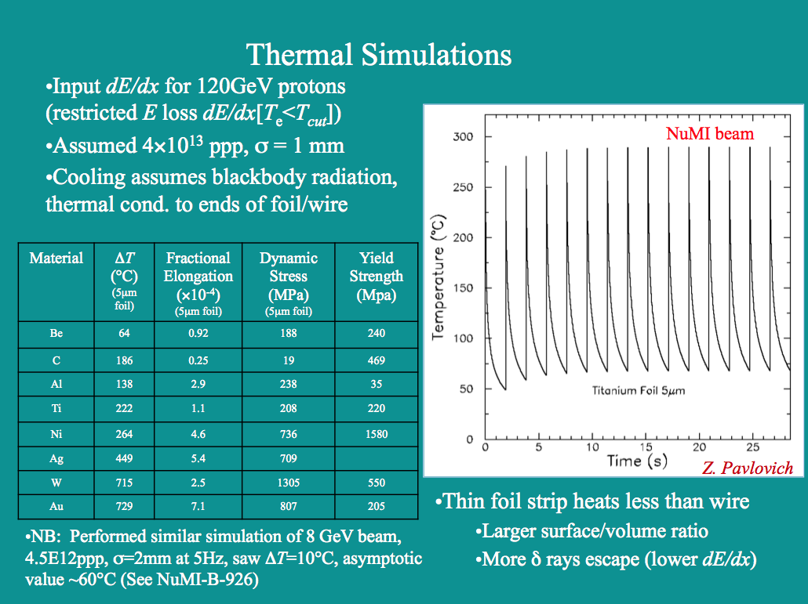
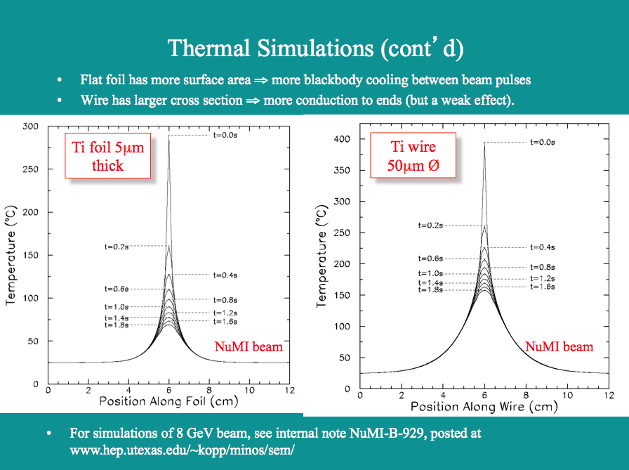
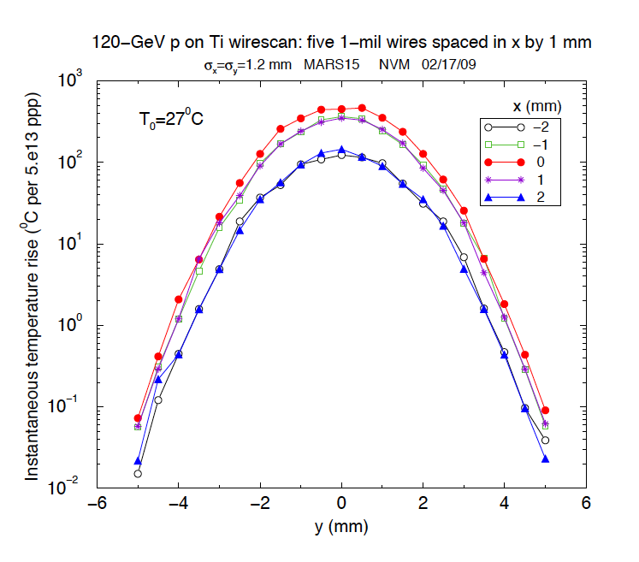
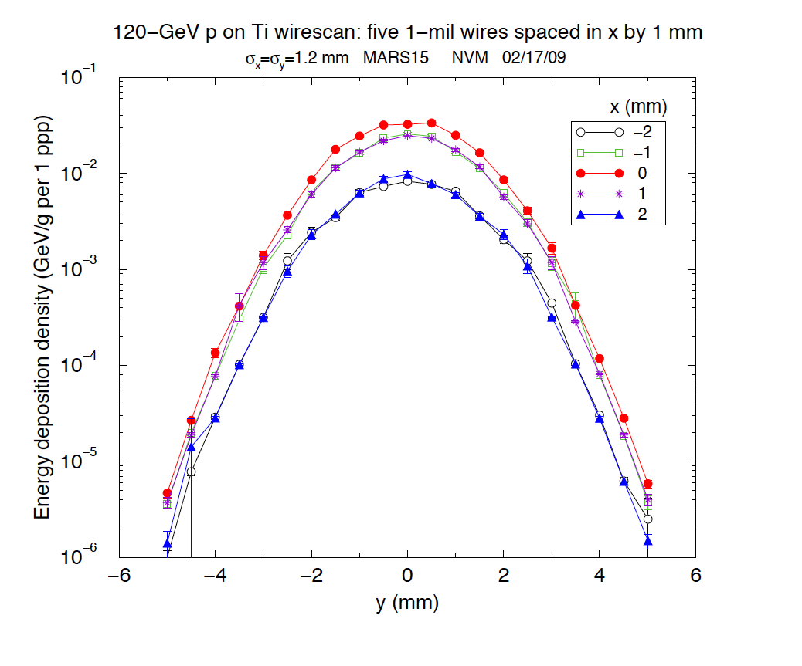
Wire Heating Simulations
Both UTA and Fermilab performed simulations. UTA simulated the temperature rise of 5 μ foil and 50 μ Ti wire. Data from: www.hep.utexas.edu/~kopp/minos/sem/
Shown to the right is the Temperature analysis using MARS15 for a 25 μm Ti wire made by Nikolai Mokhov.
The temperature rise (left plot) and the energy deposition (right plot) for a single pulse at the NoVA beam energy are shown. The center wire (red) show a temperature rise of about 450 degree C. for a 120 GeV beam pulse of 5 x 10¹³ POT.

Slide 4
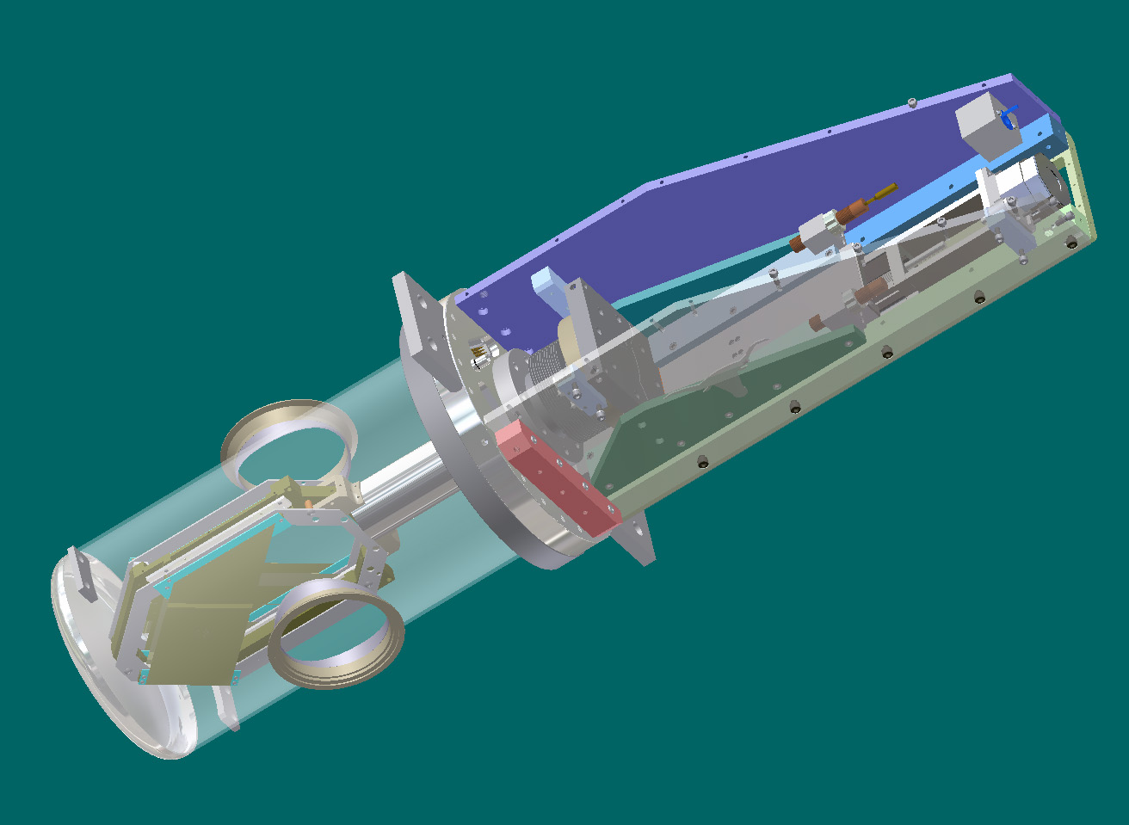
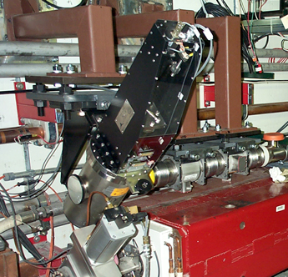
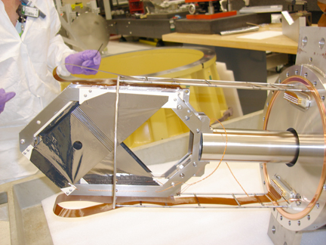
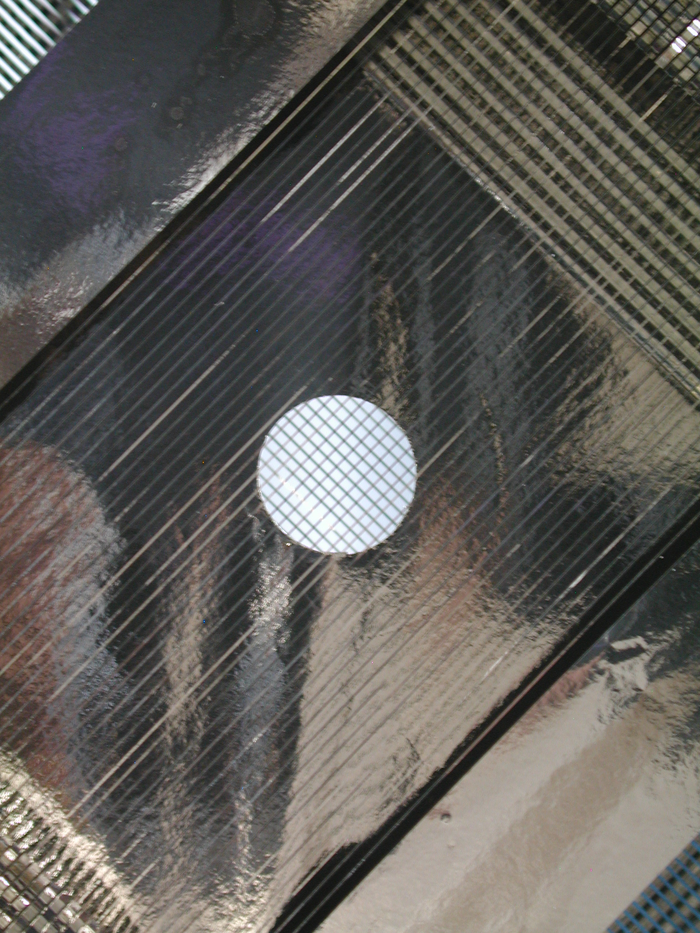
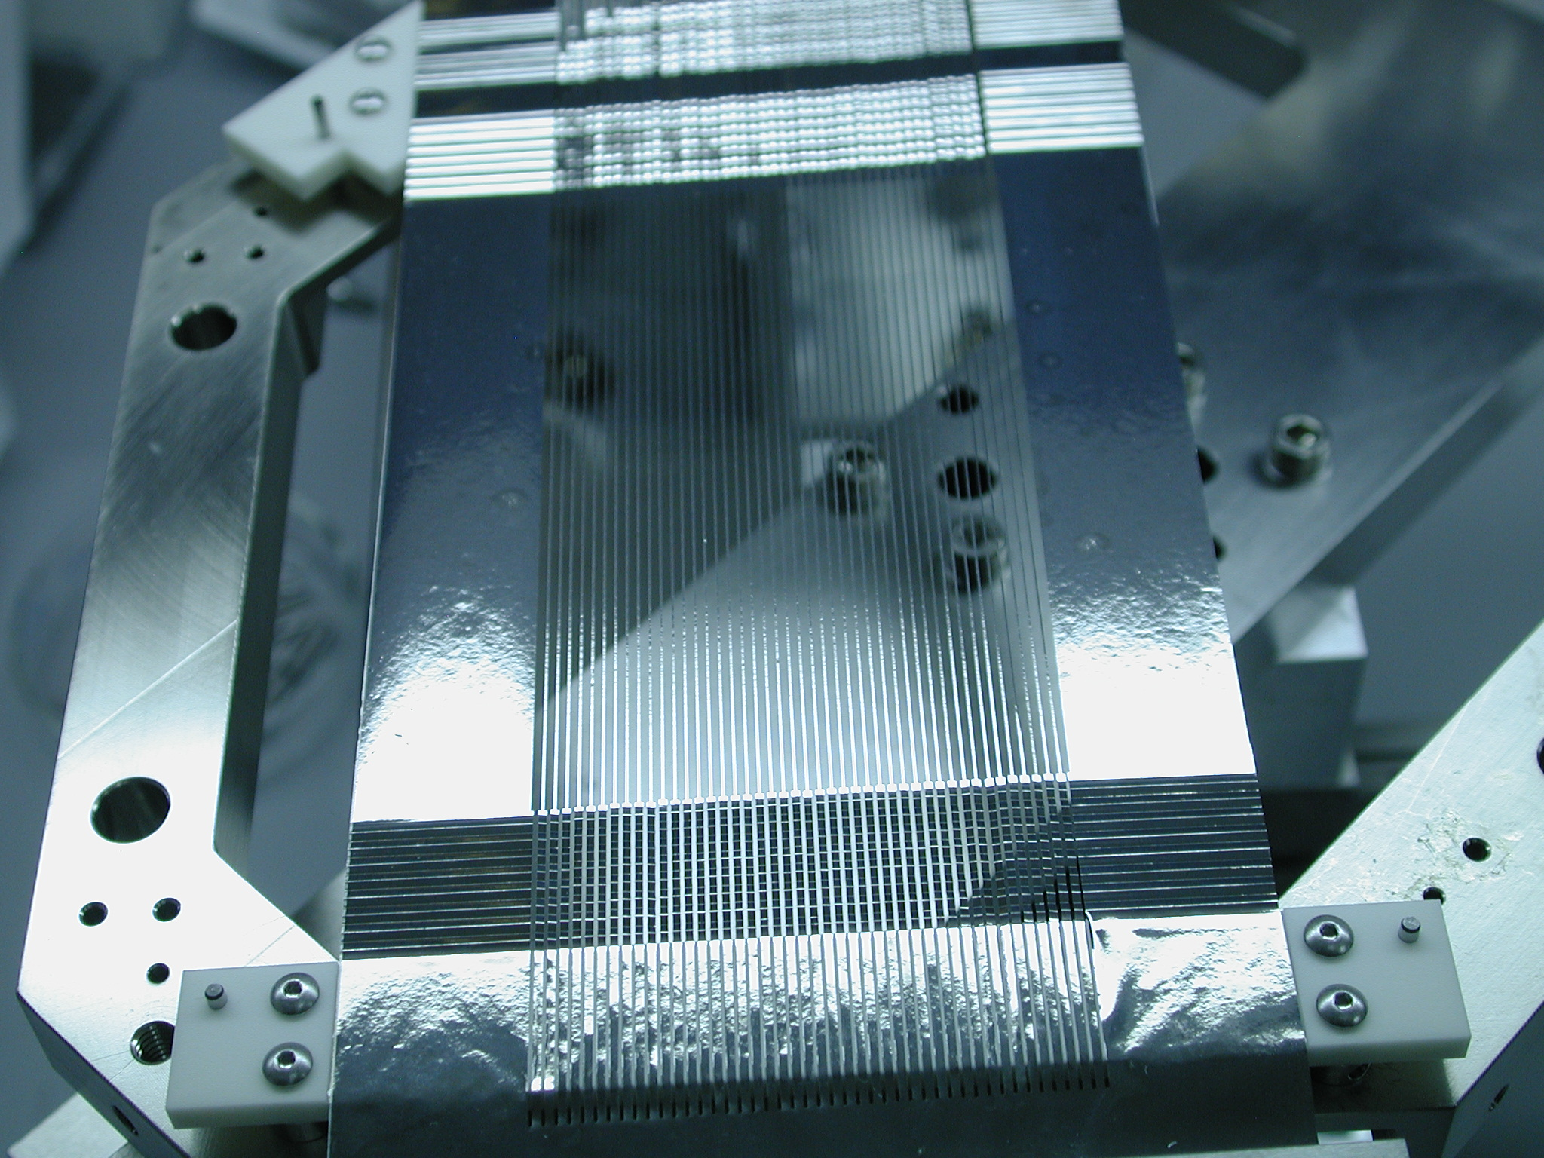
UTA Profile Monitor R&D
Initial design work was performed by University of Texas, Austin (UTA).
Key features:
  Linear drive
  5 um Ti strips, 150 um wide
  Clearing field foils (3)
  Strip tension using “accordion” crimp imparts 1-2 g tension
Target SEM was stationary and operated flawlessly for many years.
Beamline SEMs had major operational problems:
  Linear drive took many pulses to move the detector IN/OUT of the beam. 10X too much mass in beam during motion requiring to stop the beam
  Too little tension on the strips which caused them to randomly short to each other during motion
For more information about UTA SEMs see DIPAC2007.
UTA SEM design
PM-101 installed
Ti foil assembly
Clearing field foil
Accordion spring system

Slide 5
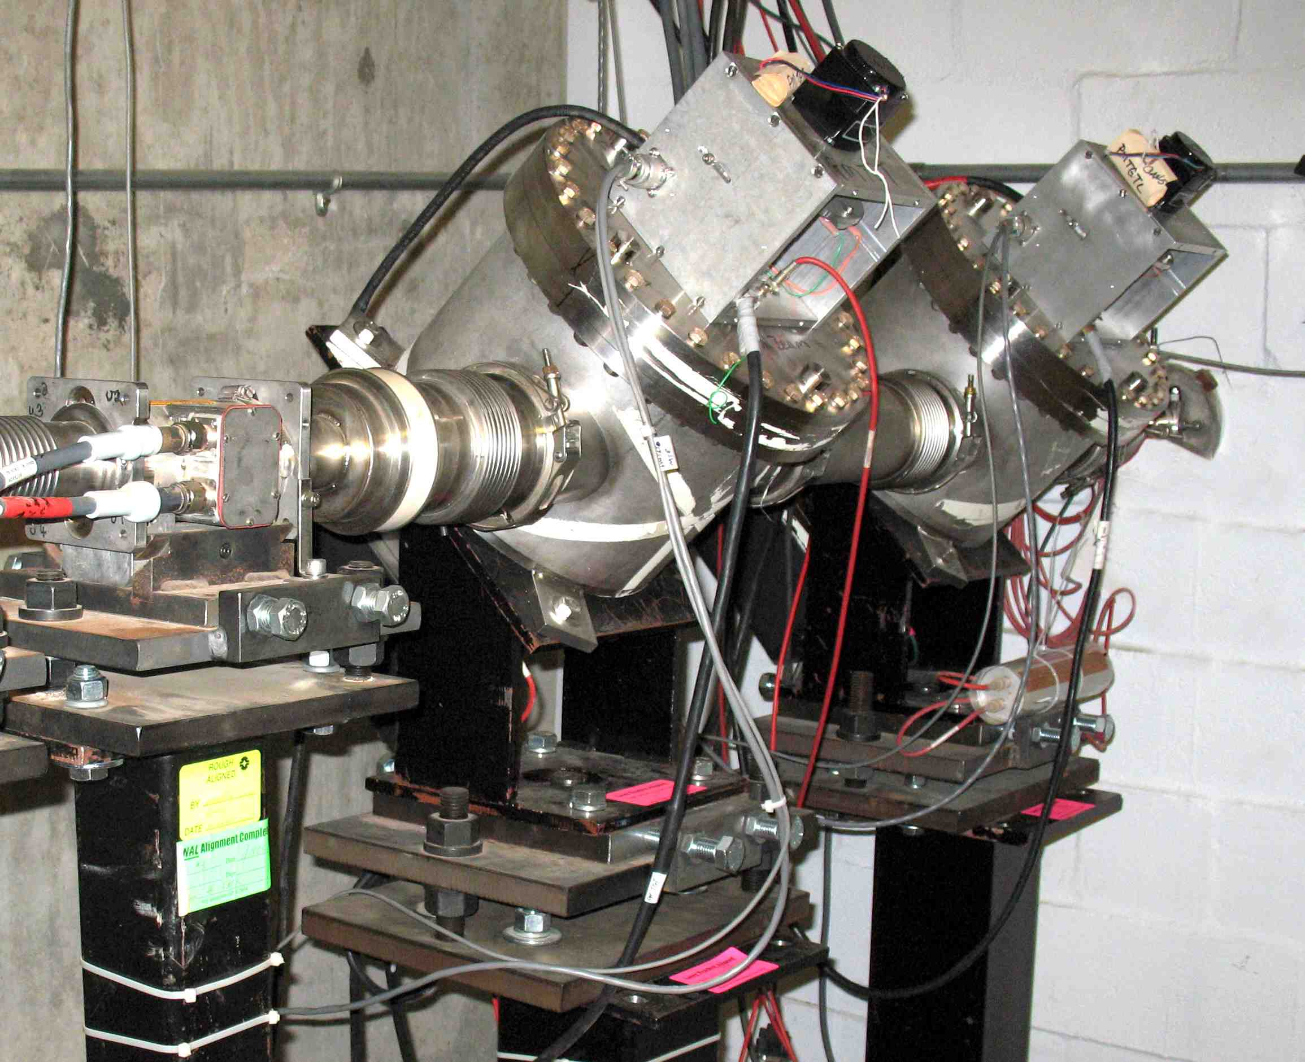
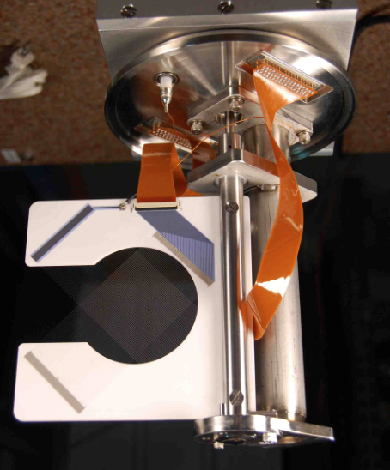
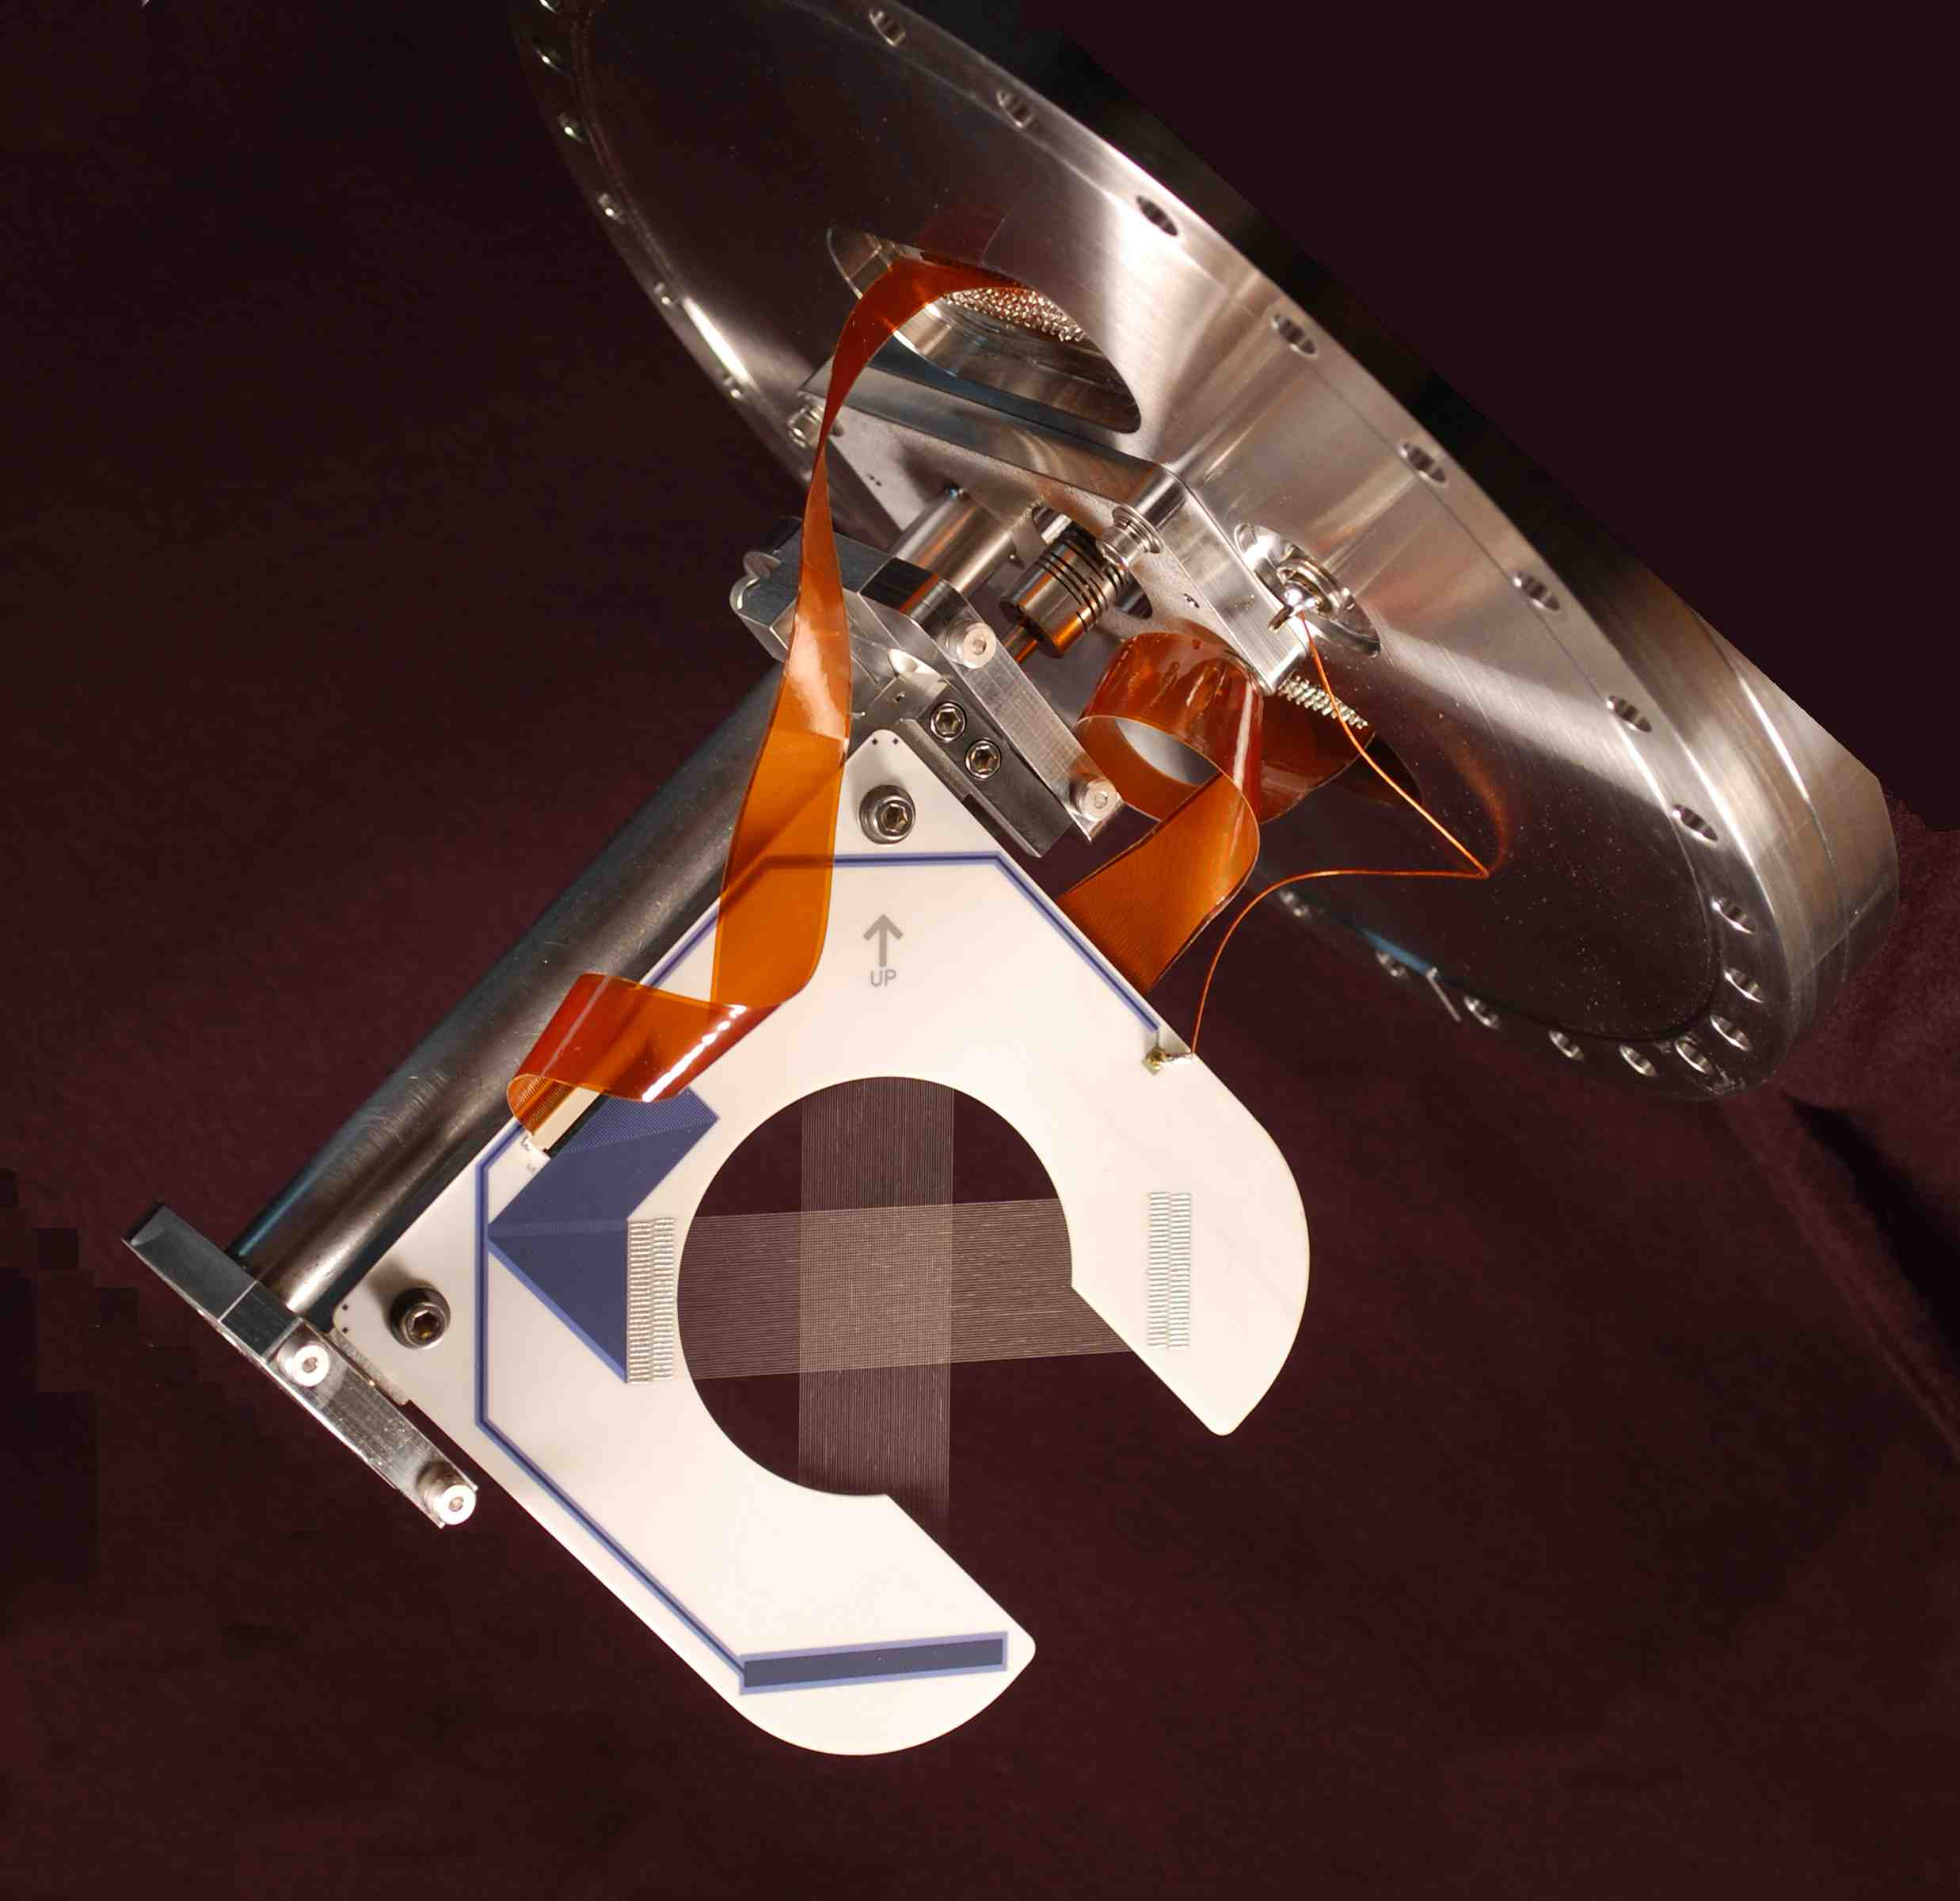
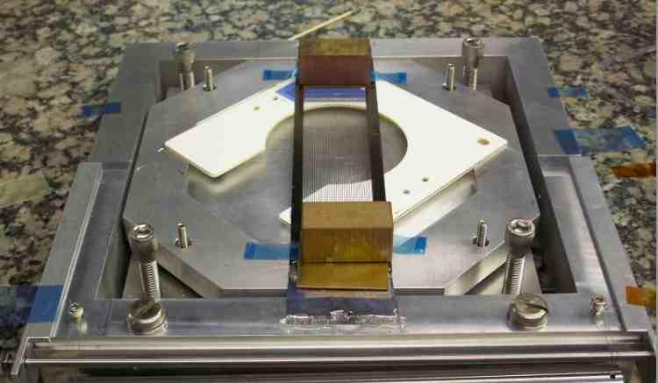
FNAL Profile Monitor Development
Fermilab performed R&D to improve the reliability of the Existing profile monitors.
Upgraded NuMI/NOvA Profile Monitor Design:
Rotary instead of linear drive.
  More robust version of existing Fermilab rotary drive design
  Mount vacuum can at 45 deg. with ceramic C-frame SEM grid mount also at 45 deg. Enables seamless insertion of monitor during beam operation.
  Tested to 500,000 cycles with no noticeable drive degradation or positioning accuracy.
Wires instead of foils for operational intensity monitors
  Enables reduced SEM grid mass, but more robust.
  Do not need the extra signal provided by bias foils.
  Conductive epoxy, EPO-TEK H20E used to insure mechanical and electrical contact for SEM grid.
The top picture shows the target station with 2 SEMs: the first has 20 μ Ti grade 5 (Ti -6AL-4V) wires, used for actual beam operation, and the second has 75 μ Ti (grade 1) used for optimizing tuning at lower intensities.
The center pictures show a 1 mm pitch wire plane ass’y and a 0.5 mm pitch target wire plane.
The bottom picture shows the set up used for assembling 7.5 μm Ti foil strips.
NuMI Target Station
1 mm pitch
TGT SEM, 0.5 mm pitch
Ti foil assembly

Slide 6
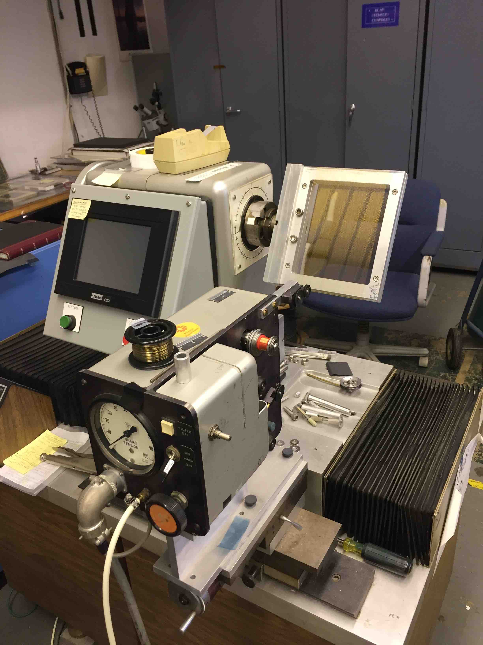
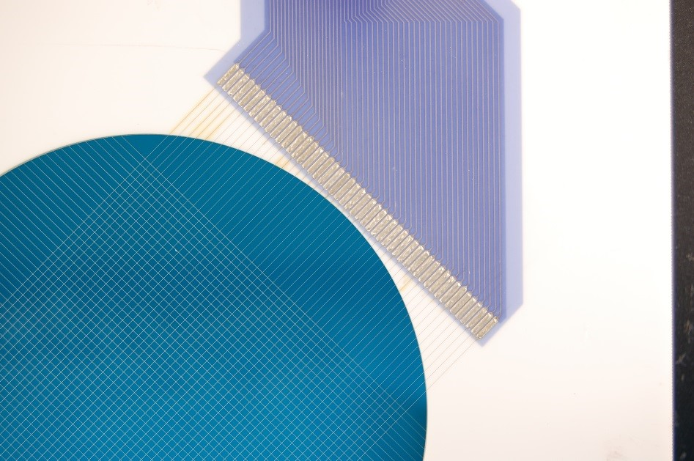
Wire Plane Assembly
The wire planes are built at Lab 6. The technician, Wanda Newby, places a spool of wire and a transfer frame on the “winder” (shown below right). As the transfer module rotates, the wire is wound at the requested pitch and tension onto the frame. The wires on the transfer frame are aligned in contact with a ceramic wireplane frame and soldered or epoxied to the pads on the ceramic frame.
Carbon filaments (33 μ) are strong longitudinally but extremely weak under a flexural force. We are presently contacting vendors for single strand carbon smaller than 33 μ needed for higher beam power runs.

Slide 7
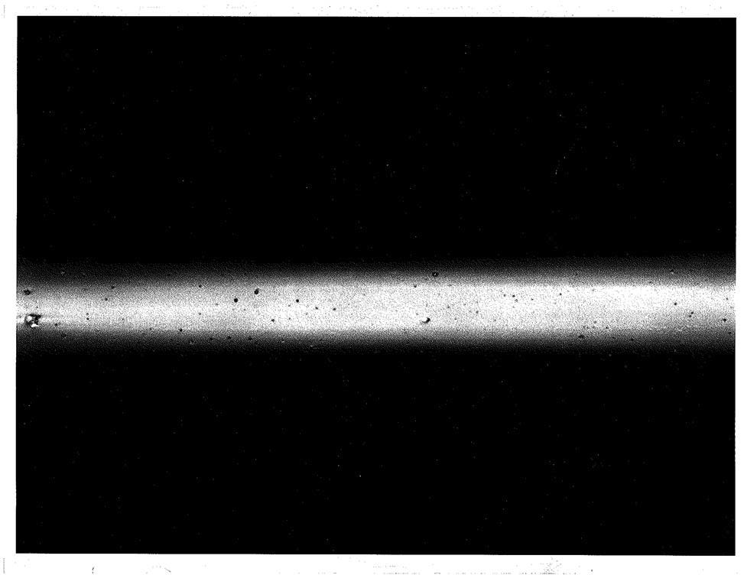
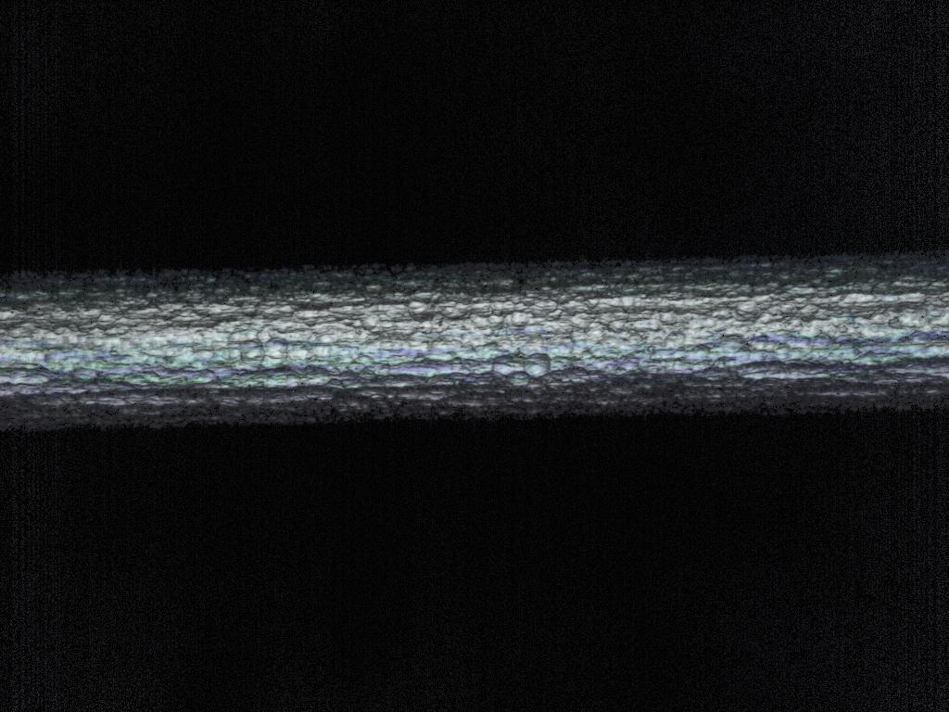

Titanium Wire Tests
I contacted Fort Wayne Metals: (fwmetals.com) about producing smaller diameter Gr-5 Ti wire. The smallest diameter they were able to send us was 20 μm but, we found out after a run that the surface was not smooth.
Ti wires and foils were put under a microscope after they were removed from the beamline to check for any damage due to the beam:
- Did not keep track of integrated intensity, assume ≈ 1E16.
- No discoloration was found.
- Ti Gr-1 was shiny but surface looked oily.
- Ti Gr-5 was very rough due the the manufacturer’s process.
The pictures below show Ti wires at 100 times magnification and Ti foil at 135 times magnification.
Carbon monofilament is produced by Specialty Materials, Inc. (specmaterials.com).
- Tensile strength = 860 MPA longitudinally.
Problems:
- Very weak with axial flexing. Technicians had to fix a few assemblies because the monofilaments broke during
the assembly process.
- Large bend radius where the filament breaks easily.
25 μm Ti Gr-1 wire
20 μm Ti Gr-5 wire
150 μm wide Ti Gr-1 foil.

Slide 8
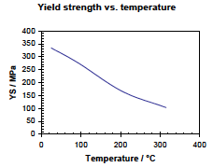
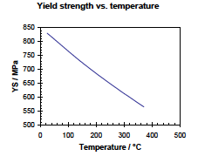
Properties for Different SEM Materials
Material Atomic number Atomic mass density(g/cm³) Melting point(C/F) Emissivity
Ti 22 47.8 4.54 1660 / 3020 0.3
C (monofilament) 6 12 1.8 3545 / 6413 0.77
Yield strength for Ti wire options
Ti grade 1 has the mechanical properties listed below.
Charts of yield strength vs. temperature stop around 300 C.
By using Ti grade 5 (Ti-6AL-4V) the yield curve is much higher.
A tension of about 20 g/wire is applied to the 25 μ wires.
A tension of 16 g is applied to 20 μ Ti grade 5 wires.
For a ΔT of 300^{ο} C yield strength change is 62% for Ti grade 1 and 31% for Ti grade 5.
The 300^{ο} C residual strength is 4.4 times greater for Ti grade 5.
Ti - Grade 1
Ti - Grade 5

Slide 9
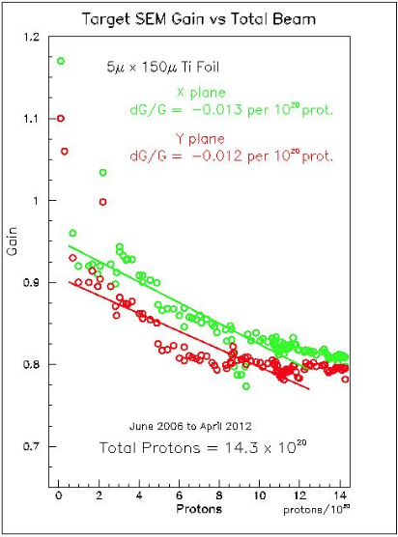
SEM Sensitivity vs. Beam Exposure
Measurements for the target NuMI SEMs have been made for Ti (wires and foils) and Carbon filaments.
SEM 118, 33 u carbon
Total POT = 4.5 x 10²⁰
Original UTA SEM 5 u thick foil
Total POT = 14.2 x 10²⁰
New SEM 20 u Ti grade 5
Total POT = 3.5 x 10²⁰
SEM sensitivity ages much more slowly as exposure increases.
Measurements made by Doug Jensen

Slide 10
Single Pulse Temperature Rise
Last year Tony Leveling performed a series of temperature rise estimates using MARS15 for a primary proton beam of 120 GeV, at 700 KW, 1.2 MW and 2.0 MW for Ti and C at smaller diameters.
700 KW.
- 25 μm Dia. Ti Gr-1 wire 1 mm and 0.5 mm pitch.
- 20 μm Dia. Ti grade 5 (6%AL, 4%V) wire 1 mm and 0.5 mm pitch.
- Ti Gr-1 foil: 5 μm thick, 125 μm wide.
- Carbon monofilament 33 μm Dia.
1.2 MW.
- 25 μm Dia. Ti Gr-1 wire 1 mm and 0.5 mm pitch.
- Ti Gr-1 foil: 5 μm wide, 150 μm wide .
- Carbon monofilament 33 μm Dia.
2 MW.
- Carbon fiber 5 μm Dia.
Beam Parameters
- Proton per pulse 5 X 10¹³ at 700 KW, 8.1 x 10¹³ at 1.2 MW, and 1.39 x 10¹⁴ at 2 MW
- Spill duration 1.0x 10⁻⁵ seconds.
- Energy 60 to 120 GeV.
- Beam size at target 1.2 mm.
- Cycle time 1.33 seconds.

Slide 11
Results
None of the wires reached the melting point for that material.
Below are pictures of the estimate of the temperature rise per beam power. Temperature is in degrees Celsius shown on the vertical axis.
25 μm Ti Gr-1 @ 700 KW
20 μm Ti GR-5 @ 700 KW
Ti Gr-1 foil 7 x 125 μm @ 700 KW
25 μm Ti Gr-1 @ 1.2 MW
33 μm C @ 700 KW
Ti Gr-1 foil 5 x 150 μm @ 1.2 MW
33 μm C @ 1.2MW
5 μm C @ 2 MW

Slide 12
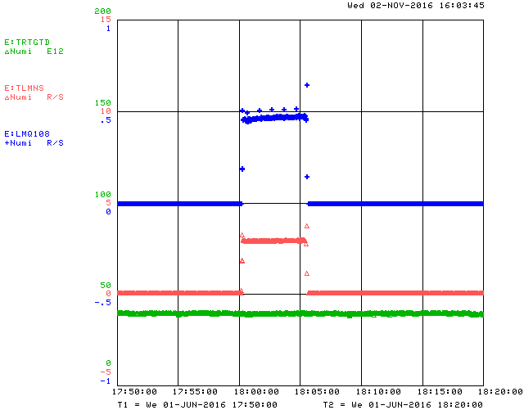
Multiwire Generated Beam Losses
The insertion of a SEM in the beam will give raise to scattering and therefore beam losses.
In the NuMI beamline there are two types of loss monitors:
  - BLMs
  - TLMs
The BLM monitors are located on a
magnet i.e., Q108.
The TLMs monitor the distributed
losses over a section of beamline.
The losses do not appreciably
change whether we use Ti vs C.
The plot to the right shows the loss
in rad/sec at an intensity of 3.6 e13.
Calculated fractional beam loss from
1 mm pitch Ti wire is approximately
3.5 parts per million.

Slide 13
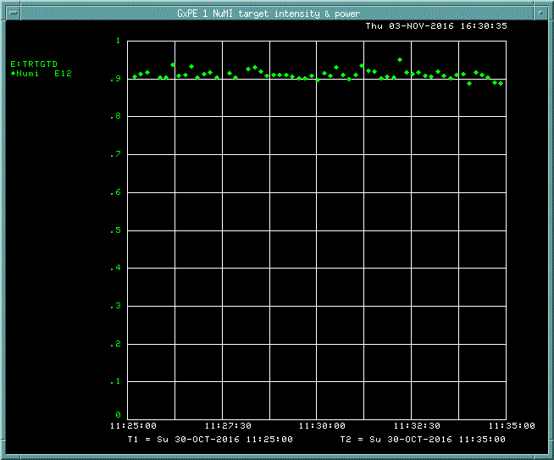
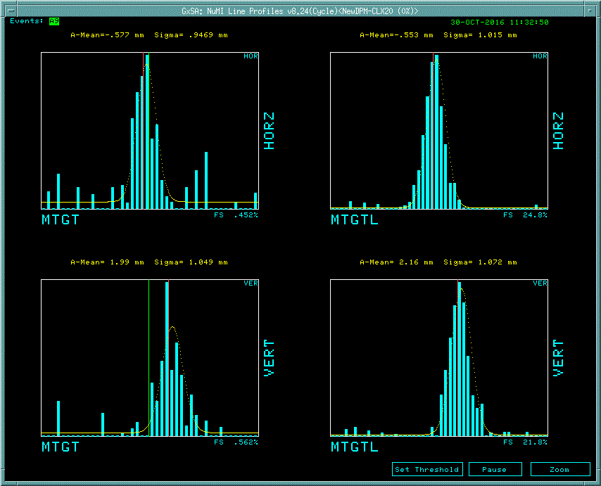
NuMI Beamline Profile Monitors.
The list below shows the list of SEMs in NuMI pretarget beamline. Wires of pure and grade 5 Ti and carbon have been installed to determine the robustness of each.
The picture to the right shows the beam intensity during the tuning phase of the beamline on 10/30/2016 as displayed by the target toroid. The lower right picture shows the beam display of the 2 target multiwires: PM-TGT and PM-TGTL. At this intensity the display of PM-TGT is barely over noise.
Beam parameters:
- Energy: 120 GeV
- Intensity: 1.8 x 10¹¹ POT
- Cycle time 1.33 sec
Name | Material/Dimension | Wire pitch (mm) | Comment
PM-101 | 25µ Dia. Ti wire | 1mmV, 1mmH | Grade 1
PM-105 | 5µ x 125µ Ti foil | 1mmV, 1mmH | Foil
PM-107 | 33µ Carbon filament | 1mmV, 1mmH
PM-108 | 25µ Dia. Ti wire | 1mmV, 1mmH | Grade 1
PM-112 | 20µ Dia. Ti wire | 1mmV, 1mmH | Grade 5
PM-114 | 20µ Dia. Ti wire | 1mmV, 1mmH | Grade 5
PM-115 | 33µ Carbon filament | 1mmV, 1mmH
PM-117 | 33µ Carbon filament | 1mmV, 1mmH
PM-118 | 33µ Carbon filament | 1mmV, 1mmH
PM-121 | 20µ Dia. Ti wire | .5mmV,.5mmH | Grade 1
PM-TGT | 20µ Dia. Ti wire | .5mmV, .5mmH | Grade 5
PM-TGTL | 75µ Dia. Ti wire | .5mmV, .5mmH | Grade 1
TORTGT = 1.8 E11
NUMI SEM PROFILES

Slide 14
Summary
Simulations show that the wire/foil will survive a single pulse of beam at 700 KW, 1.2 MW and 2 MW.
Remaining simulations:
- Complete the simulations using ANSYS to determine the
maximum temperature and stress under steady beam conditions
- Simulate the Secondary Emission (SE) signal to determine
the total charge generated.
- Experimental tests should be performed to verify simulations.
Contact vendors about producing lower diameter carbon filaments.

