Slide 1
Design of the LBNF Neutrino Beamline
Vaia Papadimitriou
LBNF Beamline Manager
US-Japan Workshop on Accelerators and Beam Equipment for High-Intensity Neutrino Beams
November 9, 2016

Slide 2
Outline
LBNF/DUNE scientific goals
LBNF Beamline Overview
Recent engineering progress in various areas of the Beamline work
  Progress on the optimization effort
    Horns
    Target
    Impacted systems
  Progress in other areas
    Target chase atmosphere (air releases, inert gas)
    Beam windows
Schedule and milestones
Conclusion

Slide 3
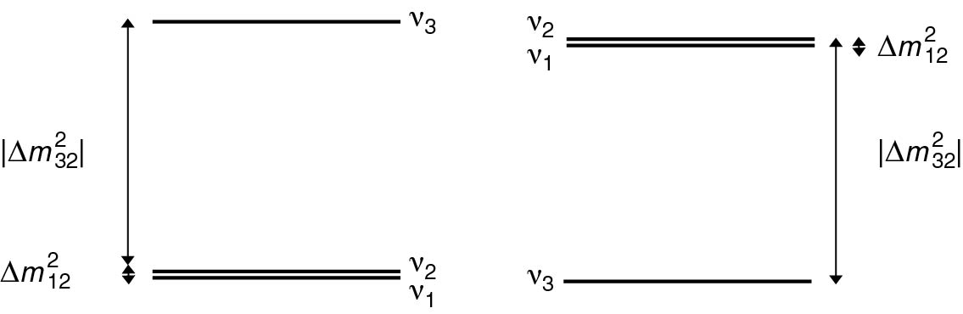

LBNF/DUNE Science Goals
LBNF/DUNE is a comprehensive program to:
Measure neutrino oscillations
  Direct determination of CP violation in the leptonic sector
  Measurement of the CP phase δ
  Determination of the neutrino mass hierarchy
  Determination of the θ₂₃ octant and other precision measurements
  Testing the 3-flavor mixing paradigm
  Precision measurements of neutrino interactions with matter
  Searching for new physics
In a single experiment
Start data taking ~ 2026

Slide 4
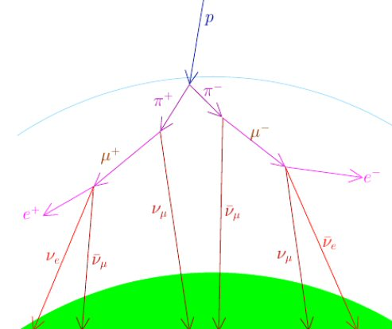


LBNF/DUNE Science Goals
LBNF/DUNE is a comprehensive program to:
Study other fundamental physics enabled by a massive, underground detector
  Search for nucleon decays (reveal a relation between the stability of matter and the Grand Unification of forces?)
  Measurement of neutrinos from galactic core collapse supernovae (peer inside newly-formed neutron stars and potentially witness the birth of a black hole?)
  Measurements with atmospheric neutrinos
Start data taking ~ 2024

Slide 5
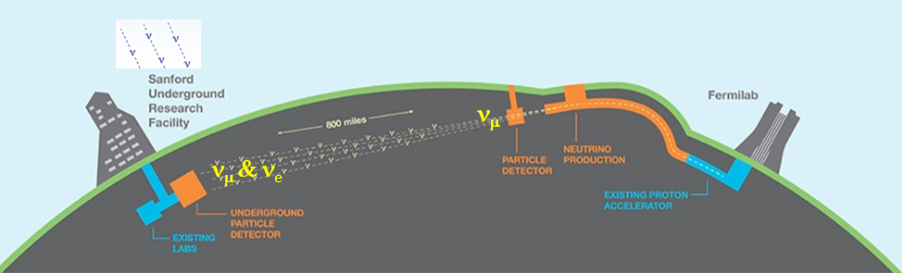
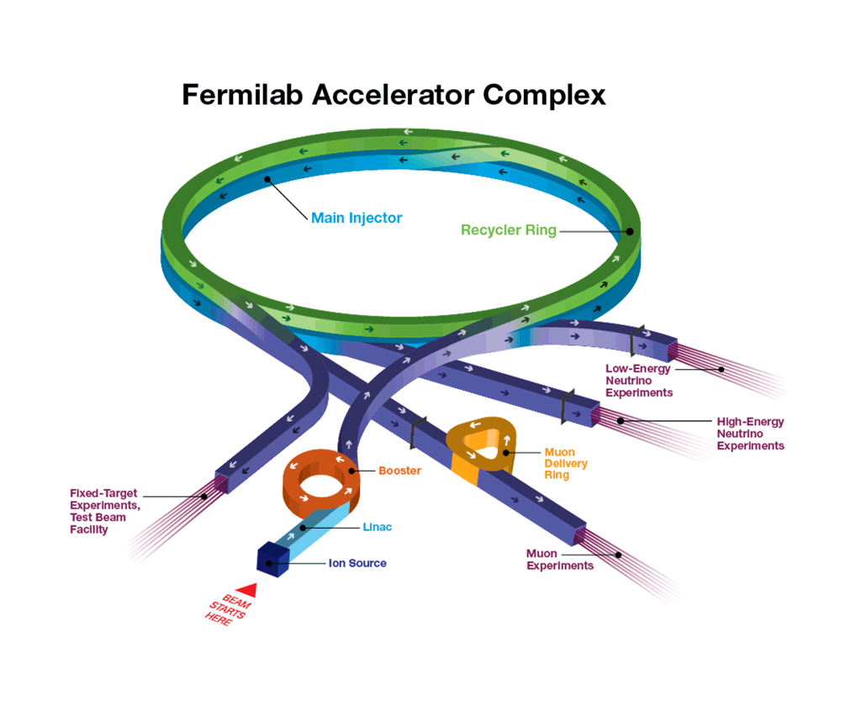
Fermilab Accelerator Complex
LBNF proton beam extracted from MI-10 straight section
800 MeV
SBN
20 Hz
MINOS, NOvA
400 MeV
701 kW on the NuMI/NOvA target in one supercycle on June 13, 2016!!
Proton Improvement Plan (PIP)
PIP-II ~ 2025
After Nov. 2016 expect to run at ~ 700 kW on a continuous basis
  1.2 MW @ 120 GeV
  100+ kW @ 800 MeV

Slide 6
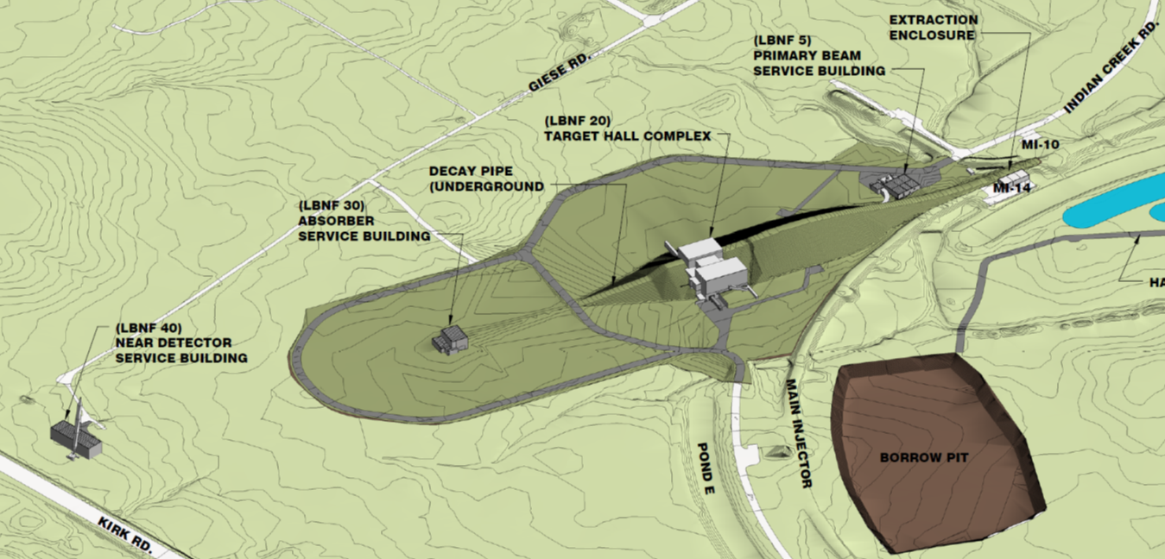
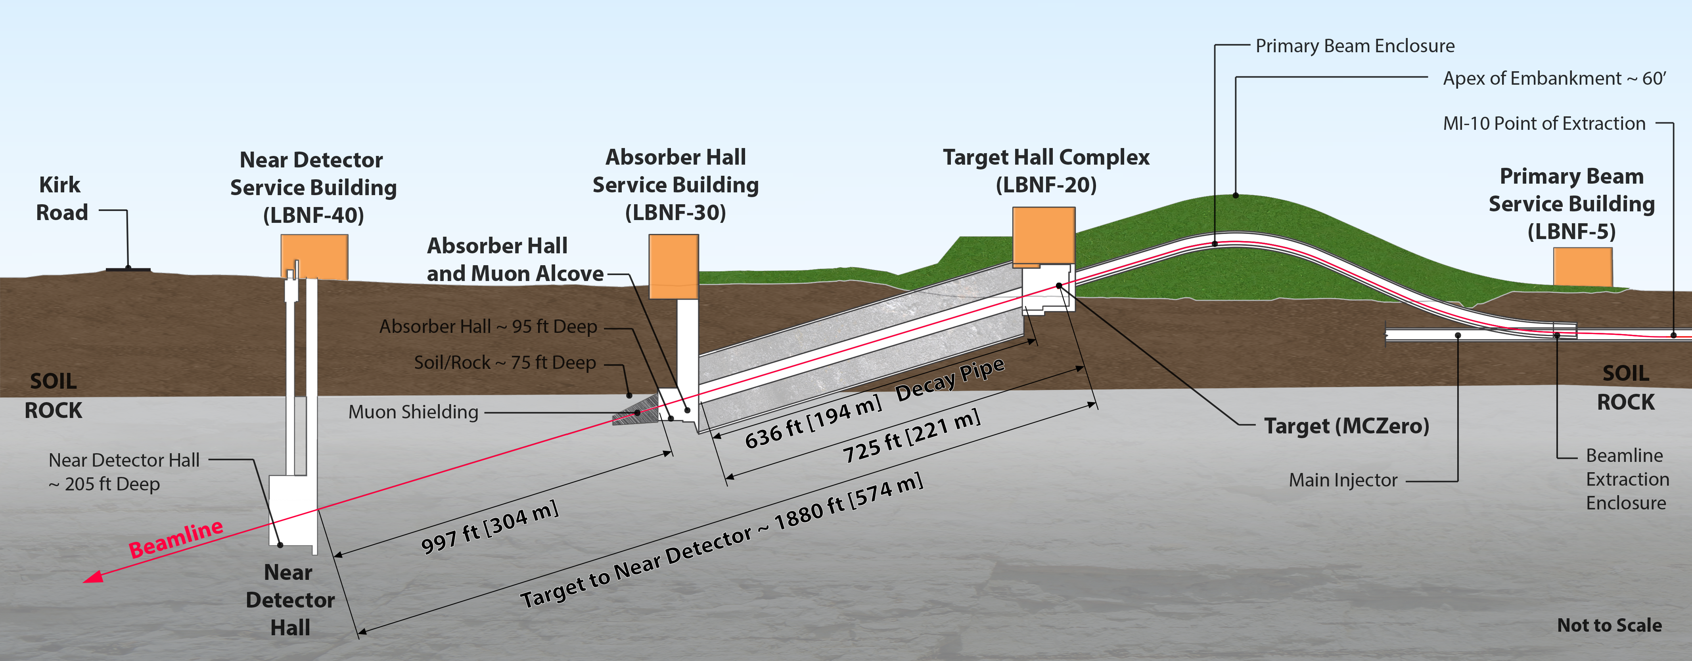
LBNF Beamline
~ 21,000 m²
To SURF
Designed to run at 1.2 MW beam power (PIP-II) and upgradable to 2.4 MW
60-120 GeV proton beam
Constructed in Open Cut
Tunneled excavation

Slide 7
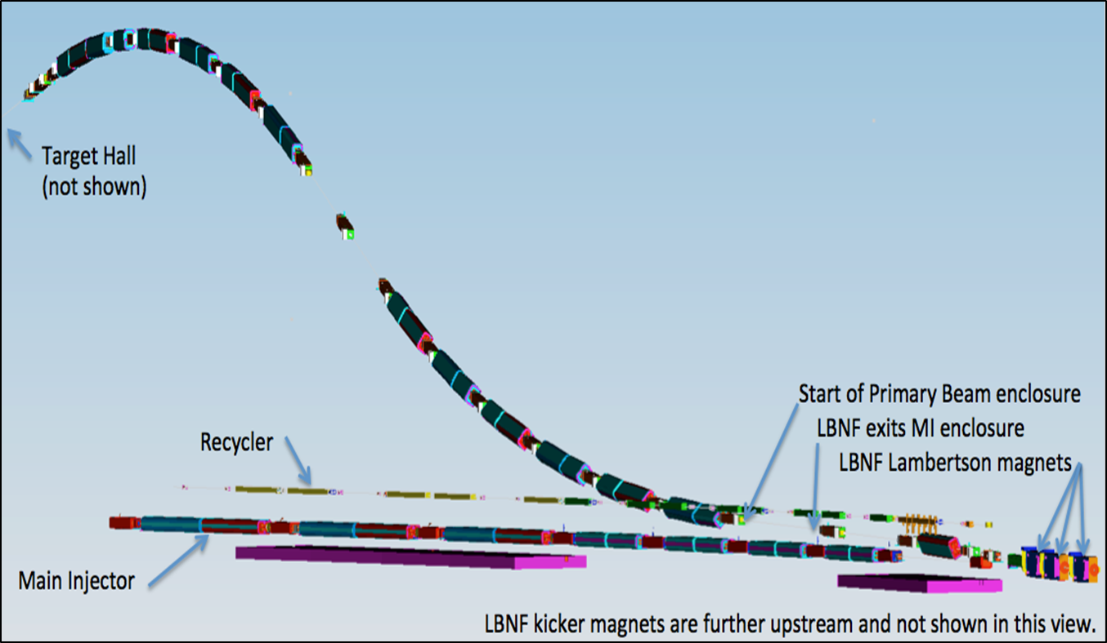
Primary Beamline
Primary beam designed to transport high intensity protons in the energy range of 60 -120 GeV to the LBNF target, with repetition rate of 0.7-1.2 sec, and 10 μs pulse duration
The beam lattice points to:
25 dipoles
21 quadrupoles
23 correctors
6 kickers
3 Lambertsons
1 C magnet
Protons/cycle:
1.2 MW era: 7.5x10¹³
2.4 MW era: (1.5-2.0)x10¹⁴
Embankment
In the process of prototyping corrector and kicker magnets
Beam size at target tunable between 1.0-4.0 mm
MI-10

Slide 8
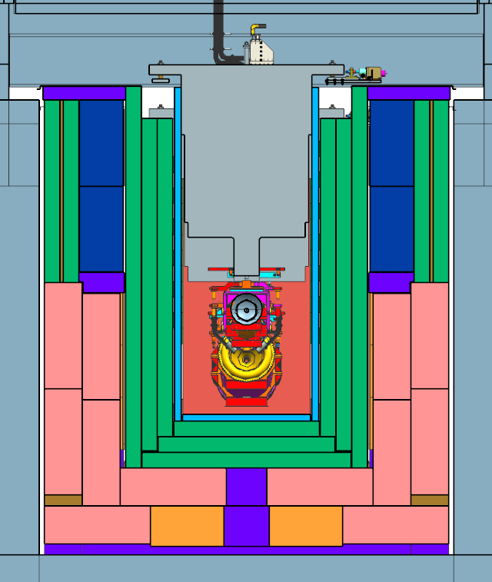
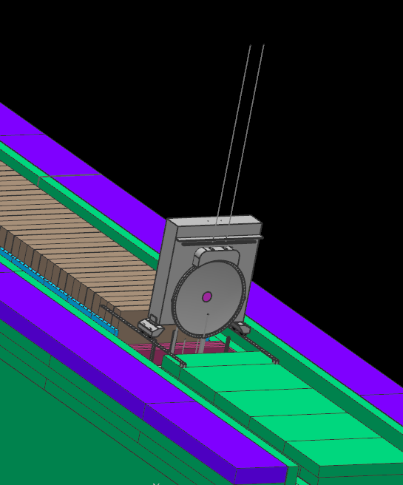
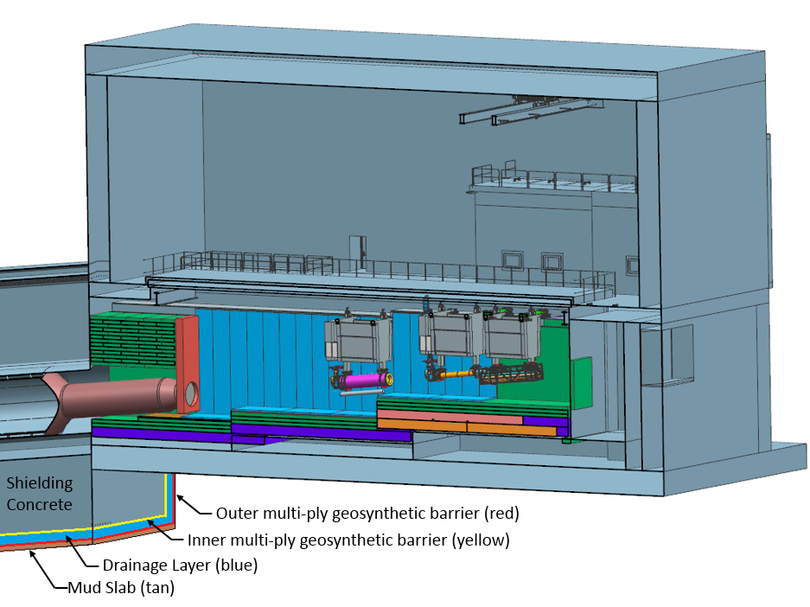
Target Hall and Decay Pipe Layout
~ 40% of beam power in target shield pile
~ 30% of beam power in decay pipe
50 TON CRANE
DECAY PIPE
UPSTREAM
WINDOW
Support modules
WORK CELL
Water cooling panels
DECAY
PIPE
SNOUT
Air
Beam
He
Downward bend of 5.8⁰
Decay Pipe: 194 m long, 4 m in diameter, double – wall carbon steel, helium filled, air-cooled.
5.6 m
Main alternatives for Chase gas atmosphere: N₂ or He
Target Chase: 2.2 m/2.0 m wide, 34.3 m long air-filled and air & water-cooled (cooling panels). Sufficiently big to fit in alternative target/horns.
10/05/2016

Slide 9
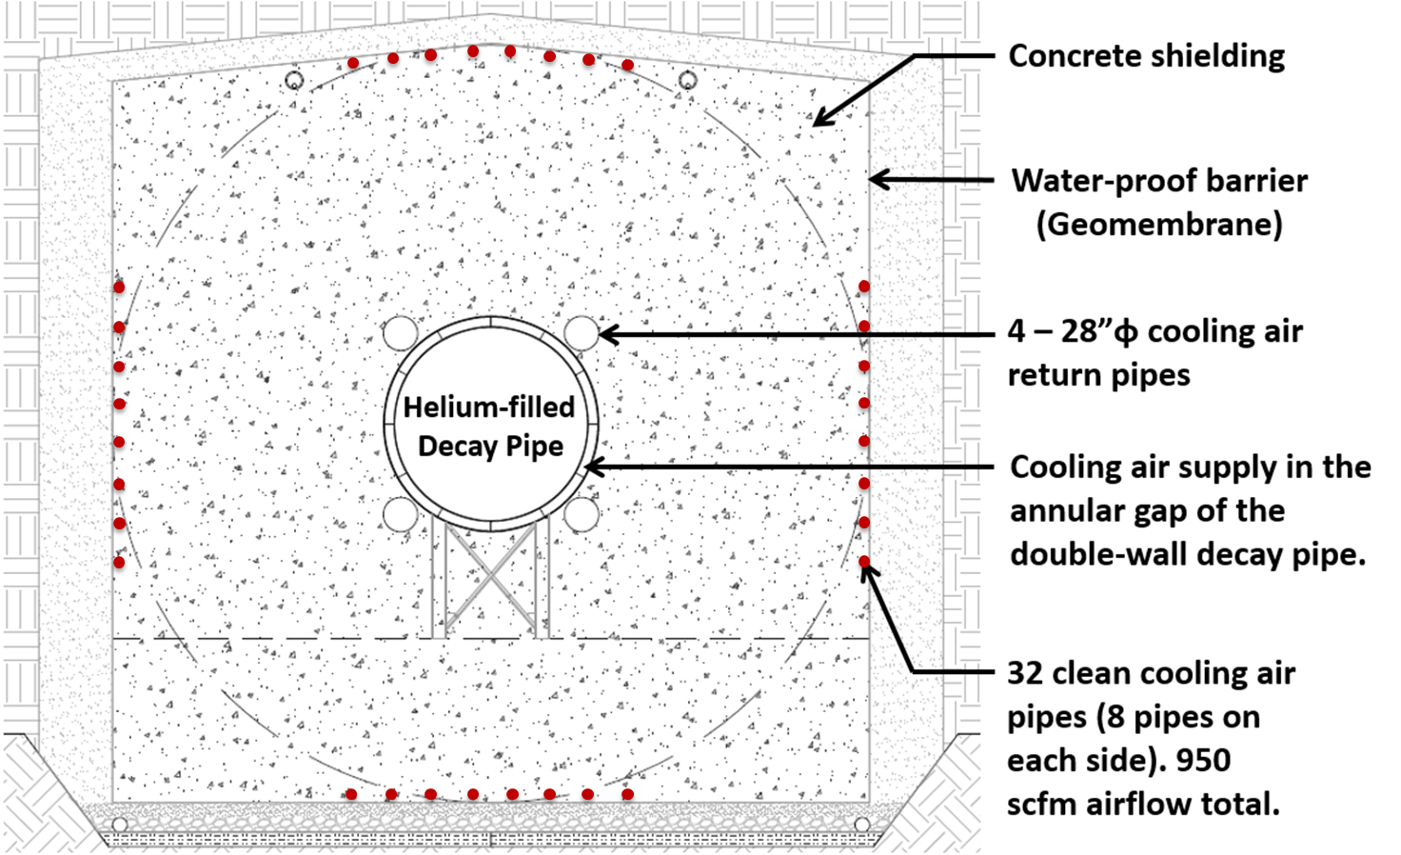
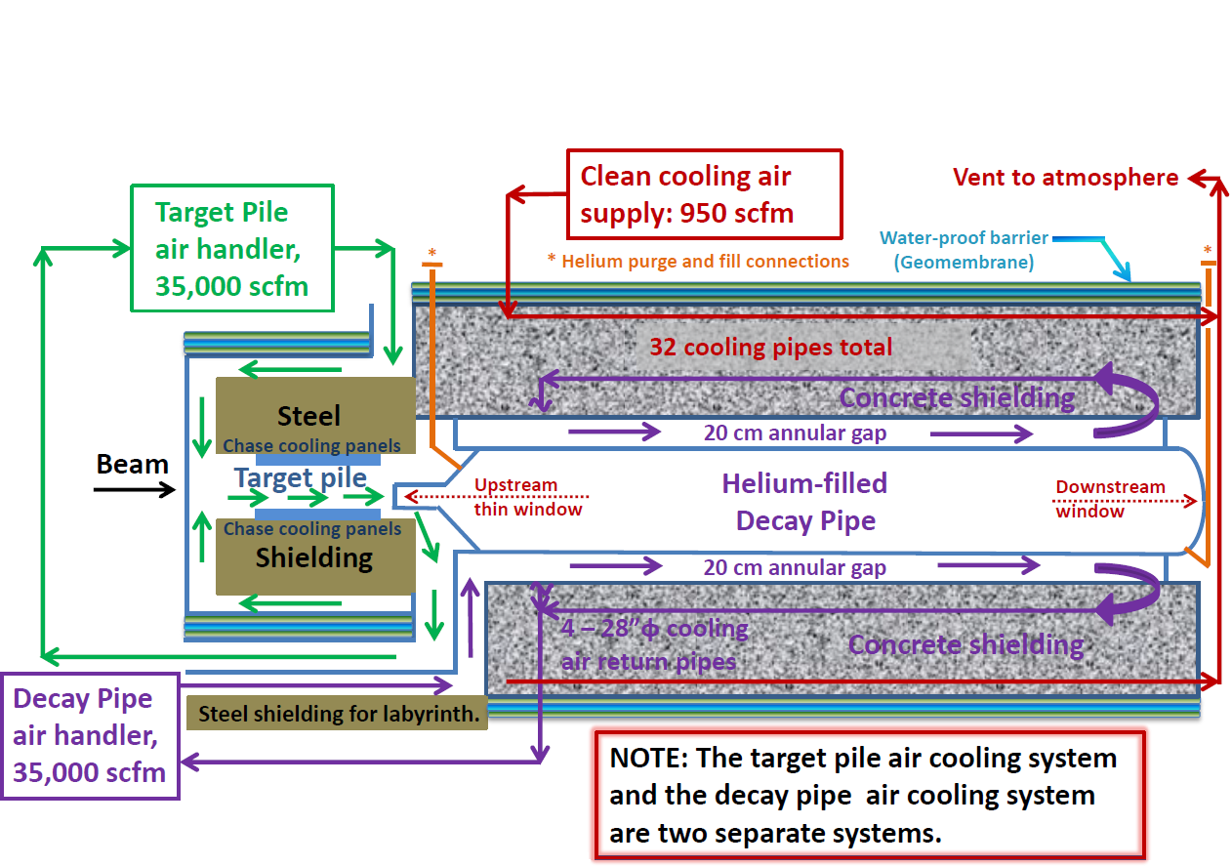
Decay Pipe Layout
Porous cellular
concrete drainage
layer
194 m long, 4 m inside diameter
Helium filled
Double-wall, carbon steel decay pipe, with 20 cm annular gap
5.6 m thick concrete shielding
It collects ~30% of the beam power, removed by an air cooling system

Slide 10
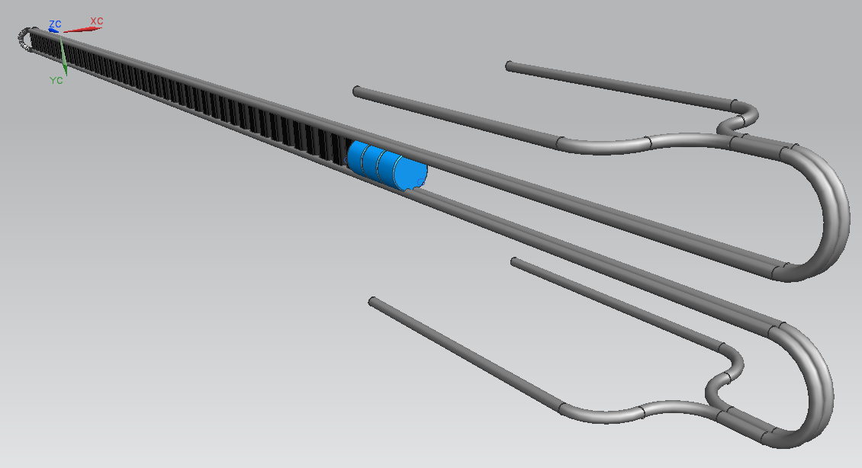
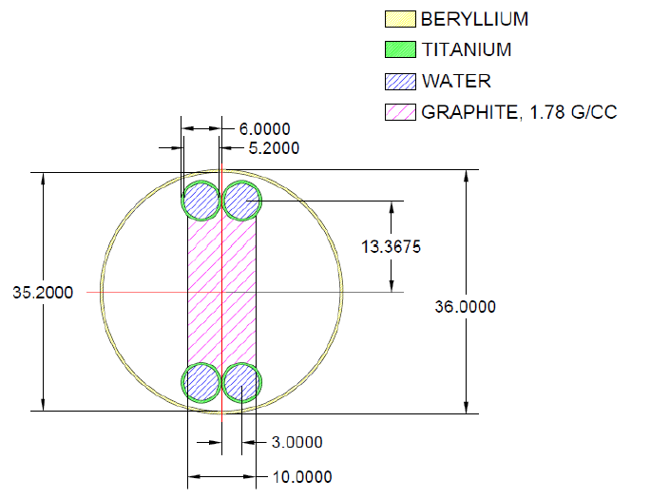
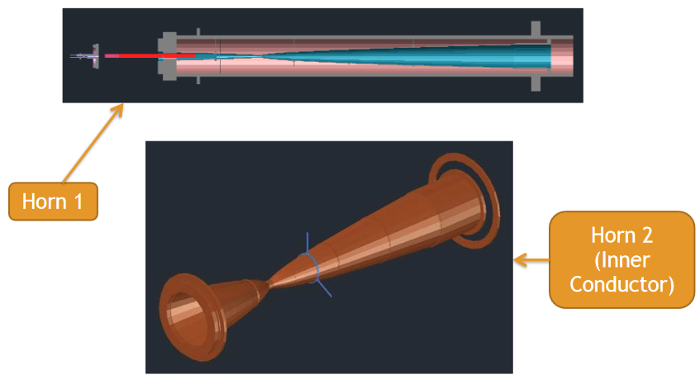
1.2 MW reference design target and horns
47 graphite target segments, each 2 cm long
NuMI-like (low energy) with modest modifications target and (two) horns
0.2 mm spacing in between
Two interaction lengths, 95 cm
First few fins have “wings”, 26 mm disks
Target cross section
Operated at 230 kA for LBNF
mm
New Horn power supply needed - reduced pulse width of 0.8 ms.

Slide 11
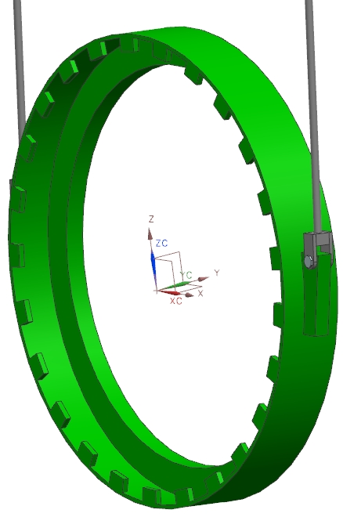
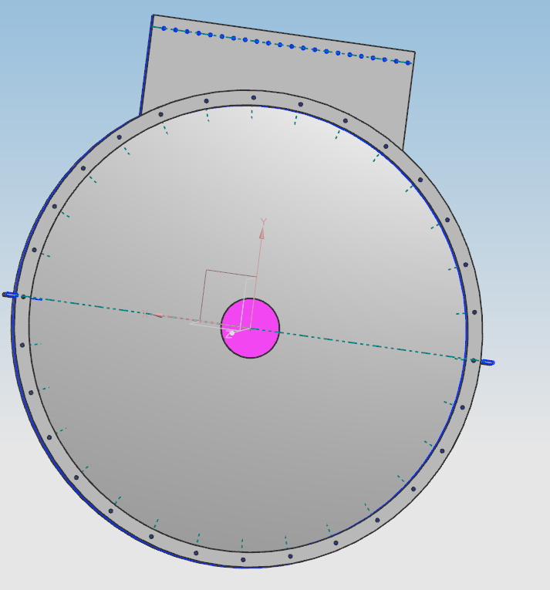
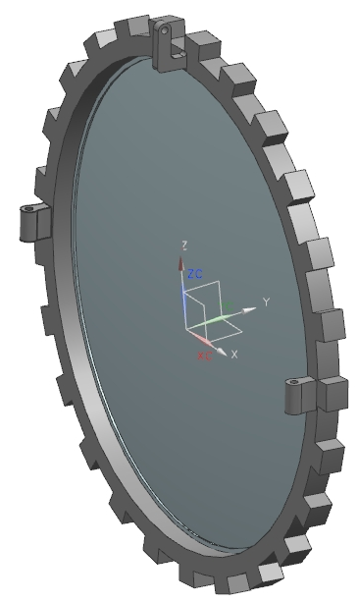
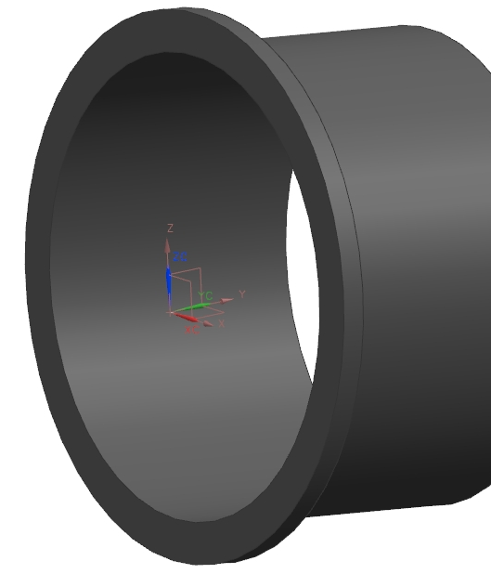
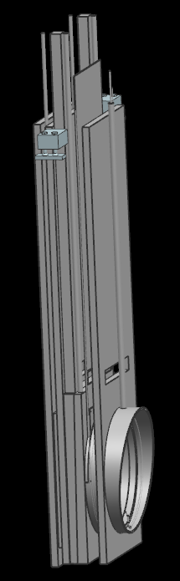
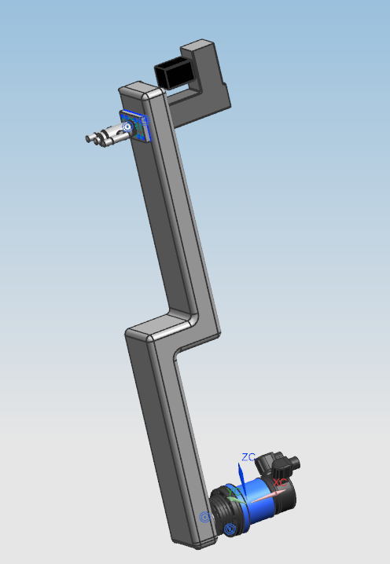
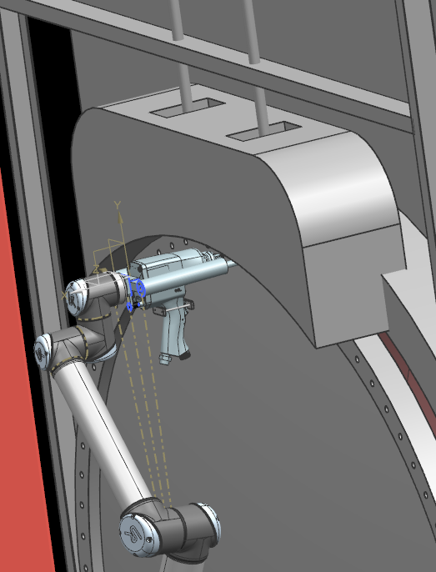
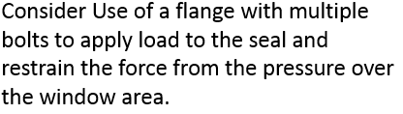
Upsteam Beam Window Concepts
Autoclave with rotating ring
Bolted Flange Connection
Pressured slabs
Remotely operated Hydraulic Wrench

Slide 12
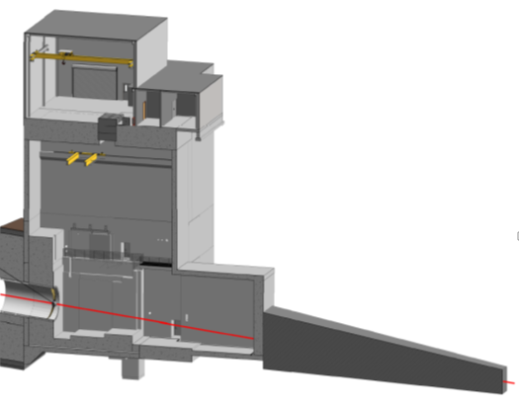
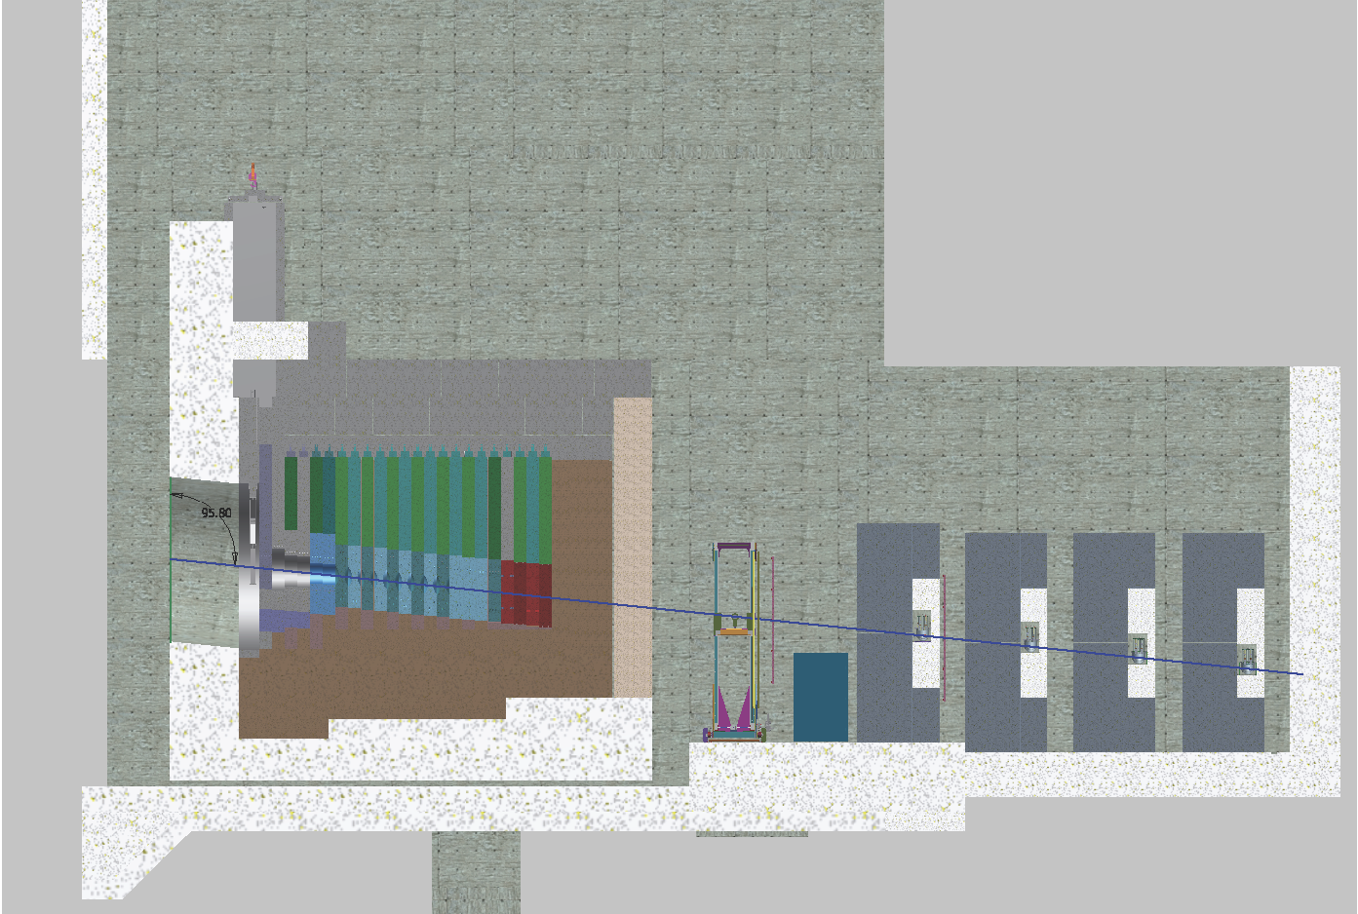
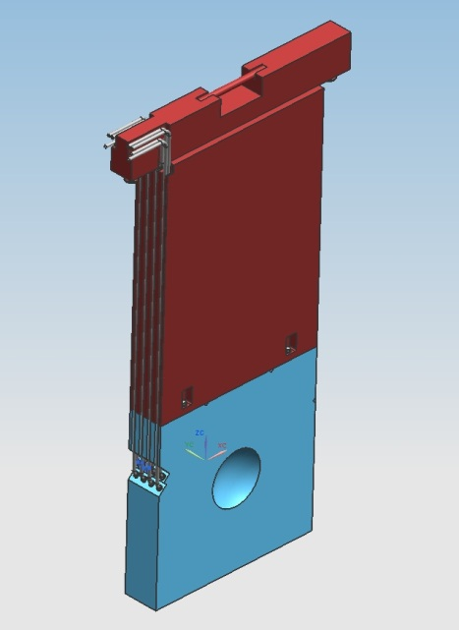
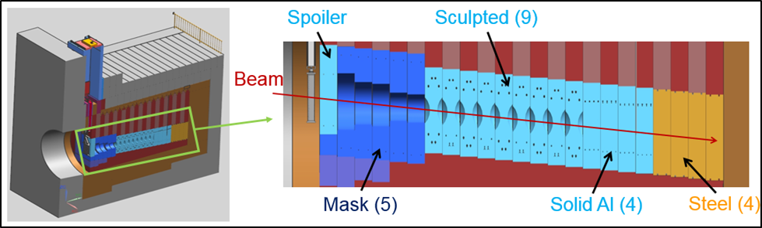
Hadron Absorber
The Absorber is designed for 2.4 MW
~ 30% of beam power in Absorber: 515 kW in central core 225 kW in steel shielding
Absorber Hall and Service Building
Absorber Cooling
Core: water-cooled
Shielding: forced air-cooled
Gas Cherenkov
Stopped μ counters
Ionization detectors
Steel shielding
Muon Alcove
Core blocks replaceable (each 1 ft thick)
Muon Shielding (steel)
Beam
Beam
Hadron Absorber
Sculpted Al (9)
Flexible, modular design
Hadron Monitor

Slide 13
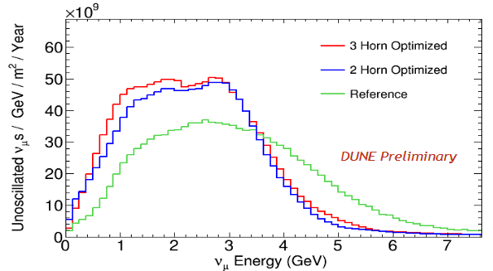
Optimizing target and horns
  Optimizing target and horns for better physics.
  Optimizing on the basis of sensitivity to CP violation.
  Encouragement by the CD-1 Refresh Review Committee to continue along these lines.
  The optimization leads to significantly more flux, a flatter spectrum in the energy range of interest and reduced high energy tail.

Slide 14
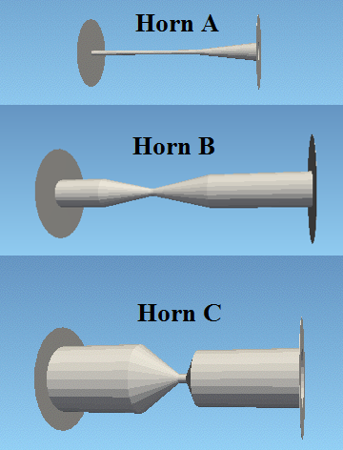
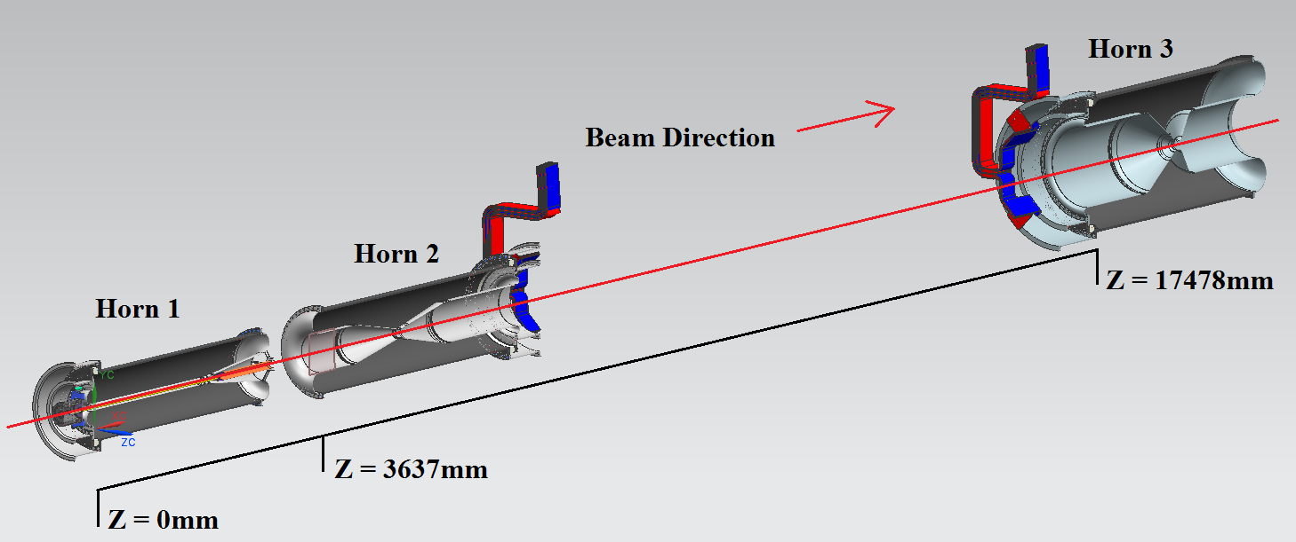
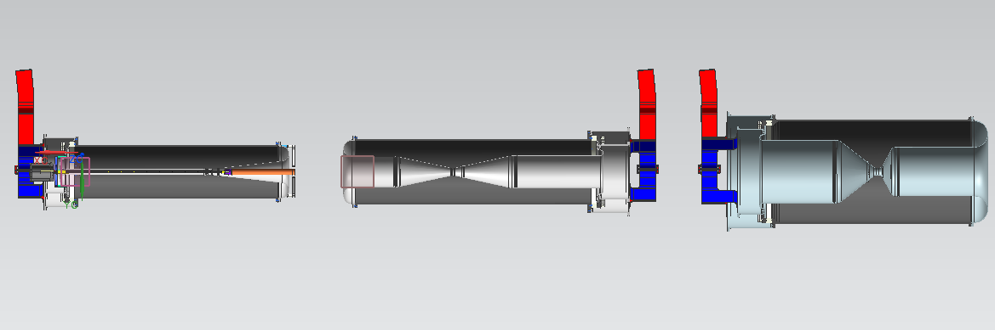
Mechanical model for optimized horns – 1st iteration
Optimizing target and horns for better physics
2.8 m long
35 mm neck radius
C
L. Fields
3.2 m long
191 mm neck radius
B
A
2.8 m long
398 mm neck radius
Operated at 300 kA for LBNF
horn striplines
Horns constructed from 6061-T6 aluminum forgings. Minimum fatigue life requirements of 100 million pulses in the proton energy range from 60 – 120 GeV.

Slide 15
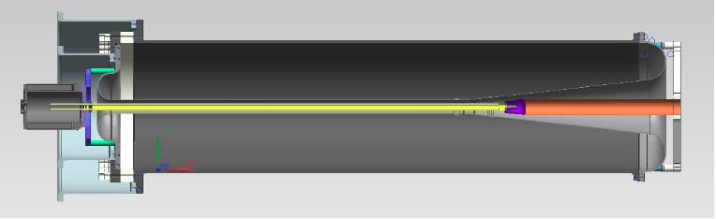
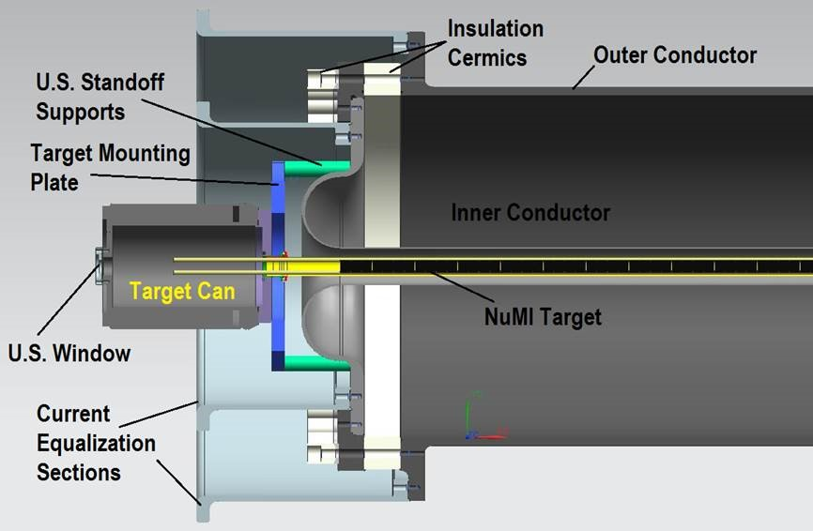
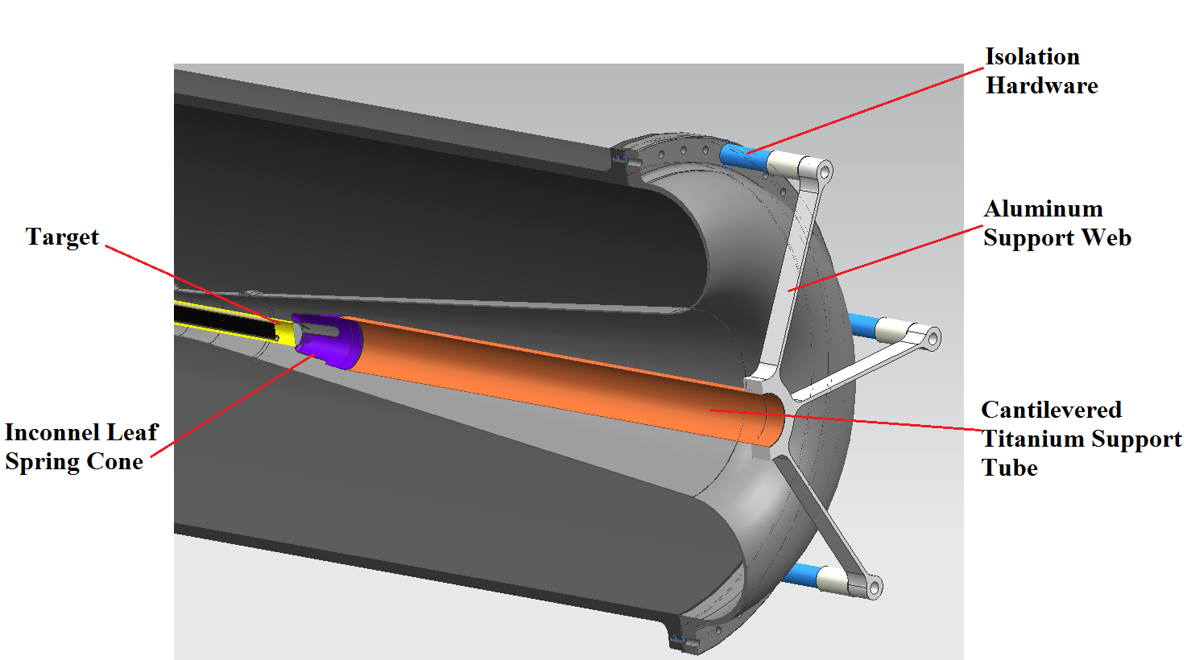
Mechanical model for optimized horn A and target integration – 1st iteration
Target – horn integration
2m long (4 interaction lengths) NuMI style target for first iteration of MARS simulations; cylindrical and spherical targets under R&D as well.

Slide 16
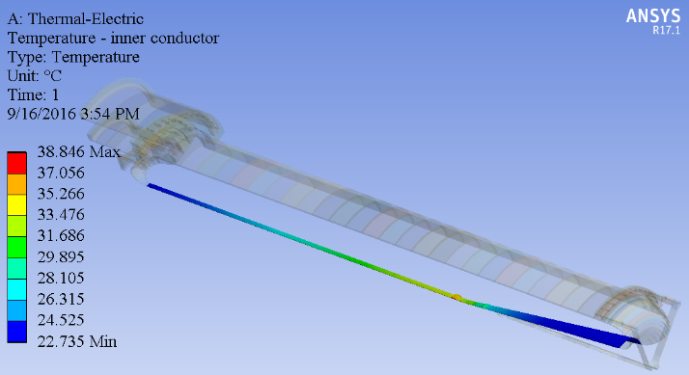
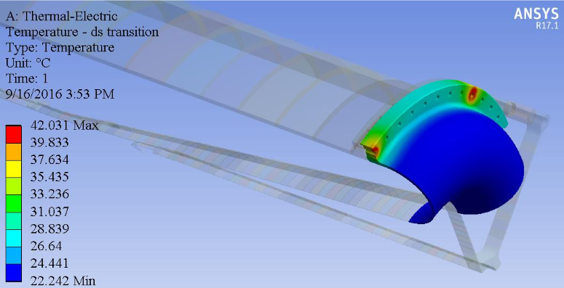
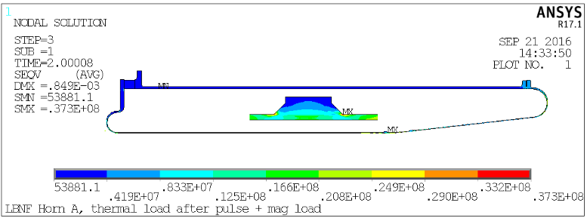
Finite Element Analysis for Horn A
Maximum current: 300 kA
Current pulse width: 0.8 ms
First iteration thermal/stress FEA for optimized horn A.
Preliminary FEA for Horn A shows:
Acceptable inner and outer conductor temperatures and stresses.
Support of target at DS end too hot (> 1,000⁰C); needs redesign.
Tentative design philosophy is to extend target containment tube till end of Horn A and support through helium-cooled titanium tubes.
Horn A
Temperature of inner conductor
Stress after beam pulse with both thermal and magnetic load
Pa
Notes:
ma to mA in 2nd capability bullet

Slide 17
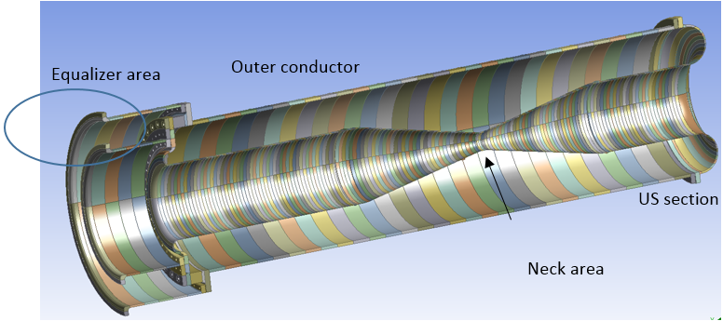
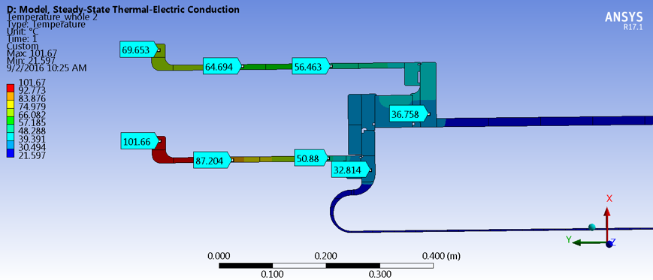
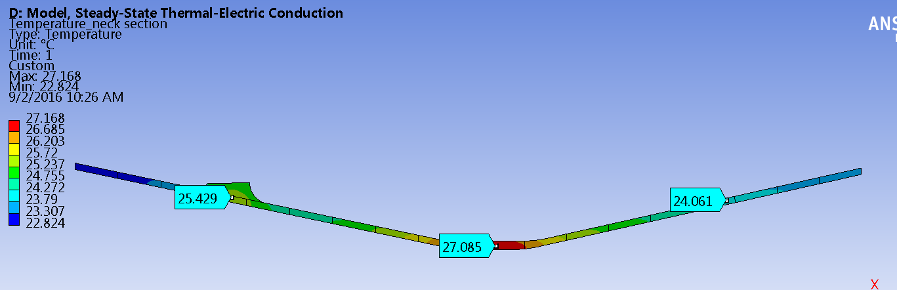
Finite Element Analysis for Horn B
Maximum current: 300 kA
Current pulse width: 0.8 ms
Preliminary FEA for Horn B shows:
Acceptable conductor temps
Inner conductor neck wall can be thinned out (from 4 mm to 3 mm)
Hot equalization sections. Must be modified. We know how to address.
Temperature around equalizer area
Temperature around neck area

Slide 18
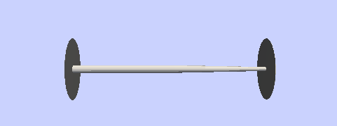
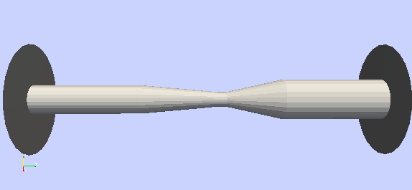
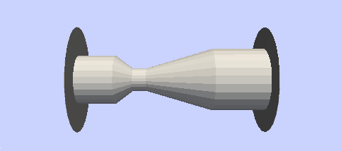
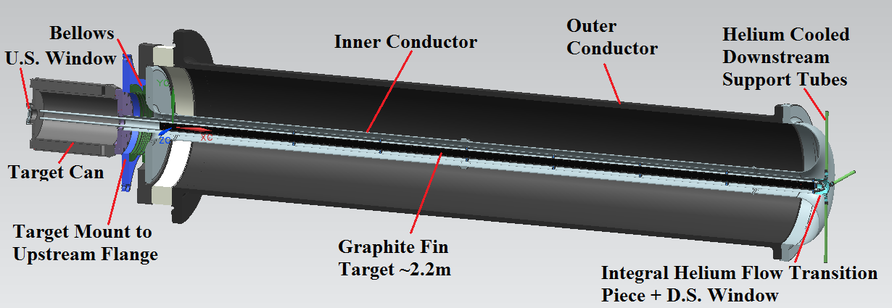
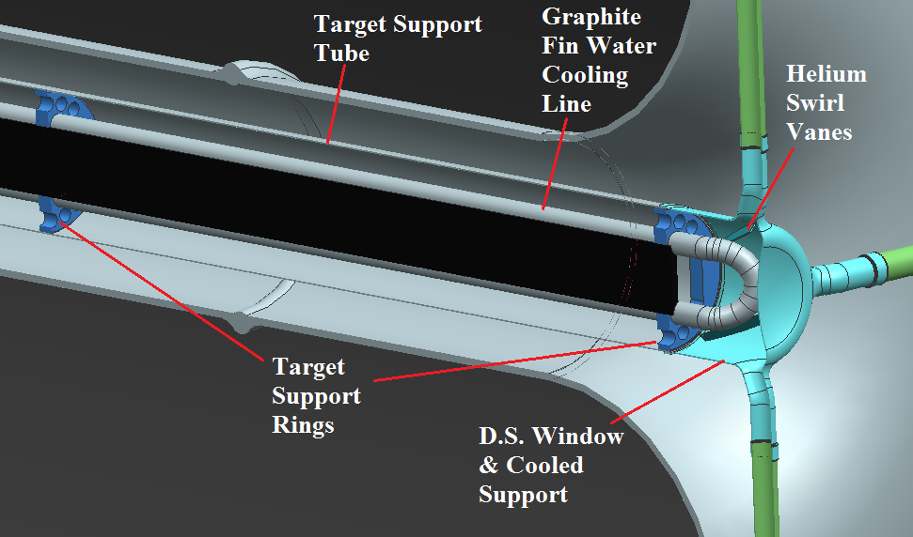
Cylindrical Horn A / integrated target
Shorter cylindrical horn A (2.2m), longer (3.9 m) horn B
Shorter, cylindrical horn A easier to build; easier to support and cool target that way
Target fins cooled by two water tubes; horn inner conductor cooled by water spray and air flow
Helium exhaust tubes act as support for D.S. end of target
Horn A and target to be exchanged as one unit

Slide 19
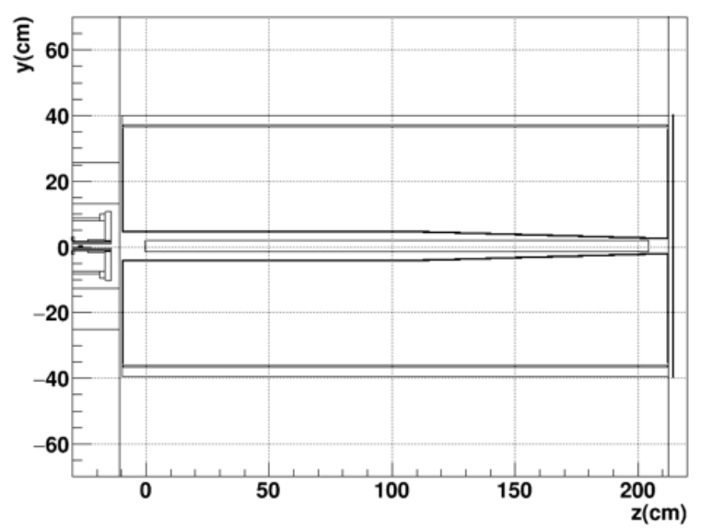
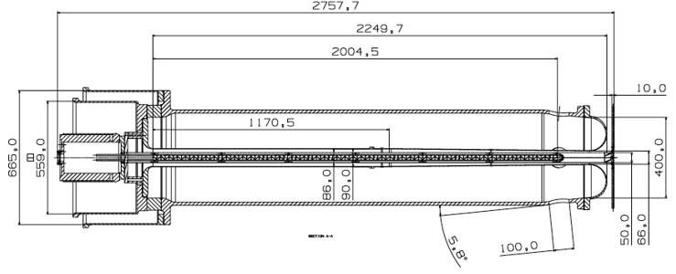
Tapered Horn A
On September 22, 2016 we decided to move forward with a “tapered” Horn A because it provided improved neutrino flux and CP sensitivity.
Mechanical Design layout of Horn A
Optimized Horn A
mm
20 mm tapered DS radius
Going lower than 33 mm will require thickening of inner conductor
Working on mechanical designs of horns B and C and on implementing all horns in 2nd MARS iteration
FEA will follow
NuMI-style target, 2 m long for now
Collaboration with RAL on target conceptual design and mounting to horn
A mounting design that allows for a separately replaceable target is desirable

Slide 20
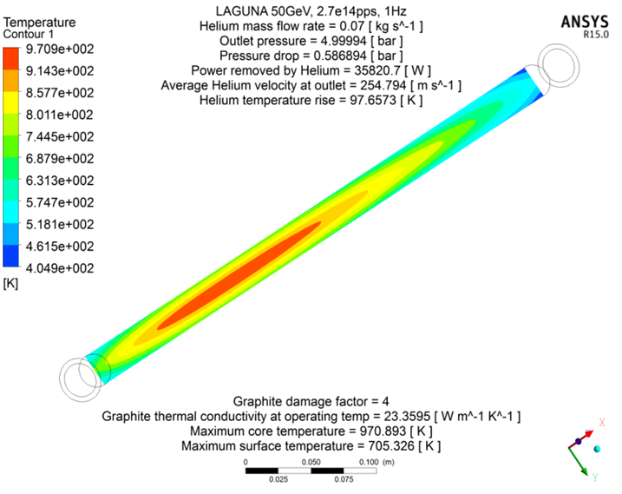
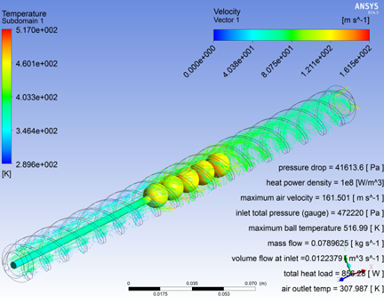
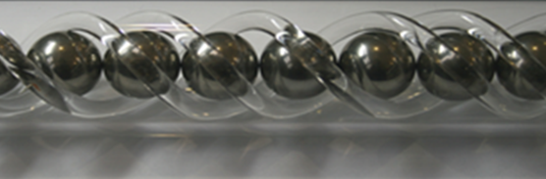
Target developments
Can we build a target lasting over a year?
Helium-cooled graphite rod
Helium-cooled spherical array target Be or graphite
36 kW in target at 2 MW
mean temperature ~700°C

Slide 21

Optimizing target and horns
  Optimizing target and horns for better physics.
  Optimizing on the basis of sensitivity to CP violation.

Slide 22

Tau appearance optimization
  Studies indicate that more than 700 events per year is possible.
  Using NuMI like target and horns

Slide 23
Impacts on other systems
  Re-assess:
  Horn support modules
  Horn power supply
  Target shielding/cooling
  Decay pipe shielding/cooling
  Decay pipe upstream window and snout
  Remote handling (casks, morgue capacity analysis, work-cell,..)
  Hadron absorber
  Muon shielding in the end of the hadron absorber
  Conventional Facilities
I
Notes:
ma to mA in 2nd capability bullet

Slide 24



Horn Support Modules preliminary FEA
Life-of-facility components, adjustable and serviceable by remote control
Modules analyzed at beam energies 60-120 GeV
Max temperature found was ~ 84⁰C for Horn A which is well within limits for mainframe
I
Notes:
ma to mA in 2nd capability bullet

Slide 25
Gas in the target chase
  Issues to be further understood with the reference design that has air in the target chase:
    Repeating air-releases calculations with bigger chase, shorter decay pipe (Preliminary results just became available from three independent analyses)
    Corrosion (work in progress; on the basis of NuMI measurements, 20-60 ppm of Ozone expected in LBNF at 2.4 MW operation with only minimal amounts of nitric acid generation.
  Developing alternative design with Nitrogen in the target chase (CDR follow-up)
I
Notes:
ma to mA in 2nd capability bullet

Slide 26


Air in the target chase – Activated Air emissions
LBNF goal < 30 μrem
(100 μrem Lab budget)
Ar⁴¹ in test sample at NuMI is a factor of a few lower than calculations but too close to the limit
Maximally Exposed
Offsite Individual
I
If we use inert gas in target chase do we still need NuMI for cooldown?
Notes:
ma to mA in 2nd capability bullet

Slide 27
Nitrogen in the target chase
  Requires robust leak-tight seals at all openings and feedthroughs, plus leak tight seal at decay pipe & and window interfaces.
  Need minimal leak rate ~6 cfm or about 2 orders magnitude less than that for air – due to ODH and nitrogen cost considerations.
  Requires containment vessel (not accessible for repair) within concrete tub that might affect thermal stability of the concrete which is currently directly cooled with air flow (alignment considerations).
  Hatch covers need to be removable including the supporting cross-members (modular design) since we don’t know the exact position, dimensions, etc. of all components and need to accommodate different component. configurations in future. Sealing at the seams and cross-beam interfaces is especially challenging.
  Requires a nitrogen fill and monitoring system plus ODH considerations.
  System will need to operate at positive pressure to prevent air/oxygen coming in and accommodate barometric pressure changes due to weather.
Notes:
ma to mA in 2nd capability bullet

Slide 28

Inert gas in the target chase – Do we need to cool the concrete?
The concrete walls support the chase components (target and horns) and therefore need to see a minimal thermal variation (∆T ≤ 4°C) in order to maintain component alignment.
The interior of the concrete walls have a stainless-steel liner (for gas containment) and a small air gap is assumed between the liner and concrete wall. The surfaces of the liner are actively cooled by the gas.
By applying a free-convection boundary condition at the outer wall surfaces, an acceptable temperature rise is achieved, with a maximum vertical wall displacement of 4mm (alignment tolerance is ~ 8mm).
Investigating forced air circulation.

Slide 29




Nitrogen in the target chase – Hatch Cover Assembly
10 Hatch Covers (some stacked for target replacement)
Hatch cover removed (~40 tons each)
I
Hatch Cover Seams with supporting cross beams underneath
Notes:
ma to mA in 2nd capability bullet

Slide 30
LBNF/DUNE Milestones
Critical Decision-0 (CD-0) approved, January 8, 2010.
CD-1 Refresh approved, November 5, 2015 (Conceptual Design)
CD-3a approved, September 1, 2016 (far-site pre-excavation and excavation)
Complete Sanford Laboratory reliability projects in FY2018
CD-2 for the entire project expected in December 2019 (baselining)
Complete first cryostat and cryo systems construction to enable detector installation to begin in 2021
Commission first 10 kTon far detector in 2024
Add a second 10 kTon far detector and the near detector by 2026
Produce neutrino beam in 2026

Slide 31
Conclusion
Reference conceptual design for the LBNF Beamline already available and approved by DOE.
Considerable effort and satisfactory progress on beam optimization and design improvement areas.
Need to take decisions on alternative/optimized options by October 2017 so that we can start the next phase of the design with the new fiscal year.

Slide 32
Backup

Slide 33



Beamline Requirements and LBNF/DUNE neutrino beam spectra
Normal mass hierarchy
CP effects
1st & 2nd max
Mass hierarchy
1st max
3 horns
2.4 GeV
0.8 GeV
Need a wide band beam to cover the
1st and 2nd oscillation maxima
3.5 yr ν_{μ} + 3.5 yr‾ν_{μ}
40 kt detector,
PIP-II beam power(1.03-1.2 MW)

Slide 34



Facility and Experiment
  LBNF:
    Near site: Fermilab, Batavia, IL – facilities and infrastructure to:
      create a broad band, sign selected neutrino beam
      host the near DUNE detector
    Far site: Sanford Underground Research Facility, Lead, SD – facilities to support the far DUNE detectors (4850 L)
  DUNE:
    Near site detector and Far site detectors
ν_{μ}
ν_{μ} & ν_{e}
FD
ND
10/05/2016

Slide 35





Corrector Magnet prototyping progress – IHEP/China
Corrector 3-D Model
Winding Former
Stacking Fixture
Potting Mold
Fermilab design, double-checked by IHEP colleagues. Large aperture, air-cooled, relatively high field, large good field region, sufficiently flexible design.
IHEP finished with final drawings and technical files of tooling needed and began fabrication of tooling early October, 2016 (punching die, stacking fixture, winding former and potting mold).
Fittings of coil and room temperature cure epoxy from Fermilab.
Prototype complete – February 2017.
SOW in review stage, covering additional 24 production corrector magnets.

Slide 36


Near Detector Hall and Detector
Near Neutrino Detector Hall and LBNF 40 Service Building
Three types of Near Detector considered:
Fine-Grained Tracker (reference)
High-Pressure Gaseous Argon TPC
Lar-TPC
Straw Tube Tracker
~205 ft deep
09.20.16

