Slide 1
Review of LBNF Hadron Monitor Design Options
Katsuya Yonehara
US-Japan Workshop on Accelerators and Beam Equipment for High-Intensity Neutrino Beams
11/09/2016

Slide 2
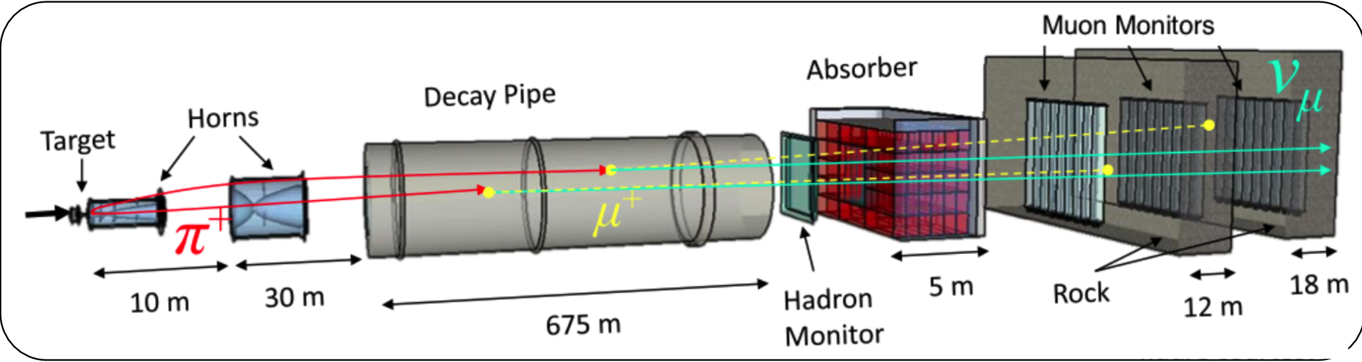
Beam Profile Monitor in Neutrino Beam Line
NuMI Front end
Beam profile monitor in a front end of a neutrino beam
  Combination of hadron and muon monitors
  Monitor beam centroid
Hadron monitor is exposed to severe radiation
  It locates at the end of a decay pipe without shielding
  Radiation hardness is a potential issue for multi-MW beam
  Unexplored beam power!! What kind of device can survive?

Slide 3
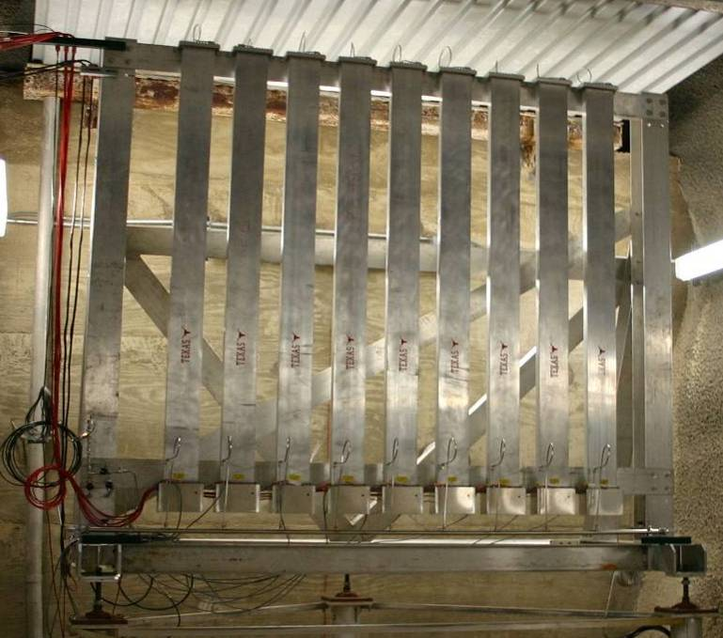
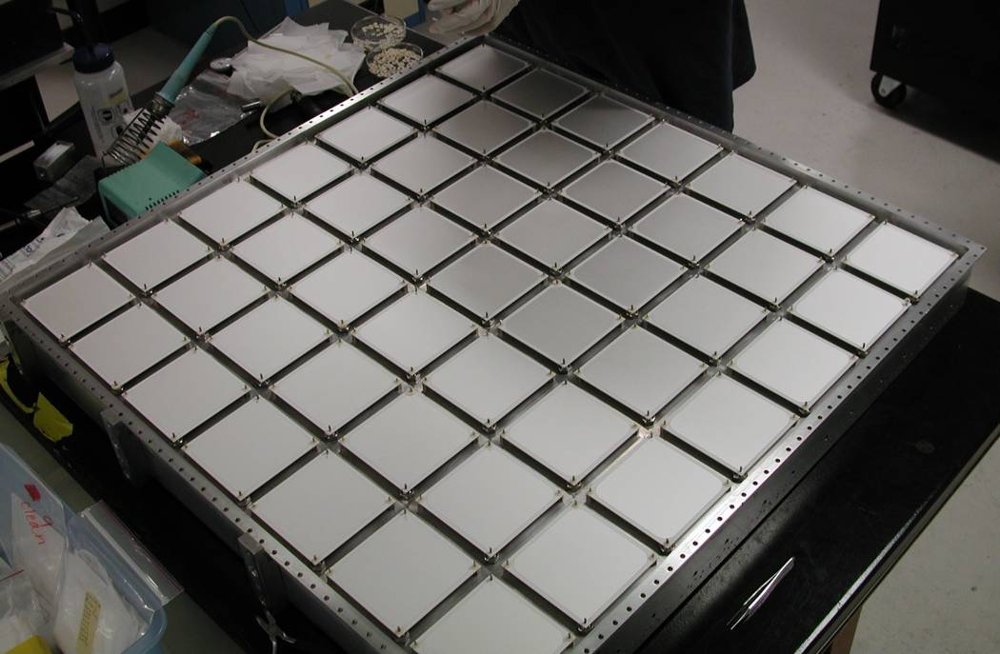
Current System Design [1] lots of ion chambers
Hadron Monitor
  7x7 grid → 1x1 m²
    1 mm gap chambers
  Radiation Hard design
    ~ 10 Grad exposure
  Mass minimized for residual activation
    57 Rem/hr
Muon Monitors
  9 tubes of 9 chambers each → 2.2x2.2 m²
    3 mm gap chambers
  Tube design allows repair
High Voltage (100-500 V) applied over He gas
  Signal acquired with charge-integrating amplifiers

Slide 4
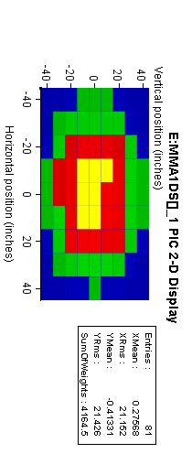
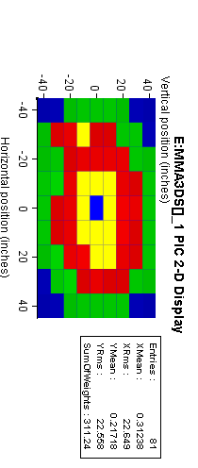
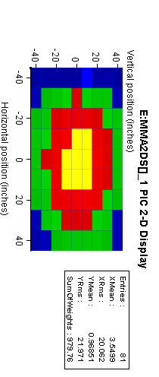
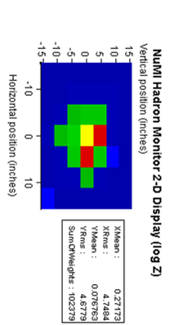
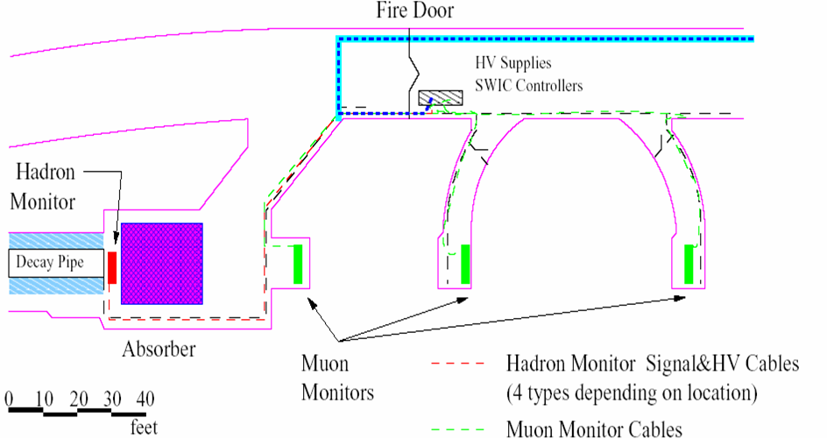
Target out -Horns off
Target in - Horns on
Hadron Monitor
Muon Alcove 1
Muon Alcove 2
Muon Alcove 3
Vertical Position (inches)
Vertical Position (inches)
Vertical Position (inches)
Vertical Position (inches)
μ⁺
p
υ_{μ}
μ⁺
π⁺
μ⁺

Slide 5
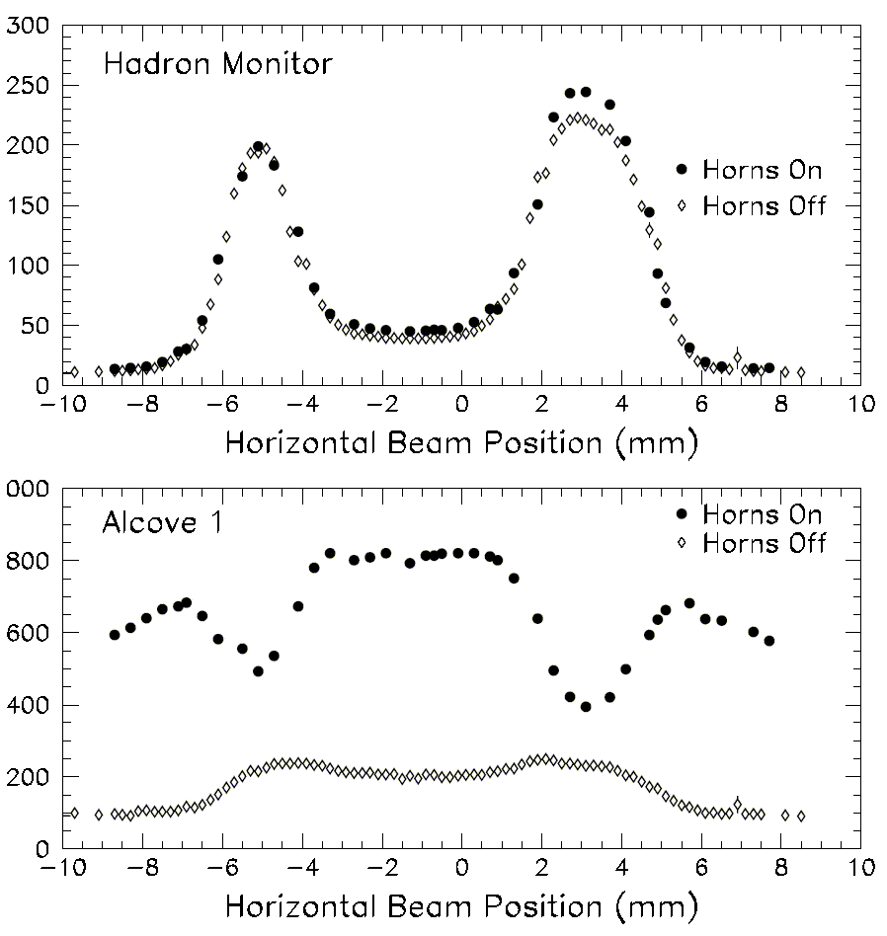
NuMI Target Alignment
Proton beam scanned horizontally across target and protection baffle
  Also used to locate horns
Hadron Monitor and the Muon Monitors used to find the edges
Measured small (~1.2 mm) offset of target relative to primary beam instrumentation.
Baffle
Horn
p
Target
π
Graphite protection baffle
baffle
baffle
target
Water cooling line
Horizontal Fin
Pulse Height in Chamber (arb.)
21.4 mm
15.0 mm
11.0 mm
baffle
baffle
target
6.4 mm
Graphite target
Notes:
Harp on implementation

Slide 6
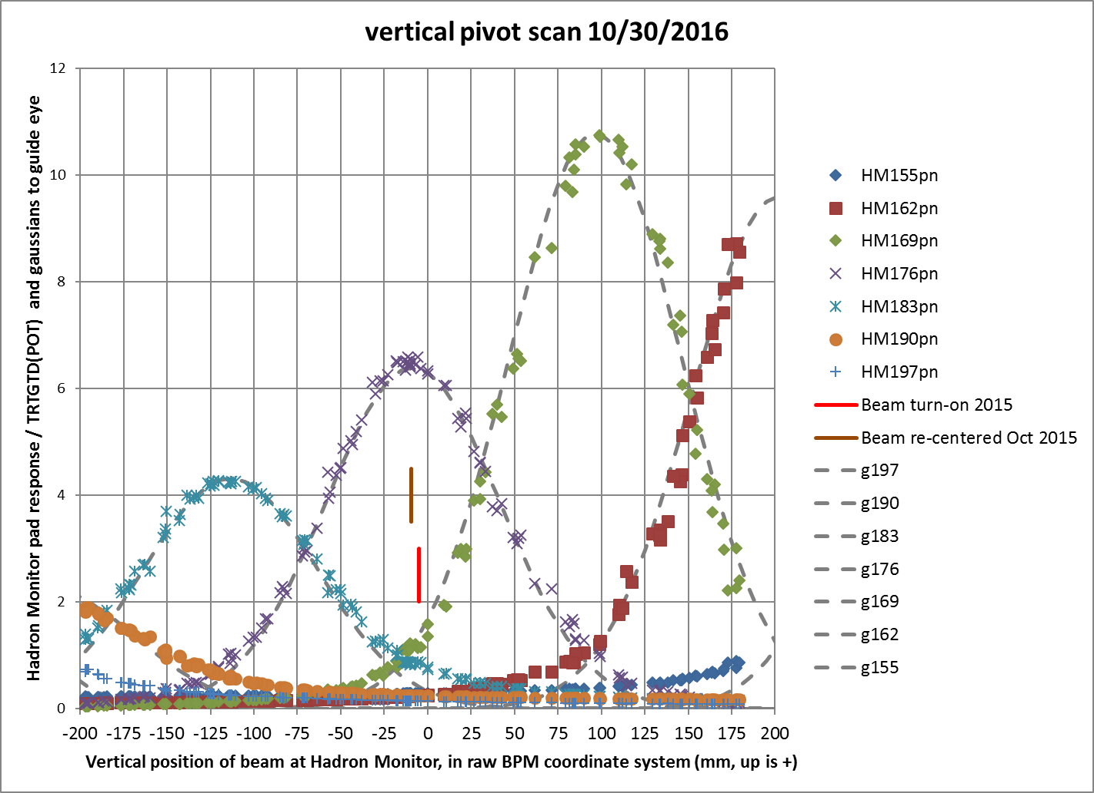
Degrade Beam Sensitivity by Radiation Damage
Sent the same amount of beam for each pixel but the response is not the same

Slide 7
Possible issues on Ion Chamber for LBNF
Courtesy of R. Zwaska, “NuMI Hadron Monitor” [1]
& “Beam Tests of Ionization Chambers for the NuMI Neutrino Beam”
Lifetime
  Degradation of the hadron monitor observed almost from the start for the NuMI application
    Certain number of damaged pixels at start
    Gradual increase in leakage voltage on HV
    Gains become variable
    Lifetime is 2-4 years in recent operations
Linearity of output signal
  Found non-linear response at > 2 10¹¹ protons/5 cm²/1.56 μs
    Space charge effect activates recombination
LBNF/DUNE situation will be a factor of 10-20 worse
  Questions of temperature, robustness, and signal response

Slide 8
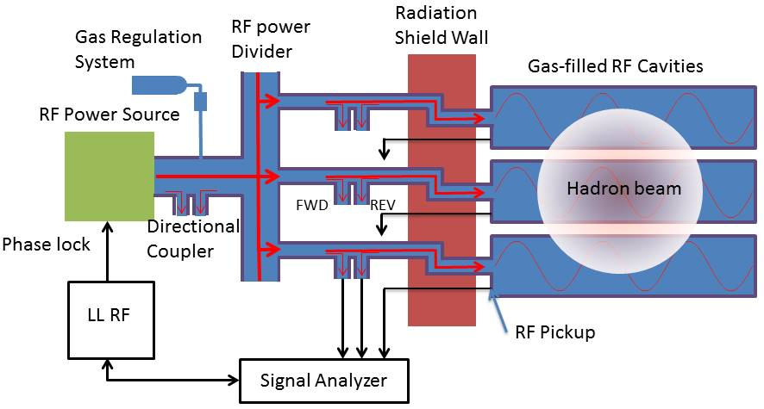
Proposed Radiation Hard RF Gas Monitor
RF cavity/waveguide made of Aluminum
No other material used in beam enclosure
(Optional: Diagnose the cavity)
• Beam induces plasma via interacting
with gas in the cavity
• Plasma changes gas permittivity
• Permittivity change is measured
by observing frequency shift and
Q factor change
DAQ & Analyzer

Slide 9
Concept of RF Gas Monitor
Gas permittivity is measured in a microwave-resonant cavity
  Permittivity change modulates the resonant frequency and the quality factor
Permittivity change is proportional to the number of ion pairs in the RF cavity
  Measure the number of ion pairs to reconstruct the number of incident charged particles in the cavity
Degree of permittivity change is dependent on the species of plasma particles
  Electrons contribute the most for RF modulations because of their light mass
  Control the plasma population in cavities is essential
  The change is also influenced by the RF amplitude and gas pressure

Slide 10
Simulated Secondary Beam Profile in LBNF
Fraction of secondary protons per single proton on target
at the end of a 200-m decay pipe (by using G4Beamline[2])
1-meter-long-C target
RMS size 7.2 cm
Bin size
3 × 3 cm², which is the required pixel size in the
monitor for LBNF
2-meter-long-C target
RMS size 14.4 cm
Primary proton beam for LBNF
• 120 GeV protons; 1.5E14 ppp for 2.4 MW; 20 ns bunch gap
• 10 μsec pulse length; 1.2 s cycle time
• Highest secondary proton intensity 5E10 ppp/cm² in this bin size

Slide 11
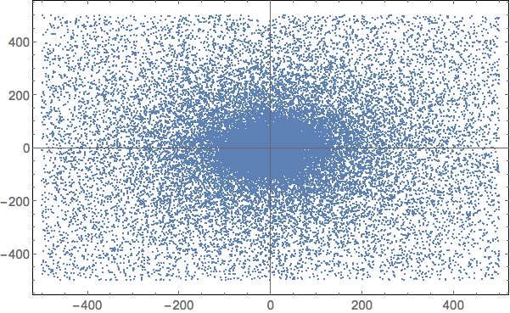
Simulated RF signal with 1 m carbon target
• Raw x-y beam profile at monitor
• Unit is mm
• Signal from gas-filled RF monitor
- RF amplitude E₀ = 0.1 MV/m
- N₂ gas pressure p_{gas} = 1 atm
• Vertical shows the plasma
loading
• RF cavity size 30 mm x 30 mm
• 12 x 12 RF cavity cells

Slide 12
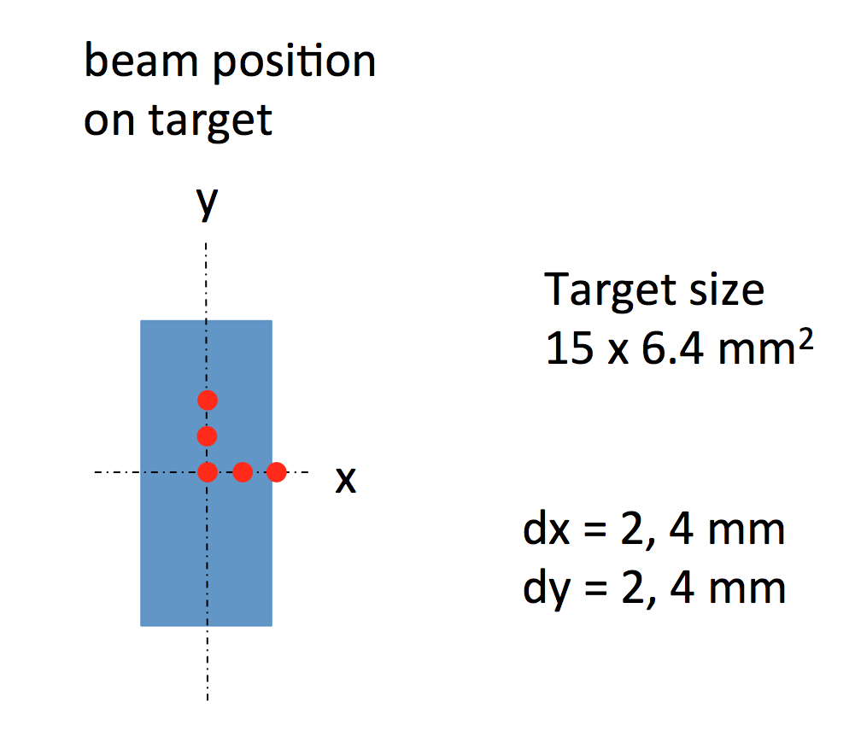
Simulated Beam Alignment with RF gas monitor
Estimated beam center
dy = 1.6 ± 0.5 mm
Estimated beam center
dy = 4.1 ± 1.1 mm
• Add beam position offset
• y-offset is reconstructed
with the absolute error
less than 0.5 mm
• Swept beam position in
x plane that is the same
procedure as for NuMI
beam alignment
• Find transvers profile of
baffle and target
Baffle
Target
Baffle

Slide 13
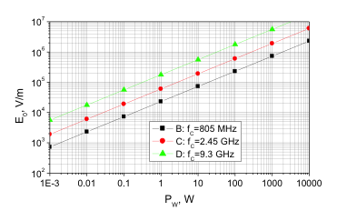
Required RF power for single RF cavity
Required peak power for single RF cavity
0.3 or 3 W for 9.3 or 2.45 GHz @ E₀ = 0.1 MV/m

Slide 14

R&D Test and Goal
Verify the concept of RF gas monitor in experiment
Study plasma dynamics in the range of RF gas monitor
  Demonstrate how to control plasma population, i.e. electron-ion recombination, ion-ion recombination, electron capture, etc
Demonstrate feasibility of the system
Propose beam test
DoE SBIR/STTR funded $1M in FY17 & FY18
Looking for beam test facilities & collaborators

Slide 15
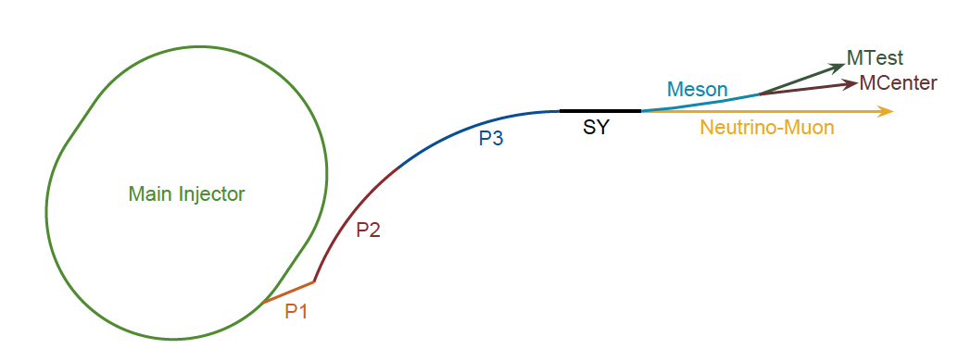
Possible Beam Test Facilities at Fermilab
 | SY dump [4] | M01
Proton energy | 120 GeV | 120 GeV
Beam pulse length | 10 μsec (fast kicker) | 4 sec (slow ext.)
Integrated beam intensity per pulse | 1E13 | 4E12
Availability | Limited | Unlimited
Purpose | Close to NuMI/LBNF beam profile: Verify the concept: Study plasma physics | Pretest the RF test equipment including with gas filled cavities and RF sources

Slide 16
Summary for RF gas monitor
It seems to work for multi-MW beams
Required demonstration
  Verify plasma dynamics
  Demonstrate feasibility of apparatus
Funded for a two-year R&D project
  Preparing beam test
  Looking for collaborators

Slide 17
Other Possible Method
Fluorescence screen
SEM
Interferometer/Faraday Shift
Thermal scan
Acoustic scan
Nuclide transformation rate
R&D required to evaluate
Radiation robustness/Lifetime
Accuracy/Reliability/Time response
Cost/Complication

Slide 18
Citations
[1] R. Zwaska, “NuMI Hadron Monitor”, http://docs.dunescience.org/cgi-bin/RetrieveFile?docid=1403&filename=zwaska_hadmon_final_v1_shortened.pdf&version=1
[2] G4Beamline, http://www.muonsinternal.com/muons3/G4beamline
[3] B. Freemire et al, “Pressurized rf Cavities in Ionizing Beams”, PRAB 19, 062004, 2016,
[4] A. Watts, “Magnetic Control of Fermilab Switchyard Beam Splits”, http://beamdocs.fnal.gov/AD/DocDB/0050/005040/002/magnetic-control-fermilab%20%281%29.pdf
[5] K. Yonehara et al., IPAC2015, 1189 (2015), IPAC2016, 2733 (2016),
[6] M. Chung et al., PRL 111, 184802 (2013).
Q. Liu, “Future Prospects of RF Hadron Beam Profile Monitors for Intense Neutrino Beam”, TUPOA44
  Discuss about temperature increment of RF cavities and possible cavity shapes

Slide 19
Backup

Slide 20
Plasma Population
No dissociation
No distinguish of ion cluster
nor ion polymer
Simplified time domain rate equation
Need β, τ, η to complete
the rate equation
Ion pair production rate has been studied and tested its validation in experiment
: Ion pair production rate [cm⁻³ s⁻¹]
n_{e}: Number density of electrons [cm⁻³]
n₊: Number density of positive ions [cm⁻³]
n₋: Number density of positive ions [cm⁻³]
β: Effective electron-ion recombination rate [cm³/s]
τ: Effective electron capture time [s]
η: Effective ion-ion recombination rate [cm³/s]

Slide 21
Effective Electron-Ion Recombination[3]
X₀ = E/p
E = RF amplitude
p = gas pressure
Electron-Ion recombination time = (Positive ion density × β)⁻¹
≈ (10¹³ × 10⁻⁷)⁻¹ = 10⁻⁶ sec < Beam pulse length @ LBNF (10 μs)
Great amount of ion pairs disappear at the end of beam pulse!!
It induces a systematic uncertainty to reproduce plasma population

Slide 22
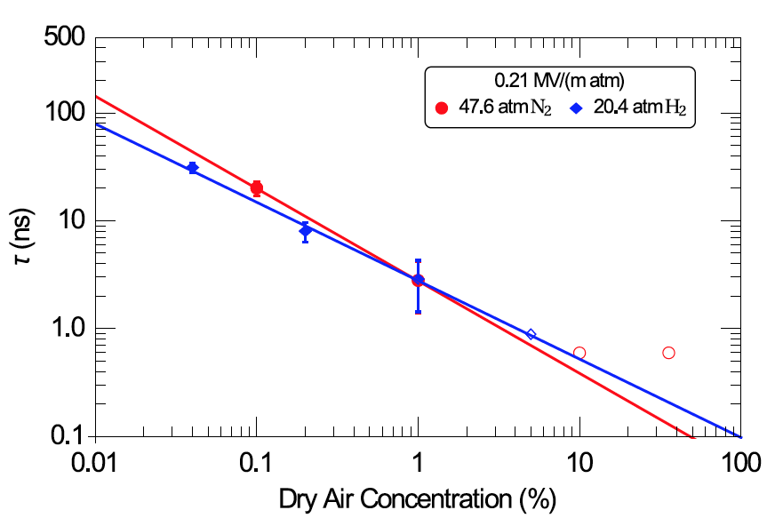
Remove Electrons by Electronegative[3]
Doping electronegative in gas to remove electrons
  Produce positive-negative ion pairs instead of electron-ion one
  Ion-ion recombination time is order of magnitude longer than electron-ion recombination time
  Contribution of electrons is negligible when τ ≤ a half RF period
  τ ≤ 1 ns is probably acceptable to have a practical system
Plasma loading is ~100 times less with dopant
  Save stored RF energy from RF power consumption by plasma
Require τ measurement in the range of RF gas monitor
Shortest time resolution
in this measurement

Slide 23
Drude model with RF field [5]
Equation of motion of electron
ν: Electron collision frequency with gas
m: Electron mass
ω_{rf}: Frequency of driving RF
Energy gain term
Drag force term
Displacement of electron
Polarization
Permittivity

Slide 24
Permittivity change [5]
n_{e} and ν are functions of a gas pressure and a RF gradient
Resonant frequency shift
Plasma loading
RF power consumed by plasma
Formulae tell us:
Permittivity change is proportional to n_{e}
Real part is enhanced at a low ν → Low RF gradient & Low pressure
Imaginary part is enhanced at a high ν → High RF gradient & High pressure

Slide 25
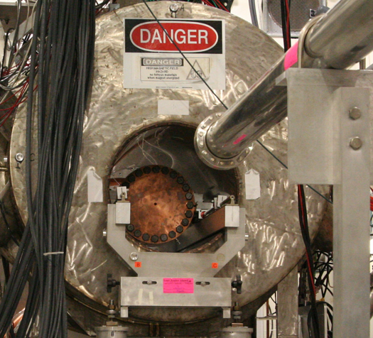
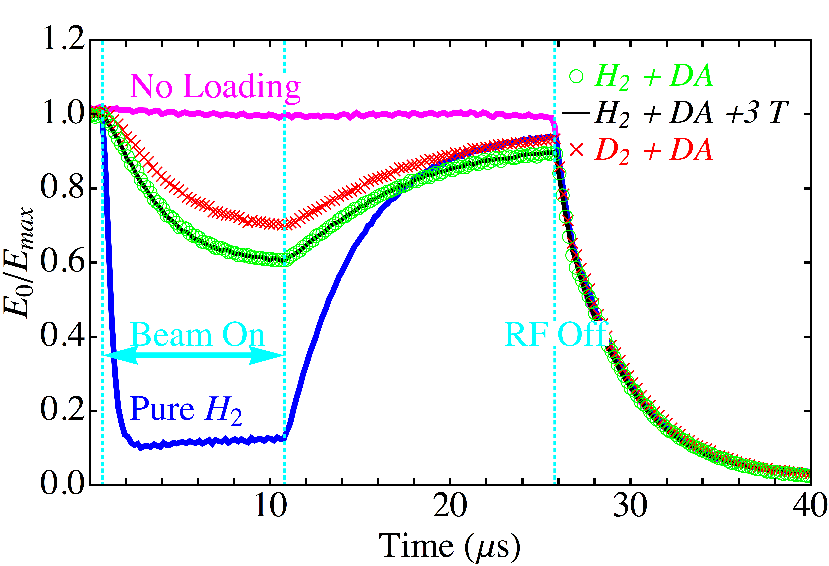
Study beam induced plasma in gas-filled RF cavity
Tested a gas-filled RF cavity with intense proton beams
Proton beam test at MTA
Gas pressure = 100 atm
DA: Dry Air
Multi-Tesla
solenoid
E_{max} = 50 MV/m
400 MeV
H⁻ Beam
Gas-Filled 800 MHz RF cell
Proton beam energy → 400 MeV
Protons per bunch → O(10⁹/2 mm diameter beam)
Bunch gap/length → 5 nsec/10 μsec
RF responses with proton beams [6]
Extract plasma population from RF signal

Slide 26
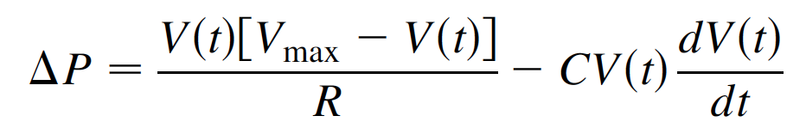
Interpret RF signal [6]
Gas pressure = 100 atm
DA: Dry Air
Ion pair production rate
Plasma loading
Recombination process
Electron capture process
E_{max} = 50 MV/m
dN/dt → Ο(10 pairs/cm) @ p_{gas}= 1 atm
μ_{e}E₀² → O(10⁻¹⁷) Joules/RF cycle
μ⁻_{i}E₀² ≈ μ⁺_{i}E₀² → O(10⁻¹⁹) Joules/RF
RF amplitude with a plasma loading
Time constant β⁻¹ρ_{i} → Ο(μsec)
RF source term
Power consumption term
Time constant τ → Ο(nsec)

