Slide 1
LBNF Muon Monitor Experience: Stopped Muon Monitor Design
Zachary Liptak
11/09/2016
US-Japan Workshop on Accelerators and Beam Equipment

Slide 2
Outline
Overview of Stopped Muon Monitor Systems
Design
Feasibility
Strategy
Prototype development and commissioning
Simulations
Plans for deployment

Slide 3
Stopped Muon Monitor Introduction
Stopped muons remain in the rock downstream of the absorber after beam pulses
Distributed as a function of initial energy
Make small, specialized modular detectors to observe these decays for:
Beam composition
Absolute muon flux
Beam monitoring
Ultimately want to incorporate beam MC to constrain neutrino spectrum

Slide 4
Stopped Muon Monitor Introduction
Stopped Muon monitors are calorimeter-type detectors large enough to contain enough of an EM shower to distinguish between Michel electrons and neutron interactions or radioactive decays.
Cherenkov inner detector with liquid scintillator veto
Detectors are to be placed at varying positions in the beamline
Multiples Z positions provide data at several rock depths
→ give information on beam energy spectrum
X/Y positions provide details of beam direction and stability

Slide 5
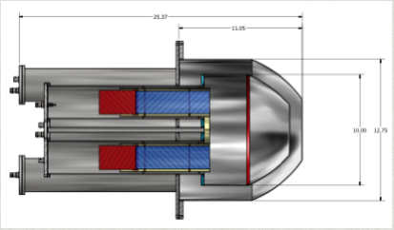
Stopped Muon Monitor Prototype
PMTs (4 in ID, 4 in OD)
Inner Cherenkov Volume
Liquid Scintillator Veto
Notes:
Add descriptions to the images!

Slide 6
Placement in the Beamline
Stopped µ-monitors to be placed after absorber
SMMs can be in individual alcoves, or one large alcove separated as shown
Counters are to be placed at multiple depths

Slide 7
Stopped Muon Counter Feasibility
Similar detectors have been built before, utilizing the same kind of strategy.
Kyoto group was able to use 6 counters to make a measurement of decay electrons in the K2K beam.

Slide 8
Stopped Muon Counter Feasibility

Slide 9
Stopped Muon Counter Feasibility

Slide 10
Stopped Muon Counter Feasibility
Similar detectors have been built before, utilizing the same kind of strategy.
Kyoto group was able to use 6 counters to make a measurement of decay electrons in the K2K beam.
…but LBNF presents new challenges:
Rate is 2 orders of magnitude higher than in K2K
Signal and background will both be larger
Longer wait time until there are reasonable numbers of muons in the detector volume

Slide 11
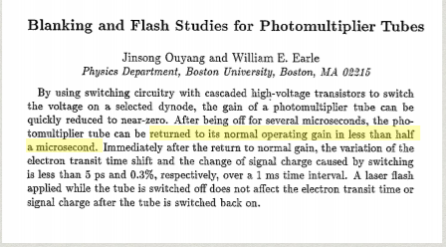
A Problem: Too Many Muons
Huge muon flux in LBNF means that detectors would be completely swamped
→PMTs need to be off during main beam pulse
Need a way to observe the beam once the number of muons has reached a reasonable level
“reasonable” → ~50 muons in the detector
BNL g-2 experiment faced a similar problem:

Slide 12
The Solution
Develop and implement gated PMTs
Keep PMT OFF while beam is on
Quickly turn bases to ON state once a reasonable level is reached
Bases have been developed and produced with our colleagues at Drexel
During PMT OFF mode, cathode does not see voltage (“gate” on)
ON mode turns the gating off and restores normal operation
Notes:
Discuss gated base things here

Slide 13
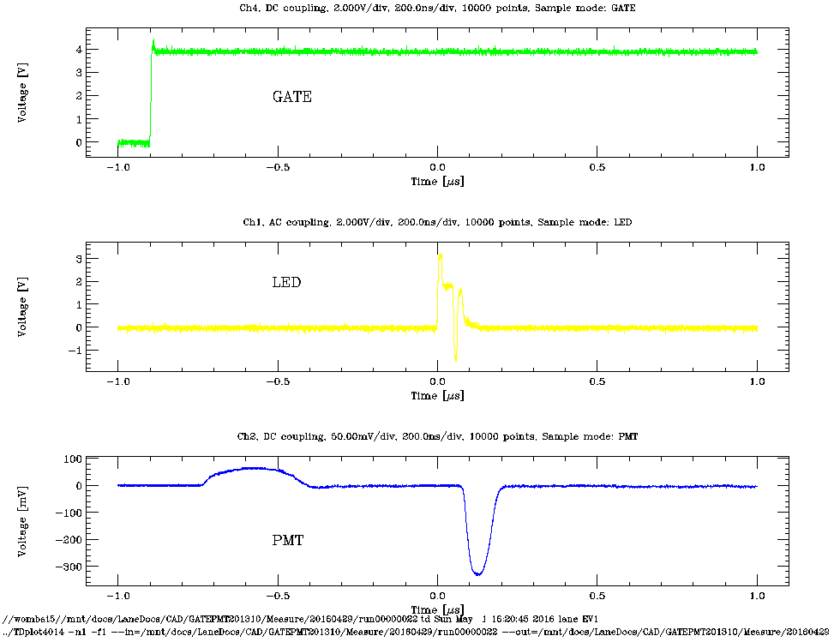
Trying it out: Large LED pulse
Courtesy C. Lane
Plots shown are from an LED test at Drexel during development of the gating system.
Notes:
Discuss gated base things here

Slide 14
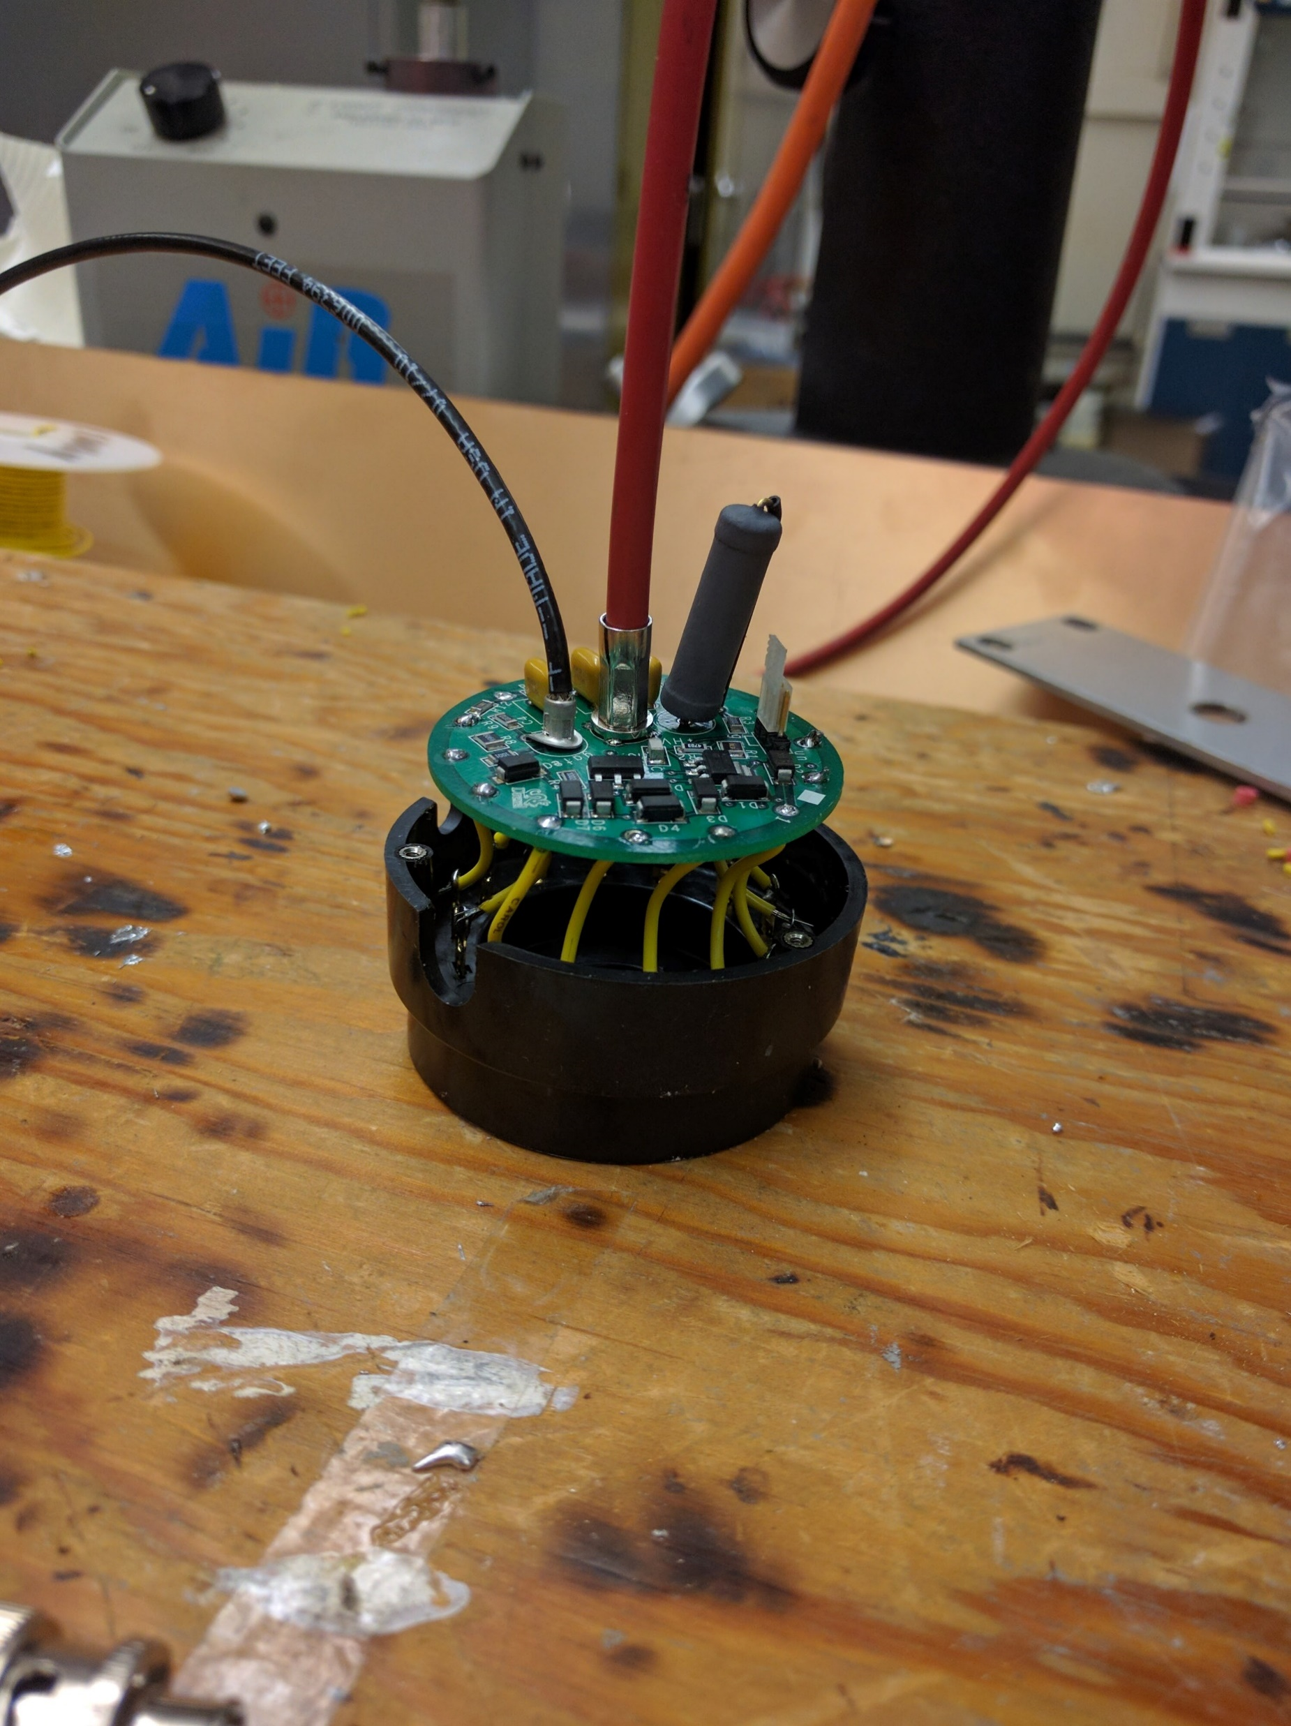
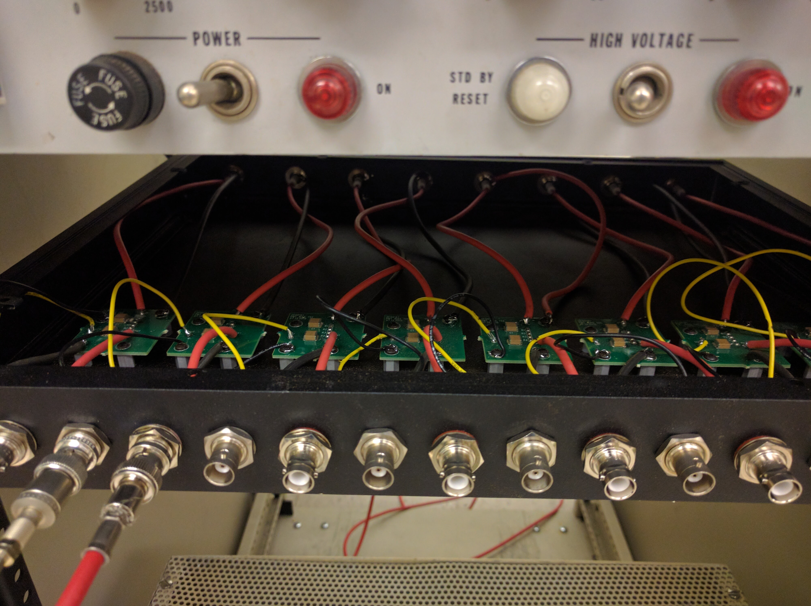
Gated Bases
Bases are designed to fit on socket and inside PMT tubes
HV Readout board developed to read the signal out from bases
Notes:
Talk about previous results from K2K

Slide 15
Testing and Commissioning
Before placing the detector in the NuMI beamline for testing, first make measurements at Colorado.
Pre-install testing makes use of cosmic muons
Boulder is at an elevation of > 1 mi (> 1600m)
→ cosmic rate is ~2x sea level
Commissioning taking place in 2 phases:
Testing detector operation with passive (i.e., not gated) PMTs
Re-testing with PMTs in gated mode
Includes veto system to get fully-contained fraction of decay electrons

Slide 16
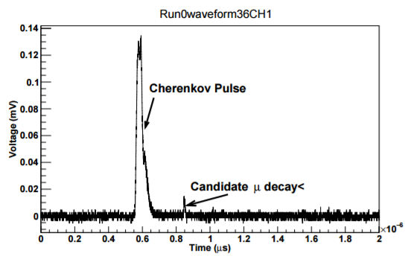
Commissioning – Phase I
First observations of candidate muon decays in the detector
Large first pulse is Cherenkov light from incoming muon
Expect a smaller pulse several μs later from decay electron

Slide 17
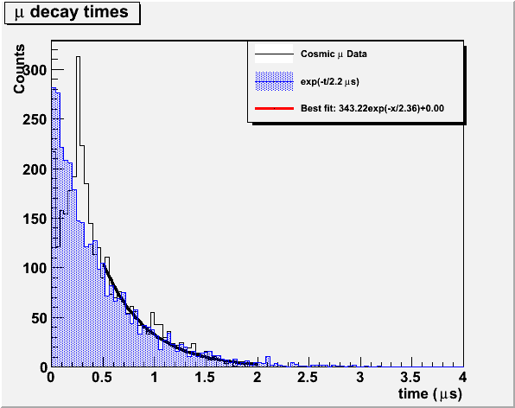
Commissioning – Phase I
Approximate muon lifetime calculated by finding time differences between pulses when a candidate decay electron is present
First results show approximate agreement with μ lifetimes after ~0.5 μs

Slide 18
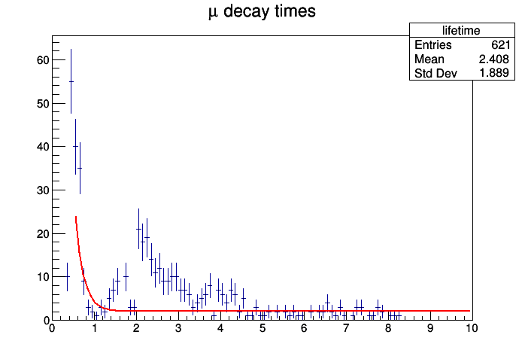
Commissioning – Phase II
Next phase of commissioning is currently underway at Colorado
Production and checks of all hardware for gating
Re-checking results from passive bases in gated mode
Using OD veto to get a fully-contained fraction of decay electrons
First signals seen from new bases during testing (passive mode)

Slide 19
Simulations
Simulations have been developed in tandem with hardware development efforts
Several students at CU have participated in the ongoing efforts
Stopped Muon Monitor simulations have been done in several areas:
Detector design
Led to several detector changes before production
Detector response
Background considerations
Determination of time to desired number of muons
Beam flux constraints

Slide 20
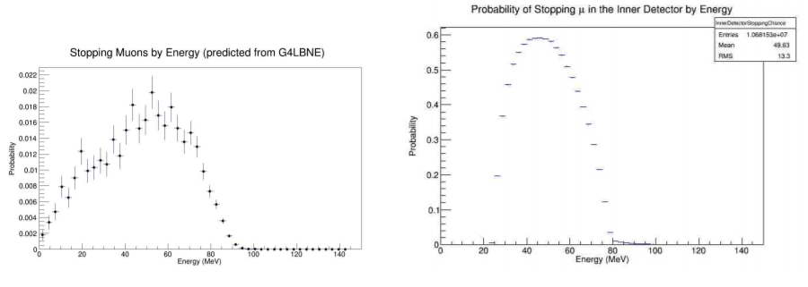
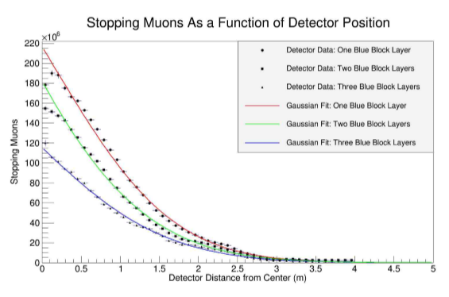
Simulations: Signal
G4LBNF utilized to simulate various beam muons stopping in the Cherenkov volume
Tests done based on muon energy, direction, position

Slide 21
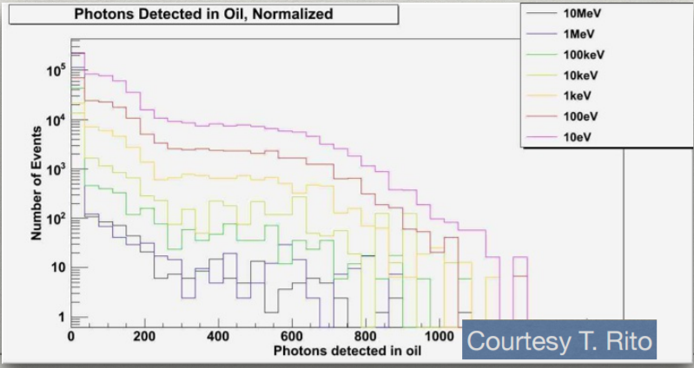
Simulations: Background
Example background simulation: neutrons in alcove 2
Neutron flux unknown
Incident fast and thermal neutrons modeled

Slide 22
Neutron Shield
As mentioned above, the overall flux of neutrons in Alcove 2 is unknown.
Overall effect that neutrons will have on our signal is still unclear.
To measure and reduce the neutron background, a neutron shield has been designed and is currently being built at CU.
Shield consists of a box made of borated PET with ventilation to prevent overheating
First data taking in NuMI will occur without shield; a second phase will have a run with the shield for comparison

Slide 23
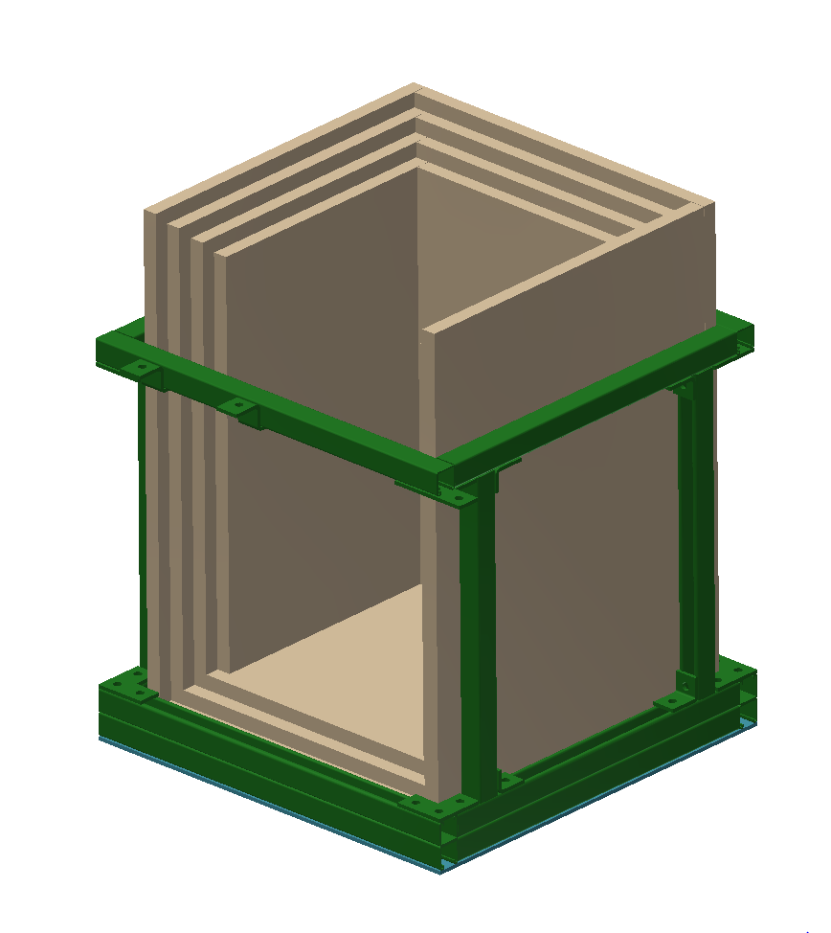
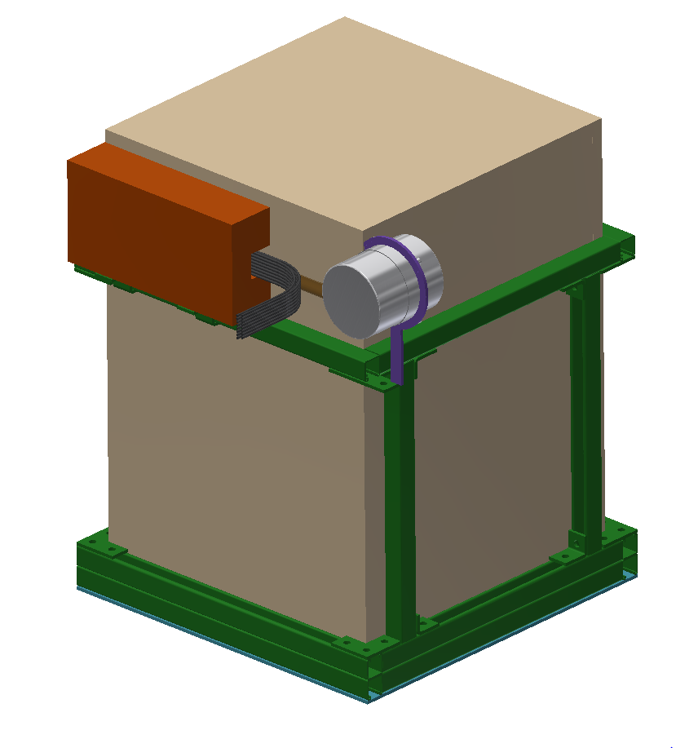
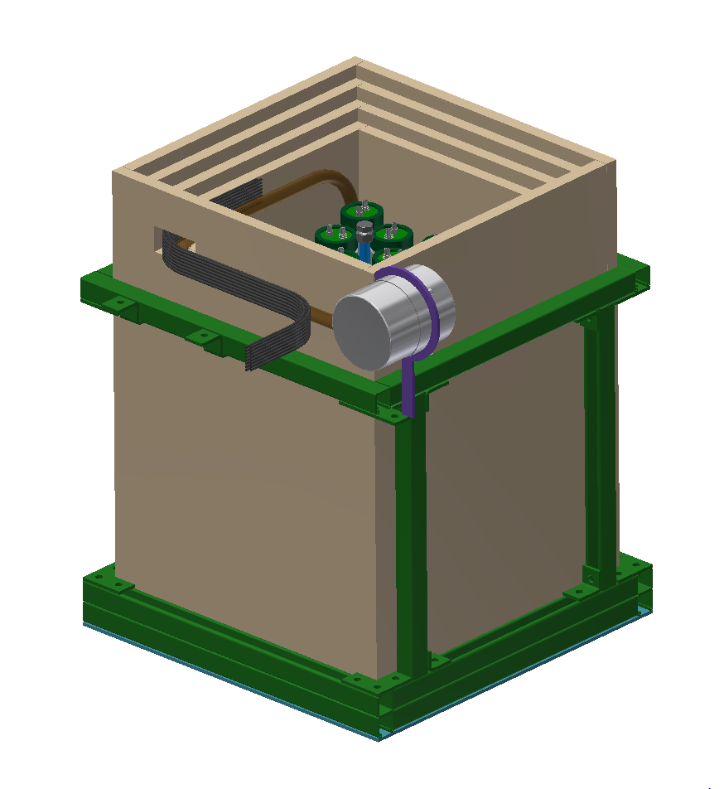
Neutron Shield
Full shield assembly
Shield-only Cutaway
Detector inserted

Slide 24
Plan for Stopped Muon Monitors in NuMI
Once commissioning is complete, detector will be brought out to the NuMI beamline and installed
Plan to take meaningful data ASAP
Neutron shield to be installed ~months later

Slide 25
Conclusions
Stopped Muon Monitors present a unique opportunity for measurements
Beam spectrum
Beam composition
Absolute muon flux
Precedent exists for detection systems
Prototype development and commissioning almost complete at CU
Cosmic ray commissioning data is encouraging
Soon to be taking data at NuMI to prepare for LBNF

Slide 26
BACKUP SLIDES

