Slide 1
Laser Notching / Chopping / Stripping
Bob Zwaska
Topics
10 November 2016

Slide 2
Laser Manipulation of H-
Fermilab is nearing an operational H⁻ notching system
Next step would be a H⁻ chopping system
  Higher duty factor (10x – 100x)
  Can replace deflecting choppers (J-PARC or PIP-II)
Ultimate is H⁻ injection
  Fermilab collaborates with SNS
  400 MeV will always be extremely challenging

Slide 3
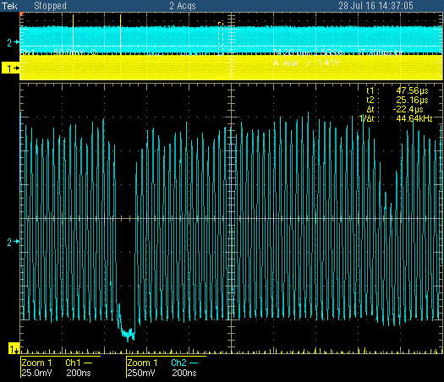
PIP Highlights – Laser Notcher (cont.)
  New accelerator development – never been done before!
Installed and tested just prior to summer shutdown
Achieved 70% neutralization, notch survived at 40% level in Booster
Finish commissioning and start routine operation after shutdown
Booster notch
Laser notch

