Slide 1
Topics for discussion – Question about Target Station sealing at T2-K
Vaia Papadimitriou/Salman Tariq
US-Japan Workshop
10 November 2016

Slide 2
Question
For the LBNF target chamber we are exploring the alternative option of an inert gas (nitrogen or helium). Our current reference design has air in the target chamber (or what we call the “target chase”).
Since the T2K target chamber uses helium and a helium vessel, we are interested to learn more details on the vessel design, specifically the vessel top cover plates and how the seal is achieved. Also we are interested in the penetrations through the vessel for utilities such as horn stripline & cooling lines plus how the helium-tight seal is achieved. Any information on this would be very helpful. In the picture at next page from J-PARC it looks like the top covers are bolted down as a flanged connection with a seal material at the interface. We would be interested in learning more details on this design plus the seal material.

Slide 3
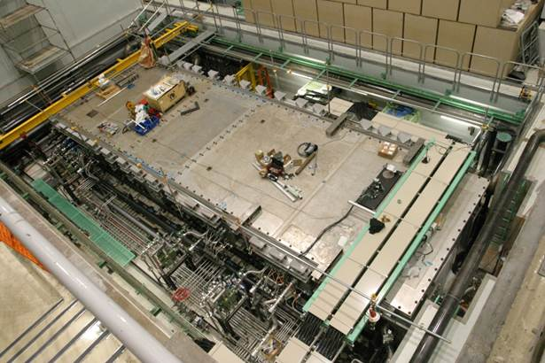
Question

