Slide 1
FNAL Intensity Monitors Summary
M. A. Ibrahim
US-Japan Mini Workshop
9-11 November 2016

Slide 2
Main Injector (MI) DCCT
2 sets of current transformers
  two 5.5” ID, 7” OD, 2”High, 2mil supermalloy (nickel-iron alloy) tape wound cores, with a minimum permeability of 45000 and driven at 200Hz modulation frequency
  set of 4 tape-wound cores similar in construction to the wall current monitor sensors
Cables consist of 4 Heliax cables and 3 Trumpeter TWC2-78
The detector housing is typically a steel shell. Inside, magnetic shielding is provided with three cylindrical metal layers. The layers are comprised of material, such as hipernorm, HYM-80, and 4.79 moly-permalloy, which all are highly permeable once annealed. The layers are separated with insulating 3/16”automotive felt.
Ceramic break is commercial 6.0” ID isolator made of alumina ceramic with 52 Nickel iron weldable lips.
Harmonics of the rotation frequency of the beam are suppressed with a resistor-capacitor network across the ceramic break. (35 parallel pairs of 100Ω in series with 390pF).

Slide 3
Recycler (RR) DCCT (Installed in 2007)
Bergoz NPCT-113-C100-HR : 113mm ID, high resolution with modulation frequency of 31.5kHz and set to a full-scale range : +/-2A
Signal cable is 100m, non-halogen, low-smoke, flame retardant polypropylene cable. (IEC 544-4 Radiation index estimate 5.5-5.9)
From datasheet, sensor is expected to have 5 μA/K temperature drift. Measured 9.64uA change /degC during RR bake as part of installation.
A copper housing enclosed the sensor and a ceramic insulator.
A cylindrical sleeve was constructed of 2 layers of 80% nickel-iron-molybdenum alloy with an initial relative magnetic permeability >25000. The alloy was annealed after all machining and forming. Inner support pieces made of G-10 Fiberglass Epoxy maintain a 5/8” air gap between the 2 layer. Closing the ends of a cylindrical shield with shielding disks, or flanges, adds very little to the shielding factor.
Ceramic break is commercial 4.0” ID isolator made of alumina-ceramic with nickel-iron weldable lips.
Harmonics of the 89811 Hz rotation frequency of the beam are suppressed with a 88uF capacitive network across the ceramic break.

Slide 4
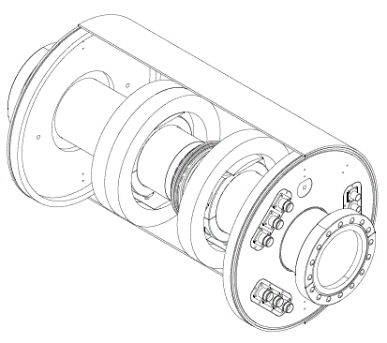
DCCTs in Development
Three 6.5” ID, 8.5” OD, 1”High, 0.007” tape wound nanocrystalline cores, held in place with expanding stainless steel clamps and G10 shoes. Two cores are driven in opposite polarity at 2KHz or 200Hz.
Cables consist of 4 Heliax cables and 3 Trumpeter TWC2-78
The detector housing is typically a steel shell. Inside, a cylindrical sleeve was constructed of 2 layers of mu-metal, separated with 0.375” air gap maintained with peek spacers and G-10 brackets.
Ceramic break is commercial 4.0” ID isolator made of 0.157” wide ceramic with stainless steel weldable lips. No network is used across the ceramic break.

Slide 5
Control System Interface
The MI and Bergoz DCCT outputs are buffered, filtered to 500Hz , and converted to a+/-5Vdifferential signal. The buffer amplifier output is processed by commercial VME ADC (ICS-110BL-8B). It provides 4 differential 24 bit sigma-delta ADC channels. The ADC samples at 2880Hz the DCCT output and averages the intensity at a 720Hz data rate. It has a measured 18.5 effective number of bits, providing a dynamic range of 110dB.
The DCCTs being developed are entirely instrumented with a VME digitzer card with 250MHz ADCs and DACs. These system directly report the beam intensity to registers readable over the VME backplane.
Both ADC cards are housed in a VME five-slot crate with a Motorola MVME controller. This controller normalizes the reported intensity with the RF frequency, corrects for baseline drifts, and averages the intensity at a 720Hz data rate.

Slide 6
DCCT Calibration Procedure
The intensity measurements are recorded and compared against expected intensities at given calibration currents.
  Initially, a calibrations were done with a DC voltage source and burden resistor. Variations in the voltage drop across the resistance were measured as well as DCCT readouts. Impedance of calibration winding is measured to <0.1%.
  In 2005, Keithley 2400 DC Current Source was purchased and dedicated for calibrations. With it, calibrations covered the full-dynamic range of the system and provided current drive up to ± 1A with 10pA minimum resolution and readout to 0.029% + 300pA accuracy
Regressions between the data sets should follow a linear model. A least-squares fit is performed between the data sets to find a simple "trend line", which minimizes the sum of the absolute values of the vertical "residuals" between points generated by the function and corresponding points in the data. The slope and offset of this trend line determine DCCT system scale factors, which are applied to the digitized feedback signal in the VME front end.
  Linearity of fit is nearly identical with data sets of linear and logarithmic steps.
  Use histogram to sample DCCT output at specific event
All DCCT systems were calibrated at least once a year and after any modifications to the systems.

Slide 7
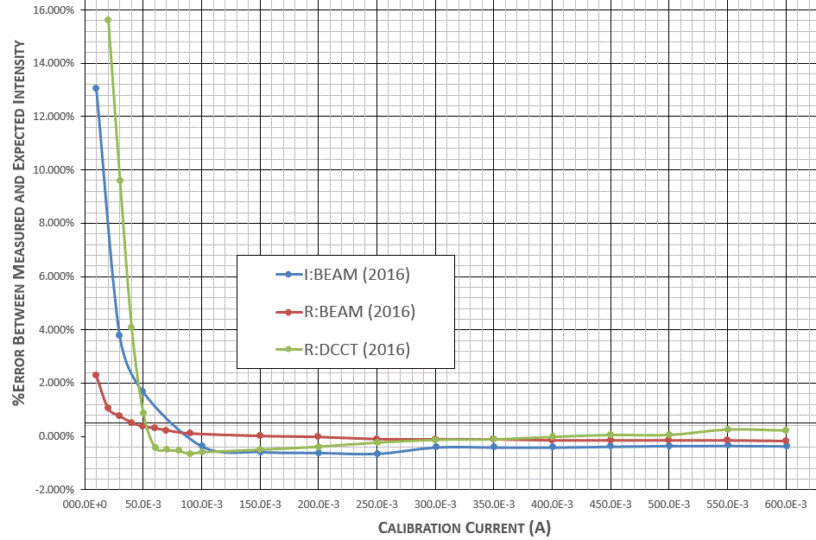
  Linearity/Absolute Accuracy of DCCT Systems

Slide 8
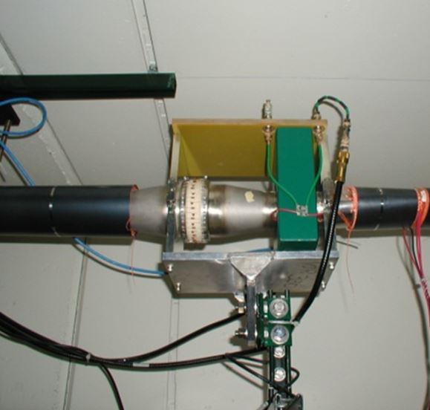
Toroid Beam Intensity Monitoring System
Sensor is a commercial wide-band tape-wound current transformer from Pearson Electronics.
  0.5V/A into 50Ω
  +0.02% error / degF
  ~0.06% error / Gauss (f>100Hz)
3/8” Heliax or Trumpeter TWC2-78 for signal cable from toroid to electronics

Slide 9
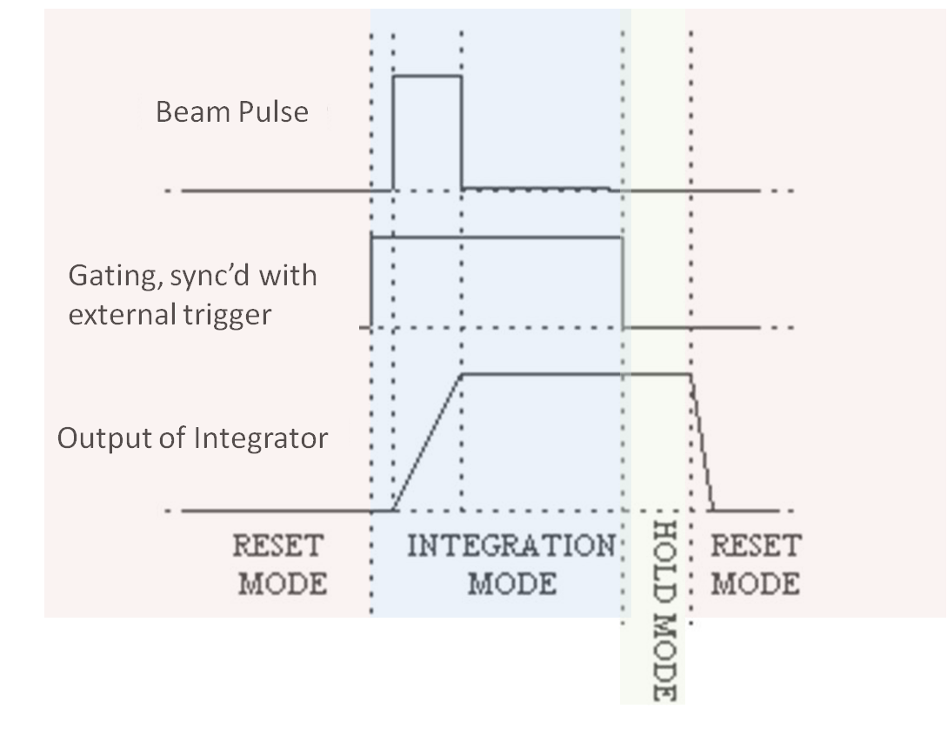
Switched Capacitor Integration
Each external TTL trigger will cause switched capacitor circuit to cycle thru reset mode, integration mode, and hold mode.
  Systematic Errors : <1%
  Timing w.r.t. gate: ~0.14-0.16% error per usec
  Temperature Sensitivity : -0.01% error / degF
The integrated value is buffered and continuously sampled by a 12bit or 14bit MADC for the control system before the next trigger.
Absolute Accuracy: <±2%
Pulse-to-Pulse Stability : <0.5%

Slide 10
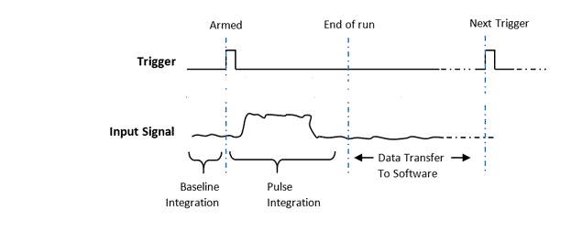
Digital Integration
For each external TTL trigger, the toroid signal is sampled at 125MHz, baseline corrected, integrated, and saved into registers readable across the VME backplane.
Upon request, the VME controller card reads out these registers into the control system. The microprocessor also does any pulse-to-pulse averaging or running sums of the report intensity for beam budget monitors or efficiency calculations.
Provides comparable absolute accuracy : <±2%
Varying time of arrival pulse with fixed width and fixed integration width
  0.186% change / 4usec delay
Varying integration gate with constant 20usec pulse width
  Poor SNR is evident ~x5 larger variations in L20TOA when the signal only occupies 16% of the integration window versus 80% of the window.
  -2.3% changes when the pulse occupies <20% of the integration window.
Varying calibration pulse width in fixed 125usec integration gate
  0.77% change as the pulse width was increased from 20usec to 124usec
  SNR also improved as the pulse occupied more of the integration window.

Slide 11
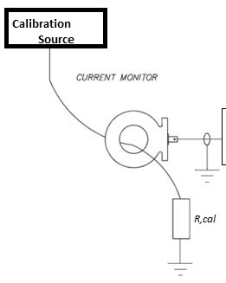
Toroid Calibration Procedure
Dedicated Calibration Equipment : HP 33120A
  Measured 50.540Ω internal source resistance
  0.5% change in gain for 1% change in output termination accuracy
  Calibration impedance is measured to <0.1%
Calibration signal needs to mimic true beam
  Timing of calibration pulse within integration gate should be relatively similarly to beam
  Calibration trigger, burst rate, and burst count should be comparable to the fastest rep rate of beam transfers
  Calibration pulse width should be maximum width of envelope of macropulse of beam transfer
  Variations in amplitude should cover most of dynamic range of expected beam intensities
Changes to scaling gain based on least squared fit between expected intensity and measured intensity
All toroid systems were calibrated at least once a year, and after any modifications to the systems.
Electronics

Slide 12
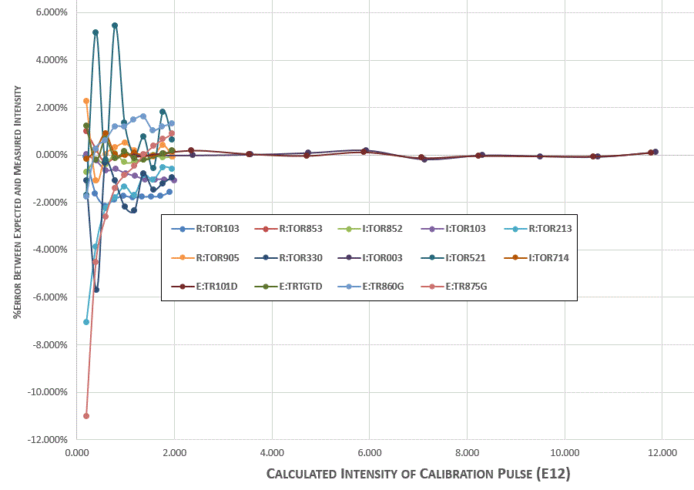
Linearity/Absolute Accuracy of Toroid Systems

Slide 13
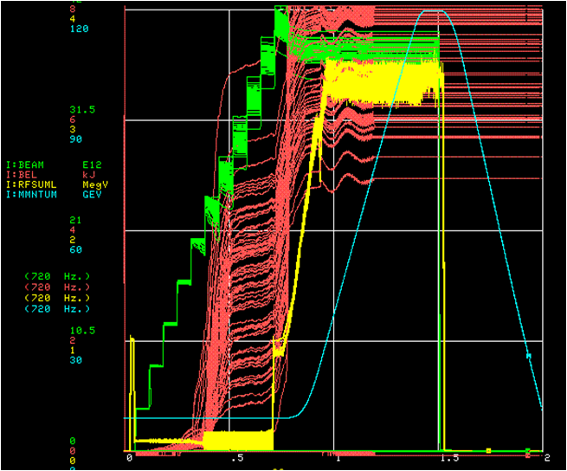
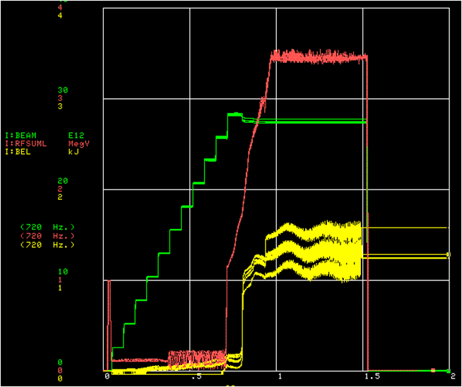
Tuning machine based on beam loss
Controller card calculates the instantaneous rate of change in the reported beam current at any given energy in the machine. This presents an instantaneous snapshot of the entire energy lost in the machine and can be used to tune the machine.
This is comparable to the total activation measured by location-specific BLM or radiation surveys.

Slide 14
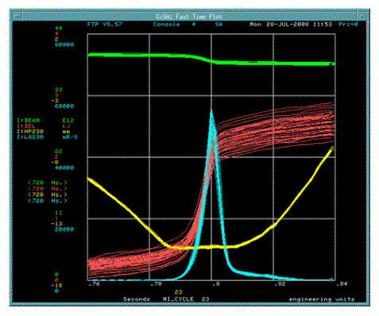
The time profile of losses (LQ230) due to the primary collimator are shown in blue. The green line shows beam intensity (DCCT). Beam position at the primary collimator (HP230) is shown in yellow. The beam energy loss (DCCT change times energy) is in red. Changes in the radial position of the primary collimator result in moving the time of this loss.

Slide 15
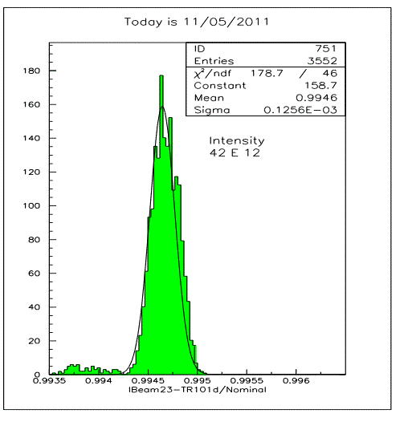
Comparing intensity monitors to determine efficiencies
A histogram is used to determine transfer line efficiency between the reported DCCT intensity sampled on extraction event and upstream toroid in the NuMI transfer line.

Slide 16
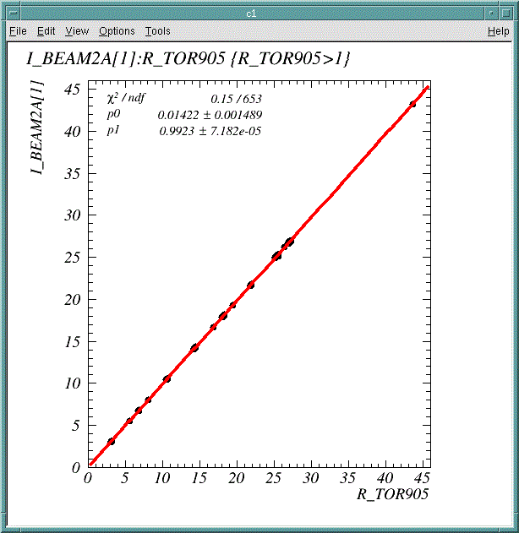
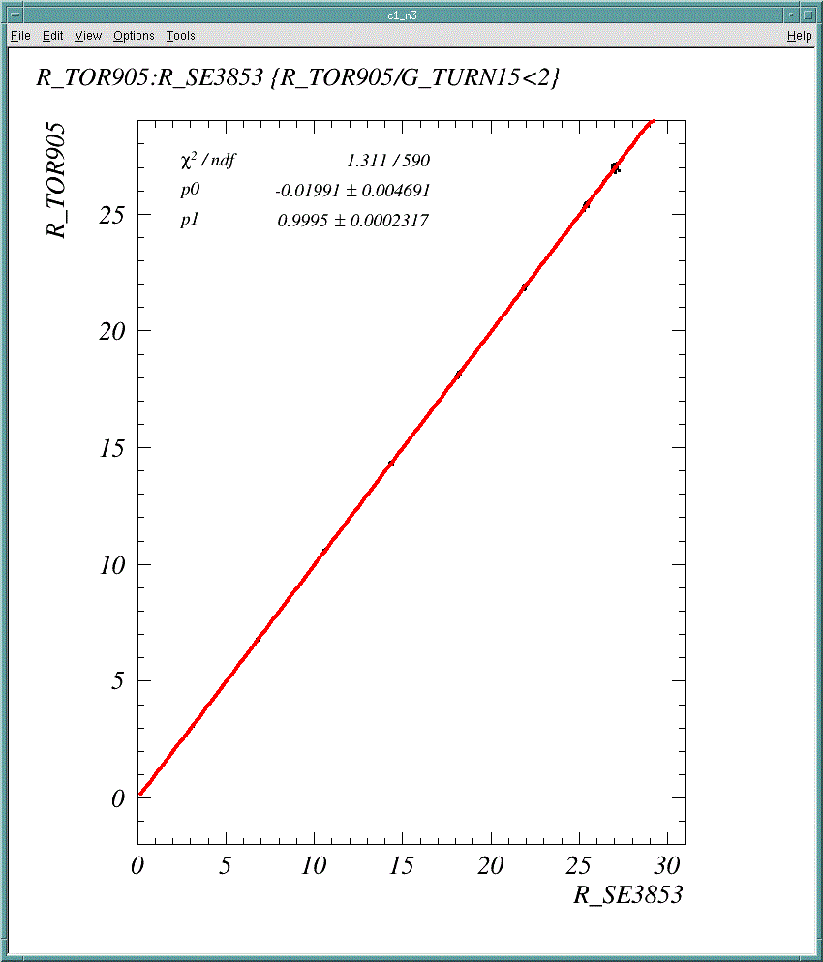
Linear fit between DCCT intensity sampled on injection event and toroid in RR->MI transfer line.
Linear fit between summed intensity at RR injection toroid and toroid in RR->MI transfer line.

Slide 17
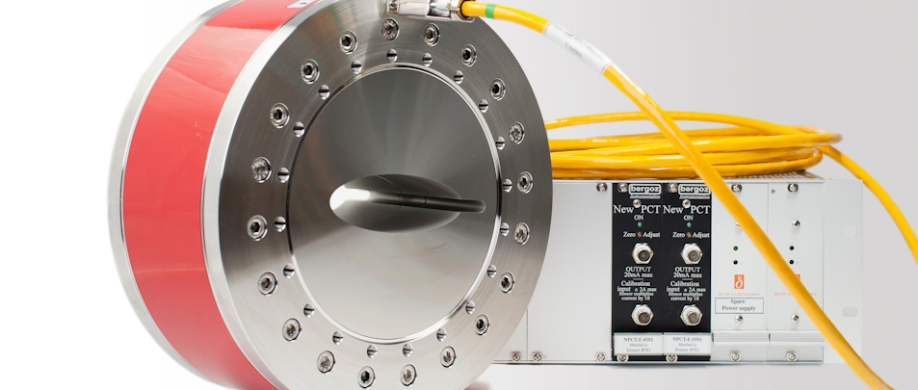
Recycler DCCT (Installed in 2007)
Bergoz NPCT-113-C100-HR : 113mm ID, high resolution with modulation frequency of 31.5kHz and set to a full-scale range : +/-2A
Signal cable is 100m, non-halogen, low-smoke, flame retardant polypropylene cable. (IEC 544-4 Radiation index estimate 5.5-5.9)
Notes:
In 2004, the Bergoz PCT-113-0100MA unit irrecoverably failed as the modulator core magnetic state became unstable. This instability occurs when one modulator core accumulates more remnant field than the other and the output drift occurs. Essentially, the permeability of the two modulated cores became so different that the second harmonic generated with beam current could not be resolved. Without any spare custom-detectors available, the Bergoz NPCT 115-C100 had to be purchased and installed as its replacement

Slide 18
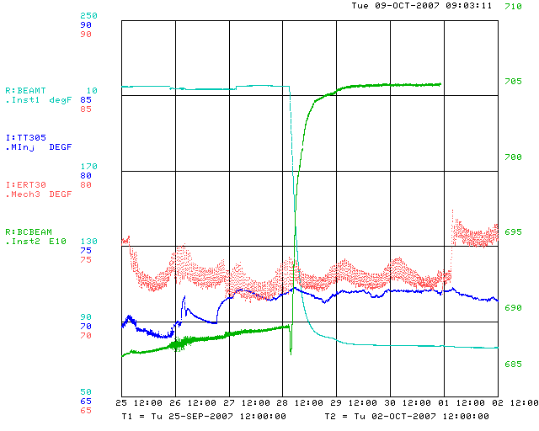
Temperature Sensitivity
From the datasheet, the Bergoz system is dominated by the sensor temperature drift of electronics has a <0.1 uA/K temperature drift while the sensor has 5 μA/K (0.035 e10/degC ) drift.
As part of installation, the RR DCCT was baked up to 80degC. The datalogger measured -0.067 e10/degC or 9.64uA/degC at 52.81MHz.

Slide 19
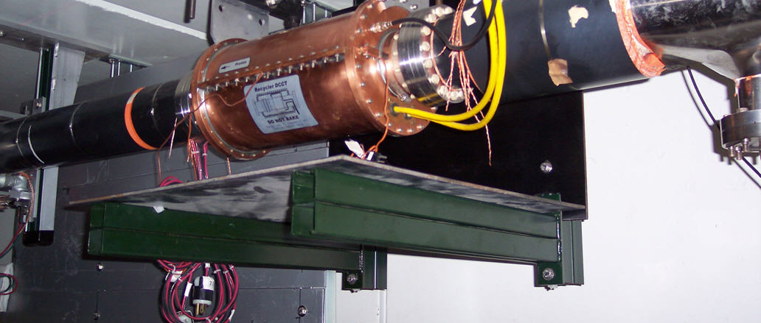
DCCT Housing and Shielding
Originally, Bergoz PCT-113-0100MA was purchased for Recycler. It had a 7kHz modulation frequency and a 20 kHz bandwidth. A copper housing enclosed the sensor and a ceramic insulator.

Slide 20
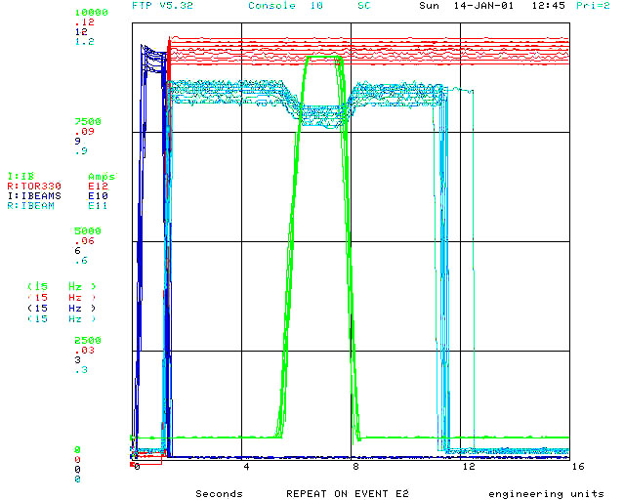
In 2000, it was moved to a new location, where there was a nearby Main Injector dipole magnet bus.
The magnetic field from the now nearby Main Injector bend buss induced a substantial error in the measured beam charge.
The observed errors were about 1e10, corresponding to 1 mA or 10 gauss.
According to the manual, the transformer has a 100 µAmp/gauss radial sensitivity to magnetic fields. Typical magnetic fields from the buss are a few gauss.

Slide 21
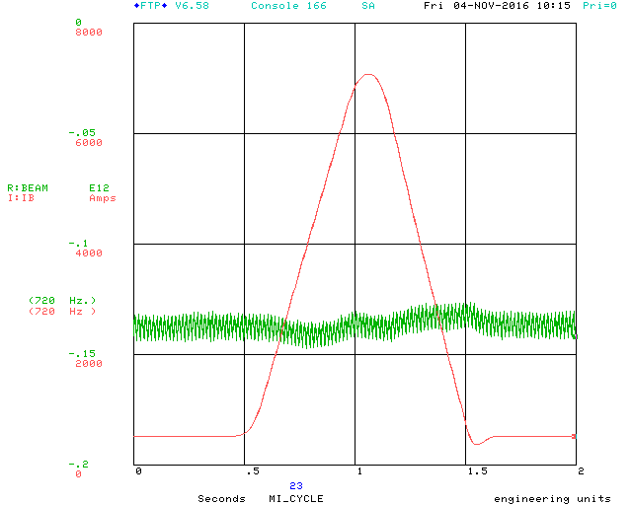
Without any shielding (MI30)
With magnetic shielding (MI62)

Slide 22
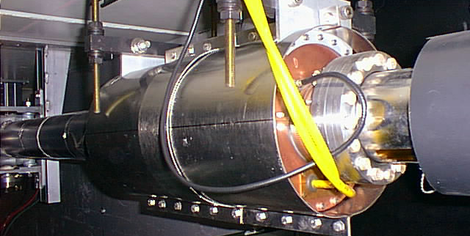
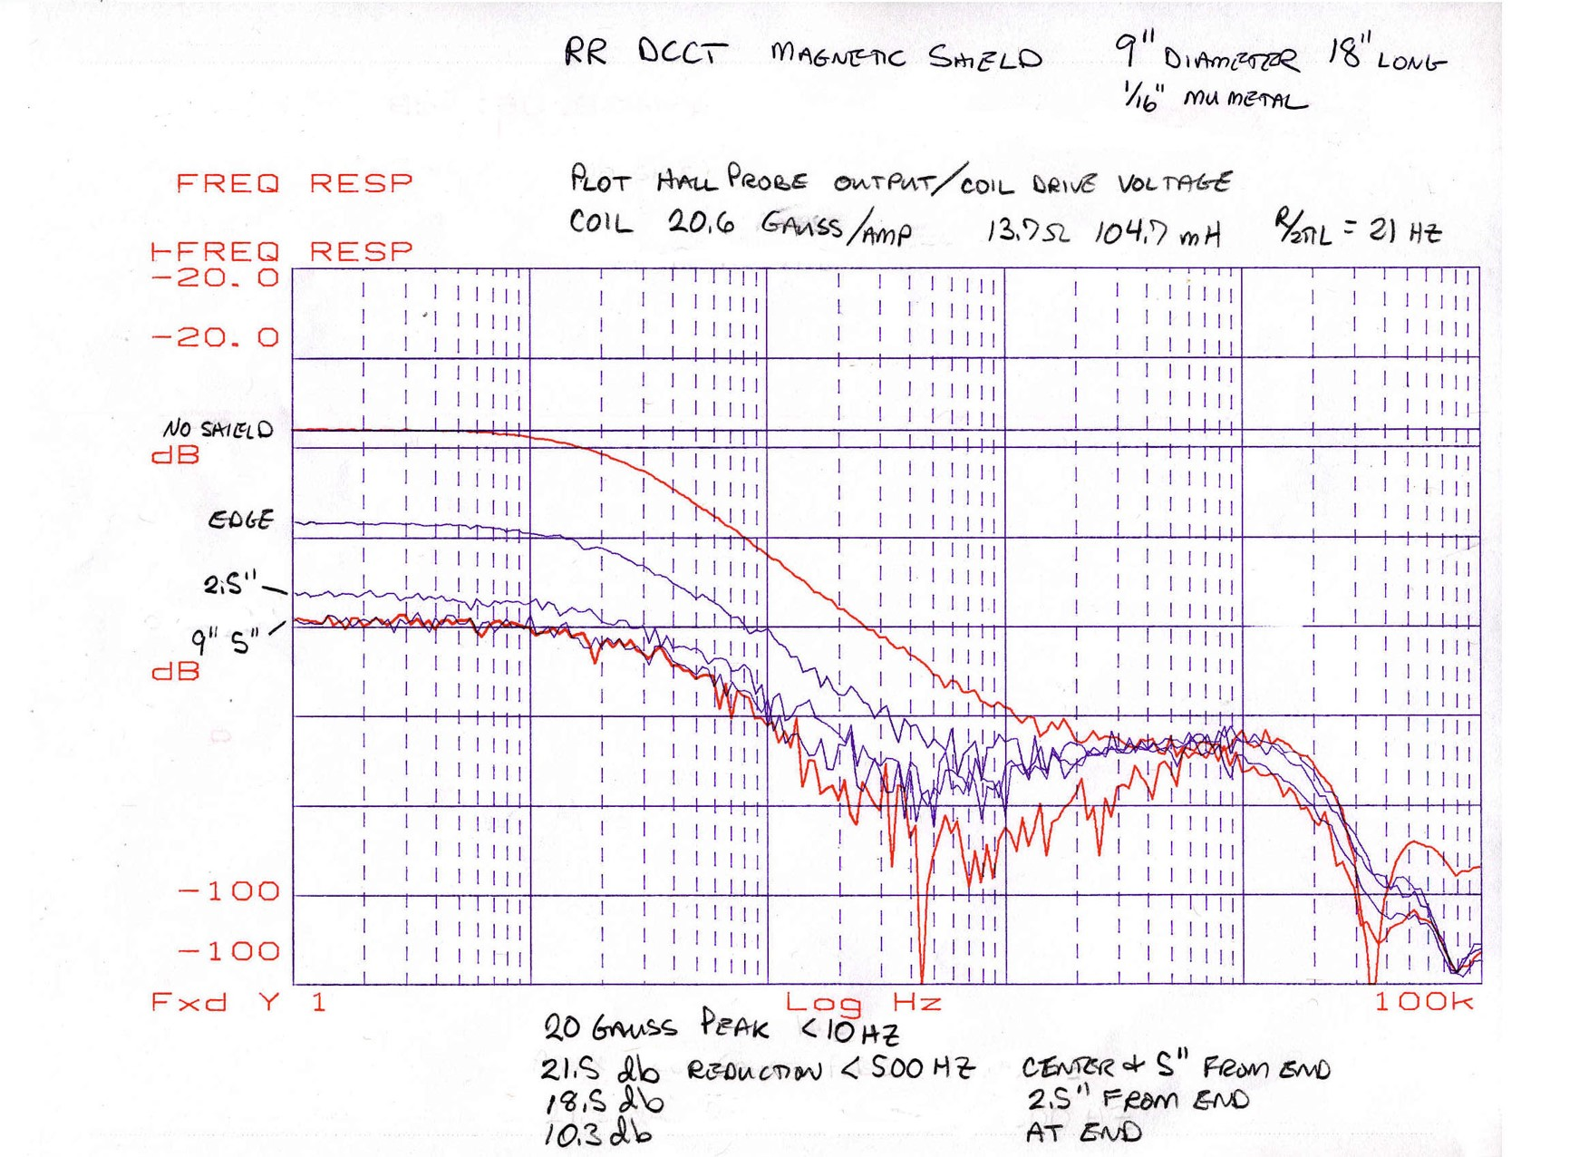
A cylindrical sleeve was constructed of 80% nickel-iron-molybdenum alloy with an initial relative magnetic permeability >25000. The alloy was annealed after all machining and forming. This shield was 9” in diameter and 18” long and reduced the magnetic field by 22 dB.
Notes:
The plot on the left indicated the measured magnetic field as a function of frequency without the shield, at the edge of the shield, and at 2.5, 5, and 9” from the edge. The shield is 9” in diamete

Slide 23
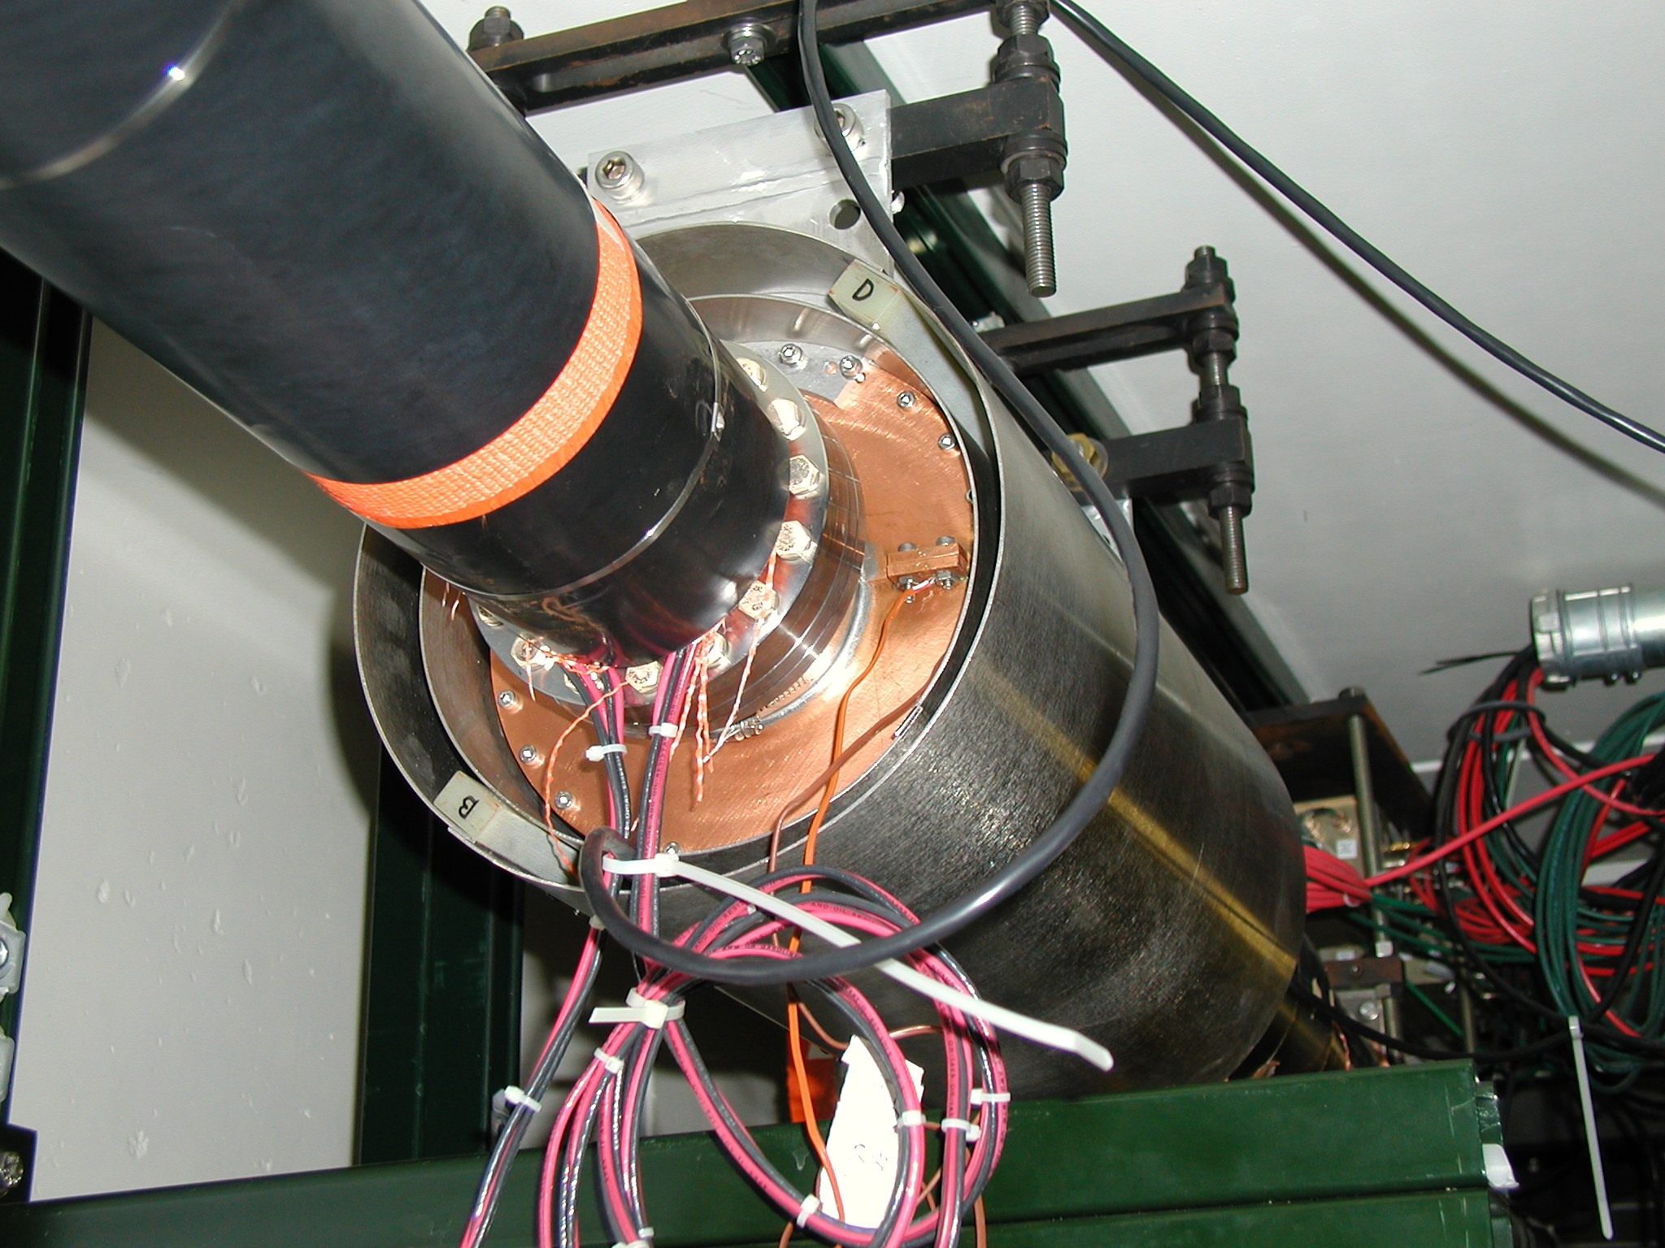
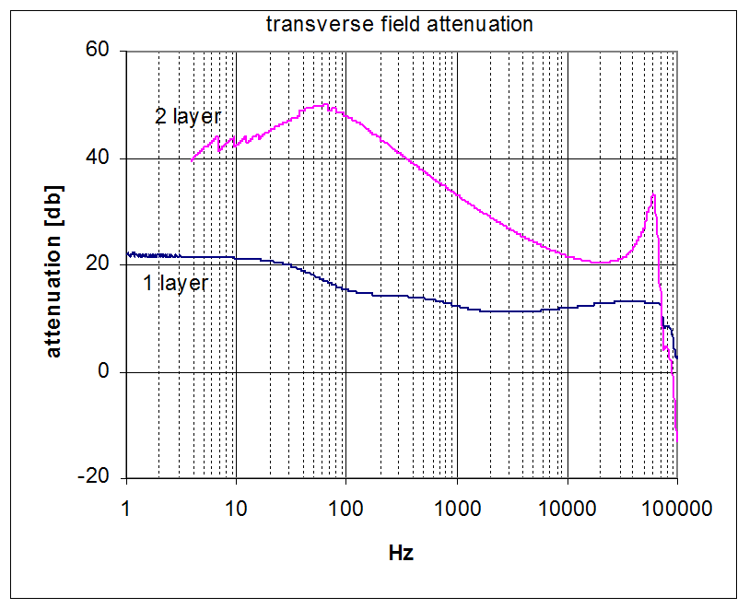
A second layer was added to increase the shielding factor. Inner support pieces made of G-10 Fiberglass Epoxy maintain a 5/8” air gap between the 2 layer. Closing the ends of a cylindrical shield with shielding disks, or flanges, adds very little to the shielding factor.

Slide 24
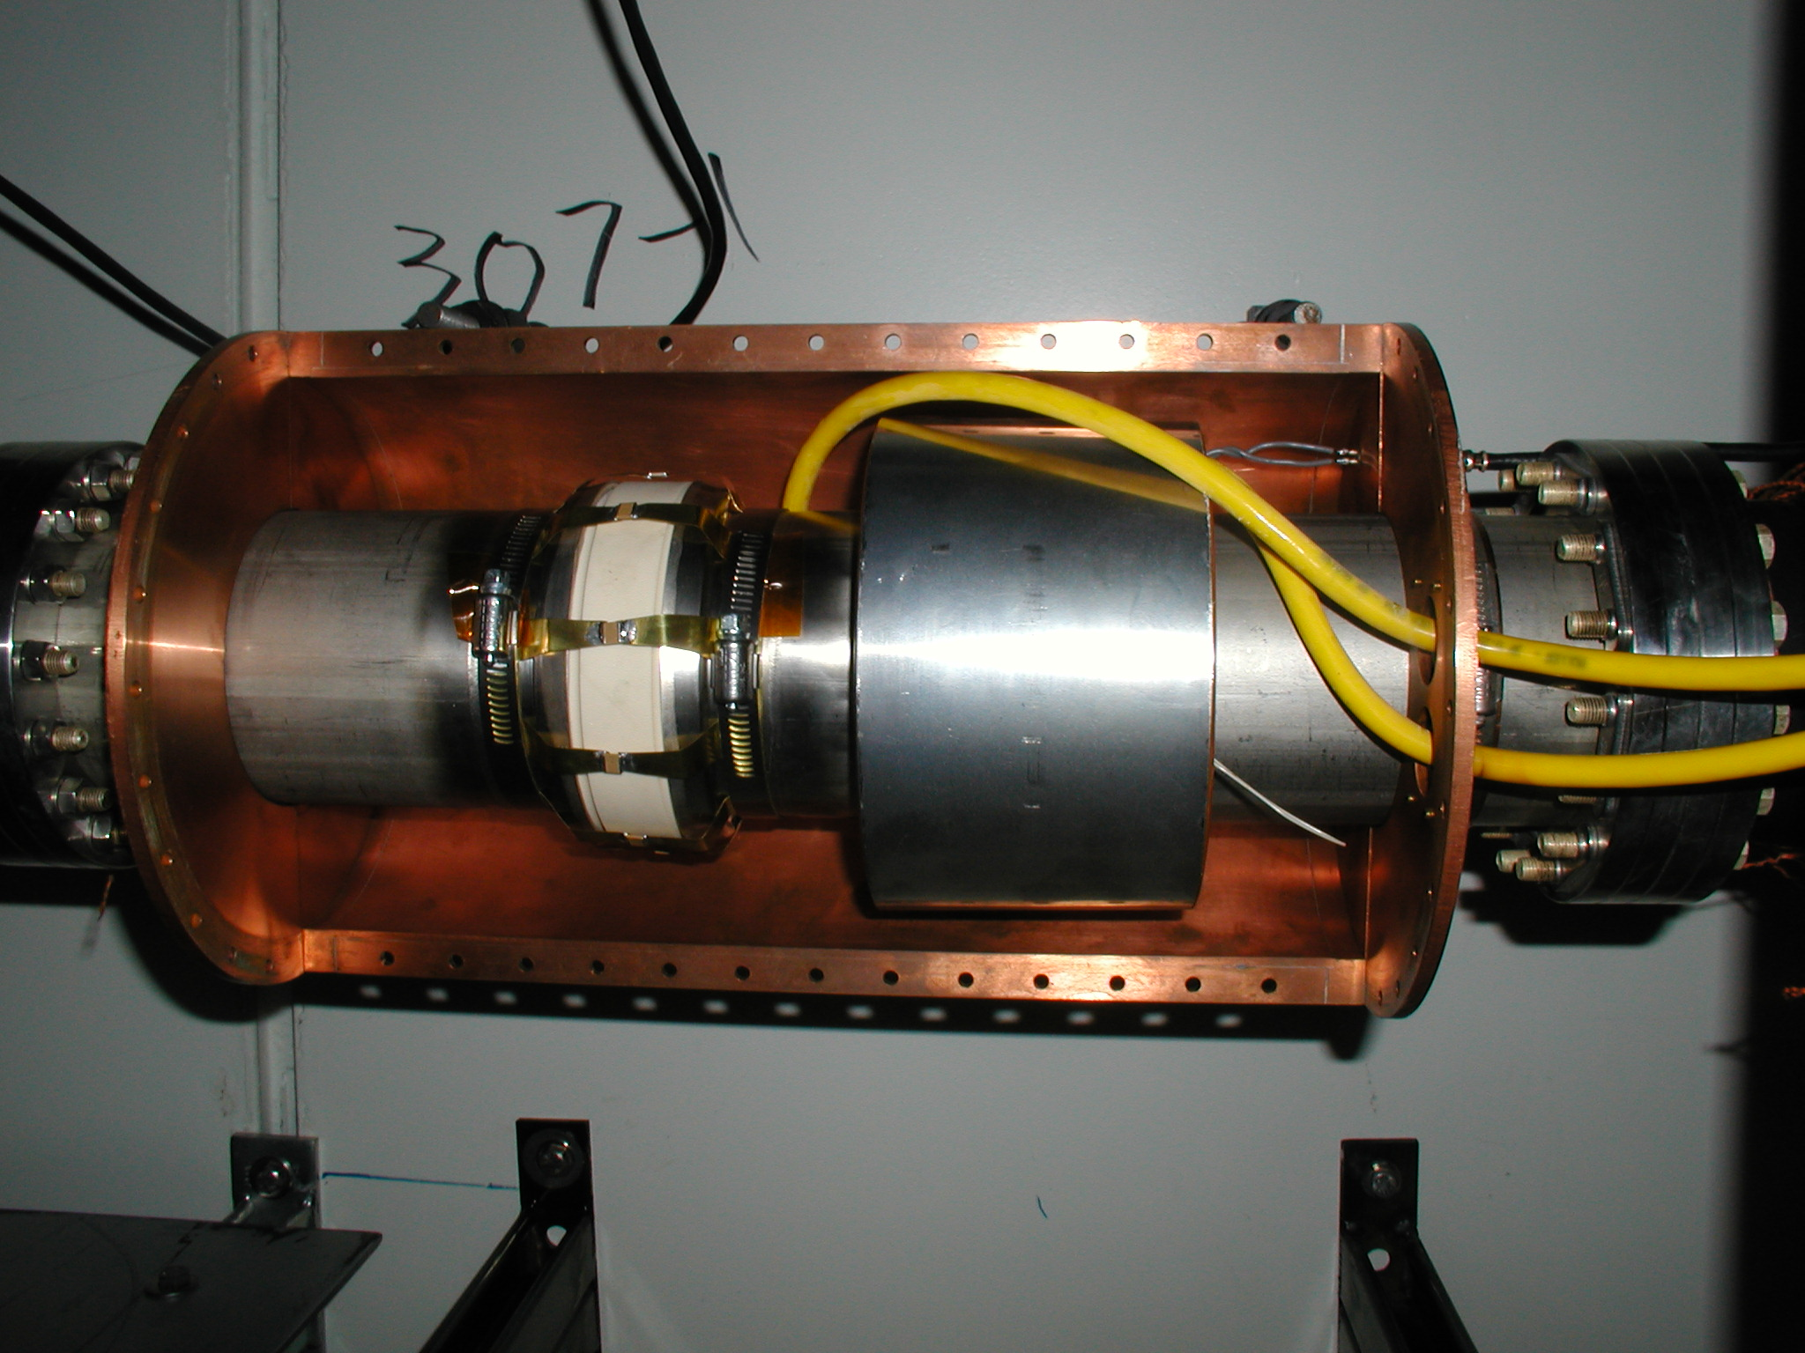
RR DCCT Ceramic Break Configuration
Ceramic break is commercial 4.0” ID isolator made of Alumina Ceramic with 52 Nickel iron weldable lips.
The Bergoz manual advises that the gap capacitance should be more than 10 nF and less than 220 nF.
The gap network was first modified to match the recommended maximum value.

Slide 25
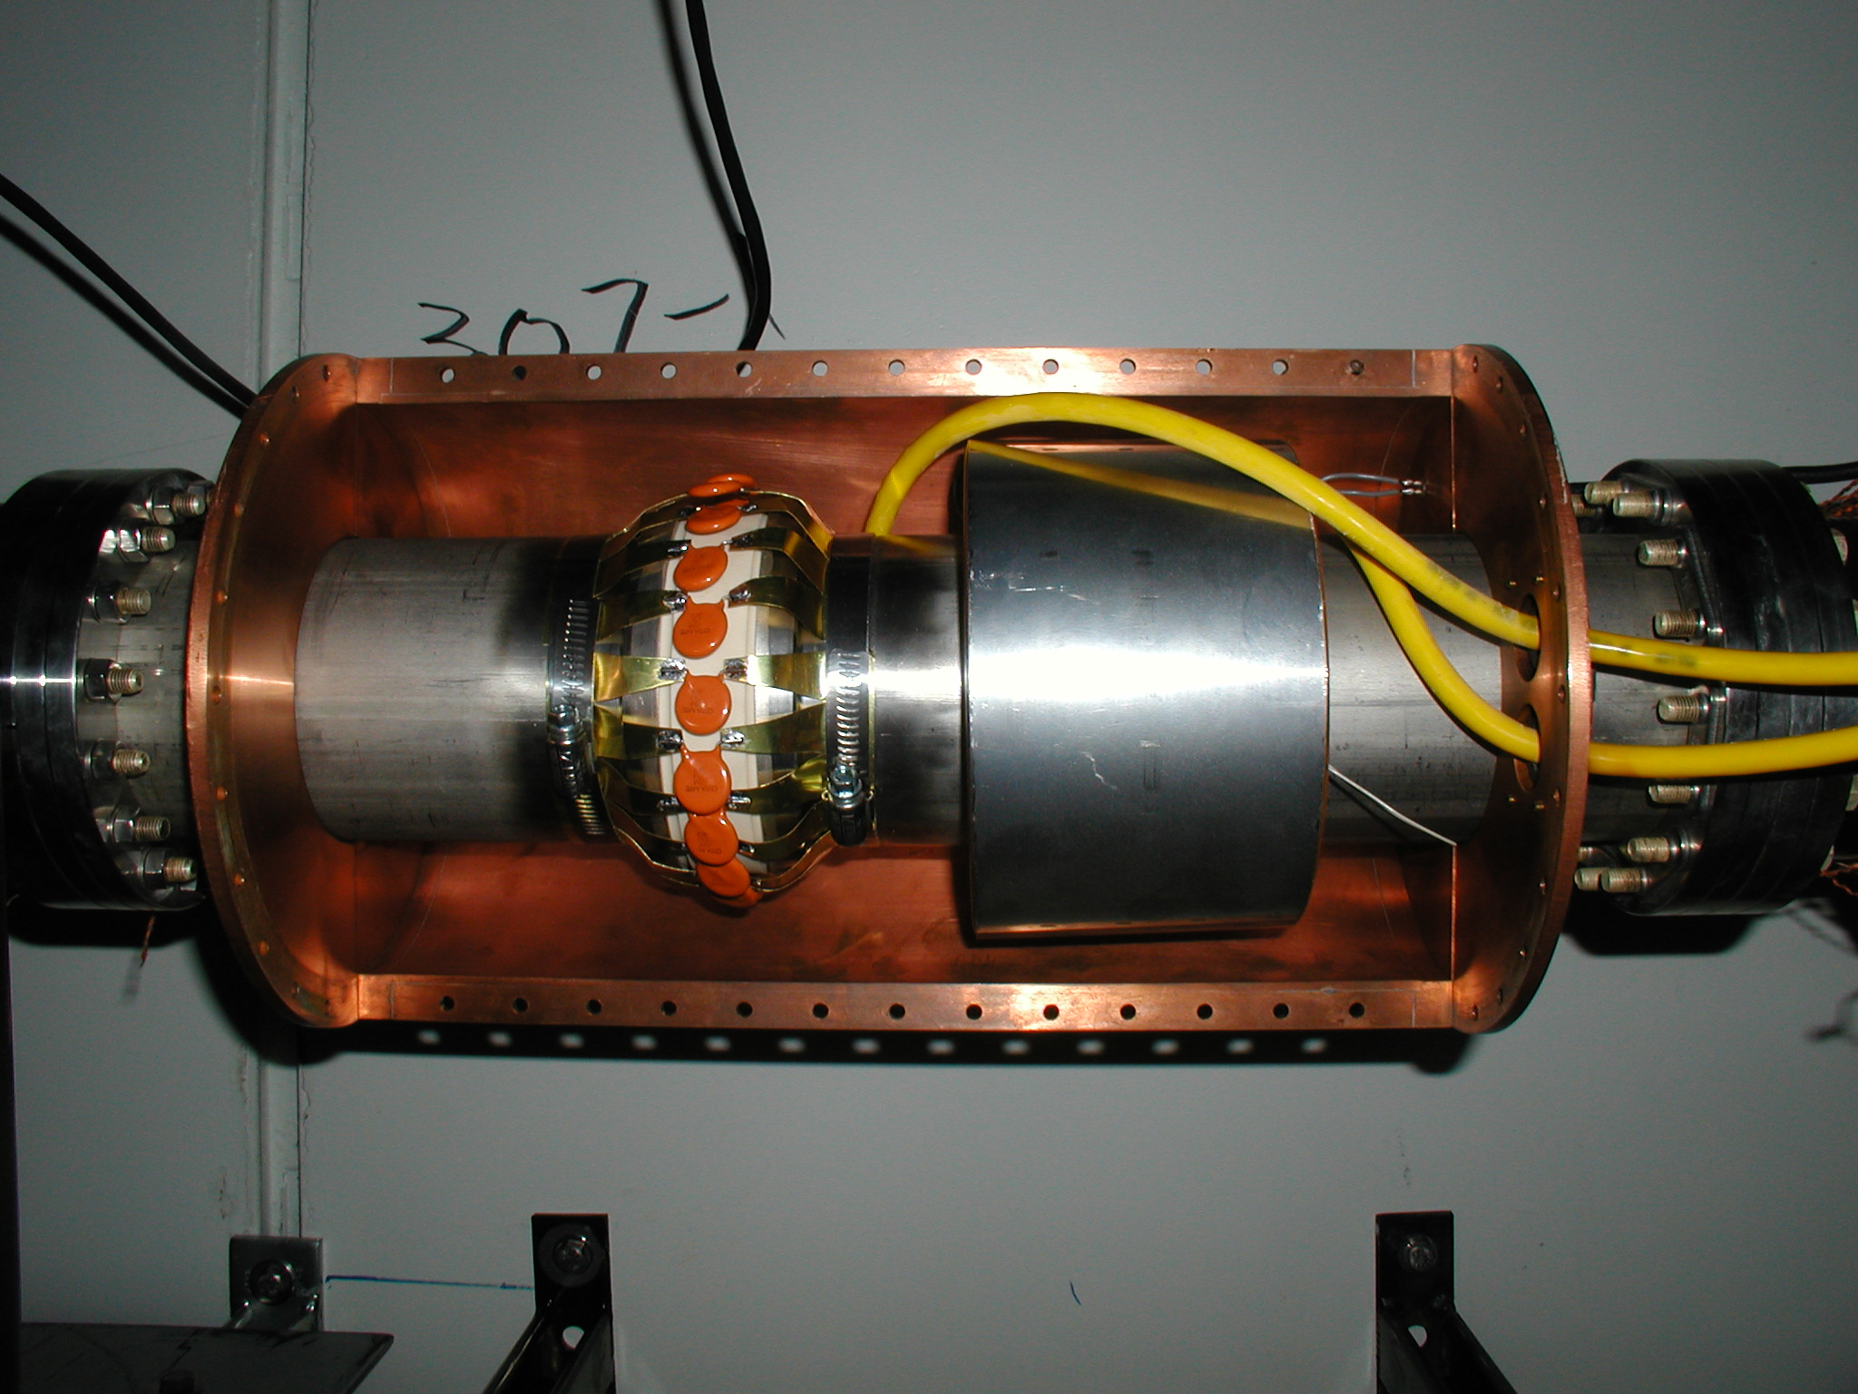
However ,the typical time structure of Recycler beam contains harmonics of the 89811 Hz rotation frequency. These high frequency components of the beam are suppressed with a capacitive network across the ceramic break. At the first rotation harmonic, 200 nF is 8.9 ohms and provides little or no effect.
The capacitor network across the ceramic break was replaced with 88uF.

Slide 26
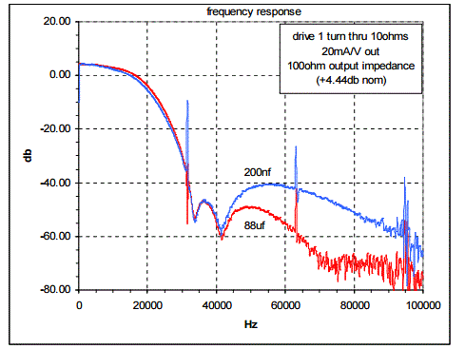
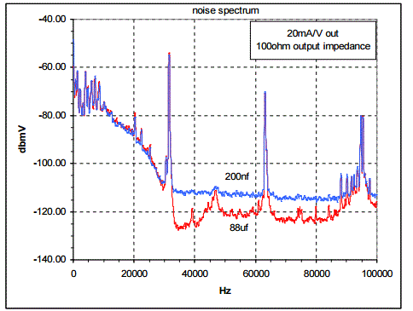
The system’s swept frequency response snd noise spectrum remains unchanged with 88uf. The 31.5KHz spike is the modulating frequency used in the NPCT.

Slide 27
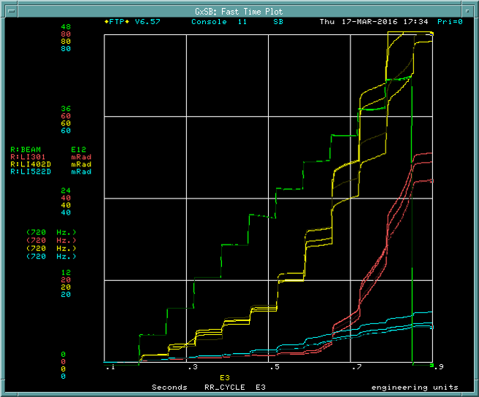
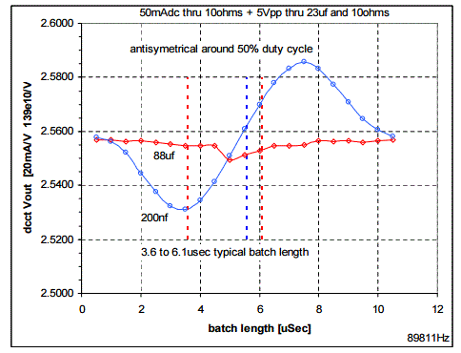
Although large ceramic gap capacitance improved bunch length sensitivity, nonlinearity still a problem with slip-stacked beam.

Slide 28
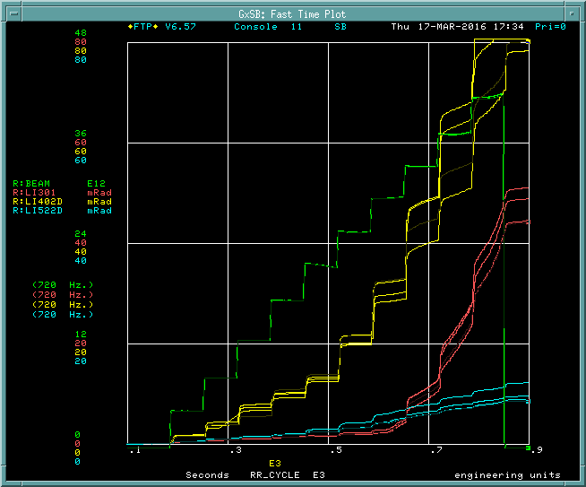
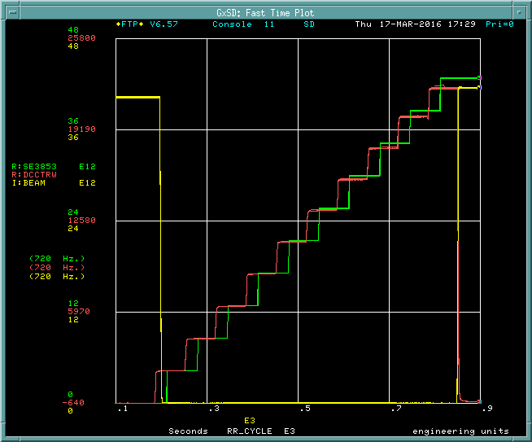
Bergoz DCCT response with slip-stacked RR beam.
New DCCT response with slip-stacked RR beam.

Slide 29
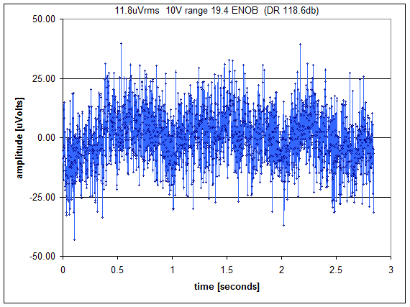
Front end specifications
±5 Volts differential input range via buffer amplifier
  Bandwidth (3rd order LPF): 530Hz
  Temperature sensitivity: 98uV/ ºC (.007e10/ ºC)
  Noise:1uV rms
2880Hz sample rate
720Hz data rate
18 effective number of bits
108db S/N ratio
Linearity = .006% .04e10
Measurement of a D cell battery demonstrates 19.4 ENOB rms noise from the ICS-110B. This is better than the manufacturers specification but does not include non-linearity error. The equivalent noise level would be 0.48uAmp rms for a 400mA full scale range.

Slide 30
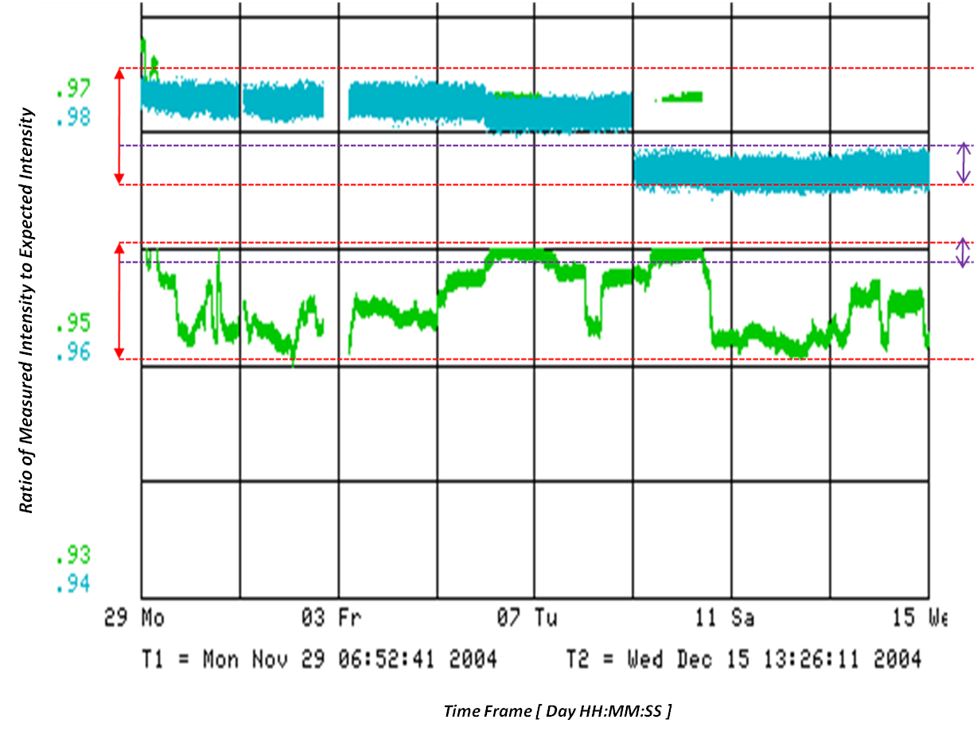
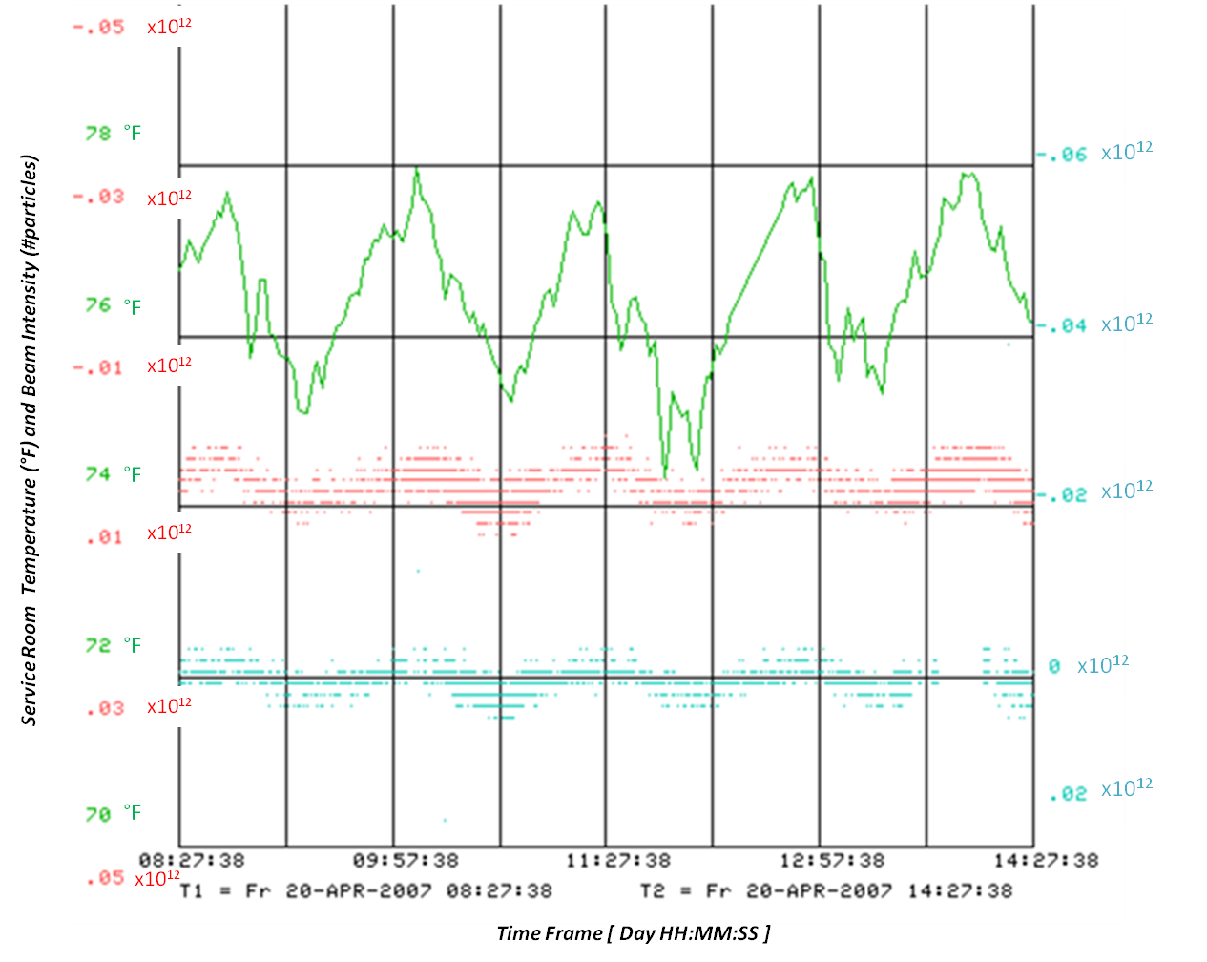
MiniBoone Toroids (2004)
The plot above compares fluctuations in gain over time between transport beam intensity monitors with (blue) and without (green) electronic modifications. The gains were tracked during successive calibrations in between beam transfers over several days and were calculated using a least squares fit model between measured intensities and expected intensities. Although both show ±0.5% long-term gain drift (red arrow bars), the new electronics show ±0.1% RMS pulse-to-pulse variation, in contrast to ±0.3% in the older electronics (purple arrow bars).
Plot showing the temperature correlation between two transport beam intensity monitors (red and cyan) and the room temperature (green). Both toroid monitors are 1x10¹³ at full-scale intensity with an 11 msec integration gate. The plot shows about 3.4x10⁹ variations due to the temperature change.

Slide 31
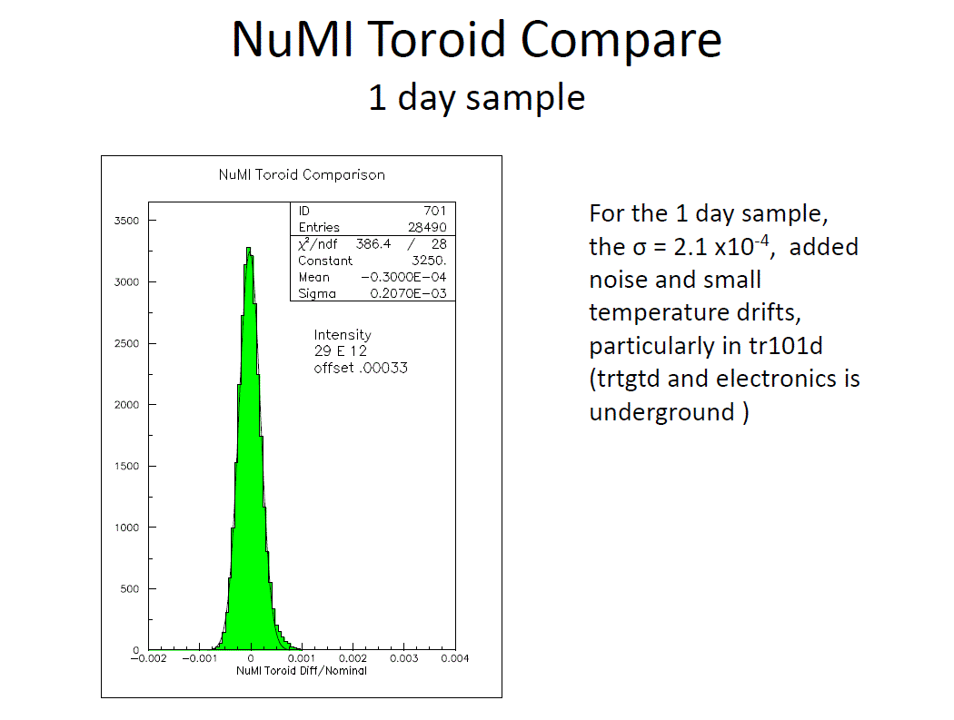
NuMI Toroids (TIPP2010)

Slide 32
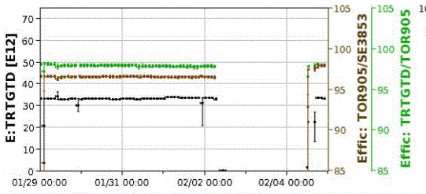
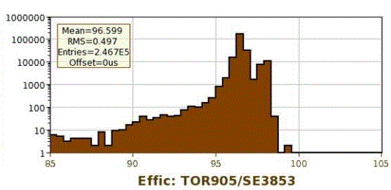

Slide 33
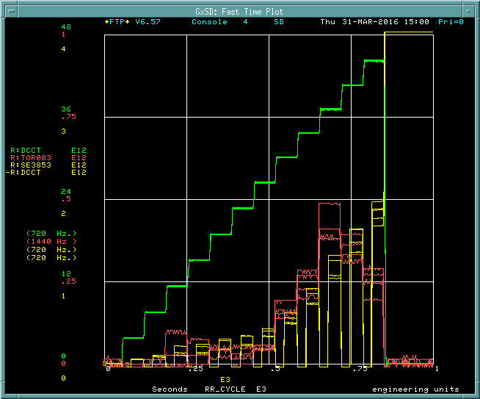
A fast time is used to compare the difference between RR DCCT intensity and RR abort toroid.

Slide 34
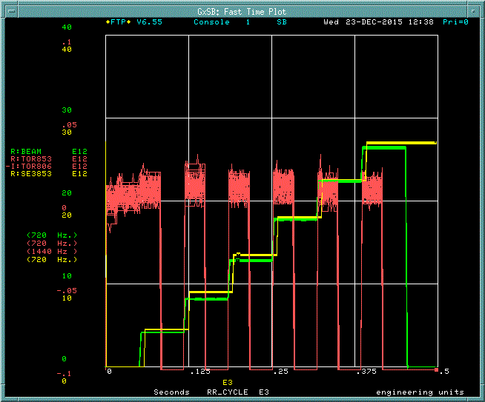
A fast time is used to compare the difference between RR DCCT intensity and RR abort toroid.
R:TOR853 and I:TOR806 agree injection-by-injection.
R:SE3853 is 3.12% higher than R:TOR905.

