Slide 1
Calculation of
Improved Tapered Coupler
~pickup in groove~
Wataru Uno, Kyoto Univ.
T.Toyama (KEK),
K. G. Nakamura, T. Nakaya, A. Ichikawa, A. Minamino (Kyoto Univ.)
Notes:
I will talk about the calculation of improved tapered coupler monitor.

Slide 2
Outline
Introduction ~some types of pickup shape
Motivation ~current problem of exponential tapered coupler
Idea to improve BPM ~trapezoid pickup in groove
Method of calculation ~setting of parameters
Result
Summary & Next Plan
Notes:
This is the outline of my talk.
Firstly, I explain some types of shapes of pickup and their advantage and disadvantage as introduction. And secondly, I speak the trapezoid tapered coupler in groove as the idea to improve current BPM. Next, I talk about setting parameter of the calculated trapezoid tapered coupler and the calculation of characters of the BPM. And fourthly, I explain the result of the simulation and lastly, summary and next plan.

Slide 3



Introduction
z
$$F\left(ω\right)=\frac{iω}{2}\int_{0}^{\frac{2l}{c}}{K\left(\frac{ct}{2}\right)e^{−iωt}}dt$$
Exponential Tapered coupler
Sensitivity at the frequency
Strength of induced
charge at z
T. Linnecar:
High frequency longitudinal and
transverse pickups used in the SPS,
CERN-SPS/ARF/78-17
z=ct
$$F\left(ω\right):transfer function$$
$K\left(z\right):coupling function$
stripline
exponential
Notes:
Firstly, introduction. According to linnecar, the transfer function F(w) and the coupling K have the relationship like this. Transfer function is the value showing the sensitivity at the frequency w and coupliing K(z) is one showing the strength of induced charge at z. in this equation, l is the length of pickup and c is light speed. In case of stripline pickup, the coupling become constant along z, so the transfer function become sine wave like green line. As you can see, there are no sensitivity at some frequency. One of ways to solve the problem is making the shape of pickup into exponential. In that case, the coupling also becomes exponential and the transfer function becomes like black line. Fluctuation is small in frequency. In fact, there is a exponential tapered coupler BPM in J-PARC.

Slide 4
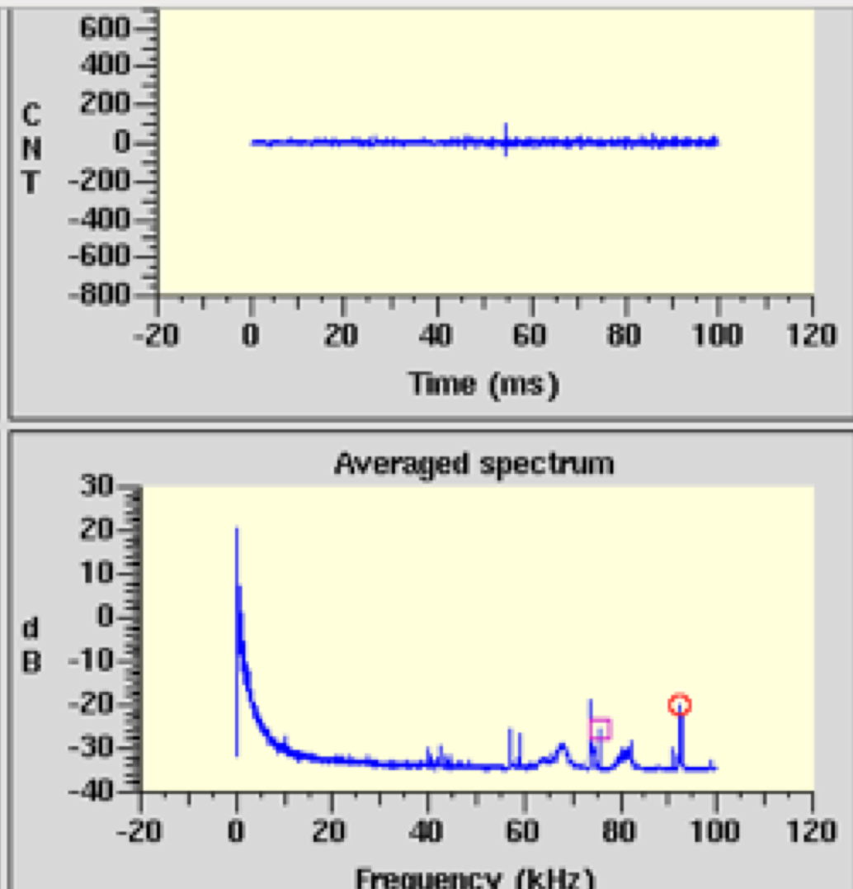
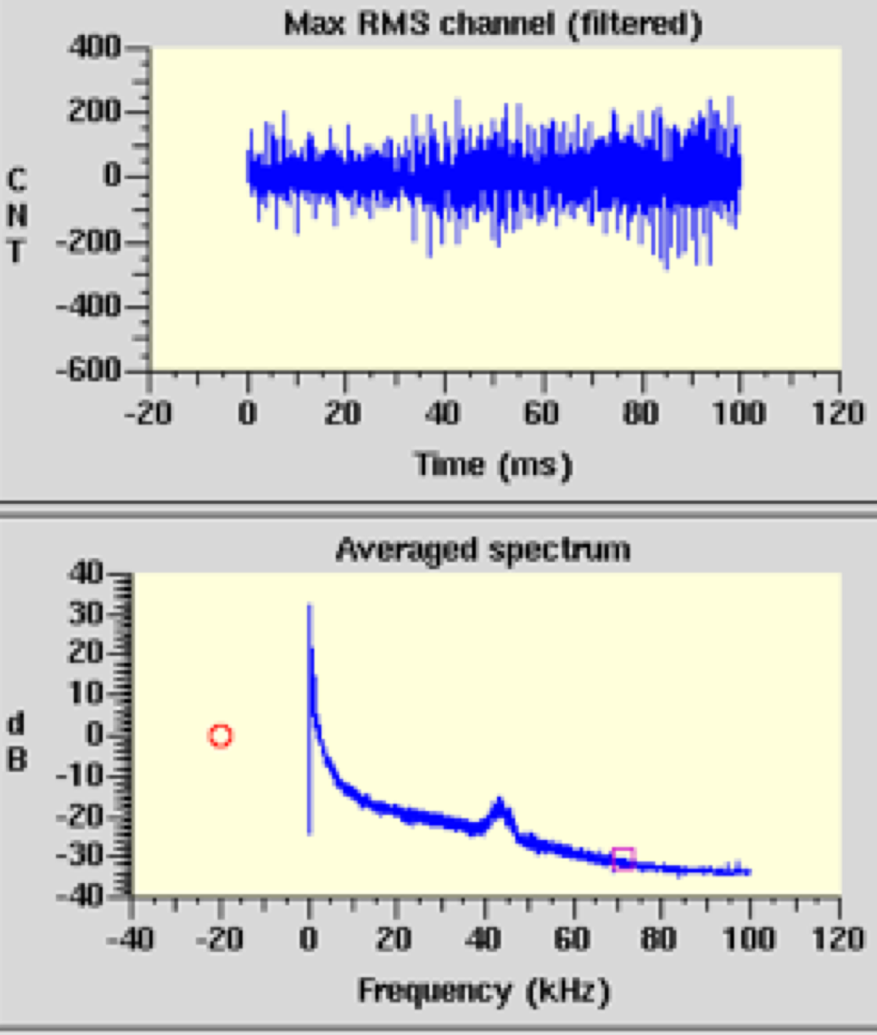
Motivation
Situation:
Intra-bunch feedback system uses exponential tapered coupler
Exponential coupler has background because of unbalance between pickups
horizontal
vertical
Notes:
It is used for Intra-bunch feedback system and it plays role for high intensity. However, the BPM has background in its signal because of difference of character between pickups. Exponential tapered coupler need complicated 3D curve to match characteristic impedance and it is difficult to make 3Dcurve accurately. The cause of differenct characters of pickup is the machining accuracy.
So we want to improve the exponential tapered coupler. One of the solutions for the problem is set the shape of pickups into linear because it is not so difficult to cut metal linearly. In this reason we adopt trapezoid as shape of pickup.

Slide 5
3D curve is needed to match characteristic impedance
-difficult to machine accurately
->Unbalance between pickups is likely to happen
Looking from up
pickup
Looking from side
pipe
Close to pipe exponentially

Slide 6
We want simple design of improved tapered coupler!
Idea: Linear shape ->Trapezoid
stripline
exponential
trapezoid
Want to make coupling small in middle z
Want to make transfer function flat in frequency
Want to coupling close to 0 at end point

Slide 7
Trapezoid pickup in groove
gap
Coupling ~ width of pickup (without groove) (1)
~ 1/depth of groove(with groove) (2)
EXPECTATION:
Combining effect (1) and (2) makes higher order
Five variable parameters:
Three parameters varied:
depth
width
Width, Thickness, Depth,
Groove width, Gap
Width, Depth, Gap
Cross section of BPM
Notes:
Coupling is approximately proportional to width of pickup. And it will be inverse proportional to depth of groove because electro-magnetic wave will hard to invade to deep area of groove.
So we expected that combining the effect of width of pickup and depth of groove makes the coupling function into higher order. So I thought of changing these parameters along z linearly.
This is the image of cross section of BPM with groove. These 4 rectangle is pickups. This is the zoom around pickup. In case of putting pickup in groove, there are 5 variable parameters in each z, width and thickness of electrode, width and depth of groove and the gap length between pickup and the bottom of groove. As I have already said, these parameters can be varied linearly along z. There are 5 parameters, however, in this time, I controled just 3 parameters for simplicity and the other parameters are fixed. The 3 parameters are width, depth and gap.

Slide 8

Method of Calculation
~2D-Boundary Element Method~
Pickup length : 300mm ->6mm step
z : 0.00mm ~300.00mm
Width : 21.30mm ~ 9.18mm
Depth : 3.70mm ~ 5.89mm
Gap : 6.00mm ~ 5.27mm
Thickness : 2.50mm
Groove width : 25mm
cf. Inner diameter of Pipe : 82.5mm
Three parameters are varied linearly along z
Notes:
Next, I talk about the method of calculation. The Energy of proton in J-PARC main ring is from 3GeV to 30GeV, and high energy enough to regard gamma factor as large. So can adopt 2-dimentional boundary element method in each z. Or I divided the boundary of BPM into many many element and I calculated the charge on each element induced when beam charge is put at center of BPM. In my calculation, I set the length of pickup to 300 mmm and I calculated by 6mm step in z. Or I calculated coupling and characteristic impedance in diferent z. This is the value of 3 parameters from and m z=0mm to z=50mm. And I set the fixed 2 parameters like this. This pictures shows the cross sections at both end point of BPM.

Slide 9
Result of Calculation
trapezoid in groove
Coupling close to exponential
Impedance mismatch
Notes:
I talk about result. This red plot shows the coupling in each z, As expected, the coupling is small in middle z. As referrence, I draw the linear line and exponetial line connected coupling of z=0mm to z=300mm . You can see that the coupling of trapezoid pickup in groove is close to exponential shape.
This is the characteristic impedance along z. Unfortunately there are impedance mismatch from 50Ω.

Slide 10
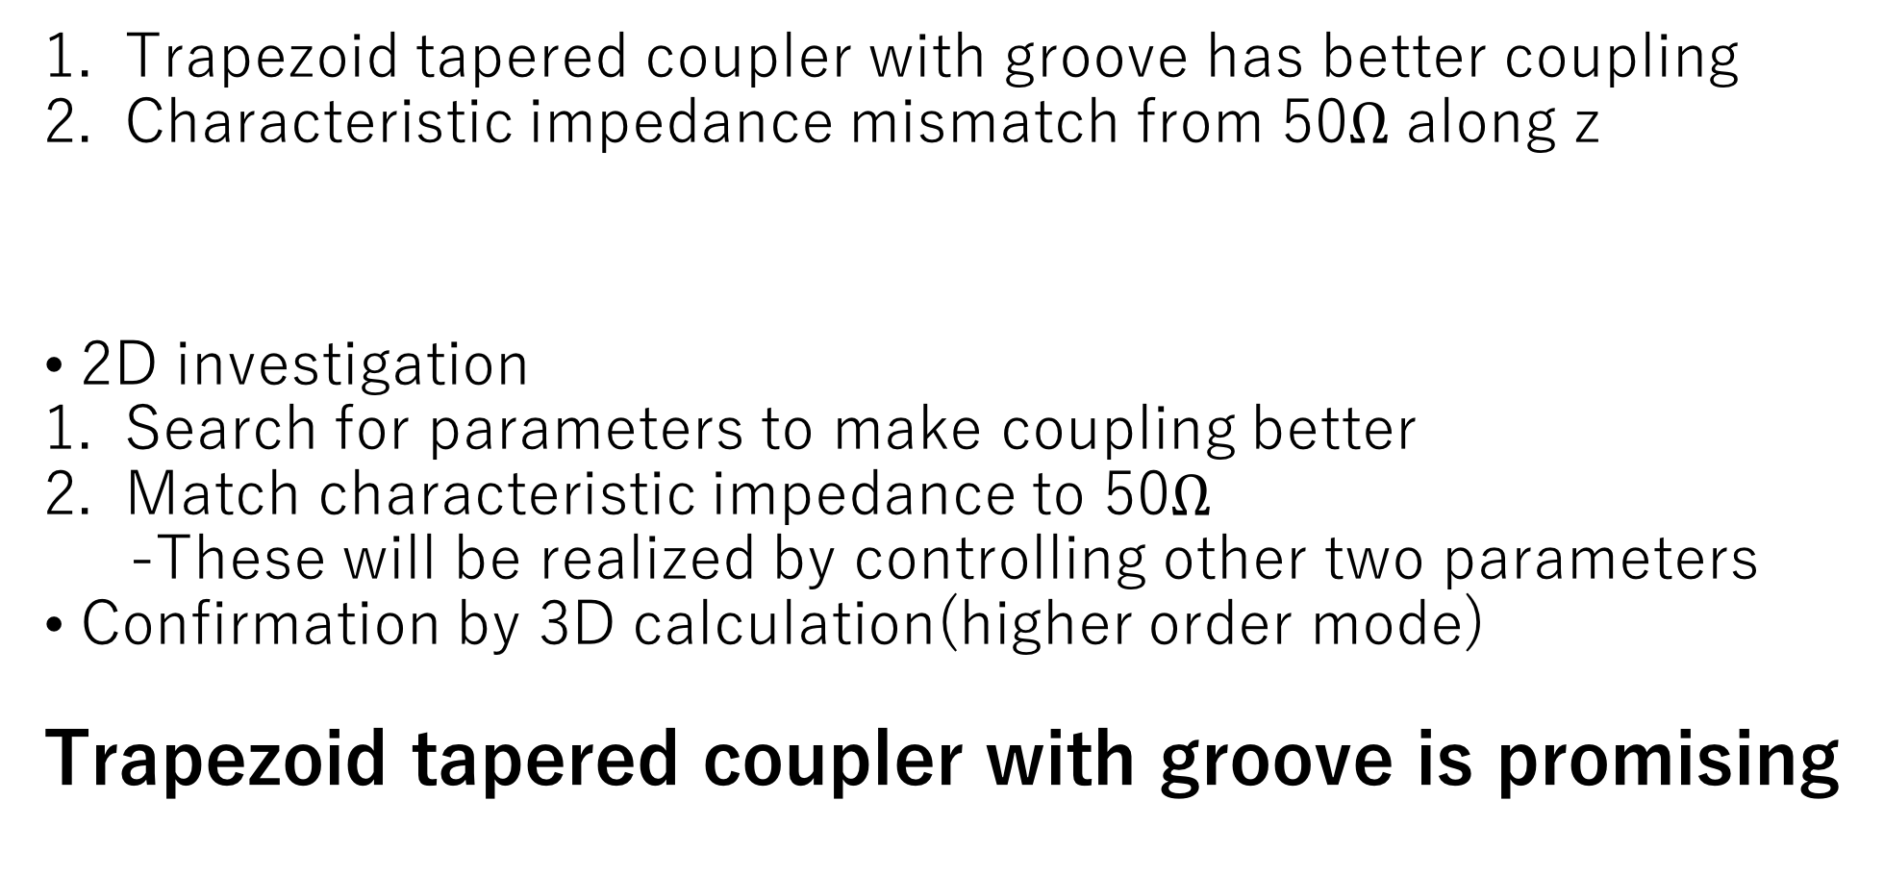
Summary
Trapezoid tapered coupler with groove has better coupling
Characteristic impedance mismatch from 50$Ω$ along z
2D investigation
Search for parameters to make coupling better
Match characteristic impedance to 50$Ω$
-These will be realized by controlling other two parameters
Confirmation by 3D calculation(higher order mode)
Trapezoid tapered coupler with groove is promising
Next Plan
Notes:
Summary. I can get the better coupling function in trapezoid pickup monitor with groove than that without groove. But there are impedance mismatch from 50Ω.
As my next plan, I want to search for better parameters to make the coupling more near to exponential shape. And I also want to search for the setting in which impedance mismatch is as small as possible. We expect that these goal will be realized by controlling other 2 parameters in addition to 3 parameters varied in this time.
That’s all. Thank you.

Slide 11
Backup

Slide 12
Exponential monitor character in MR
down
up
left
right

Slide 13
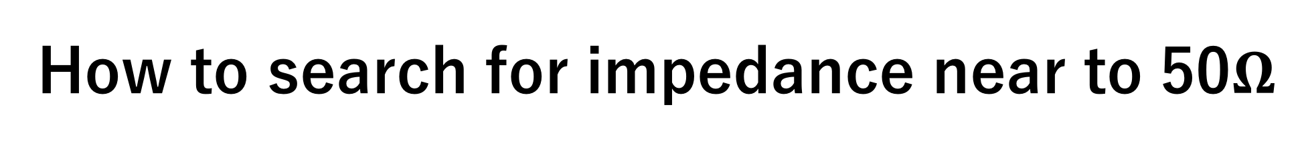
How to search for impedance near to 50$Ω$

Slide 14
What is wire-cut discharge machining?
wire
Wire
stainless

Slide 15
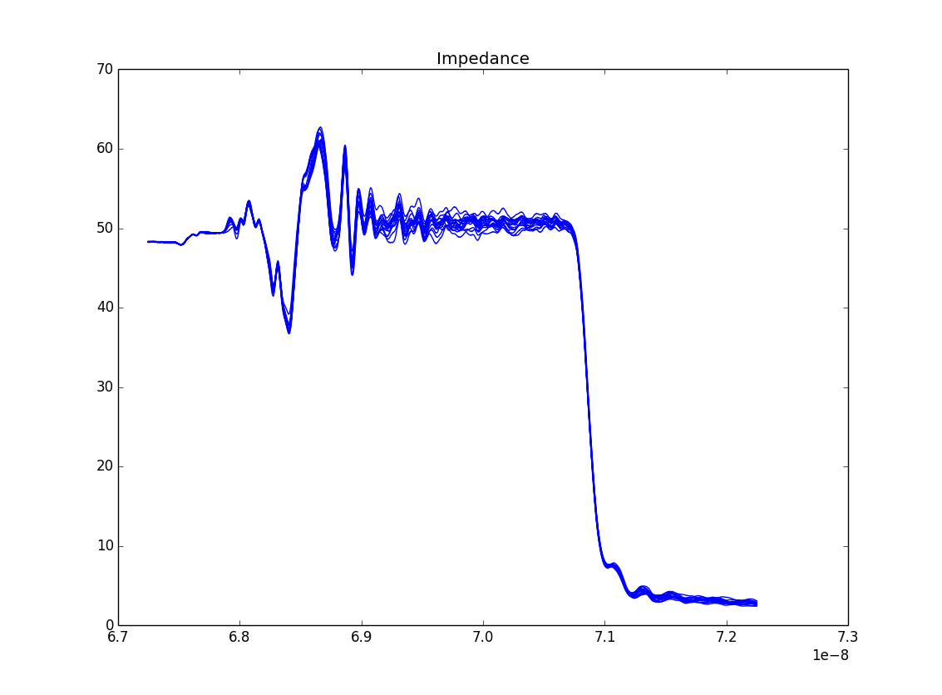
machining accuraccy of groove

