Slide 1
While the DCCTs have better performance than the toroids, the DCCTs here at DCCTs are used to provide average intensity in the machines. As a result, intensity measurement are filtered to a final data rate of 720Hz and turn-by-turn comparsions of intensity or beam energy loss is done on a turn by turn basis.
The beam energy loss measurement (I:BEL) is product of the derivative of the intensity (I:BEAM) and energy in the machine. I:BEL can then provide a fast summary of the overall energy lost in the ring. Turn by turn, the machine parameters are tuned to keep large steps or wiggles in I:BEL at low energies. Losses at lower energies relates to less activation in the loss monitors.
Since I:BEL is determined by the changes to intensity, the MI DCCT must provide <<1% error. The table is from 2012.
The effects of the BEL tuning can then qualitatively compared to sum of the loss monitor outputs. Loss monitor showing regions of higher losses are then looked at more closely with other diagnostic devices in that region.
Collected data over several years show good correlation between the loss monitor trends and trends on how well I:BEL is maintained.

Slide 2
Time plot of the beam energy loss measurement (red trace–I:BEL) during Main Injector injection cycle. I:BEAM (green trace) represents the time plot of the beam intensity. Calculations for this cycle, in which 44:561012 protons were injected, showed 4.11% 8 Gev loss.
Time plot of the beam energy loss measurement (red trace–I:BEL) during Main Injector injection cycle. I:BEAM (green trace) represents the time plot of the beam intensity. Calculations for this cycle, in which 28:531012 protons were injected, showed 0.40% 8 Gev loss.

Slide 3
Since toroids are relied on for transfers and more localized intensity losses, much effort has been done to minimize systematic errors in the readout.
Errors related to timing, burden resistor measurements, and temperature can be difficult to overcome on the <1% level. Over a several years, these issues were addressed in the toroid systems with the switched capacitor integrator.
MiniBoone first observed the improved repeatability of the toroid system in 2004. NuMI has also seem better than 0.5% stability.

Slide 4
MiniBoone Toroids (2004)
The plot above compares fluctuations in gain over time between transport beam intensity monitors with (blue) and without (green) electronic modifications. The gains were tracked during successive calibrations in between beam transfers over several days and were calculated using a least squares fit model between measured intensities and expected intensities. Although both show ±0.5% long-term gain drift (red arrow bars), the new electronics show ±0.1% RMS pulse-to-pulse variation, in contrast to ±0.3% in the older electronics (purple arrow bars).
Plot showing the temperature correlation between two transport beam intensity monitors (red and cyan) and the room temperature (green). Both toroid monitors are 1x10¹³ at full-scale intensity with an 11 msec integration gate. The plot shows about 3.4x10⁹ variations due to the temperature change.

Slide 5
The errors in intensity systems have to be understood to better than the resolution/accuracy of the calibration source used. As a result, the errors due to calibration is bound by the equipment.
Specific equipment is dedicated for the intensity monitor calibrations. And it is kept within its resolution requirements with its own calibration.
The calibration procedure should try to reproduce the nominal operations. This minimize the impact of non-beam related errors of the system.
The linearity of the systems are reproduceable year-to-year within the absolute accuracy of the system. For the Fermilab toroids, the calibration remains within +/-1% (or better in “quiet” locations). For DCCTs, calibration stability to <0.5%.

Slide 6
MI DCCT Open Loop Gain Response
In the MI DCCT, the response of the AC section and the DC section is combined into 1 feedback signal, which is driven through the entire pickup. It is important to note that while it is ideal to have a high gain in the integrator of the DC section, the initial system was designed for a much smaller dynamic range. Over the decades with the RF changes to the beam structure and increase of intensity/power, additional filtering to both sections was need to keep op amps away from their slew-rate limits or from region of instabilities due to higher beam harmonics. Presently, the MI DCCT will become unstable if the gain in the DC section is too high. The gain in each section is adjusted, and their sum is applied in feedback with relatively small gain. In addition, the closed loop 3dB corner of the MI DCCT closed system has been rolled off to 720Hz bandwidth.
With a control system analyzer, the sum of the AC section and the DC section in the closed feedback loop determine the depth and position of the crossover frequency.
Adjusting the gain of each section minimizes the dip in the frequency domain, which translates to reducing the slow oscillation of the same frequency in the time domain.

Slide 7
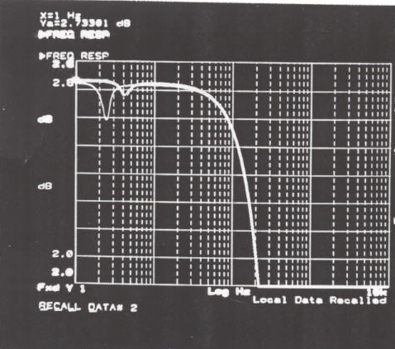
Here is an example, captured in 1999. At the time, the DCCT was instrumented with a 14bit digitizer (instead of the present-day 18bit digitizer). There is no documentation of how the machine is operating at the time, but, here in red the 0.1dB dip gives a 10% effect at close to 1Hz.

