Slide 1
Accelerator Division Status
Daniel Johnson
All Experimenters’ Meeting
10 October 2016

Slide 2
Content Slide [22pt Bold]
Bullet points are optional. If preferred, only first level bullets can be used or bullets can be set to “NONE.” [18pt Regular]
First level bullet [18pt Regular]
  Second level bullet [16pt Regular]
    Third level bullet [15pt Regular]
      Fourth level bullet [14pt Regular]
        Fifth level bullet [14pt Regular]

Slide 3
Complex Status
Summer Shutdown 2016
  Jobs continue to go well
    On schedule
      Linac and Booster Safety Signoff Complete
      BNB Safety Signoff tomorrow
      Main Injector work going well
Power Outages
  Pulsed power maintenance
  Wednesday, October 12 @ 0800-1530
    Switchyard, Feeder 43, FCC 2 & 3, FCC Transfer Switch to run on Generators
Cooling/Water Outages
  None Scheduled
  ICW flushes on hold

Slide 4
Comparison Slide [22pt Bold]
First level bullet [18pt Reg]
  Second level bullet [16pt]
    Third level bullet [15pt]
      Fourth level bullet [14pt]
        Fifth level bullet [14pt]
First level bullet [18pt Reg]
  Second level bullet [16pt]
    Third level bullet [15pt]
      Fourth level bullet [14pt]
        Fifth level bullet [14pt]
Click to add caption text [13pt Bold]
Click to add caption text [13pt Bold]

Slide 5
Content and Caption Slide [22pt Bold]
Click to add caption text
[13pt Bold]
First level bullet [18pt Reg]
  Second level bullet [16pt]
    Third level bullet [15pt]
      Fourth level bullet [14pt]
        Fifth level bullet [14pt]

Slide 6
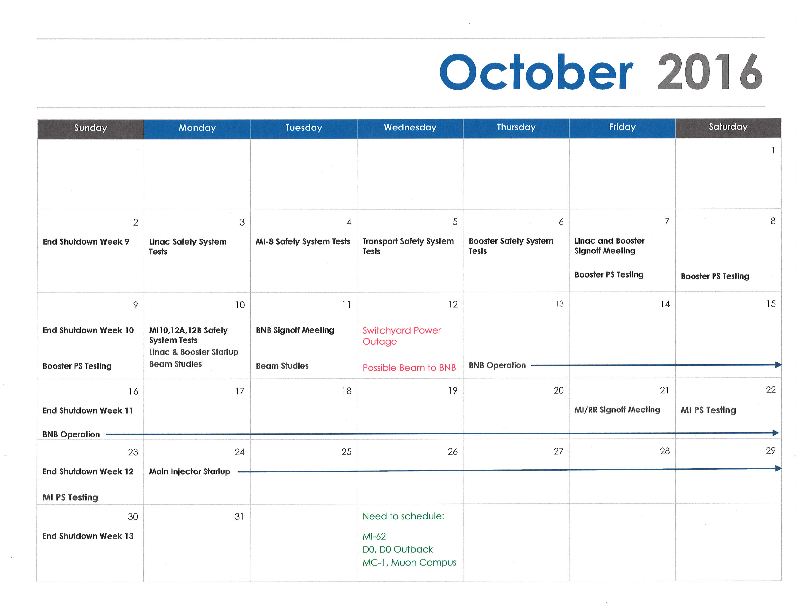
October 2016

Slide 7
PIP-II Injector Test & FAST Status
PIP-II Injector Test
  CW RFQ operation startup
    Conditioning
    Pulsed beam with 60 Hz duty factor
  Work on cave interlocks for CW operation
  Beam scans
FAST
  No gun operation
  Shutdown for 300 MeV upgrade
  Cave Block Installation Nearing Completion
  Electrical Conduit Installation continues

Slide 8
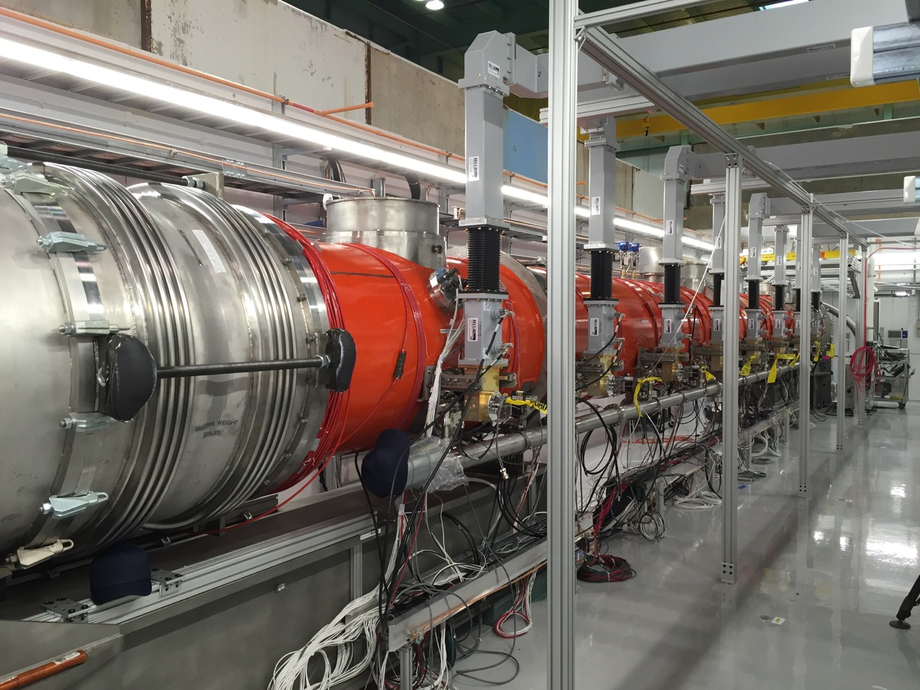
CMTS1 Status
LCLSII Prototype Cryo Module
  Things were going well
    CM accelerating voltage exceeds specification (128 MV)
  Cryo plant trip on Friday due to chiller contactor trip, recovery began Saturday
  Compressor trip this morning due to ICW flow impacted by flushing
  Plans for the week
    DOE Review next week
    Recover and cool down
    Return to CM testing
      Q0 measurements this week

Slide 9
Schedules and Links
Schedule can be accessed from the Operations Department Home Page
  Schedules -> Operations Schedule
Direct link to schedule
  http://www-ad.fnal.gov/ops/schedule.html

Slide 10














Collaborations / Partnerships / Members [22pt Bold]

