Slide 1
Engineering Documentation Strategy
Don Mitchell, PIP-II Project Engineer
DOE Independent Project Review of PIP-II
15 November 2016

Slide 2
Outline
Document Management
Project Organization
Reviews
IIFC Data Sharing
IIFC Documentation Deliverables and Dates
Addresses Charge 6:
India Institutions and Fermilab Collaboration (IIFC): Is the collaboration proceeding satisfactorily towards meeting the goals outlined in the Joint R&D document? Will the deliverables outlined in the Joint R&D document position India for a successful contribution to the PIP-II construction phase?

Slide 3
PIP-II Documentation
Docdb
Scientific publications
PIP-II department presentations
SharePoint
General documents (non revision-controlled)
Meetings
Presentations
IIFC agreements and schedules
Teamcenter
Revision-controlled engineering documents (FRS, TRS, etc.)
3-D / 2-D CAD
Design reviews
And more…

Slide 4
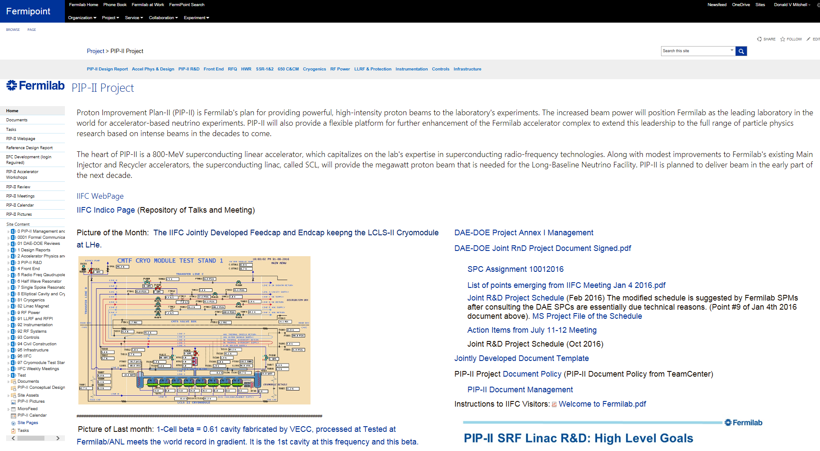
PIP-II SharePoint Documentation

Slide 5
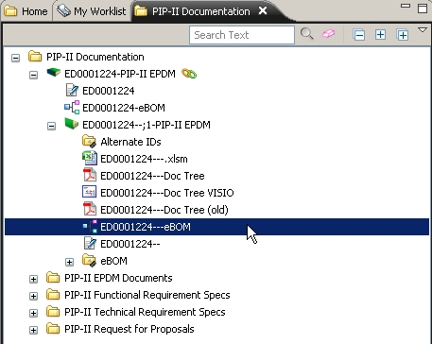
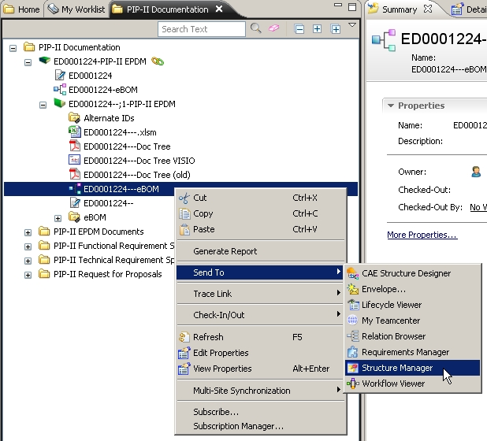
Project Organization in Teamcenter
Top Level Engineering Doc Item
Send the Hierarchy BOM to the Structure Manager.
ED0001224

Slide 6
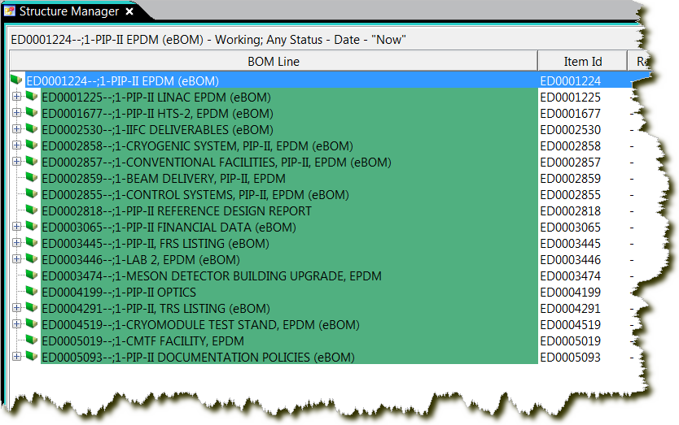
Project Organization in Teamcenter cont.
Work Packages
Links to IIFC
Facilities
Design Reports
Quarterly Reports
Optics files
Policies

Slide 7
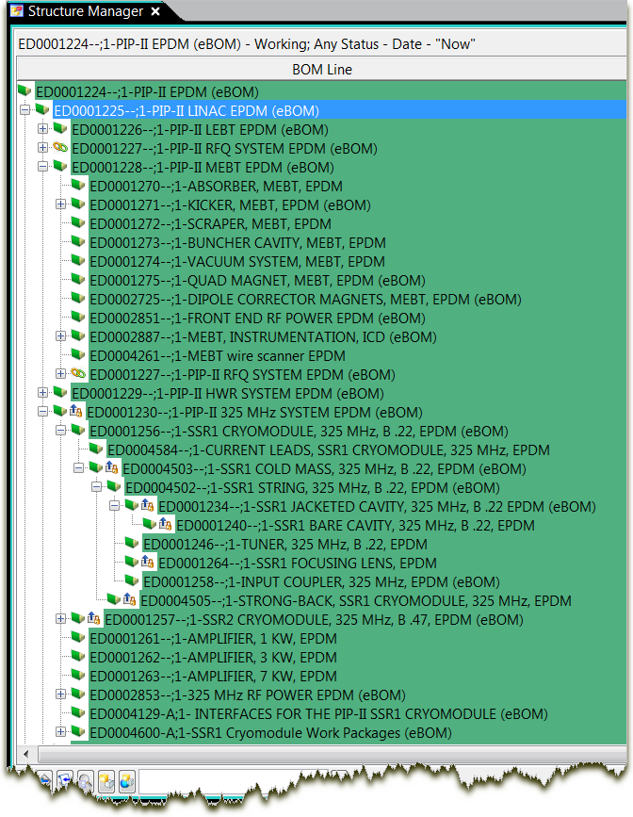
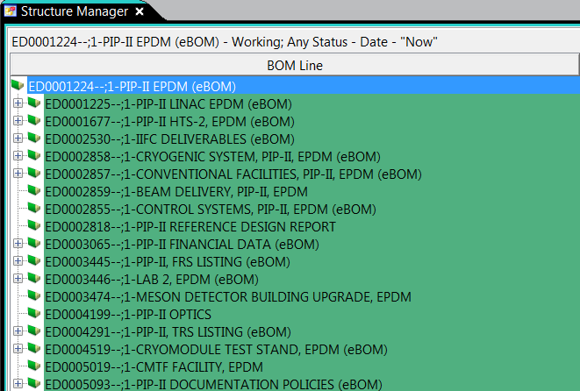
Expanding the LINAC Item
The Document structure contains the project’s work packages (EPDMs).
The data is Live and can be edited at any time.
It can be released and revised for document control.
Work Packages

Slide 8
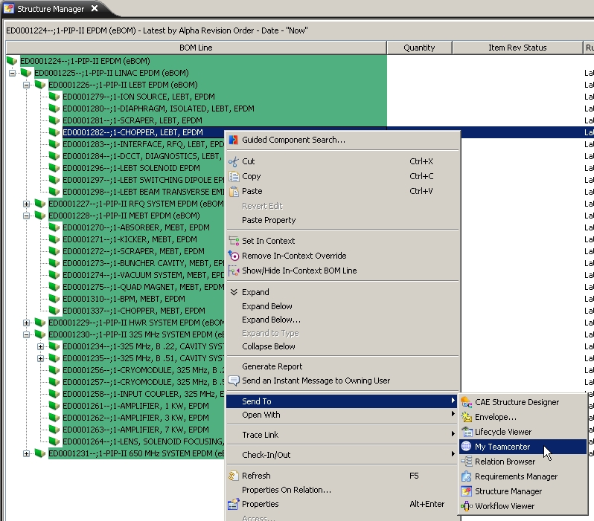
Select any item of interest and quickly send it to My Teamcenter to access the datasets.
You only need to remember the Top Level document in your project to have direct access to all of the project documentation and CAD data!

Slide 9
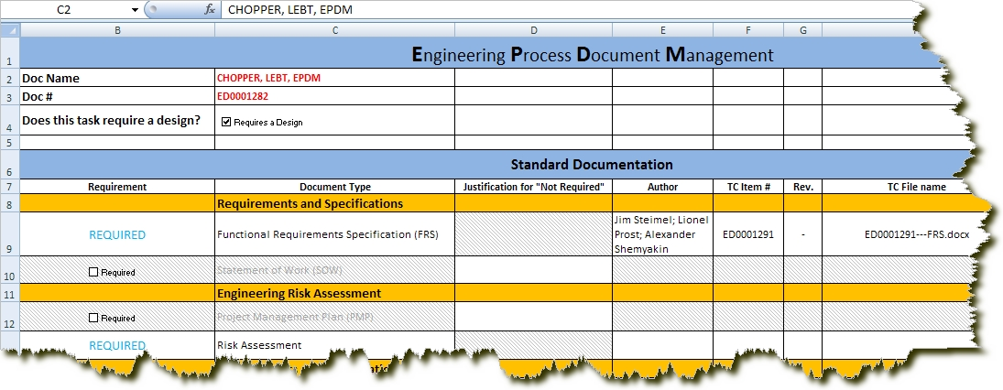
Double-Click on the Excel dataset to launch it into Excel.

Slide 10
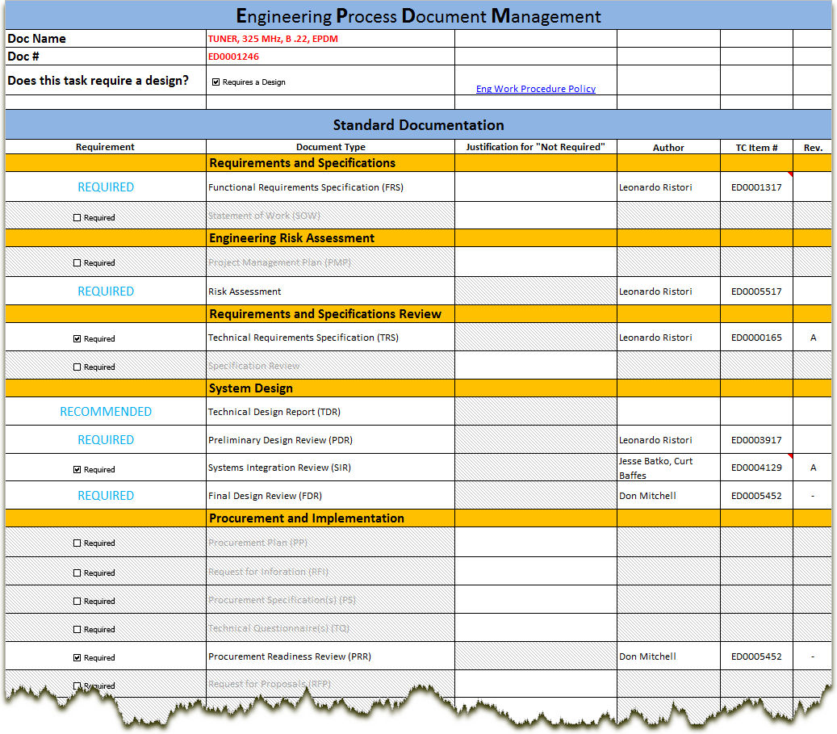

Slide 11
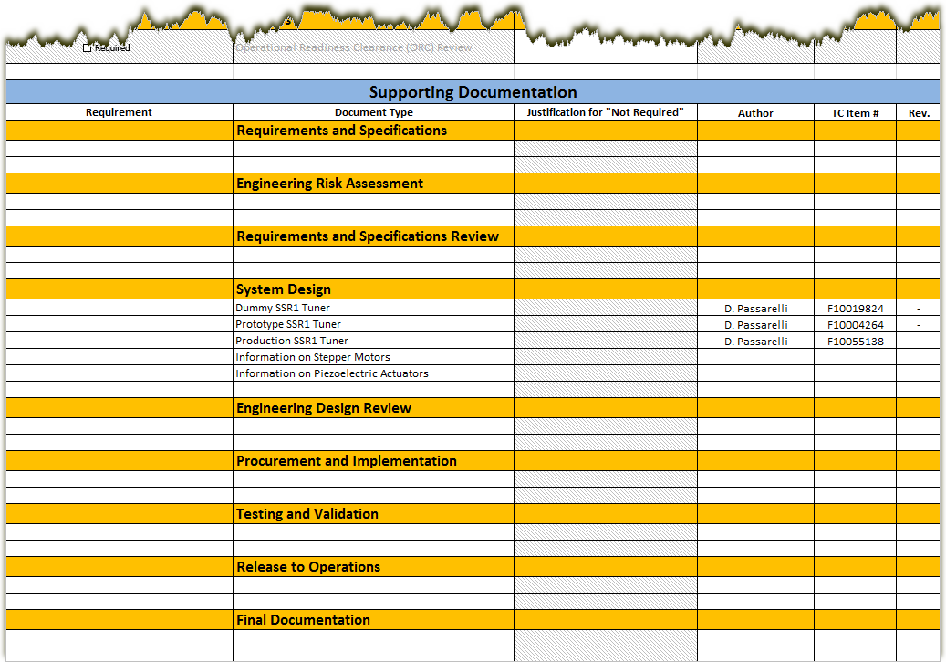
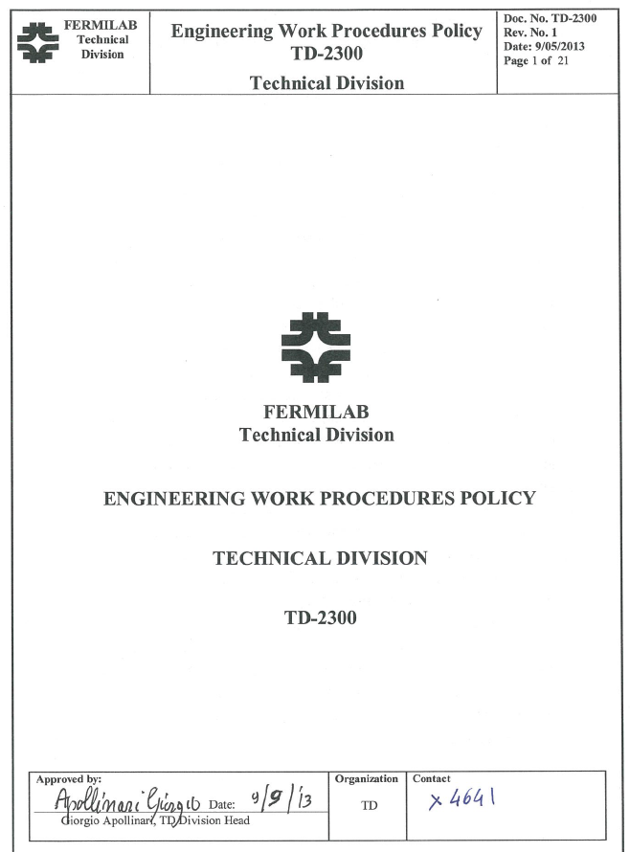
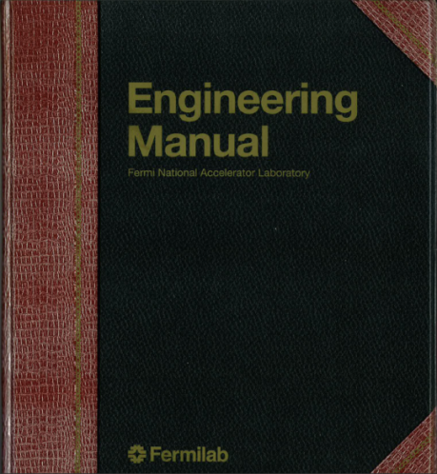
A work-package process: cradle-to-grave documentation

Slide 12
Design Reviews
Types of Reviews
Preliminary Design Review
Final Design Review
Safety Review
Operational Readiness Clearance
Frequency of Reviews
As part of the design/engineering process
Booked in advance according to the delivery schedule
Components of the review
Charge is written
Committee is formed
Supporting documentation is collected
Report with action items is prepared

Slide 13
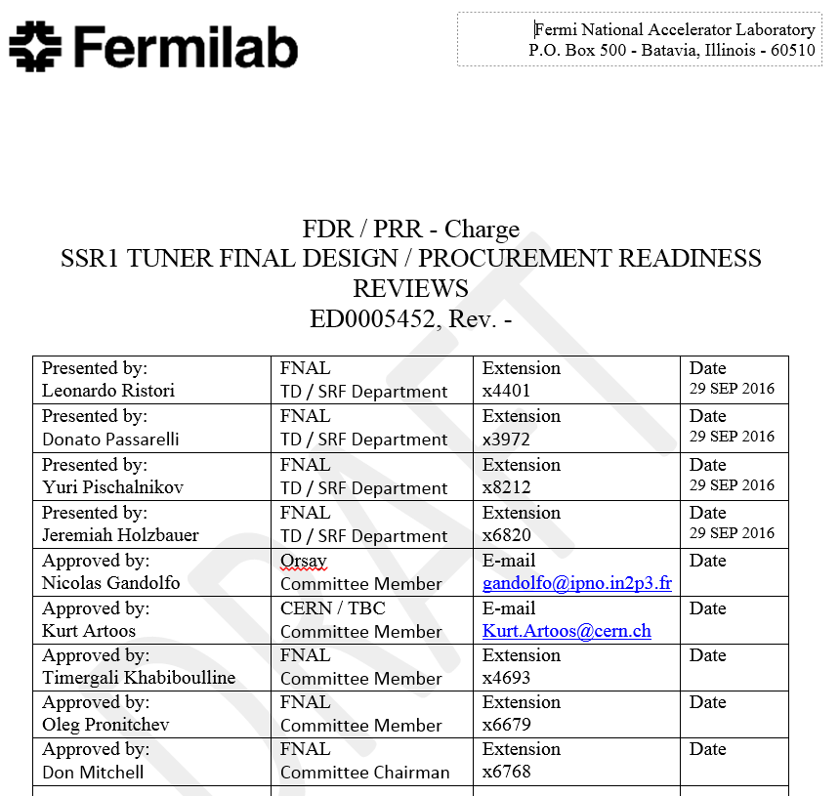
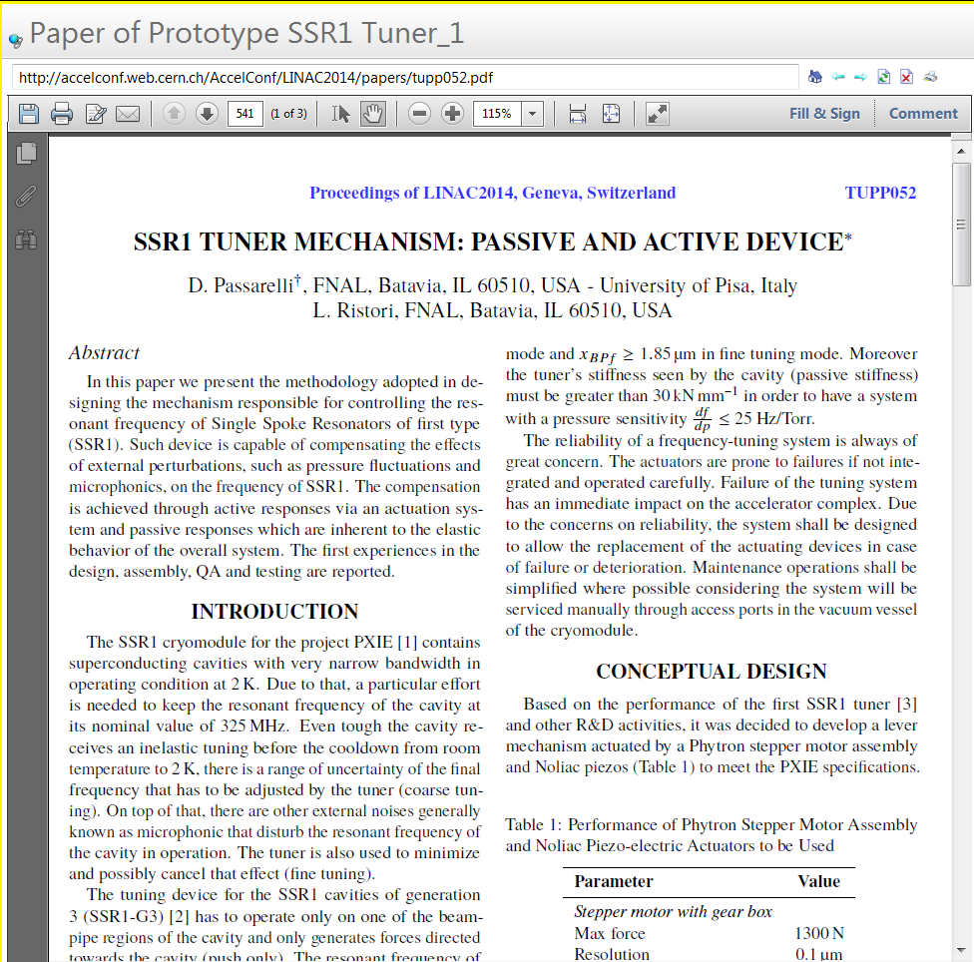
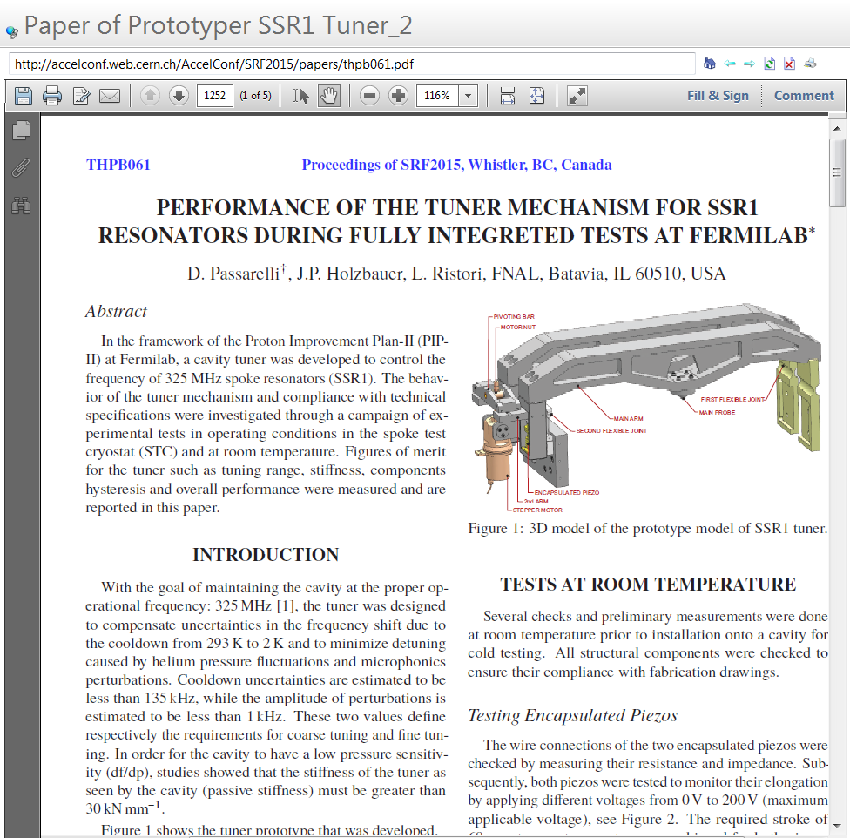
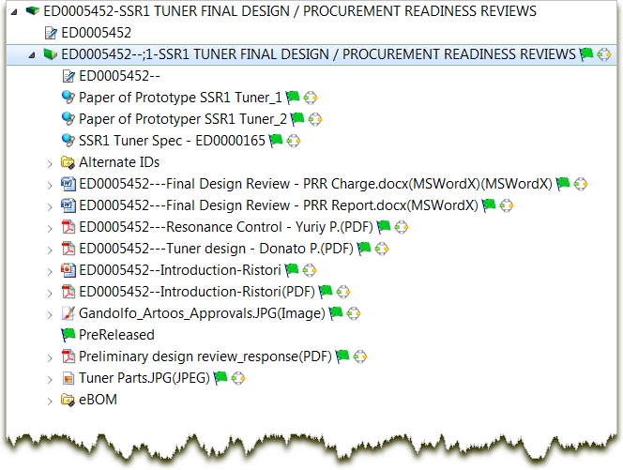
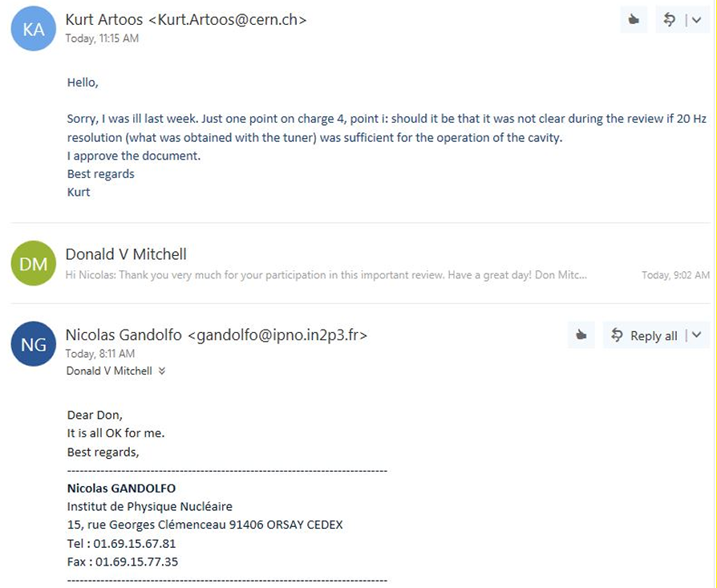
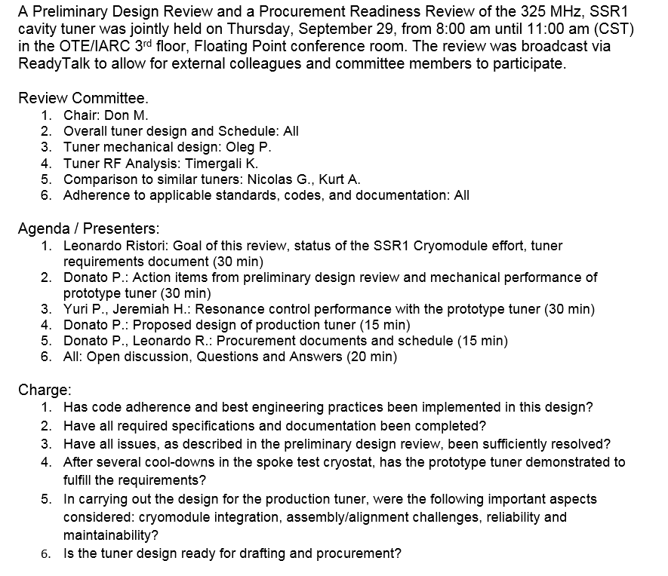
Design Review Example

Slide 14
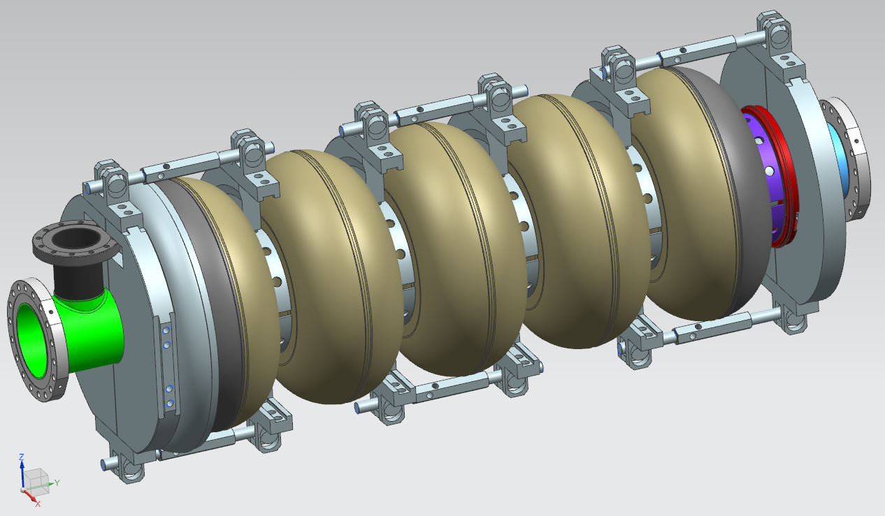
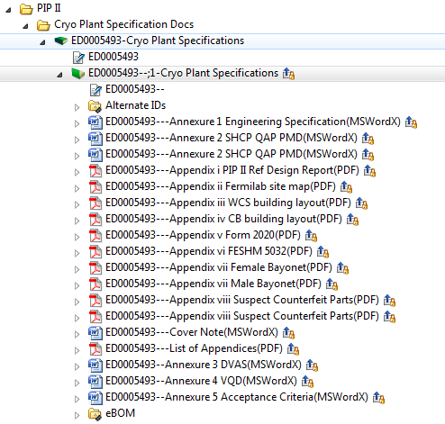
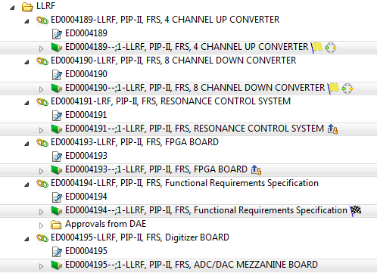
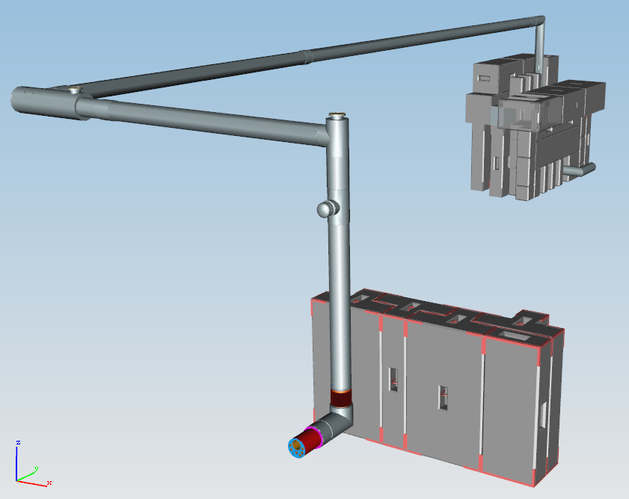
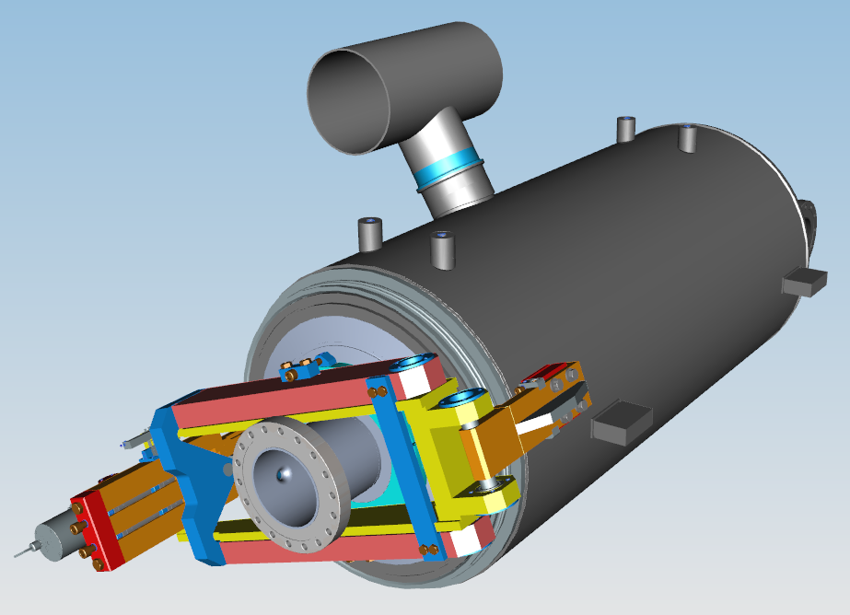
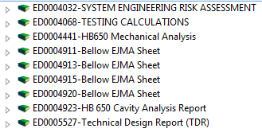
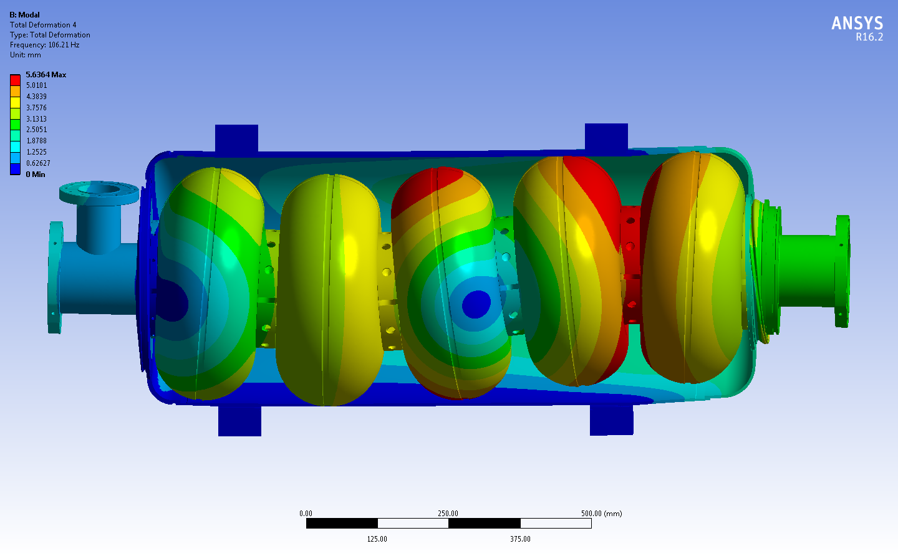
DAE Guest engineers and Scientists at Fermilab
Cryogenic
Tejas Rane
Anindya Chakravarty
Mechanical
Vikas Jain
Navneet Sharma
LLRF
Shailesh Khole
Deeraj Sharma
PIP2IT
Vyaghri Sista (Sunny)

Slide 15
PIP-II Collaboration
Collaborative effort by:
IIFC: Indian Institutions and Fermilab Collaboration
FNAL
BARC
IUAC
RRCAT
VECC
European Institutions
INFN
STFC – Daresbury
Collaborating on:
Cavities, Cryomodules, Tuners, Couplers, LLRF, Interlocks, Test stands, SC Magnets, RT Magnets, Amplifiers

Slide 16
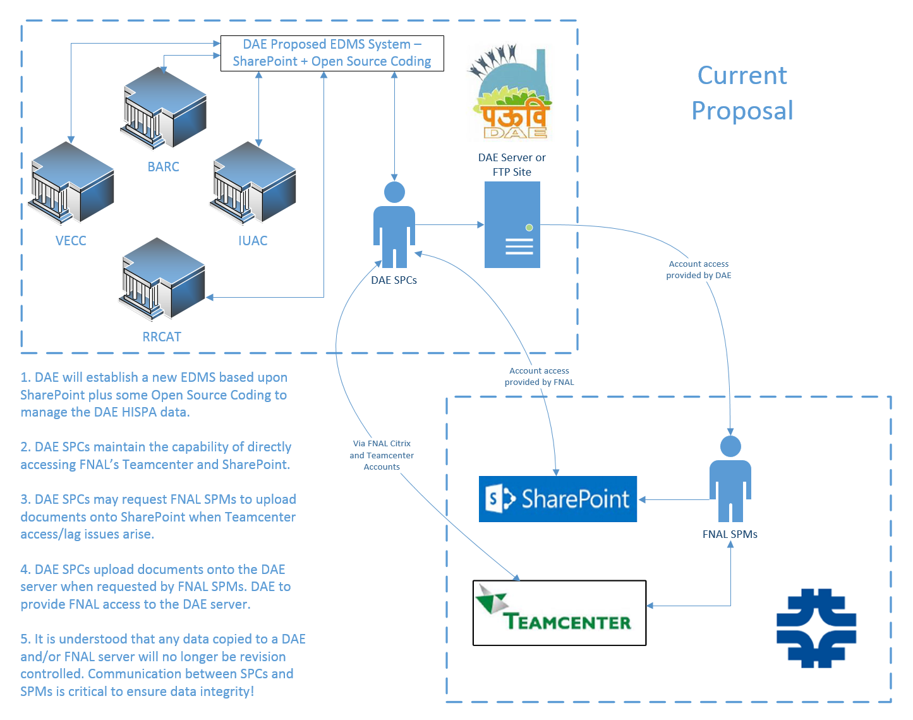
IIFC Data Sharing

Slide 17
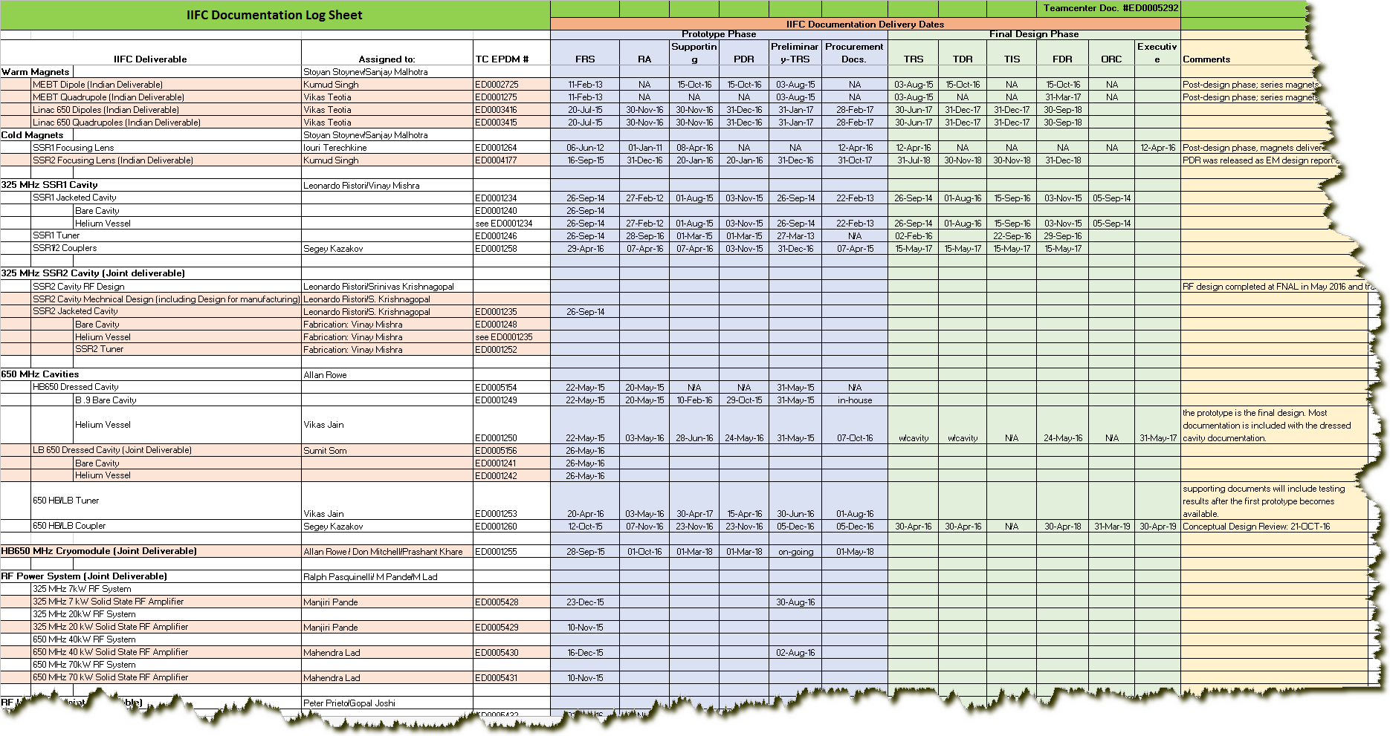
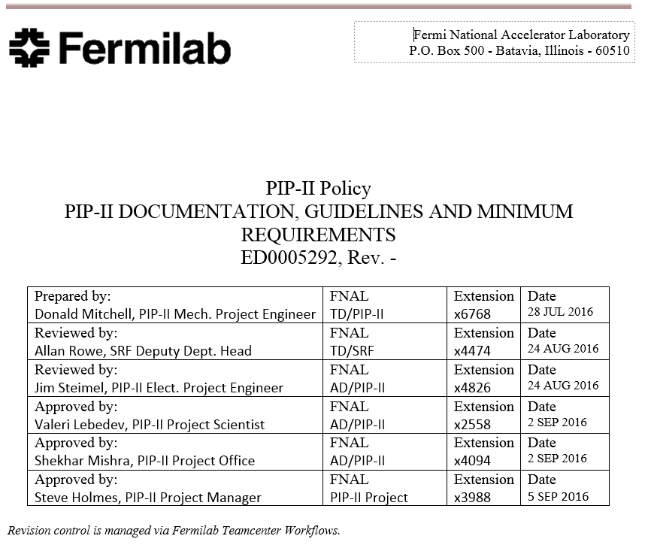
IIFC Documentation Deliverables

Slide 18
Summary
The DAE/DOE collaboration (IIFC) is progressing positively with 7 guest DAE engineers and scientists working closely with Fermilab staff to accomplish all stated goals.
Fermilab is coordinating with European institutions to collaborate on cavity and cryomodule deliverables.
Policies and procedures for document management are in place to provide document sharing among all collaborators.
Commercial software at Fermilab is being utilized to allow controlled access to all project data. (Teamcenter and SharePoint)
DAE is developing their own EDMS and is working with Fermilab to resolve outstanding IT issues.
A list of documentation with delivery dates has been established for all IIFC deliverables.

Slide 19
Questions?
Thanks for your attention,
Don - dmitchel@fnal.gov

