Slide 1
SSR2 Electromagnetic design

Slide 2
Outline
Introduction
Cavity EM parameters
Cavity geometry
Multipacting studies and mitigation
Quadrupole field asymmetry
SSR coupler Qext calculation
HOMs analysis
Summary

Slide 3
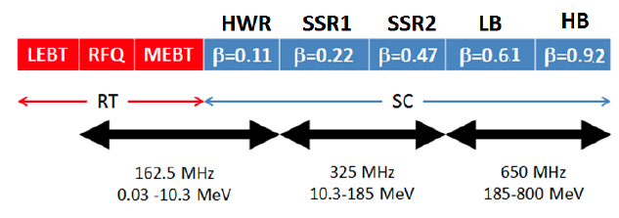
Introduction
PIP-II technology map
SSR2 is part of the SC LINAC of PIP-II, it will accelerate the H⁻ beam
from the end of SSR1 (MeV) to the beginning of the first 5-cell cavity
section (185 MeV).
The total number of SSR2 cavities needed is 35 divided into 7
cryomodules, having 5 resonators each.
SSR2 beam pipe aperture is 40 mm
Peak fields limitations are 40 MV/m for electric and 70 mT for magnetic field.
Focusing is achieved with solenoids, having integrated quadrupole and dipole correctors coils.

Slide 4
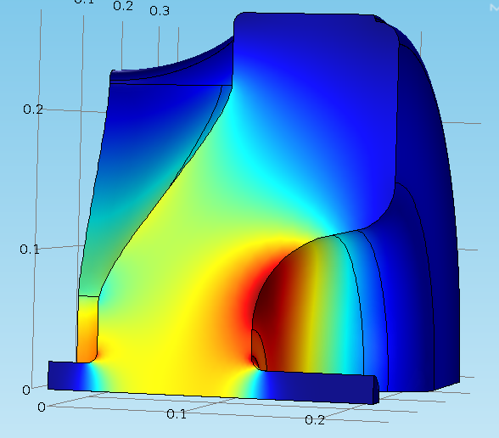
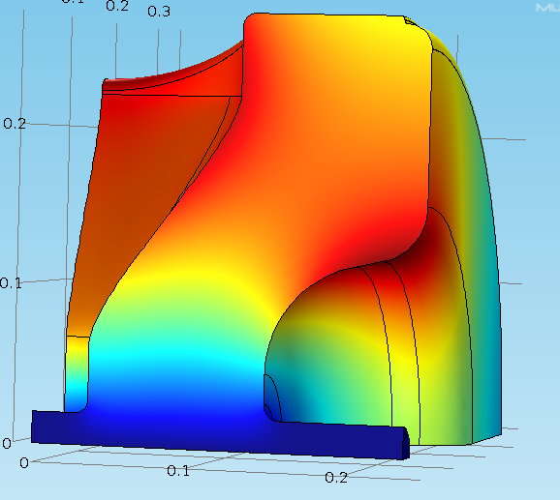
Cavity design and EM parameters
Value of beta has been optimized for PIP-II.
The RF design has been finalized.
EM parameters allow 5.17 MeV energy gain at max peak fields.
3D EM fields are shown below E on the left and H on the right.
Parameters | SSR2 v 2.6
Optimal beta β_{opt} | 0.475
Geometrical beta β_{g} | 0.402
Aperture [mm] | 40
Frequency [MHz] | 325
Effective length 2β_{opt}λ/2 [m] | 0.438
Epeak/Eacc | 3.38
Bpeak/Eacc [mT/(MV/m)] | 5.93
G [Ohm] | 115.2
R/Q [Ohm] | 296.6
Max Epeak [MV/m] | 40
Max Bpeak [mT] | 70
Max energy gain [MeV] | 5.17
Max gradient [MV/m] | 11.8

Slide 5
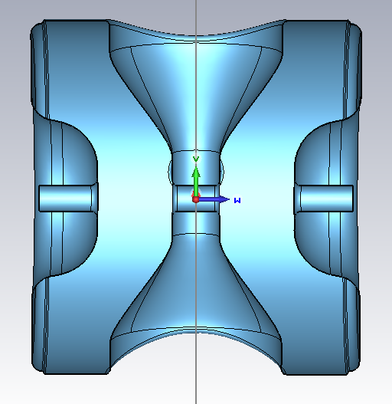
Electromagnetic Design - I
All dimensions are for the cold cavity (2K)
R_spoke
Parameter | Length [mm]
L_cav | 500
R_cav | 271.6
R_spoke | 130.71
D_aperture | 40
Gap_to_gap | 185.9
W_spoke | 72.26
L_cav
D_aperture
Gap_to_gap
W_spoke
R_cav
Z-Y cavity cross section

Slide 6
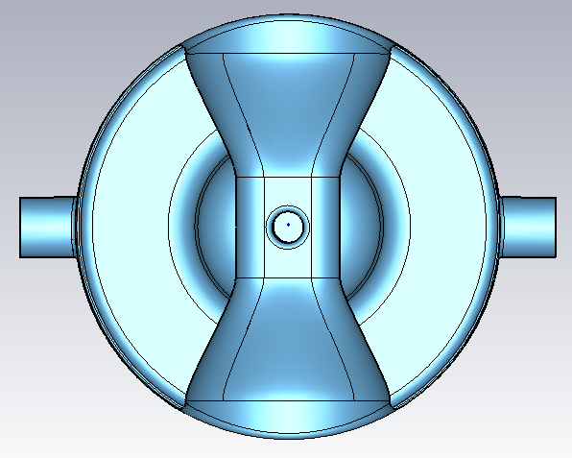
Electromagnetic Design - II
Parameter | Length [mm]
CP_to_center | 337
CP_diam | 76.90
H_spoke | 133
R-cav | 271.6
R_cav
CP_to_center
H_spoke
X-Y cavity cross section

Slide 7
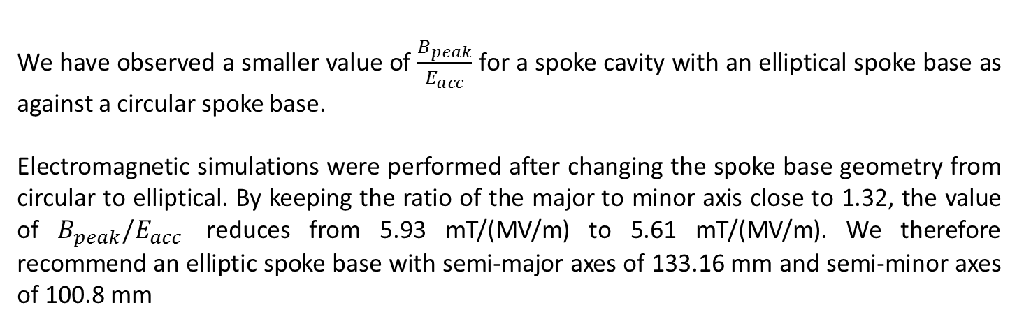


Elliptical spoke base
D

Slide 8
Multipacting simulations

Slide 9
Multipacting Simulation
Multipacting simulations were performed using MW CST, Particle-in–cell module.
Systematic simulations were performed to study the dependence of mesh density, particle number, number of bunches, initial electron energy and simulation time on the secondary electron emission yield.
Corner radius of curvature was varied to study the effect of the multipacting results (based on initial work by Paolo Berutti).
Effect of change in the curvature radius on the rf parameters was also studied.

Slide 10
Multipacting Simulation
Table.1: Variation with number of mesh points.
No. of mesh cells (million) | Simulation time (nsec) | No. of bunches | No. of particles | Electron energy (eV) | Growth rate (ns⁻¹)
20 | 100 | 1 | 1200 | 0.00167 | 0.05
50 | 100 | 1 | 1200 | 0.00167 | 0.036
100 | 100 | 1 | 1200 |  | 0.034
No. of mesh cells (million) | Simulation time (nsec) | No. of bunches | No. of particles | Electron energy (eV) | Growth rate (ns⁻¹)
20 | 100 | 1 | 1200 | 0.00167 | 0.05
50 | 100 | 1 | 1200 | 0.00167 | 0.036
100 | 100 | 1 | 1200 |  | 0.034
Table 2: Variation with simulation time.
No. of mesh cells (million) | Simulation time (nsec) | No. of bunches | No. of particles | Electron energy (eV) | Growth rate (ns⁻¹) | Comments
50 | 100 | 1 | 1200 |  | 0.036 | Not saturated
50 | 150 | 1 | 1200 | 0.00167 | 0.037 | saturated
No. of mesh cells (million) | Simulation time (nsec) | No. of bunches | No. of particles | Electron energy (eV) | Growth rate (ns⁻¹) | Comments
50 | 100 | 1 | 1200 |  | 0.036 | Not saturated
50 | 150 | 1 | 1200 | 0.00167 | 0.037 | saturated
Table 3: Variation with number of bunches.
No. of mesh cells (million) | Simulation time (nsec) | No. of bunches | No. of particles | Electron energy (eV) | Growth rate (ns⁻¹)
50 | 150 | 1 | 1200 | 0.00167 | 0.037
50 | 150 | 3 | 1200 | 0.00167 | 0.037

Slide 11
Multipacting Simulation
Table 4: Variation with electron energy.
No. of mesh cells (million) | Simulation time (nsec) | No. of bunches | No. of particles | Electron energy (eV) | Growth rate (ns⁻¹)
50 | 150 | 1 | 1200 | 0.00167 | 0.037
50 | 150 | 1 |  | 4 | 0.037
No. of mesh cells (million) | Simulation time (nsec) | No. of bunches | No. of particles | Electron energy (eV) | Growth rate (ns⁻¹)
50 | 150 | 1 | 1200 | 0.00167 | 0.037
50 | 150 | 1 |  | 4 | 0.037
Table 5: Variation with number of particles.
No. of mesh cells (million) | Simulation time (nsec) | No. of bunches | No. of particles | Electron energy (eV) | Growth rate (ns⁻¹)
50 | 150 | 1 | 1200 | 0.00167 | 0.037
50 | 150 | 1 |  | 0.00167 | 0.037
No. of mesh cells (million) | Simulation time (nsec) | No. of bunches | No. of particles | Electron energy (eV) | Growth rate (ns⁻¹)
50 | 150 | 1 | 1200 | 0.00167 | 0.037
50 | 150 | 1 |  | 0.00167 | 0.037
The above results shows that, the growth rate is primarily determine by the mesh density and simulation time

Slide 12
Dependence on RF parameters
Table. 7. Effect on multipacting by varying the double corner radius on Fermilab’s SSR 2 cavity.
Radius (mm) | Epk/Eacc | Bpk/Eacc (mT/(MV/m)) | R/Q | Growth rate
3 | 3.42 | 5.93 | 294 | 0.037
5 | 3.42 | 5.98 | 296 | 0.042
7 | 3.42 | 6.01 | 297 | 0.042

Slide 13
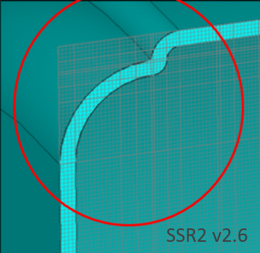
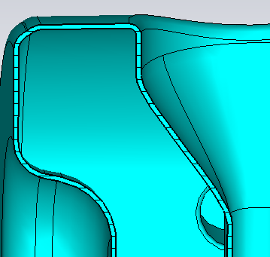
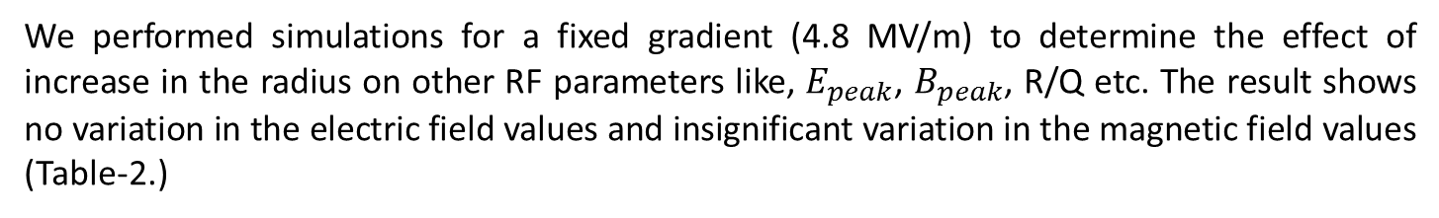
Corner curvature radius
The current simulation design of SSR-2 contained a small corner curvature that leads to reduction in secondary electron growth rate. The radius of curvature need to be chosen carefully tp avoid any kind of fabrication limits. So we studied the effect of an increase in radius on multipacting as well as peak fields
3 mm curvature radius
7 mm curvature radius
Radius (mm) | Epk/Eacc | Bpk/Eacc (mT/(MV/m)) | R/Q (ohm) | Growth rate (nsec⁻¹)
3 | 3.42 | 5.93 | 294 | 0.037
5 | 3.42 | 5.98 | 296 | 0.042
7 | 3.42 | 6.01 | 297 | 0.042

Slide 14
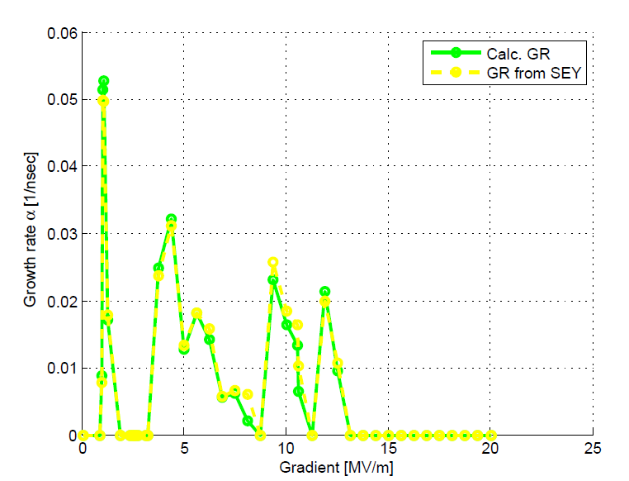
Multipacting simulations result
Simulations are performed to determine the growth rate for the SSR-22 cavity at the corner curvature radius of 7 mm and is compared with the growth rate with a corner curvature radius of 3 mm.

Slide 15
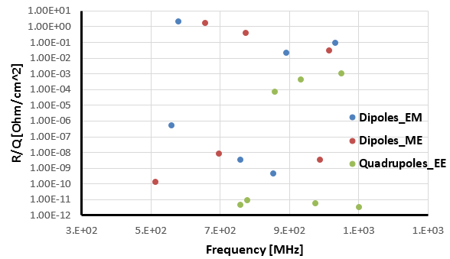
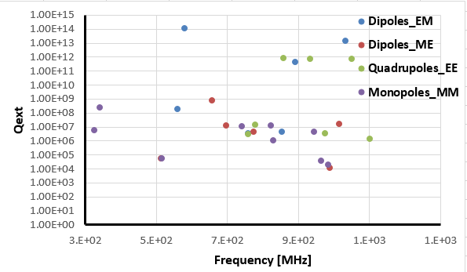
HOM Analysis-I
R/Q and Qext have been calculated for all the HOMs: monopoles, dipoles and quadrupoles.
The pics below show R/Q for all dipoles and quadrupoles, on the left, and Qext calculation, on the right including monopoles.
<number>
P. Berrutti - SSR2 RF Design

Slide 16
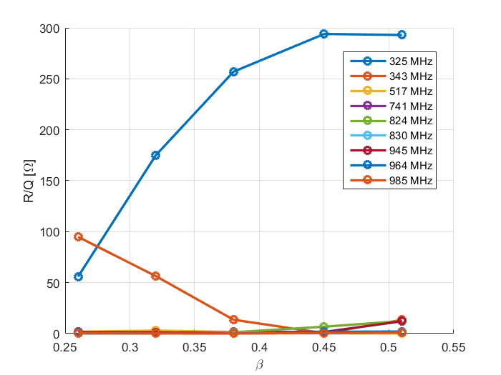
HOM Analysis-II
R/Q for monopoles modes has been calculated as a function of the particle beta, in the energy range of SSR2 cavity.
The zero mode (343 MHz) R/Q is higher than the accelerating mode R/Q, being the frequency ≈18 MHz away from the accelerating mode it should not be a dangerous resonance, it needs to be checked (beam harmonic analysis).
<number>
P. Berrutti - SSR2 RF Design

Slide 17
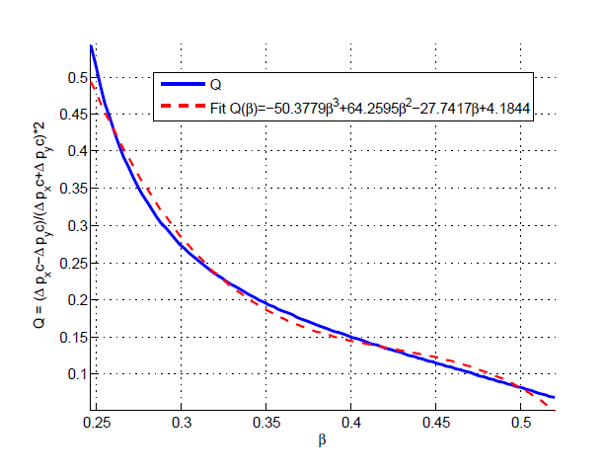
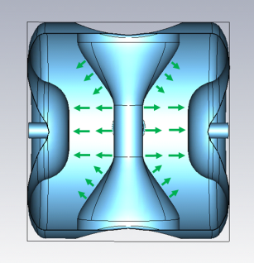
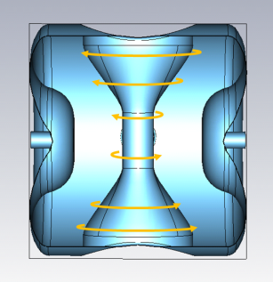
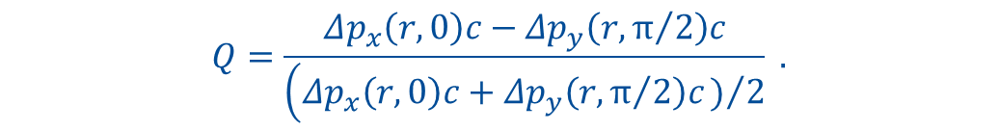
Quadrupole field asymmetry
Spoke resonators have a central electrode that lies on one of the axes perpendicular to the particles motion, breaking axial symmetry of the cavity.
Electric and magnetic field SSR2 fundamental mode sketch.
Q vs particle beta for the whole energy range of SSR2
The quadrupole field asymmetry of SSR2 has been studied and it is within the range of the quadrupole corrector integrated in the solenoids.
<number>
P. Berrutti - SSR2 RF Design

Slide 18
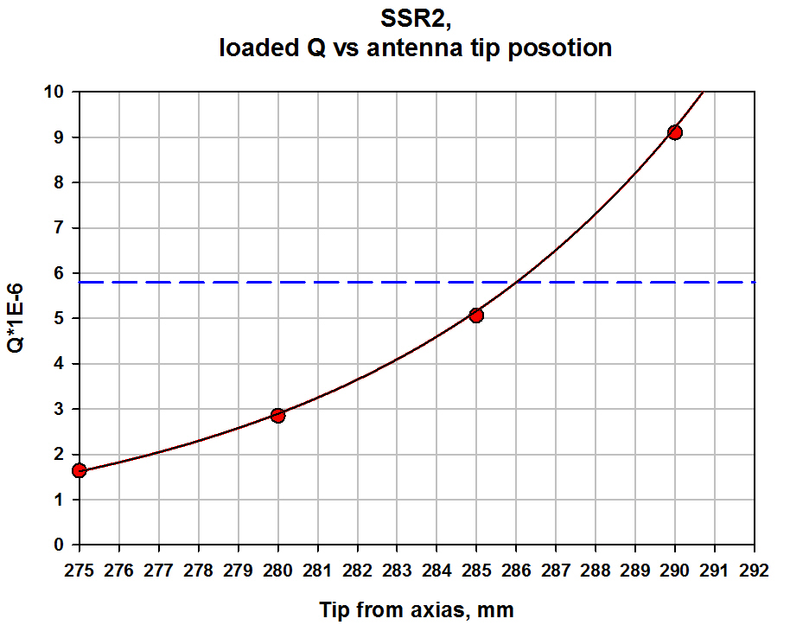
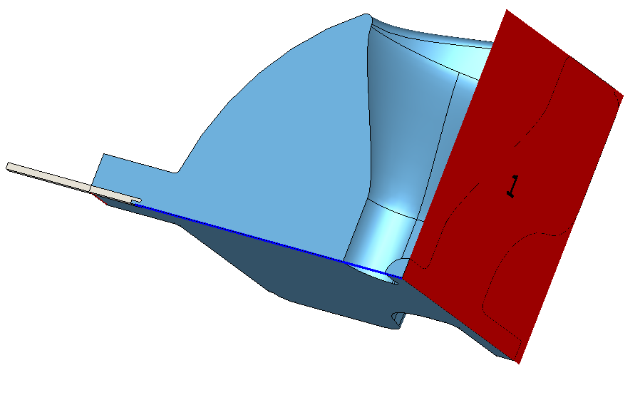
Coupler Qext simulation
The coupler used for SSR2 cavities is going to be the same as SSR1.
Nominal position of the antenna tip has been simulated to match the Qext required for operation.
Qext approx. 5.8E6 at 286 mm distance from the cavity center, for comparison: Qext SSR1 approx. 3.75E6 at 255 mm.
The coupler satisfies the project specification for Qext.
S. Kazakov
Antenna tip position, mm | S21, dB | Radiated power through full port (0.5W in), W | Radiated power trough port (1 J), W | Qext
275 | -52.782 | 1.054E-5 | 1.249E+3 | 1.635E+6
280 | -55.191 | 6.052E-6 | 707.2 | 2.847E+6
285 | -57.689 | 3.405E-6 | 403.5 | 5.061E+6
290 | -60.237 | 1.894E-6 | 224.4 | 9.101E+6
295 | -62.837 | 1.041E-6 | 123.3 | 1.656E+7
<number>
P. Berrutti - SSR2 RF Design

Slide 19
Summary
SSR2 EM parameters satisfy PIP-II project needs
Multipacting has been mitigated: SSR2 cavity shows MP levels lower
than SSR1 (built and tested)
Quadrupole asymmetry is within the corrector range
Qext target value for SSR2 is achievable using the same coupler used for SSR1
HOMs analysis shows no modes represent an issue for operation in PIP-II, even the zero mode at 342 MHz.

