Slide 1
Resource Loaded Schedule
Luisella Lari
DOE Independent Project Review of PIP-II
15 November 2016

Slide 2
Outline
Steps performed to develop the RLS schedule up-to-date;
The RLS defined as a Multi-Phases, Multi-Levels, Deliverables Oriented schedule that integrates In-Kind Contributions;
The WBS for the whole PIP-II Project;
The systematic approach applied for all the RLS sub-projects;
RLS R&D status;
Some Examples of the RLS for major R&D sub-projects;
Next steps i.e. ready for CD-1;
Summary;

Slide 3
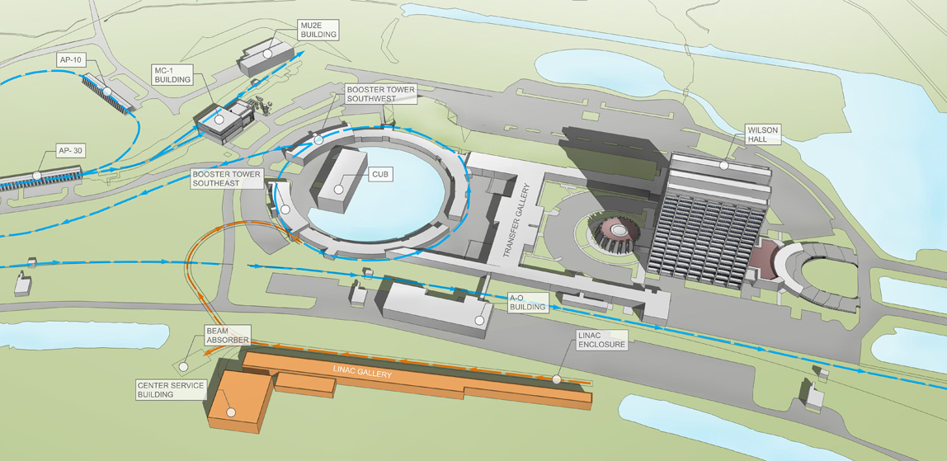




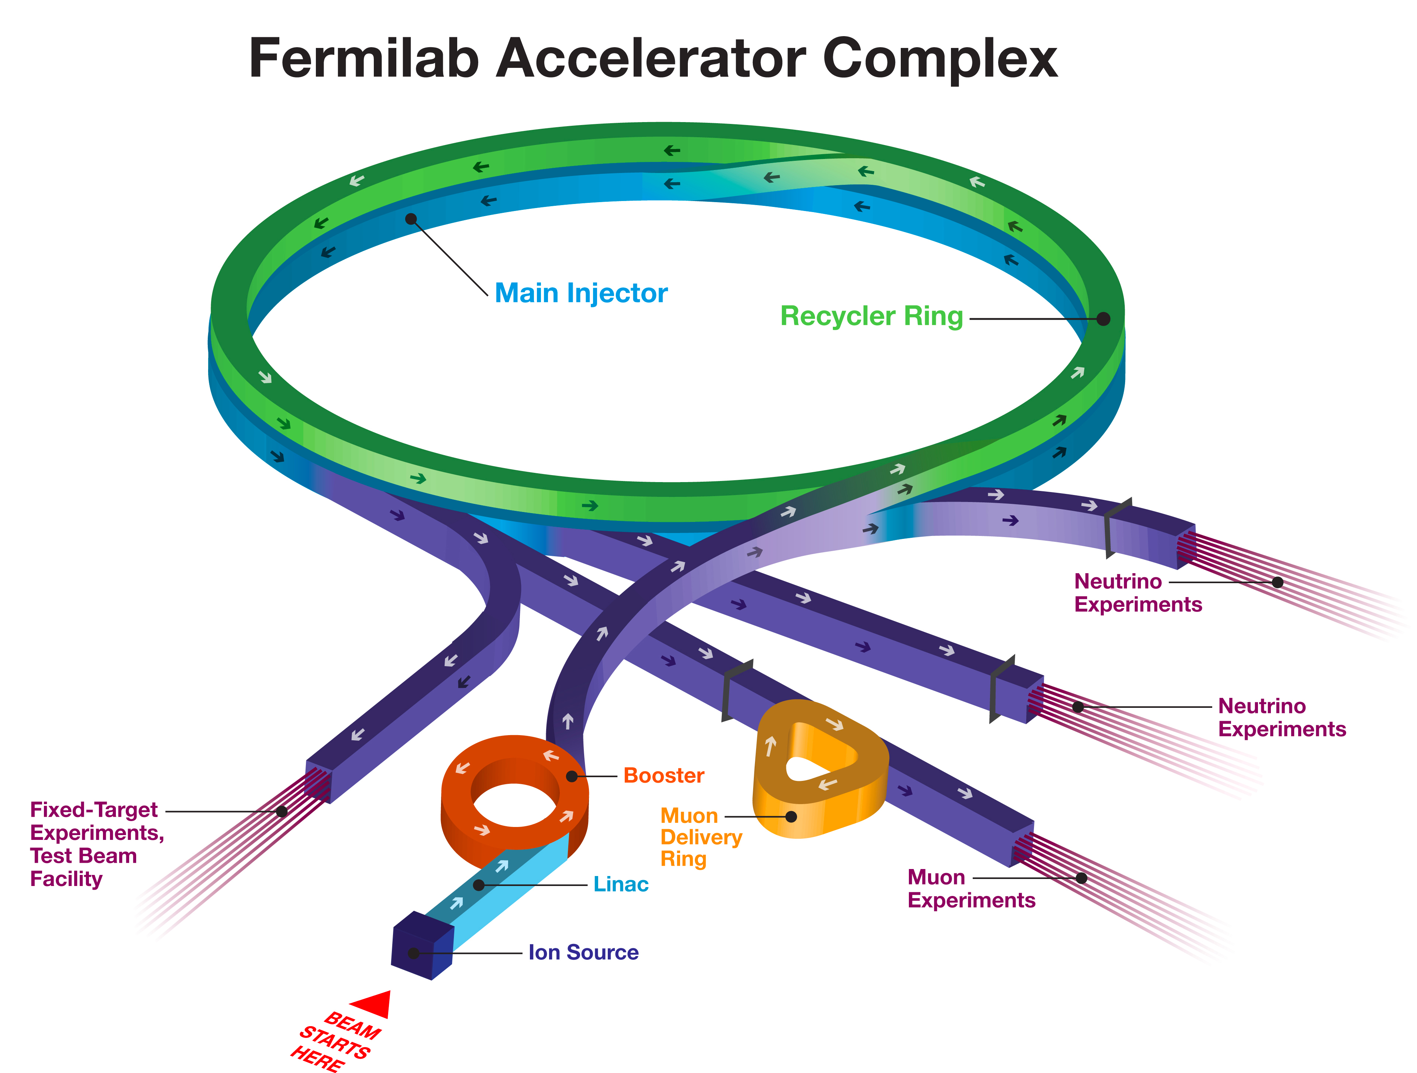
Steps Performed up-to-date (1/2)
The PIP-II Project requires a complex RLS schedule
External Constraints
Contributions from USA laboratories
FONSI
LBNF shutdown
Civil Engineering
In-kind Contributions
A new 800 MeV Linac
Upgrades of existing machines

Slide 4
Steps Performed up-to-date (2/2)
Since April 2016, the process to develop the RLS schedule was started for Alternative 1. In details:
WBS for R&D and Construction phases defined;
Target dates i.e. Milestones technical oriented to complete the whole PIP-II Project in the timeframe foreseen defined;
In-kind Milestones to be integrated into the plan identified;
R&D phase RLS scope of work and timeframe checked using a top-down and bottom-up approach;
R&D phase RLS developed, focusing on major R&D deliverables and using a systematic approach;

Slide 5
The RLS definition (1/5)
The PIP-II RLS is a Multi-Phases, Multi-Levels, Deliverable Oriented schedule developed with the scope of reporting to DOE the progress with respect to the DOE given budget.
Multi-Phases
R&D phase and Construction phase
T0, T1, T2, T3, T4 Milestones and Different Levels of Responsibilities for the PIP-II Managers
Multi-Levels
Working schedule @ Level 4 that includes all the major technical deliverables from Fermilab (T4) and from In-kind partners (I4)
Deliverable Oriented

Slide 6
The RLS definition (2/5)
High Level Master Schedule (T0, T1, T2, I3 & External MS)

Slide 7
The RLS definition (3/5)
The PIP-II RLS is a Multi-Phases, Multi-Levels, Deliverable Oriented schedule developed with the scope of reporting to DOE the progress with respect to the DOE given budget.
Multi-Phases
R&D phase and Construction phase
T0, T1, T2, T3, T4 Milestones and Different Levels of Responsibilities for the PIP-II Managers
Multi-Levels
Working schedule i.e. Early dates @ Level 4. It includes all the major technical deliverables from Fermilab (T4) and from In-kind partners (I4)
Deliverable Oriented

Slide 8
The RLS definition (4/5)
High Level Working Schedule (T4, I3 & External MS)
Early date yellow Milestones i.e. no margin;
NB: In-kind and External Milestones are at the same dates as High Level Master Schedule

Slide 9
The RLS definition (5/5)
The links between Master / Working and P6 schedule:
Late Dates
Early dates
6 m floating between T2 & T4 Milestones
On-going: Each T4 Milestones date is verified through the development of the detailed RLS

Slide 10
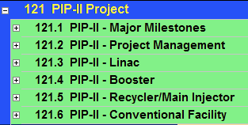
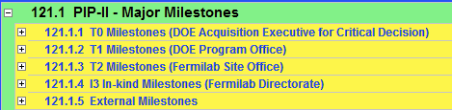
The PIP-II WBS in P6 (1/5)
Level 1 in P6
Level 2 in P6
Following the directions of the Fermilab Office of Project Support Services (OPSS):
Guidelines for Developing Schedule MS - Doc#12.PM-004.DT-03

Slide 11
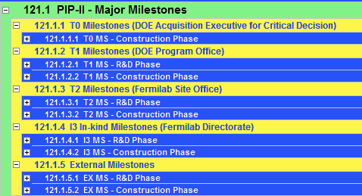
The PIP-II WBS in P6 (2/5)
Level 3 & 4 in P6
Phases level is L4
Phases level is L3

Slide 12
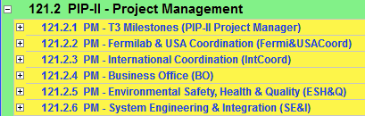
The PIP-II WBS in P6 (3/5)
121.2 Project Management
Identified >120 T3 Milestones,
(excluding the T2 Milestones @ T3 level):
They are mainly “Ready For Installation” Milestones
i.e. delivery dates of the major equipment on-site before the final installation in the PIP-II buildings

Slide 13
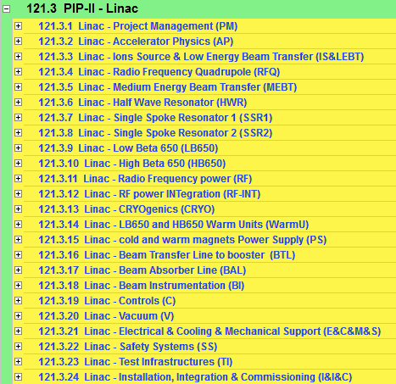
The PIP-II WBS in P6 (4/5)
121.3 Linac
WBS @ L3 →L3 Managers
Construction phase
R&D phase

Slide 14
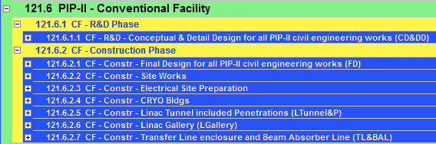
The PIP-II WBS in P6 (5/5)
121.5 Conventional Facility

Slide 15


The Systematic Approach @ lower WBS
Chargeable Task Codes (CTC) mapping starts at this level
Roll-up to Control Account following the WBS
(see slide 16 – Chris Jacobsen presentation)
This approach helps during EVMS analysis

Slide 16
RLS R&D status (1/2)
The P6 PIP-II RLS starts with the release of funds after CD-0 i.e. Jan 2016
The RLS development for the R&D phase is starting:
For FY16 → The P6 R&D RLS covers exactly the costs and the technical achievements
For FY17 → The P6 R&D RLS will check the budget for M&S and for FTEs
> FY18 → The P6 RLS is developed as first as technical oriented schedule and then tuning to try to match the given budget profile, if possible.

Slide 17

RLS R&D status (2/2)
Covering 70% of the R&D budget

Slide 18
RLS R&D status – Examples 1 – CF (1/2)
Time window:
From: T4 MS - Release of 2016 funds after CD-0 approval (1st JAN 2016)
Until: T4 MS - CD-2 Early date
Tot 6 Contracts with Fermilab pre-qualified vendors
3 already opened
1 to be open for detail design
2 consultant contracts
1 FTE → S.Dixon
3 Major MS to complete:
T4 MS - Documentation & Drawings ready for CDR
T4 MS - Documentation & Drawings ready for CD-1 – End of Preliminary Design
T4 MS - Documentation & Drawings ready for TDR
T4 MS - Documentation & Drawings ready for CD-1 – End of Detail Design
No In-Kind

Slide 19
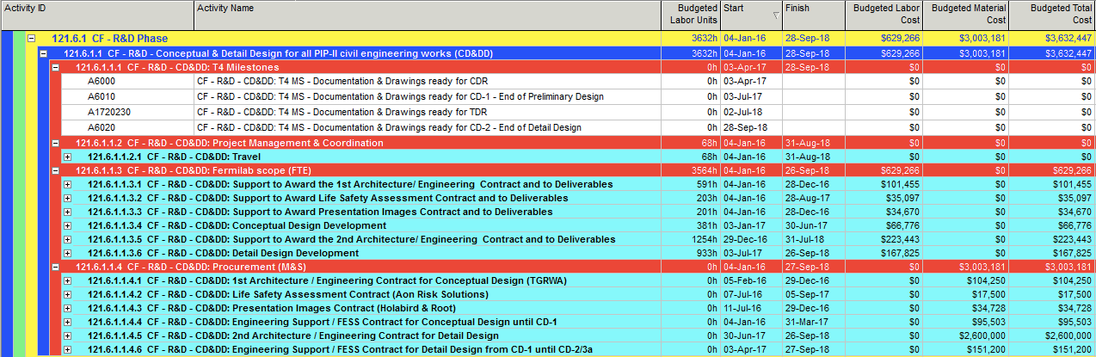
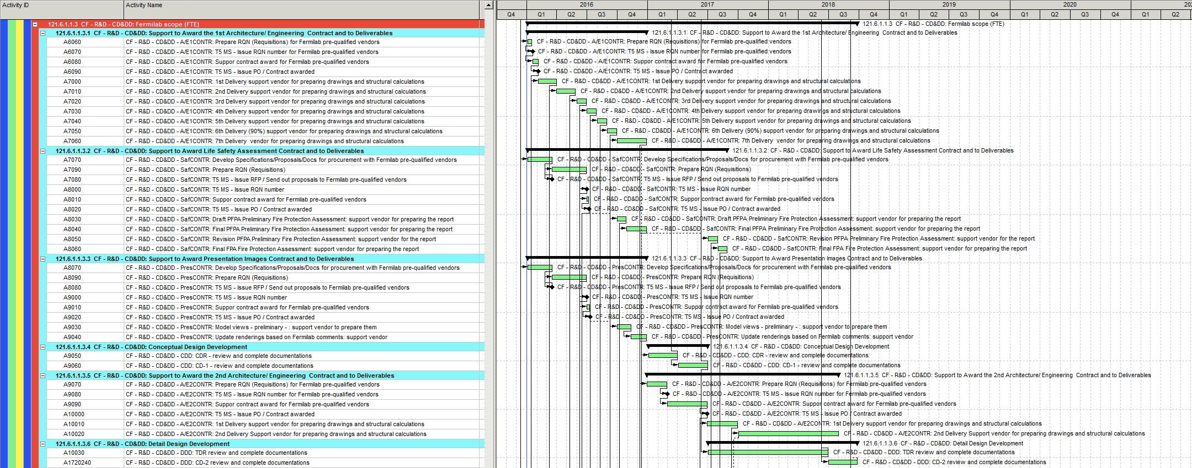
RLS R&D status – Examples 1 – CF (2/2)

Slide 20
RLS R&D status – Examples 2 – SSR1 (1/2)
Time window:
From: T4 MS - Release of 2016 funds after CD-0 approval (1st JAN 2016)
Until: T4 MS – SSR1 first prototype CM delivered for PIP2IT
Contracts:
13 major contracts to be opened using OPC funds
FTE profile: ~12 FY16, ~11 FY17, ~6 FY18
13 Major MS to complete for the 1st SSR1 prototype:
T4 MS – 1st Dressed Cavity Qualified (x 8)
T4 MS – 1st IIFC Dressed Cavity Qualified (x 2)
T4 MS – SSR1 String assembled
T4 MS – SSR1 Cold Mass Assembled
T4 MS – SSR1 first prototype CM delivered for PIP2IT
In-kind:
I4 MS – Delivery of 2 IIFC Jacketed Cavities

Slide 21
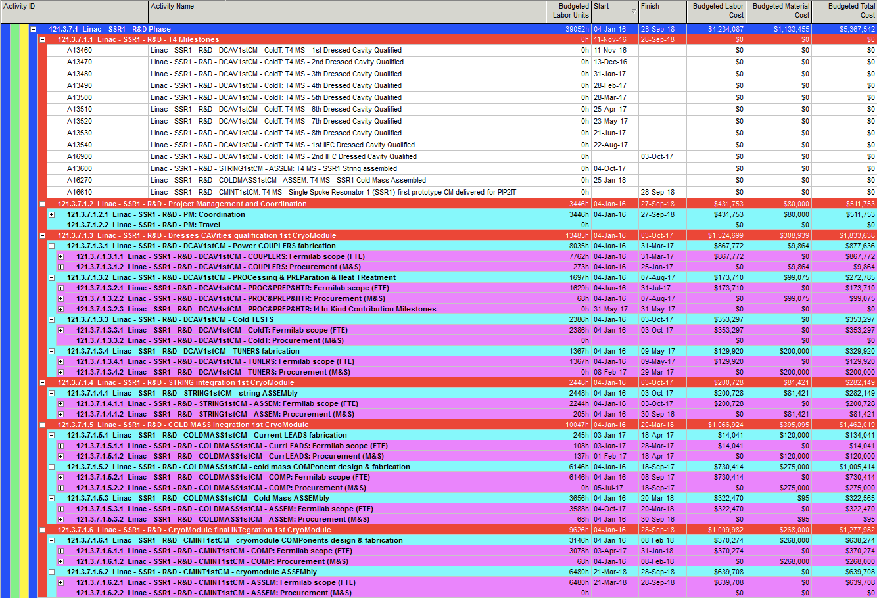
RLS R&D status – Examples 2 – SSR1 (2/2)

Slide 22
RLS R&D status – Examples 3 – Cryo (1/2)
Time window:
From: T4 MS - Release of 2016 funds after CD-0 approval (1st JAN 2016)
Until: T4 MS – Start of PIP2IT Cool-down / End of R&D for Cryogenics
Contracts:
1 major contract to be opened using OPC funds
FTE profile:
~2 FY16, ~3 FY17, ~5 FY18
2 Major MS to complete for the 1st SSR1 prototype:
T4 MS – Ready for CDS Installation (External & Cave TL)
T4 MS – Start of PIP2IT Cool-down / End of R&D for Cryogenics
No In-Kind

Slide 23
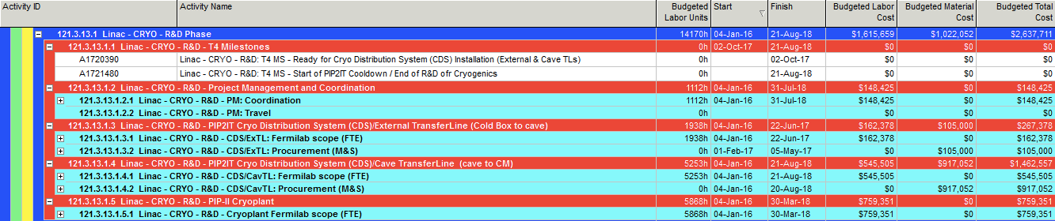
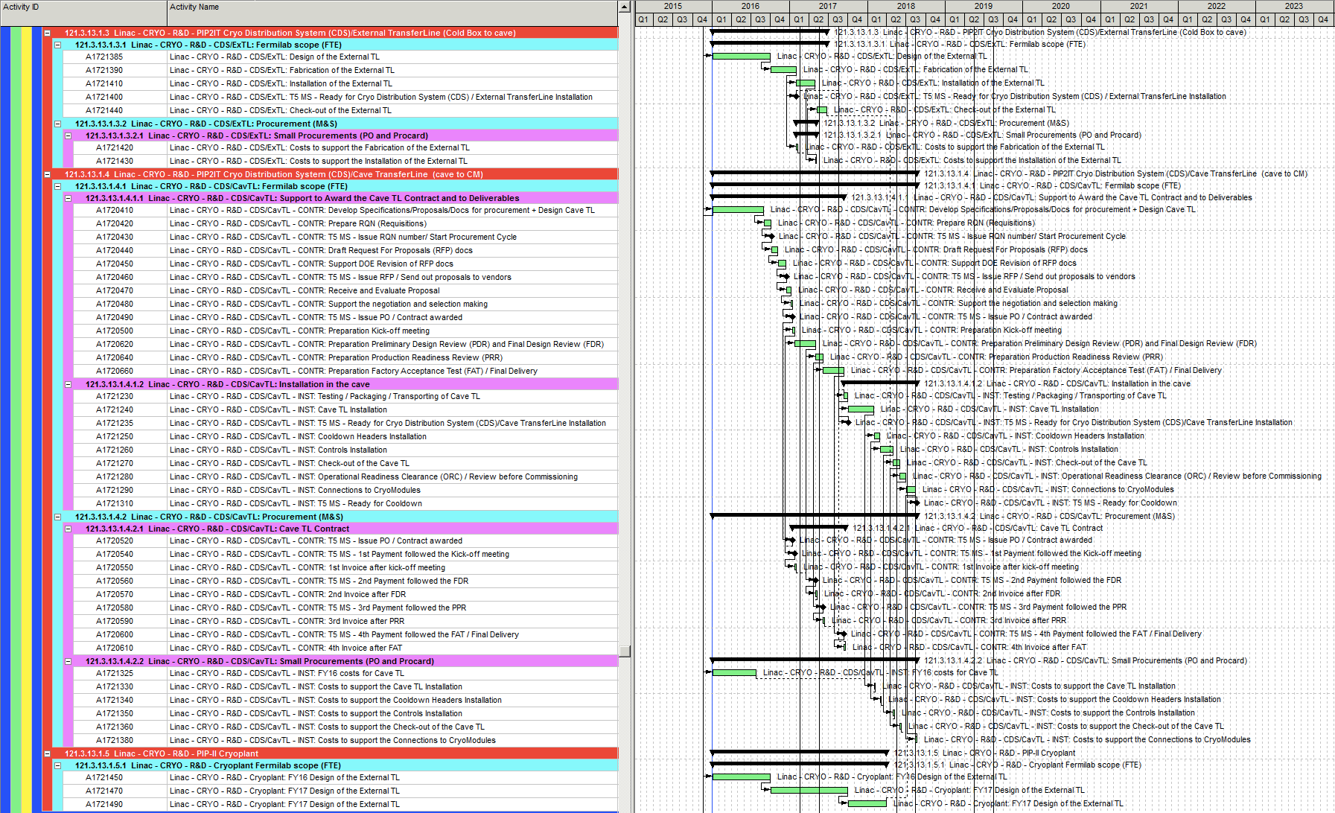
RLS R&D status – Examples 3 – Cryo (2/2)

Slide 24
RLS Next steps → CD-1
Precondition: The Learning Curve is almost over
Complete the R&D RLS;
Check the budget profile for FY17, FY18, FY19, FY20;
Develop the RLS for Construction Phase, meeting the early technical driven target dates;
Check the staff plan for Construction Phase;
Compare the results with the proposed budget profile;

Slide 25
Summary
WBS established for the full project, including R&D and Construction phases;
PIP-II RLS development is on-going, starting with R&D phase;
Technical oriented target milestones are identified for R&D and Construction Phases;
In-kind deliveries are integrated/linked in the PIP-II RLS, in such a way that they can potentially drive the schedule variance;
A systematic approach is used to develop the PIP-II RLS. It helps during the activities definition and it can be applied independently by the scope of the different PIP-II sub-projects. Moreover this configuration helps to prevent major modifications, if required as following EVMS analysis;
A complete RLS is achievable for CD-1;

