Slide 1
International Collaboration
Shekhar Mishra
DOE Independent Project Review of PIP-II
15 November 2016

Slide 2
Outline
Introduction
R&D Phase Goals
  Technology Map
R&D Schedule to complete
  Division of responsibility between Fermilab and DAE.
    Fermilab
    Jointly with DAE Institutions
Fermilab Information Sharing and Export Control
R&D Status
  R&D Schedule to complete
IIFC: PIP-II Construction Phase Scope of Work
  Construction Schedule
Summary

Slide 3
Introduction
Indian Institutions and Fermilab Collaboration (IIFC) was established in 2009 to collaborate on
  High Intensity Superconducting Proton Accelerator for the respective domestic accelerator programs
    PIP-II, ISNS and PATHIPA
IIFC is established with a concept of “Total Project Collaboration” with two continuous phases.
  R&D Phase (CY2008 – CY2020):
    Fermilab and Joint (Fermilab-Collaborating DAE Institutions) development of technology
      Open Sharing of Fermilab and Jointly developed Technology
    Fermilab, Joint preparation of DAE laboratory and US and Indian industrial infrastructure towards the construction of accelerators.
    Reduce technical, cost and schedule risk to a level that will allow initiation of the construction phase
  Construction Phase (CY2020 – CY2025):
    Fabrication of accelerator components for PIP-II accelerator
Fermilab has been exploring possible collaboration with other countries on PIP-II R&D and Construction: Italy/INFN and UK/STFC

Slide 4
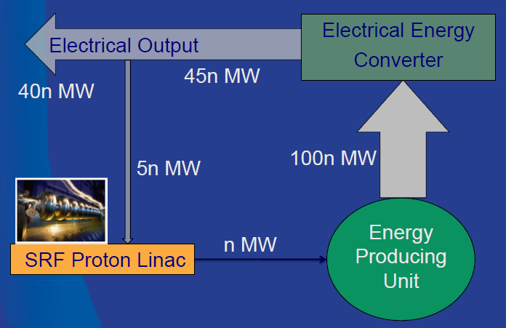
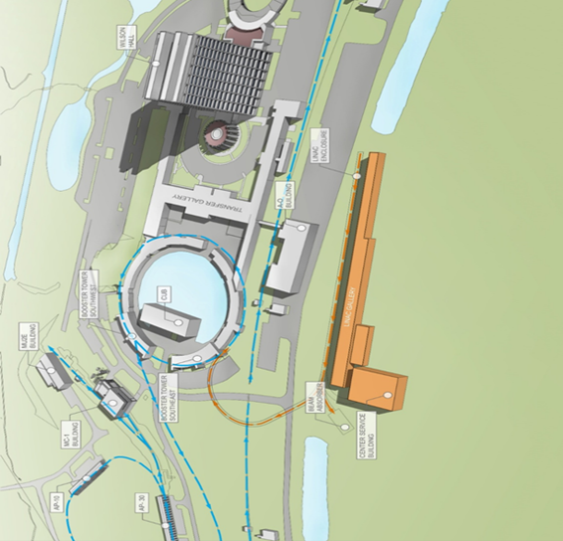
International Interest in Fermilab Accelerator Program
Fermilab is building a High Intensity Superconducting Proton Accelerator PIP-II which is a ~1 GeV SRF Linac.
It is design to provide 1.2 MW of beam for Deep Underground Neutrino Experiment (DUNE) (INFN and UK are collaborators).
India: Multi Mega Watt beam at ~1 GeV (similar to Fermilab SRF Proton Linac) could be the accelerator technology demonstration project corresponding to 10s of MW electrical power, utilizing Thorium.
Development of Indian Spallation Neutron Source.
SRF Proton Linac

Slide 5
PIP-II SRF Linac R&D
High Level Goal: The retirement of risks associated with operation of the PIP-II Linac in pulsed mode as required for neutrino operations and described in the CDR (1% duty factor).
Major Elements:
Warm Front End (Source, RFQ and MEBT)
HWR CM testing with Beam at PIP2IT (CY19)
  Finish construction of HWR and Install at PIP2IT (CY18)
International Collaboration on:
SSR I CM testing with beam at PIP2IT (CY19)
  Finish construction of SSR1 CM and Install at PIP2IT (CY18)
HB650 CM testing with RF at CMTF (CY20)
  Finish construction of HB650 CM and Install at CMTF (CY19)
LB650 Dressed Cavity High Power test at HTS-2 (CY19)
SSR2 Bare Cavity Low Power test at VTS (CY19)

Slide 6

Mapping International Collaboration onto PIP-II
The DAE laboratories are completely integrated into nearly all aspects of the PIP-II Superconducting Linac R&D.
INFN/Italy and STFC/UK have expressed interest in elliptical 650 MHz Section of the PIP-II SRF Linac.
IIFC

Slide 7
Division of Responsibilities: Fermilab and DAE
Fermilab and collaborating Indian Institutions (BARC, IUAC, RRCAT and VECC) have been Independently or Jointly developing technologies and infrastructure for the High Intensity Superconducting Proton Accelerator (aka PIP-II for Fermilab).
  Fermilab (DOE) has agreed to share all the Fermilab Developed technologies (Intellectual Property) for the SRF Linac with the Collaborating DAE laboratories for its use in the Indian HISPA program.
The scope of work in the R&D phase has been outlined in the Joint R&D document.
  This phase can generally be characterized as Fermilab shares technology development, while DAE is providing hardware
  Some of this hardware is stand-alone and some is integrated into jointly fabricated prototypes.
  Some of if is test facilities such as Horizontal Test Facility

Slide 8
Technology Development Map for HISPA under IIFC
Fermilab (US) Developed Technology
  PIP-II Accelerator Design (Pulsed and CW)
  Warm Front End (Source and RFQ)
  Half Wave Resonator Cavity and Cryomodule
  162.5 MHz RF Source
  SRF Infrastructure for Cavity and Cryomodule fabrication, tuning and processing techniques, and low and high power testing
  SSR1 Cavity and Cryomodule Design
  HB650 Cavity and Cryomodule Design
  325 and 650 MHz Power Couplers and Power Distribution
  Resonance Control of the SRF Cavity
  Cryogenic Technology
Jointly (IIFC) Developed Technology
  SSR2 Cavity and Cryomodule Design
  SSR2 Solenoid Magnets
  LB650 Cavity and Cryomodule Design
  RF Protection and Low Level RF System
  RF System Controls
  Helium Cryogenic plant design
  Horizontal Test Stand
  650 MHz Cryomodule Test Stand
DAE Developed Technology
  325 and 650 MHz Solid State RF Amplifier
  Warm Magnets

Slide 9
Fermilab Information Sharing and Export Control
Fermilab has made available two platforms for sharing detailed technical information with DAE and International collaborators
  Team Center and SharePoint
  Fermilab has published a document ED0005292, which outlines all the document we have or will have at Fermilab and their timeline through 2020 (end of R&D period).
  DAE is setting up its own server in India to hold all jointly developed documents.
Access to third party IP is important in developing DAE capabilities.
  We do our best on this, but not always possible.
  When not possible we offer advice and share our understanding of manufacturing techniques.
Developing capabilities at DAE laboratories and access to products under export control in a timely manner are also important for the development of this collaboration.
  We are getting experience in doing this and planning ahead has been helpful.
In all of the above three areas (Fermilab Information, IP and Export Control) collaborative understanding of the underlining issues are very helpful.

Slide 10
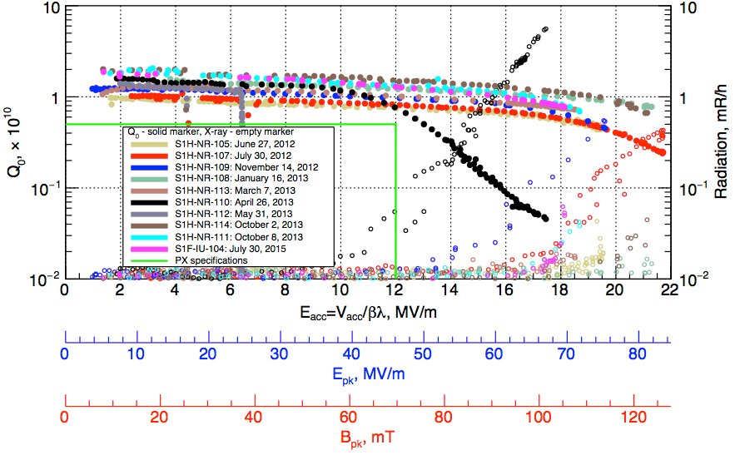
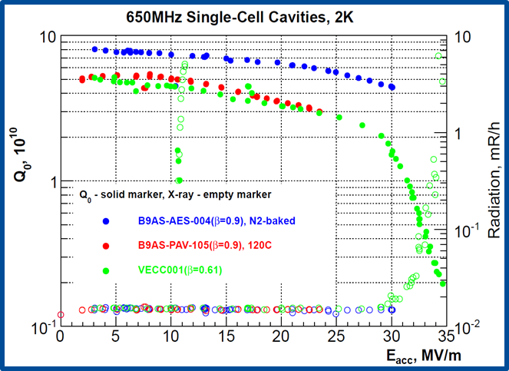
R&D Status: SSR1 and LB650
2 SSR1 cavities have been fabricated by IUAC.
  Chemically processed at ANL and cold-tested at Fermilab
    IIFC cavities meet the PIP-II specifications
At present these two cavities are being jacketed with a Helium Vessel at BARC.
  Will be high RF power tested Fermilab in Summer of 2017
5-cell LB650 cavity design carried out Jointly with VECC.
  The necessary parameters are well within the prescribed FRS limits .
The design studies includes
  3D Multipacting
  Lorentz Force Detuning (LFD)
  Pressure sensitivity under external liquid helium pressure
  Structural analysis with Stiffener Rings
Final Mechanical design has started at VECC.
  Design review scheduled for Dec 2016.

Slide 11
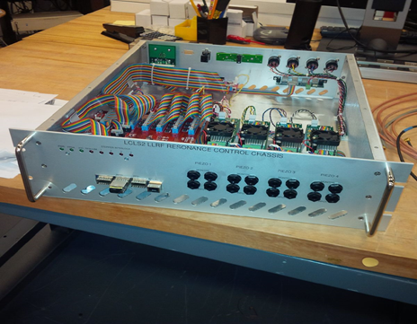
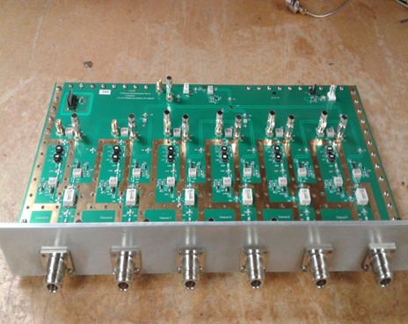
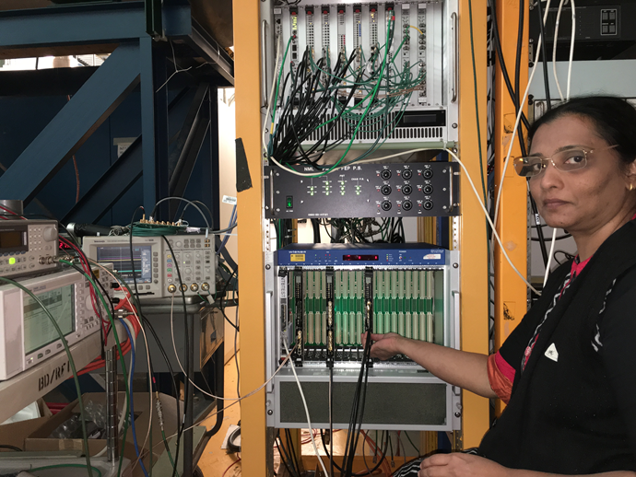
R&D Status: RF Systems (RF Protection and LLRF)
A complete redesign of the Fermilab RF Protection Interlock system has been done in collaboration with BARC.
BARC has completed detail test
  At present the system is being tested at Fermilab by integrating it in to Spoke Resonator Test Cryostat (STC).
6 Ch. Downconverter module
Resonance Controller
Fermilab Meson Building
Fermilab and BARC are jointly working on the design of a next generation Low Level RF System for PIP-II. System includes
  Down and Up Converters
  Resonance Controller
  Digitizer board
  Digital LLLRF board
  RF Reference distribution System
  Support System:
    Power Supply
    Temperature Control
    Rack Interconnect

Slide 12
PIP-II Cryogenic Plant: System architecture
Refrigeration Load
Capacity (W) | HTTS | LTTS | 2 K
Maximum | ≥ 9,100 | ≥ 1,500 | ≥ 1,900
Nominal | ≥ 7,000 | ≥ 1,150 | ≥ 1,750
Fully segmented Linac
Single cold box with turbines and cold compressors
Distribution box located in a refrigerator room
Cryogenic transferline with bayonet cans that runs parallel to the cryomodules
Status of Cryogenic Plant Order:
Functional Requirement Specification
Procurement Package Ready and approved
Financial Responsibilities document approved
IIFC approval for procurement
BARC working on Bid Package with a plan to award contract in March 2018.

Slide 13
PIP-II and IIFC: SRF Linac R&D Schedule to Complete*
* Proposed by Fermilab and consistent with PIP-II RLS

Slide 14
IIFC: PIP-II Construction Phase Scope of Work
At the conclusion of R&D, IIFC will jointly finalize all the designs and the R&D areas will morph into the fabrication of components for the PIP-II SRF Linac, as agreed between DOE and DAE.
  Fermilab expects to get CD-2/3A for PIP-II in early FY19.
    Project Baseline
    This will trigger the procurement of all the long lead items for the PIP-II construction
      Nb, Ti, Steel etc.
    This will allow Fermilab to start procurement contracts with vendors for all long lead items
      Cavity, RF, Cryogenics etc.
  This is the natural point at which to anticipate that work toward DAE construction phase deliverables could also start
    In our planning we have included expected long delay in DAE procurement process.
    All DAE deliverables for PIP-II accelerator is expected to conclude in April 2024.
      Allowing Fermilab 1 year to assemble remaining Cryomodule and install them in the tunnel

Slide 15
PIP-II and IIFC SRF Linac Construction Schedule
PIP-II Construction Phase will starts with DOE approving CD-3 for the Project (FY20).
Based on the DOE funding profile we are developing the following PIP-II construction schedule after CD-3
  Initiation all fabrication in Spring of 2020
  1st set of hardware, ordered at CD-3A (FY19), to start arriving for processing and testing in Spring of 2021
  Completion of SRF Linac components deliverables in Spring of 2024
  Cryogenic plant commissioning by the end of 2023.
  Completion of Cryomodule and RF stations at Fermilab in Spring of 2025
  Installation of PIP-II Linac to complete CY2025, early 26.
This PIP-II construction schedule includes a pipeline of hardware from DAE on similar schedule.

Slide 16
Summary
PIP-II Joint R&D under IIFC is progressing rather well
Recent R&D highlights are
  Delivery of the MEBT Dipoles and Quadrupoles
  Fabrication, processing and testing of two SSR1 Cavity
  Development of LB650 Cavity design
  Testing of RF Protection System at Fermilab
Information Sharing is improving
  Fermilab has provided DAE with a complete list of document it will provide and on what time scale.
  We are working to develop a methodology for document sharing that meets the needs of both the PIP-II project and the DAE.
Management focus is on the successful completion of the R&D phase.
  This phase is well aligned with current vision of DAE contributions to the construction phase.
Notes:
Added second sub-bullet under third bullet. I think we need this.

