Slide 1
R&D program - SSR1 Status
Donato Passarelli
DOE Independent Project Review of PIP-II
15 November 2016

Slide 2
Outline
SSR1 cryomodule for PIP-II
  R&D program and milestones
  Work packages
Status of SSR1 cryomodule
  String assembly
    Jacketed cavities
    Input power coupler
    Solenoids and beam position monitors
  Cold mass assembly
    SSR1 tuner
IIFC for SSR1 cryomodule
SSR1 CM schedule and critical path
Summary

Slide 3
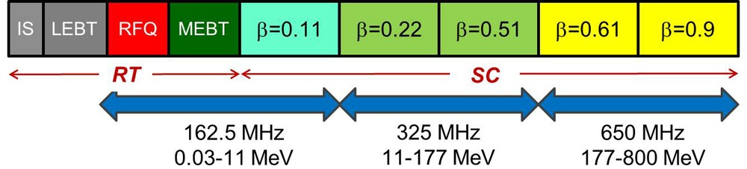
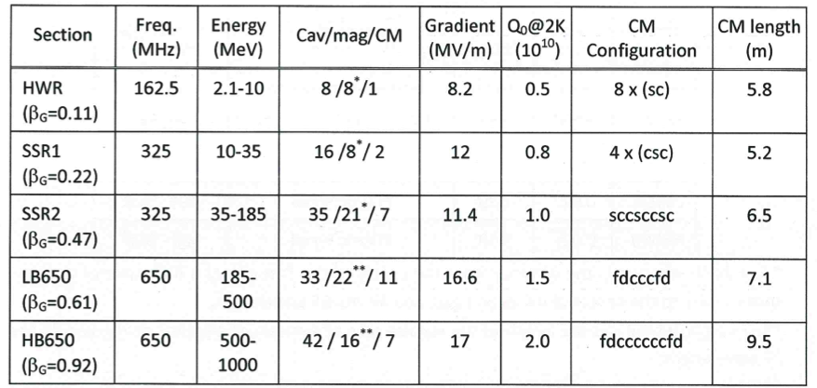
SSR1 cavities and cryomodules for PIP-II
Single Spoke Resonators of type 1 (SSR1) - superconducting cavities - with βopt = 0.22 operating at 325 MHz are employed for the acceleration from 11 MeV to 35 MeV
16 SSR1 cavities and 8 focusing lenses compose the two SSR1 cryomodules for PIP-II

Slide 4
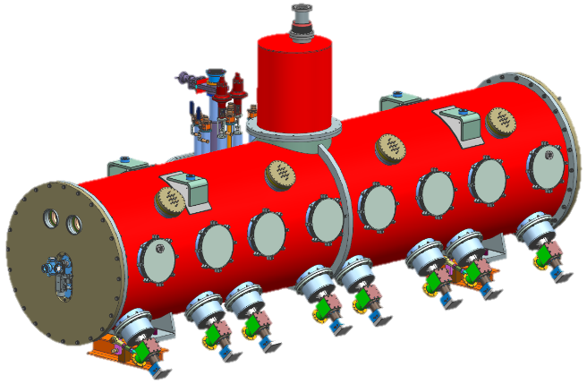
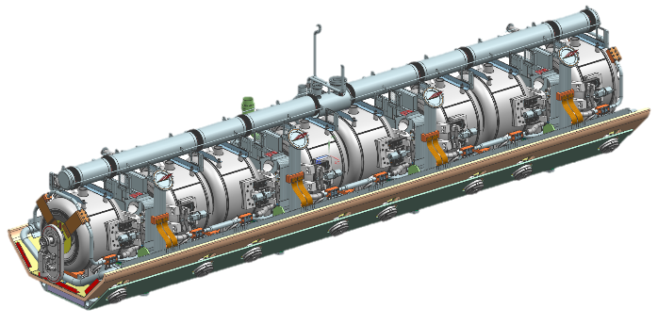
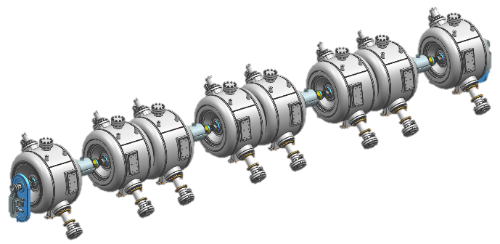
SSR1 R&D phase: milestones
SSR1 cryomodule – Top assembly
Conceptual design: completed
Final design: ~85% completed
First CM delivered by Sep 2018
SSR1 coldmass
Final design: ~85% completed
Procurement: ~60% completed
Coldmass assembled by Jan 2018
SSR1 string assembly
Final design: 100% completed
Procurement: 100% completed
Assembly completed by Oct 2017

Slide 5
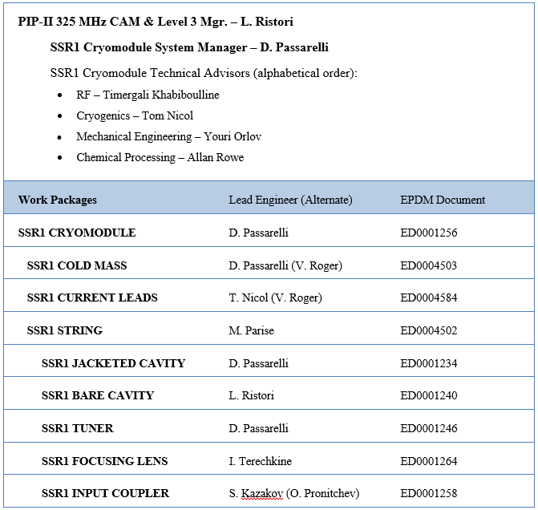
SSR1 Cryomodule Work Packages
Lead Engineers appointed for each work package
EPDM sheets managed in Teamcenter by each Lead Engineer
EPDM sheets promoting adherence to Fermilab Engineering Manual
EPDM sheets provide “bookmarks” to relevant documentation in TC
Teamcenter ED0004600

Slide 6
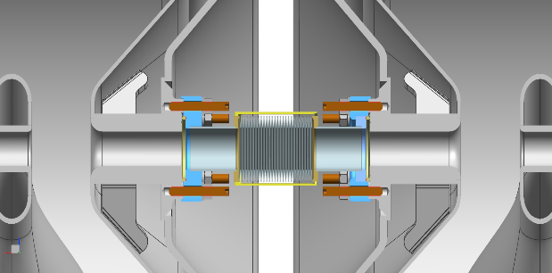
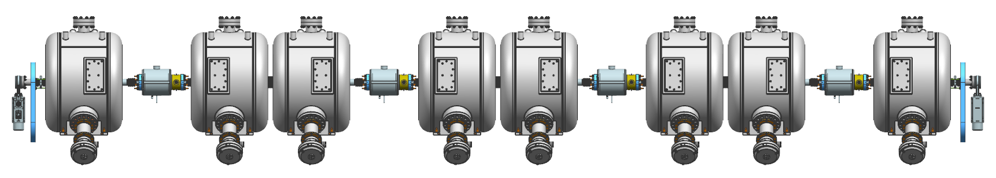
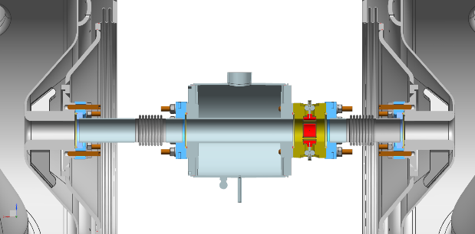
SSR1 String Assembly: design status
Interconnection cavity-cavity
Ultra High Vacuum connection
Edge-welded bellows
Al-diamond seals
SiBr set screws
316L stainless nuts and washers
Status of design: completed
Drawings and documents are in the approval phase
Many lessons learned and challenges addressed
20mm
IIFC SSR1 cavities
SSR1
Type A
SSR1 Type B
SSR1
Type A
SSR1 Type B
SSR1
Type A
SSR1 Type B
SSR1
Type A
SSR1 Type B
Gate Valve
Gate Valve
Coupler
(cold-end)
Solenoid
BPM
Solenoid-BPM subassembly
Hydro-formed bellows
Ultra High Vacuum connections
Al-diamond seals
SiBr set screws
316L stainless nuts and washers

Slide 7
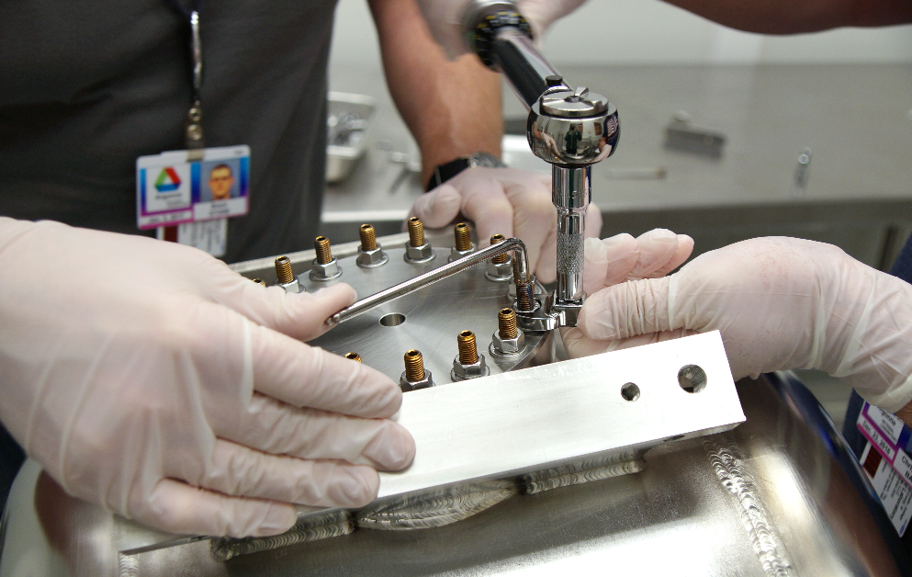
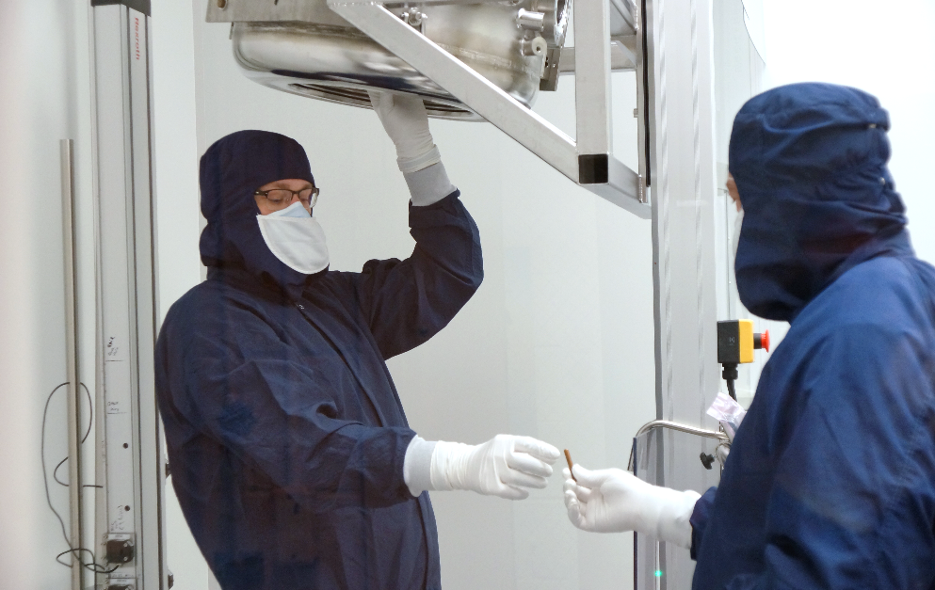
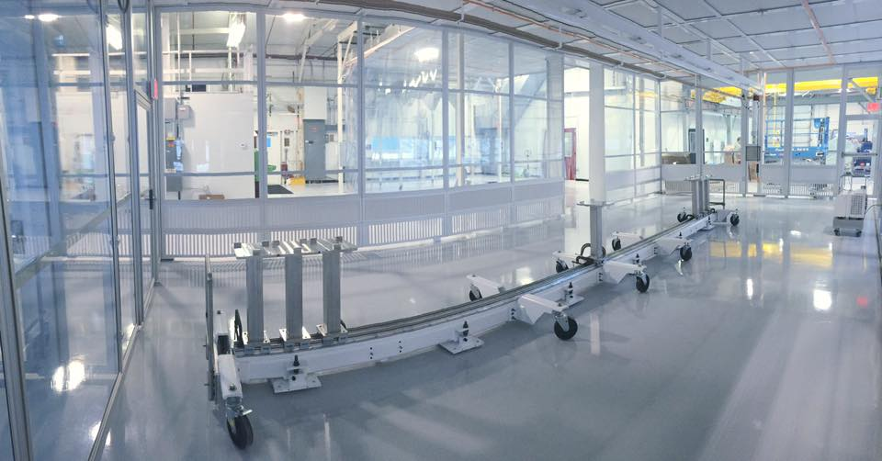
SSR1 string assembly: procedures and facility
General Particle-free assembly procedure is under development ED0004656
The customized particle free procedure for SSR1 flanged connections ensures high reliability and avoids catastrophic damaging of cavity flange threaded holes (ED0004744).
Procedure was successfully validated on two units.
  The cleanroom at Lab 2 is ready to receive the SSR1 string assembly
  Cleanroom construction completed and qualified
  Vacuum cart assembled and qualified to provide field emission free venting and pump out
  Ultra Pure Water system and ultrasonic cleaners are fully operational
  900 gal liquid nitrogen dewar installed outside to supply building with nitrogen gas for cleaning parts; line installation completed and undergoing commissioning

Slide 8
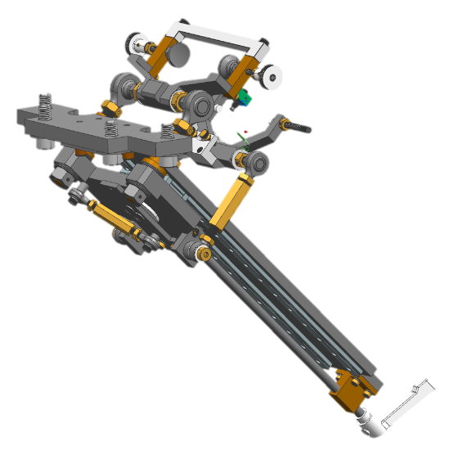
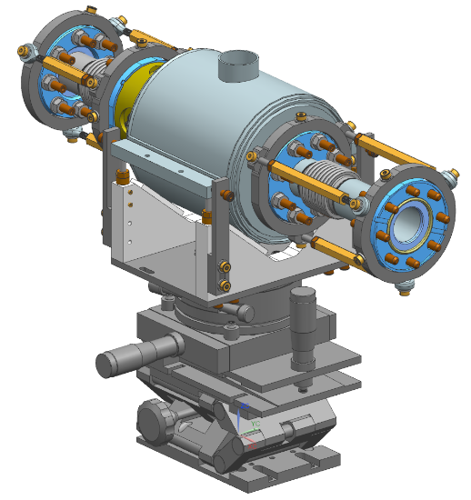
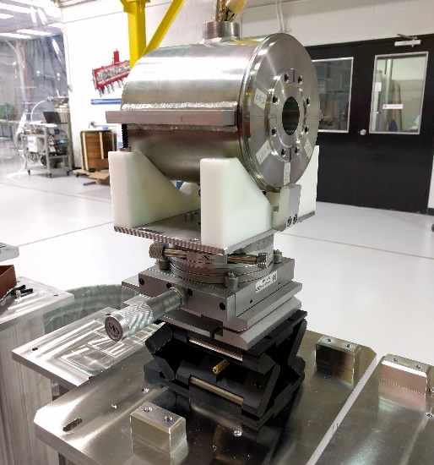
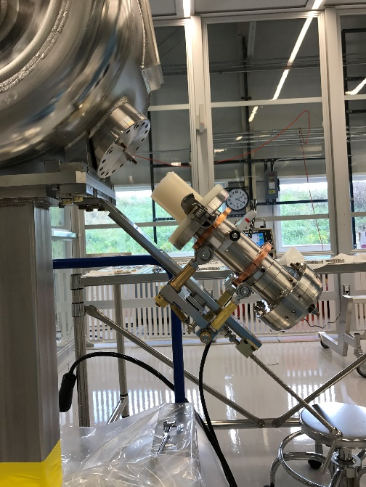
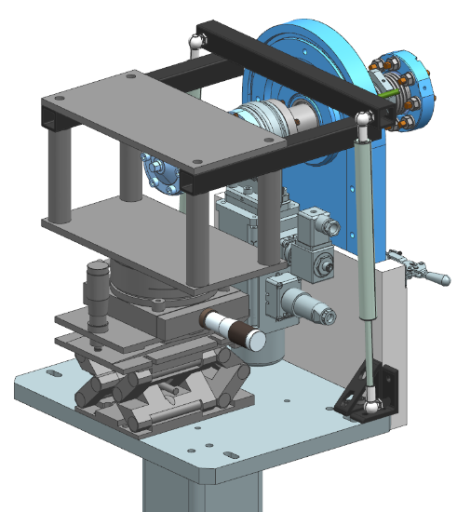
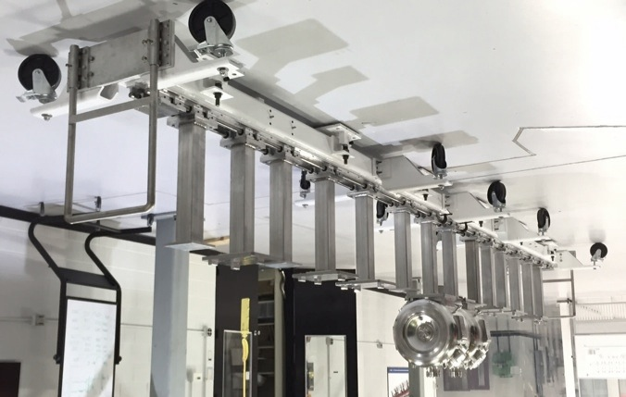
SSR1 string assembly: tooling
Design and procurement of tooling for the string assembly is completed.
Coupler installation tooling: F10048182
Solenoid assembly tooling: F10054275
End-pipe installation tooling: F10058069
Movable rail system: F10044542

Slide 9
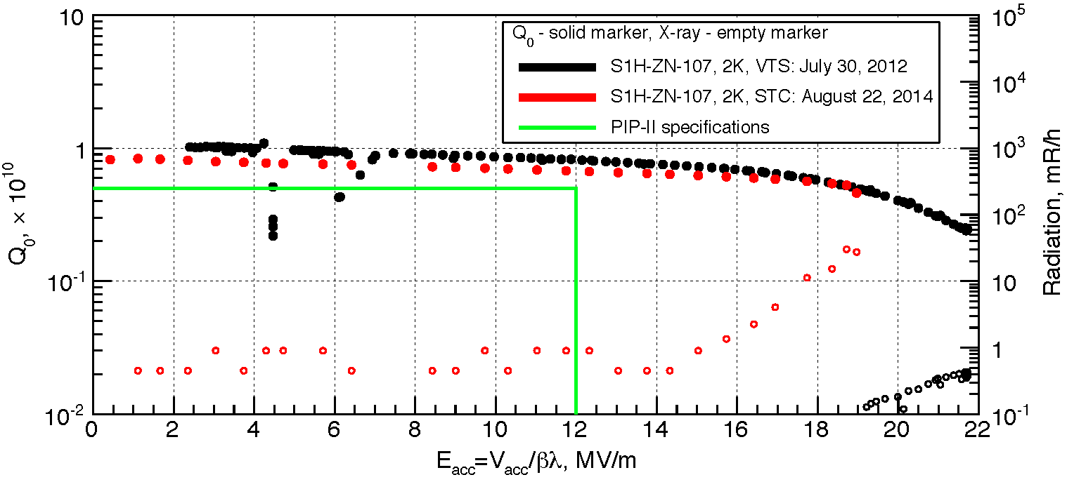
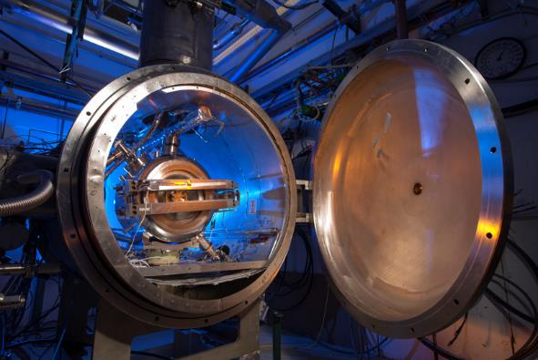
Jacketed SSR1 cavities: status
Eight jacketed SSR1 cavities (made by Fermilab) are ready to be qualified at 2K in the Spoke Test Cryostat (STC) at Fermilab
First jacketed cavity (S1H-NR-107) was tested three times in the STC:
  Prototype coupler and prototype tuner installed
  Performance of cavity, coupler and tuner were confirmed [1, 2]
  Studies of resonance control have been carried out*
Qualification of production of nine jacketed SSR1 cavities (8 made by Fermilab and 2 made by IIFC) in the STC has started and it will be completed by August 2017
Procedures to fully prepare the cavity for STC qualification were written and experimentally qualified
Qualification test plan was defined (ED0005578)
  Meet the gradient and the quality factor
  Perform any needed MP and FE conditioning
  Check input coupler and tuner performance
[1] Result of Cold Tests of the Fermilab SSR1 Cavities, A. Sukhanov et al., Proceedings of LINAC2014, Geneva, Switzerland
[2] Performance of the Tuner Mechanism for SSR1 Resonators During Fully Integreted Tests at Fermilab, D. Passarelli et al., SRF2015, Canada
* See presentation for DOE IPR: Resonance Control of Cavities by W. Schappert

Slide 10
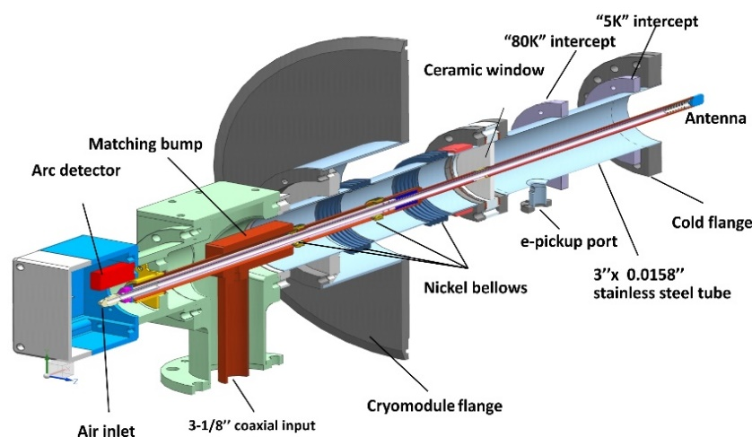
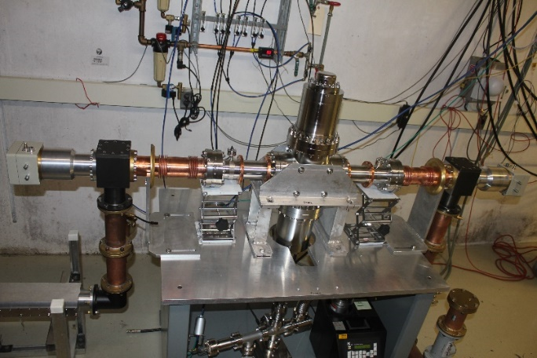
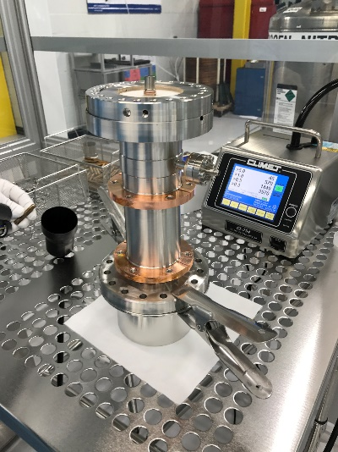
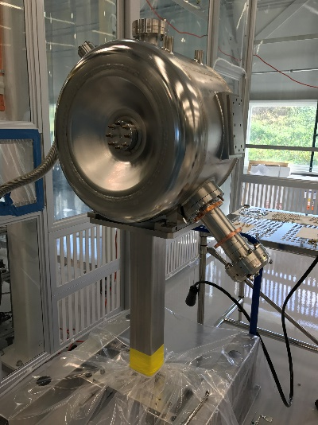
Main Power Couplers: status
Design of main coupler: completed [1]
Procurement and testing: in progress
Prototype main power couplers
Two units were succesfully tested up to 30 kW on the RF test stand at room temperature
One unit was tested to failure at 47 kW on the RF test stand at room temperature
One unit was successfully qualified during tests in STC
Several lessons learned
Production main power couplers
Procedures for conditioning and free particles assembling were written and qualified
10 production coupler vacuum ends are in procurement
2 out of 10 units were delivered, conditioned and successfully tested up to at 20kW, in full reflection on the RF test stand at room temperature
First unit successfully installed jacketed cavity (S1H-NR-112) for cold test at STC
[1] “Mechanical Design of a High Power Coupler for the PIP-II 325 MHz SSR1 RF Cavity”, O. Pronitchev, et al., SRF2015, Whistler, Canada
[2] “Testing of 325 MHz Couplers at Test Stand in Resonance Mode”, S. Kazakov, et al., SRF2015, Whistler, Canada

Slide 11
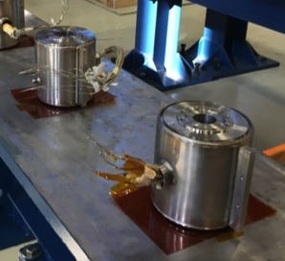
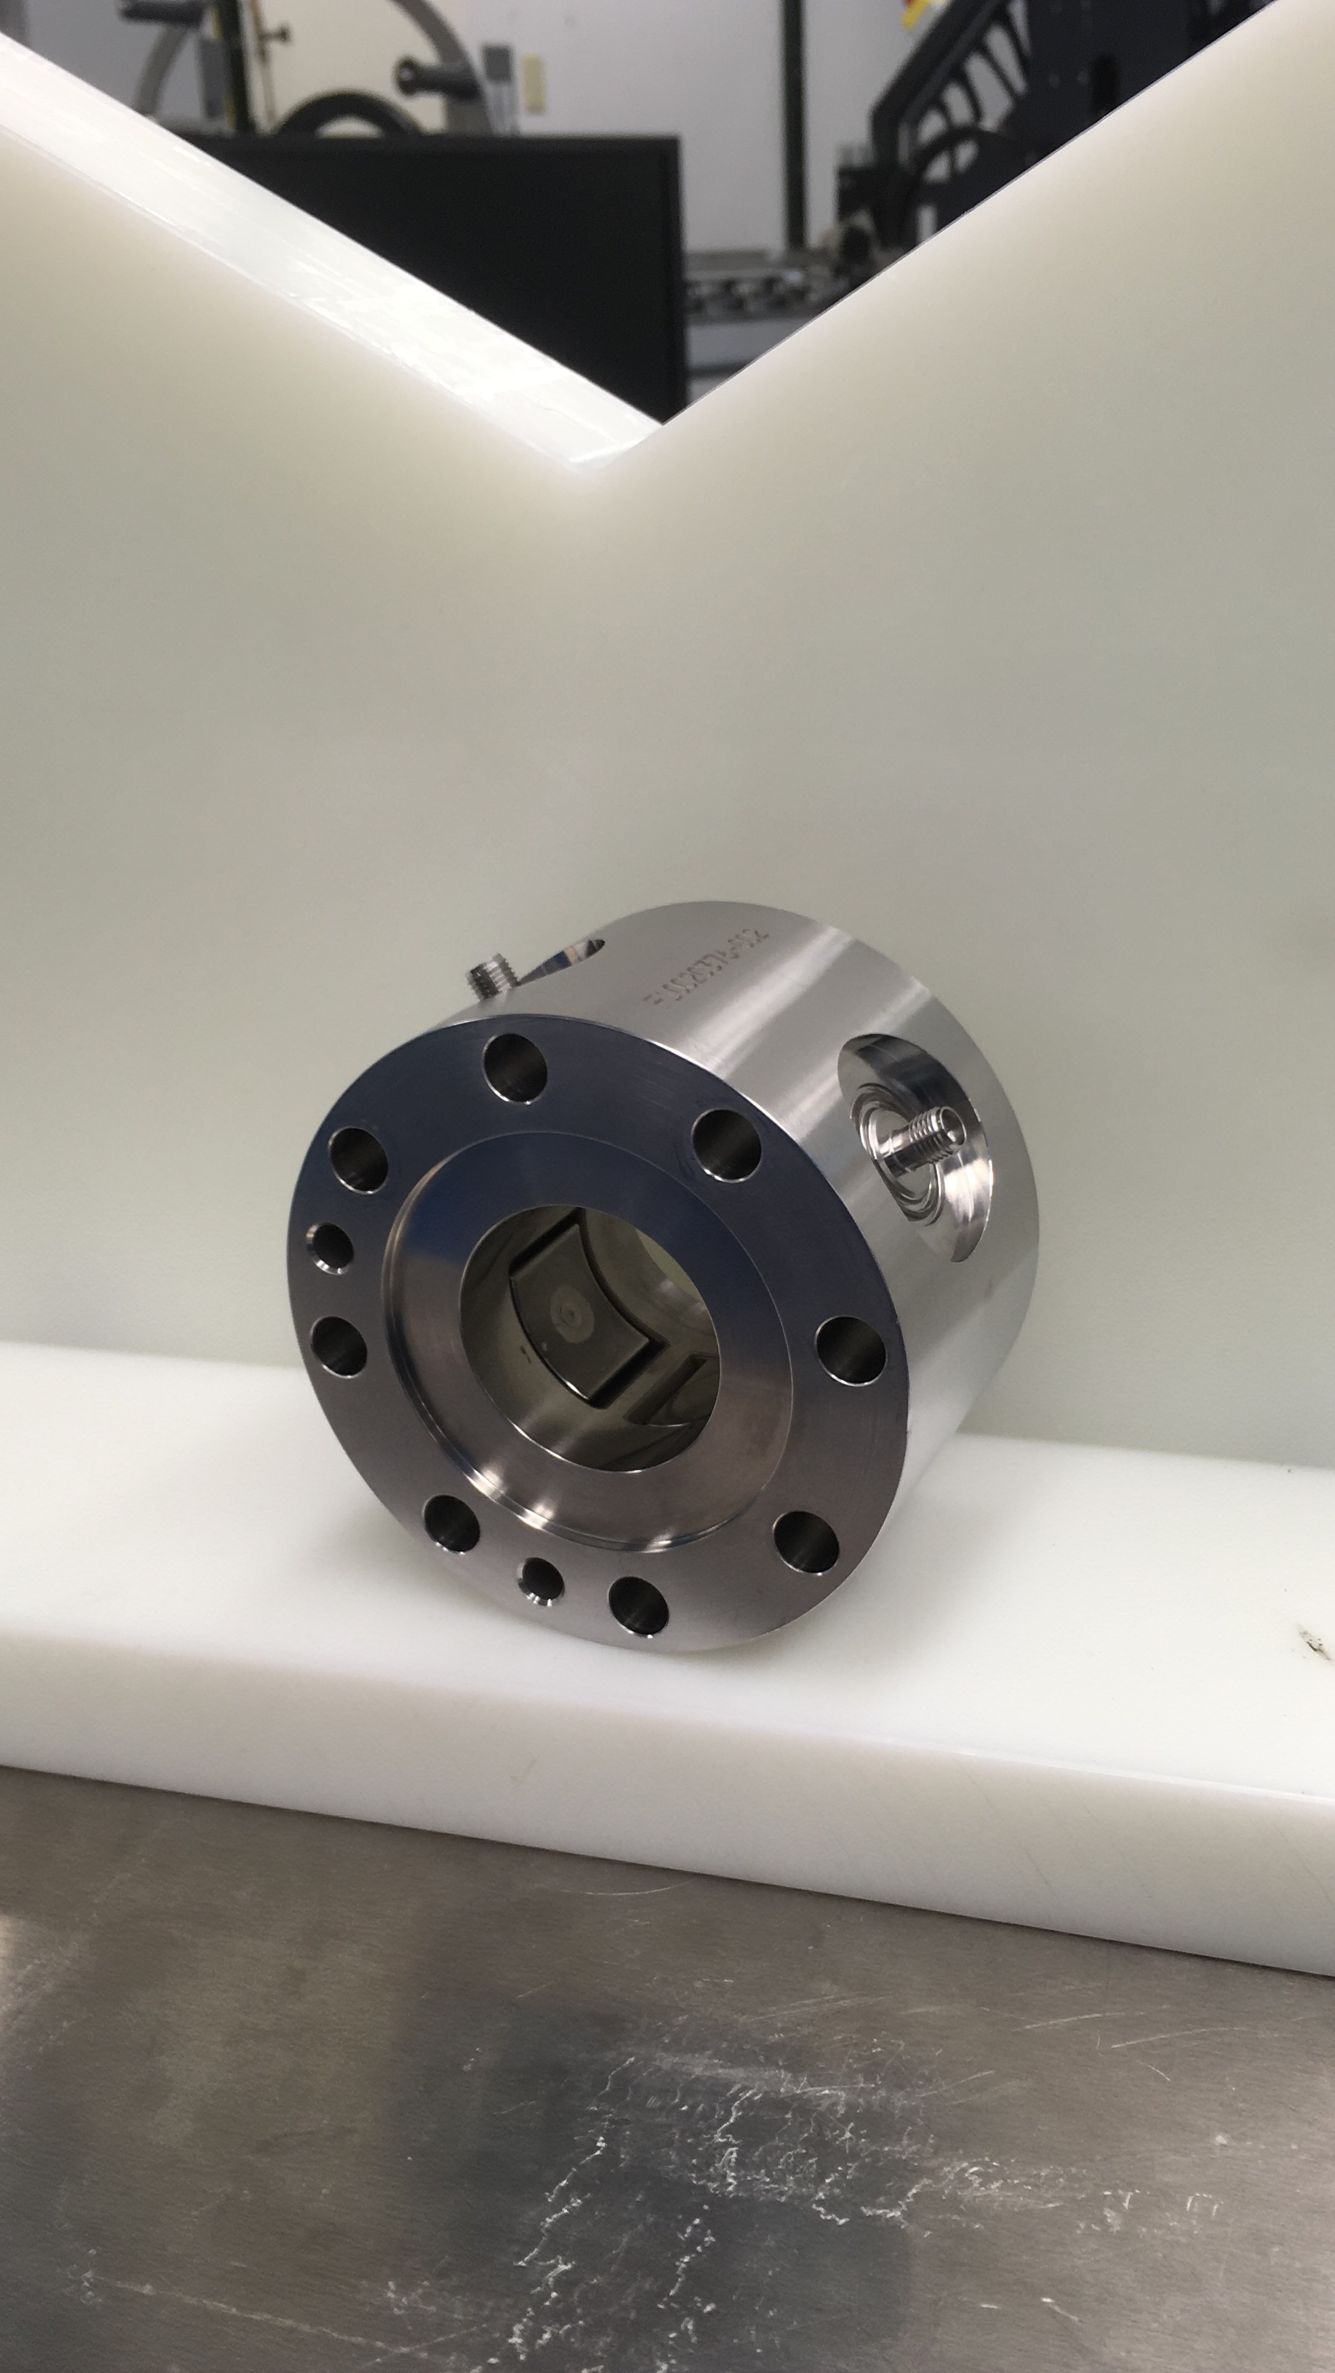
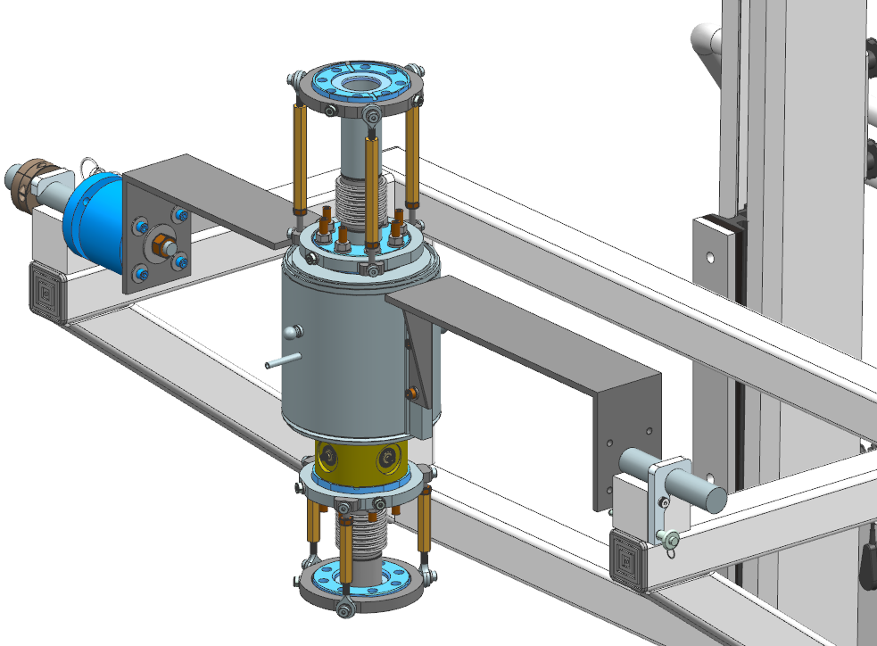
Solenoids and Beam Position Monitors
Four production solenoids were successfully designed, procured and qualified.
Four production BPMs were successfully designed, procured and qualified.
Free particle assembling procedure of the solenoid/BPM sub-assembly is under development

Slide 12
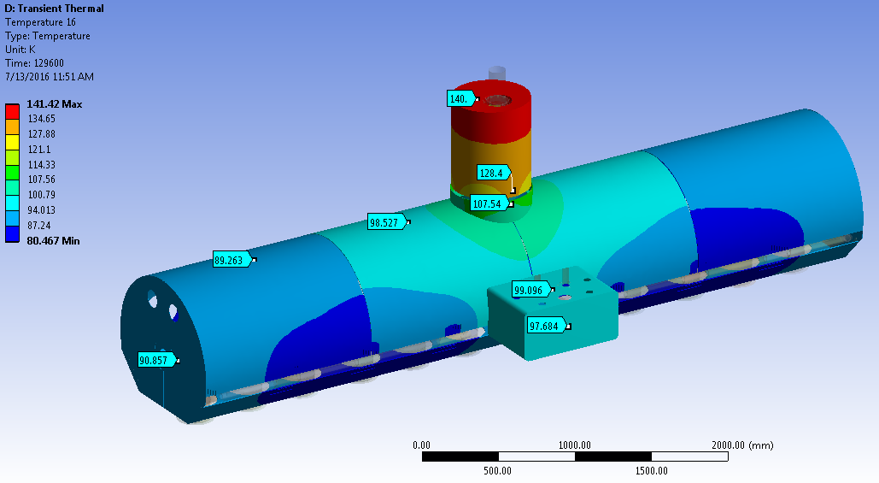
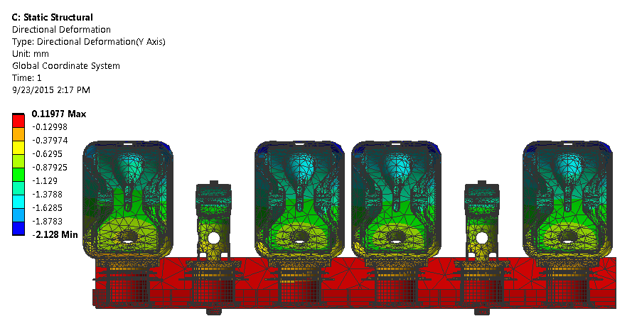
SSR1 coldmass: design status
The design of the coldmass is quite mature
Structural and thermal analyses completed
Piping system, thermal shields and magnetic shields were conceptualized [1]
Strong back and support post were designed and procured
Estimation of cavities and solenoids misalignments due to cooldown (293K --> 2K) done
[1] SSR1 Cryomodule Design for PXIE, T. Nicol et al., Proceedings of PAC2013, Pasadena, CA USA

Slide 13
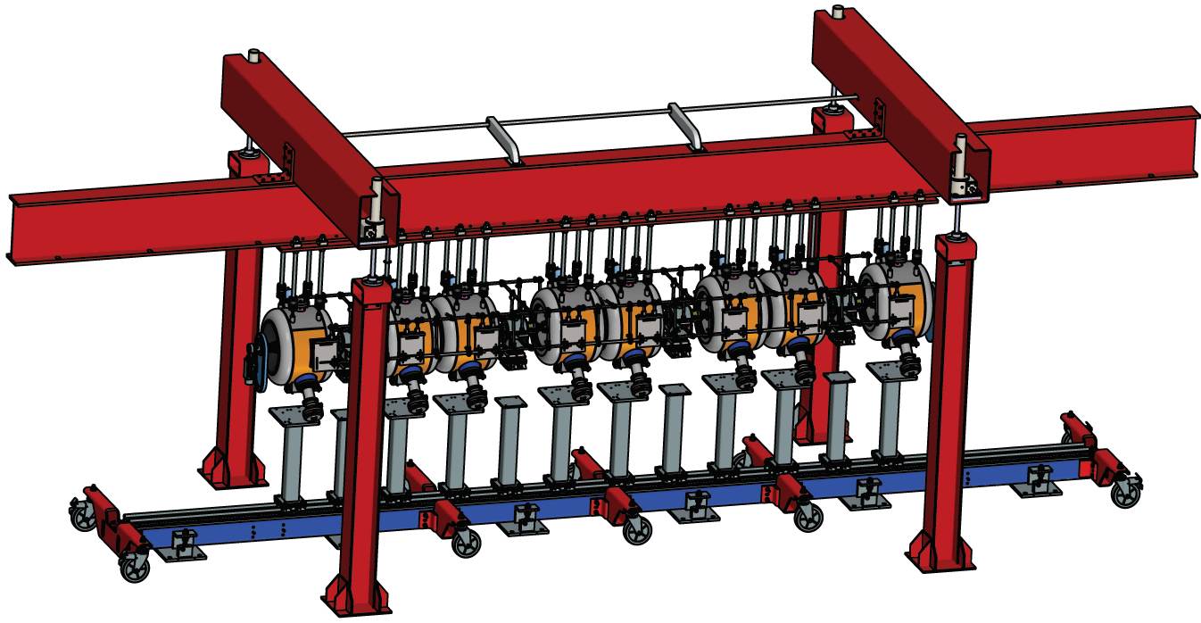
SSR1 coldmass: procurement and assembling
Several components were already procured: strongback, support post, cavity adapting plate, solenoid adapting plate, vacuum vessel (top assembly).
Analytical model to systematically align cavities in the coldmass
The cavities will be aligned according to the geometric axis with the help of the laser tracking technology
The model helps to reach the desired position by suggesting the rotation to be applied at each of the seven screws
Conceptual design of string assembly/coldmass lifting tooling
The conceptual design includes a portal structure realized with standard steel beams and a mechanical lifting system
Structure designed to minimize the deformation during the lifting operation
The design includes an external frame on the string so as to protect itself and support the solenoids
Designed to be also compatible for 650 coldmass

Slide 14
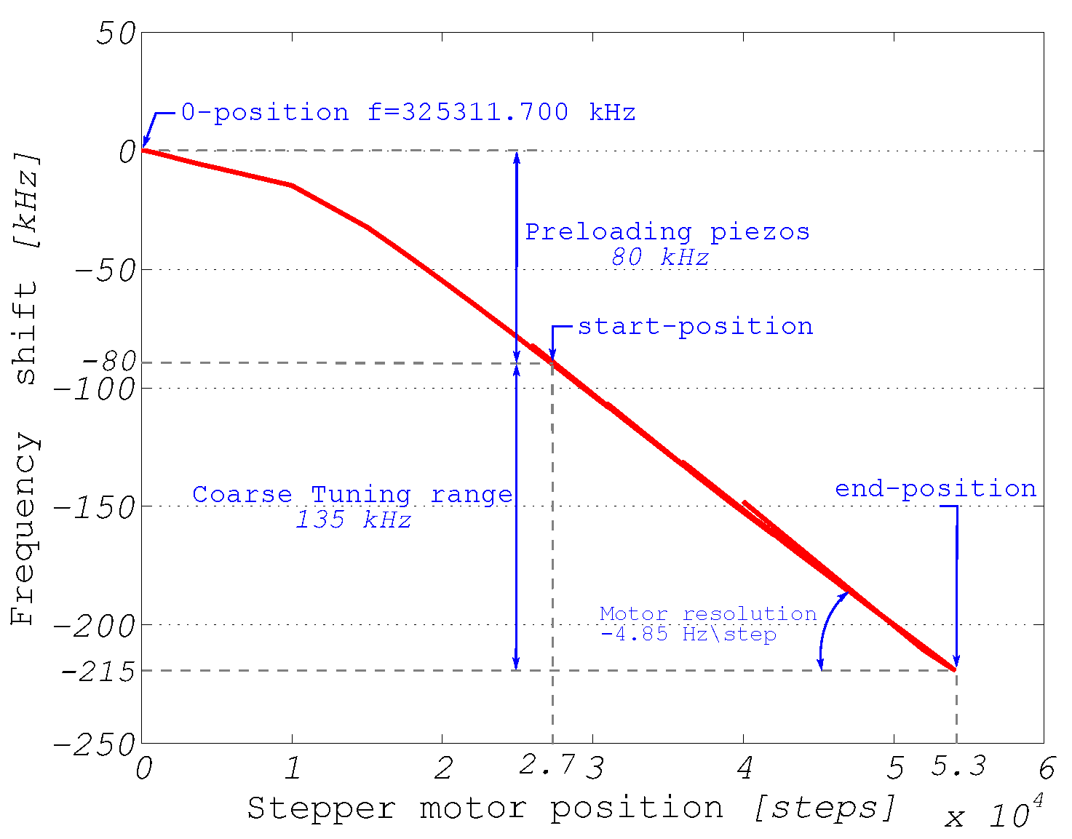
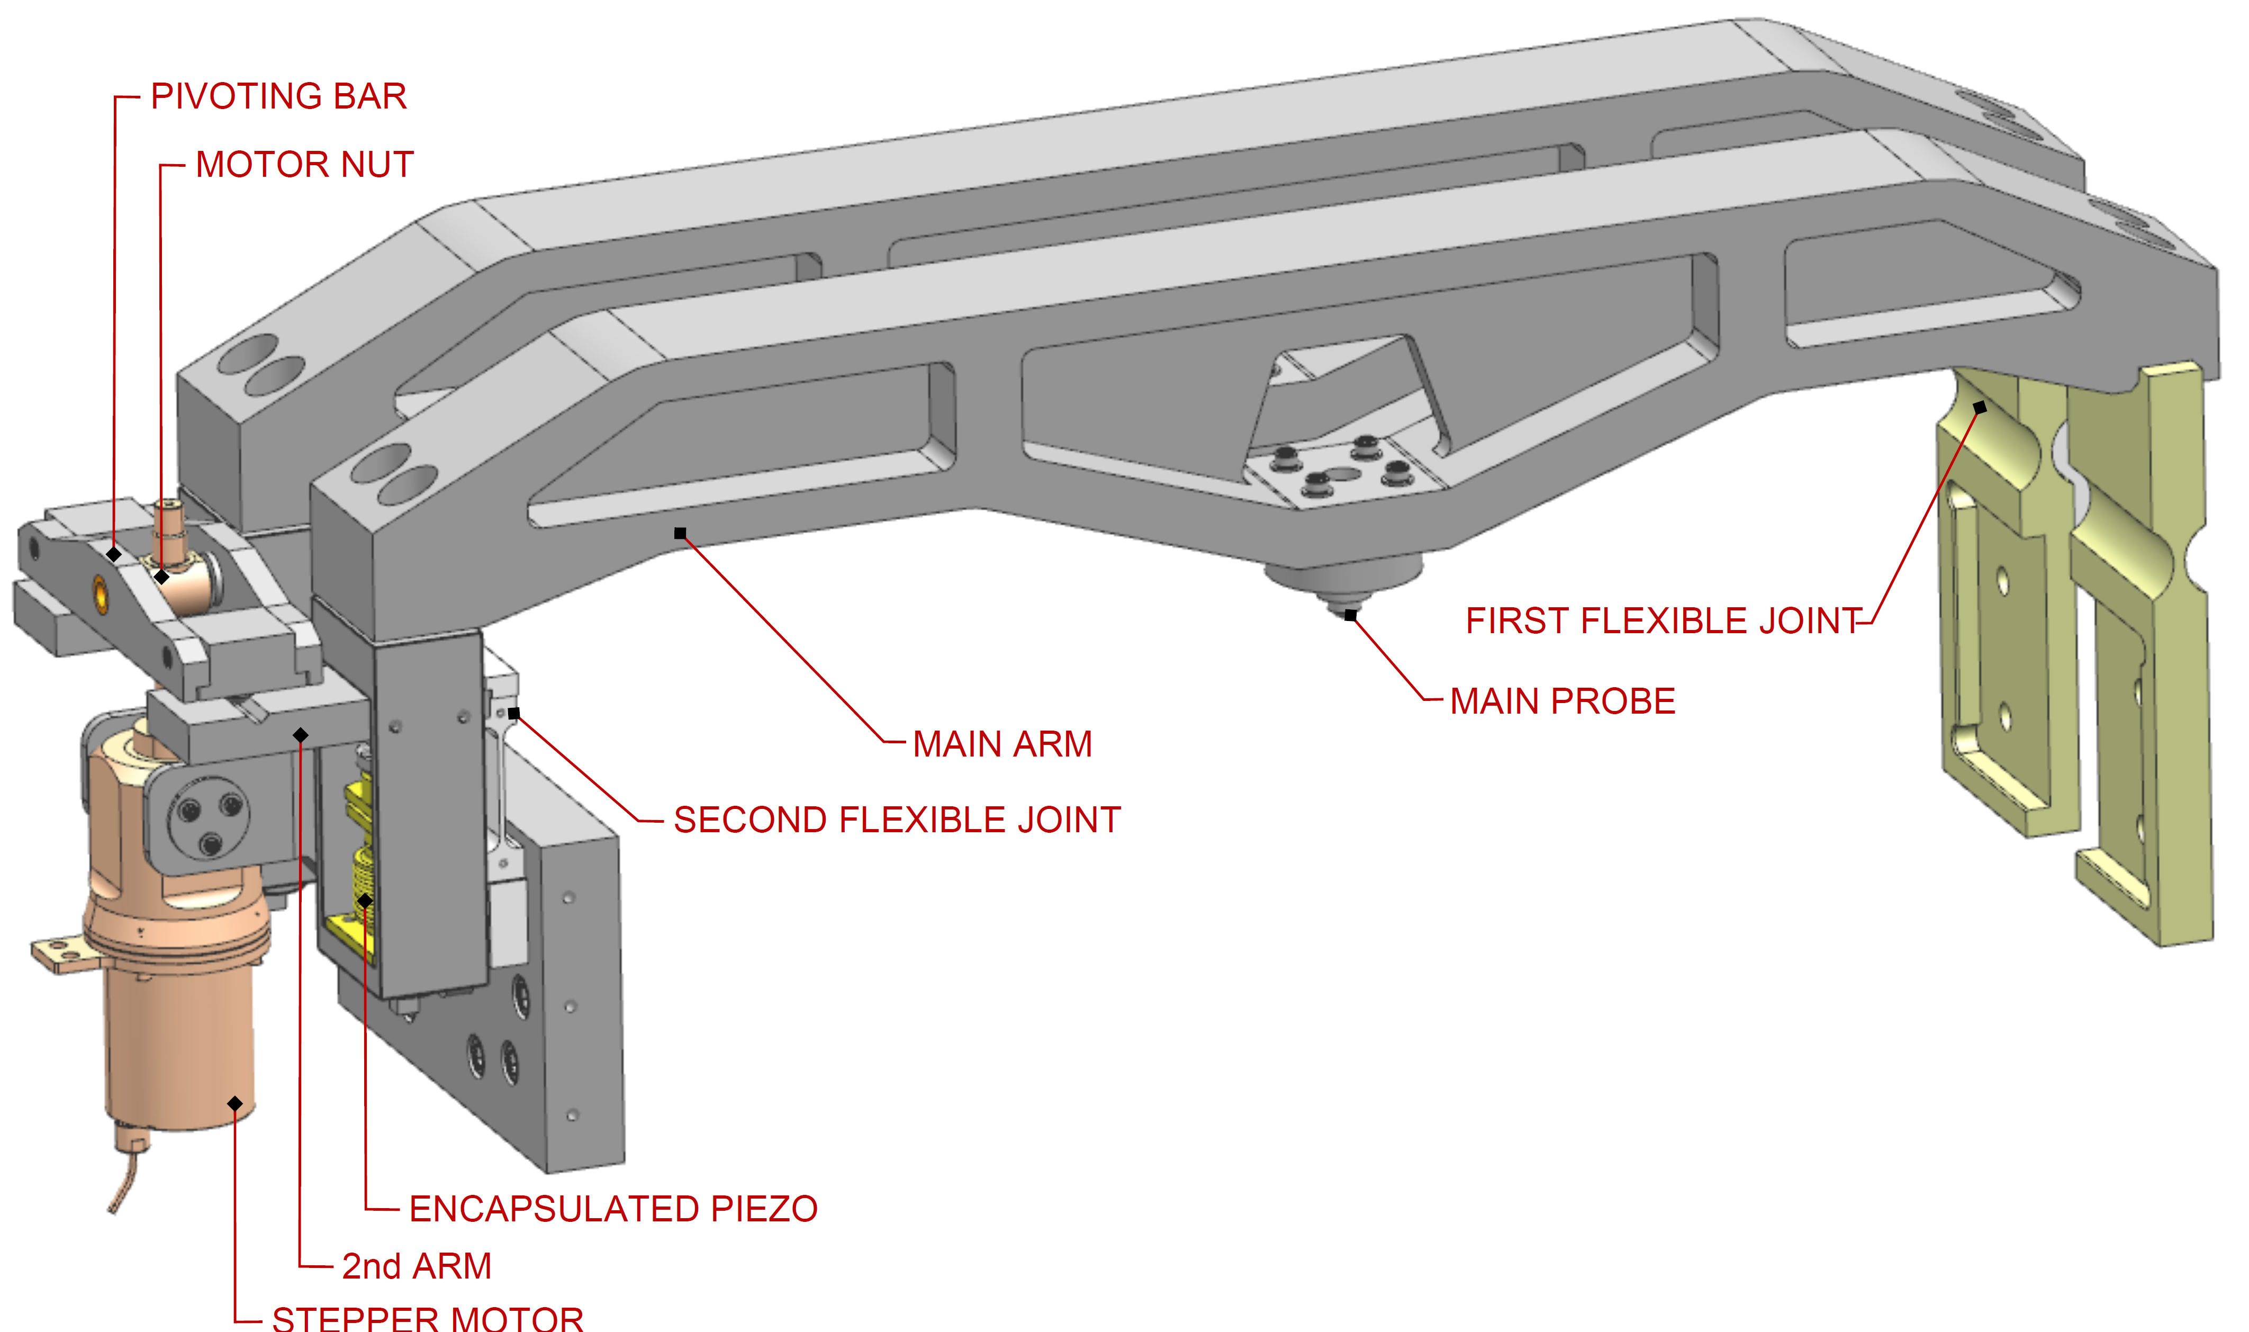
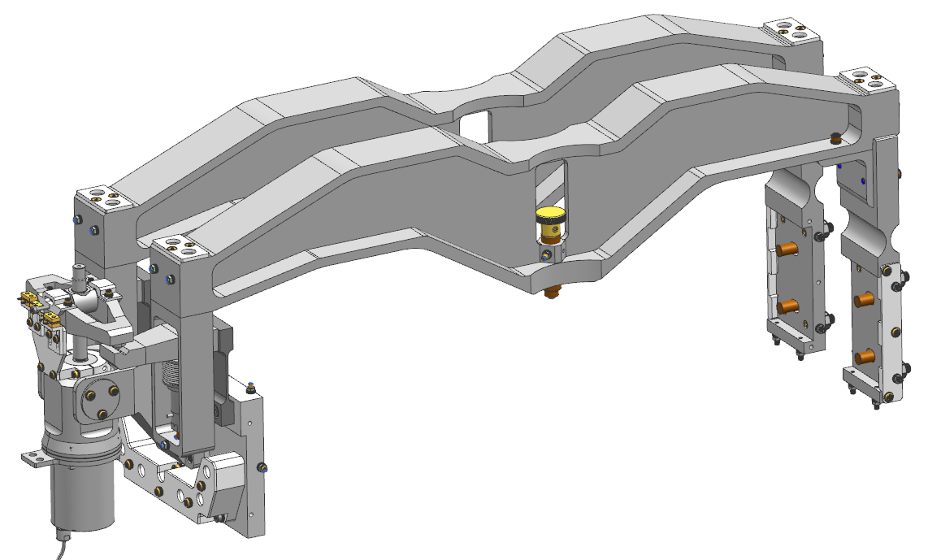
SSR1 tuner: status
Prototype SSR1 tuner
One unit was prototyped
Successfully tested at 293K and cold temperature
Production SSR1 tuner
Design on the way of completion
10 units will be procured (+2 units from IIFC)
Qualification at STC will be performed
Main changes:
Reliability of the piezos, integrating of encapsulated PI piezos stack
Easier installation
Easier handling: reducing the overall weight
Prototype SSR1 tuner
Production SSR1 tuner
SSR1 Tuner Mechanism: Passive and Active Device, D. Passarelli et al., Proceedings of LINAC2014, Geneva, Switzerland
Performance of the Tuner mechanism for SSR1 Resonators During Fully Integrated Tests at Fermilab, D. Passarelli et. al., SRF2015, Canada

Slide 15
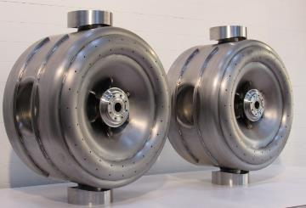
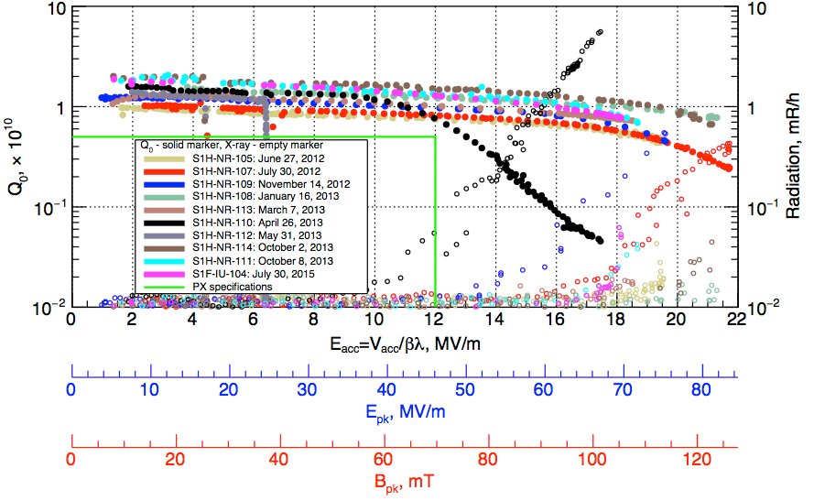
IIFC on SSR1 cryomodule: status
IIFC SSR1 cavities
Two bare SSR1 cavities were received from IUAC, chemically processed and cold-tested at Fermilab. S104 yielded excellent results, S103 presented issues with UHV flange connections [1].
Jacketing will happen at BARC.
Delivery to FNAL by March 2017 for qualification and integration in SSR1 CM.
Additional actions after receiving: QC inspection, Processing, Qualification at STC
IIFC SSR1 tuner
The design of the production SSR1 tuner will be completed in several weeks and the entire package of drawings will be shared with Indian collaborators.
Delivery of two units to FNAL by July 2017
[1] Cold Tests of SSR1 Resonators Manufactured by IUAC for the Fermilab PIP-II Project, L. Ristori et. al, SRF15 Conference

Slide 16
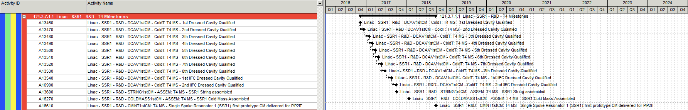
SSR1 CM Schedule
Two activities are on critical path for SSR1 milestones:
the procurement of the remaining (8 out of 10) cold-end power couplers, because of RFQ couplers (also at MEGA) were given highest priority by Fermilab.
the receiving 8th jacketed SSR1 cavity for the crymodule made by IIFC.

Slide 17
Summary
The production and qualification of the SSR1 cryomodule is an important milestone for the entire superconducting linac section of PIP-II, since it will validate also the concept of other SRF cryomodules: SSR2, LB650, HB650.
The schedule and status of the activities are promising to get the first SSR1 cryomodule delivered by Sep 2018.

Slide 18
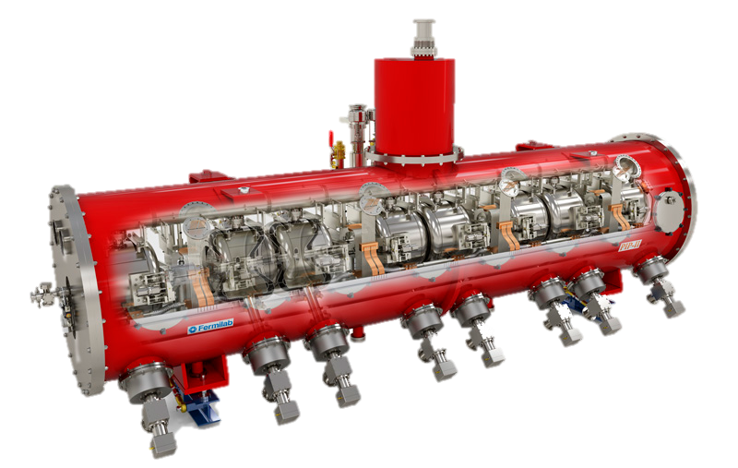
Thank you for you attention
On behalf of the SSR1 team

