Slide 1
PIP-II Perspective on IIFC
Steve Holmes
DOE Independent Project Review of PIP-II
15 November 2016

Slide 2
What are we trying to achieve?
“Total Project Collaboration”
R&D Phase
Develop capabilities, infrastructure, and working relationships at Fermilab and DAE labs, and allied vendors, that will support construction of the PIP-II linac
Develop capabilities and infrastructure in DAE labs and allied vendors that will support successful construction of high intensity proton accelerators in India
PIP-II Construction Phase
Construct and commission PIP-II with a significant India/DAE in-kind contribution, and significant engagement of DAE staff
India/DAE contribution supports a very significant reduction in the cost to DOE of the PIP-II Project
In-kind contribution requires a successful R&D phase
Many challenges
Success requires consistent attention and guidance from management
But not micromanagement
Constructive interaction at the technical level is essential in making this work

Slide 3
Outline
Organization
Mapping IIFC onto PIP-II
Challenges
Moving Forward

Slide 4
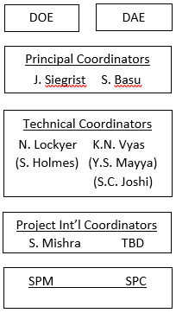
IIFC Organization
Scope and deliverables schedule for R&D phase are governed by the Joint R&D document
Signed by S. Basu and J. Siegrist
High level management via two Principal Coordinators, supported by two Technical Coordinators
TC weekly teleconference
Technical integration of work via Fermilab SPMs and Indian SPCs
SPM/SPC weekly teleconferences
Semi-annual meetings initiated
January/July 2016 (both at BARC)

Slide 5
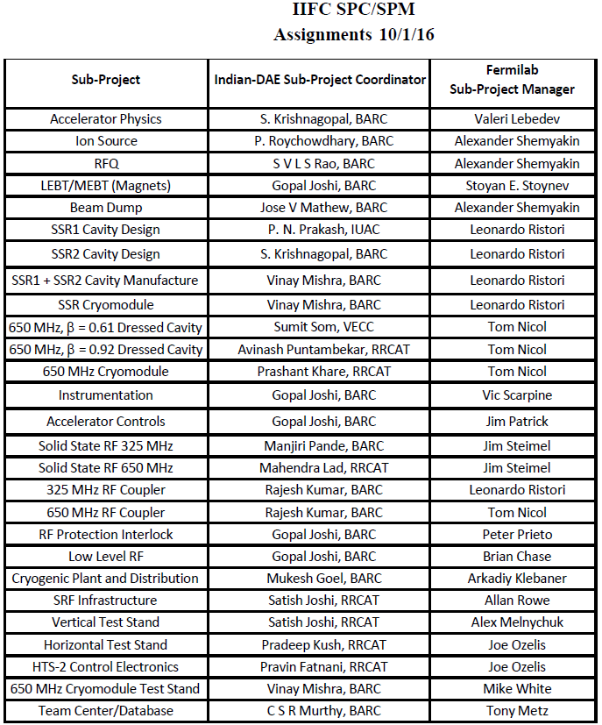
SPC/SPM Assignments
Current SPM/SPC assignments
Generally all are engineers or scientists
Within Fermilab SPMs are typically level 3 managers within PIP-II Project

Slide 6
Mapping IIFC onto PIP-II/Strategy
Mapping based on consideration of:
DAE technology interests
PIP-II risk mitigation strategies
R&D phase scope of work reflects vision of construction phase deliverables
Development and testing of prototypes
Development of infrastructure
DAE interests
Primary interest is acquiring capabilities, intellectual and physical, to construct high power proton accelerators domestically
Result: DAE is engaged in all critical systems
PIP-II interests/risk mitigation
All DOE projects are required to mitigate risks: technical and cost
Primary mechanisms for technically demanding components:
Multiple suppliers
Project host lab serves as “general contractor”

Slide 7
Mapping IIFC onto PIP-II
The DAE laboratories are completely integrated into nearly all aspects of the PIP-II superconducting linac
Areas of collaborative development include:
Superconducting radio frequency accelerating modules
Radio frequency power sources
Radio frequency controls
Super- and normal-conducting magnets
Cryogenic Plant
Beam diagnostics
Controls
IIFC

Slide 8
Mapping IIFC onto PIP-II/Major IIFC Deliverables
System/Component | R&D Deliverable | Construction Deliverable*
SSR1 | 2 dressed cavities | NA
SSR2 | 2 dressed cavities | 50% dressed cavities
LB650 | 2 dressed cavities | 50% dressed cavities
HB650 | 4 dressed cavities | 50% dressed cavities
SC solenoids | 4 magnets (SSR2) | All SC solenoids
Warm magnets | All PIP2IT/MEBT magnets 2 focusing magnets (650) | All warm magnets (650)
RF Power Sources/325 | 9 sources (SSR1) | All rf sources
RF Power Sources/650 | 7 sources (HB650) | All rf sources
LLRF/RFPI | 4 systems (SSR1,2xHTS-2, CMTF) | 50% of required boards
HTS-2 | 2 test stands (FNAL & RRCAT)
LHe Cryoplant |  | 1900 W (@2K) Plant (2)
* Subject to adjustment and formalization between DAE and DOE

Slide 9
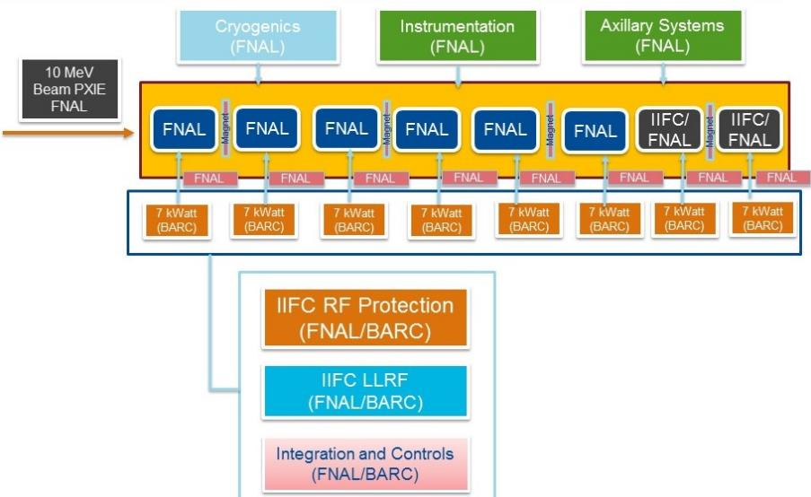
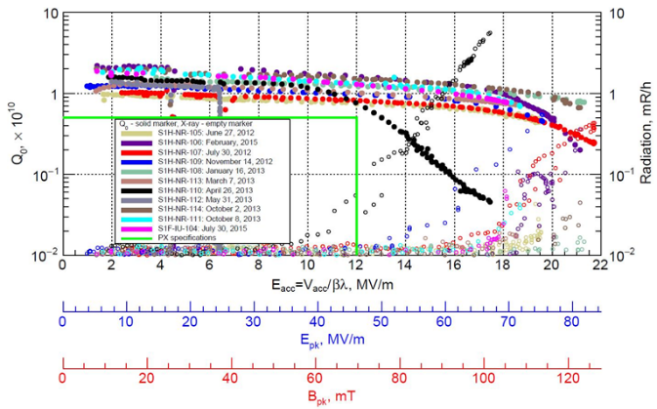
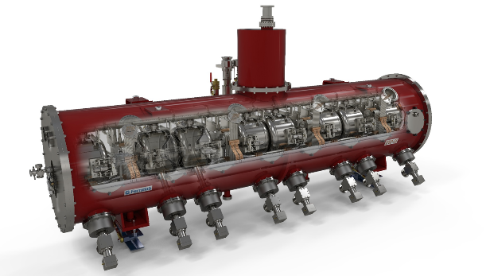
Integrated Systems Tests/SSR1 (w/beam)
SSR1 cryomodule under development by IIFC
Install in PIP2IT immediately downstream of HWR cryomodule
Plan: 6 U.S. cavities + 2 (successfully tested) Indian cavities
RF sources from India (8 x 325 MHz, 7 kW)
Goal: Late 2018

Slide 10
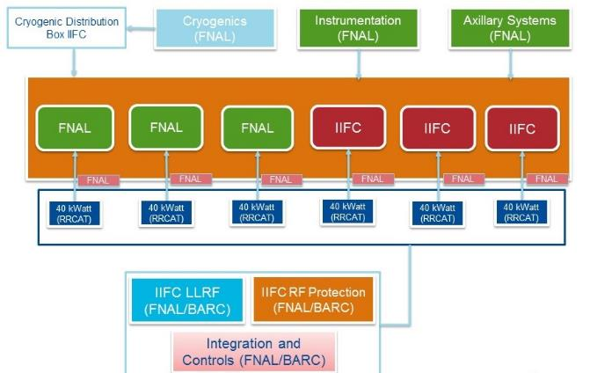
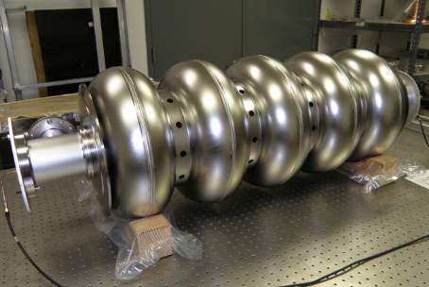
Integrated Systems Tests/HB650 (w/ RF)
HB650 MHz Prototype Cryomodule
3 U.S. + 3 Indian cavities (RRCAT)
Test at full RF power (CMTS)
RF sources from RRCAT (650 MHz, 40 kW)
LLRF and RF Protection (BARC w/Fermilab)
Goal: Early 2020

Slide 11
Challenges
PIP-II, as far as I am aware, is the first attempt by DOE to construct a domestic accelerator incorporating international in-kind contributions
Creates a set of generic challenges in how to organize and manage
India creates a number of specific challenges…
Conducting a collaboration between institutions separated by 11 time zones and 8000 miles
Communications
Visits
Equipment exchange
Export regulations
India is classified as a “sensitive country” with BARC subject to special scrutiny
Differences in engineering and management cultures also need to be recognized
Many discussions on what “design” means
Control of documentation
(Fermilab processes codified in Fermilab Engineering Manual)

Slide 12
Moving Forward
Most important: Establish and maintain confidence among the partners
In process…
Several things have been particularly successful (my opinion)
FRS/TRS
Establish the basic requirements, including interfaces to other systems
Generally involve significant discussion and iteration
Signed off by both Fermilab and DAE lab
Guest engineers/scientists
Our goal for these visits is to provide an experience that is both professionally and personally fulfilling
7 engineers/scientists at Fermilab for 2-year residencies
Augmented by a set of shorter term (1-6 months) visitors
Provide direct support to efforts at Fermilab
Provide interface to home laboratories
Upon return will be in unique position to facilitate interactions between Fermilab and DAE labs as well as carrying home knowledge & experience
Weekly teleconferences
SPM/SPC
TC/TC
These elements form a strong basis for moving forward

Slide 13
Moving Forward
Areas requiring management attention:
Management of shared engineering documentation
Horizontal Test Stand
Preparing for identical test stands at Fermilab and RRCAT
Cryoplant
Very long lead item
Export licensing
Involves multiple agency interactions: Dept of Commerce, DOE
Intellectual Property
Especially third-party
DAE Chairman’s Report (March 2017)
Review of R&D progress;
Will supports transition to constructing phase
Prioritization in face of resource limitations
SPC/SPM interactions
This is the foundation of everything we do together

Slide 14
Summary
IIFC has been going for seven years
Interactions have picked up considerably over the last two years, and deliverables are starting to arrive at Fermilab
In most cases these meet requirements
The approach to requirements and specifications has been formalized
Jointly developed and jointly approved
Communications have improved over the last two years, both at the SPM/SPC and higher levels
DAE staff at Fermilab for extended visits have had significant positive impact
Challenges remain, but both sides are committed to making this work

Slide 15
Backups

