Slide 1
Plan to CD-1
Paul Derwent
DOE Independent Project Review of PIP-II
15 November 2016

Slide 2
Plan to CD-1
CD-1, Approve Alternative Selection and Cost Range
  The selected alternative and approach is the optimum solution
  CD-1 approval marks the completion of the project definition phase and the conceptual design.
  The recommended alternative should provide the essential functions and capabilities at an optimum life-cycle cost, consistent with required cost, scope, schedule, performance, and risk considerations. It should be reflected in the site’s long-range planning documents as well.
  The cost range provided at CD-1 is the preliminary estimate for the selected alternative.

Slide 3
CD-1 Requirements

Slide 4
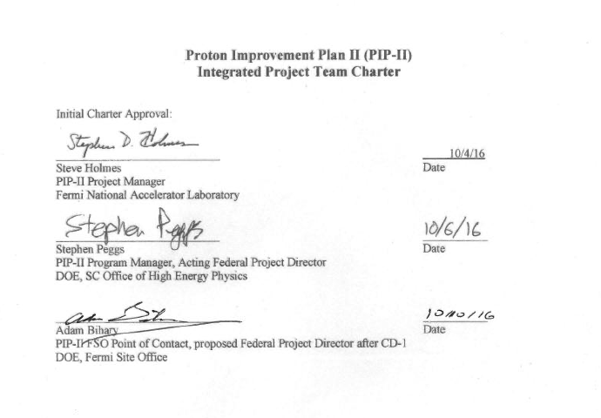
Integrated Project Team :
Federal Project Director: Adam Bihary, Fermi Site Office
OHEP Program Manager: Steve Peggs
PIP-II Project Manager
  Steve Holmes,
PIP-II Deputy PM
  Shekhar Mishra, Paul Derwent
PIP-II Assoc PM
  Luisella Lari
Meeting since September 2015
Charter October 2016

Slide 5
Requirements
Deliverable | Responsible Party | Dependent on Alternative Selection | Status
Acquisition Strategy | FPD / Project | Yes | Base on recent projects
Preliminary Project Execution Plan | FPD / Project | Yes | Draft complete
Risk Management Plan | Project | No to write /Yes to execute | Tailor Laboratory Risk Management Plan to project requirement
One for One Building Replacement | Project | No | Laboratory space bank has sufficient square footage to accommodate the construction of this project.
Conceptual Design Report Review | Project Project | Yes Yes | Draft complete to be scheduled
Preliminary Hazard Analysis Report | Project | Yes | draft covering the Injector Test Facility, need to expand to entire project
Integrated Safety Management Plan | Project | No | not started, base on recent projects
Quality Assurance Plan | Project | No | Base on Laboratory QA manual
Safeguards and Security | Project | No | not started, base on recent projects
NEPA Strategy EENF Environmental Assessment | Site Office Project Project / SO | No | in progress draft exists described by V. Kuchler
Independent Cost Review | PMOA | Yes | to be scheduled
Independent Project Review | OPA | Yes | to be scheduled

Slide 6
Analysis of Alternatives
Project prepared an Analysis of Alternatives document
  reviewed by OHEP committee in Author / Referee Model
  Accepted by OHEP in September 2016
  4 alternatives:
    CW capable SRF linac
    Pulsed SRF Linac
    Pulsed Cu + SRF Linac
    Pulsed Cu Linac
  10 evaluation criteria
The AoA does not include a recommendation of an alternative
  a quantitative analysis
  DOE makes the decision

Slide 7
AoA Evaluation Table

Slide 8
AoA Evaluation Table
Note that progress on multiple CD-1 requirements does depend on Alternative selection

Slide 9
High Level Project Risks: PPEP
The PIP-II Project will follow a risk management process in accordance with the Fermilab Risk Management Procedure for Projects that describes the project’s risk identification and management approach.
Project Funding: Risks arise from uncertainty in the funding profile. Changes can cause delays in the project schedule prior to defining the schedule baseline. The project is focusing resources on reducing technical risk through the R&D program. Development of a more detailed resource loaded schedule will enable the project to re-plan work as funding changes occur. Close coordination between PIP-II project, the Program office, and the laboratory are needed to ensure impacts are mitigated.
ESH&Q: With higher beam power available from the line, there are environmental risks associated with groundwater activation and radiation. By careful evaluation through the NEPA process and adherence to the Fermilab Radiological Control Manual, the review process and assessment will document the mitigations necessary for these risks.
Technical Risks: Developing new capabilities from existing technology, the possible use of a limited amount of unproven technology and the need for long-term operational reliability and integrity of components all pose risk to the PIP-II project. They impact the project cost and schedule as well as future accelerator performance. The R&D plan, including the PIP-II Injector Test and cryomodule development, addresses the key technical risks. Potential opportunities include the ability to operate beyond the nominal performance envelope defined in support of LBNF/DUNE.
Resource Availability: There are critical skills and resources (e.g., cryogenic engineering) necessary to complete the project. Working with the laboratory management, the project will work to define the needs for these critical resources in advance so that the resource plan for the laboratory can be adjusted to meet these needs.
Procurements/Suppliers: Limited vendors for key components, specifically SRF cavities, will be a risk factor. There are no such vendors in North America. While there are proven European vendors, the project is using different frequencies, and hence different size cavities that each require development cycles. The project is developing plans to work with the European vendors. RF power sources are provided through international contributions, with limited other development through existing vendors. Delivery of sources during the R&D phase should demonstrate the capabilities of the project’s international partners.

Slide 10
Key Performance Parameters
The Threshold KPPs are the minimum parameters which comprise the CD-4 completion criteria for the PIP-II Project, and will be a prerequisite for approval of CD-4, Project Completion. Objective KPPs are those additional parameters or technical goals that will be added to the project if facilitated by available contingency and/or non-DOE partner contributions, and may be further defined at CD-2.
# | Description of Scope | Threshold KPP | Objective KPP
1 | 800 MeV SRF linac | Beam delivered through the linac, to the Booster Injection Region | 800 MeV beam delivered to Booster Injection Region
2 | Booster/RR/MI upgrades | Components capable of delivering 1.2 MW to external beamline installed and beam accelerated in the Booster
3 | Cryogenic Infrastructure | Cryogenic plant and distribution ready to support beam operation, and cooled to operating temperature
4 | Civil Construction | Tunnel enclosures and service buildings ready to support 700 MeV SRF linac and transfer line to the Booster | Tunnel enclosures and service buildings to support 1 GeV SRF linac and transfer line to the Booster
Beam delivery requirements:
recent development
not included in Cost estimate

Slide 11
Summary
Documentation for CD-1 underway
  CDR and PPEP in draft form
  Preliminary KPPs
Integrated Project Team and Monthly reporting
Analysis of Alternatives report submitted to OHEP
  Preparation for CD-1 does depend on alternative selection

