Slide 1
LB650 Cavity and Cryomodule Status
Tom Nicol, LB650 SPM
DOE Independent Project Review of PIP-II
15 November 2016

Slide 2
Outline
Program scope.
Milestones and schedule.
R&D status.
Division of responsibility.
Five-cell cavity development.
Ancillary hardware development.
Current status and summary.

Slide 3

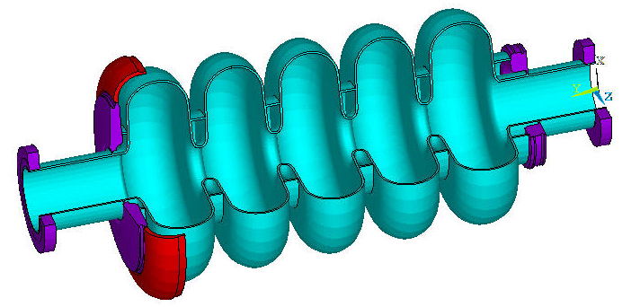
PIP-II
33 LB650 cavities in 11 cryomodules

Slide 4
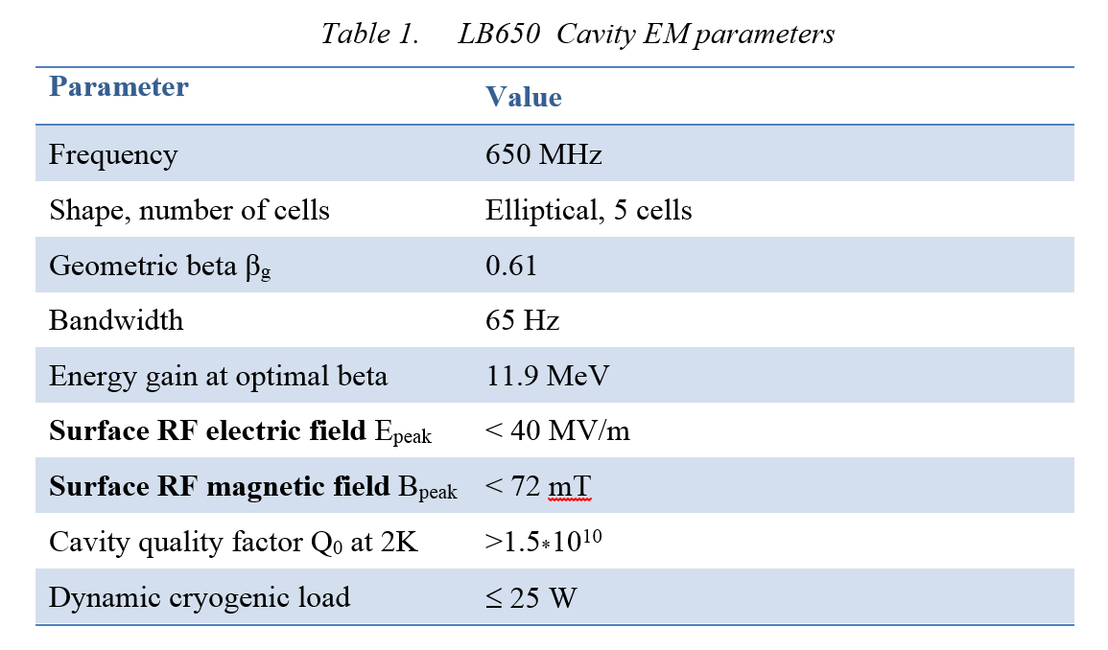
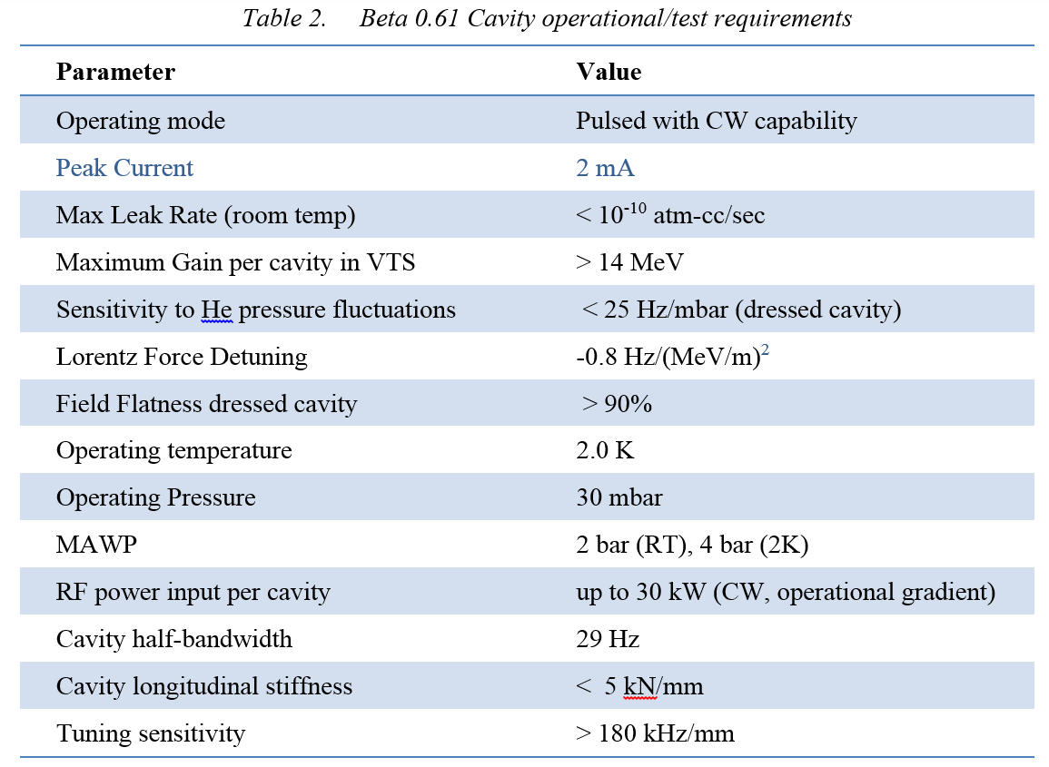
Cavity performance parameters from the FRS
Operational requirements from the FRS (ED0001834)

Slide 5
Cryomodule performance parameters from the FRS
General
 | Physical beam aperture, mm | 83
 | Overall length (flange-to-flange), m | 3.9
 | Overall width, m | ≤1.6
 | Beamline height from the floor, m | 1.3
 | Cryomodule height (from floor), m | ≤2.00
 | Ceiling height in the tunnel, m | 3.20
 | Max allowed heat load to 70 K, W | 100
 | Max allowed heat load to 5 K, W | 15
 | Max allowed heat load to 2 K, W | 100
 | Maximum number of lifetime thermal cycles | 50
 | Intermediate thermal shield temperature, K | 45-80
 | Thermal intercept temperatures, K | 5 and 45-80
 | Cryo-system pressure stability at 2 K (RMS), mbar | ~0.1
 | Environmental contribution to internal field | <0.1 mG
 | Transverse cavity alignment error, mm RMS | <0.5
 | Angular cavity alignment error, mrad RMS | ≤5
Cavities
 | Number, total per cryomodule | 3
 | Frequency, MHz | 650
 | β geometric | 0.61
 | Operating temperature, K | 2
 | Operating mode | CW and pulsed (0-100%)
 | Operating energy gain, MV/m | 17.7
 | Coupler power rating (TW, full reflection), kW | 120
Operational requirements from the FRS (ED0001830)

Slide 6
LB650 milestones and schedule*
Major Milestone | Delivery Date
Fabricate 1-cell LB650 Cavity | Done
Process and test 1-cell LB650 cavity at Fermilab | Done
Finalize the design of 5-cell LB650 cavity | 31-Dec-16
Design review of 5-cell LB650 cavity | 31-Jan-17
Fabrication of 1st 5-cell LB650 cavity | 30-Jun-18
Processing and vertical testing 1st 5-cell cavity | 30-Sep-18
Fabrication of 5-cell LB650 helium vessel and its interface to the end group at DAE laboratories | 30-Oct-18
Dressing LB650 cavity | 28-Feb-19
Testing of 1st 5-cell dressed LB650 at Fermilab | 31-May-19
Fabrication of 2nd 5-cell LB650 Cavity | 30-Oct-18
Processing and Vertical testing 2nd 5-cell cavity | 28-Feb-19
Dressing 2nd LB650 Cavity | 31-May-19
Testing of 2nd 5-cell dressed LB650 at Fermilab | 30-Sep-19
*: This new schedule takes into account of the presentations made by DAE Sub Project Managers at the January and July 2016 meetings of the IIFC in Mumbai.

Slide 7
LB650 milestones and schedule
Major Milestone | Delivery Date
Design of LB650 slow and fast tuner | 30-Jun-16
Design of 5-cell LB650 tuner interface | 30-Jun-16
Fabrication of 5-cell LB650 tuner, motor, readout and its interface to the end group at DAE laboratories | 30-Jun-18
Design of 650 MHz power coupler | 30-Apr-17
Fabrication of 650 MHz power coupler | 30-Jun-19
Design of 650 MHz LB/HB cryomodule DAE laboratories and Fermilab | 30-Jun-18

Slide 8
IIFC single-cell LB650
To ensure the RF and mechanical design is sound, a single-cell LB650 niobium cavity was designed and developed by VECC with the help of Electron Beam Welding (EBW) facility at IUAC, New Delhi.
The cavity was sent to Fermilab/ANL in March 2016 for processing and testing in vertical test stand at 2 K.
It achieved an accelerating gradient of 34.5 MV/m.
Although the required operating accelerating gradient is 17 MV/m with Q₀=1.5E+10, the cavity reached up to 34.5 MV/m with Q₀=1.5E+10.

Slide 9
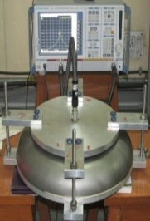
IIFC single-cell LB650 (at VECC)
Half Cells were formed at local industry in Kolkata, India.
Machining at VECC Workshop.
CMM inspection at VECC and frequency measurement.
EB welding at IUAC, Delhi.
  Welding fixtures were manufactured at local Industry
  Development of weld parameters for future multi-cell cavities
  Past experience of IUAC helped to complete successful welding
Forming set up
Half-cell machining
CMM inspection
of half-cell
RF measurement of half cell
EBW,IUAC

Slide 10
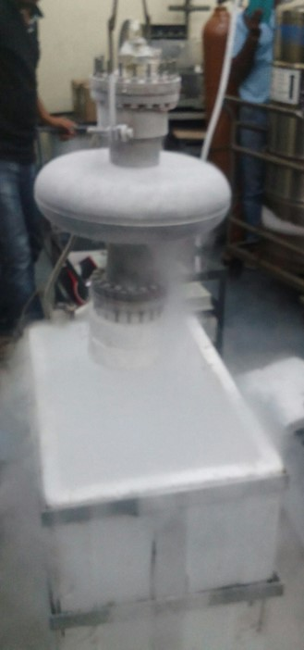
IIFC single-cell LB650 (at VECC)
Cavity Inspection after welding.
  Cold-shocking with LN₂ : 3 cycles
  Leak check
  RF measurement
EBW,IUAC
Cold-shocking
MSLD
RF measurement

Slide 11
IIFC single-cell LB650 (at Fermilab/Argonne)
Inner conductor of VTS couplers were trimmed to the required length.
RF measurement with VTS couplers.
Electro polishing at Argonne in May 2016.
  120 µm bulk EP (Total process time : 560 minutes).
  Ultrasonic thickness measurement after EP.
  Process parameters were strictly controlled during the process.
RF measurement
EP at ANL
Before EP
After EP

Slide 12
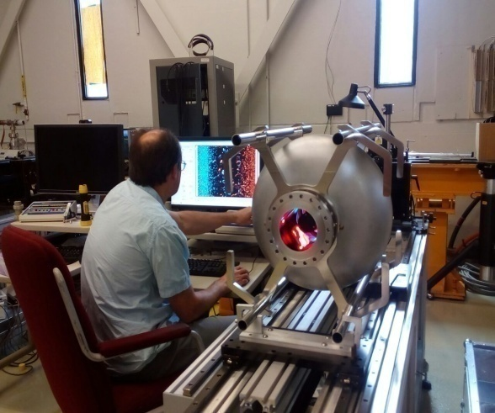
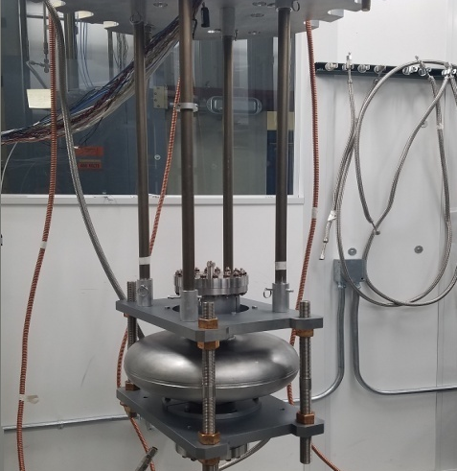
IIFC single-cell LB650 (at Fermilab/Argonne)
High pressure rinsing at Argonne.
800°C baking at FNAL for 3 hours at Fermilab in June 2016.
Optical Inspection of cavity RF surface at FNAL.
Final HPR at Argonne.
VTS Assembly at Fermilab on 30th June 2016.
HPR, ANL
Baking, FNAL
Optical inspection
VTS insert assy

Slide 13
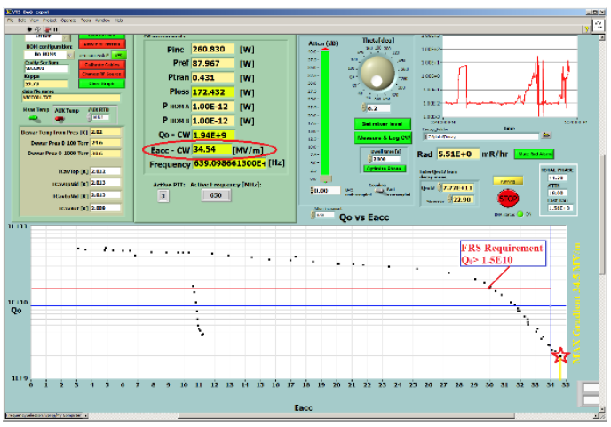
VTS test results of LB650 VECC single-cell cavity
Maximum gradient: 34.5 MV/m @2 K.
No quench at full RF power ~200 W.
30 MV/m Eacc at unloaded cavity quality factor Q₀=1.5E+10.
Eacc & Q₀ - greater than required in FRS.
VTS Test Results on 6th July 2016

Slide 14
LB and HB650 division of responsibility
Low beta cavities
  Fermilab – RF and end group design
  VECC – Bare and dressed cavity mechanical design and fabrication
High beta (0.92) cavities
  Fermilab – RF and bare and dressed mechanical design
  RRCAT – Bare and dressed cavity fabrication
High beta (0.90) cavities (beta 0.90 is an earlier design, superseded by 0.92 – both will be used in the first high beta cryomodule)
  Fermilab – Bare and dressed cavity design and fabrication
Low beta cryomodule
  DAE and Fermilab – Complete cryomodule design with specifications from Fermilab
High beta cryomodule
  Fermilab and RRCAT – Complete cryomodule design
Tuner design and fabrication
  Fermilab – Prototype tuner design and fabrication
Input coupler design and fabrication
  Fermilab – Prototype coupler design and fabrication

Slide 15
LB650 mechanical design dimensions
Dimensional parameters | Cold dimension (as designed) (mm) | Cold dimension Pre- BCP treatment of 250 μm (mm) | Warm dimension (for fabrication) (mm)
Equator radius | 194.646 | 194.396 | 194.674
Iris radius | 41.5 | 41.25 | 41.30899
A | 52.14 | 51.89 | 51.9642
B | 56 | 55.75 | 55.82972
a | 12.95 | 13.2 | 13.21888
b | 23.55 | 23.8 | 23.83403
Iris radius (for end cell) | 59 | 58.75 | 58.83401
A (for end cell) | 53.52 | 53.27 | 53.34618
B (for end cell) | 48 | 47.75 | 47.81828
a (for end cell) | 10.8 | 11.05 | 11.0658
b (for end cell) | 25.7 | 25.95 | 25.98711
Equator flat (end cell) | 3.79 | 3.79 | 3.79542
Iris flat (mid cell) | 2.61 | 2.61 | 2.613732
Half cell length (L/2) | 70.335 | 70.335 | 70.43488

Slide 16
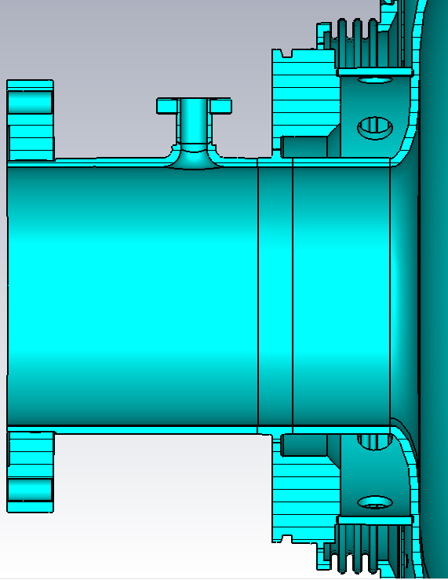
LB650 cavity end group
Field probe and tuner end group
Tuner end group design details developed at Fermilab and made available to VECC for low beta cavity design
Ø=12 mm
L=89.5mm
L=91 mm
L=176 mm
Ø=118 mm

Slide 17
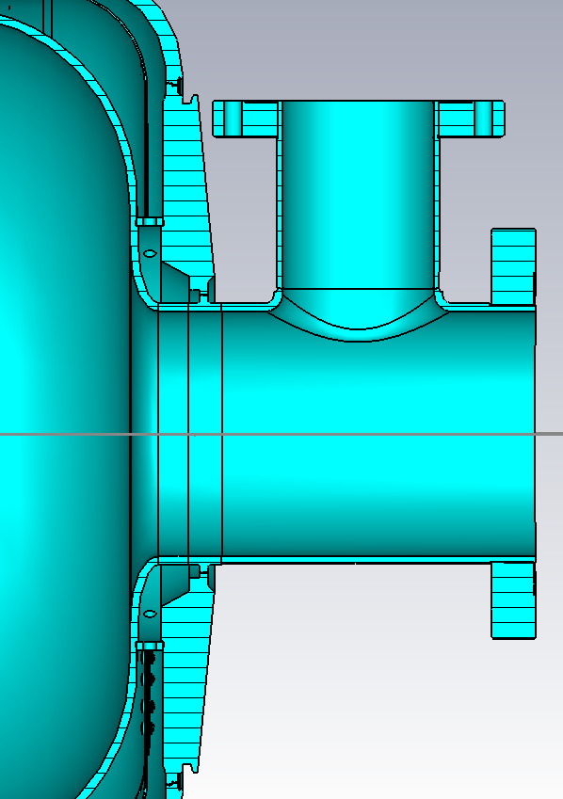
LB650 cavity end group
Power coupler end group design details developed at Fermilab and made available to VECC for low beta cavity design
FPC end group
Ø=72.9 mm
L=160 mm
L=98 mm
Ø=118 mm
Lbeam_Pipe=183 mm

Slide 18
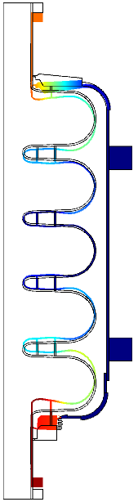
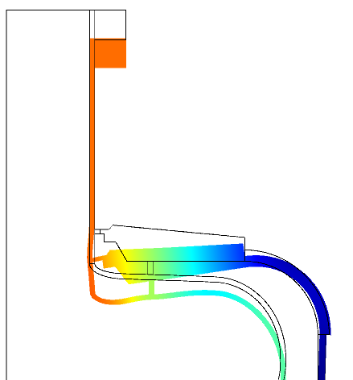
Stiffening ring optimizations
LFD=-1.21Hz/(MV/m)^2
VECC β=0.61 CAVITY, 2 Rings 70/109mm, Tuner stiffness 68kN/mm + no second rings on the both end cells + 8mm rounding both sides

Slide 19
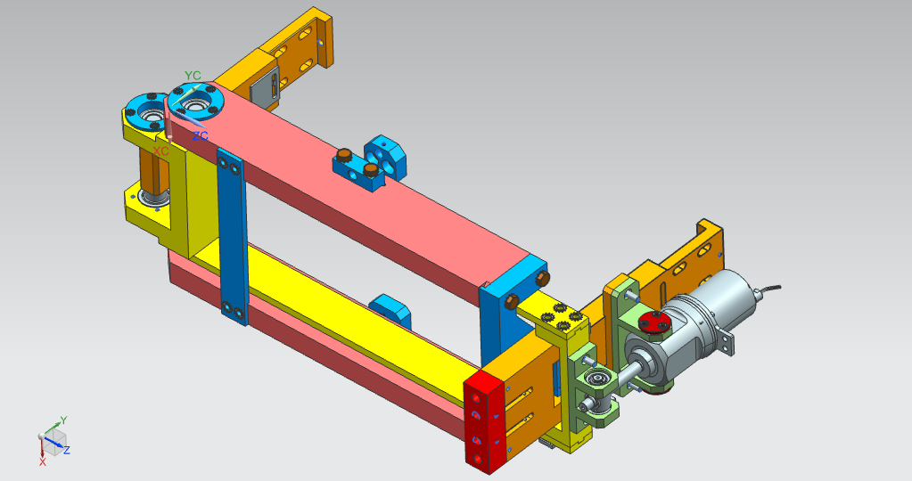
LB and HB650 tuner concept

Slide 20
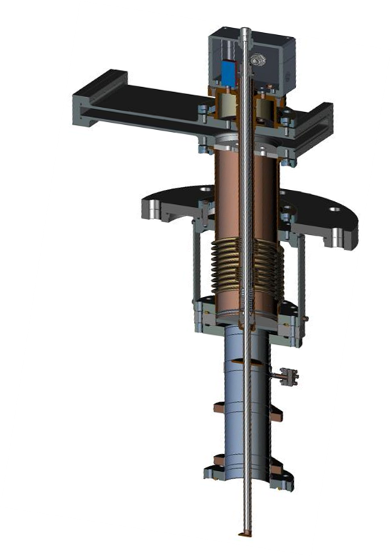
LB and HB650 coupler concept

Slide 21
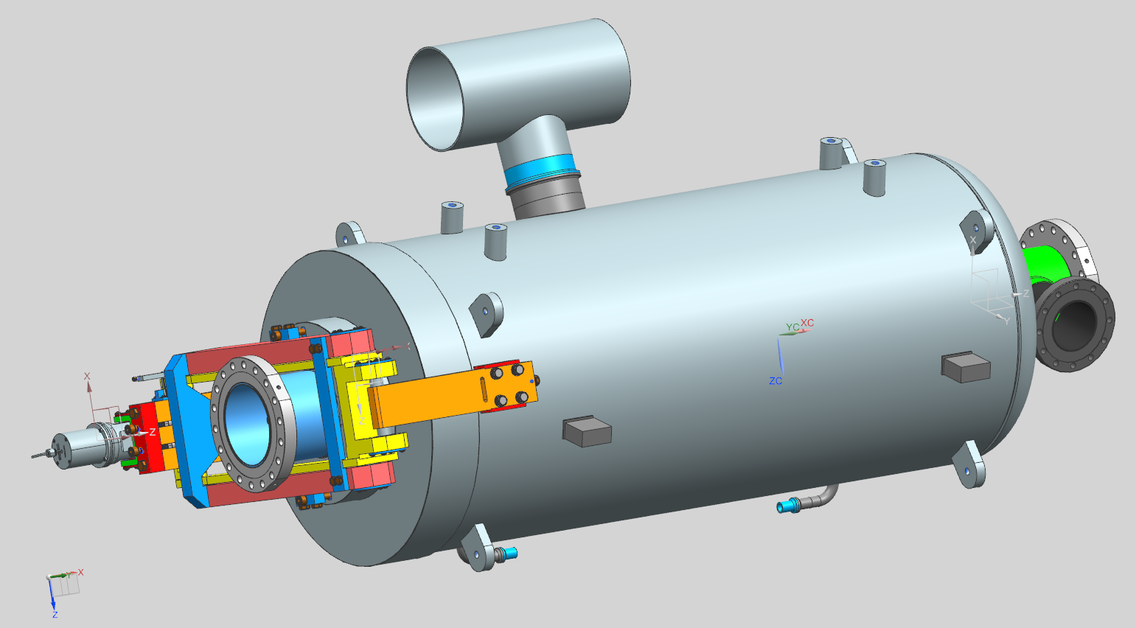
LB650 dressed cavity concept
Power coupler port
Tuner
Helium vessel and pipe connections are compatible with HTS-2

Slide 22
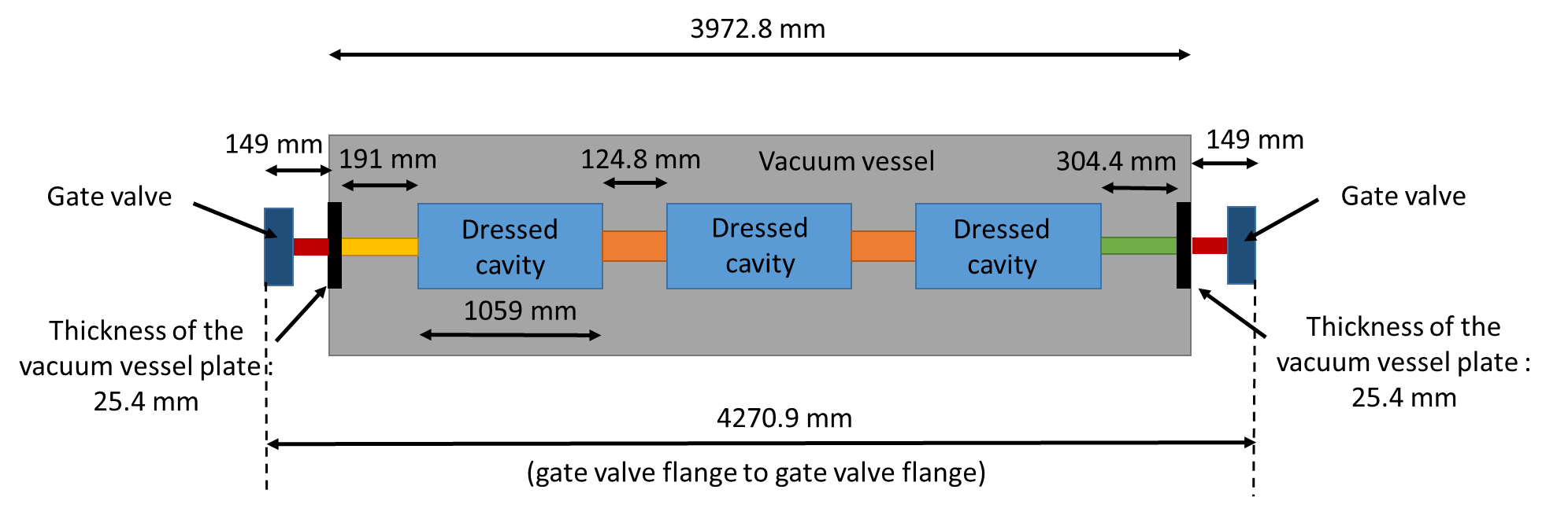
LB650 cryomodule concept

Slide 23
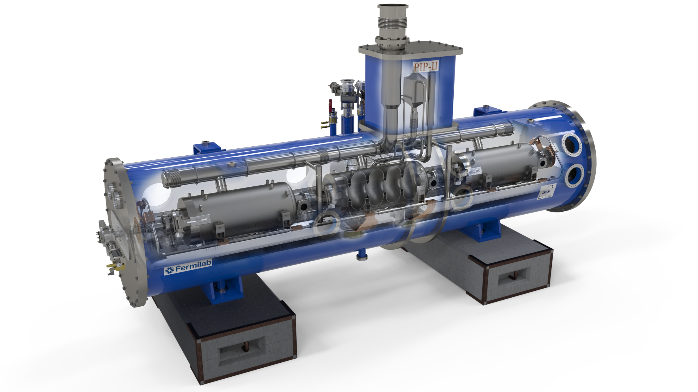
LB650 cryomodule concept

Slide 24
Current status and summary
The first single cell LB650 cavity was tested successfully in VTS to a gradient of 34.5 MV/m.
EM design of the 5-cavity has been done and optimization of the stiffening ring size and position is being carried out to meet the FRS criteria for LFD, dF/dP and cavity stiffness.
The mechanical design of the 5-cell LB650 bare cavity is in progress.
After stiffening ring optimization, structural and modal analysis will be carried out for the LB650 cavity to finalize design.
Helium vessel, tuner, and coupler designs similar to the HB650 designs continue at Fermilab.
Fabrication of a 5-cell LB650 cavity will start after a review of the final design.
Fabrication of the first 5-cell LB650 cavity is expected to be completed within 24 months of the final design review.
Design of the LB650 cryomodule will follow.

Slide 25
Backup slides

Slide 26
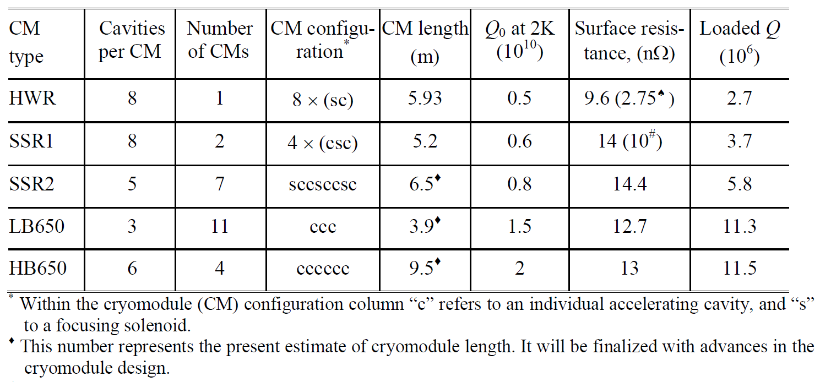
General cryomodule parameters

Slide 27
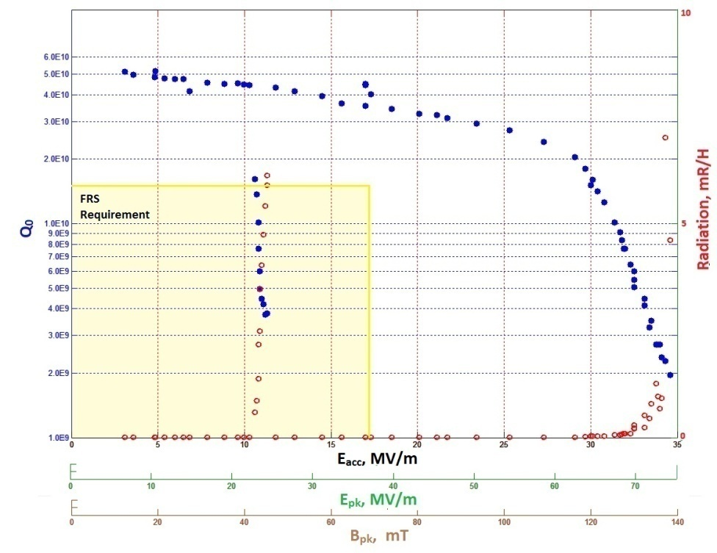
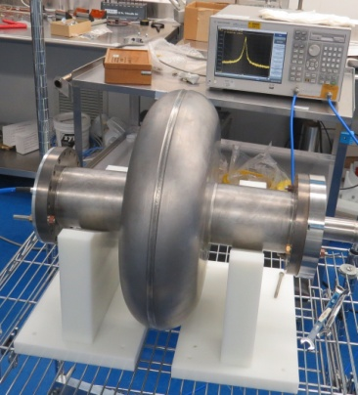
VTS test results of LB650 VECC single-cell cavity
Cavity could sustain 74 MV/m peak electric field and 137 mT peak magnetic field, with accelerating gradient of 34.5 MV/m @ 2 K.
Single-cell LB650 niobium cavity
Maximum accelerating Gradient: 34.5 MV/m @2K
Accelerating Gradient of 30 MV/m @2K achieved with unloaded cavity quality factor Q₀ =1.5E+10.

Slide 28
Multipacting analysis – 5-cell LB650 cavity
60 mm of equator region has been simulated.
Multipacting Analysis has been carried out for both mid-cell and end-cell.
Multipacting has been found up to 4.8 MV/m.
Multipacting rate is very high in the region of 2.5MV/m.
At 4.8MV/m, increase in particles due to multipacting is very low.
Particle vs. time (ns) at 2.6 MV/m (mid cell)
Particles after 16ns at 2.6MV/m (midcell)

Slide 29
Multipacting analysis – 5-cell LB650 cavity
Particle vs. time (ns) at 4.7 MV/m (end cell)
Particle vs. time (ns) at 17.5 MV/m (mid-cell)(no multipacting)
Particle after 30ns at 4.7 MV/m(end cell)
Particle vs. time (ns) at 17.5 MV/m(end cell)(No multipacting)

Slide 30
Stiffening ring optimizations
Single ring at 70 mm radius
2 rings at 70 and 109 mm radius
2 rings at 70 and 109 mm radius + second ring on the tuner end cell
2 rings at 70 and 109 mm radius + second ring on the tuner end cell + 8 mm thick rounding transition
2 rings at 70 and 109 mm radius + two seconds ring on the both end cells + 8 mm thick rounding transition
2 rings at 70 and 109 mm radius + no rings on end cells + 8 mm thick rounding transitions on both ends

