Slide 1
Cost Estimate Review
Christopher (Chris) Jacobsen
DOE Independent Project Review of PIP-II
15 November 2016

Slide 2
Christopher (Chris) Jacobsen
PIP-II Financial Manager
Over 25 years in a financial management role in not-for-profit and commercial environments with emphasis on budgeting and cost management
4.5 years experience in national laboratory environment at both Argonne National Laboratory and Fermilab
Certified Public Accountant (CPA) 1996

Slide 3
Outline
Charge Item: #3
Methodology
International Deliverables
Overview of the Total Project Cost
Project Estimate in Core Costs (Point Estimate)
Cost Range
Summary

Slide 4
Methodology
The starting point for the estimation is the P5 estimate from 2013
  All 2013 estimates were reviewed/updated as necessary, in advance of he June 2015 IPR
  Several items not included in the P5 estimate were added:
    SRF R&D
    LLRF: assumes PIP2IT LLRF is non-recoverable
    Warm magnets
    RF Interlocks
    Recycler upgrade
    Booster upgrade
    Main Injection upgrade
Subtract potential International in-kind contributions
Add overhead, contingency, escalation = Point Cost Estimate
Apply DOE high/low percentages to develop the Cost Range
Perform a benchmark cost estimate comparison with SNS linac
  SNS actual costs adjusted to match PIP-II configuration and energy

Slide 5
Methodology - Cost Estimation Process
Step 1. L3/SME Detail Cost Development and Validation
Step 2. International Contribution Defined
Step 3. Data Consolidated and Prepared for Management Review
Step 4. Review of L3/SME Cost Estimates and Updates Request, if Necessary
Step 5. Repeat Steps 1 to 4 As Necessary

Slide 6
Methodology – CD-0 Basis of Estimate

Slide 7
Methodology – Basis of Estimate Examples
325 MHz SSR1 Cryomodule
  Prototype/Actual
    Bill of Materials (BOM) with actuals incurred to date
  Engineering estimate
    Based on BOMs
RF Power
  Parametric estimate
    Solid State RF Amplifier (SSRFA) based on $ per watt
  Engineering estimate
    Support infrastructure based on quantity/unit cost
Civil Construction
  Parametric estimates
    Based on pre-conceptual facilities layouts

Slide 8
International Deliverables
Charge Item: 6
S. Mishra
In-kind contributions will come from multiple sources
  India/DAE contributions
    Signed agreements exist today
      R&D phase: specific scope defined
      Construction phase: - general scope and total value defined
    Cost estimate based on model of contributions, consistent with R&D program and discussion to date
  Other contributions
    We are discussing additional opportunities for international collaboration with INFN and STFC (see S. Mishra presentation)
    LB 650 MHz cryomodules are assumed to be an international in-kind contribution
      India and/or Europe

Slide 9
Overview of Total Project Cost to DOE
Cost estimate covers the period from FY16 through project completion (currently the same as June 2015 IPR)
Estimate all components as if constructed by Fermilab
Subtract all international in-kind contributions
M&S estimates were made for all major systems, conventional facilities, and R&D
  Scope: R&D + Superconducting Linac + beam transfer line + upgrades to the Recycler Ring, Booster, and Main Ring Injector
  Includes component fabrication and installation but not commissioning
  Estimates in direct FY13$
The labor is estimated in person-years and by skills type (OHAP categories)
  Translated to dollars at Fermilab FY13 labor rates
  Includes EDIA and Project Management
Apply Fermilab overhead rates
Apply contingency at 35%
Apply escalation of 18.2% (FY13 to FY20 @ 2.4%/year)

Slide 10
PIP-II Project Estimate in Direct Cost by Funding Source

Slide 11
PIP-II Project DOE Scope - DOE TPC Accounting

Slide 12
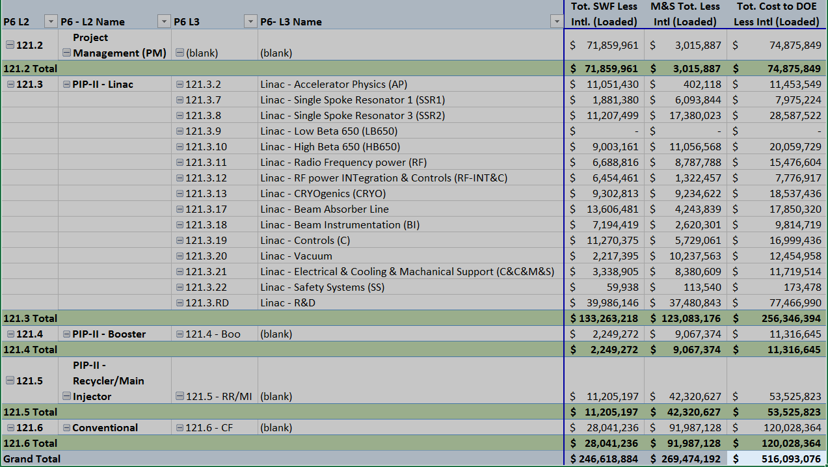
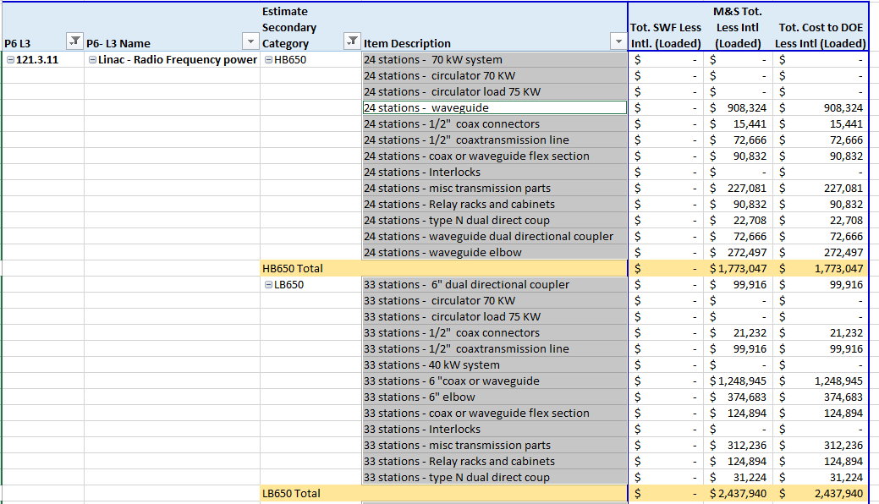
PIP-II Detail Cost

Slide 13
Methodology – Cost Range Per DOE Cost Estimating
Based on DOE Cost Estimating Guide (DOE Guide 413.3-21)
Inputs used to evaluate Project Definition
  Scope
  Requirements
  Specifications
  Project Plans
  Drawings
  Calculations
  Learning from Past Projects
Project Definition (% of complete definition, i.e. 100% = fully defined)
  SRF Components – 40%
  RF Components – 40%
  Conventional Facilities – 20%
  Cryogenics Infrastructure - 25%

Slide 14
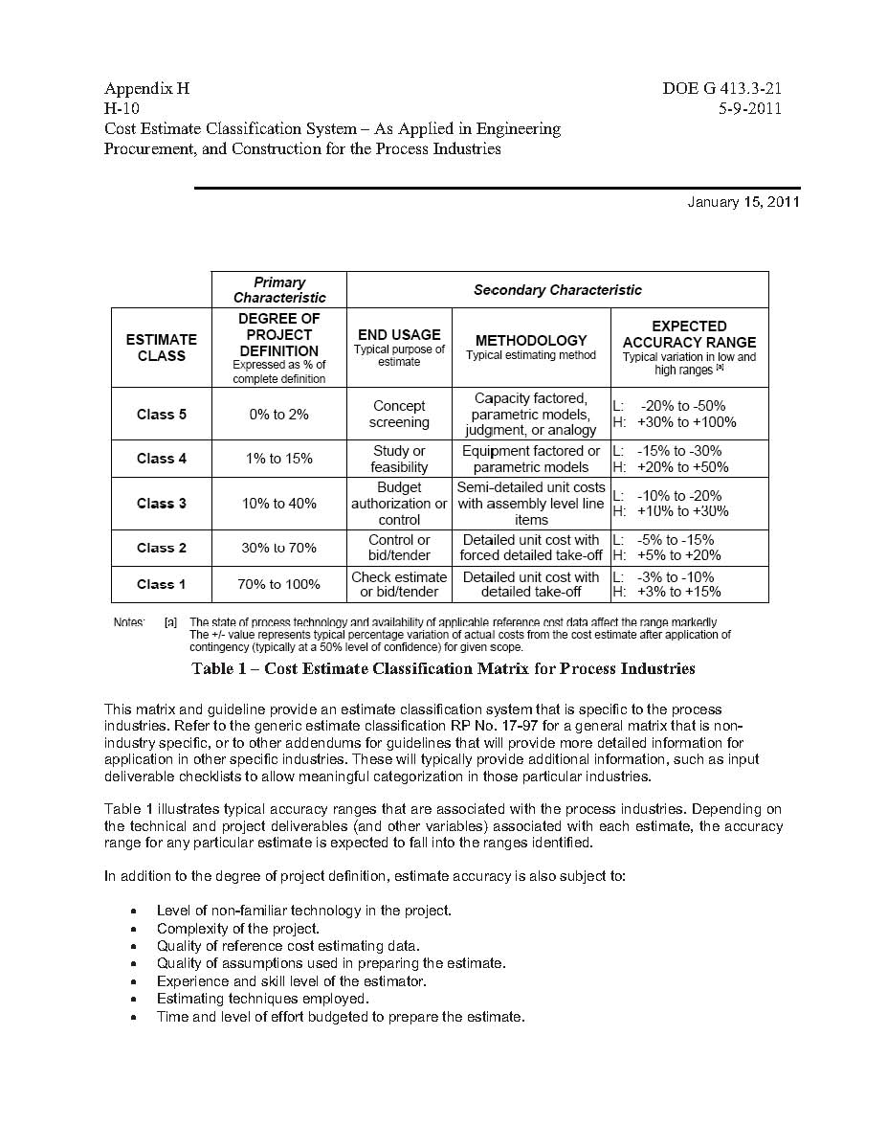
Methodology – Cost Range cont.
Expected Accuracy Range
Low range: -10%, High range: 26%

Slide 15
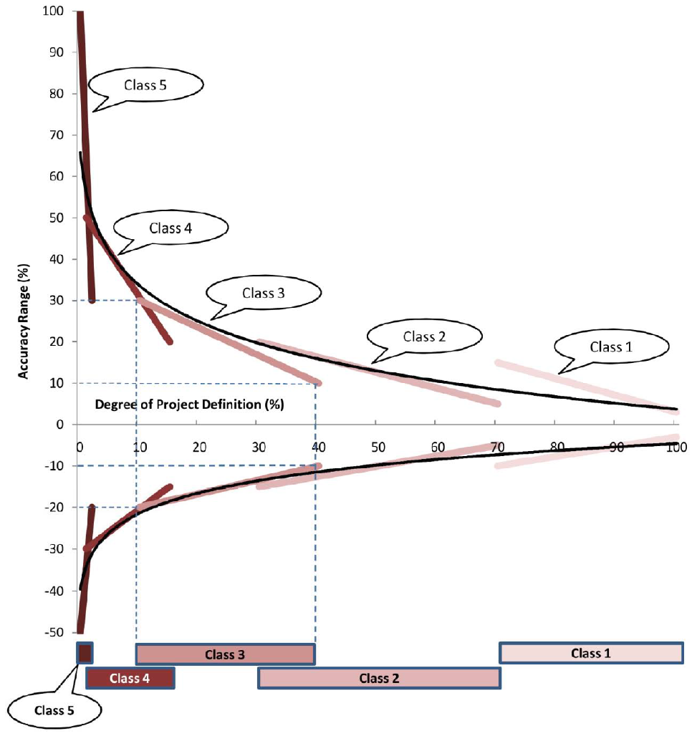
Methodology – Cost Range cont.
PIP-II current state is in Class 3
Per the DOE chart, the cost range recommendation is ~-10%→~30%
PIP-II chooses to use: -10%→26%
PIP-II

Slide 16
PIP-II Project Cost to DOE – Cost Range
Based on Class

Slide 17
PIP-II Project Cost Status

Slide 18
Summary
Charge Item: #3
Detailed cost estimates exist at Level 3
Cost estimate reflects international contributions
Cost estimate synchronized In RLS in collaboration with L3 managers and APM-PR
Actual cost incurred is aligned to WBS and reported to DOE
Revised cost estimate for CD-1, if necessary will leverage data and process from CD-0 IPR – documented BOE will be updated/modified as necessary

Slide 19
Backup-Supplementary Slides
Backup and supplementary information to this presentation can be found after this slide

Slide 20
PIP-II Project Estimate in Direct Costs
Notes:
Supplemental slide

Slide 21
Benchmark
The PIP-II linac estimate is benchmarked against the actual cost of constructing the Spallation Neutron Source linac at Oak Ridge National Laboratory.
Methodology:
  The available SNS costing data is based in 2003 dollars.
  The 1000 MeV linac costs are isolated and combined with appropriate pro-rating of project management and global systems (e.g. controls)
  Scaled to 800 MeV based on incremental cost/MeV in the SNS HB section
  2003 – 2020 escalation at 2.4%/year: factor of 1.5
  Differences in accelerator efficiency and overall beam power levels tend to make SNS more expensive than PIP-II linac

Slide 22
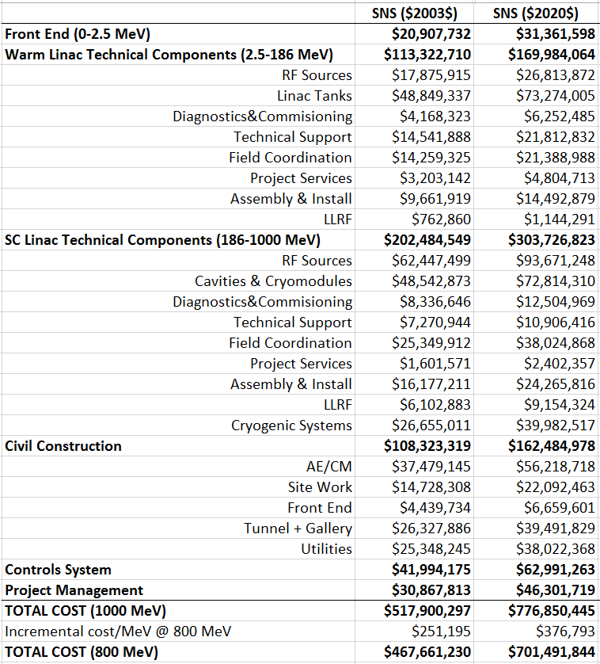
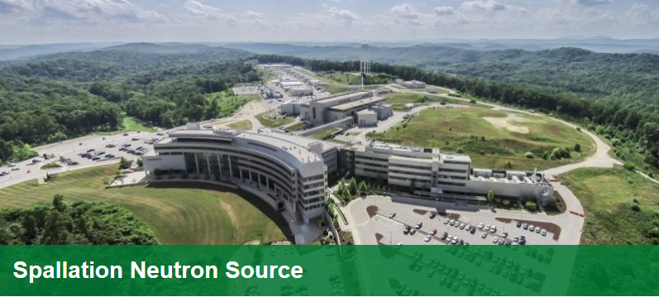
Benchmark – SNS Linac 2003 Costs
The actual cost of constructing the 1000 MeV SNS accelerator have been escalated to 2020 dollars and scaled to match PIP-II at 800 MeV.
SNS costs do not include R&D, Beam Transfer expenses, or existing beam-line upgrades

Slide 23
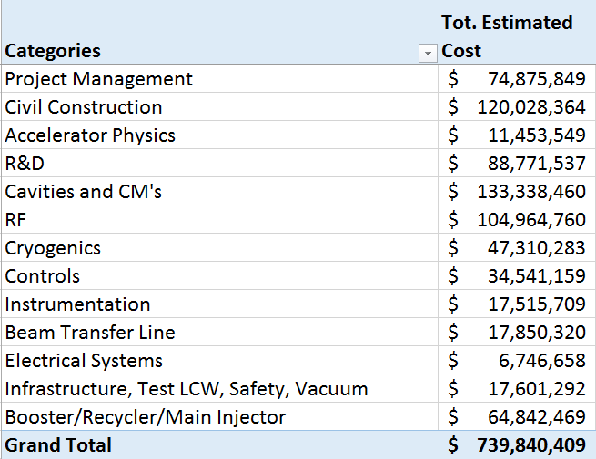
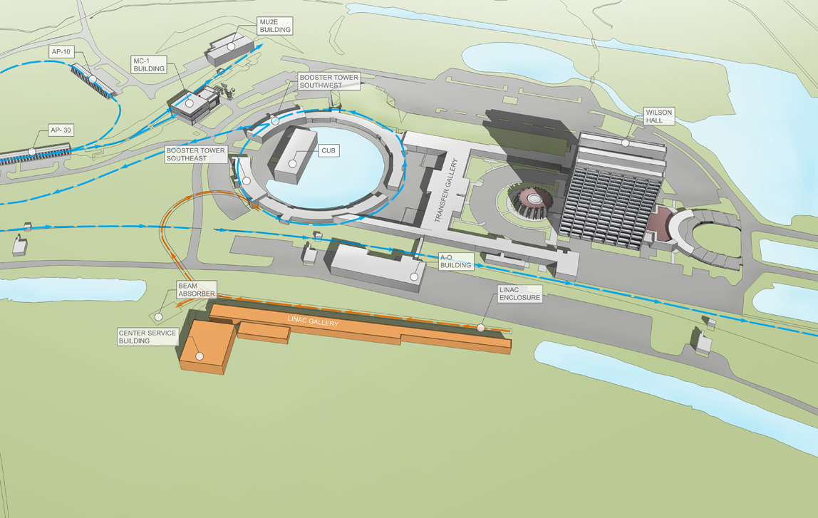
Benchmark – SNS compared to PIP-II
PIP-II estimate without removing international
in-kind contributions.
For cost comparison only!
PIP-II R&D + Beam Transfer + Upgrades to Booster + Recycler + Main Injector = $171,464,326
  For apples to apples comparison, subtract from TPC of PIP-II
PIP-II comparison cost = $568,376,083

Slide 24
Benchmark - Summary
SNS / PIP-II comparison $701,491,844 vs $568,376,083
PIP-II estimate is 19% less than SNS

