Slide 1
Booster/Recycler/Main Injector
Ioanis Kourbanis
DOE Independent Project Review of PIP-II
15 November 2016

Slide 2
Outline
Booster in PIP II.
Booster R&D.
MI/RR in PIP II.
MI/RR R&D and Issues.
Conclusions.

Slide 3
Booster in PIP II
PIP II will require 50% higher intensity and 33% higher frequency than the planned PIP operations.
PIP flux FY17: 2.3e17 pph
PIP-II flux: 3.5e17pph (15Hz)
PIP-II flux: 4.6E17pph (20Hz)

Slide 4
Booster R&D
New injection point at L11
New injection girder
Space charge mitigation: painting
New stripping foil system
H°, H- absorber
RF capture
Capture scheme
2nd harmonic cavities
Transition crossing
Damper upgrades
Longitudinal quad damping during transition
Longitudinal coupled bunch mode damping at high field
Transverse dampers for coupled bunch modes.

Slide 5
R&D (cont’d)
Collimation system
Evaluation of the present system w.r.t expected PIP II
New shielding assessment
Beam quality at extraction
Beam emittances and dp/p
20 Hz operation
GMPS
Pulsed systems
Controls

Slide 6
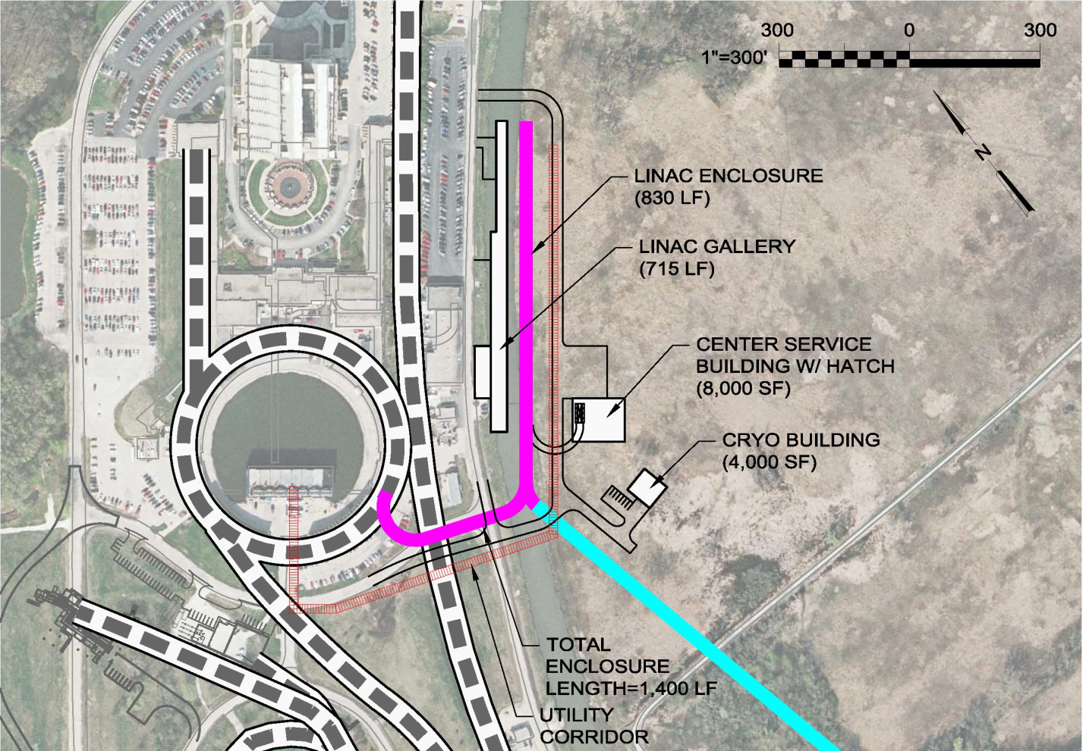
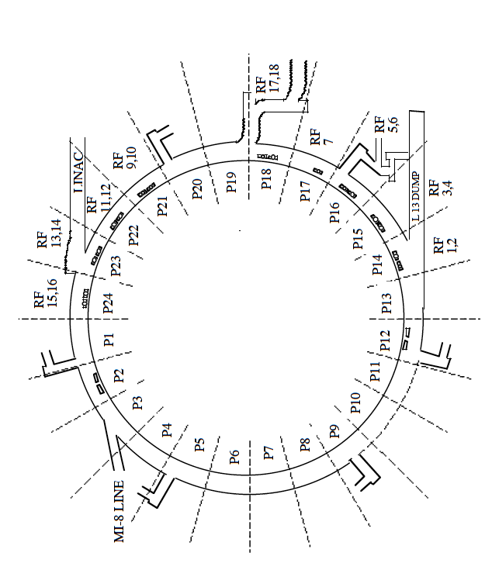
PIP II Injection into Booster
Present injection point at L1
New injection point at L11

Slide 7
New Booster injection girder
Beam can enter either horizontally or vertically.
A new 3 bump system that take 800 MeV beam (2x stronger)
Beam painting to mitigate space charge effects because of longer injection time (0.6 msec).
Carbon foil for stripping (315 turns vs 15 turns)
Lifetime effects
New beam absorber for H° and H-
Build inside a gradient magnet
Design new stronger and shorter gradient magnet to make space for an absorber.
Need about 2 years to finalize the design.

Slide 8
Vertical Injection Concept
Using a three-bump chicane within the unmodified length of the long straight section

Slide 9
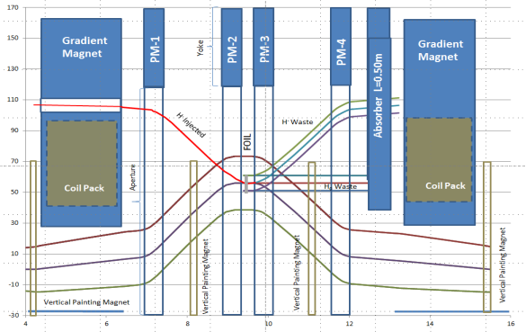
Alternative design for injection girder
D. Johnson
New shorter gradient magnets; larger absorber outside the magnet

Slide 10
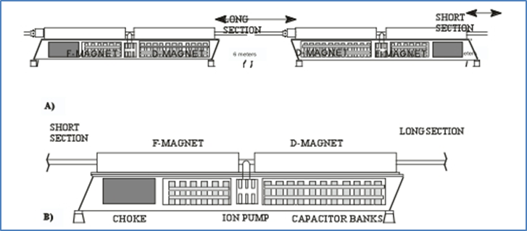
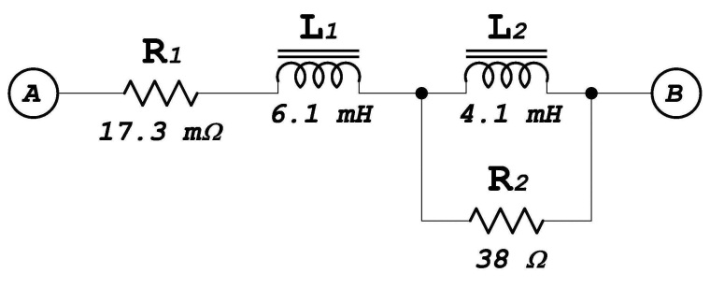
20 Hz operations
Booster magnet system
Booster is a 15 Hz resonance system
Pulsed devices
Injection bump
Extraction systems
Kickers
Septas
Correctors
Controls
Lab built around 15 Hz clock system

Slide 11
Booster Magnets 20 Hz
We have looked at Booster 20 Hz operations several times….most recently by AD/EE support (George Krafczyk)
‘Measurements were performed on both a Booster gradient magnet and a Booster choke with the intent to compare the 15 Hz losses with the 20 Hz losses for a proposed Booster upgrade.’
This analysis suggests that running the booster at 20 Hz with a current equal to the present 15 Hz Booster will require about 3.9% more power. Capacitor voltage will increase by about 32% and the resonant capacitor at each “Girder” must decrease from ~8.33 mF to ~4.69 mF. This also carries the implication that the RMS current per µF will also increase as well.

Slide 12
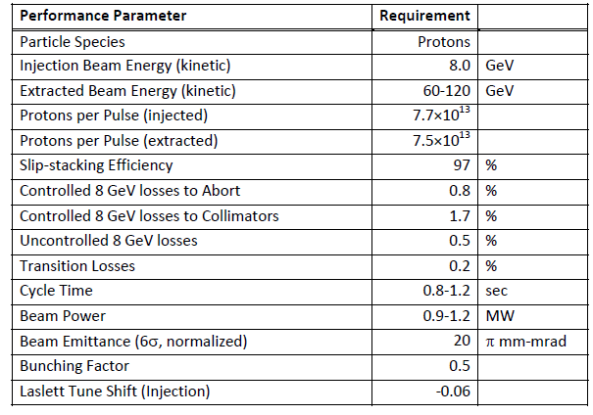
MI/RR Performance Requirements
Slip stack and accelerate 50% more intensity.
Run MI at lower energies.

Slide 13
MI/RR Accelerator Issues
Can we slip stack and accelerate 50% more intensity.
Power loss from slip stacking (8 GeV)
RF Power (Acceleration)
Running Recycler 53 MHz Cavities CW (Running at 60 GeV)
Transition crossing.
Electron cloud.
Beam loss control/mitigation.

Slide 14
Slip Stacking in the Recycler
We need to maintain the same power loss from slip stacking with 50% more intensity per bunch (120 GeV operation).
Increase slip stacking efficiency from 95% to 97%.
Limits on longitudinal emittance and bunch height from Booster beam are not much different than the NOvA ones due to the higher frequency separation and RF voltage.
Higher chromaticity will be required.
For MI operation at energies lower than 120 GeV the power loss will increase up to 50% in both MI and RR.
Have no un-controlled losses (Collimators).
Collimators should be able to handle the extra loss.

Slide 15
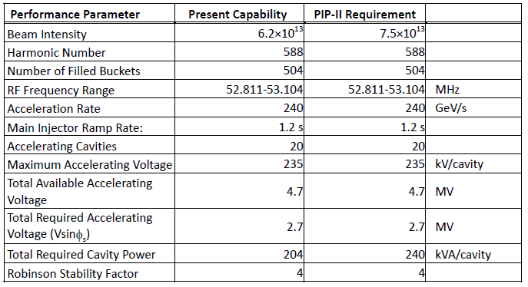
Present and Required MI RF Capabilities
*
* Maximum Beam Intensity capable with current RF system. It is 27% higher than the required Beam Intensity for PIP I (4.9E13).
Present RF System does not have the power to accelerate the PIP-II Beam intensities

Slide 16
MI RF Options for higher power
Operate the current RF cavities with two power tubes instead of one in a push-pull configuration.
Need to double the number of modulators and solid state drivers.
Use a new more powerful power tube (EIMAC 4CW250,000B).
New mounting configuration (much longer tube).
New modulators and upgraded PA cooling.
We have established an R&D plan to test and evaluate both options.
We estimate ~2 years for the R&D plan.

Slide 17
New RR RF Cavities
The present Recycler 53 MHz cavities used for slip stacking have a high power dissipation (90 KW, 60% DF) because of the low R/Q (13 Ohms).
Running MI at energies as low as 60 GeV will require the slip stacking cavities to run CW.
Running Booster at 20 Hz will require higher RF voltage (140 KV instead of 80 KV).
We only have space for 3 cavities
We will need a different cavity design with higher R/Q and active beam loading compensation.
Preliminary design exists.
Estimate ~ 2years to finalizing the design and be ready to build a prototype.

Slide 18
Transition crossing
A design of a first order gamma-t jump system for the Main Injector was completed as part of the Project X Reference design (2.3 MW operation).
Transition crossing simulations for the PIP II intensities and emittances have confirmed that the gamma-t jump system is needed for loss free transition crossing.
Only half of the originally planned gamma-t jump ($±$1/2 unit) will be required.
We plan to revisit the MI transition crossing simulations with the new codes currently under development.
Finding space for gamma-t quad placement is an issue.

Slide 19
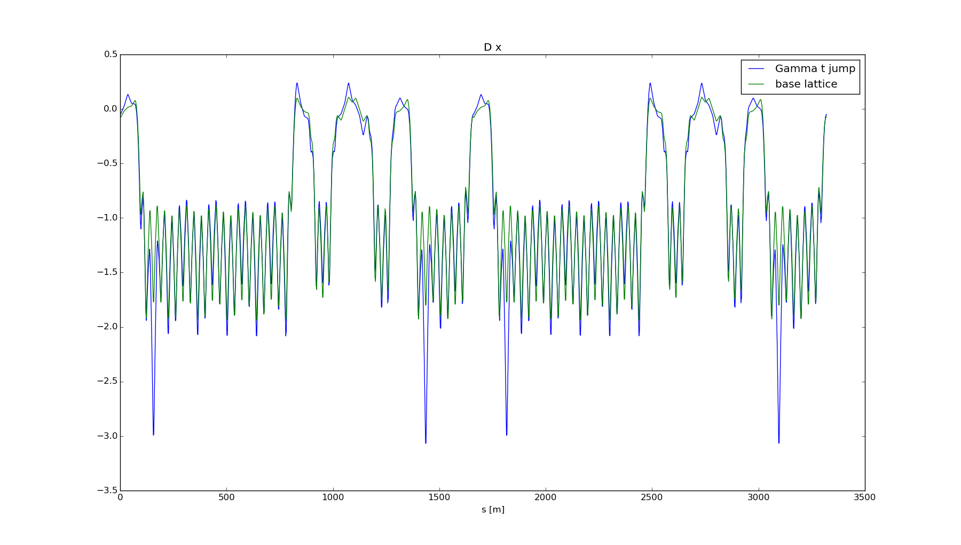
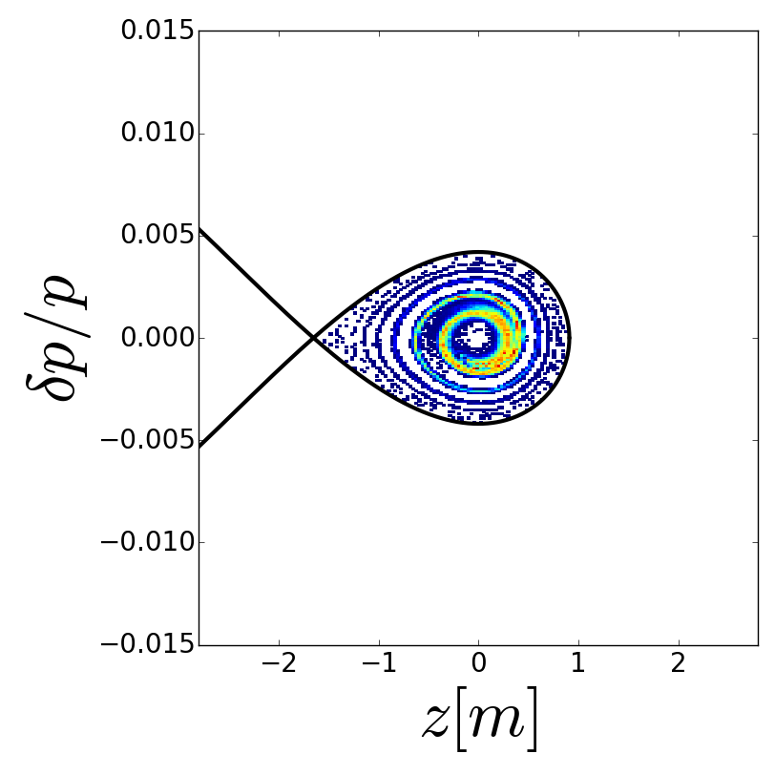
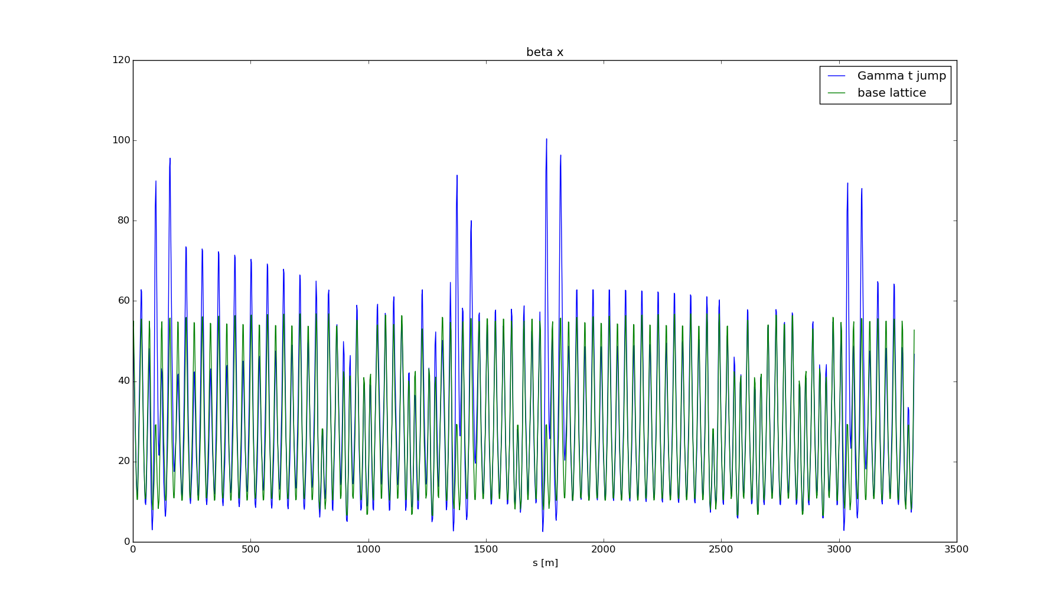
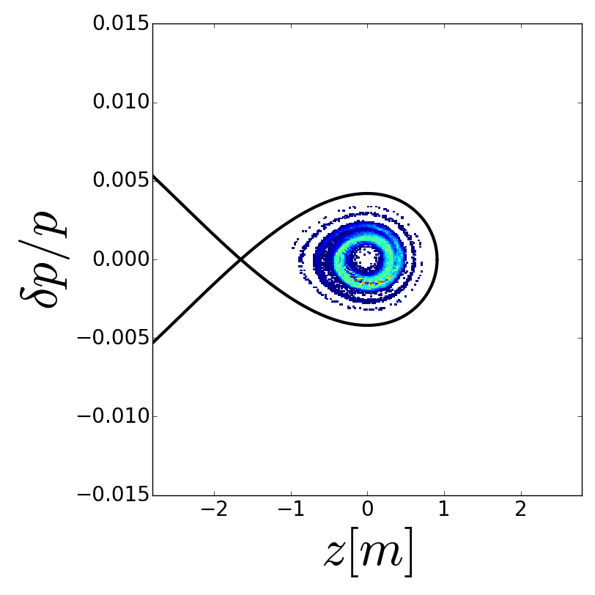
MI Transition crossing simulations with a gamma-t jump
Lattice Functions
Longitudinal Distributions at 40 GeV
SYNERGIA Simulations
R. Ainsworth et al.
No-Jump
$$±\frac{1}{2}unit jump$$

Slide 20
Electron Cloud
Recent measurements in MI indicate that beam scrubbing is quite effective in reducing the SEY of the beam pipe so no electron cloud problems are anticipated.
Beam scrubbing has also been observed in Recycler during slip stacking commissioning.
Electron cloud simulations indicate that a SEY smaller than 1.4 will be sufficient for suppressing the e-cloud in both MI and Recycler.
We have the capability to coat both the MI and the Recycler beam pipe.
The MI beam coating has to be done in situ.
The Recycler beam pipe can be replaced.

Slide 21
Loss control
Need to understand and control the space charge losses with the higher intensity beam in MI and Recycler.
In MI the collimators intercept most of these losses.
One primary and two secondary collimators were installed during the current shutdown in the Recycler.
Realistic simulations(real apertures, magnet multipoles, space charge..) using SYNERGIA are under way.
Comparing slip stacking in PIP II to current operations.

Slide 22
Conclusions
The new Booster injection girder for PIP II is the biggest item that we need to finalize the design.
The progress that being made in Booster higher flux operations will help us understand most of the high intensity PIP II issues.
We need to establish a plan for upgrading the MI RF power and finalize the design of the RR 53 MHz ASAP.
Loss control in MI/Recycler will continue to be a challenge.

