Slide 1
Low Level RF Control System
Brian Chase
DOE Independent Project Review of PIP-II
15 November 2016

Slide 2
Bio for Brian Chase
Principal Electrical Engineer, 34 years experience at Fermilab
Low Level RF Group leader, Deputy RF Department Head
Work experience in cryogenics, power supplies, D0 detector electronics
Beam Instrumentation – Flying Wires, BPMs, etc.
LLRF – Linac, Main Injector, Tevatron, Recycler Ring
SRF LLRF – Proton Driver, ILC, ILCTA, DESY (9mA Tests)
LCLS-II, CMTS, PIP-II
Development work in LLRF control for Magnetrons
Team
  AD LLRF - E. Cullerton, P. Varghese, J. Edelen, J. Einstein-Curtis, D. Klepec
  IIFC - G. Joshi, S. Khole, D. Sharma, & many others
  CSU – A. Edelen

Slide 3
Outline
Project Status
System overview
Simulation and Results

Slide 4
Project Status

Slide 5
LLRF Systems needed to meet R&D Goals
325 MHz Horizontal test stand
  Support for CW and pulsed mode operation
  Operational
650 MHz Horizontal test stand
  Support for CW and pulsed mode operation
  To be supplied by India
PIP2IT
  Master Oscillator and Phase Reference distribution line
    162.5 MHz & 325 MHz (Operational)
  RFQ – 162.5 MHz (Q4FY15)
    2 RF amplifier system (Operational in pulsed and CW modes)
  Buncher - 3 cavities - 162.5 MHz (1st buncher operational in pulsed and CW)
  Half Wave Resonators - 8 cavities @162.5 MHz
  SSR1 - 8 cavities @ 325 MHz
  Kicker waveform generator

Slide 6
Synergy Between LLRF DOE Projects at FNAL
 | RF Converters | Digital controller | Algorithms FW/SW | Phase Line | Resonance Control
NML-ILC | FNAL v1,v2 | FNAL MFC | FNAL v1 | FNAL v1 | Development
PIP2 IT HTS | v3 | SOC-MFC | FNAL ongoing | in development
CMTS-1 | v3 | SOC-MFC | FNAL ongoing | simplified
LCLS-II 1.3 GHz | FNAL v4 | LBNL | LBNL | SLAC | JLAB/FNAL
PIP2 IIFC HTS1 | v5 | leveraged from LCLS-II | Leveraged | Leveraged | Leveraged
Mu2e G-2 |  | SOC-MFC
Lots of good project cross pollination going on

Slide 7
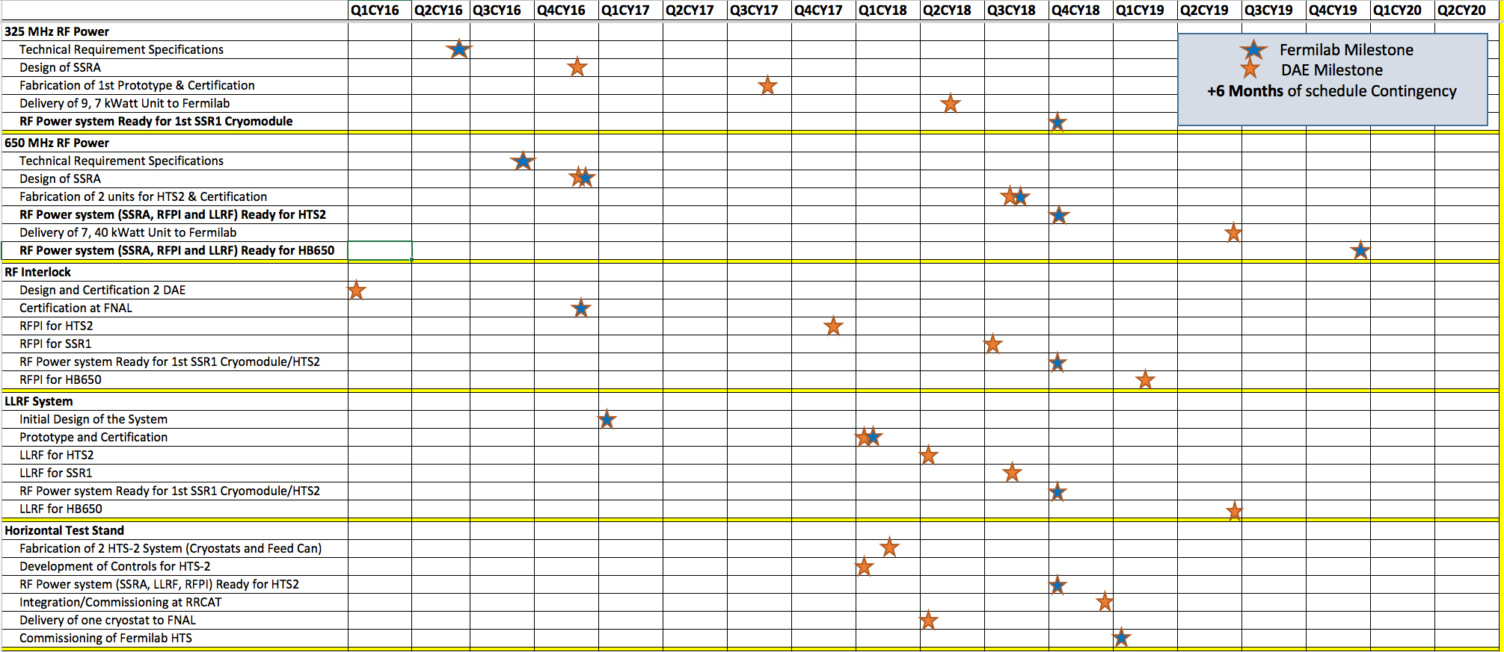
IIFC Deliverable Schedule

Slide 8
IIFC Status
Nine FRSs Approved (or near approval)
  TRSs in process
8-Channel Down-Converters
  FNAL version tested
  BARC version is in manufacturing process
4-Channel Up-Converters
  FNAL version tested
  BARC version is in manufacturing process
FPGA Board
  In schematic review process
ADC-DAC FMC Module
  Ready for layout
Resonance Control Chassis
  Leverage from FNAL LCLS-II design and is in progress

Slide 9
LLRF System Overview

Slide 10
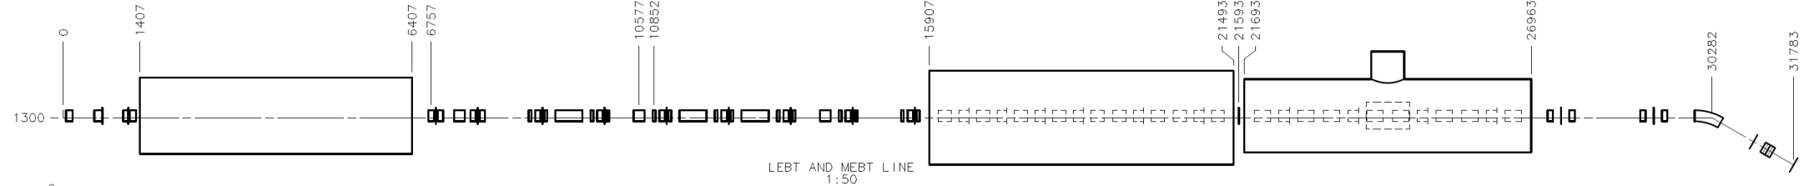
PIP2IT Low Level RF
Now
2015
2016
2017
2018
30 keV
2.1 MeV
10 MeV
25 MeV
RFQ
MEBT
HWR
SSR1
HEBT
LEBT
40 m, ~25 MeV
- Drive 20 accelerating structures
4 RF frequencies
MO and phase reference lines
0.01% 0.01 deg. regulation goal

Slide 11
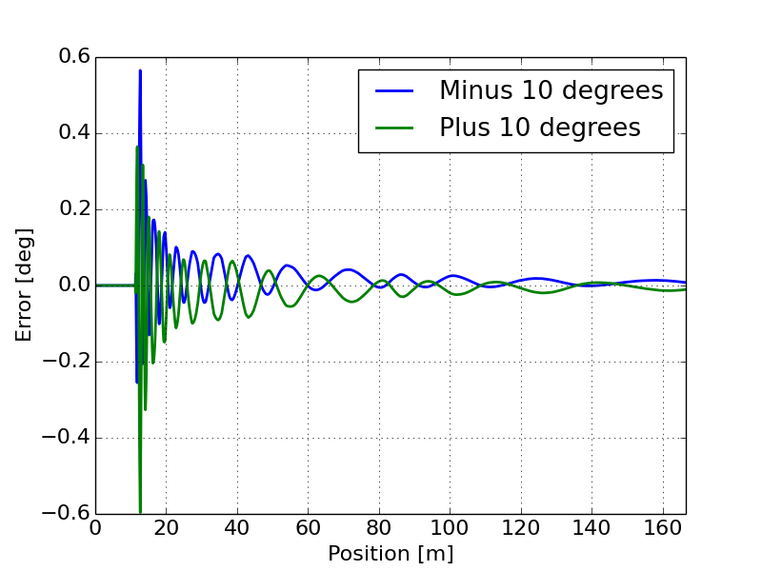
Primary Technical Risks
Resonance Control for 5 new cavity designs
  Lorentz Force Detuning compensation for narrow bandwidth cavities operated in pulsed mode
  New cavity designs with new mechanical properties
  ~20 Hz half BW with expected 420 Hz Lorentz Force Detuning in SSR1
  See resonance control talk
10⁻⁴ beam energy regulation with pulsed system
    Sensitivity analysis in progress
RMS phase along LINAC from 10 deg cavity phase change in first HWR

Slide 12
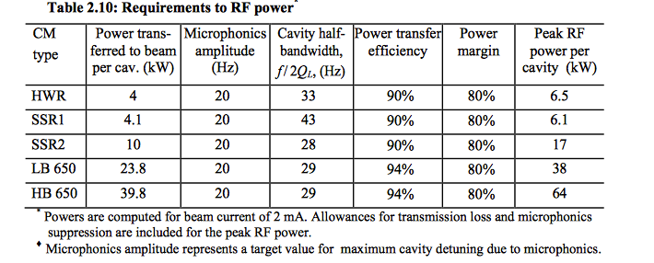
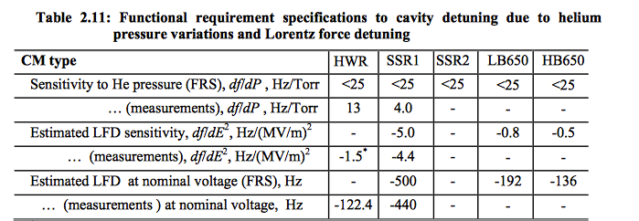
RF Power budget and Ql
Total cavity detuning budget including LFD
Measured LFD is 22 times
larger than the entire
resonance error budget
May need real-time feedback during pulse
Ongoing cavity design efforts
to lower these numbers

Slide 13
Example of Microphonic Detuning at CMTS-1
Main source is believed to be pressure fluctuation from a check valve in the helium return line and will be fixed in current shutdown.

Slide 14
PIXIE RF Stations Diagram

Slide 15
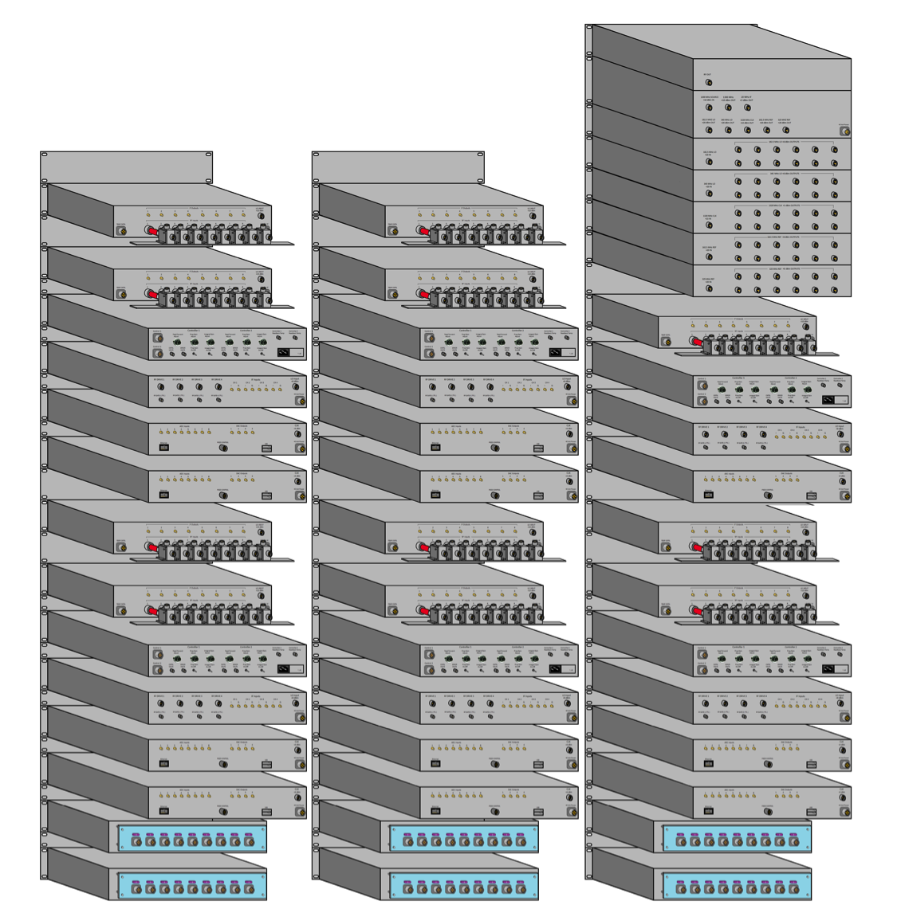
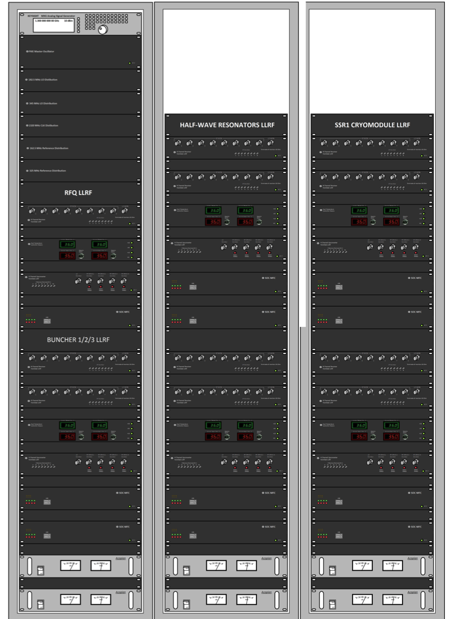
PIP2IT LLRF rack layout - front and rear view
RFQ
HWR
SSR

Slide 16
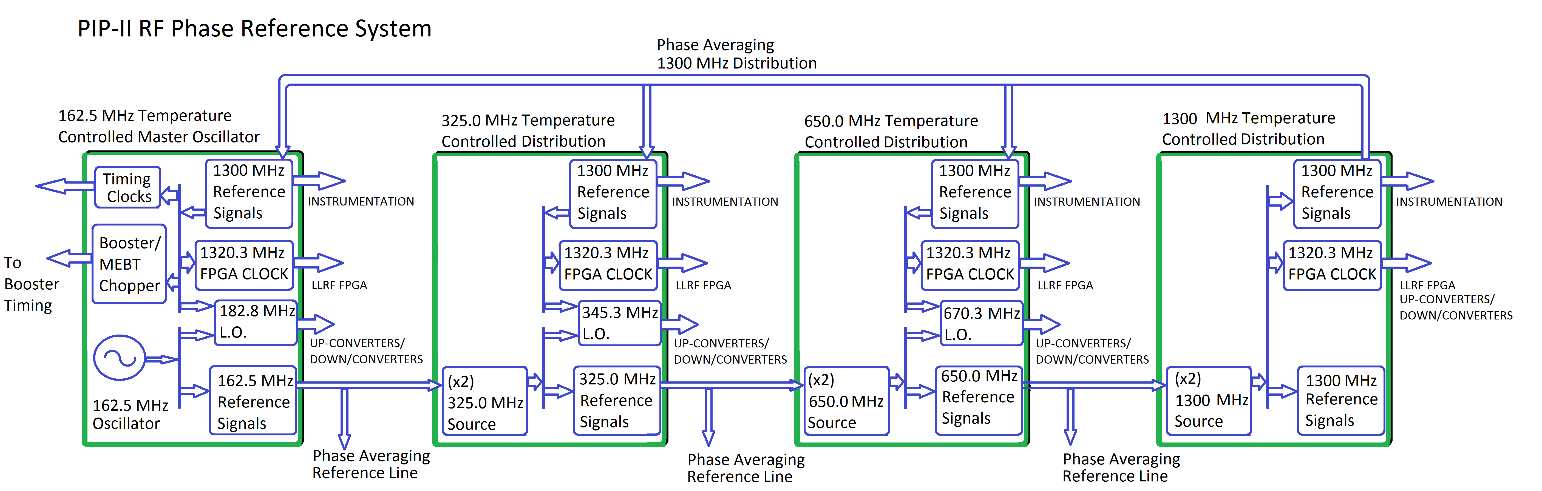
Phase Reference Lines (162.5, 325, 650 ,1300 MHz)
Multi-frequency Phase References and Local Oscillators
We are building up the first sections for PIP2IT

Slide 17
Basic LLRF Station Diagram for 4 cavities

Slide 18
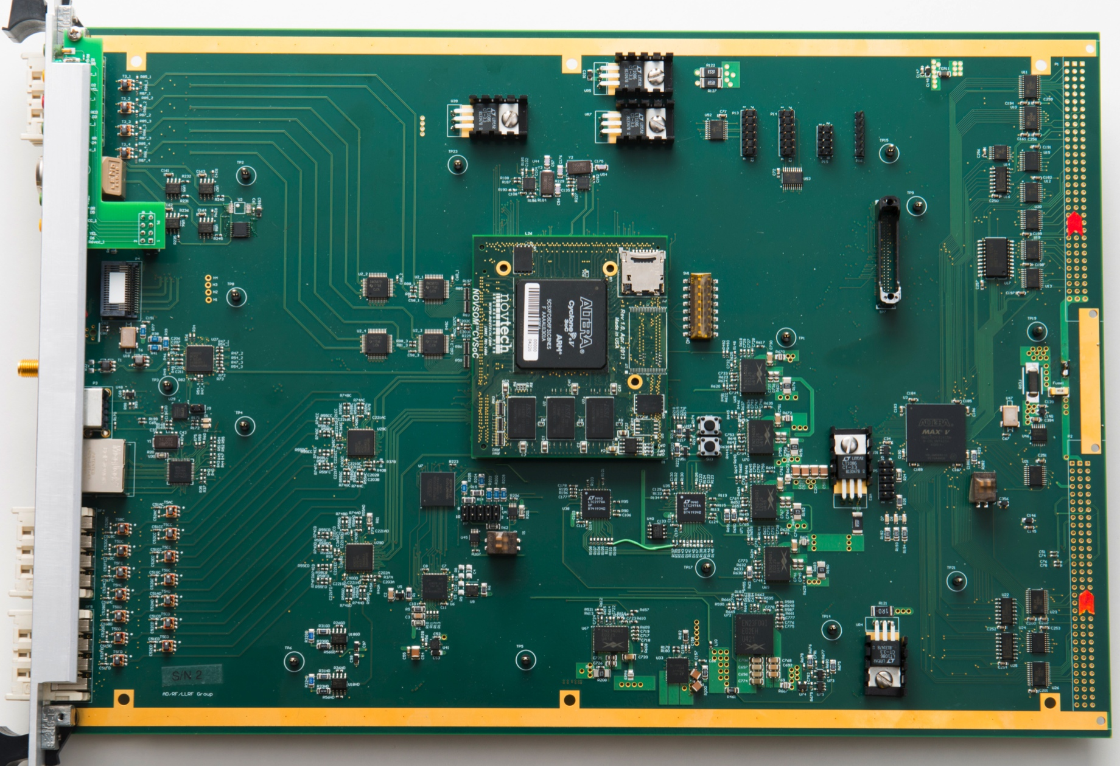
System on Chip Multi-channel Field Controller
(16) 14 bit ADCs
(8)14 bit DACs
System on Module
Dual core Arm processor
with FPGA eliminates
the need for a backplane and CPU card

Slide 19
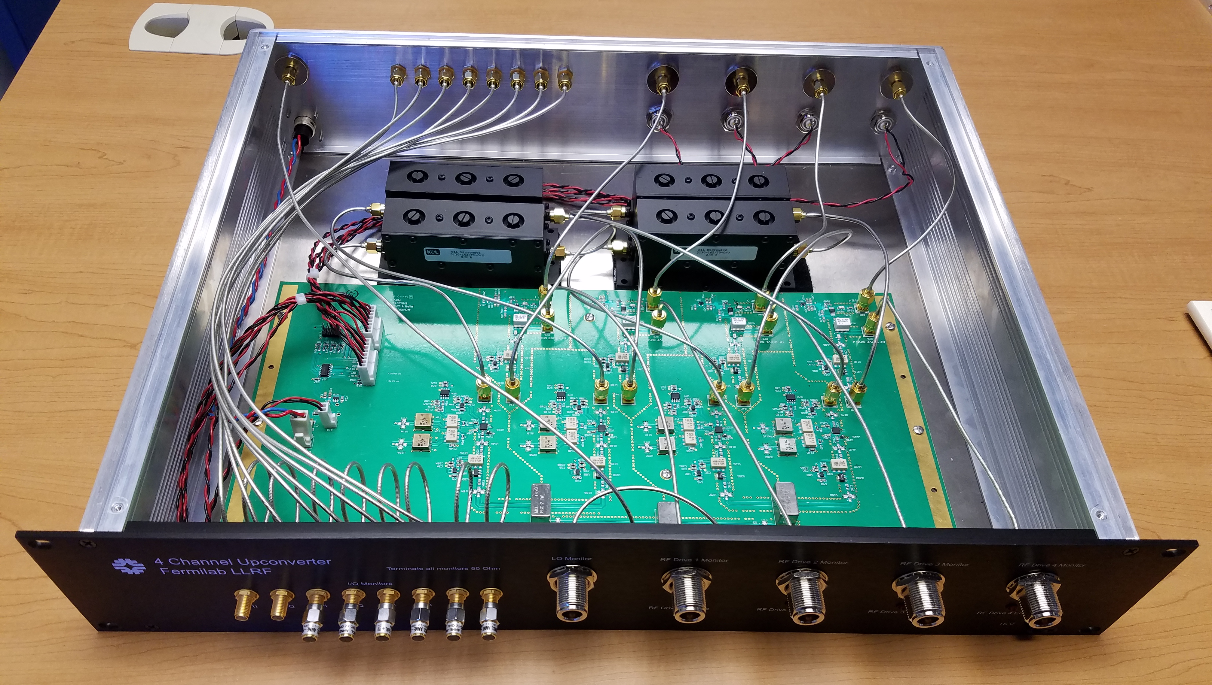
4-Channel Upconverter
20 MHz IF input -2 dBm max
162.5, 325, and 650 MHz Output, +11 dBm max
13 dB IF to RF Conversion Gain typ.
Channel to Channel Isolation > 88 dB
Spurious Signal Suppression > 80 dB
High isolation (>68 dB) TTL RF switch
Power Supply 6V, 1.8 Amp

Slide 20
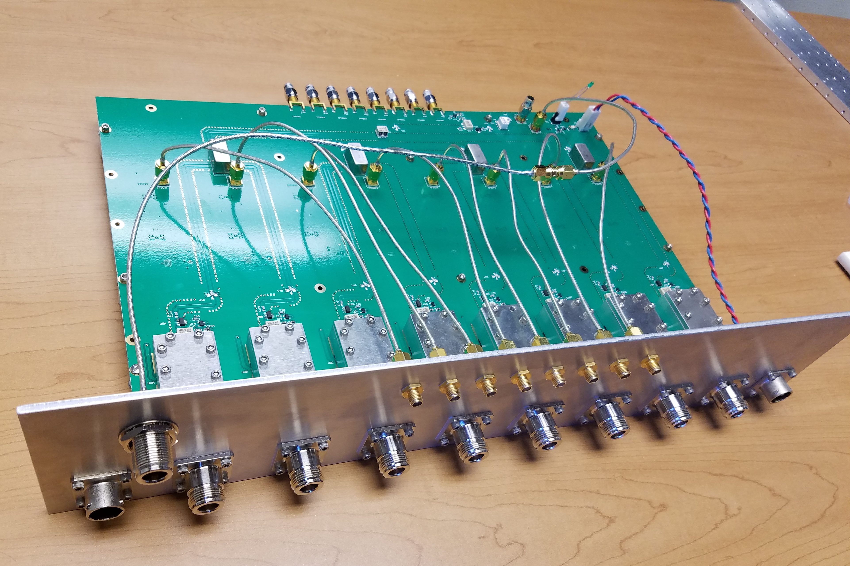
PIP-II LLRF 8-Channel Downconverter Prototype
RF input 162.5 MHz – 650 MHz
Less than 1% non-linearity up to 10 dBm RF input
1.8, 2.1, 2 dB conversion loss @ 162.5, 325, 650 MHz respectively
Better than 82 dB Channel to Channel Isolation
RF, LO, IF monitor ports
Absorptive IF output low pass filter
Noise output floor of -161 dBc/sqrt(Hz)
Integrated output 1/f noise < 1.84, (0.02 to 20 Hz)
LO Input power of 3.1, 3.8, and 5.7 dBm @ 162.5, 325, 650 MHz respectively
Power Supply 6V, 2.25 Amps

Slide 21
Simulation and Results

Slide 22
Baseband cavity and controller model

Slide 23
Open loop transfer function of cavity and controller
Magnitude
Phase
Closed-loop bandwidth: ~50 kHz
Control system zero: 15 kHz
Proportional gain: 1500
Integral gain: 1.44e+08
Code developed for LCLS-II
Larry Doolittle LBNL and FNAL

Slide 24
Total phase noise to SSA from controller and oscillator sources
Closed loop response
Cumulative SSA phase noise voltage
Careful attention to noise terms will allow high controller gains
Cavity: 0.00078° rms
SSA: 1.04°
SSA from ADC noise 0.96°

Slide 25
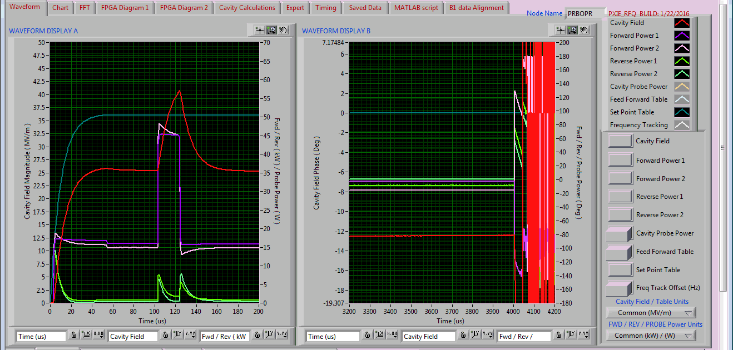
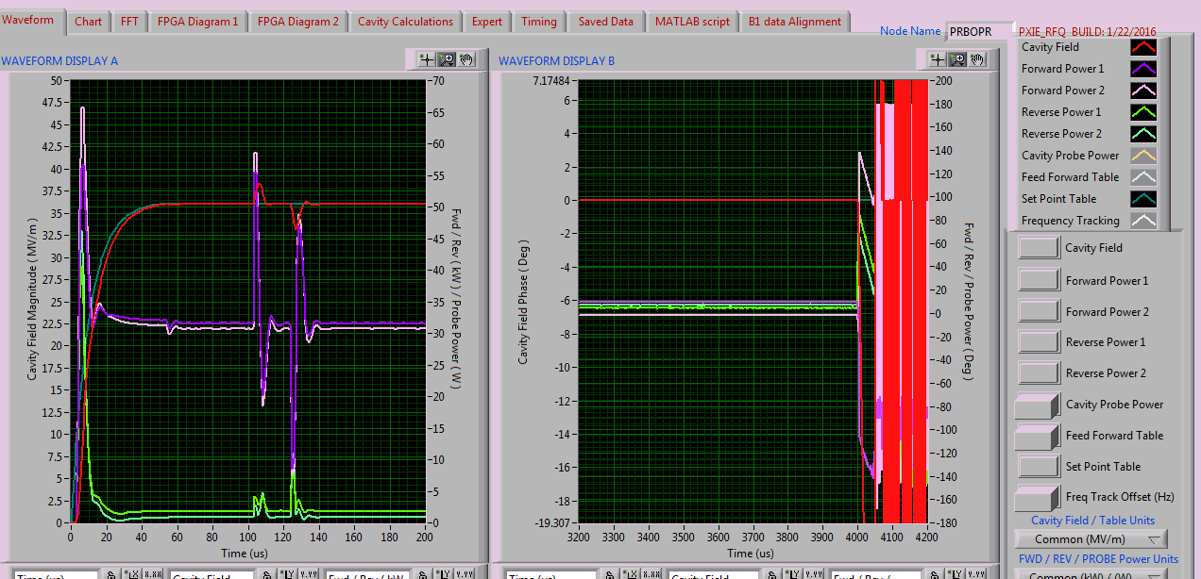
RFQ disturbance response
Open loop response to a 20 μsec full scale disturbance
Closed loop
Q_{l} = 6900
Kp=6
Ki=3.5e6
settling time~10 μsec
In loop noise measurement
0.008% rms, < 0.002° rms

Slide 26
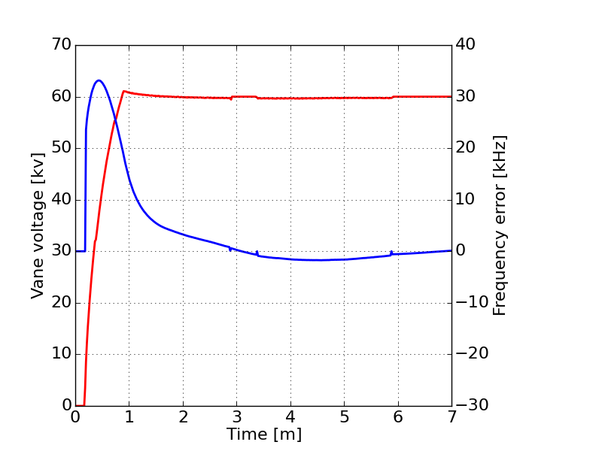
Trip recovery, fully automatic starting at time = 0
Note that the resonance controller switched into GDR and feedback at time = 3 min, then back into SEL. This is doe to overshoot on the frequency error. By adjusting the way resonance control handles SEL-GDR switching we can mitigate this.
Vane voltage: Red
Frequency error: Blue
Grey: RFQ ramp, resonance control is idle, LLRF is in SEL
Orange: Resonance control bringing RFQ to frequency, LLRF is in SEL
Green: RFQ is in GDR and LLRF feedback is active

Slide 27
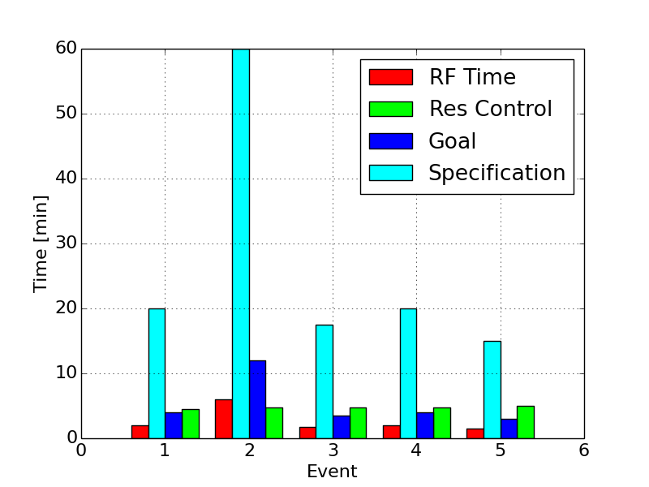
RFQ Resonance control
Currently meeting specification
  Specification was to recover the RFQ in less than 10 times the RF recovery time
  Goal of less than twice the RF recovery time
  We anticipate meeting our goal requirement after the next round of improvements
The controller interfaces with the water instrumentation, ACNET, and LLRF
The controller framework is modular and can easily be improved or adapted to new systems
Plans to improve performance will decrease the initial start time and decrease the trip recovery time

Slide 28
Conclusions
PIP2IT LLRF is operational with the RFQ and first buncher and are on schedule for the next stages.
IIFC designs are in progress
PIP-II LLRF systems level requirements are still being developed with simulation work

Slide 29
Thank you for your attention!

Slide 30
Backup slides

Slide 31
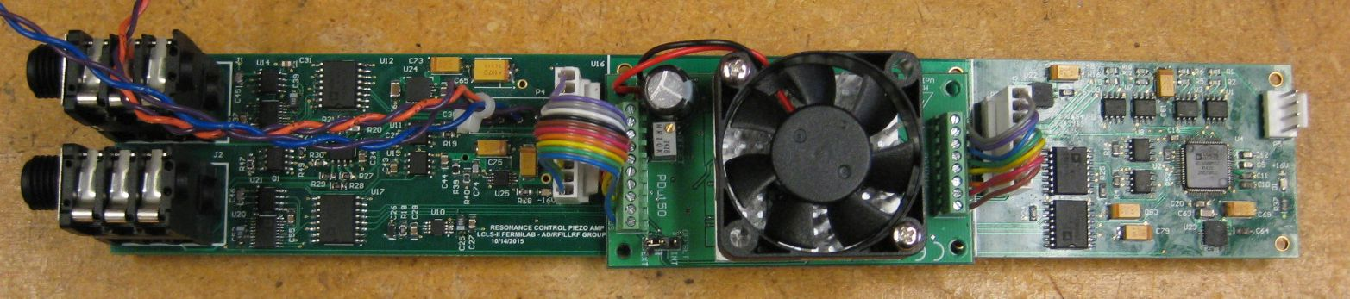
Piezo Resonance Control Requirements
Minimize microphonics to <10 Hz
1 Hz or better resolution
+- 1kHz tuning range
2 drive amplifiers for 2 piezo stack groups per cavity
  (1 module per cavity)
  4 drive modules per chassis

Slide 32
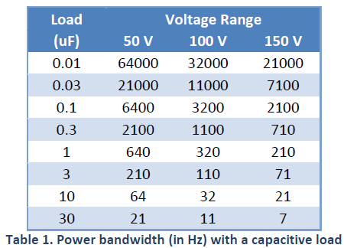
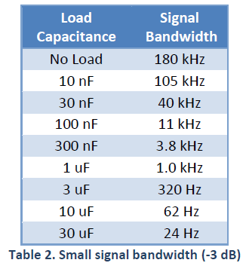
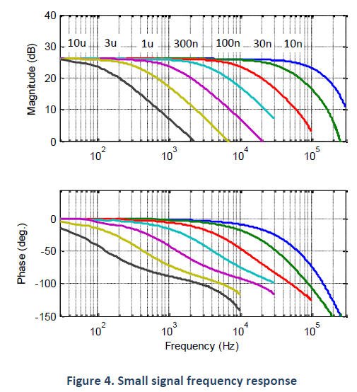
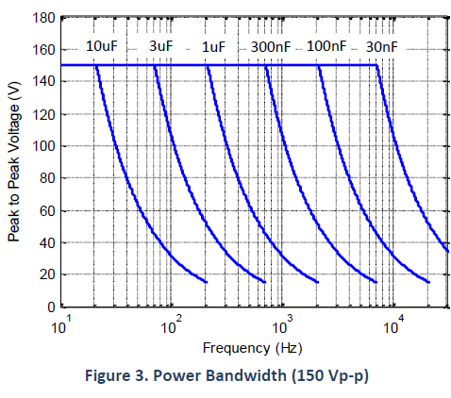
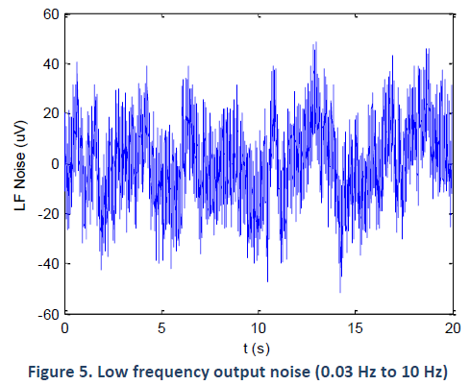
Piezo Amplifier – PDu150

Slide 33
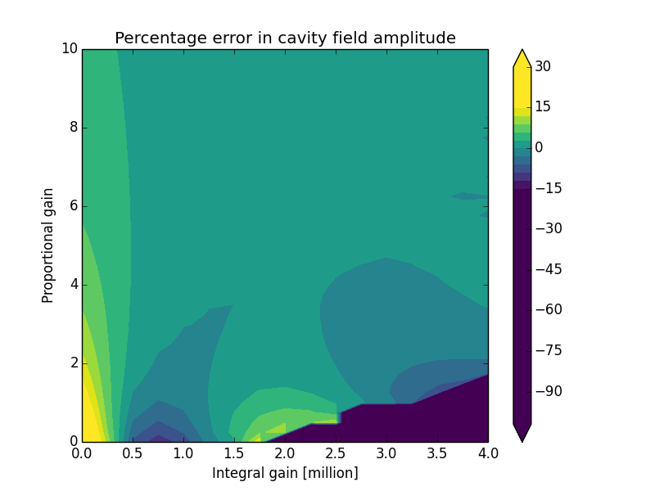
Feedback gain studies
Percentage error in the cavity field amplitude at 20 microseconds after a disturbance
The disturbance was 10% of full scale
For cases with large integral gain and low proportional gain, the feedback loop is unstable

Slide 34
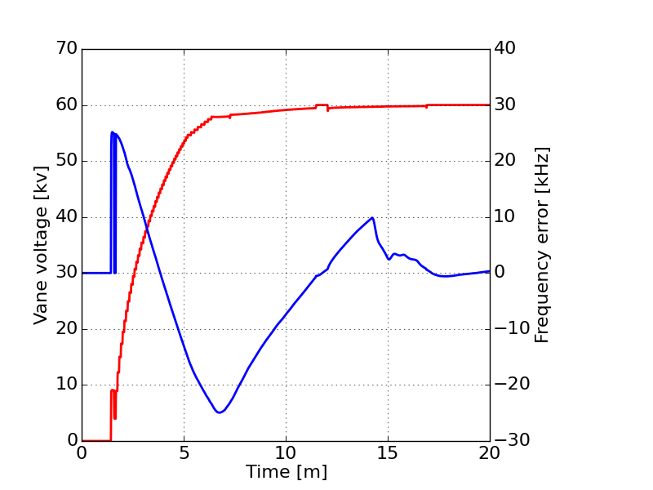
5 min ramp. Mostly automated (operator tuning at 14 minutes to speed things up a little)
Testing faster start, not fully automated. Kink in resonance frequency at 14 minutes was due to operator tuning not automatic tuning.
Vane voltage: Red
Frequency error: Blue
Grey: RFQ ramp, resonance control is idle, LLRF is in SEL
Orange: Resonance control bringing RFQ to frequency, LLRF is in SEL
Green: RFQ is in GDR and LLRF feedback is active

Slide 35
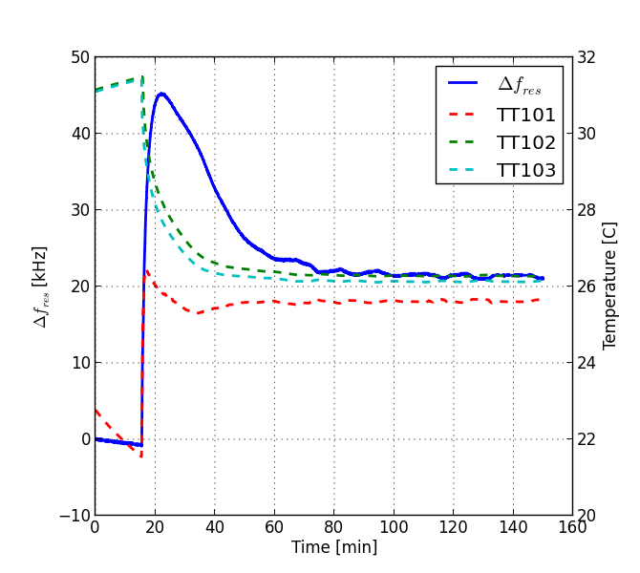
RFQ vane system step response
Transient response of the RFQ resonant frequency due to change in the vane flow control valve. Prior to changing the flow valve, the intermediate skid was cooled to approximately 25C. The control valve was stepped from 0% open to 50% open.
Notes:
\begin{tabular}{c|c|c|c}
& initial & transient & steady state \\ \hline
Time & 0 & 7.2 min & 115.4 min \\
$\Delta f_{res}$& 0 & 46.13 kHz& 21.15 kHz \\
$TT_{101}$ &22.280 $^o$C&25.796 $^o$C& 25.649 $^o$C \\
$TT_{102}$ &31.489 $^o$C& 28.126 $^o$C& 26.141 $^o$C\\
$TT_{103}$& 30.941 $^o$C& 27.639 $^o$C& 26.284 $^o$C\\
\end{tabular}
\begin{tabular}{c|c}
flow path & time delay [s] \\ \hline
$TT_{101} \rightarrow TT_{103} $& 1.0 \\
$TT_{103} \rightarrow TT_{102} $& 17.0 \\
\end{tabular}

Slide 36
Feedback requirements and analysis
Expecting large disturbances from LFD, want fast response from beam loading transient
  get 15 dB from feedforward beamloading compensation
Approach - find highest stable loop gain and determine system noise requirements
Determine best gain settings from operational experience and needs of beam-based feedback
  It is easy to turn down the gain on a well designed system, impossible to turn up gain on a poorly designed one
Assume a low noise oscillator
  Wenzel VHF ULN 100 MHz 13.7 dBm
  % http://www.wenzel.com/model/vhf-uln/
System loop delay of 2.1 μsec
Cavity bandwidth 30 Hz

Slide 37
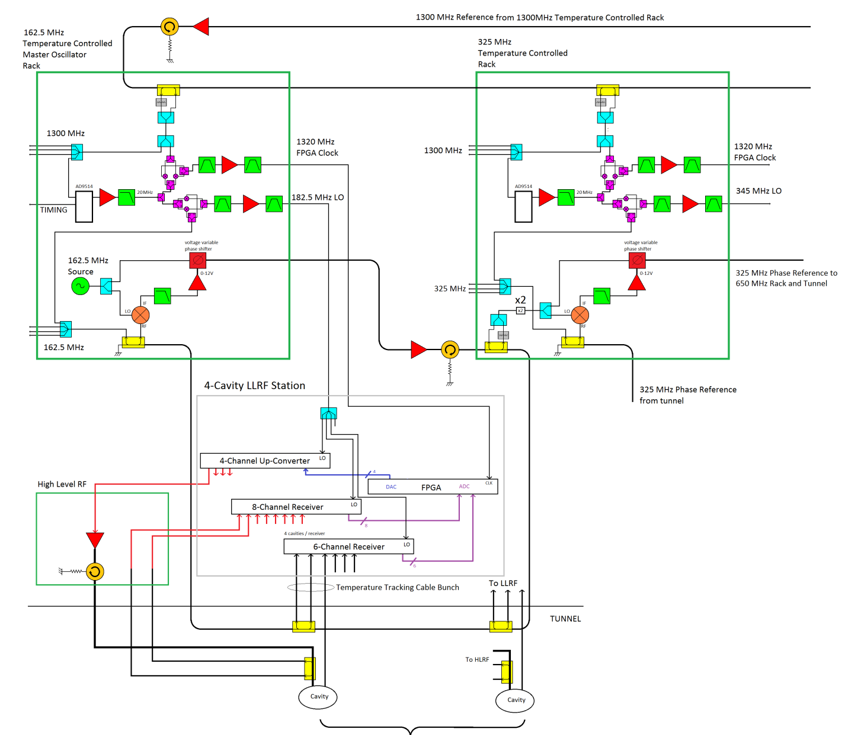
Details of First 162.5 MHz RF Section
Phase stability across
harmonics (400 fs)
Temperature controlled racks and component plates
We have this experience and see a path forward

Slide 38
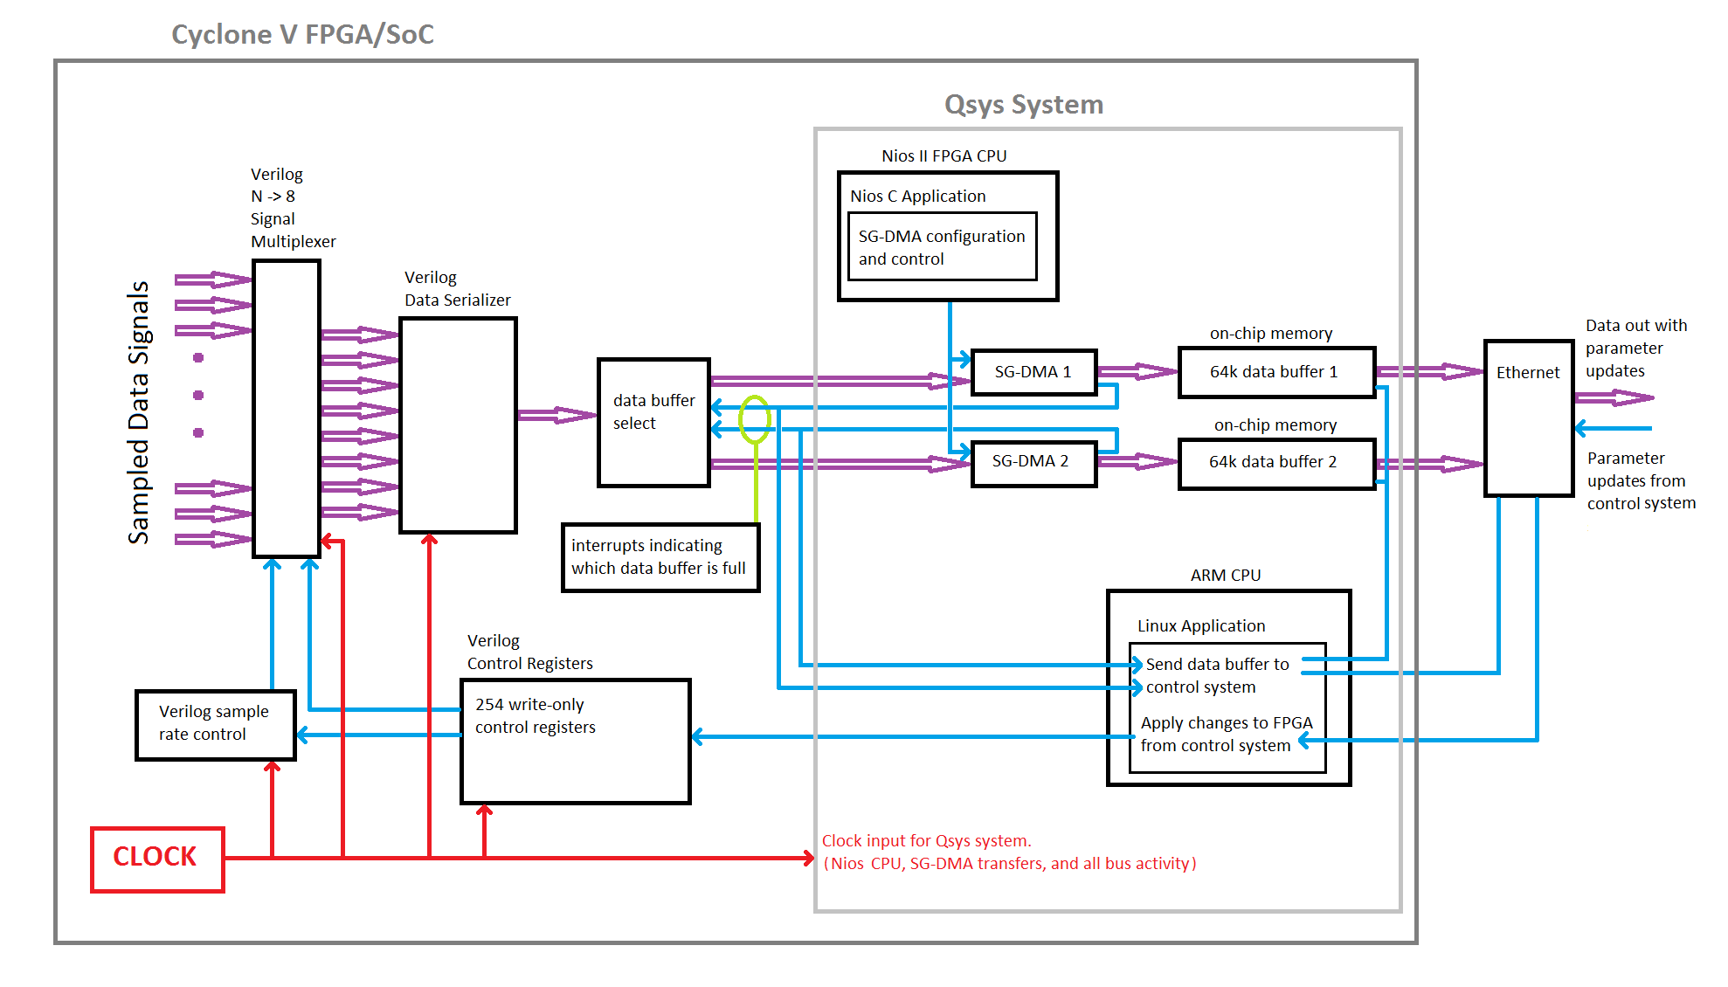
SOC Data Acquisition Software / Firmware Model
800 Mbit/s data transmission has been demonstrated

Slide 39
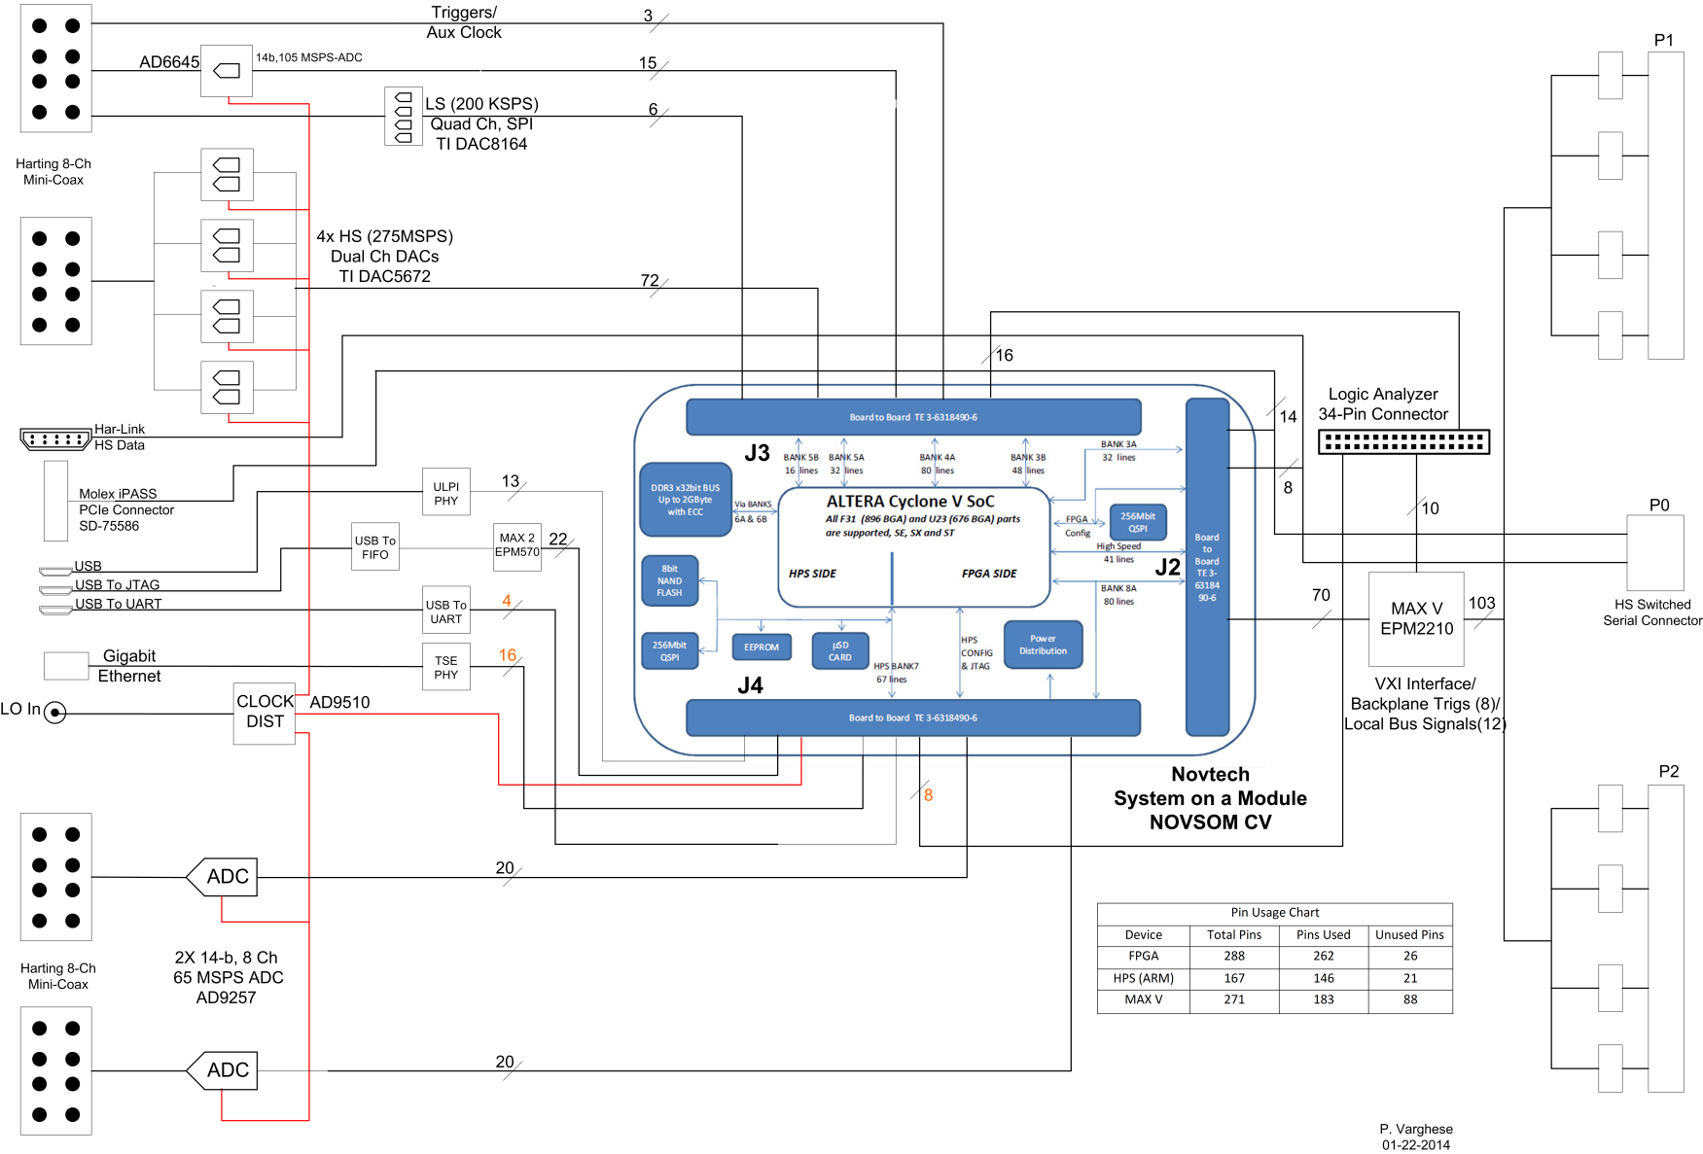
System on Module Multi-cavity Field Controller (SOM-MFC)
SOM is socketed
and upgradable

