Slide 1
RF Power
David Peterson, James Steimel
DOE Independent Project Review of PIP-II
15 November 2016

Slide 2
Outline
Construction phase scope of work
R&D phase goals
R&D status
R&D schedule to complete
Division of responsibility between Fermilab and DAE.
Summary

Slide 3
David Peterson
Electrical Engineer – MSEE 1983, University of Illinois, Urbana
IBM – Electron Beam Lithography
Fermilab –
  1984 Tev I Project -> Antiproton Source
    Microwave & RF Systems engineer for Stochastic Cooling, RF, beam instrumentation, interlocks, controls integration
    Loma Linda Medical Accelerator instrumentation
    Engineering Group Leader
    PET Helium3 Linac RF and vacuum controls
    SSR1, Coupler Test and HINS RF & Interlocks at MDB
  2011 AD/RF
    Engineering Group Leader
    PIP-II RFQ amplifier initial cost estimates
    MuCool MTA test area cavity conditioning system
    Pbar Rings conversion to Muon Ring
    Muon Rings RF and instrumentation support
    PIP-II Injector Test RF systems integration and support

Slide 4
Construction Phase - Scope of Work
“RF Power” includes
  Amplifiers
  Circulators
  RF Distribution
    Coax transmission lines and waveguide
    Connectors, elbows, adapters, etc.
    Directional Couplers
    Loads
  Controls & Interlocks (where not otherwise provided)
    Reflected power and RF leakage detection
    Interface to Accelerator Control Network

Slide 5
Construction Phase - Amplifiers
Section | Num of ampl | Freq (MHz) | Power (kW) | Duty
RFQ | 2 | 162.5 | 75 | CW
Buncher | 3 | 162.5 | 3 | CW
HWR | 1 | 162.5 | 3 | CW
HWR | 7 | 162.5 | 7 | CW
SSR1 | 16 | 325 | 7 | Pulse
SSR2 | 35 | 325 | 20 | Pulse
LB650 | 33 | 650 | 40 | Pulse
HB650 | 24 | 650 | 70 | Pulse
= Room Temperature Cavities
= Superconducting Cavities
V. Lebedev, FNAL, The PIP-II Reference Design Report, V1.00, June 2015

Slide 6
R&D Phase - Scope of Work
Linac RF Power through SSR1
Also 650 MHz RF Power for STC, Coupler Test Stand, and Cavity Tests
  Initially using Fermilab owned 30 kW IOT amplifiers
  Transition to RRCAT 40 kW Solid State Amplifiers

Slide 7
R&D Phase Goals
FRONT END 162.5 MHZ RF POWER
  PLC Interlocks
  Installation & Verification of 3kW Amplifiers
  Installation and Commissioning of 3kW Distribution
SRF CAVITY 162.5 MHZ RF POWER
  Procurement and Testing of 7kW Amplifiers
  Procurement, Testing, and Commissioning of 7kW Amplifiers
STC 650 MHZ POWER
COUPLER TEST STAND 650 MHZ POWER

Slide 8
R&D Phase Goals cont’d
325 MHZ RF POWER AMPLIFIERS
  7 KW Power Amplifier
    325 MHz IIFC Liaison
    Design of 325 MHz, 7 kW RF Power for SSR CM of PXIE
    First prototype constructed as per BARC design and jointly tested in India
    Fabrication and testing of 8 Nos. of 7kW, 325 MHz RF System
  Design and Installation of 325 MHz Distribution
650 MHZ RF POWER AMPLFIERS
  40 KW Power Amplifier
    650 MHz IIFC Liaison
    Design of 650 MHz, 40 kW RF Power for HTS-2 & CMTF
    First prototype constructed & tested as per RRCAT design
    Fabrication and testing of 2 Nos. of 40kW, 650 MHz RF System
    Fabrication and testing of 6 Nos. of 40kW, 650 MHz RF System for CMTF
    Design and Installation of 650 MHz Distribution HTS-2
    Design and Installation of 650 MHz Distribution CMTS

Slide 9
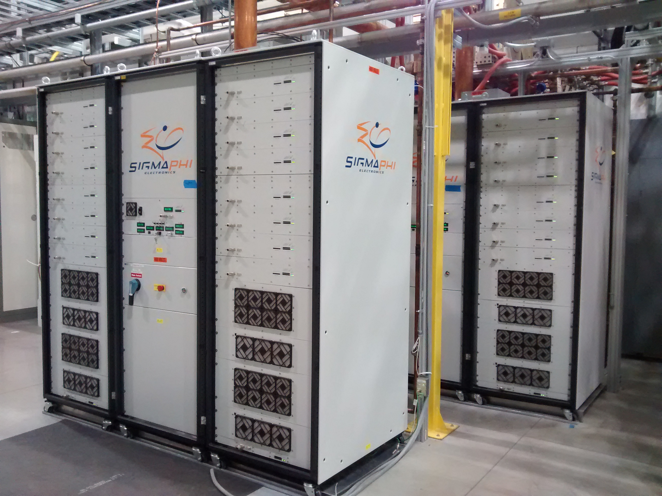
R&D Status – RFQ Amplifiers
SigmaPhi 162.5 MHz, 75 kW amplifiers for RFQ are operational.
  First RF out of amplifier #1 Sept 2014 & #2 Nov 2014
  First power to RFQ February 15, 2016
  Over 29.7 million pulses and untold hours of CW operation
  Some failures
    RF “Slices” had some poor solder and water tubing joints
    480VAC input terminals insufficiently torqued
    Some intermittent CAN Bus and Ethernet communications
  Work continues on the module and slice test stand.
SigmaPhi 162.5 MHz 75 kW Amplifiers

Slide 10
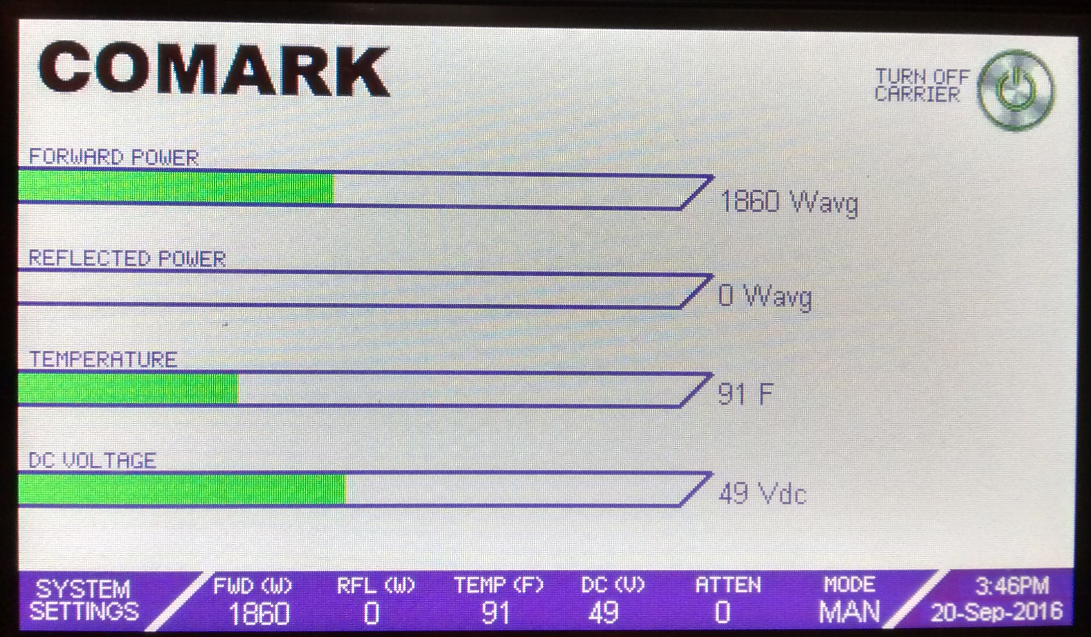
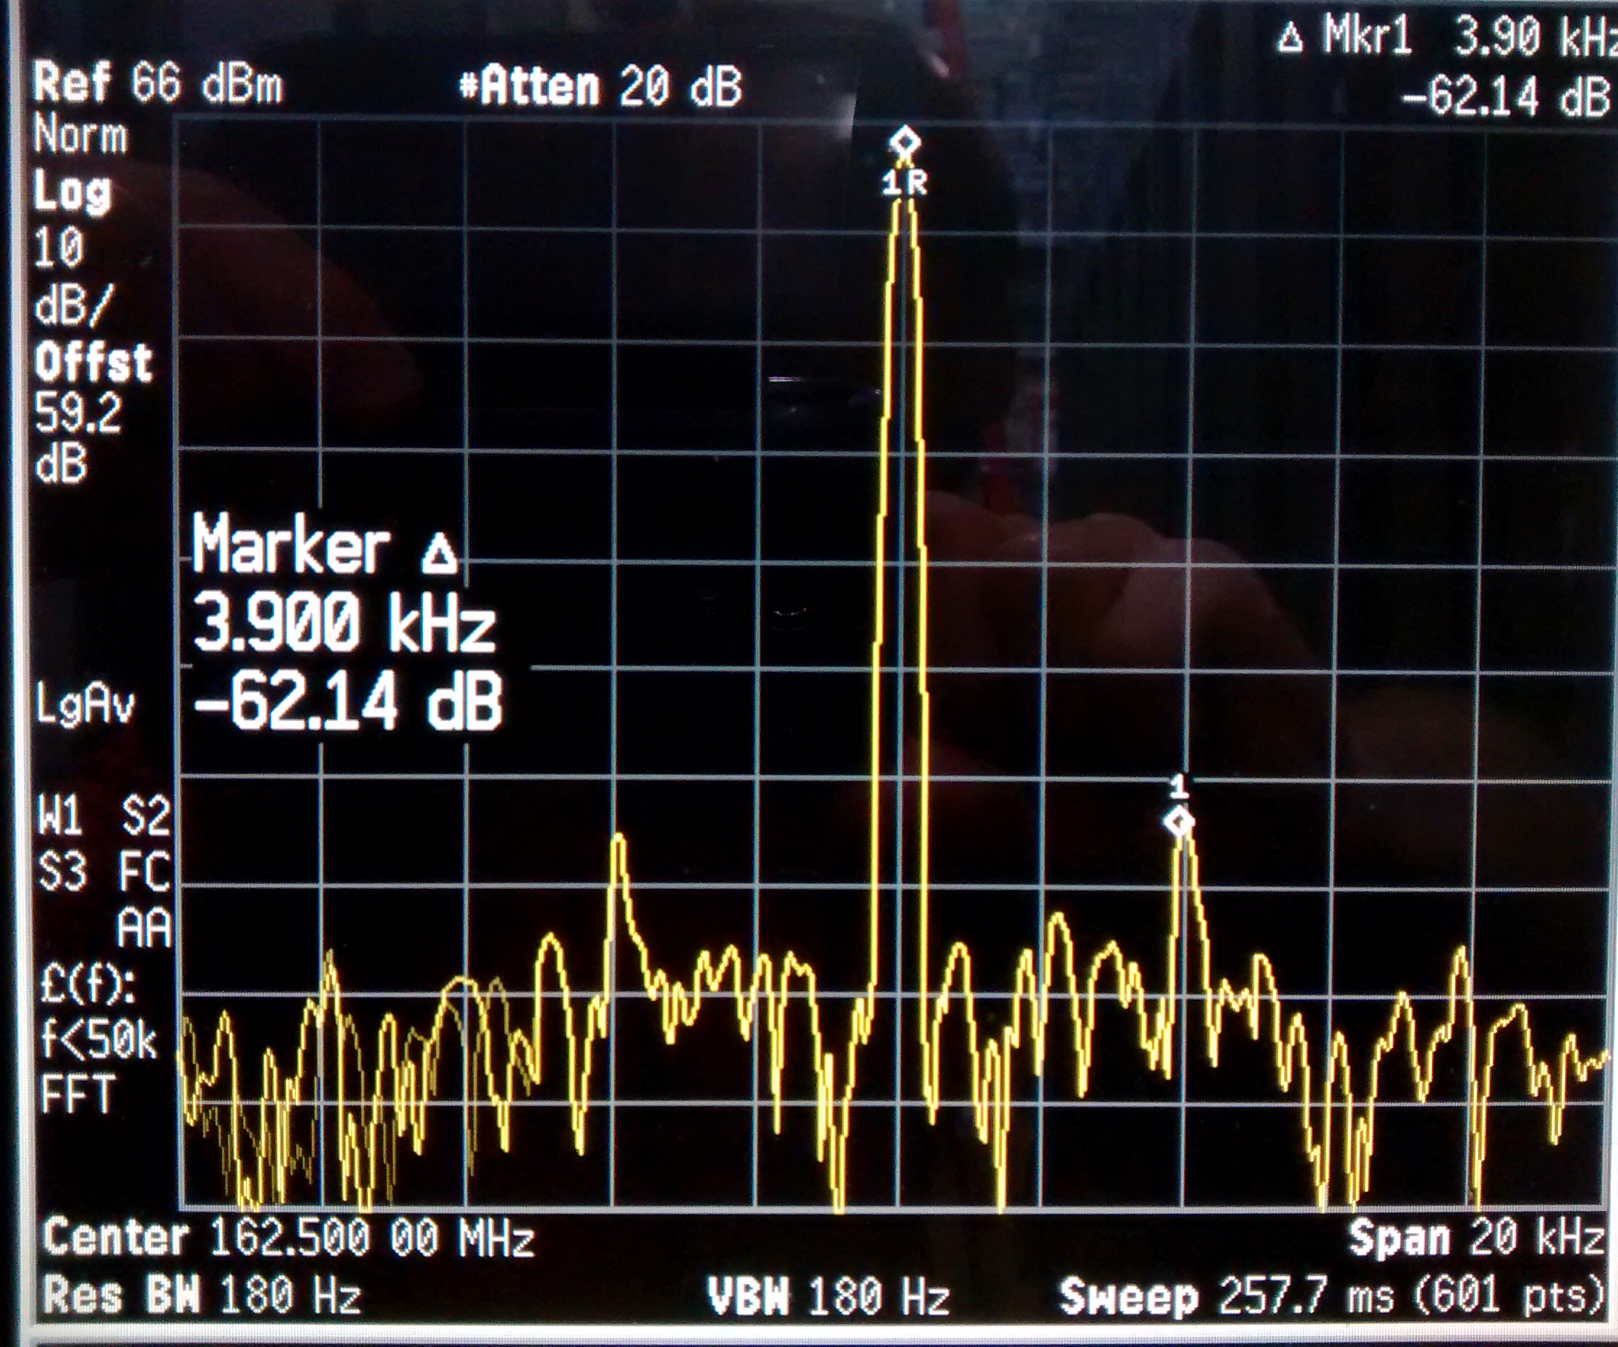
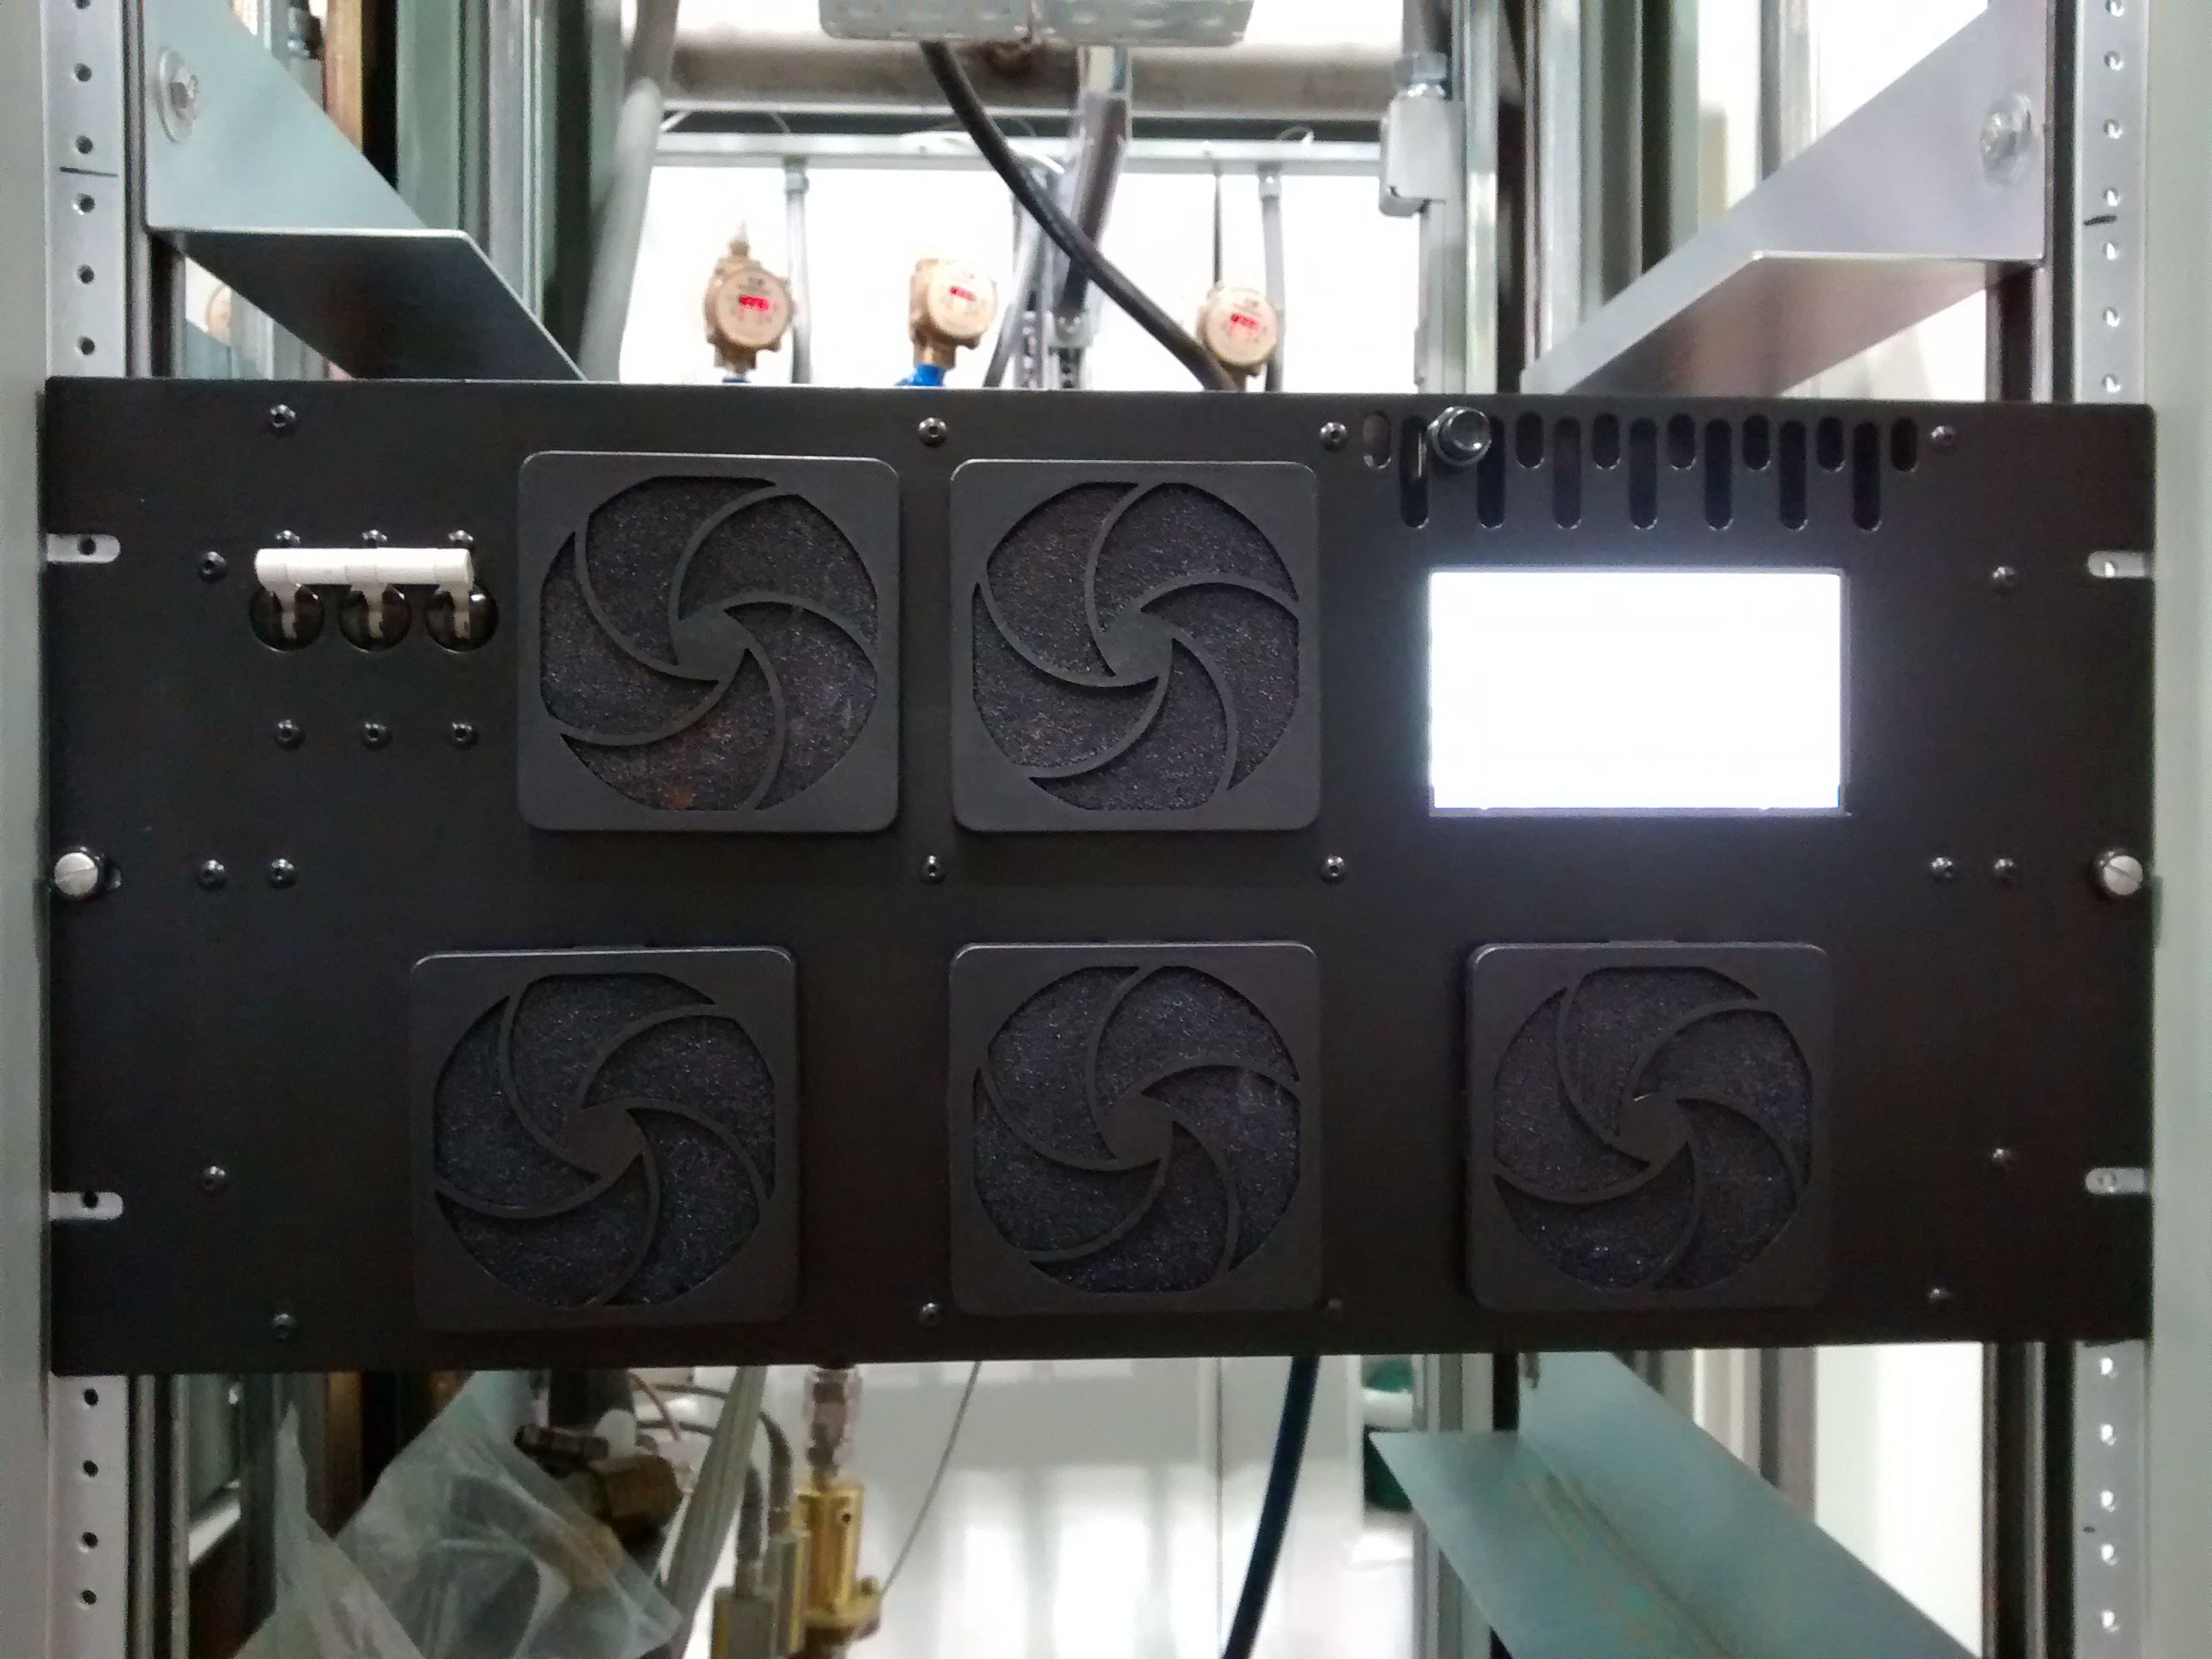
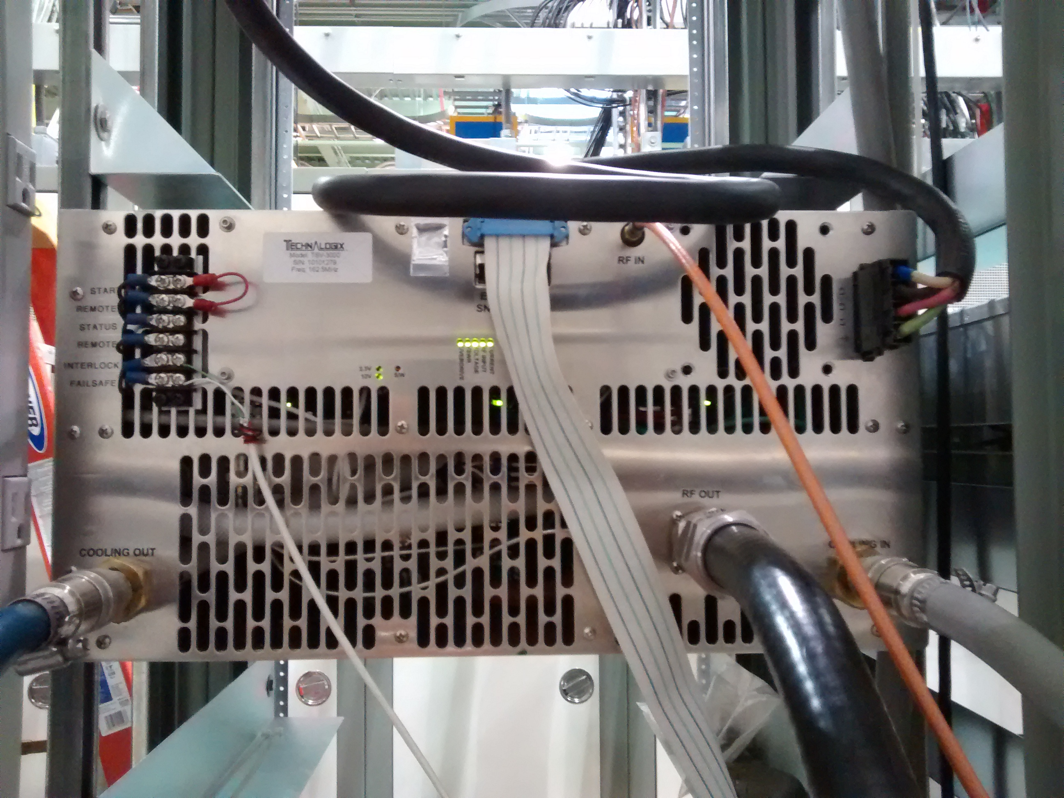
R&D Status - Amplifiers
Comark/Technalogix 162.5 MHz, 3 kW amplifiers
  RF performance meets specifications
    Gain, Gain and Phase vs Power, 1dB Compression, Spurious and Harmonics, Pulse performance
    >100 hour continuous duty burn-in at 2 kW
  Two amplifiers at Fermilab
    Original version powering Buncher 1 Cavity.
    Newer Version 2 combines RF and Power Supply units
  Control interface issues still being addressed
    Some spurious trips of Carrier enable
    Non-functional Carrier status bit
Front Panel Display
Comark/Technalogix 3 kW amplifier
Rear View
Spurious output: +/-3.9 kHz, -62.1 dBc.

Slide 11
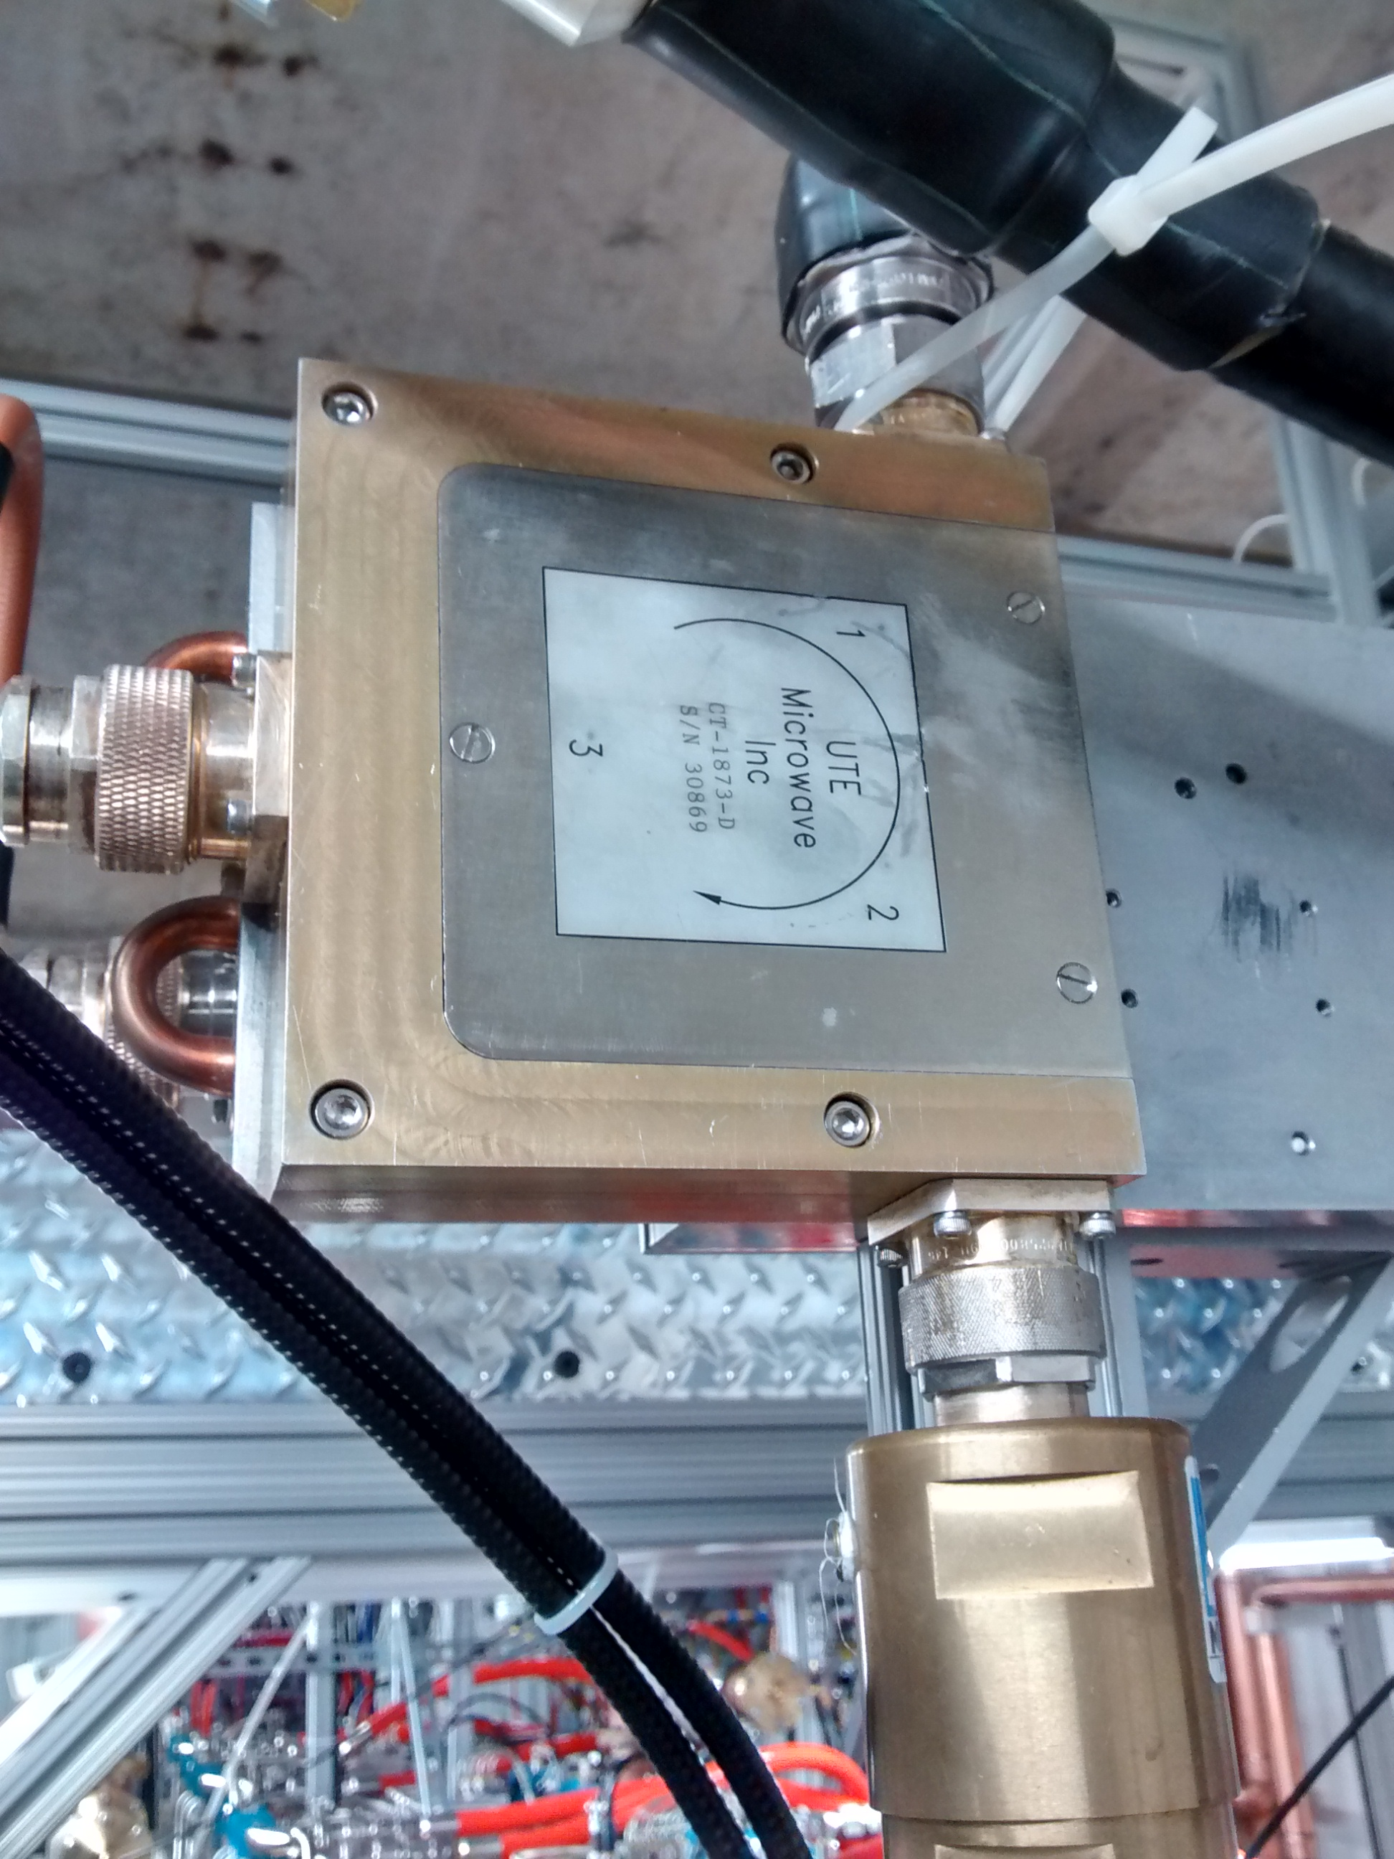
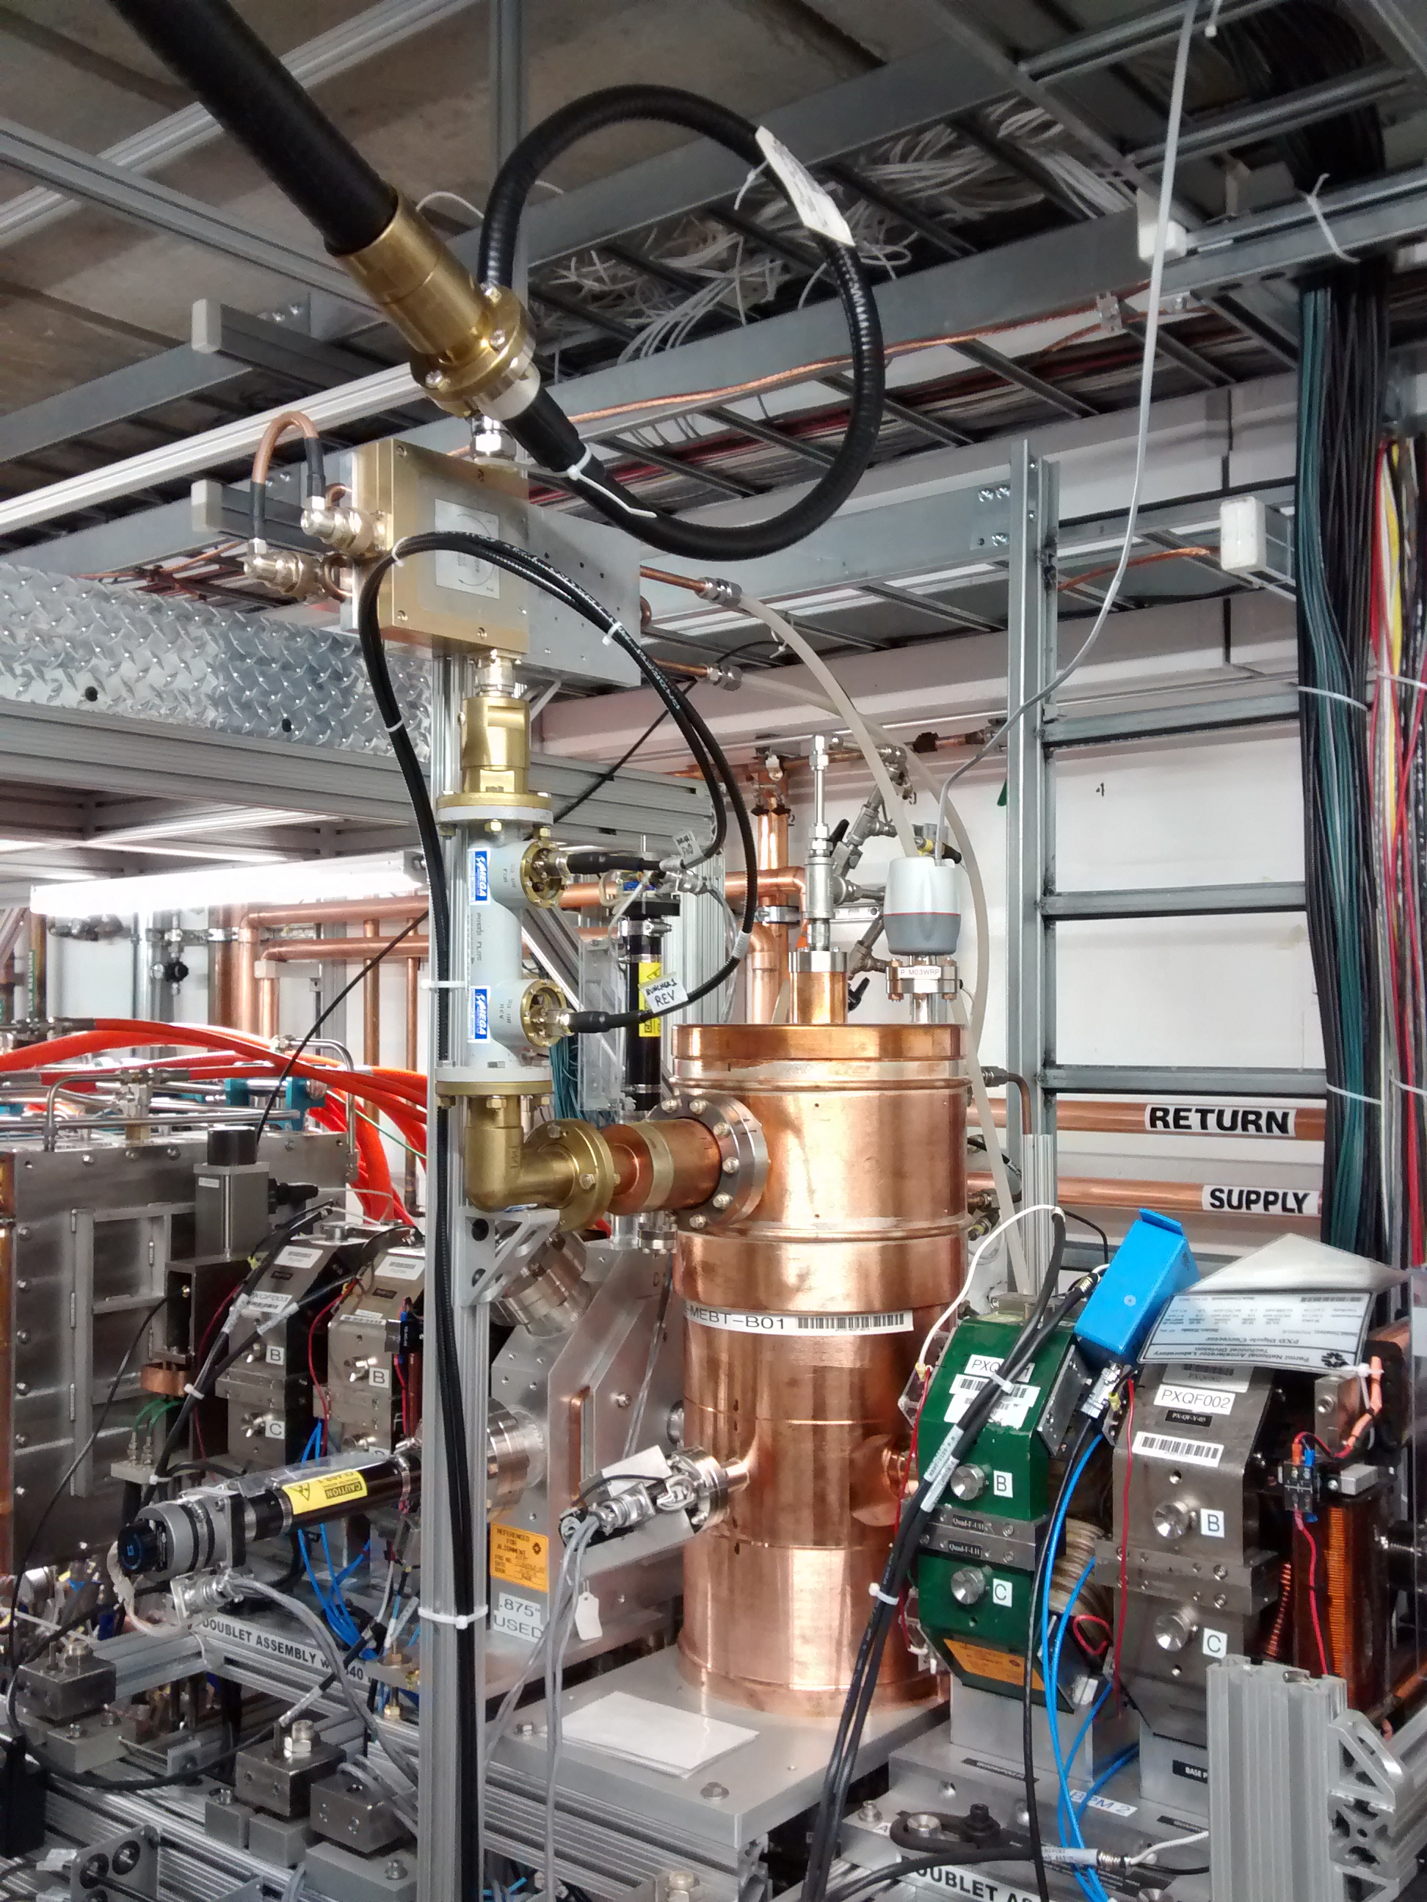
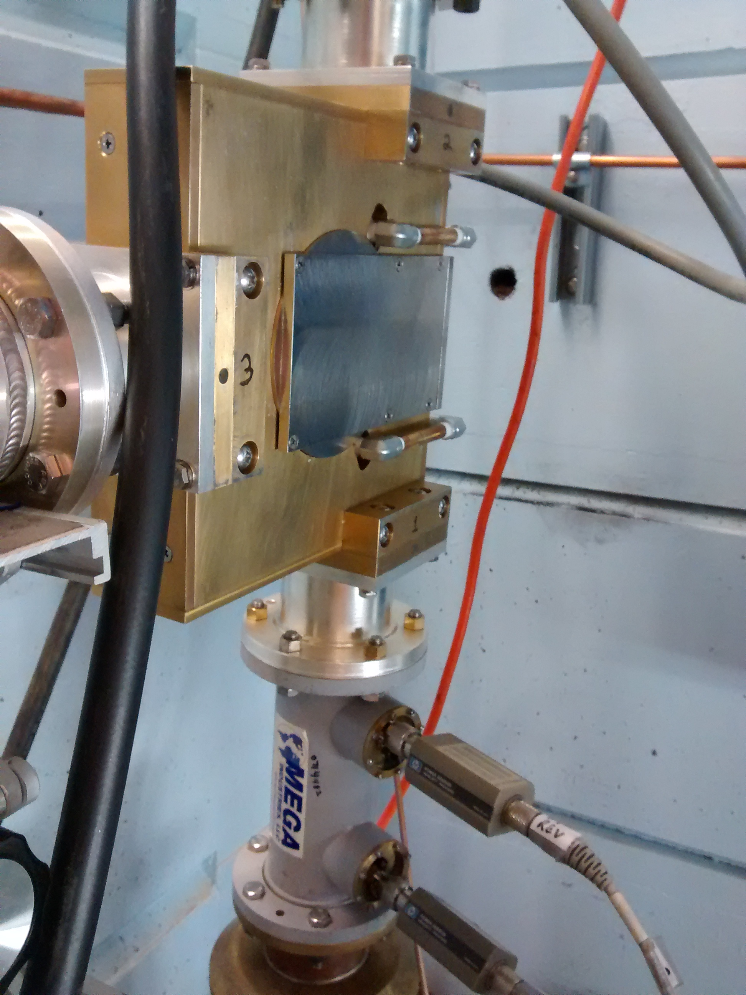
R&D Status - Circulators
Comark provided UTE Circulator
  Sufficient for Buncher cavities
  Does not provide sufficient isolation for HWR operation: ~ 6 dB with short circuit
McManus 162.5 MHz, 7 KW Circulator
  Passed 3 kW and 7 kW tests
    7 kW Insertion loss <0.33 dB
    Isolation 23.1 dB @ 162.5 MHz, >20 dB across 6 MHz BW
    Short Circuit return loss 13.7 dB
  Is a possible alternative for the UTE circulators in the 3 kW systems
UTE 3 kW Circulator
UTE Circulator and Buncher 1 Cavity
McManus 7 kW Circulator Test

Slide 12
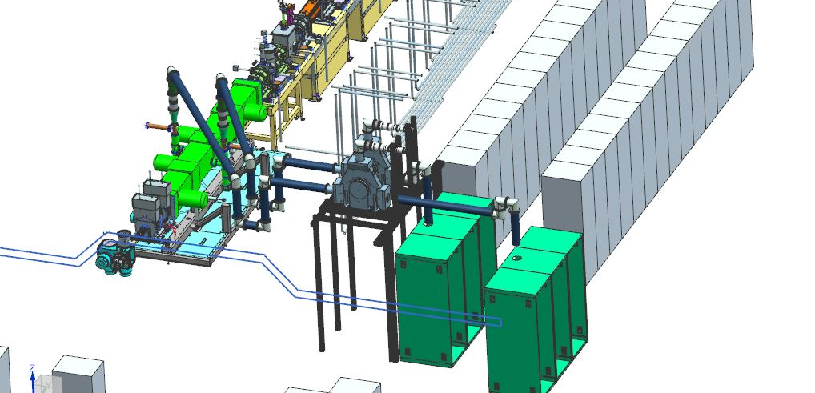
R&D Status – RF Distribution
RF Distribution in place for RFQ and Buncher 1.

Slide 13
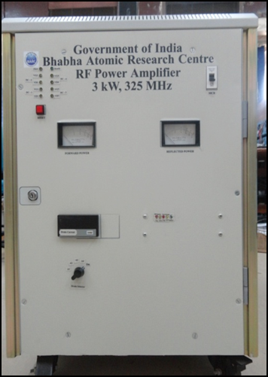
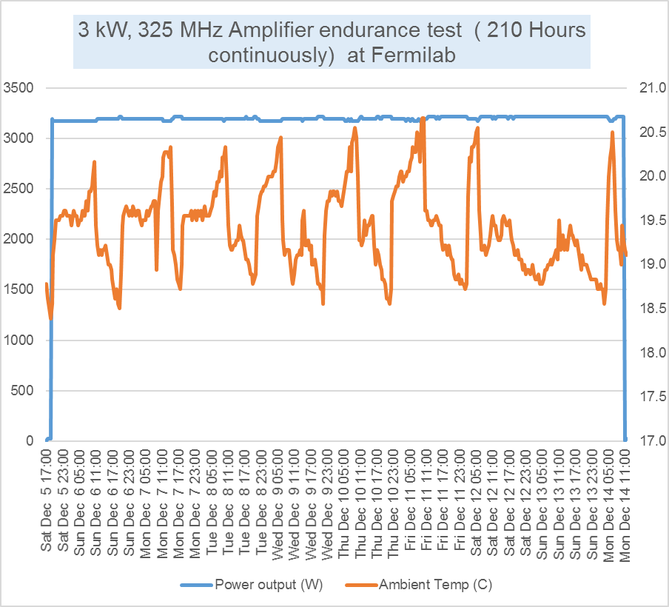
R&D Status - 325 MHz RF Power Amplifiers
A 3 kW Solid State RF Amplifier (SSRA)system was developed based on the old FRS (of Dec. 2010) by DAE and was jointly tested successfully at Fermilab in late 2015.

Slide 14
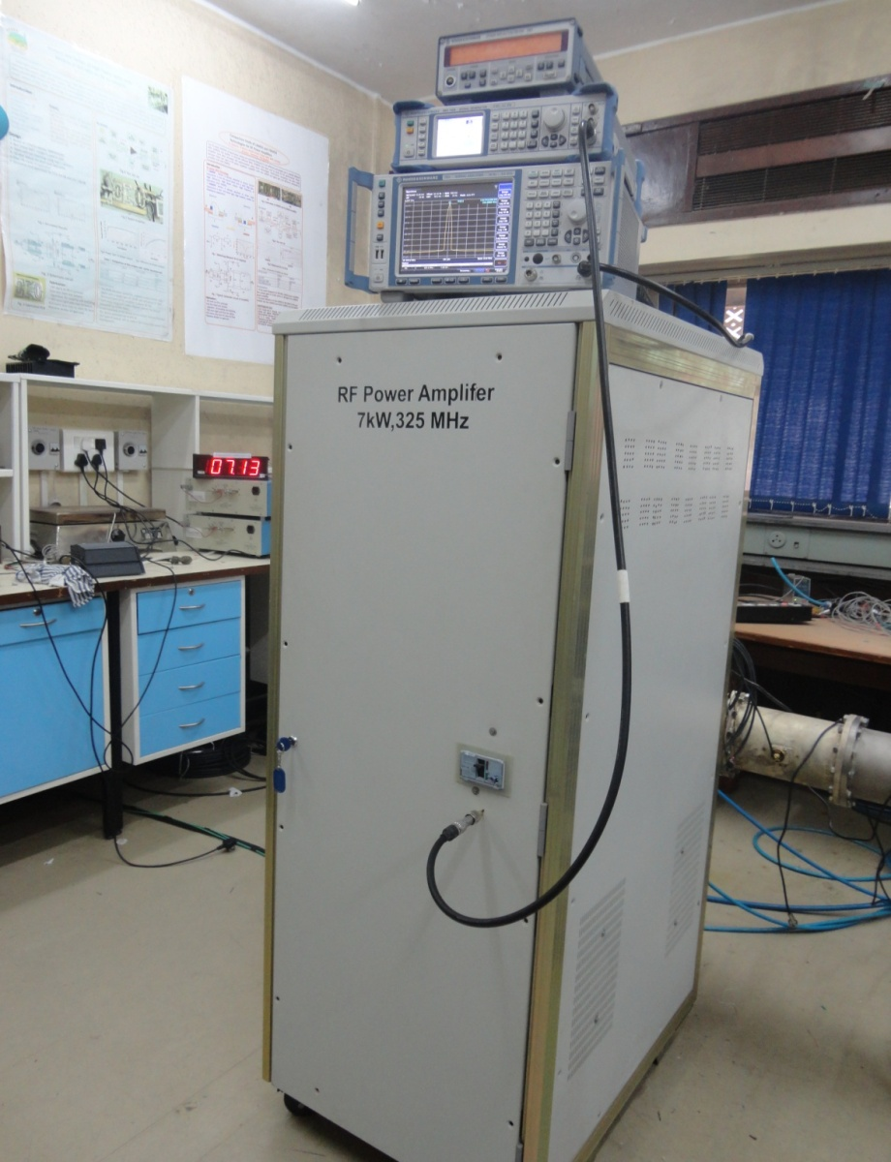
R&D Status - 325 MHz RF Power Amplifiers
7kW prototype based on original specifications already tested at BARC.
New specifications based on experience with 3kW prototype complete.

Slide 15
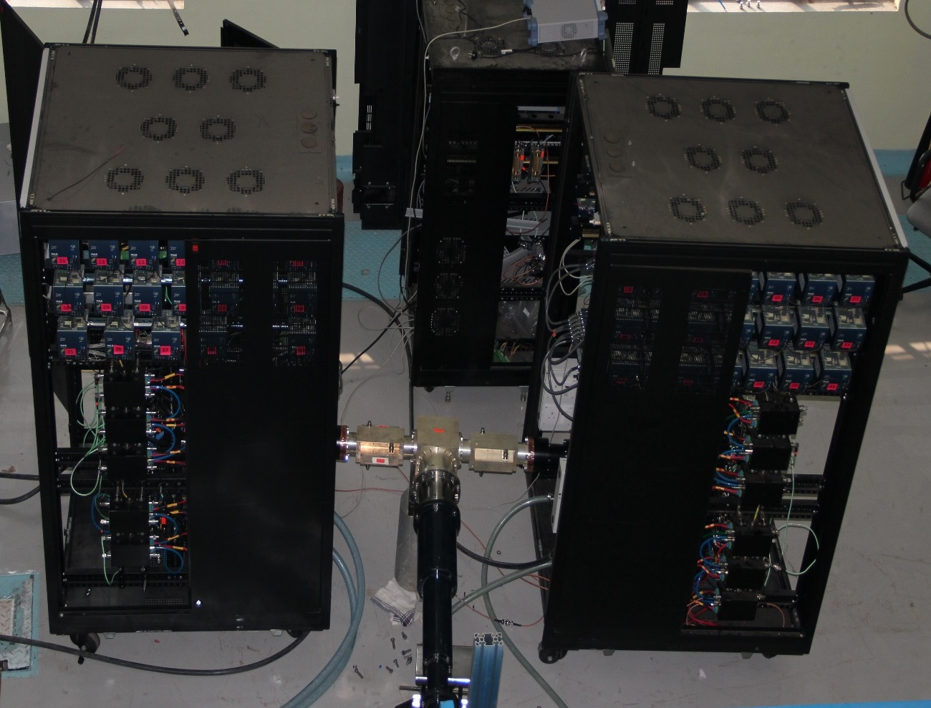
R&D Status - 650 MHz RF Power Amplifiers
30 kW prototype based on early specifications constructed and tested.
Design modifications for 40 kW prototype underway; final specifications nearly complete.
30 kW, 650 MHz Solid State RF Amplifier

Slide 16
R&D Schedule to complete

Slide 17
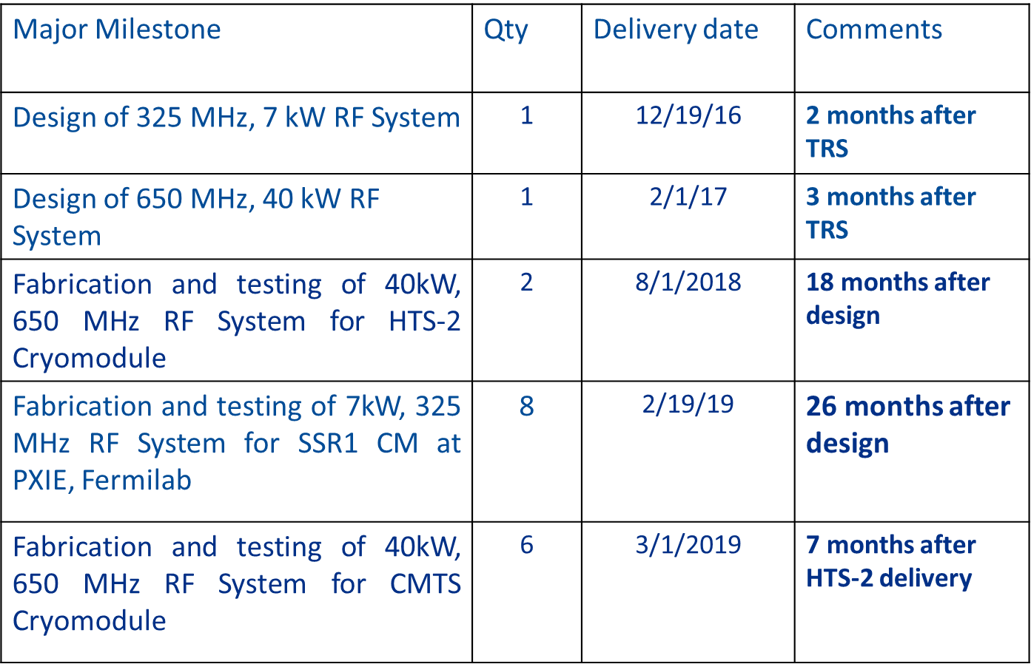
R&D Schedule to complete

Slide 18
R&D Division of Responsibility - Fermilab and DAE
Fermilab provides 162.5 MHz RF amplifiers, circulators, and RF distribution.
DAE provides 325 MHz 7 kW and 650 MHz 40 kW Solid State RF amplifiers.
Fermilab provides 325 MHz and 650 MHz circulators and RF distribution.
Fermilab provides 650 MHz IOT amplifiers for initial STC and Coupler Test Stand operations.

Slide 19
Summary
At the end of the PIP-II R&D the RF Power activity will have:
  provided 162.5 MHz 3 kW and 7 kW amplifiers, circulators and RF distribution for the Buncher and HWR cavities.
  provided 650 MHz amplifiers, circulators and RF distribution for the STC and Coupler Test Stand.
  provided 325 MHz 7 kW amplifiers for the SSR1 cavities through a collaboration with BARC.
  provided 325 MHz circulators and RF distribution for the SSR1 cavities.
  provided 650 MHz 40 kW amplifiers for HTS-2 & CMTF through a collaboration with RRCAT.
  provided 650 MHz circulators and RF distribution for HTS-2 & CMTF.

