Slide 1
PMTs Interferences
19-10-2016
Enrique Calvo.

Slide 2
Option 1
1020
1020
680
1020
1020
There are several lineal interferences with the pipes and the junction of the PMMA plates.
The pipes interferences can be avoided by shifting the pipes.
The PMTs are spaced 1020 and 680 mm.
1020
1020
680
1020
1020

Slide 3
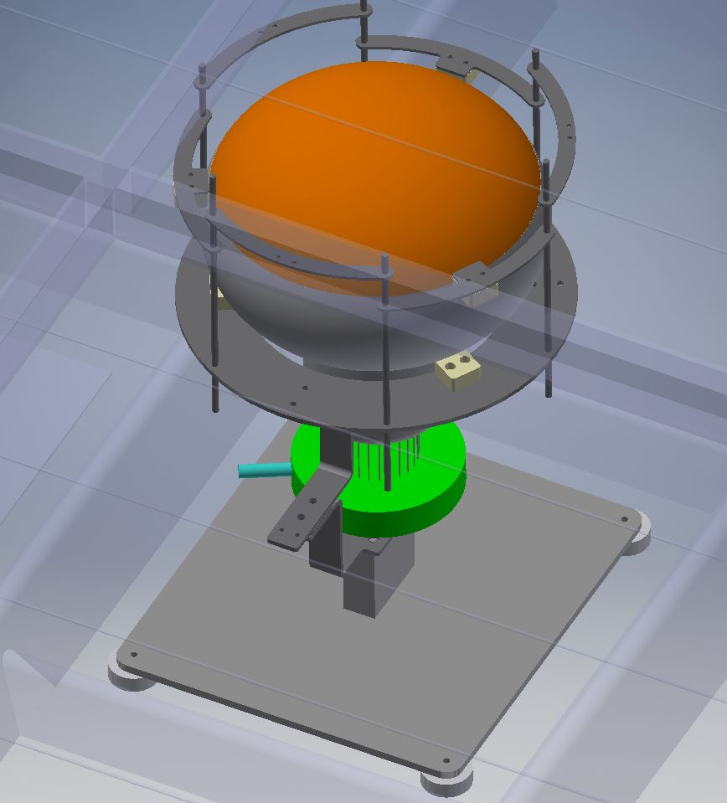
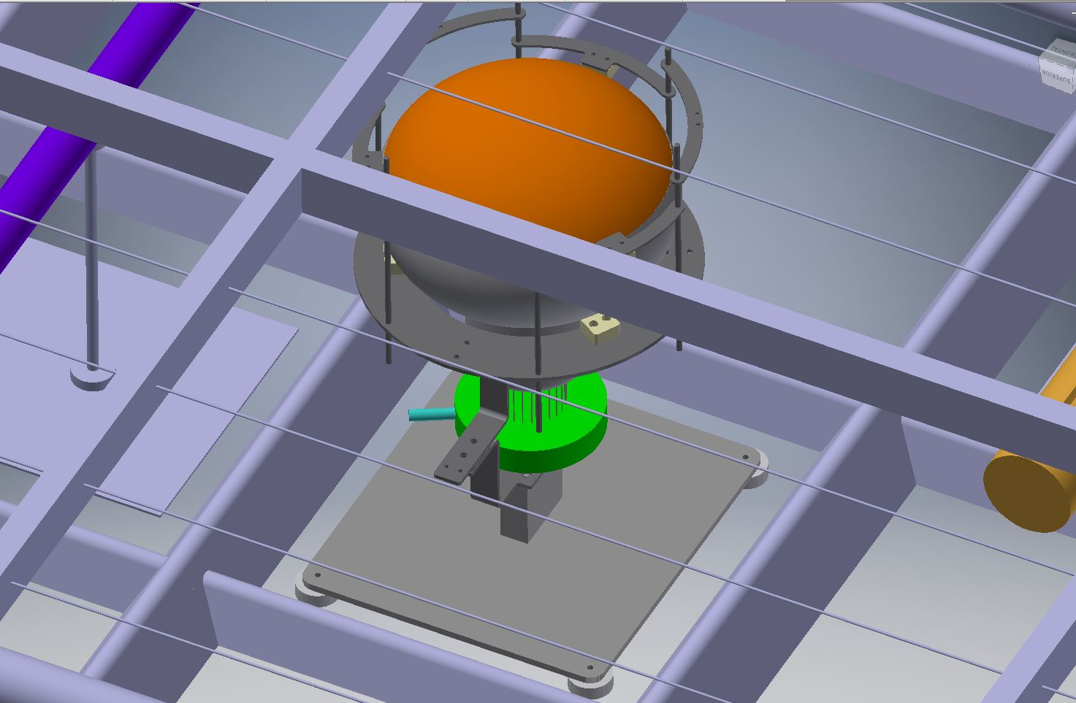
The PMT can be placed on the centre of the ‘square’ position between the stiffener of the shell .

Slide 4
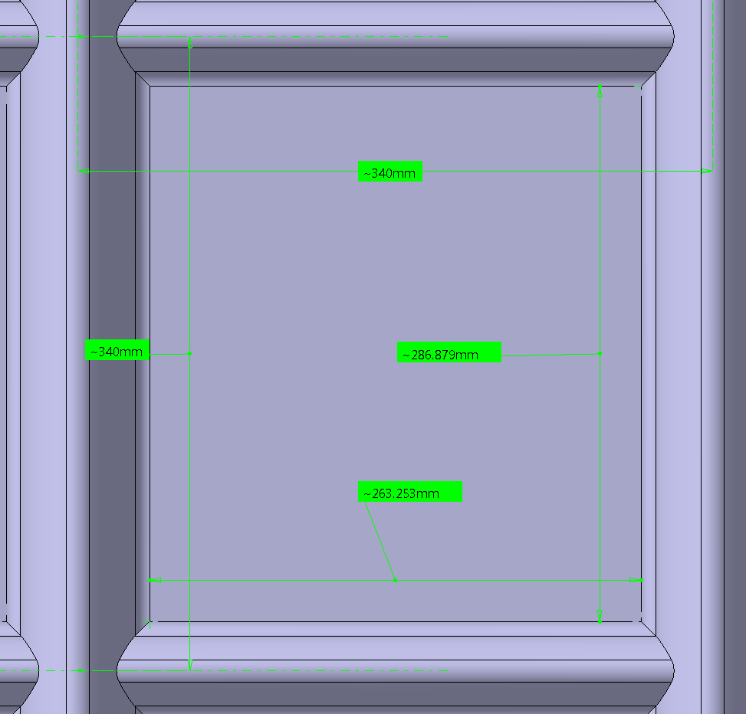
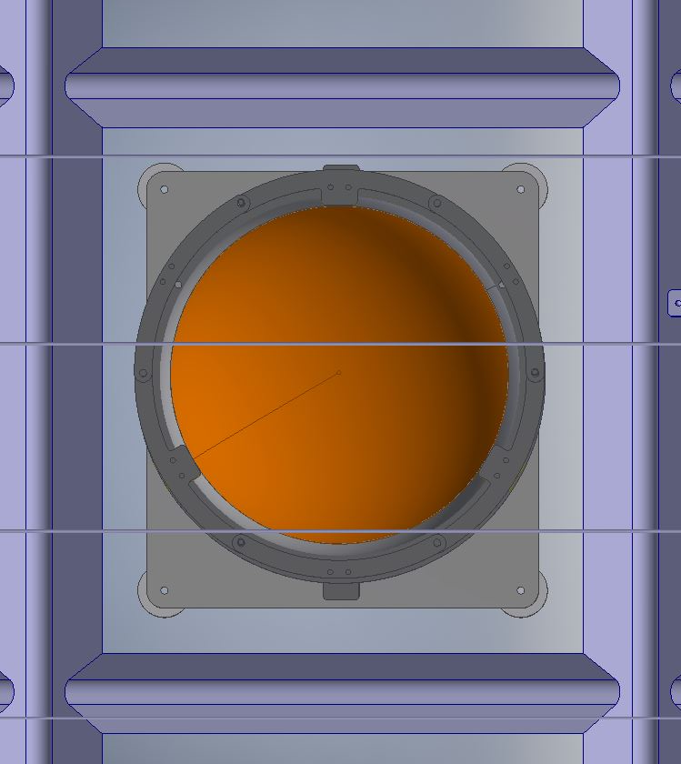
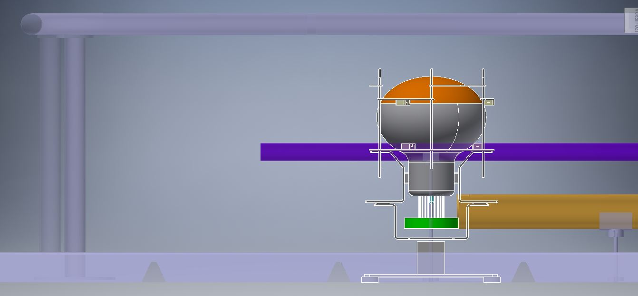
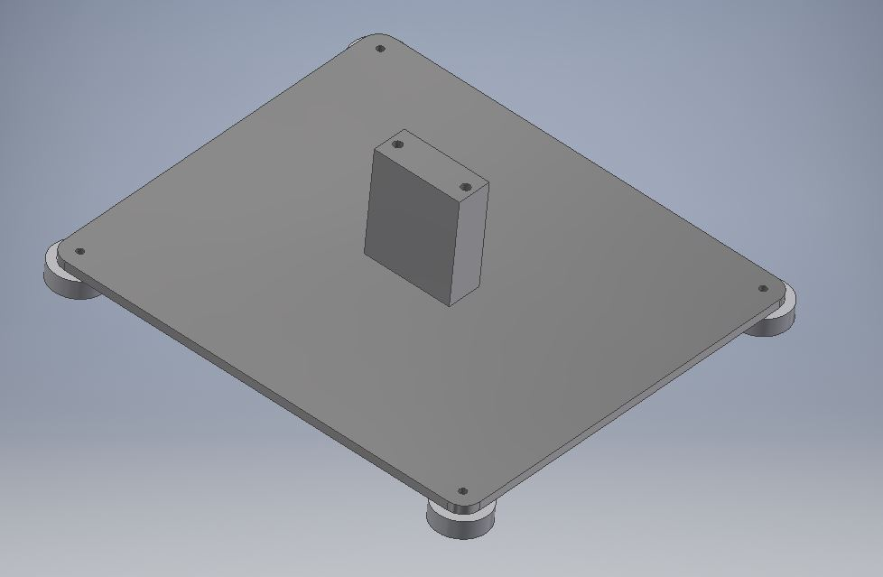
Weight of the PMT +support & base ~6,5 kg.
Buoyancy force of the system ~5,5 kg.
230
From Adamo
255
800 mm
Stainless Steel support base of the PMTs:
4 PTFE Ø30 mm contact pieces on the shell.

Slide 5
Option 2
1020
1020
680
1020
1020
1020
1020
There are several lineal interferences with the pipes.
Those interferences can be avoided by shifting the pipes.
The PMTs are distributed non-uniformly.
680
1020
1020

Slide 6
Option 3
1020
1020
680
1020
1020
1020
1020
There are several lineal interferences with the pipes.
Those interferences can be avoided by shifting the pipes.
The PMTs are distributed non-uniformly.
680
1020
1020

Slide 7
Option 4
There are several lineal interferences with the pipes.
Those interferences can be avoided by shifting the pipes.
The PMTs are distributed non-uniformly.
1020
1020
680
1020
1020
1020
1020
680
1020
1020

Slide 8
Option 5
There are several lineal interferences with the pipes.
Those interferences can be avoided by shifting the pipes.
The PMTs are distributed uniformly (650 x 650 mm2) and centred on the PMMA plates. But the PMT it is not centred in the corrugated square, each PMT base support needs to be different.
650
650
There are many possible different distributions.
But the physics simulations should give the optimum distribution.

