Slide 1
Run Control, Operational Monitoring, and Configuration
Wesley Ketchum
ProtoDUNE DAQ Design Review
November 3 2016

Slide 2
Introduction
Run control
  Suite of software managing the state of DAQ
  Interface between shifters/operators and DAQ
Operational monitoring
  Monitoring of the state of DAQ processes and data flow to ensure smooth operation of the DAQ
    DAQ process monitoring (what is running? in what state?)
    DAQ node monitoring (are the nodes healthy? disk usage? cpu load?)
    DAQ data flow monitoring (how much data from each node? buffer occupancies?)
Configuration
  Storage of DAQ configuration for online and offline use
  Interfaces for updating/creating new configurations
  Interfaces to run control for choosing and passing configurations to DAQ components

Slide 3
Quick detour: what is a run?
We define a run as a period of contiguous data-taking from detector components in a static configuration state
  Change of detector configuration → change of run
  A run history database will provide basic information on runs taken
    Start/end times, configuration ID/name used, run type, etc
  Detector state/conditions can change during run
    Operational monitoring / slow monitoring
An event is the total collected data from a contiguous period of time during an individual run
  For ProtoDUNE, usually defined by some triggered readout
  Each event has a unique identifier
    Run number and event number (with optional subrun number)
  Each event has a unique “start” or “triggered” time

Slide 4
Requirements
Provide clean interface between shifter control and existing DAQ control infrastructure
  Integrated run control not currently provided with artdaq, but procedure for process management and control message passing exists
Integrate DAQ operational monitoring with monitoring of other hardware components
  Centralized monitoring → simpler operation and easier debugging
Ability to alarm on DAQ status and internal data flow status
  Interfaces for customized DAQ monitoring metrics
Easy to maintain and modify configurations
  Flexibility for new configuration parameters
Configuration parameters fully accessible for offline reconstruction
  And maintained over expected lifetime of data

Slide 5
artdaq State Machine
Empty
Terminated
Booted
Configured/Ready
Stopped
Running
Paused

Slide 6
artdaq Control Processes
Processes started using custom/simple Process Management Tool (PMT)
  Currently started via MPI as MPI ranks used for data transfer pathway
  Upcoming modifications: socket-based data transfer
    More flexibility in how to start processes in PMT
XML-RPC commands used for communication to DAQ processes
  Check status, and pass through state transitions
Experiment-specific long-running interface programs have previously been used for calling these processes
  e.g. DAQInterface in 35-ton

Slide 7
Run control: JCOP
JCOP: Joint Controls Project
  Grouping of representatives from CERN experiments
  Developed framework of common software components for control systems
    Hardware and software interfaces
  Uses WinCC-OA for supervisory control and data acquisition
    Control interfaces, custom data point elements, alarm capabilities, storage/archiving of controls data, and single event manager server subsystem managers
Well-developed and common system at CERN
  Benefit from expertise/common tools from many experiments
  CERN support and expertise for JCOP system
Decision to integrate DAQ into this system
  Where the significant work now is ongoing

Slide 8
Interface of DAQ to JCOP
Maintain existing artdaq infrastructure, but build interface layer to JCOP
Consulting experts → use CERN’s DIM (Distributed Information Management System) as interface protocol
  Simple server/client model
  Python and C++ APIs
  Interface from DIM to JCOP already developed (fwDIM)
Interface plan
  Write parent control with DIM server
  Write DIM client to issue commands → PMT/XMLRPC
  Write DIM client to receive back DAQ state
  Integrate DIM client into JCOP
    Developing DAQ process data elements with necessary state

Slide 9
Block diagram

Slide 10
Operational monitoring in JCOP
JCOP also good choice for operational monitoring
  Integrated controls/alarming/archiving of status with other components
artdaq provides simple metric manager plugins to allow display of built-in and custom monitoring metrics
  Monitoring metrics easily defined in DAQ software code
  Plugins exist for ganglia, graphite, text files, EPICS
  Can run multiple monitoring plugins at same time
Interface plan
  Both DIM and WinCC-OA have C++ APIs, so plugins can exist for both
    Choice of DIM would imply then interfacing DIM servers to JCOP
  Likely start with plugin for DIM server (looks more fault-tolerant on artdaq side)
    Then create data point elements in JCOP for describing DAQ monitoring metrics

Slide 11
JCOP at NA62

Slide 12
Process logging
Logging utilities exist in artdaq
  TRACE debugging tool, with message type markers and accurate time-stamps per “printf”-type statement
  Message facility, with configurable message filtering/routing and message severity levels
Plan to use “Elastic Stack” products to store, search, and visualize log messages
  In use at CERN, with hooks to JCOP
  Allow for customizable queries/searches across log files
  Customizable visualization, with different types of data representations and support for time-series metrics

Slide 13
Configuration management
artdaq configurations consist of three main parts
  Architecture configuration
    How many nodes, where, doing what?
  Core software configuration
    Core configuration for the BoardReaders, EventBuilders, Aggregators, and online monitoring process
      Not dependent on experiment-specific hardware interfaces
  “hardware” configuration
    Configuration of the fragment generator processes that interface to hardware
Current uses
  Architecture configuration used at process launch time (mpirun)
  Software and hardware configurations combined in FHiCL configuration source (one per process)

Slide 14
Configuration Management Tool
artdaq team developing a common configuration management tool
  MongoDB and file-system-based options for storing FHiCL configurations
    Schema-less → very flexible/easy to change
  Simple interfaces for uploading, downloading, and changing interfaces
    Including graphical interface for changing single values
  History stored in the database, and full configuration FHiCL available in final data files
    art utilities allow storing of all FHiCL configurations throughout file history, so piggy-backing on that
Will need to work out detailed interface to JCOP
  Simplest method through same mechanisms as the run control, and maintain standalone configuration management tool

Slide 15
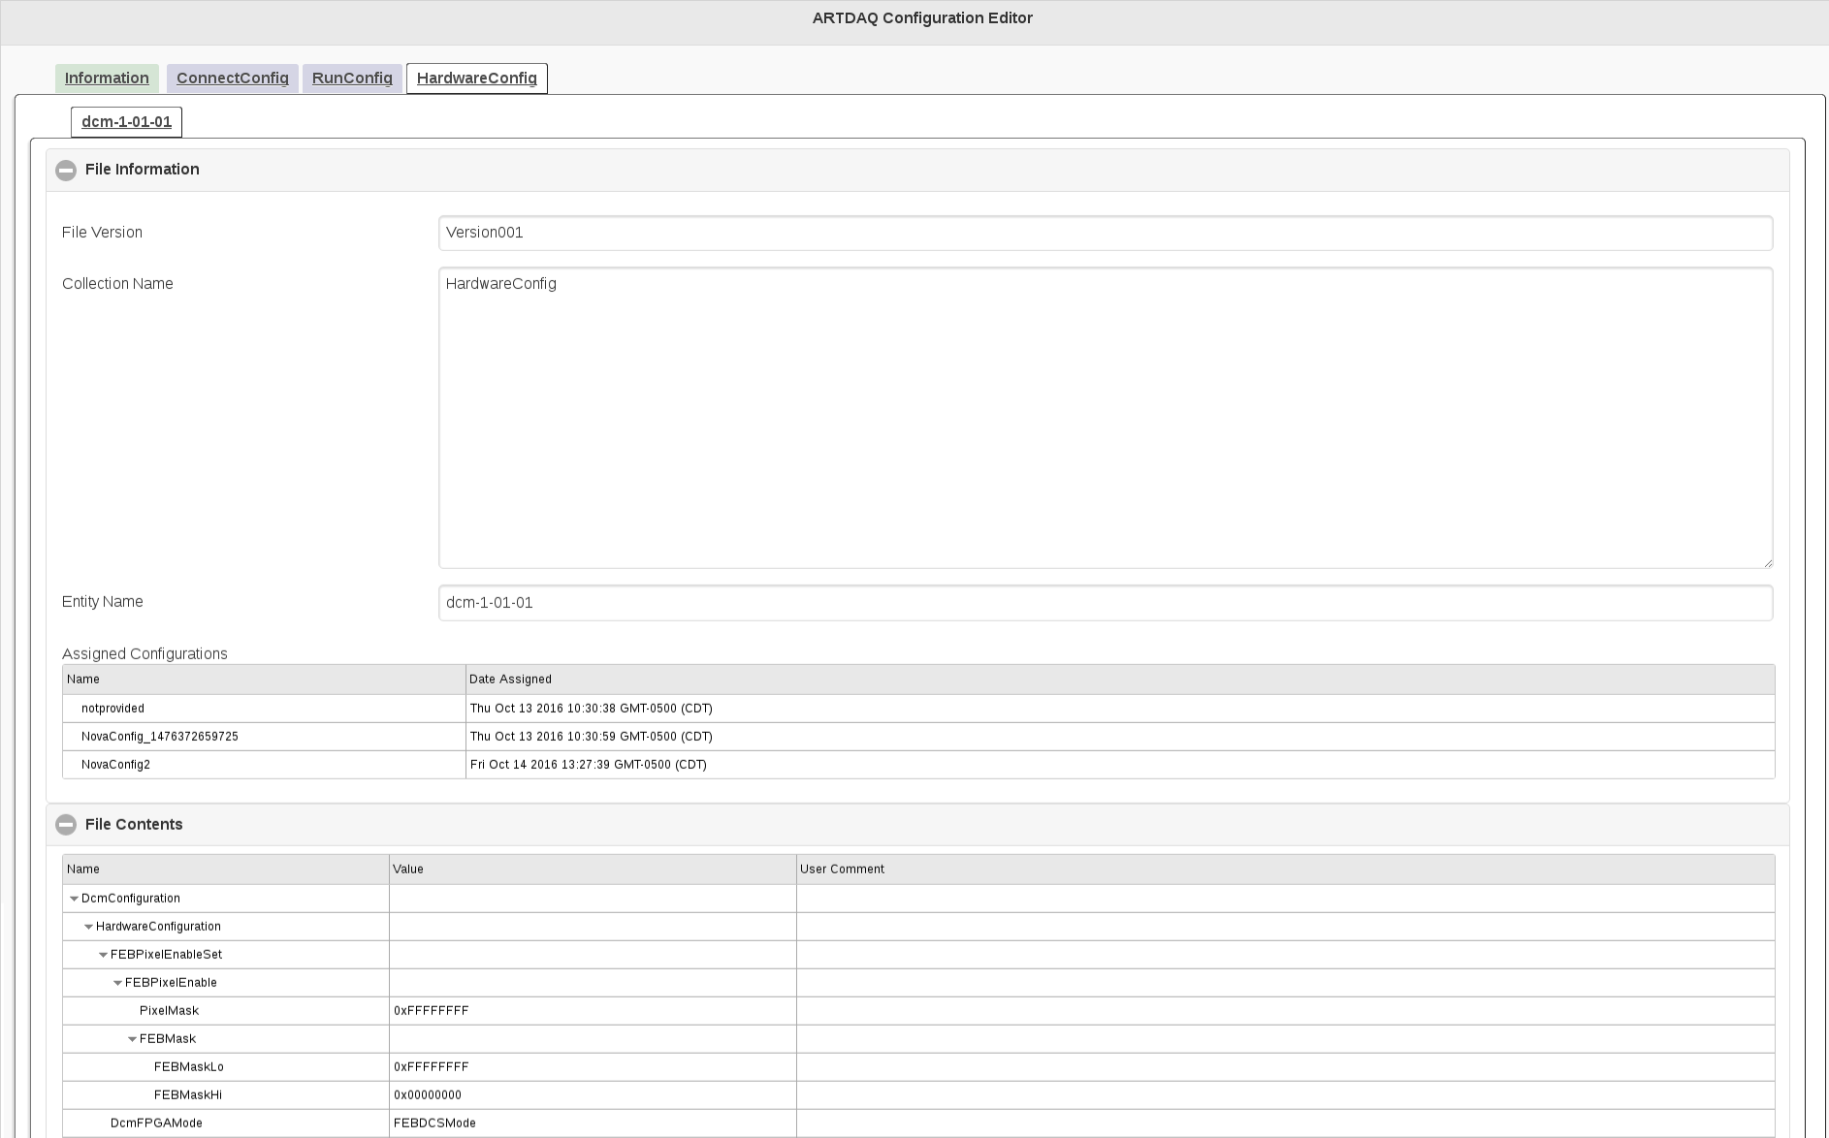
artdaq Configuration Editor (beta)

Slide 16
Component testing
Run control/operational monitoring
  Initial DIM server to DAQInterface and connection to JCOP system for process status and management in November 2016
  Metric plugin to artdaq monitoring metrics in December 2016
Configuration management
  Initial testing versions exist and undergoing final refinement
  Components expected to all be ready January 2017
Testing plan:
  Develop integrated system on artdaq demo project, and then translate tools to protodune DAQ as they are in final form
  Expect artdaq demo demonstrator with JCOP and configuration management finalized in February 2017

Slide 17
Risks
Immediate/urgent needs during commissioning to “get something working” lead to incoherent operation plan
  Always a risk for downstream software components
  Mitigating by…
    Relying on solid, developed, scalable, flexible frameworks
    Establishing system control/monitoring design with clear interfaces
      Delivering working test system as template/guide for further development
    Maintaining good communication across DAQ groups on needs and integration

Slide 18
Conclusion
Have designs in place for run control, operational monitoring, and configuration
  Exploiting many existing elements of artdaq system
  Where we need something new or different…
    Leveraging experience from 35-ton and other experiments to inform design
    Leveraging CERN tools, resources, and support
Designs will meet requirements/needs of ProtoDUNE for full-featured run control, monitoring, and configuration tools

Slide 19
Backup

