Slide 1
Beam instrumentation trigger input and readout
Paola Sala
DAQ Review
November 3,2016

Slide 2
Introduction
This presentation addresses the Interface between Beam Line Instrumentation and ProtoDune DAQ [DUNE-doc-1651-v2]
The Beam Line Instrumentation (BLI) accomplishes different tasks and includes different detectors [see TDR]:
    Beam Monitoring, Particle tracking, Momentum measurement
      Scintillating fibres monitors (CERN BI group)
    Particle Identification
      Cherenkovs (CERN BI)
      ToF from pLAPPD (FNAL) or scintillating fibres (CERN BI)
      PiD actual configuration will change according to beam momentum
Total length of the beam line 37m

Slide 3
Beam line schematics
H4 –VeryLowEnergy beam optics and detectors(draft)
ProtoDUNE cryostat
Cherenkovs , last monitor, last ToF
Monitors for momentum measurement
First ToF station
Secondary target

Slide 4
Introduction-II
BLI will provide to PD
  Trigger signals
  Data fragments
BLI data fragments will be included in PD events.
BLI Data/trigger comes from two separate sources
  BI Instrumentation, external to PD
  FNAL pLAPPD, internal to Dune collaboration

Slide 5
Architecture

Slide 6
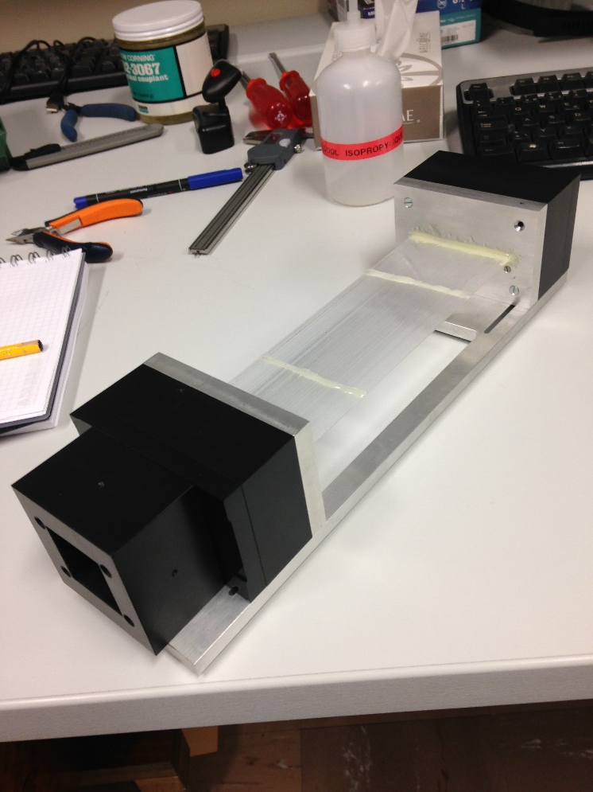
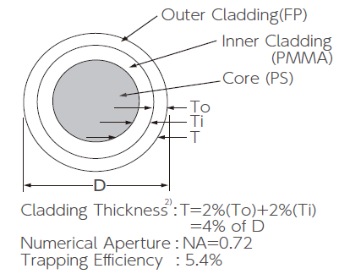
CERN-BI Beam Monitors
Scintillating fibres, square section, double cladding, 1mm
Light detected with SiPM, one per fibre
1 or 2 planes of fibres, 192 fibres per plane, 192x192 mm area==beam
3 planes for momentum measurement , 2x2 planes for tracking ➔ 7 planes in total
Prototypes tested in beam line, readout with
CITIROC: an analogue front-end ASIC made by Omega Microelectronics (CNRS-IN2P3-Ecole Polytechnique)
[I. Ortega et al, proceedings to be published]
Different ASIC under test for ToF application: STiC [JINST 9, C02003 (2014) ]
Example ofassembly

Slide 7
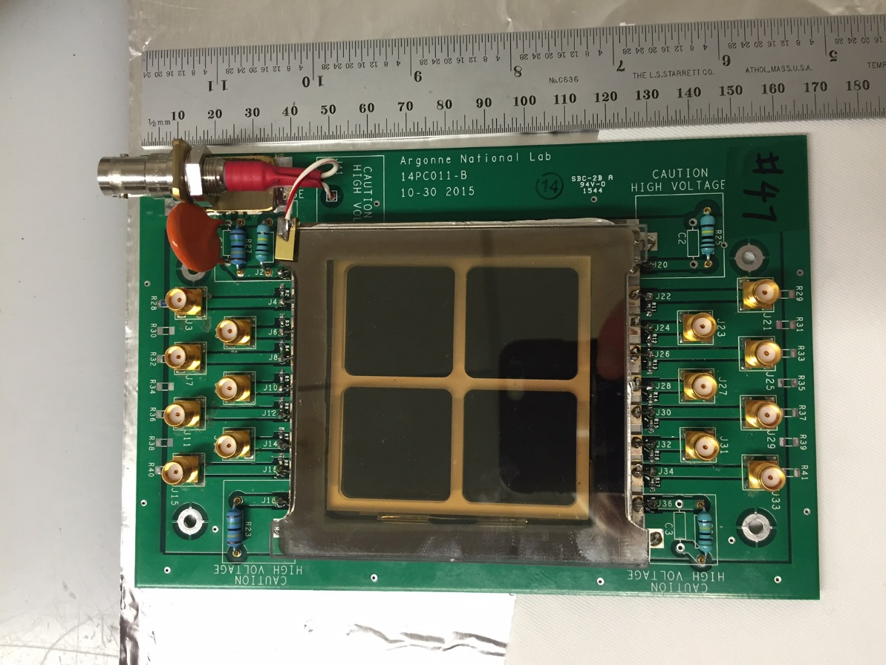
FNAl pLAPPD ToF
Plan to use two 6 cm x 6 cm MicroChannelPlate-based prototype Large Area Picosecond Photodetectors (pLAPPDs) from Argonne National Lab
Split pulses, one stream to protoDUNE DAQ, the other copy going into a PID trigger board.
The PID trigger board will look for coincidences between the two ToF detectors, do some fast analysis to measure a ToF (beam momentum is programmed into the board), and based on that provide “is consistent with a proton”, “is consistent with a kaon” .. Signals
pLAPPD data readout is managed by PD, not by CERN BI

Slide 8
Interfaces
The instrumentation will be used by the CERN BI and EA (Experimental Areas) groups to commission, steer and monitor the beam
BI/EA need data acquisition and trigger independently from PD
Front-end readout is responsibility of the BI group and is separate, also physically, from PD readout
➔ BI will provide NIM signals to PD i.e. for trigger
Regarding access to data, for reliability reasons the Technical Network (TN) used by BI is not accessible from the General Network (GN).
→ BI will publish data on a public location where it can be retrieved by PD
Data will be merged in offline prompt processing
Note instead that the pLAPPDs data could be directly read out into the PD DAQ

Slide 9
Timing
Synchronization will be ensured by time stamping of data with the White Rabbit (WR) system [J. Serrano, ICALEPCS2009, http://www.ohwr.org/projects/white-rabbit]
WR timestamps have a precision of +/-700 ps
A common GPS signal will come from a WR master switch in the CCR (Cern Control Room), same GPS as for LHC
The signal will be propagated to slave WR nodes, one for BI and one for PD.
This will provide a 10 MHz clock and a 1 PPS output to both systems.
PD will derive its primary 50 MHz clock from this 10 MHz
Front-end digitizers of each BI and PD detector will time-stamp their buffer recording, corresponding to the time of the received trigger, with their internal clock, which is freestreaming
Synchronisation is then ensured by time-stamping of trigger signals distributed to these detectors with WR
Time stamping of the trigger signals is performed using FMC TDC mezzanines plugged onto a VME64x or PCIe WR-enabled carrier.

Slide 10
Trigger
The primary trigger will come from the BI as a coincidence of beam scintillators or fibre trackers.
In both cases, fast signals (<100 ns)
BI will deliver this trigger as NIM signal to PD trigger box
The present BI plan is to locate two VME crates (one for H2 and one for H4) in HNA394, that is at the border between old North Area and Extension. A barrack 30-40 meters further downstream could also be considered in order to gain 100 ns on the NIM trigger from BI.
In any case, delivery of trigger signal will be within few hundreds of nanoseconds
Reminder: requirement is beam rate < 100 Hz

Slide 11
Trigger-II
Other logical signals will also be delivered to allow for PD trigger logic :
  Cherenkov “ above threshold “ (2 signals)
  Good event in all monitors (max 5, orthogonal planes will be in AND): NIM or TTL or LVDS
pLAPPD ToF ( max 3 signals )
In total, the beam instrumentation needs max 11 inputs in the PD trigger box
Warning Extraction (WE) and End of Extraction (EE) will be provided on a Lemo00 patch panel in PD

Slide 12
BI data volume
Expected data volumes (excluding headers):
  7 fibres planes , 200 fibres each , one bit per fibre➔ 1400 bits
  1 sci-fi ToF (3 words, TDC +2 ADCs)
  2 Cherenkovs (2 words)
  For a total of about 200 Bytes +headers/event
  To be added: pLAPPD ToF: waveform readout, 16 ADC samples + 1 TDC per channel, few channels per event → 200 values in 400 Bytes/events
  For a total of about 600 Bytes +headers /event
60 kB /s at 100 Hz trigger rate

Slide 13
Data merging
BI data fragments will be published at the end of each SPS cycle. Duration of the cycle is of the order of 40s. Each cycle can contain from zero to a few spills to NP04
  PD DAQ will need a nearline merger
  PD data will be written on local storage, and merged with BI data in the first, prompt, offline processing
  BI data will be converted to standard artDAQ format
  Complete PD+BI event will be sent to offline storage
BI data will be aggregated to PD data based on GPS timestamps

Slide 14
Data - interface
BI data will be published on the CERN DIP and DIM Servers https://wikis.web.cern.ch/wikis/display/EN/DIP+and+DIM immediately after the end of extraction
DIP name servers are operated as a critical service, aiming for 100% availability through server redundancy.
An API (Application Programming Interface) is available to publish and receive information.
BI data will be also published to the CERN Accelerator Logging Service database (CERN-ATS-2009- 099, https://wikis.cern.ch/display/CALS/CERN+Accelerator+Logging+Service) for medium and long-term storge

Slide 15
Component testing
Cherenkovs: in use since decades
Scintillating fibres monitors
  Prototypes of the fibers monitors have been already tested
  Event-by-event readout under development
WhiteRabbit
  Modules commercially available
  Widely used and tested (cite)
Prototype of the full BI DAQ expected to be ready before summer 2017
BI will be ready to be used with the PD trigger box in summer 2017
pLAPPD DAQ under development.

Slide 16
Risks
Trigger signals will be delivered on standard cables with <1µs latency . No risk is foreseen on this item
Merging of BI data fragment with PD may fail if PD nearline/prompt processing cannot sustain the delay due to end-of-cycle BI buffering.
  BI data are always logged on the CERN logging system. Offline retrieval of information is painful but possible
The low event rate render the effect of jitters in time-stamping negligible

Slide 17
Conclusion
The interface of Beam Instrumentation to PD DAQ has been defined
Beam Instrumentation will provide a main trigger and auxiliary logic signals as NIM to PD trigger box with 100s ns latency
Beam Instrumentation and PD will be synchronized through WhiteRabbit and a common GPS signal
Data fragments from BI will be published and acquired at the end of each beam spill
BI data converted to artDAQ format and merged to PD data
pLAPPD DAQ and trigger under development
A prototype of BI DAQ will be available for testing by summer 2017

