Slide 1
DAQ Architecture
Giovanna Lehmann Miotto
DAQ Design Review
3 Nov 2016

Slide 2
Introduction
From DUNE DAQ to ProtoDUNE DAQ
External interfaces and constraints
DAQ logical architecture
Main DAQ components and their interaction
Risks & timescales
Summary

Slide 3
DUNE Trigger and DAQ Requirements
Very high up-time (>99%)
Collect beam+atmospheric neutrinos as well as proton decay candidates (E_{tot}>100 MeV) with high resolution and no dead-time
Collect interactions with E_{tot}<100 MeV with a limited zero-suppression loss
Be able to trigger on beam pulses irrespective of the deposited energy
Collect data with the most favorable zero-suppression possible over >10 s periods (supernova trigger)
+ all DAQ ancillaries (event building, calibration, control, …)
Difficult to satisfy so varied requirements!

Slide 4
Main Trigger & DAQ Features
The DUNE DAQ is designed combining ideas of
Continuous readout systems
Triggered systems
No dead time achieved by streaming the data summaries into a trigger farm and keeping raw data in ring buffers on readout system during decision making
HE events:
trigger request sent to readout system and data fully readout, built, processed, stored
LE events:
Trigger stream of hits are useful for SNB analysis and will be buffered/stored as long as possible (ring buffer of disk files)
When a SNB is noticed in the trigger farm, it directs to also extract data from ring buffers

Slide 5
Sketch of the DUNE DAQ
Off detector readout systems
Trigger Farm
Data summaries
Detectors’ Electronics
Ring Buffer
Data Processing
Farm

Slide 6
Sketch of the DUNE DAQ
Off detector readout systems
Trigger Farm
Data summaries
Detectors’ Electronics
Ring Buffer
Data Processing
Farm

Slide 7
Sketch of the DUNE DAQ
Off detector readout systems
Trigger Farm
Data summaries
Detectors’ Electronics
Ring Buffer
Data Processing
Farm

Slide 8
Sketch of the DUNE DAQ
Off detector readout systems
Trigger Farm
Data summaries
Detectors’ Electronics
Ring Buffer
Data Processing
Farm
Zero suppression and compression occurring at different stages of the DAQ, depending on trigger type.

Slide 9
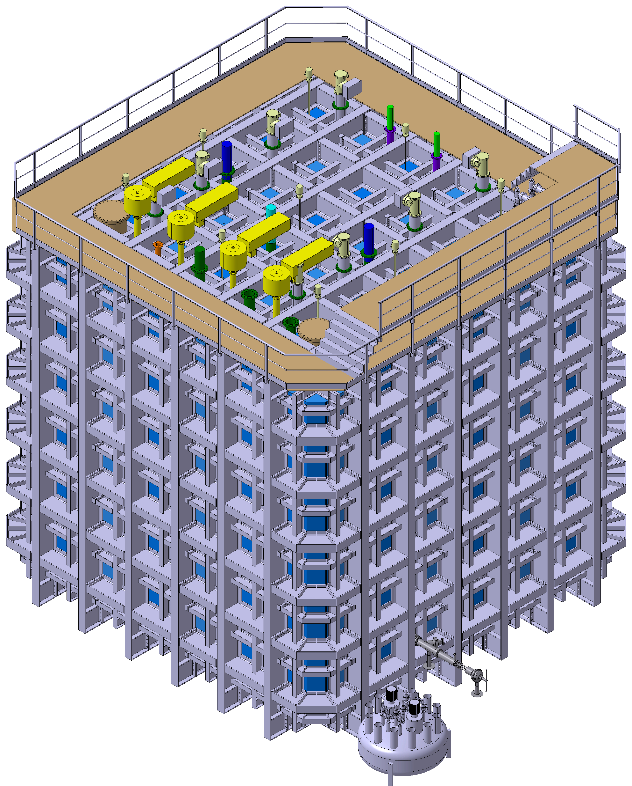
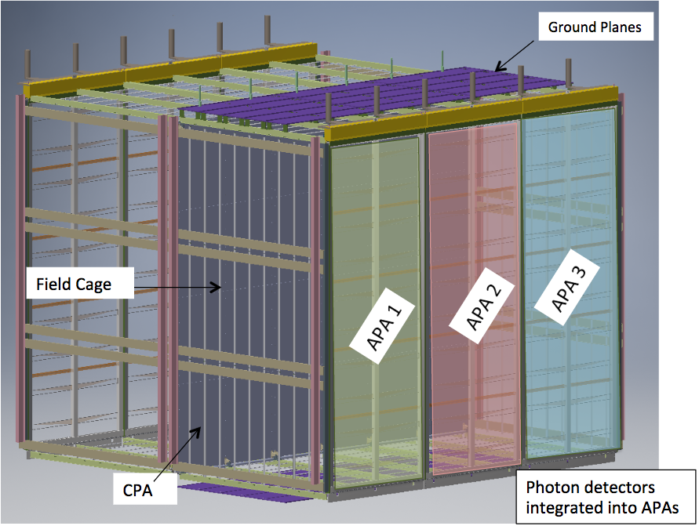
From DUNE to ProtoDUNE SP
Smaller
0.77 kt vs 10 kt LAr per DUNE module; only 1 module
Less components but each component is full-scale pre-production module; only 6 APA
On surface
Higher flux of cosmic ray particles
On SPS beam line
charged particles 0.5 – 7 Gev/c
The rate and volume of data produced by these detectors will be substantial (O(Tb/s))

Slide 10
The ProtoDUNE DAQ Environment
6 Anode Plane Assemblies (APA)
TPC ~ 430 Gb/s (15kCh @ 2 MHz)
Photon Detectors ~ 1 Gb/s (288 SiPM, headers only)
Beam instrumentation (BI) & Cosmic Rays Tagger (CRT) detectors
Negligible throughput
SPS super cycle structure: 2 x 4.8 s bursts in 48 s
Full readout -> ~85 Gb/s
Too much for DAQ as well as for storage!
Introduction of a simple trigger to mitigate data flow
Retain full readout off detector
Use of lossless data reduction techniques

Slide 11
From DUNE to ProtoDUNE DAQ
Off detector readout systems
✗
✗
Data summaries
TPC
✗
Ring Buffer
Trigger Farm
Off detector readout system
Photon Detectors
Data summaries
Data Processing
Farm
Trigger
Beam Instrumentation, cosmic μtagger

Slide 12
The 35 t prototype DAQ
HERE SLIDE FROM GILES

Slide 13
Scope of the ProtoDUNE DAQ
Provide service to the detector/electronics validation
Take and store data safely and efficiently
Reuse existing components, experience, …
Evaluate DAQ solutions and technologies that may be suitable for DUNE
TPC readout system
Data storage
Dataflow software (hardware fully COTs servers + switches)
Control and monitoring software

Slide 14
Interfaces
TPC (WiB)
SPS
Spill Signal
Timing + Trg out
Photon Detectors (SSP)
Data
DAQ
Beam Instrumentation
Trg In
Trg In
Data files + metadata
CRT
Offline Computing

Slide 15
Constraints
Decoupling
The DAQ needs to ensure a proper decoupling between the “online” and the “offline” worlds
Sufficient storage space for raw data files on the DAQ side should be available to store up to 3 days worth of data taking.
Grounding
Try to keep all DAQ equipment on building ground
Any link connecting the detector must be isolated -> optical
Direct impact on readout, timing, trigger

Slide 16
Grounding Isolation
Detector
Building
Other DAQ equipment
Ethernet switch
Beam Instrumentation
SSP
Trigger Board
Timing
CRT
WIB

Slide 17
The ProtoDUNE DAQ
Off detector readout systems
Ring Buffer
Event size ~ 60 MB (5ms window, x4 compression)
TPC
Data Compression
24 Gb/s
430 Gb/s
Event Building
Farm
Off detector readout system
Photon Detectors
Summary Info
Temporary Storage
25 Hz in burst
Trg+Timing
DB
20 Gb/s
EOS
Beam Instrumentation, cosmic ray tagger

Slide 18
ProtoDUNE Software
Dataflow software is based on artDAQ developed at FNAL
Customizable “Board Reader” application
Event building
Dispatching to monitoring apps
Aggregation
Storage
Control, operational monitoring, graphical UIs
Joint COntrols Project (JCOP) toolkit developed originally for LHC experiments
Uniform interface also for detector control and safety systems
Software approach
Minimize the risks by relying on existing frameworks
Focus effort only on experiment specific needs

Slide 19
Readout of External Systems
PDS
On detector electronics already does data reduction and sends data over TCP/IP (-> DAQ starts at Board Reader)
TPC (point-to-point optical links from WiB)
2 solutions being implemented
Baseline: ATCA platform from SLAC
Prototype alternative: ATLAS FELIX + network connected PCs
5 APAs will be readout via ATCA boards (12800 ch), 1 APA (2560 ch) via FELIXs
2 firmware variants in electronics (WiB)
API for transparently treating data at software level
Provision to read out all system with ATCA
From a software point of view the interface towards the event builder is the Board Reader application for all readout systems

Slide 20
ProtoDUNE Data Flow
Trg/Timing
1
Board Reader
Board Reader
Board Reader
3
10 Gbps Ethernet
(Brocade ICX7750)
4
DataFlow Orchestrator
2
Event Builder
Event Builder
Aggregator/Storage
5

Slide 21
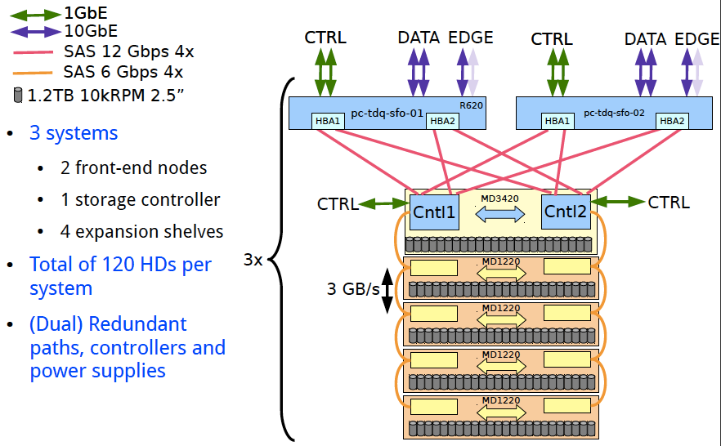
DAQ Temporary Storage
I/O requirements similar to ATLAS/CMS now
Hardware solution similar to ATLAS data loggers (modular!)
Transfer to EOS using F-FTS and XRootD
Courtesy W. Vandelli, CERN

Slide 22
ProtoDUNE Trigger Throttling
Trg/Timing
Readout full/free
-> BUSY/NBUSY
Due to the low trigger rates and the “continuous” readout mode of on-detector electronics, software throttling seems sufficient
-> hardware throttling still possible as an option
Board Reader
Board Reader
Board Reader
DFO full/free
-> BUSY/NBUSY
DataFlow Orchestrator
No storage space or slowed down disk writing
-> EB cannot clear events
EB cannot get rid of events
-> DFO cannot assign new events
Event Builder
Event Builder
Aggregator/Storage

Slide 23
A Word on Partitioning
Partitioning = the mechanism by which multiple copies of the DAQ can run on a same installation
The DAQ has a few elements that cannot be split
(Virtual) duplication to allow for parallel running
Partitioning is normally extremely useful during commissioning & testing
Even if it wasn’t a requirement from the experiment point of view it is a requirement from the DAQ side
Proposal to be able to partition the system into vertical slices, i.e. by APA
Only one partition will make use of the central trigger board, while others will use random or constant rate triggers

Slide 24
ProtoDUNE Timeline
Nov‘16
Jun’17
Jul‘18
End’18 LS2
TDR
Test 1st APA
Data Taking
DAQ design review
Installation complete
Continue data taking and R&D
in 2019, possibly….
DAQ ~functional
DAQ complete

Slide 25
Risks
External Interfaces
Detailed specs (physical links, connectors, protocols, information content)
Continuous interaction between sub-system leaders AND detailed work sessions with sub-system specialists
Internal Interfaces
New timing system to be integrated with trigger and many endpoints
Detailed specs and regular meetings
Continuous integration testing!
Resources
We are confident that the people and institutions that committed to the DAQ will deliver on their components
Sufficient effort will be needed @CERN to ensure smooth integration, commissioning, tuning, operation

Slide 26
Summary
A complete design of the DAQ system exists
Interfaces
Components model, Interactions and data flow
All hardware components required for the DAQ identified
COTs servers, switches, interconnects (not a large system!), storage solution
ATCA based SLAC solution
FELIX PCIe cards
Timing units
Central Trigger board
Main risks have been identified at the external interfaces level
Mitigation through direct discussions at different levels
We are confident that the proposed DAQ design can be implemented on the timescales required by ProtoDUNE, that it satisfies the requirements that have been put forward by the experiment and that it has sufficient modularity to allow for flexibility, in case of additional performance needs.

