Slide 1
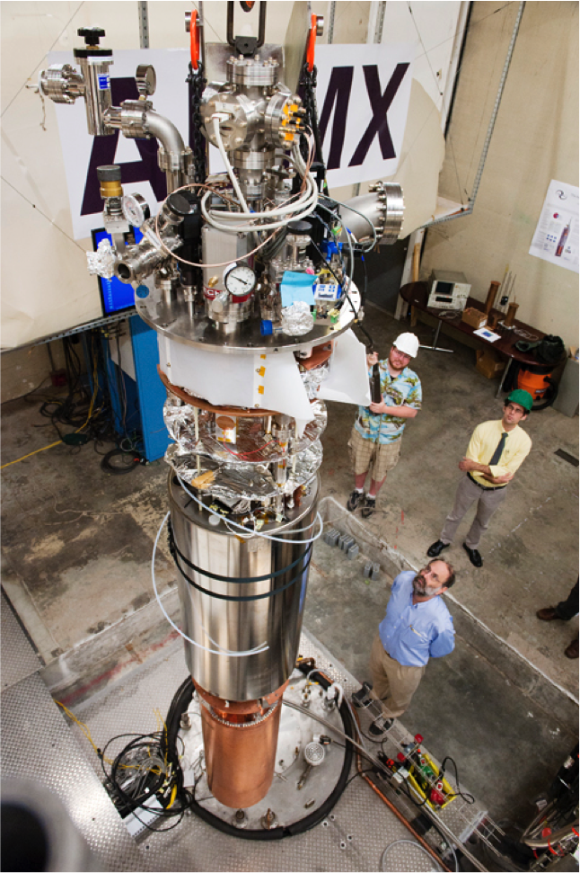
Fermilab Physics Advisory Committee Meeting
Nov 10th, 2016
ADMX Status & Plans
Gianpaolo Carosi
ADMX co-spokesperson
LLNL

Slide 2
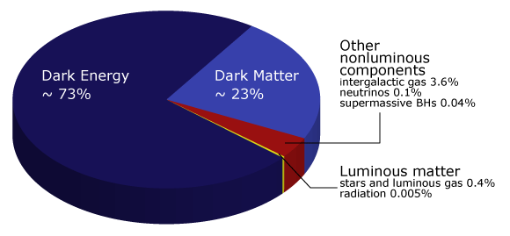
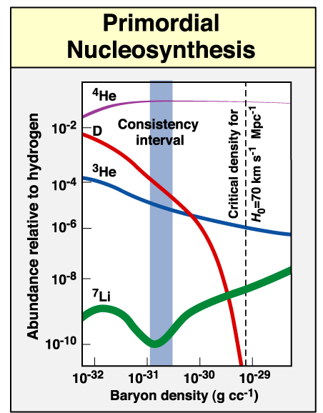
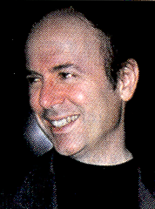
The Nature of Dark Matter
One of the premier unsolved mysteries in physics
Likely new particle outside standard model
Baryons essentially ruled out!
Neutrinos likely only small fraction.
I’m much more optimistic about the dark matter problem. Here we have the unusual situation that two good ideas exist…” Frank Wilczek referring to WIMPs and Axions!
Tremendous progress in the last 20 years on searches for both!
Recently DOE has made a major investment in three “Generation 2” direct dark-matter projects
LZ (Liquid Zenon WIMP search)
SuperCDMS-Snolab (Ge/Si WIMPS search)
ADMX (axion dark matter search)
The choice for ADMX was clear.
Only experiment to have reached plausible axion cold-dark matter parameter space.
Only experiment with the proper scale to quickly cover significant parameters space.
Best suited to discover the dark matter axion.
Our Hubble Volume
Individual galaxies
Galaxy collisions

Slide 3
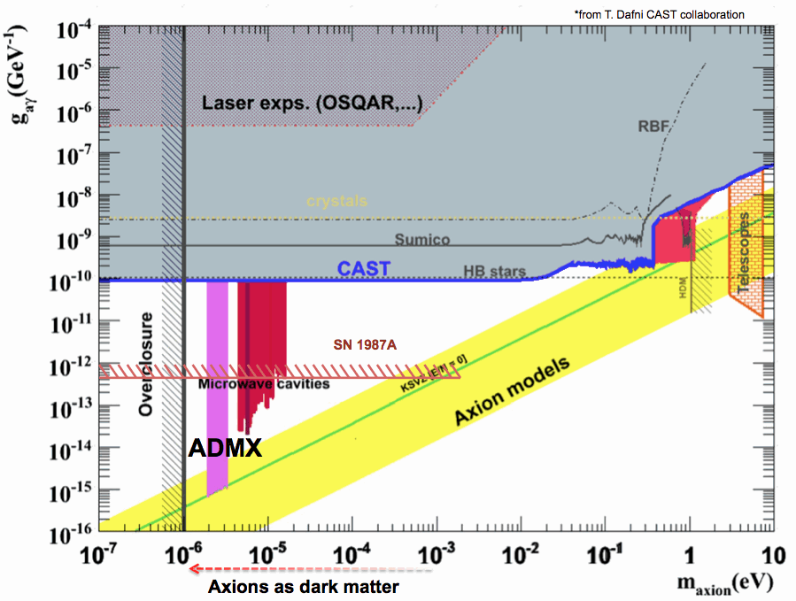
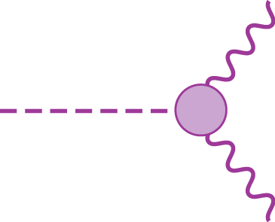
The axion and where to find it.
It’s a pseudoscalar (π°-like), extremely light and weakly coupled
2γ coupling (Primakoff effect) : Key to potential detection
g_{aγγ}
The axion remains a very attractive dark-matter candidate
(HEPAP, DMSAG, P5 …)

Slide 4












ADMX: Collaboration
Recently Joined
Sponsors
ADMX now DOE Gen 2 project
Primary support
Historical
R&D

Slide 5
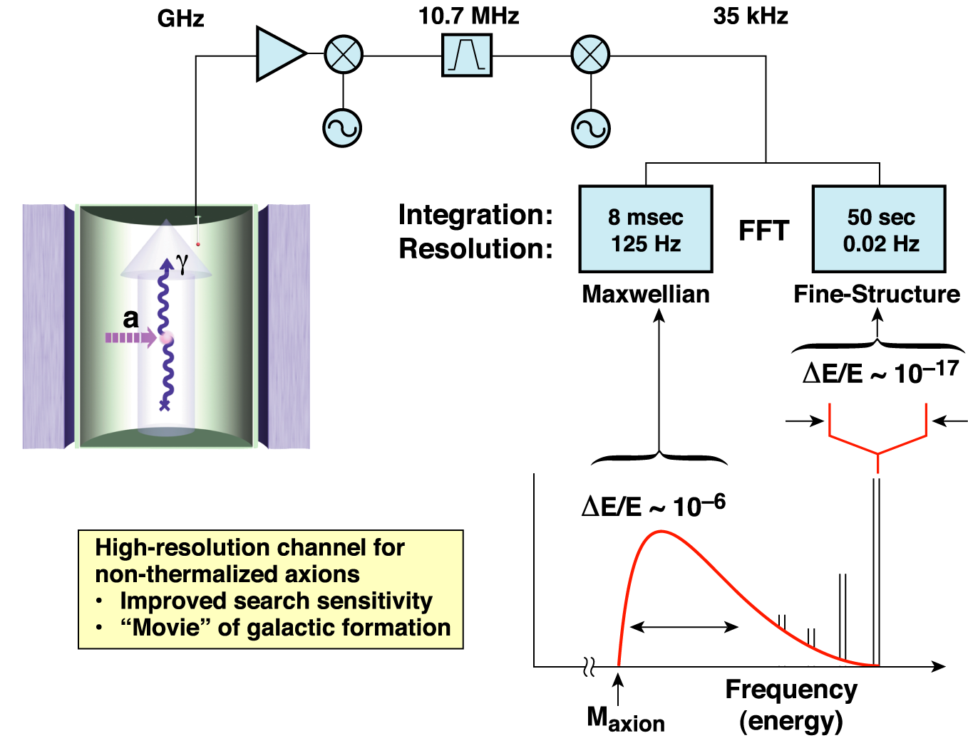
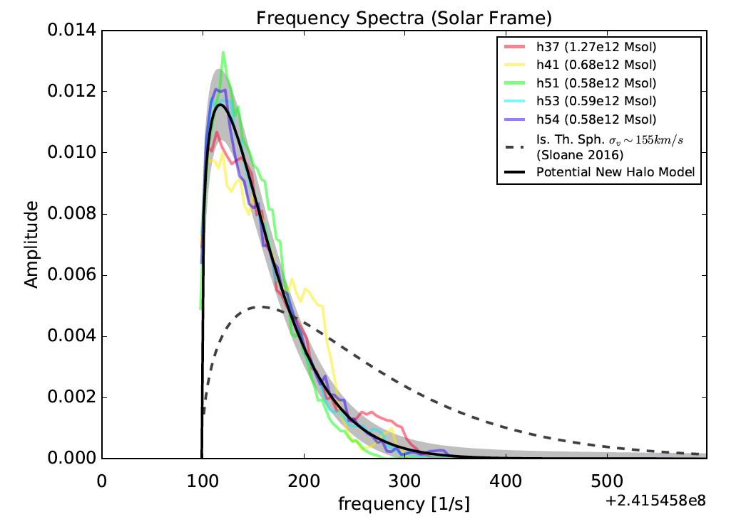
ADMX: Haloscope search technique
original concept from P. Sikivie
Local Milky Way density:
ρ_{halo} ~ 450 MeV/cm³
Thus for m_{a} ~ 10 μeV:
ρ_{halo} ~ 10¹⁴ cm^{–3}
ΔE/E ~ 10^{–22}
“High Resolution” channel
“Medium Resolution” channel
β _{virial} ~ 10^{–3} :
λ _{De Broglie} ~ 100 m
Δ β _{flow} ~ 10^{–11} :
λ _{Coherence} ~ 1000 km
N-body line shape (increase in SNR): Potential to greatly increase science reach

Slide 6
Tuning microwave cavity resonant mode
Antennas
Tuning Rod
Transmittance between Antennas
Cavity
1.5 GHz
Frequency

Slide 7
Tuning microwave cavity resonant mode
Antennas
Tuning Rod
Transmittance between Antennas
Cavity
1.5 GHz
1.6 GHz
Frequency

Slide 8
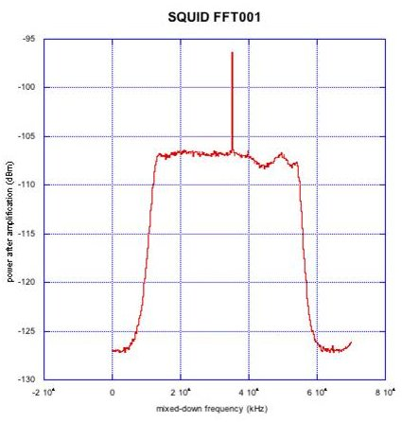
Example of injected tone (fake axion)
(Phase I with SQUID amplifiers)
Injected Power
x100-1000 axion power
Noise floor
Bandpass filter

Slide 9
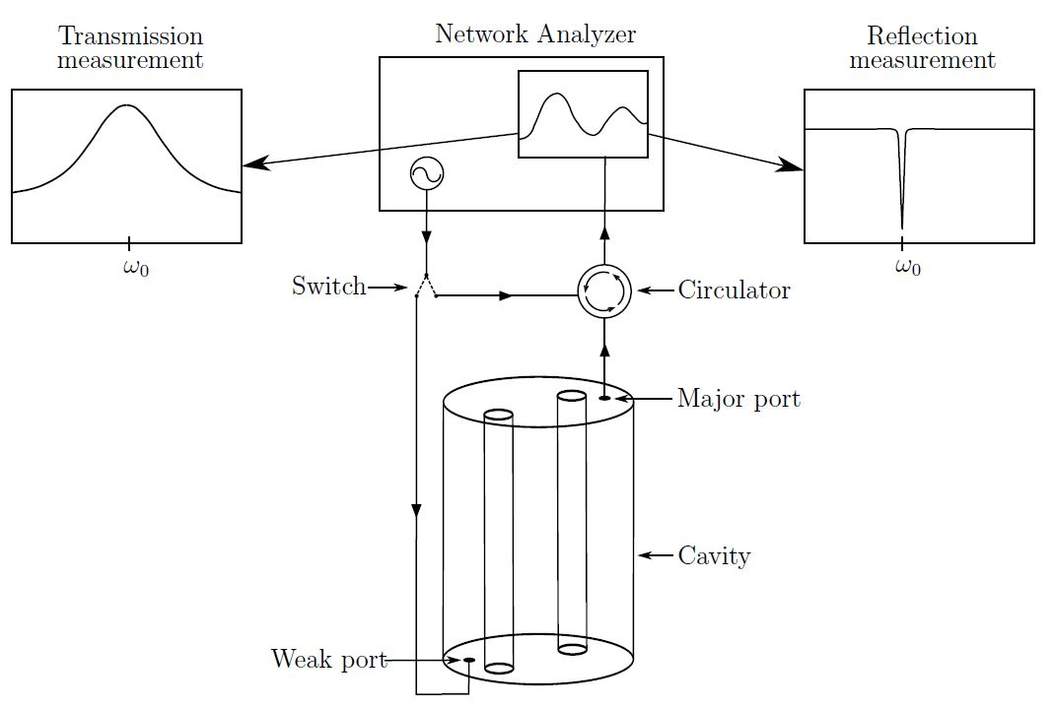
Typical Run Cadence
Start by injecting a broad, swept RF signal to record cavity response. Record state data (temperatures, hall sensors, pressures, etc)
Integrate for ~ 100 sec to 10s of minutes (final integration time dependent experimental parameters).
Every few days adjust the critical coupling of the antennas
Scan rate is determined by experimental parameters and the trade off in sensitivity vs frequency (mass) coverage
The scan rate uses a threshold sensitivity. Any candidate above threshold is flagged for further study.

Slide 10
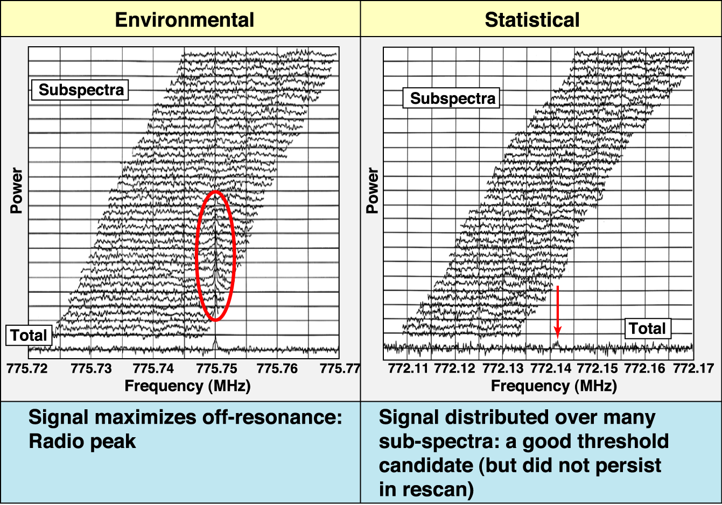
Sample data and flagged candidates
Notes:
10

Slide 11
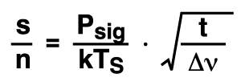
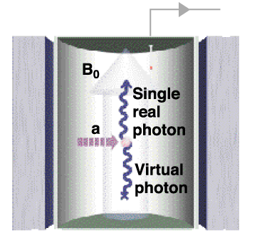
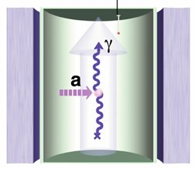
Radiometer equation dictates search strategy
But integration time ~ 100 sec
* Dicke, 1946
ADMX initially used pumped ⁴He for T = 1.5 K
T_{S} = T + T_{Amp} ~ 1.5 + 1.5 K
But T_{Quant} ~ 30 mK
Invested in lower T!
P_{sig} ~ ( B²V Q_{cav}C)( g² m_{a} ρ_{a} )
But magnet size, strength B²V ~ $
~ 10^{–23} Watts for ADMX

Slide 12
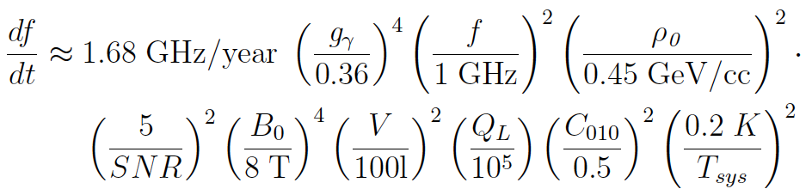
Scan rate
Rate determined from SNR
SNR is the Signal-to-Noise for detection (usually set to 5)
f is the frequency being searched (where 1 GHz ~ m_{a} = 4.1 µeV)
T_{sys} is the total system temperature (T_{sys} = T_{cavity} + T_{amps})
To scan at this sensitivity would take > 100 years with original ADMX (T_{sys} = 3 K)

Slide 13
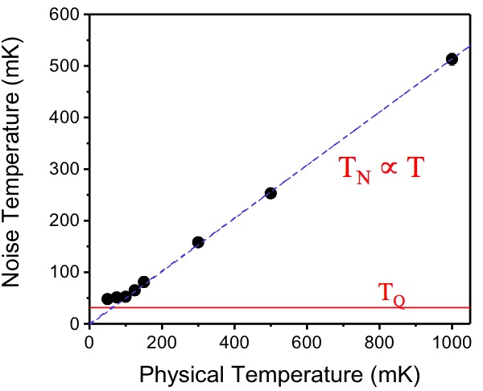
Quantum-limited SQUID-based amplification
SQUIDs have been measured with
T_{N} ~ 50 mK
Near quantum-limited noise
Enabling technology
> 2 K
HFET amplifiers
ADMX Phase 0
SQUID amplifiers

Slide 14
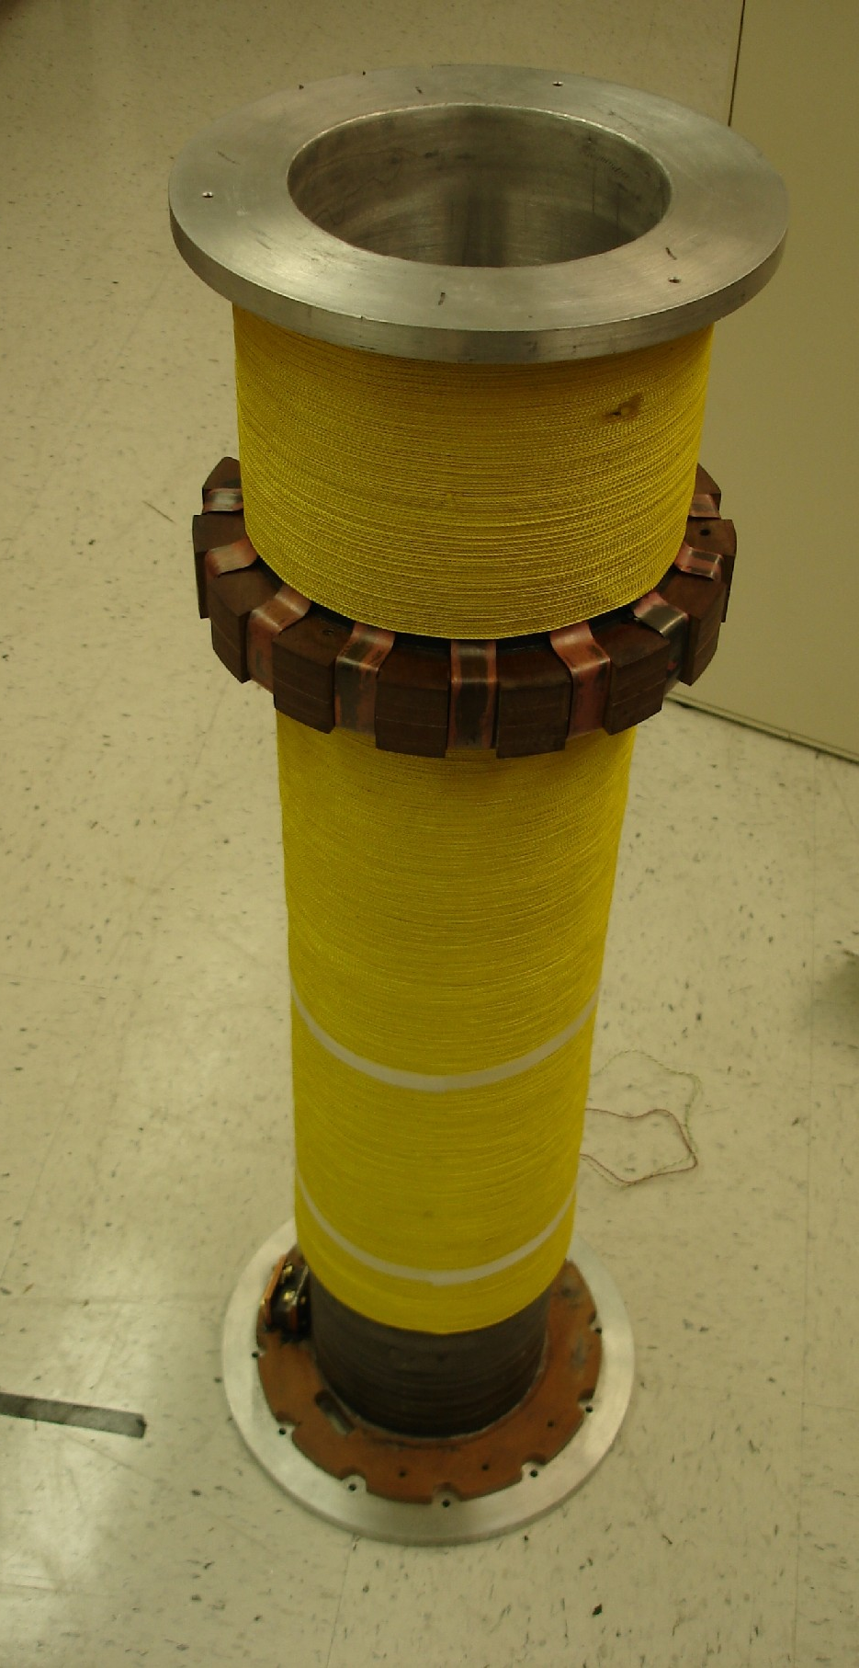
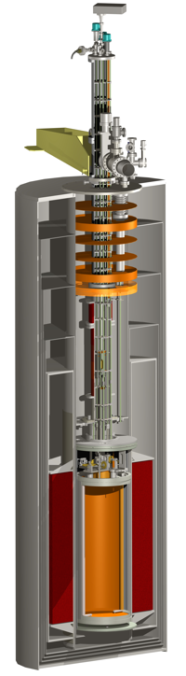
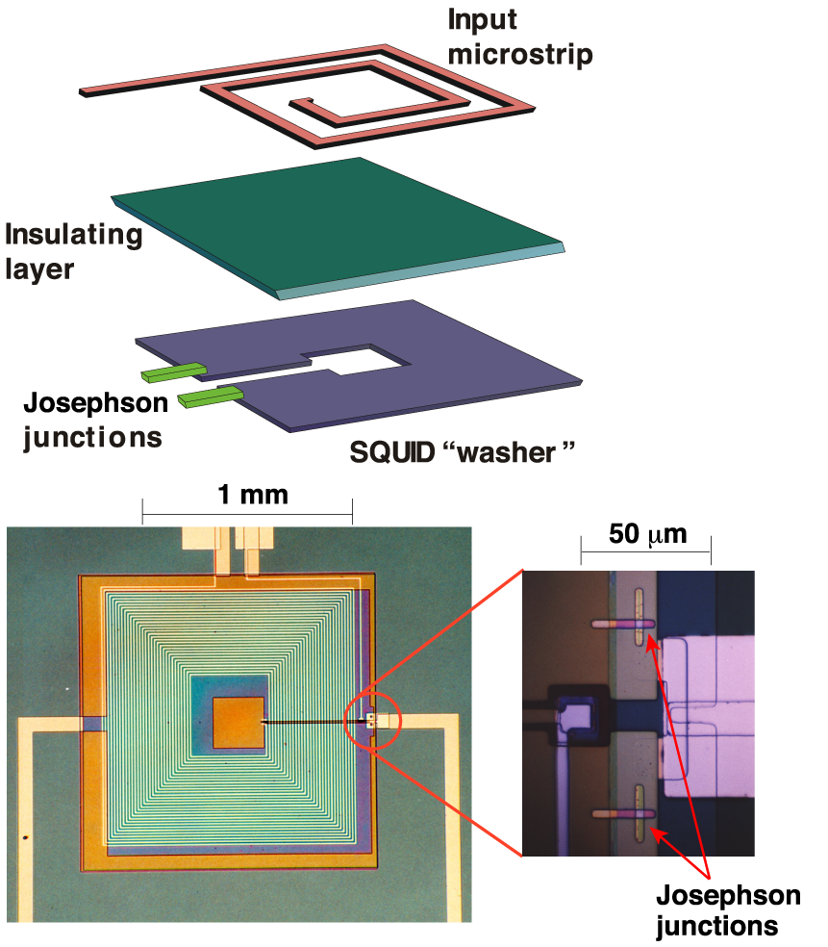
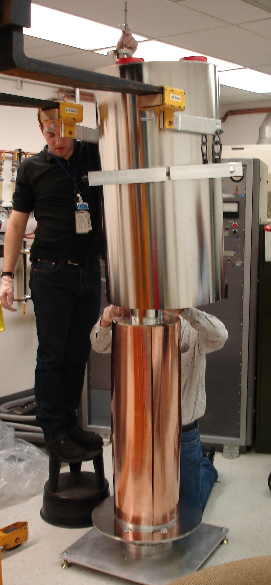
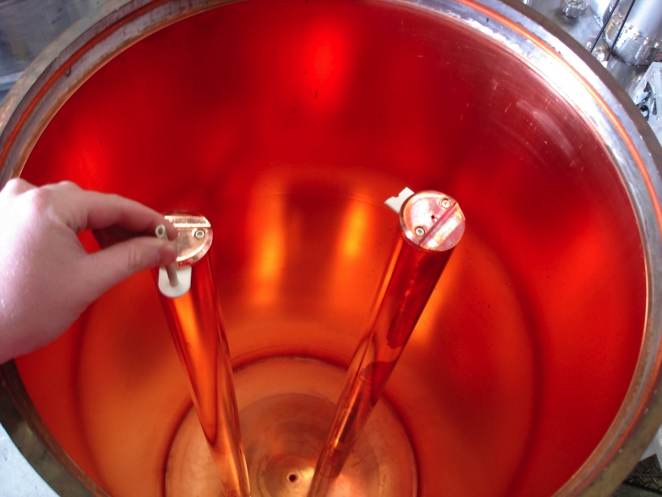
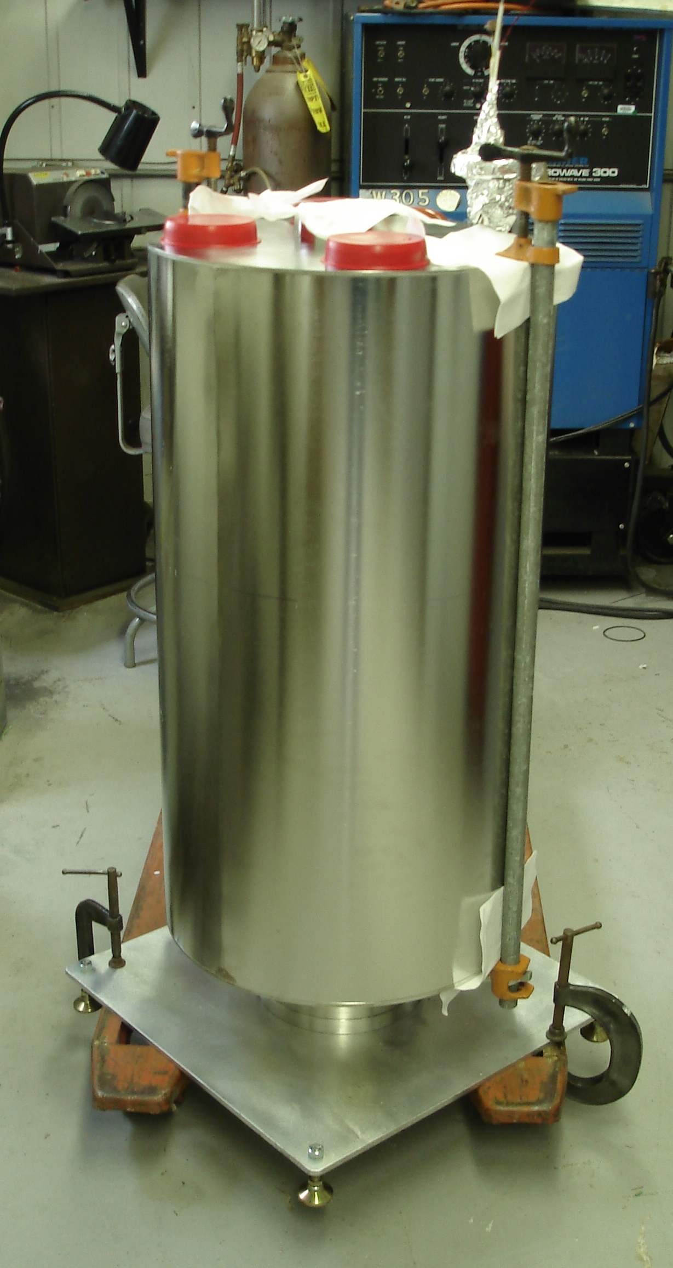
ADMX Experimental Apparatus
SQUID
amplifier
Field compensation
magnet for SQUIDs/JPAs
11’
8 Tesla Magnet
133 liter microwave cavity
(500 MHz - 1 GHz)

Slide 15
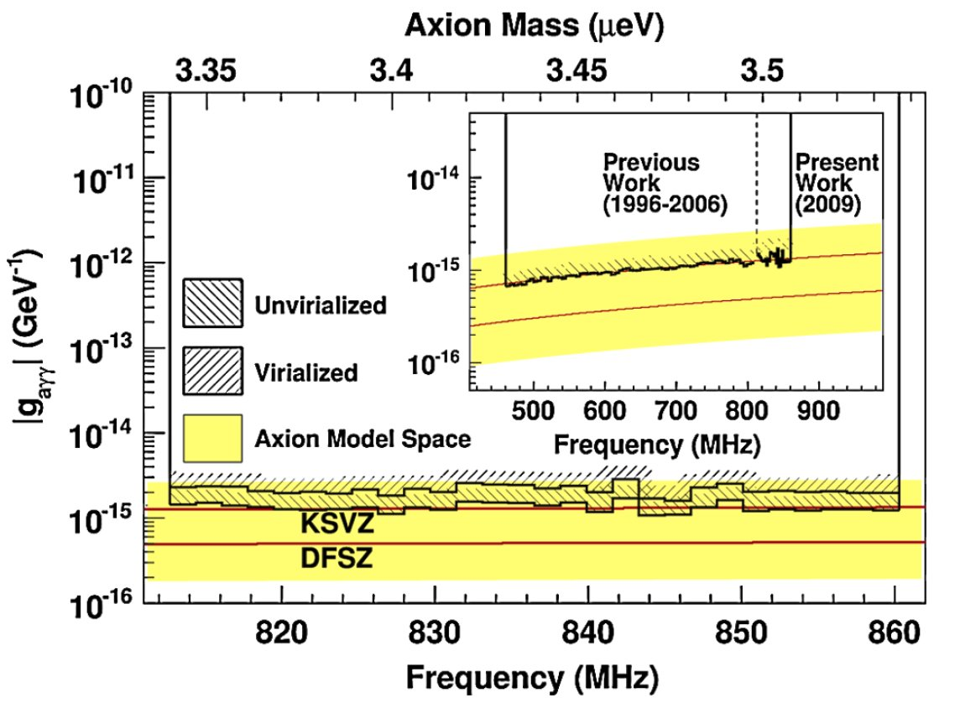
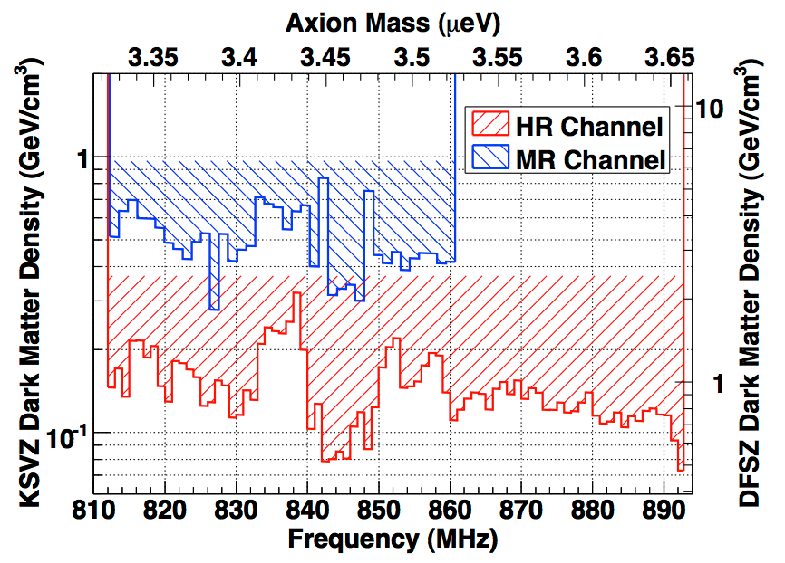
ADMX Phase I: 2008-2010 at LLNL
Successfully operated experiment with SQUID amp near 7 Tesla field and published results!
Medium Res. results
High Res. results
Covered 812 – 860 MHz = 48 MHz
Total Run Time: 19 months
Continuous Data Collecting: 8 months

Slide 16
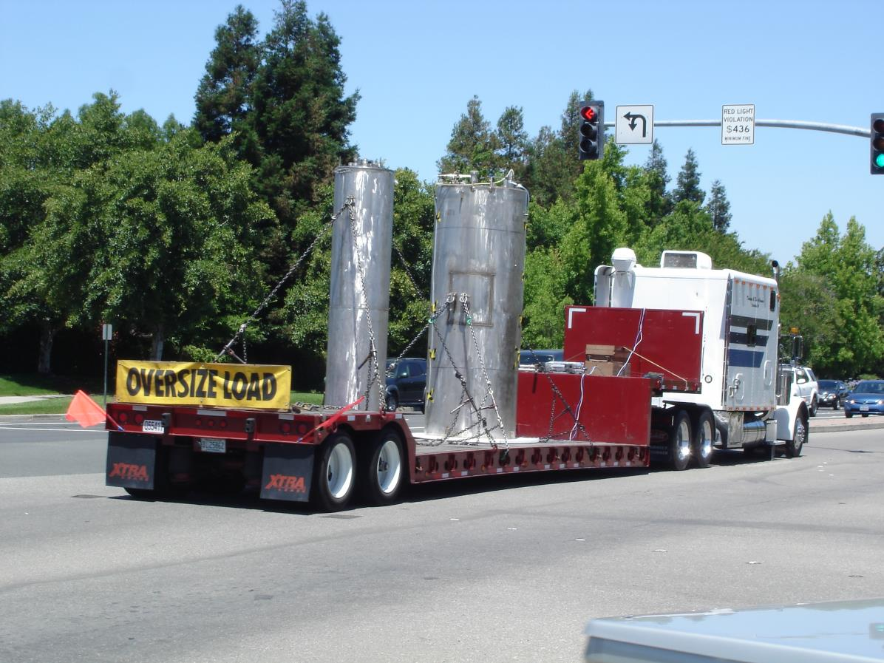
After Phase I ADMX from LLNL to U.W.

Slide 17
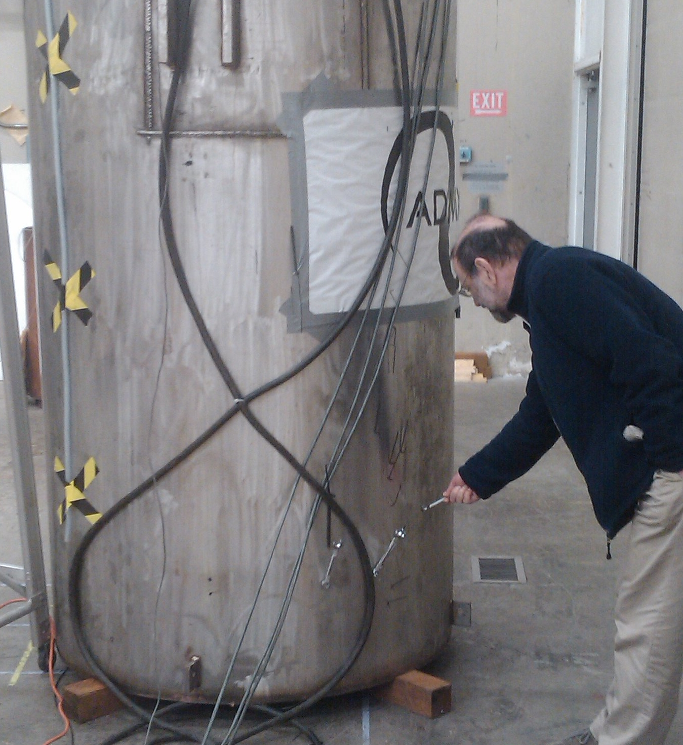
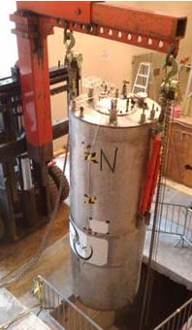
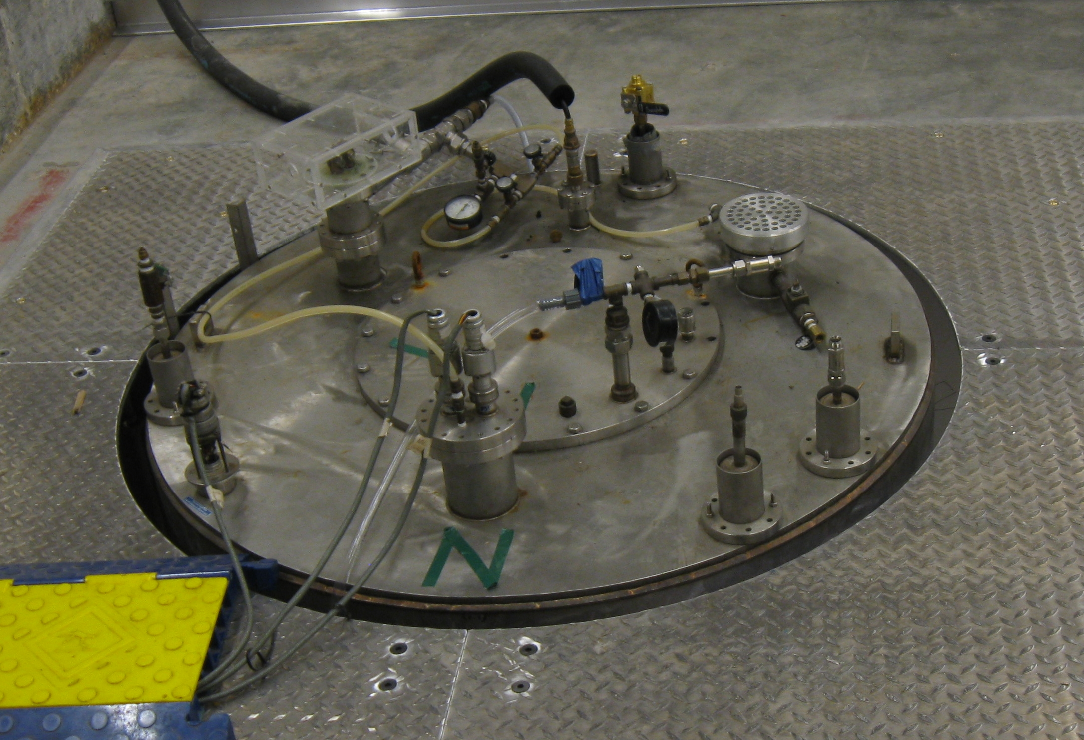
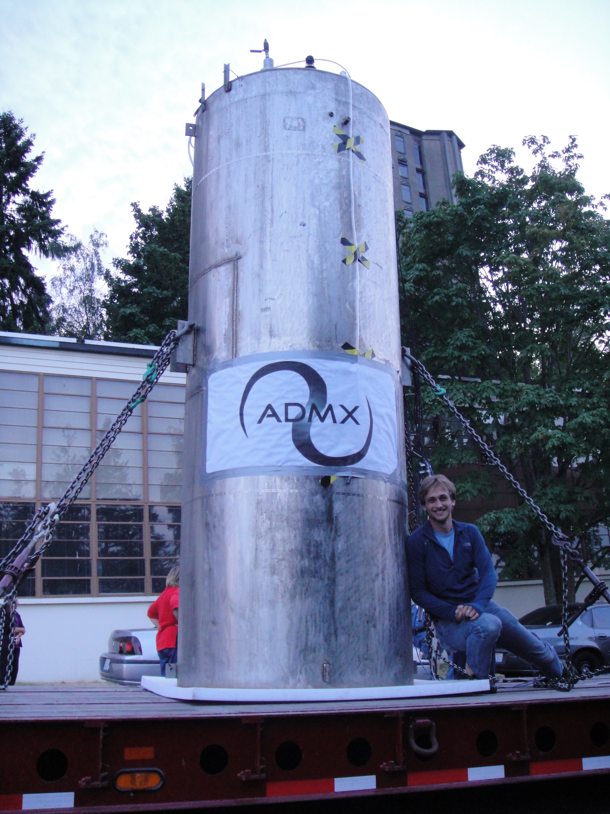
ADMX reinstalled at UW
17

Slide 18
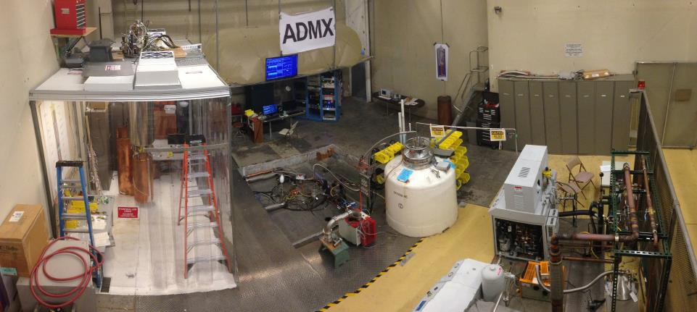
ADMX site infrastructure
Helium recovery bag
Clean room
Helium liquifier
ADMX

Slide 19
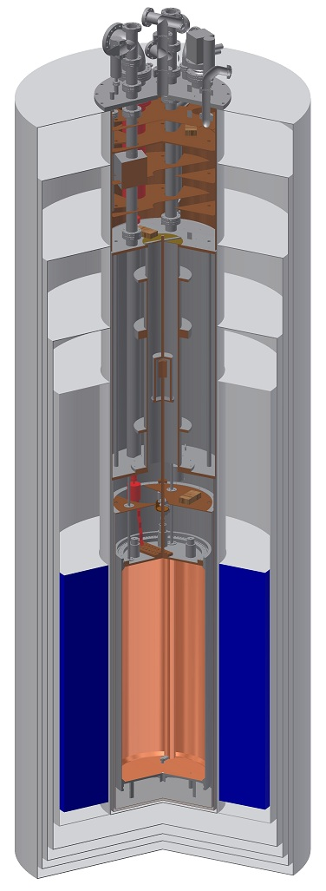
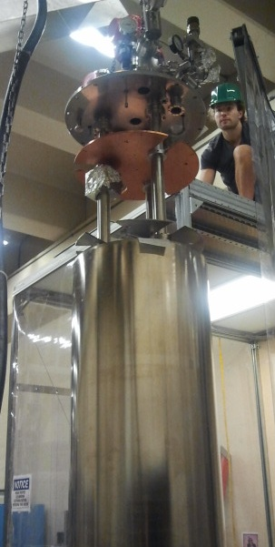
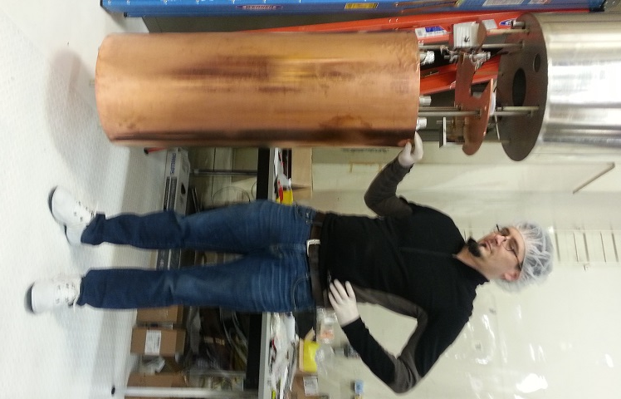
Completely redesigned insert for new phase

Slide 20
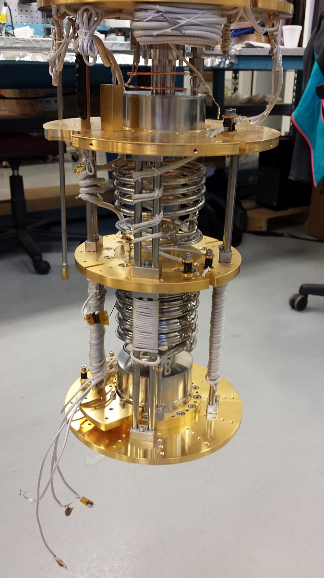
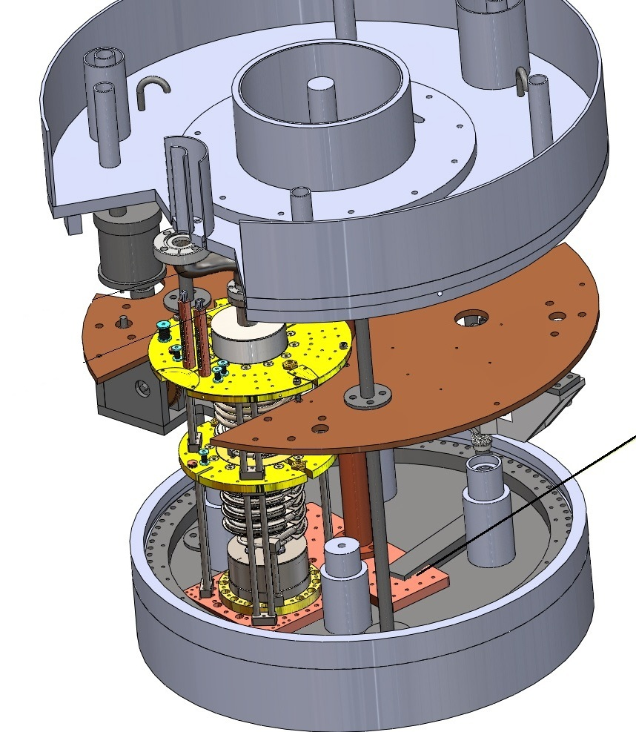
Designed to accept dilution refrigerator
LHe reservoir
1K pot
1K plate
Still
Cavity
top plate
Mixing chamber
ADMX
Dilution Fridge
at Janis
Notes:
Add another slide that shows the

Slide 21
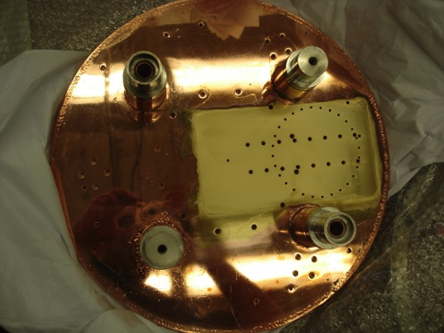
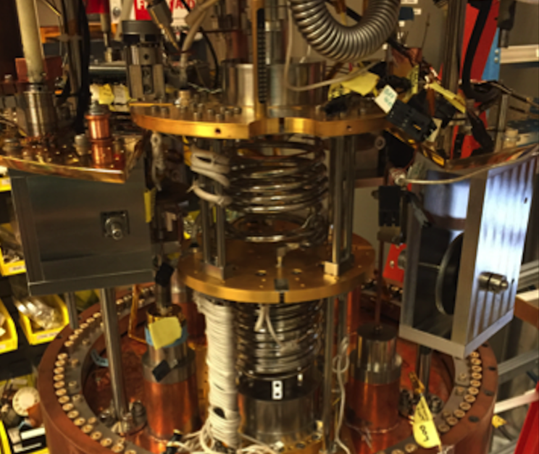
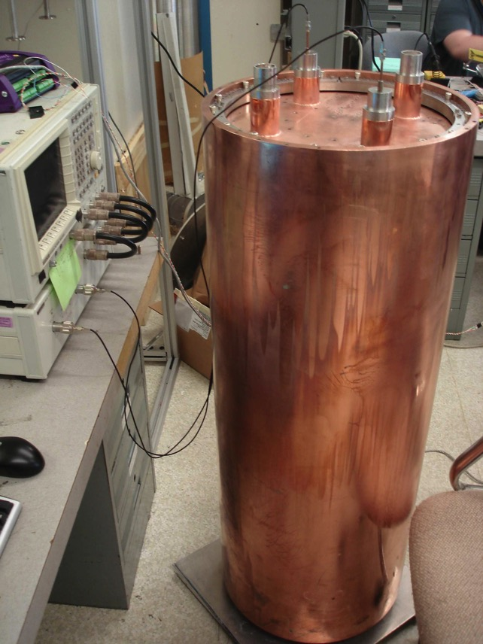
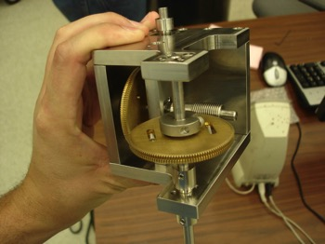
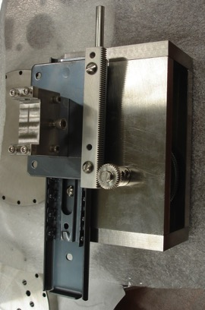
Currently installed Cavity & Motion Control
Dilution Fridge mounted directly to cavity top
Quality factor: ~ 70k at cryogenic temps
Rotary gearbox
1:19,600 gear reduction
Linear gearbox (coupling)

Slide 22
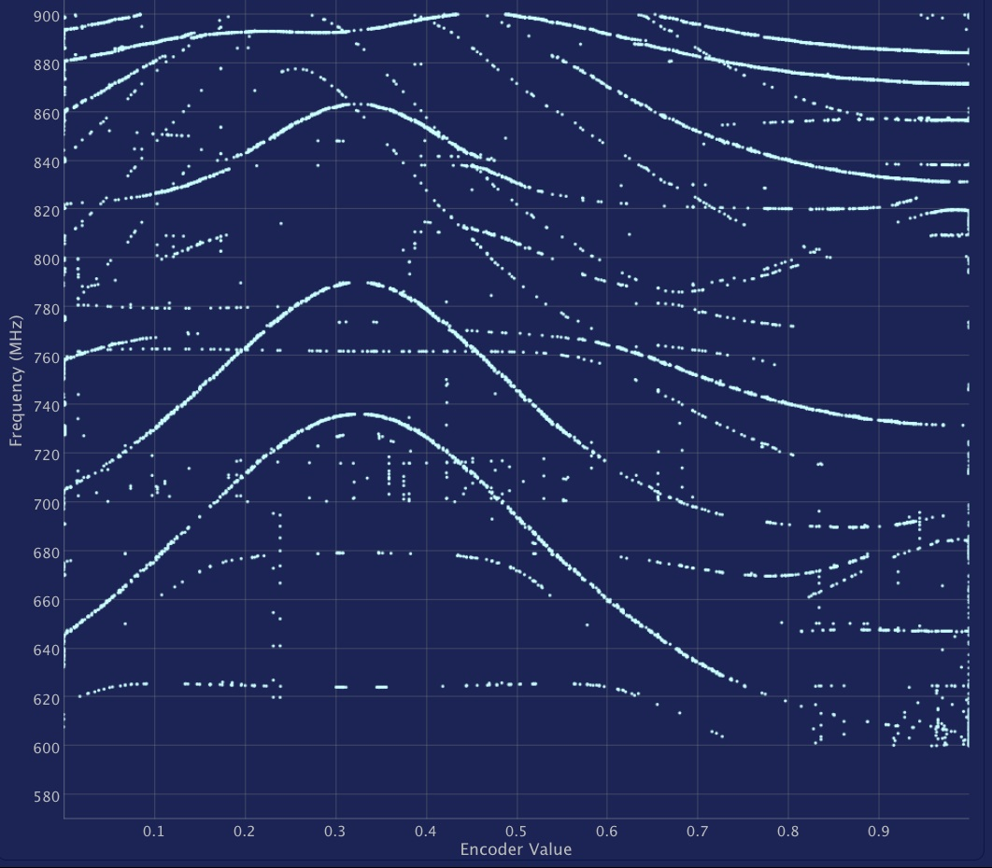
Mode map of cavity at UW (one rod at wall)
Most modes do not couple to the axion
TM₀₁₀ mode
strongest coupling to axions
Full Range (TM₀₁₀) 580 – 890 MHz (both tuning rods)
Notes:
What do we want to get out of this. Isolated mode. Our data… compares 200 MHz.

Slide 23
Hardware synthetic axion
Able to directly inject RF into the cavity’s weak port to mimic an axion signal
Useful for calibrating system & blind signal injection through analysis chain

Slide 24
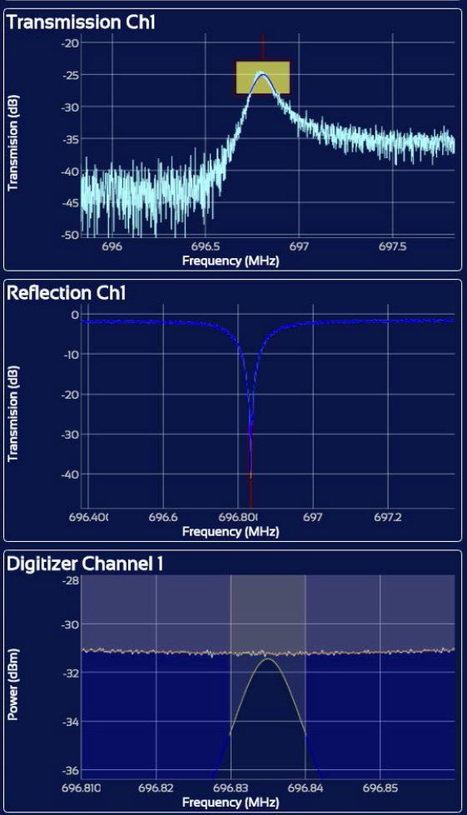
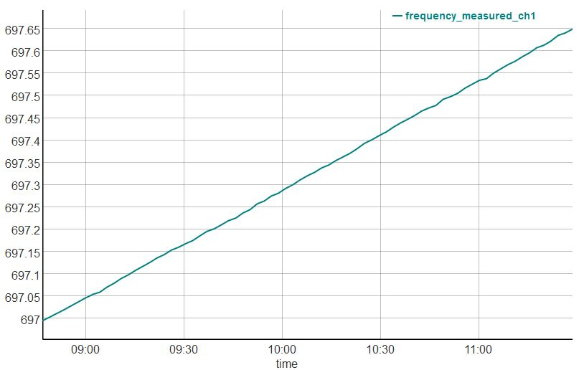
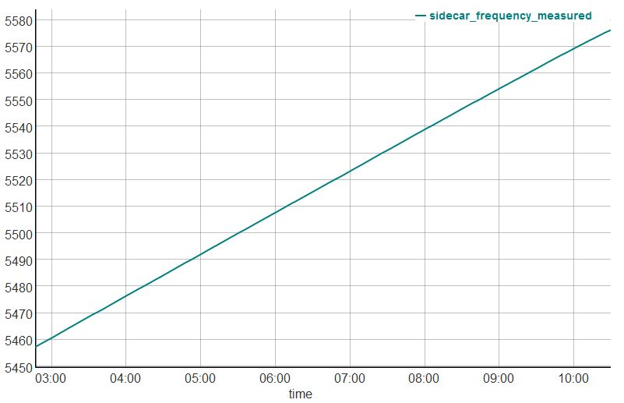
ADMX recent cold commissioning data
Data taken from Aug 9th-Oct 3rd, 2016
Dilution refrigerator reached stable operations @ < 200 mK
  Not at design temp yet (< 150 mK).
  Inadequate heat sinking of incoming gas mixture (new heat sinking has been installed)
Channel 1 operational (taking data with SQUID amp)
Channel 2 inoperable (under study)
Sidecar cavity operational and taking data
Ch1 frequency vs time
Sidecar frequency vs time
Ch1 DAQ

Slide 25
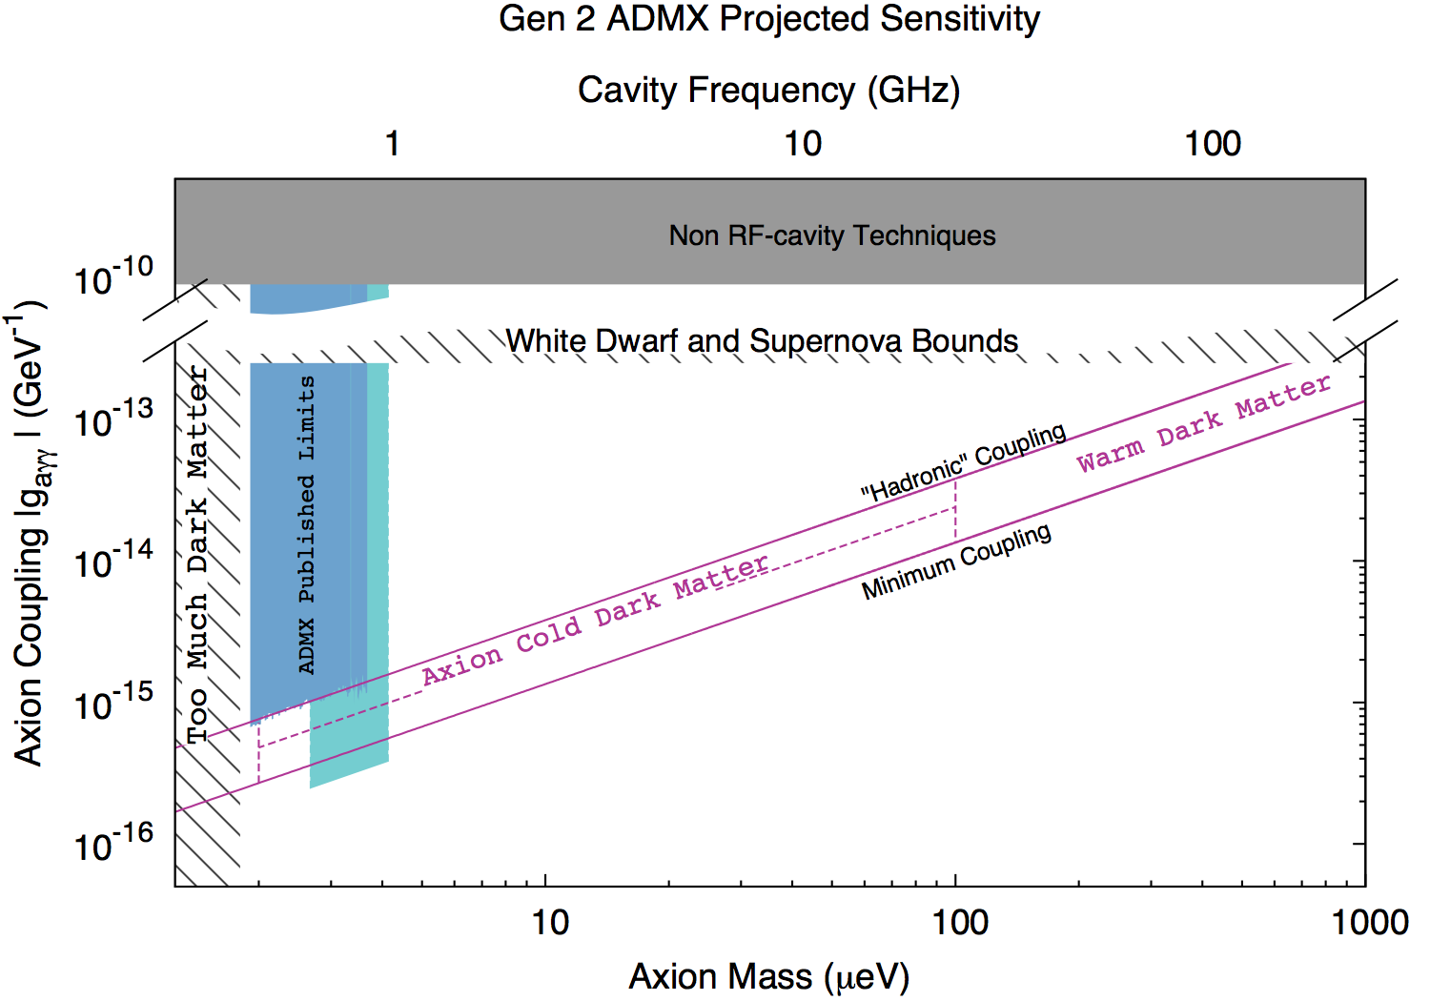
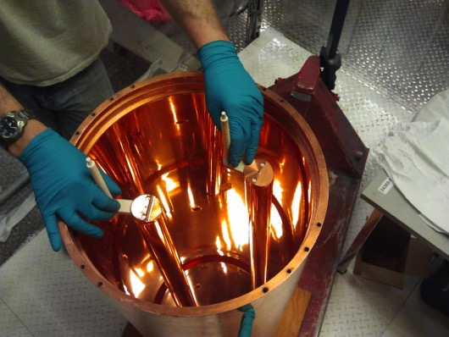
Anticipated sensitivity by Dec 2017
Notes:
Note… the previous data was over 10 years!!! HUGE increase

Slide 26
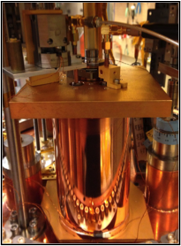
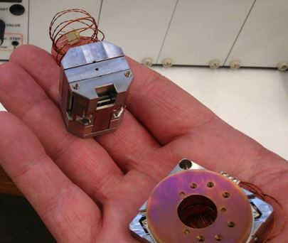
3rd instrumented channel: Sidecar cavity
Test new technologies in-situ and search in new frequency ranges (4-6 GHz) (piezoelectric motors, JPAs, etc)
Mounted directly above main cavity
Baseline for next set of multi-cavity arrays
Piezos replace large bulky gearboxes (2 wires)
Linear drive controls antenna depth
Rotary drive
controls tuning rod
Commercial linear & rotary piezoelectric drives (attocube)
Compatible with high B-field (>30 T), vacuum and cryogenic temperatures (10 mK)

Slide 27

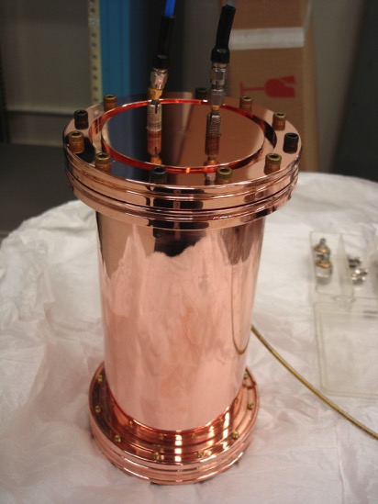
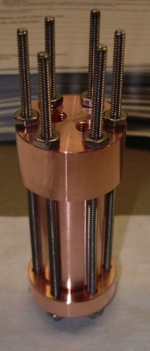
Challenge of higher frequency axion searches
Scaling single cavity to higher frequencies (f) – Volume ~ (f)⁻³ !
Quality factor also goes down as frequency increases (Q_{L} ~ 10⁵ · (f)^{-2/3})
Need to move to multi-cavity array’s.
Frequency ~ 540 MHz
Q_{L} – 100,000
Axion Mass ~ 2 μeV
Volume – 135 liters
Frequency ~ 2.4 GHz
Axion Mass ~ 9 μeV
Q_{L} – 60,000
Volume ~ 2.6 liters
Frequency ~ 10 GHz
Axion Mass ~ 36 μeV
Q_{L} – 25,000
Volume – 0.025 liters
1” diameter
16” diameter
5” diameter

Slide 28



1-2 GHz cavity baseline design (UF & LLNL)
Axion signal coherent over 100s of meters. Co-add cavities in phase before amplification
(N independent cavities → N amplifiers and noise adds in quadrature... only √N improvement)
4 – cavity array that is power combined
System based on previous ADMX Phase 0 work (low risk… demonstrated before)
Each cavity ~22 liters (88 liters total) with Q_{L}~ 60k
Wilkinson power dividers/combiners to co-add signals.
CAD drawings of 4-cavity array
Schematic of 4-cavity array
4-cavity array from Phase 0 for controls testing
Notes:
This is baselines.
We feel this is a simple, low risk system… Has been demonstrated before!

Slide 29




2 – 6 GHz frequency range (FNAL)
FNAL taken lead in designing 2-6 GHz cavity system
Design concept is multiple cavities locked together
Build off experience from 4-cavity array & Sidecar cavity
Splitting it into operational years as a 2-4 GHz and a 4-6 GHz system.
2-4 GHz ← conceptual design phase
Sidecar cavity system as baseline geometry
Hexagonally packed
7 cavity array x 2 layers = 14 cavities
Usable volume = 44 liters
4-6 GHz (under study)
35 mm radius, 168 mm long cavities,
19 cavity array x 3 layers = 57 cavities
Usable volume = 33 liters
7-cavity cutaway
19-cavity cutaway
Single cavity element simulation
Notes:
Will get an updated slide here!

Slide 30



Different concept for 6 – 10 GHz
Photonic Bandgap Cavities
Lattice of posts that can be translated/rotated as group to adjust frequency.
Trade off from multi-cavity array
  Maintain reasonably large V (20-40 liters) and C_{lmn}~0.4 – 0.5
  Bulk motion → less moving parts
  Smaller tuning range (10-20%)
  More stringent mechanical requirements
Simulation of Electric field of the TM₀₁₀ mode of a 96 metallic post array.
Frequency 5 times empty cylinder
Form Factor C ~ 0.5
Simulation of 96 post array
Concept for stack of PBG cavities in ADMX
Prototype multi-post cavity
Notes:
Add the multiple cavities 200… to beyond.
Introduce the PBG… these are lattice.

Slide 31
ADMX Science Prospects: Year 1 (0.6 – 1 GHz)
Current cavity system
3σ sensitivity reach

Slide 32

ADMX Science Prospects: Year 2 (1 – 2 GHz)
4-cavity array
3σ sensitivity reach
Notes:
Replace

Slide 33


ADMX Science Prospects: Year 3 (2 – 4 GHz)
Multi-cavity array
3σ sensitivity reach
Notes:
Put

Slide 34


ADMX Science Prospects: Year 4 (4 – 6 GHz)
Multi-cavity array
3σ sensitivity reach

Slide 35

ADMX Science Prospects: Year 5 (6 – 8 GHz)
Photonic bandgap cavities
3σ sensitivity reach

Slide 36

ADMX Science Prospects: Year 6 (8 – 10 GHz)
Photonic bandgap cavities
3σ sensitivity reach

Slide 37




ADMX Science Prospects: Out-Years < 0.5 GHz
3σ sensitivity reach
Slow-wave cavity with alumina tuning rods
Notes:
Scientifically higher frequency more attractive.
We do have an option to go lower. Straightforward for us. Haven’t costed it.

Slide 38
Fermilab:
Ongoing and Proposed Contributions to ADMX
Fermilab joined ADMX in 2015.
Physicists Aaron Chou, Daniel Bowring, Andrew Sonnenschein, William Wester (2 FTEs). Grad student Akash Dixit (U. Chicago).
Design and construction (if funded) of 2-6 GHz cavity array.
  Fermilab has well matched RF cavity and cryogenic design experience.
  Conceptual design work and RF simulations started Summer 2016.
R&D towards electronics and cavities for higher frequency bands.
Upgrades to ADMX liquid helium plant and control system to improve reliability.
Help with operations and data analysis for 0.5-1 GHz and 1-2 GHz.
Data management and archiving.
Operations management- role as lead lab for operations under discussion with DOE. Developed WBS and budget materials for Sept 2016 operations review.

Slide 39
Summary & Conclusions
Axions: solve the Strong-CP problem and are a compelling DM candidate
The ADMX Gen 2 project A narrow band experiment with concurrent R&D
Takes data in one mass range while developing systems for higher masses.
Recently finished commissioning run.
Primary near term focus:
  Achieve quantum-limited noise performance.
  Scan 0.6 – 2 GHz at DFSZ sensitivity over next 2 years.
  Follow up by scanning to 10 GHz over the full 6 year Gen 2 program.

Slide 40
For more info see our list of publications
Selected Letter publications
“Results from a High Sensitivity Search for Cosmic Axions”, C. Hagmann et al., PRL 80, 2043 (1998)
“Experimental Constraints on the Axion Dark Matter Halo Density”, S. Asztalos et al., Ap.J. 571:L27-30 (2002)
“Results of a Search for Cold Flows of Dark Matter Axions”, L. Duffy et al., PRL 95 (9) 091304 (2005)
“A SQUID-Based Microwave Cavity Search for Dark-Matter Axions”, S. Asztalos et al., PRL 104, 041301 (2010)
“A Search for Hidden Sector Photons with ADMX”, A. Wagner et al., PRL 105, 171801 (2010)
“A Search for Scalar Chameleons with ADMX”, G. Rybka et al., PRL 105, 051801 (2010)
Selected archival publications
“A Search for Non-Viralized Axionic Dark Matter”, J. Hoskins et al., PRD 84 121302 (2011)
“Design and Performance of the ADMX SQUID-Based Microwave Receiver”, S.Asztalos et al., NIM A656, 39 (2011)
“A High-Resolution Search for Dark-Matter Axions”, L.D. Duffy et al., PRD 74 (1) 012006 (2006)
“An Improved RF Cavity Search for Halo Axions”, S.J. Asztalos et al., PRD 69 011101 (R) (2004)
“A Large-Scale Microwave Cavity Search for Dark-Matter Axions”, S. Asztalos et al., PRD 64, 092003 (2001)
“Cryogenic Cavity Detector for the Large-Scale Dark-Matter Axion Search”, S. Asztalos et al., NIM A444 21 (2000)
Plus PhD theses,
Instrumentation papers,
SQUID papers,
conference reports …
Selected Review articles
“Overview of Experimental Limits on Light Axions”, C. Hagmann, K. van Bibber, L.J Rosenberg, Review of Particle Properties, Euro. Phys. J. C15 1 (2000)
“Searches for Invisible Axions”, L. Rosenberg, K. van Bibber, Physics Reports 325 (1) 1 (2000)
“Microwave Cavity Searches for Dark-Matter Axions”, R. Bradley, J. Clarke, S.D. Kinion, M. Mueck, L.J Rosenberg, P. Sikivie, Rev. Mod. Phys. 75:777-817 (2003)
“Searches for Astrophysical and Cosmological Axions”, S. Asztalos, L.J Rosenberg, K. van Bibber, P. Sikivie, K. Zioutas, Annual Reviews of Nuclear and Particle Science 2006
Selected Popular publications
“Searching for Dark Matter Axions”, L.J Rosenberg, K. van Bibber, SLAC Beam Line 27 (3) 3 (1997)
“Small Particle May Answer Large Physics Questions”, L.J Rosenberg, Science & Technology Review ( 2004)
“Ultrasensitive Searches for the Axion”, L.J Rosenberg, K. van Bibber, Physics Today 59 (8) 30 (2006)
Notes:
Update with recent ones

Slide 41

ADMX collaboration
41

