Slide 1
Muon Campus Timing and Signals
Jerry Annala
Introduction to Muon Campus operational modes
24 October 2016

Slide 2
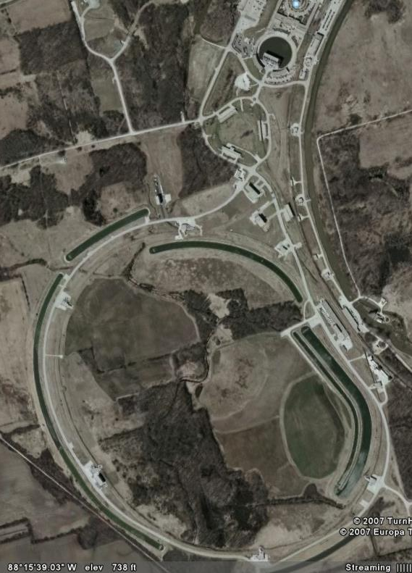
Bunches formed in the Recycler for Muon Campus
For Muon Campus experiments, 2 Booster Batches on each cycle are rebunched into 8 bunches in the Recycler
g-2 bunches are extracted every 10 msec and are directed toward the AP-0 target
  3.1 GeV muons are collected off the target and circle the Delivery Ring 4 times before being extracted toward MC-1
  This g-2 cycle is repeated twice every NOvA cycle
  No RF and no BPM data in the Delivery Ring for g-2 operations
Mu2e bunches are extracted every 48 msec and bypass the AP-0 target.
  The beam is resonantly extracted from the Delivery Ring over 43 msec and sent to the Mu2e target
  This Mu2e cycle occurs once every NOvA cycle
  RF, synchronous transfers, and BPM data are required for Mu2e operations

Slide 3
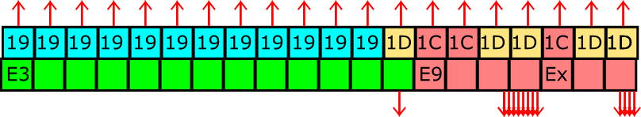
g-2 Pulse Train (12 Hz average – 100 Hz peak)
Begin cycle
End cycle
Bunch length
of 1 pulse
11 / 20 Nova Cycles
120 nsec
100Hz
Pulse separation
10 msec
Lens pulse length 400 µsec
193 msec
990 msec
~
~
1
2
3
4
5
6
7
8
9
10
11
12
13
14
15
16
Pulse #
MI Nova Cycle Length
1.4 sec

Slide 4
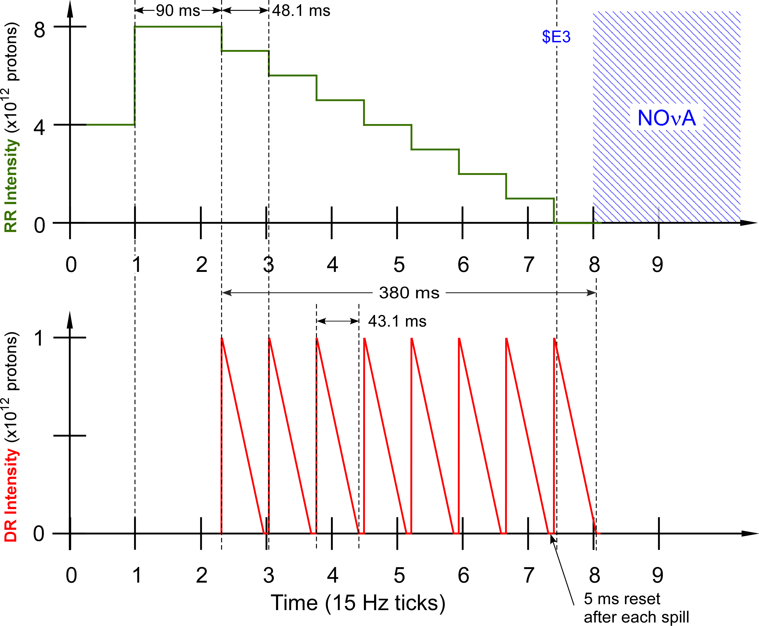
Mu2e Part of Timeline
8 transfers @ 21 Hz
During the Mu2e part of the cycle 2 proton batches are sent to the RR from the Booster
After the 2nd batch is injected the beam is rebunched with 2.5 MHz RF (90 ms)
Each of the resulting 8 bunches is transferred from the RR to the DR
Each bunch is slow spilled to the Mu2e proton target
Between each spill is a 5 msec reset period in which there is no beam
After the 8th spill, beam is off for 1.02 sec
2nd batch
RF Rebunching
1st batch
Beam off for 1.02 sec

Slide 5
Commissioning for g-2 operations (spring of 2017)
We will need to get first turn BPM data in all beam lines and in the Delivery Ring.
We will need to be able to acquire BPM closed orbit in the Delivery Ring.
We would like to be able to acquire TBT data from Delivery Ring BPMs
We need to be able to capture beam in 2.3 MHz buckets in the Delivery Ring to make BPM measurements
We would like to be able to transfer beam directly into the 2.3 MHz bucket in the Delivery Ring

