Slide 1
Accelerator Division Status
Daniel Johnson
All Experimenters’ Meeting
07 November 2016

Slide 2
Content Slide [22pt Bold]
Bullet points are optional. If preferred, only first level bullets can be used or bullets can be set to “NONE.” [18pt Regular]
First level bullet [18pt Regular]
Second level bullet [16pt Regular]
Third level bullet [15pt Regular]
Fourth level bullet [14pt Regular]
Fifth level bullet [14pt Regular]

Slide 3
Accelerator Operations Summary
From: October 31, 2016 (0000 hours)
To: November 07, 2016 (0000 hours)
Calendar Week # 44
NuMI Weekly Integrated Intensity 1.34 E15 protons
Beam Hours To NuMI 0.0 hours
BNB Weekly Integrated Intensity 1.11 E19 protons
Beam Hours To BNB 142.5 hours
NMuon Weekly Integrated Intensity 5.36 E13 protons
Beam Hours To NMuon 4.6 hours
MTest Weekly Integrated Intensity 0.00 E13 protons
Beam Hours To MTest 0.0 hours
MCenter Weekly Integrated Intensity 0.00 E12 protons
Beam Hours To MCenter 0.0 hours

Slide 4
BNB Operation

Slide 5
Content and Caption Slide [22pt Bold]
Click to add caption text [13pt Bold]
First level bullet [18pt Reg]
Second level bullet [16pt]
Third level bullet [15pt]
Fourth level bullet [14pt]
Fifth level bullet [14pt]

Slide 6
Complex Status
LINAC
Running well
Booster
Running well
~4.5 E12 p/p
MI/RR
Starting up
Vacuum scrubbing in Recycler
Access this week to valve water in Recycler cavities (possibly Thursday)
TSP firing in MI-10 area (4 hours)
NuMI
Horn scans done
Target scans this week
Booster Neutrino Beamline (BNB)
Running well
Switchyard
Ran beam to absorber
Delivered initial beam to SeaQuest
Work in Meson Service Building (MS1) replacing failed Bus.
General
Possible access to MI/RR on Thursday

Slide 7
November 2016

Slide 8
MI-12 Communication Duct
Damaged on 10/24/16
Protected from further damage
Able to run experiments now
Provides timing/date to Neutrino Experiments
Also safety & fire systems
Working on possible solutions
Will present solutions and choose direction forward

Slide 9
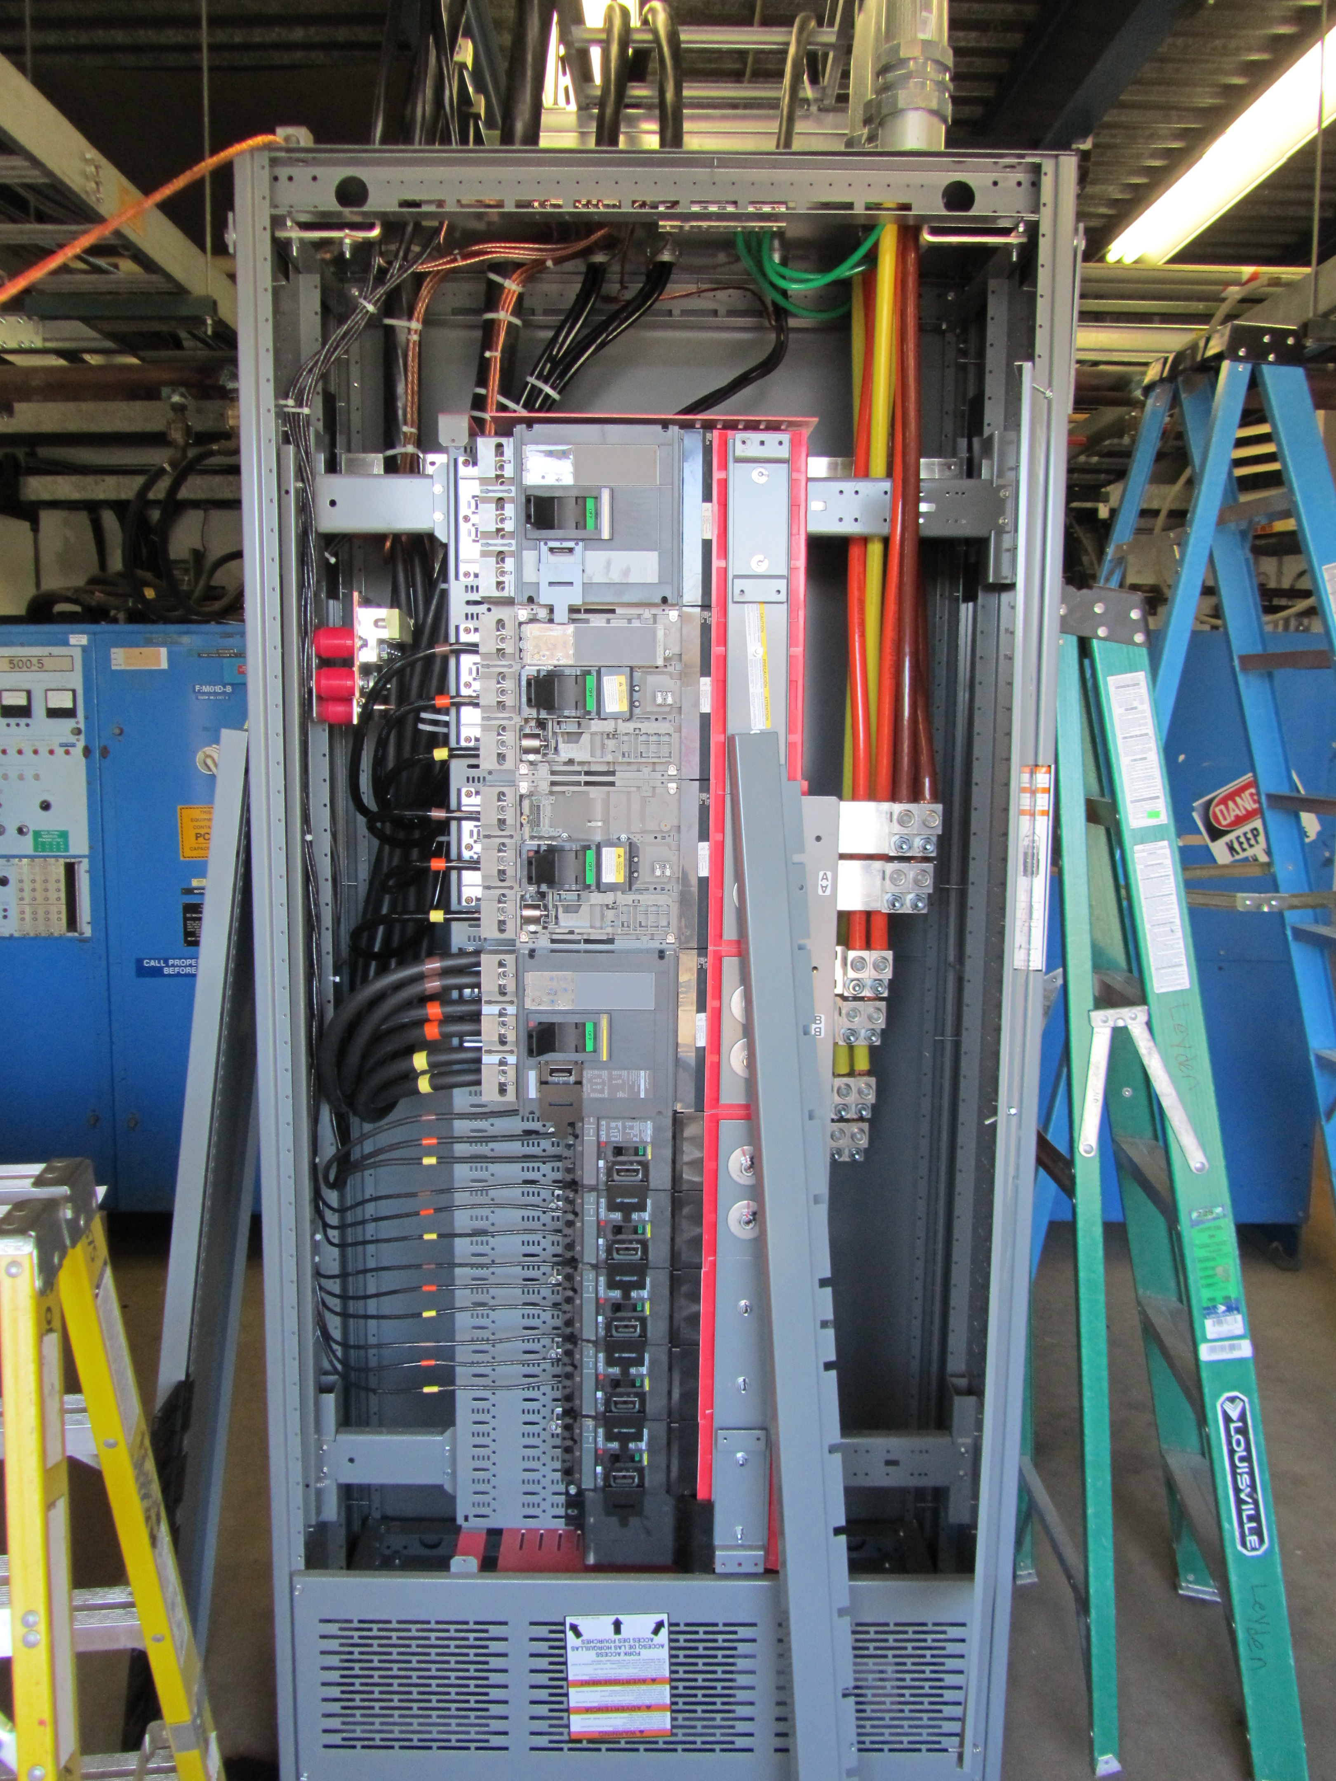
MS1 Bus Failure
Each supply was tapped into power bus
All power supplies cabled into breaker panel
Will improve LOTO with single switch lockout
Work expected to be complete in ~ 1 week

Slide 10
PIP-II Injector Test & FAST Status
PIP-II Injector Test
CW RFQ operation startup
Running long runs within limits
Pulsed beam with 60 Hz duty factor
Cave interlocks for CW operation
Final safety system connections and testing
Waiting for final approval
Beam scans and studies
CW studies
Collecting data
FAST
No gun operation
Shutdown for 300 MeV upgrade
Cave Roof Block Installation complete
Begin magnet and stand installation

Slide 11
CMTS1 Status
LCLSII Prototype Cryo Module
Cryo warming up
Pursuing long term improvements
Plan 2.0 K operation until after shutdown
Accomplishments
Completed tests
Shutdown began last week
Plan for the week
Expect to be shutdown most of November

Slide 12
ICW Reduction
Looking at measuring flows on systems
Stakeholders impacted
AD, TD, PPD, CD, FESS
Need to establish new Casey’s Pond West Strainer Vault
Everybody working on priority projects
Will be difficult to line up downtime schedules
Reducing flow will be painful
Estimate two week reduction for work
Performing measurements in late November
Planning on early 2017 (January)
Will know more after November measurements
2 week reduction period
Should not impact most experiments
Will impact experiments/projects with cryogenic operation

Slide 13
Schedules and Links
Schedule can be accessed from the Operations Department Home Page
Schedules -> Operations Schedule
Direct link to schedule
http://www-ad.fnal.gov/ops/schedule.html

Slide 14
Collaborations / Partnerships / Members [22pt Bold]

