Slide 1
MP in HOMs. Dark Current and X-ray
LCLS-II team

Slide 2
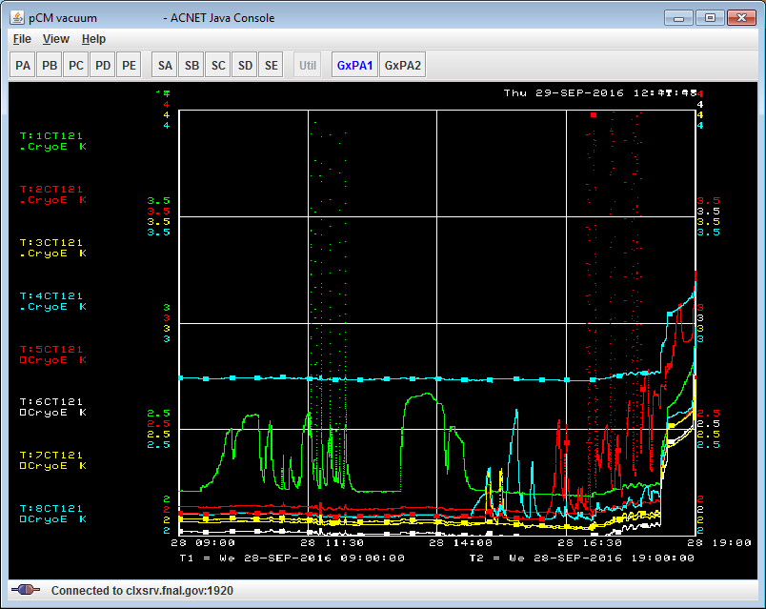
MP in HOM couplers (cav#1 and cav#5)
Sign of MP in HOM – overheating of the HOM can
Two cavities #1 & #5 shown MP in downstream HOM couplers
After processing MP gone in cav#1. In cav#5 gradient improved, but MP still there.
Temp on HOM2 can:
-Green - cav#1
-Red - cav#5
HOM overheating due to MP
cav1
cav5
No MP after processing

Slide 3
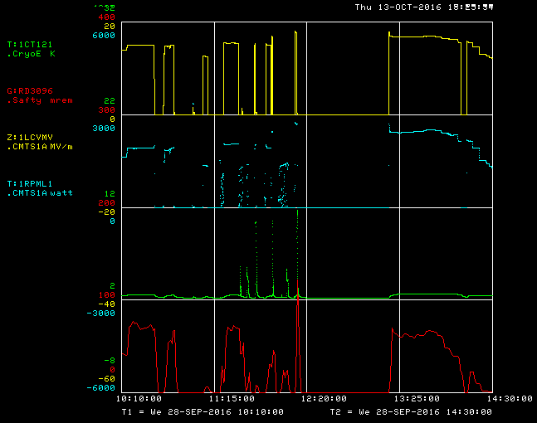
MP in HOM of cavity#1 (zoom)
Before processing
processing
After
processing
MP starts at ~12MV/m
HOM can T quickly goes up above threshold gradient
Processed in short pulses (seconds) until T< 20K
After processing no MP up to max gradient
Radiation reduced after processing,
Exist w/o MP
Gradient
RF power
HOM can Temp.
Radiation

Slide 4
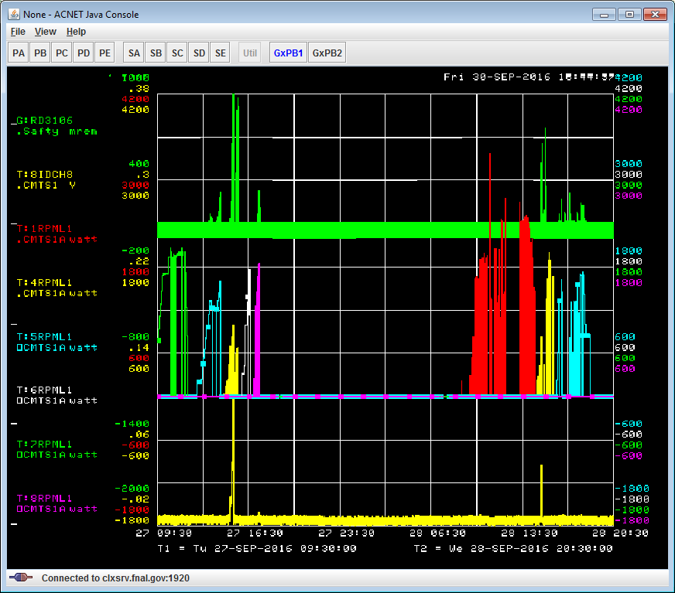
Dark Current / X-ray and MP
History plot
X-ray (mrem/hr)
Cavity 2 & 3 tested, but not plotted here. No FE/ MP @16MV/m
MP in cav 1& 5. In cav1 MP processed away.
DC on cav#4 (pk 1&3) ➔Processed away.
X-ray activity on cavities 5, 8; no DC
C7
C1
C4
C5
C5
C4
C8
C6
~16 MV/m
RF power (W)
Peak1
14nA
Peak3
4nA
Dark Current
Peak2
0.5 nA

Slide 5
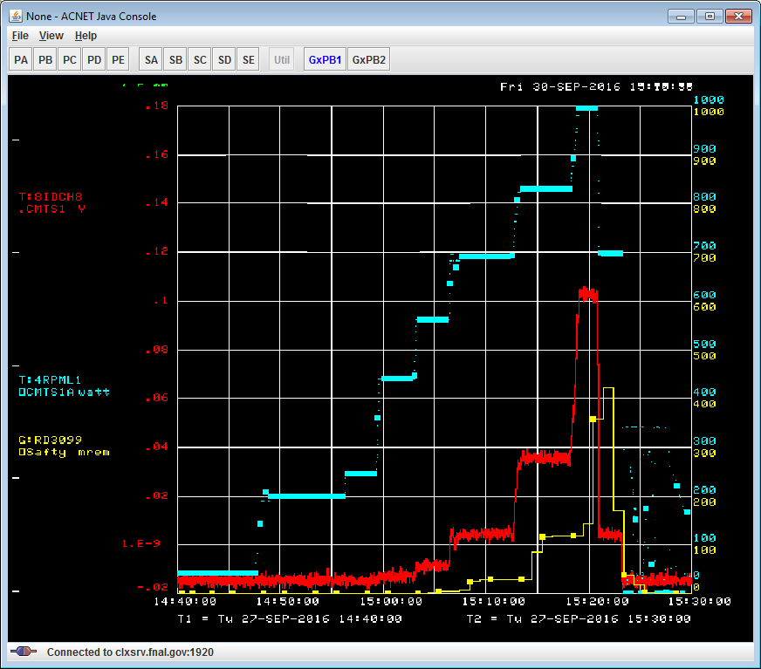
FE: Dark Current / X-ray on cav#4 before processing (zoom)
Cavity #4
(Peak 1)
Blue – RF power (W)
red – Dark Current (DC)
South detector (down)
Scale 100nA/V
Noise level 0.4 nA
Max DC = 12nA
Yellow- radiation mrem/hr
Shifted due to integration time
Max = 400 mrem/hr
RF power
12 nA
Dark current

Slide 6
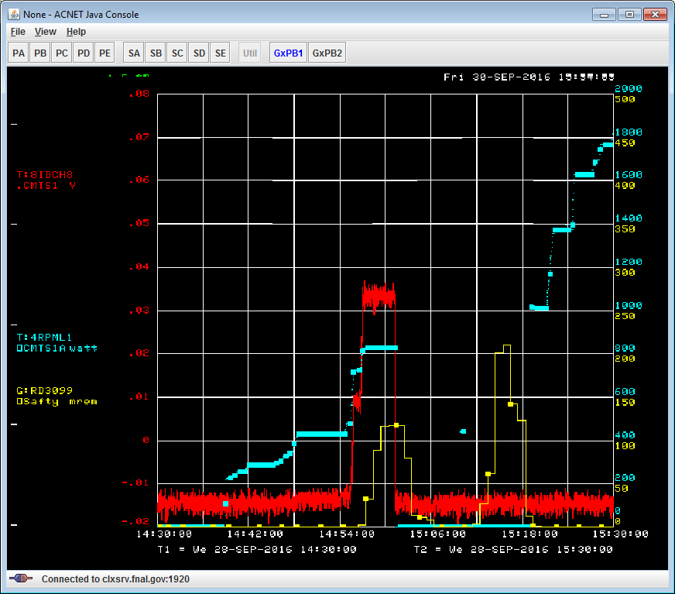
Cavity #4 FE before and after processing (Sept.28):
Cavity #4 processing
Blue – RF power (W)
Red – dark Current
South detector (DS),
Scale = 100 [nA/V]
Noise level 0.4nA
Max DC = 4 nA
Yellow- radiation (mrem/hr)
Shifted due to integration
RF power
16MV/m
Dark current
1nA/div
X-ray
Pulse mode
FE processing

Slide 7
Conclusion
Multipactoring in HOM couplers
found in downstream couplers of cav#1 & cavi#5 (overheating of HOM can. After pulse processing MP disappear in cav#1. In cav#5 gradient was improved, but MP is not completely processed yet.
Dark Current activity
Initially cavity #4 show high dark current max 12nA at ~12MV/m. After short processing (in pulse regime) DC completely disappear.
Cav#8 shows small dark current (<0.5 nA) at ~18MV/m. Disappear after short processing.
Dark current produced by all other cavities is below noise level (<0.4nA).

