Slide 1
Low-background radio-assay capability in the UK
Paul Scovell – DMUK
UCL – 18/01/17

Slide 2
Introduction
Last DMUK meeting was Oxford in Dec 2014
In the past few years, low background screening in the UK has matured significantly
Between Boulby, UCL and MSSI we now posses an enviable screening capability
Boulby
4 ULB HPGe detectors – soon to become 7
UCL
Agilent 7900 ICP-MS – with almost universal sample digestion capability
MSSI
Radon emanation chamber – running successfully for several years for SuperNEMO and LZ

Slide 3
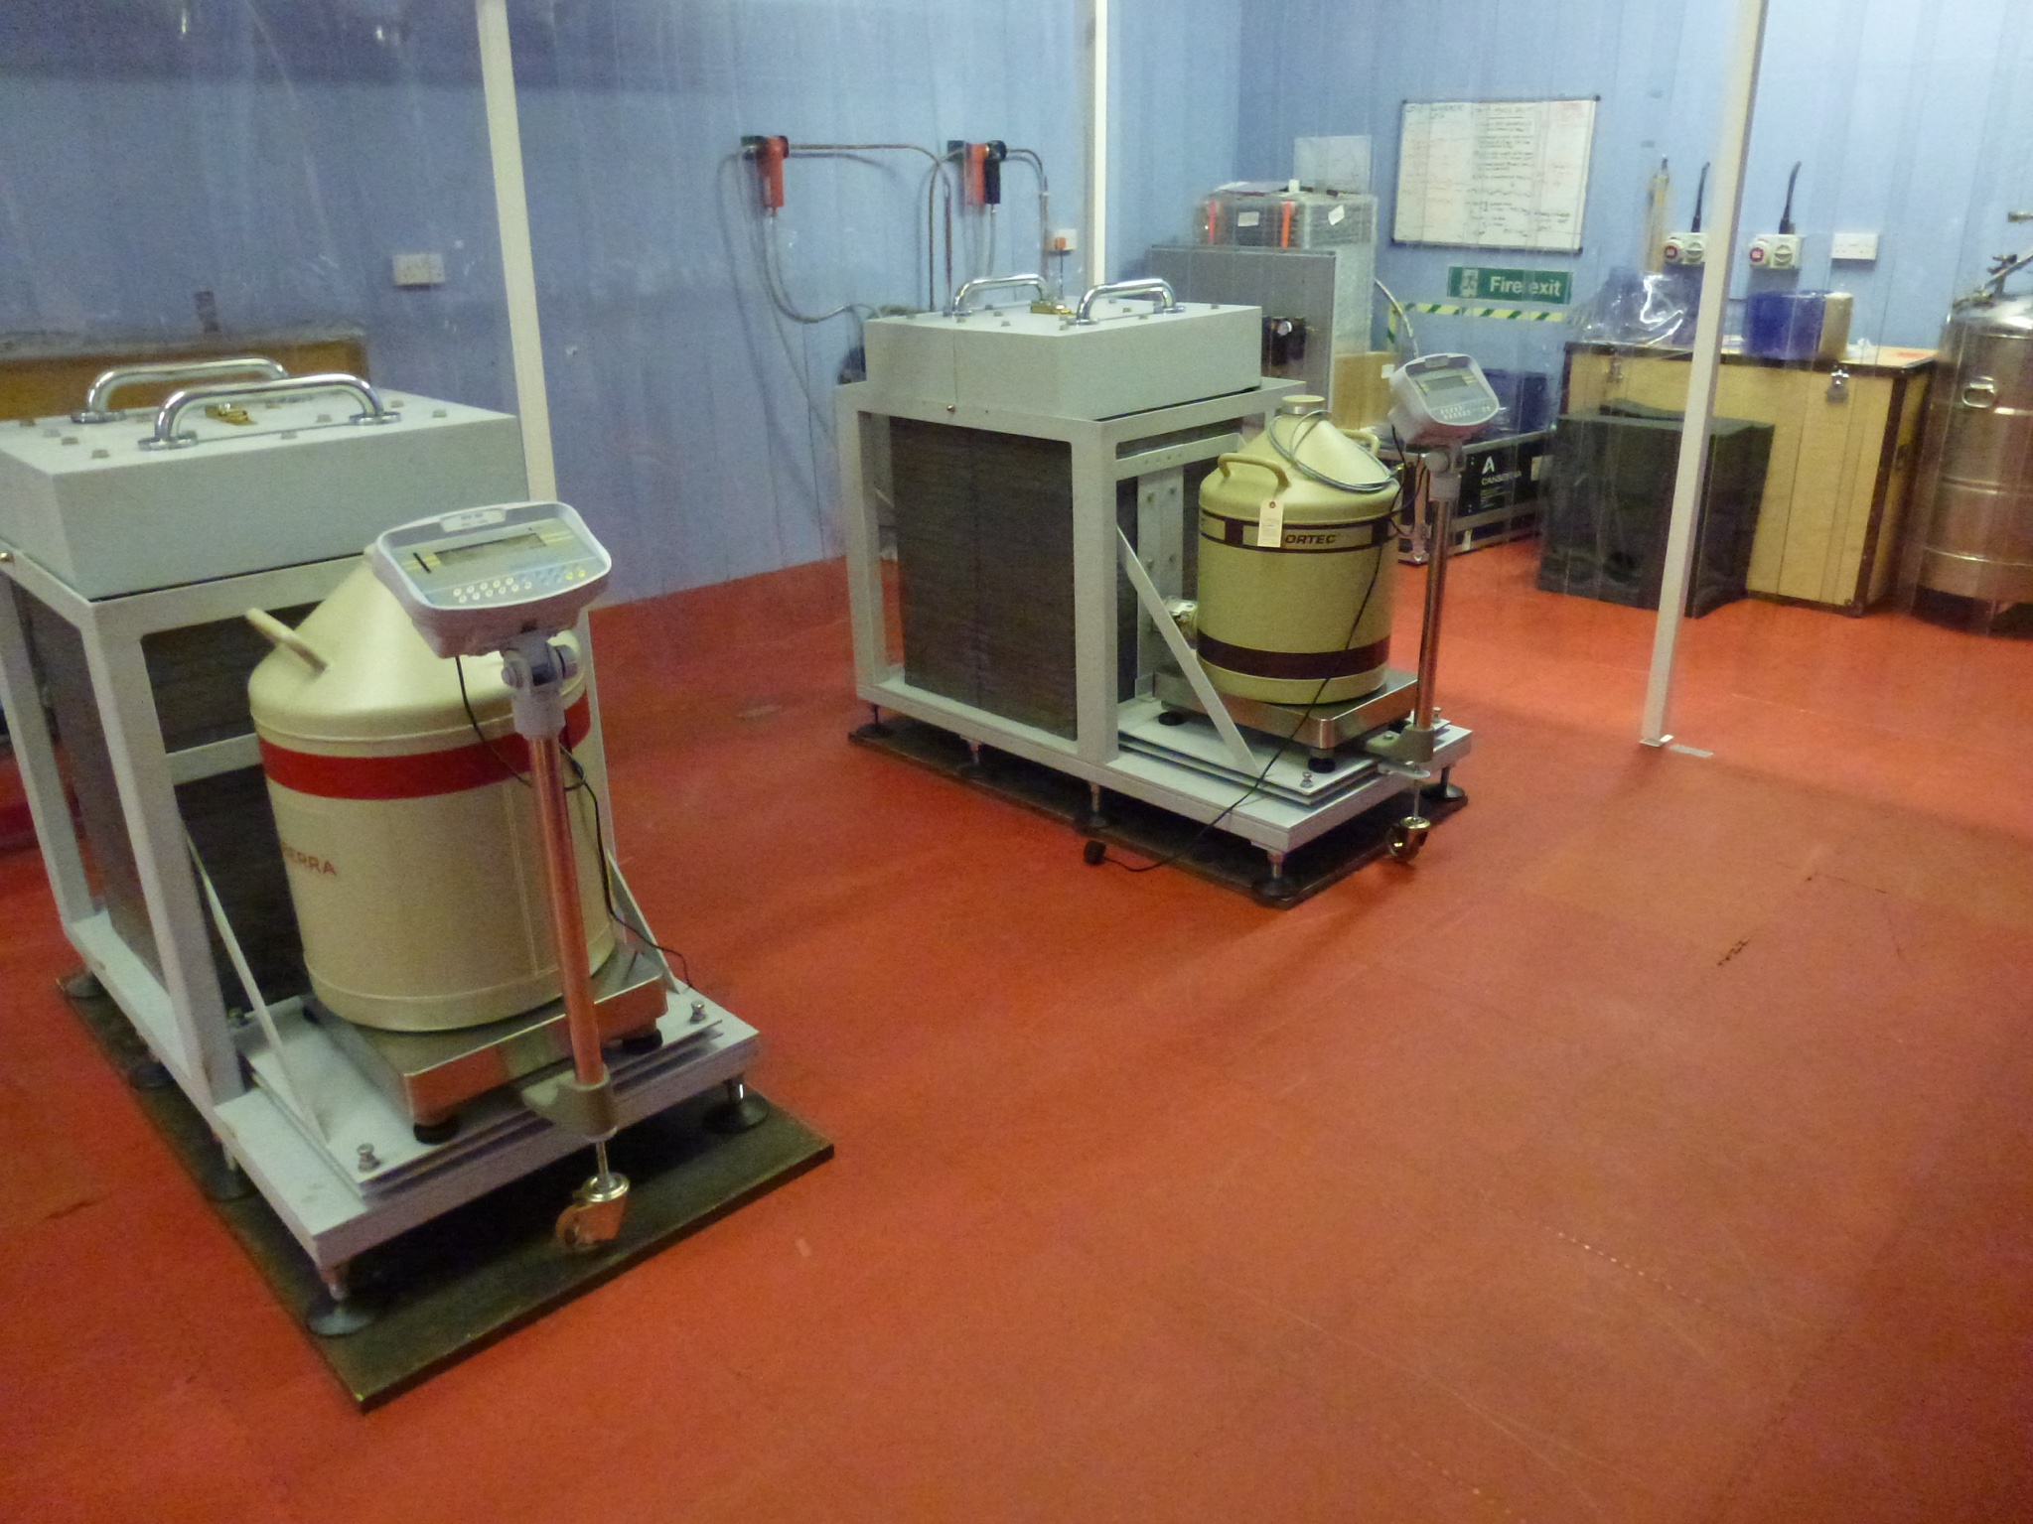
HPGE @ Boulby
Status in Dec 2014:
We had two detectors, Chaloner (BEGe 5030) and Lunehead (Ortec p-type) installed under a cleanroom tent in the Boulby Palmer Laboratory
Represented the lowest background HPGe detectors run in the UK
We didn’t stop there!
Sep 2015:
Additionally added a SAGe well detector and a BEGe 2825
”Lumpsey” and “Wilton”

Slide 4
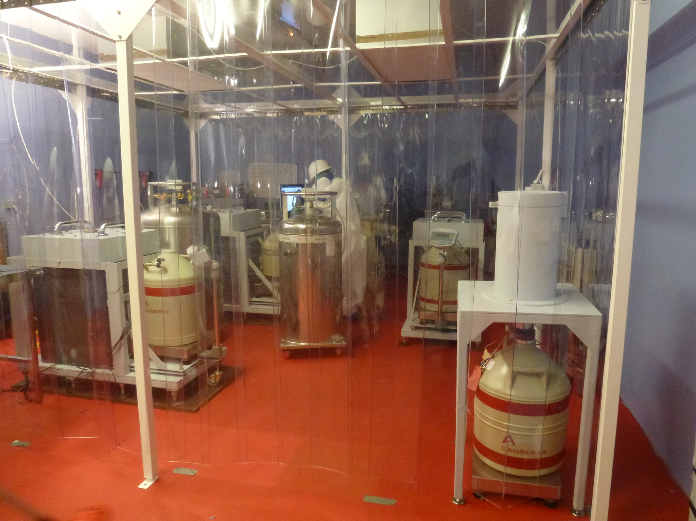
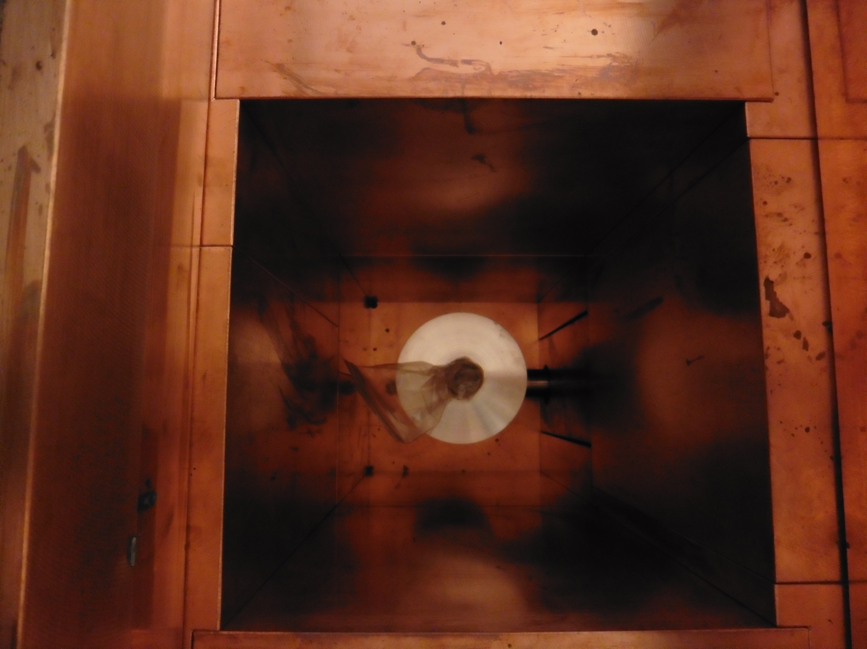
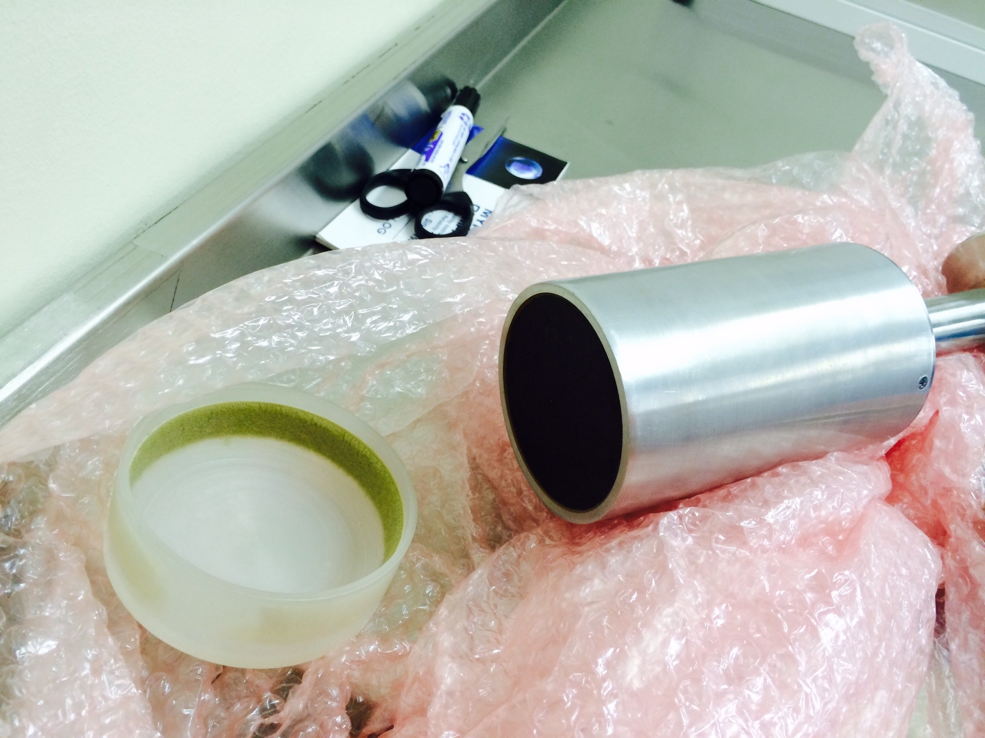
HPGe – The Past
Well Detector - Lumpsey
Pre-Screening Detector - Wilton

Slide 5
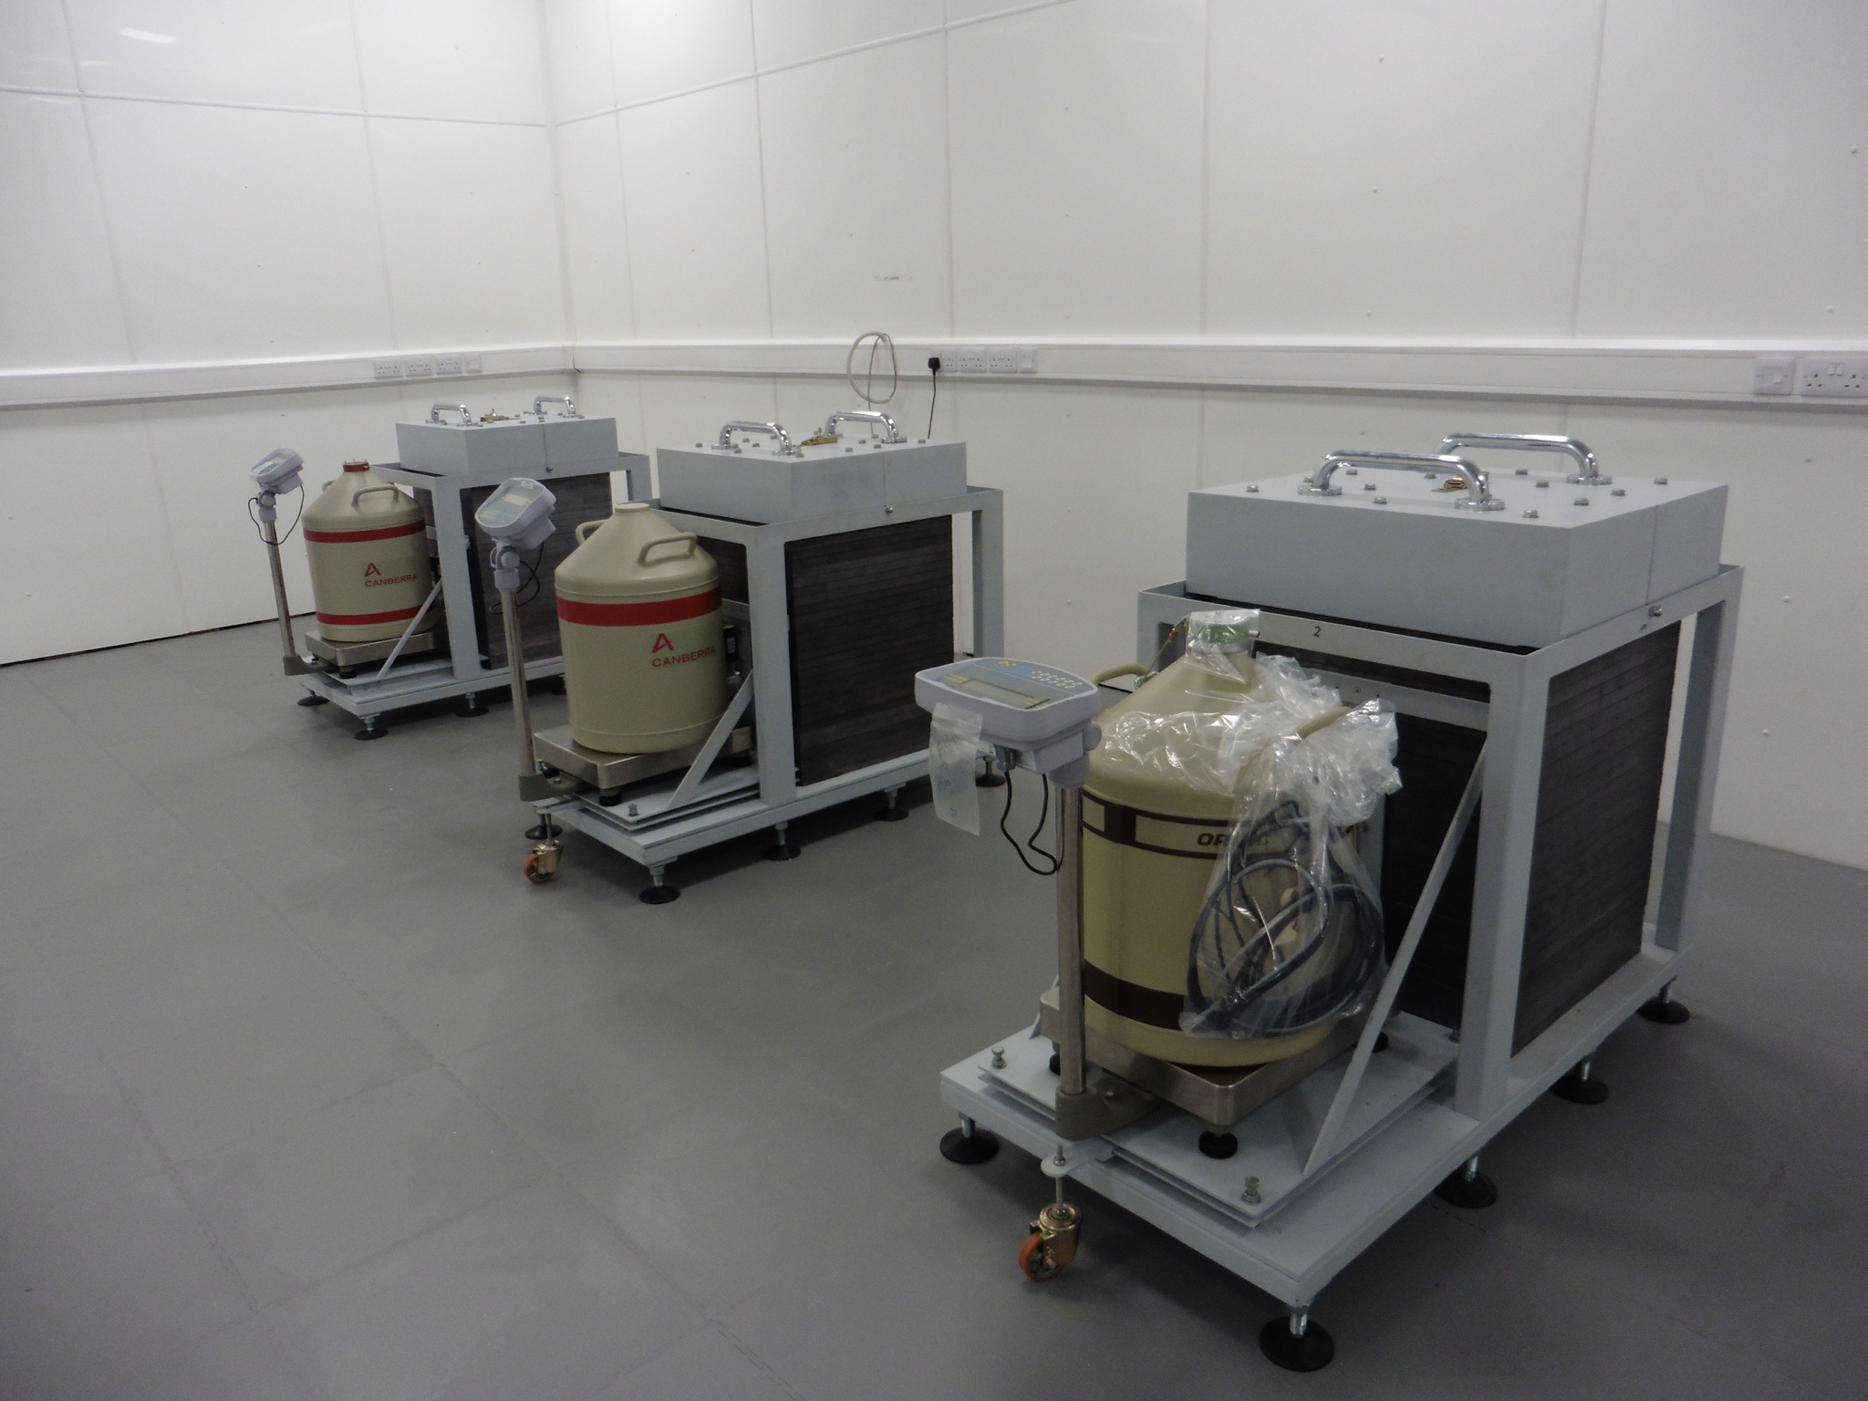
HPGE – the present
In March 2016, things changed again
Ageing(!) Palmer Laboratory vacated
Detectors moved to New BUGS laboratory
Boulby Underground Germanium Suite
Class 1000 cleanroom
HEPA & A/C
Environmental Monitoring
LOTS of space
3/4 of the castles purged with 3 LPM of N₂ gas

Slide 6
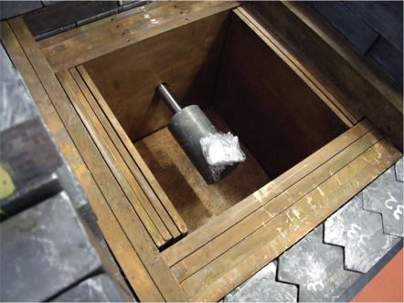
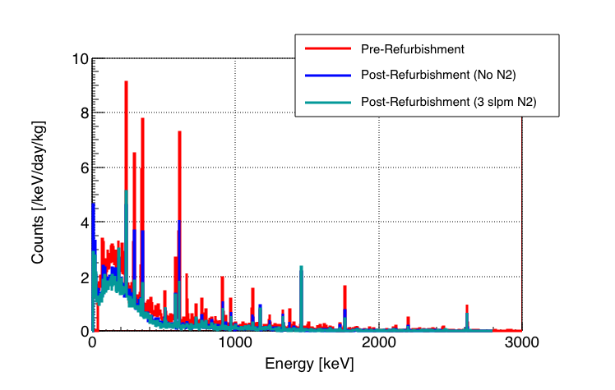
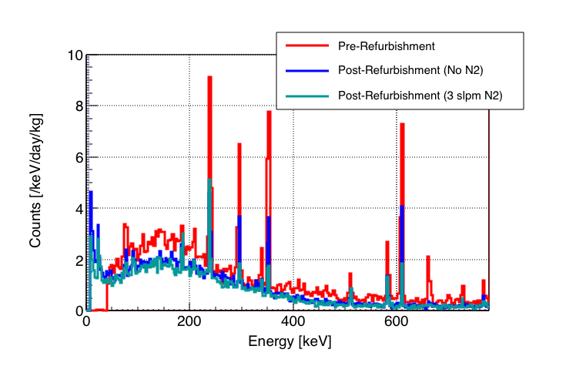
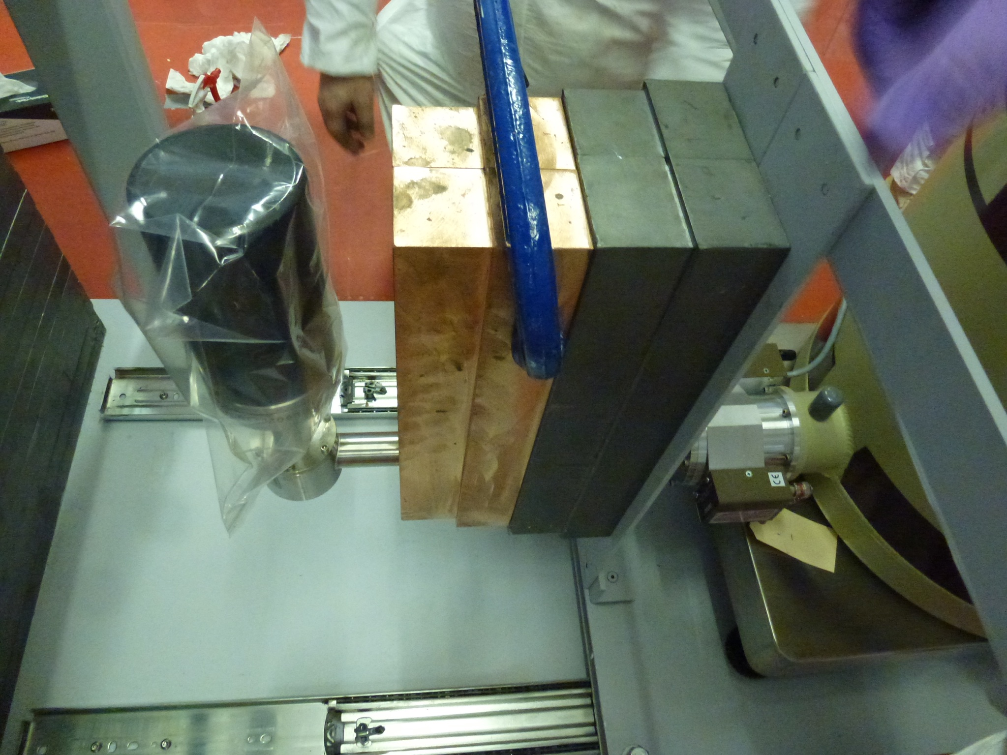
HPGe Backgrounds - Lunehead
²¹²Pb
²¹⁴Pb
²¹⁴Pb
²¹⁴Bi
¹³⁷Cs
⁴⁰K
²⁰⁸Tl + An
⁶⁰Co
²⁰⁸Tl

Slide 7
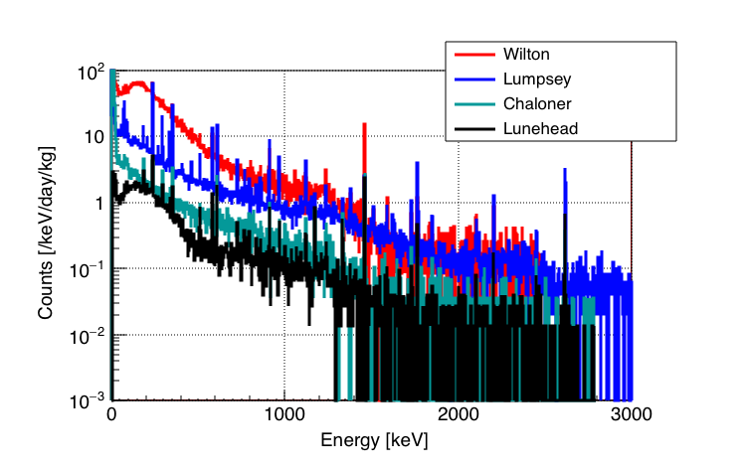
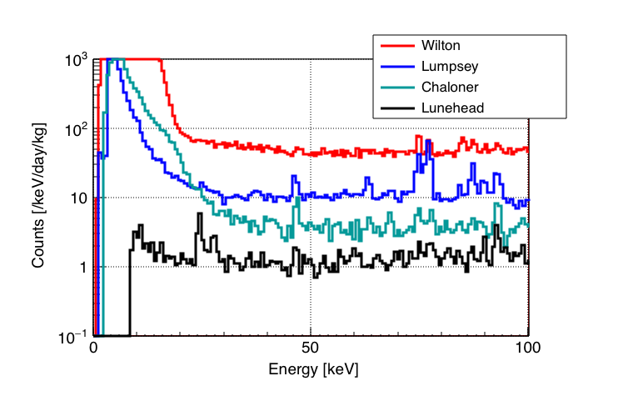
HPGE BackgroundS - All
Wilton has much smaller (thinner) shield
Hence much more prominent ⁴⁰K
Lumpsey not quite ULB
To get sufficient resolution, some non-LB components must be used
Chaloner and Lumpsey show great low-E response
²¹⁰Pb @ 46.5 keV
²³⁴Th @ 63.3 keV

Slide 8
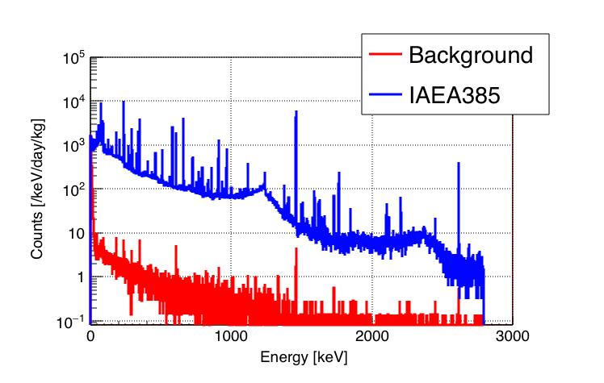
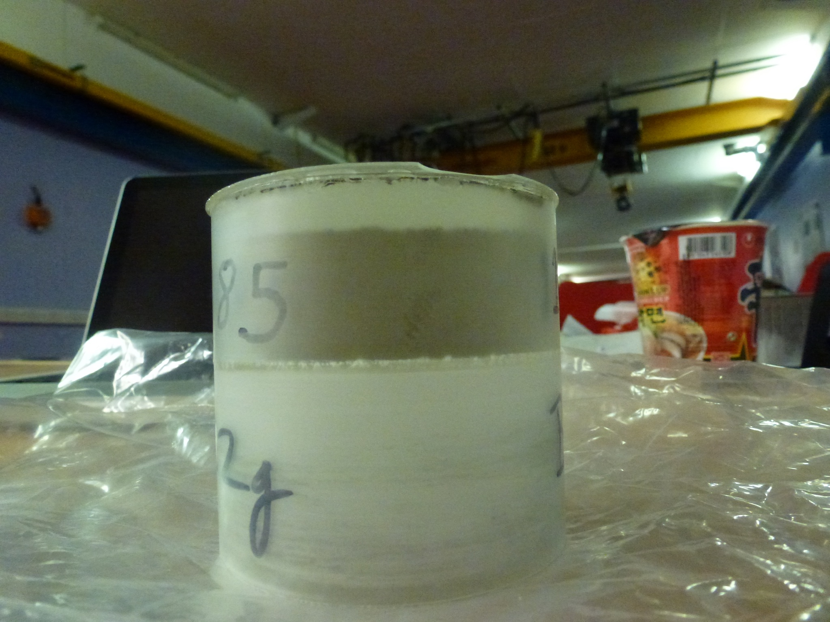
HPGe Characterisation
IAEA 385 used to characterise detectors
Irish Sea sediment sent to ~100 labs for analysis (HPGe + others)
Used to characterise detectors for extended and well samples

Slide 9
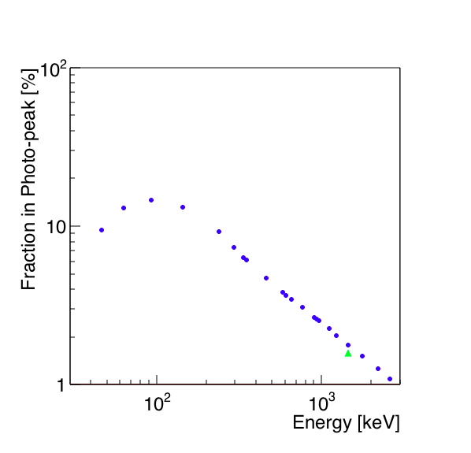
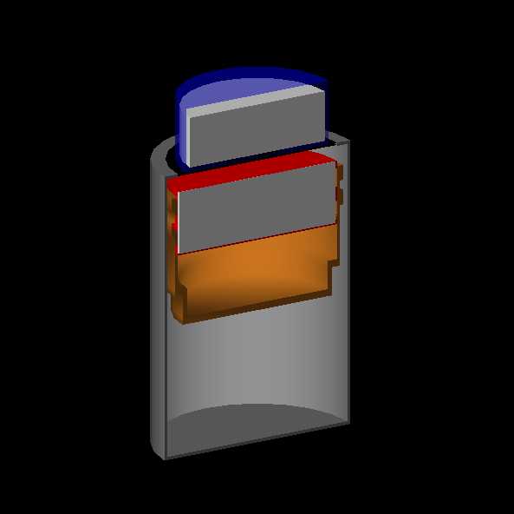
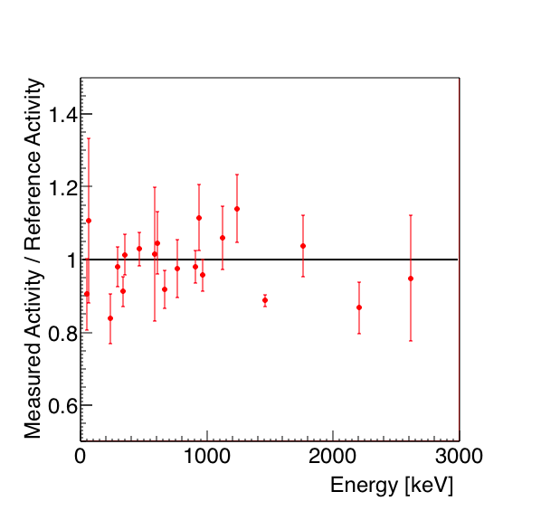
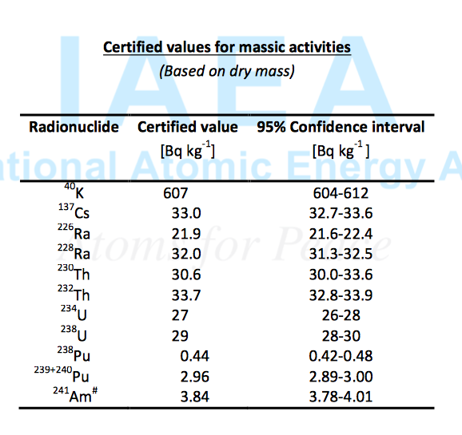
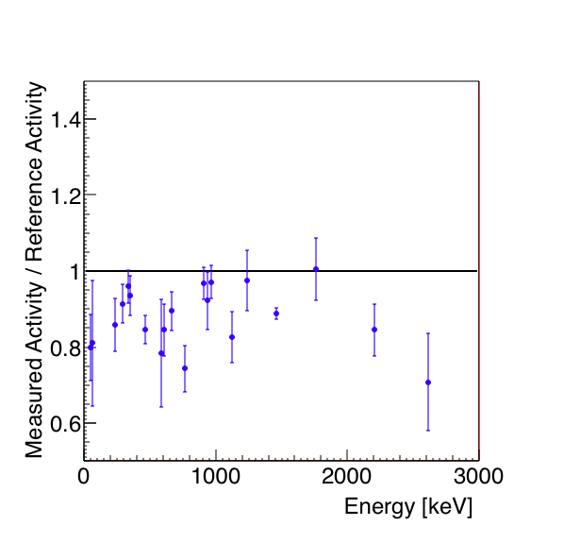
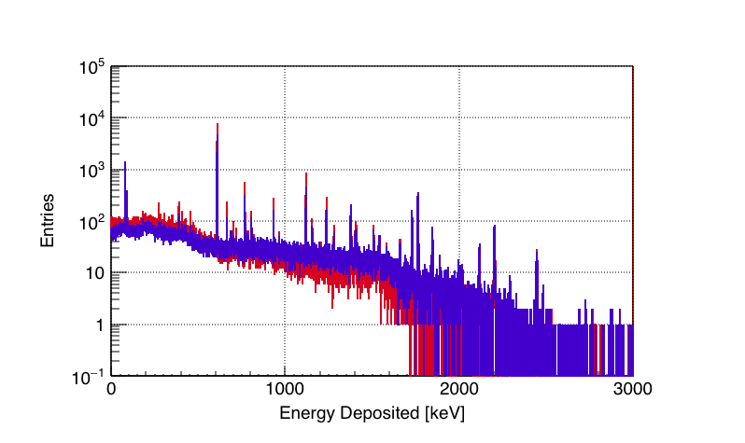
Comparison to Literature Values
Efficiency
Bq/kg
Coincidence Summing
609
768
1120
934
1238
1764
&
1847
2204
=>
2447

Slide 10
HPGE – Screening efforts
We are currently screening components for a number of projects
The majority of samples currently come from LZ including:
Hamamtsu R11410 3” PMTs & PMT bases
Individual components for the above
We also screen a smaller number of components for SuperNEMO
We contribute to the SuperKamiokande gadolinium (EGADS) screening programme
We also assay samples for industry and potential new collaborators
However this is now. Looking toward the future…

Slide 11
HPGe – The future
We continue to screen for LZ through 2017/18
The gadolinium screening programme extends beyond this
Additionally, BUGS is growing
We will add 3 new detectors in the next few months
All in S-ULB configuration in collaboration with Canberra Lingolsheim
New “revolutionary” BEGe detector (everyone will want one) - Roseberry
100% p-type - unnamed
160% p-type – unnamed
We also plan to upgrade the well detector to S-ULB (money permitting!)

Slide 12
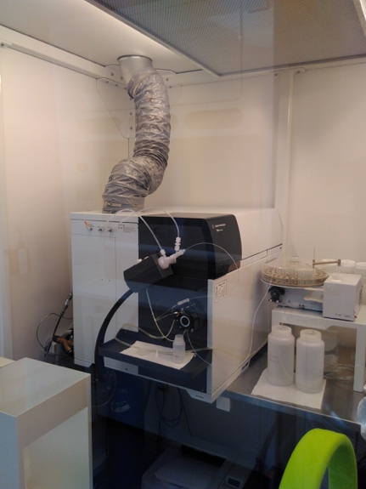
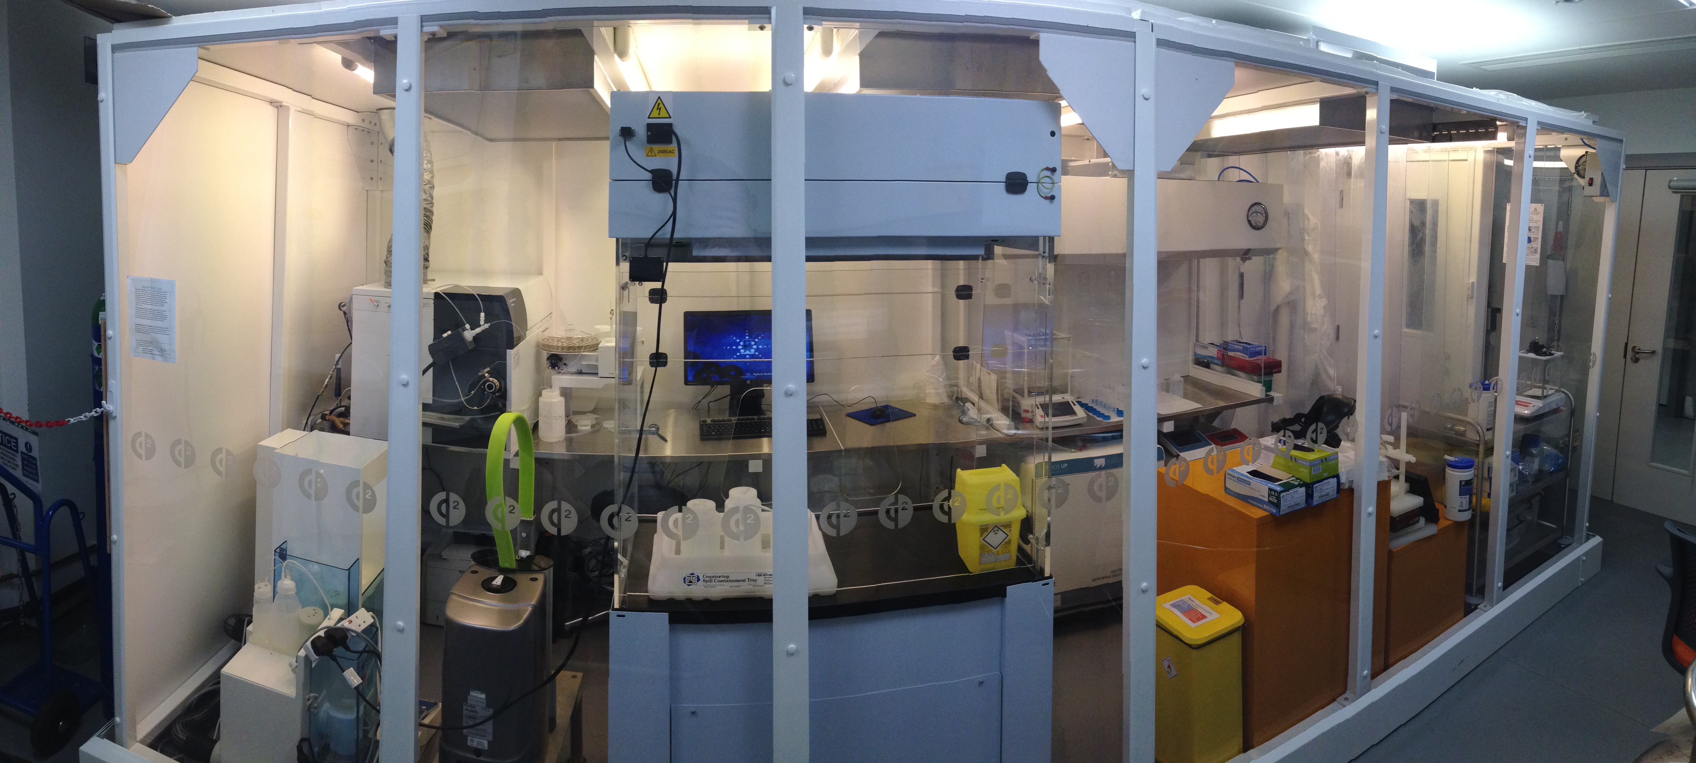
ICP-MS @ UCL
Similarly to HPGe, ICP-MS has moved on in leaps and bounds since Dec 2014
Dedicated ISO Class 6 facility
Operated by Jim Dobson (the other 100% of his time - see LZ talk)
Agilent 7900 ICP-MS
Integrated auto-sampler
HF ability
Able to digest a wide range of materials
Currently dedicated to LZ screening

Slide 13
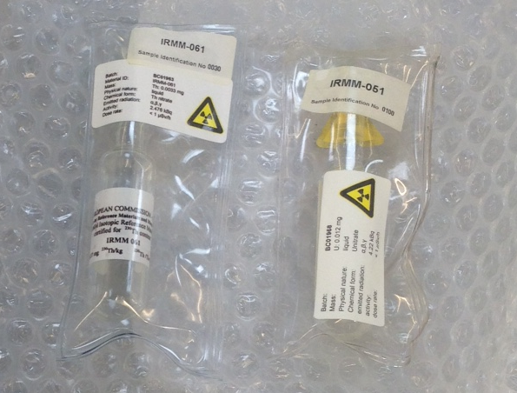
ICP-MS
ICP-MS probes the top of the U/Th chain
Unlike HPGe which mostly probes lower daughters
Two techniques are complementary
To improve sensitivity we use radiological tracers
U233 and Th230 – same atomic number, different mass number
Tracking of known contamination of tracer
Significantly reduces uncertainty of measurement
ICP-MS now hits ultimate sensitivity of 0.05 ppt
Although this is equivalent to ~10 ppt (g/g) due to dilution

Slide 14
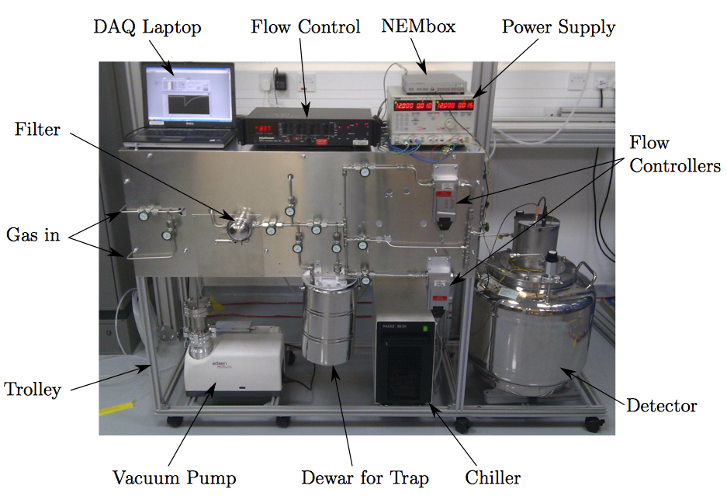
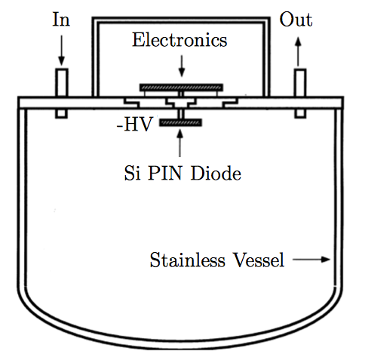
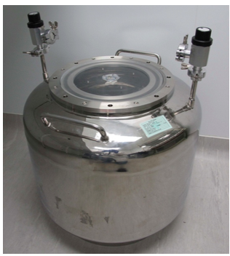
Radon Emanation @ MSSI

Slide 15
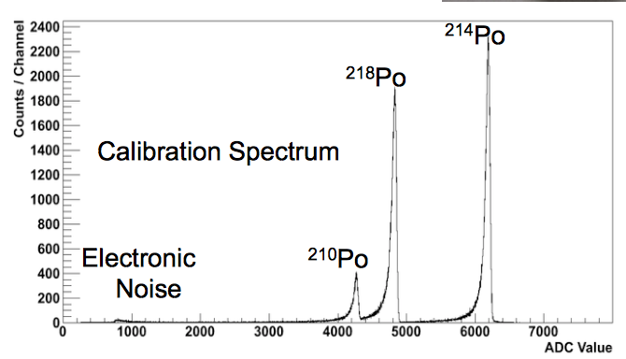
Radon Emanation
Electro-polished 70 l vessel
Silicon PiN diode at -1500 V
Calibrated using a ²²²Rn flow-through source
Gives the standard Po alpha-decay signature
Credit X.-R. Liu (UCL)

Slide 16
Radon Emanation – The Future?
Many low-background cryogenic detectors expect background from radon to dominate other sources
Radon emanation studies are mostly carried out at room temperature
It is known that radon emanation has a strong dependence on temperature
Diffusion from materials doesn’t happen so readily at low temperature
Current background predictions for such experiments cannot yet take credit for this reduction
Leads to unnecessary conservatism
Plans in place to create a low temperature radon emanation facility in the UK
This will place the UK at the forefront for G3 DM and next-gen 0𝜈𝛽𝛽 detectors

Slide 17
Conclusions
The UK is positioning itself as a world leader in low background screening
Very few nations have the breadth of facilities we will have in the next year
Whilst making key contributions to current generation detectors, we have an eye on the future
The is particularly timely with R&D for future low-background experiments on the horizon
Through these facilities we have the opportunity to gain strong leadership in these experiments
Results will shape the design and construction
These facilities will be used to prove that we can source and measure materials to the required sensitivity
It is a low-risk and high-reward!

