Slide 1
Data Acquisition for Muon g-2
Wesley Gohn
University of Kentucky
7 November 2016

Slide 2
DAQ Requirements
Source | MB Per Fill | MB Per Second
Raw data | 1,600 | 19,400
T-Method | 9.4 | 112.5
Q-Method | 4.0 | 48.5
Prescaled Raw | 1.6 | 19.4
Tracker | 0.25 | 3
Laser Monitor | 0.08 | 1
Auxiliary | 0.33 | 4
Event Builder: | 15.7 | 188.4
Accommodate 12 Hz average rate of muon fills that consist of sequences of eight successive 700 µs fills with 10 ms fill-separations.
Time-averaged rate of raw ADC samples is 20 GB/s, which must be reduced by a factor of 100.
Data is processed in GPUs to accomplish this task.
Total data on tape after 2 years of running will be 10 PB.

Slide 3
DAQ Design
Calo
Tracker
Auxiliary
Layered array of commodity, networked processors
Frontend layer for readout of detectors.
Backend layer for assembly of event fragments.
Slow control layer.
Online analysis layer using art+JS.
Field DAQ operates independently, but with a similar design.

Slide 4
Rider/AMC13 Source
DAQ for calorimeters and auxiliary detectors reads data from Riders in µTCA crates.
Each crate contains 12 waveform digitizers that we call ”Riders”. They are 12 bit, 800 MSPS, so a 700 us fill is 560,000 samples in length.
Each crate is controlled by an AMC13, and data is read from the AMC13 to the DAQ via a dedicated 10 Gbps fiber connection.

Slide 5
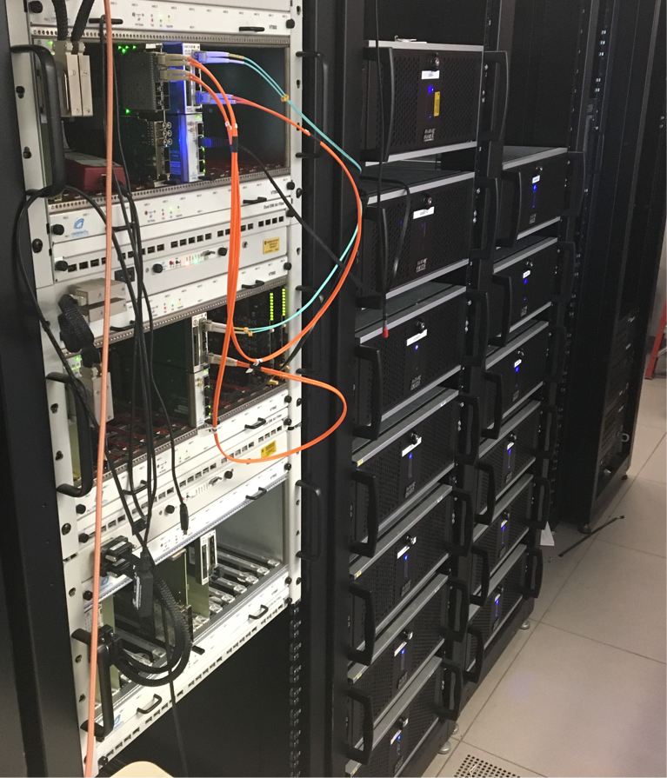
Installation Status
Detector frontend machines installed (12 for calorimeters, 1 for auxiliary detectors, 1 for tracker, 1 spare).
Field machines installed (analyzer, frontend, server).
3/4 Backend machines installed (1 event builder, 1 analyzer, 1 slow control). 4th backend has been ordered to be database server.
Redundant gateways for external access.
40 TB RAID in external JBOD
Spare parts on hand and support contract has been negotiated between Rave and our on-site support.

Slide 6
System Configurations
All systems based on two different base systems, following advice from FNAL SCD personnel (R. Scott, B. King, G, Cooper, et al).
Backend has 64 GB DDR4, 8c Xeon E5-2667 v3, redundant 920W
Frontend has 32 GB DDR4, 8c Xeon E5-1660 v5, 2x K40 GPU
Systems purchased from Rave Computing. All are under a 5 year warranty, and we have a service agreement between Rave and the on-site Dell support team, so Dell can fix minor hardware failures immediately and then have replacement parts sent by Rave.
All run SLF6.7 and are managed using puppet by the SLAM group.

Slide 7
Cyber Security
All systems accessible only with Fermilab Kerberos principal.
Redundant gateway system used for off-site access.
Network ports controlled with ACLs by Fermilab networking group.
Access to core DAQ machines restricted, control room machines only open to entire collaboration.
Special authorizations needed to edit online database.
Midas webserver viewable only behind firewall, protected with SSL certificate.
UPS system provides limited power in case of infrastructural attack.

Slide 8
Hardware Considerations
Using an ASUS X99-E WS/USB 3.1 motherboard for frontend systems.
Motherboard must support PCIe version 3.0 and run at least five slots in parallel.
Require Xeon processor to support ECC memory.
Need a motherboard with a PLX chip, which allows it to distribute the load over 40 lanes in order to operate all PCIe slots at 16x.
PCIe version | GPU | Host to device, Pageable | Host to device, Pinned
2.0 | K20 | 3326.6 MB/s | 5028.3 MB/s
3.0 | K20 | 5628.6 MB/s | 6003.6 MB/s
3.0 | K40 | 6647.8 MB/s | 10044.3 MB/s

Slide 9
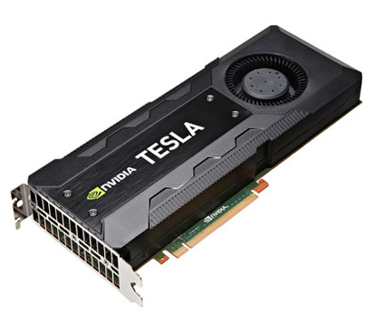
GPU Selection
Data will be processed using Nvidia Tesla K40 GPUs
Peak double precision floating point performance: 1.43 Tflops
Peak single precision floating point performance: 4.29 Tflops
Memory bandwidth: 288 GB/s
Memory size (GDDR5): 12 GB
CUDA cores: 2880
Supports ECC memory protection for greater data reliability.
We tested the K20 and K40 GPUs, and chose K40 for it’s increased performance.
K80 was released more recently, but price point is too high, and K40 is already meeting our needs.

Slide 10
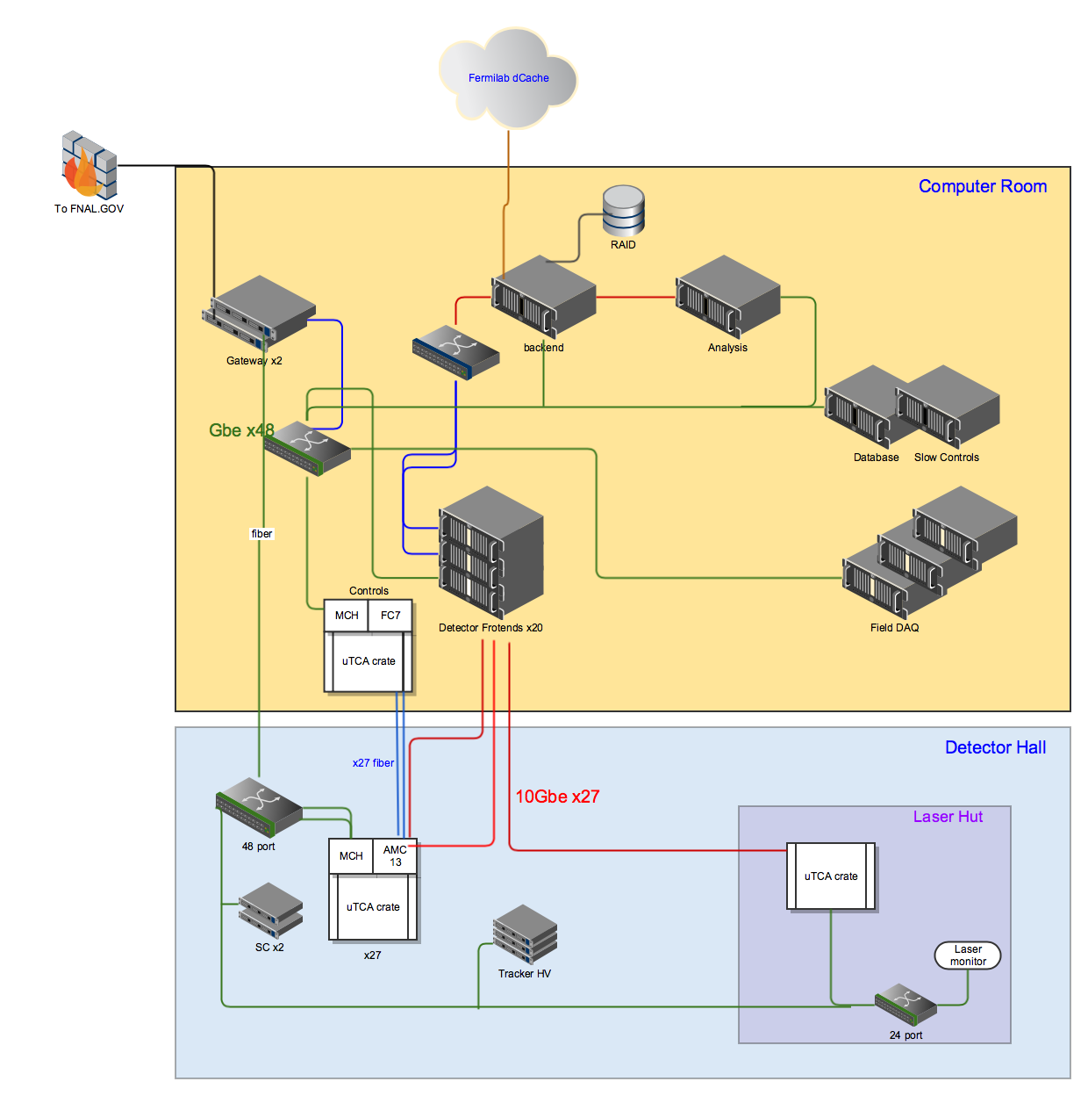
Network Installation
Fiber trunk installed between computer room and detector hall with 144 fibers.
Network to the laser hut is being installed.
Patch panels are installed on both sides.
Still need to run jumpers from patch panels to frontends in computer room, and from patch panel to calorimeter crates in the hall.

Slide 11
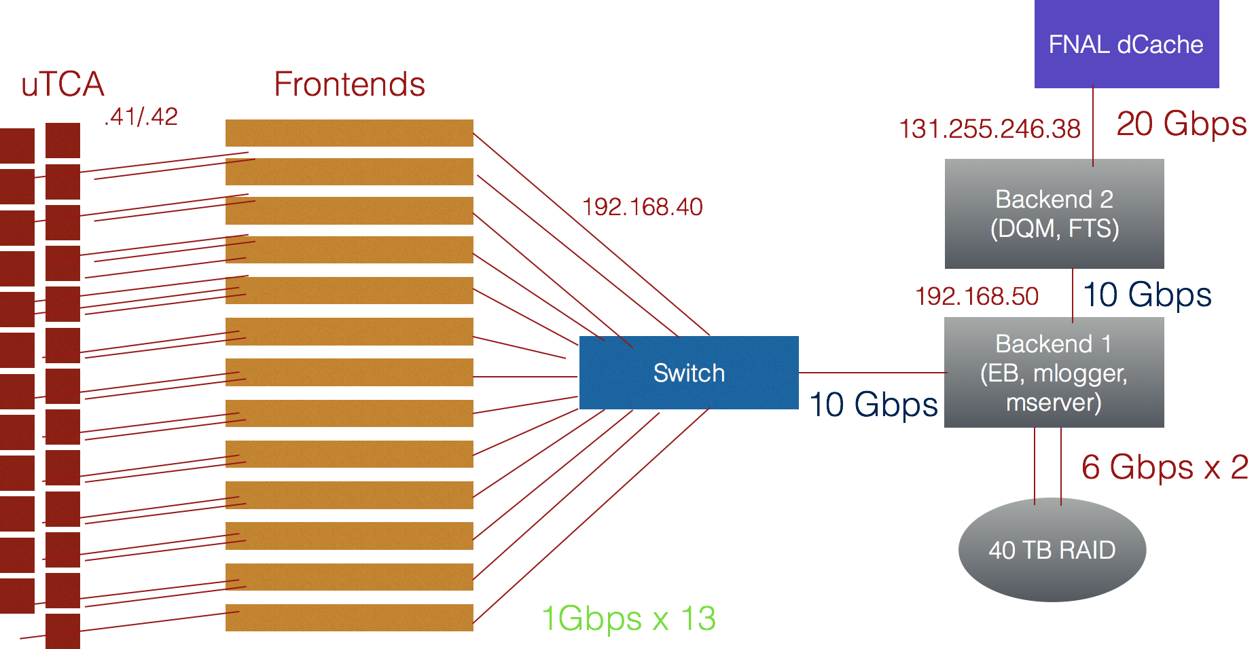
DAQ Data Network

Slide 12
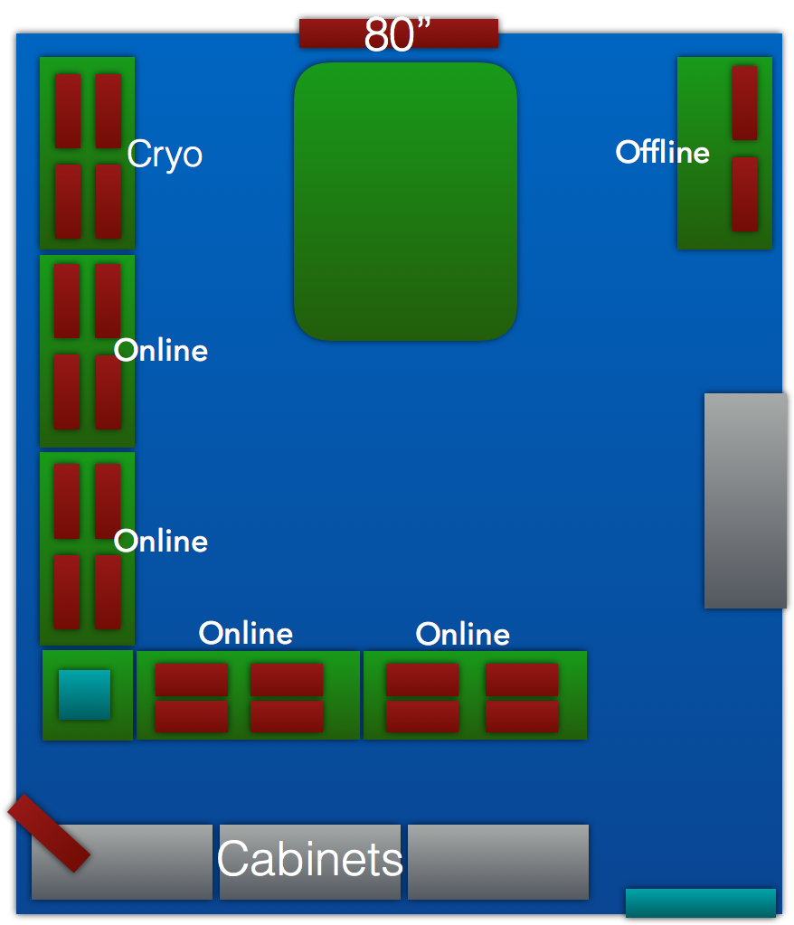
Control Room Installation
2/4 monitoring PCs installed + 8/16 monitors
Need computer to run event display on 80” screen (grant proposal pending)
Looking at equipment for videoconferencing – consulting FNAL experts.

Slide 13
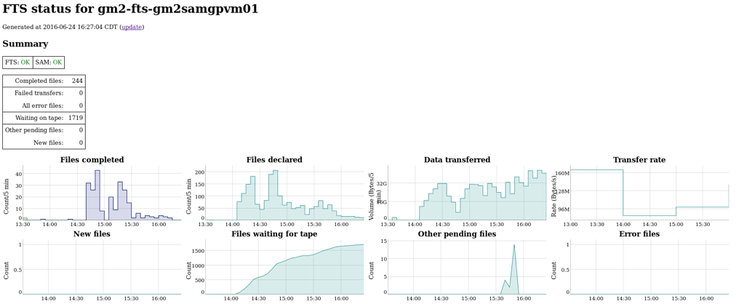
Fermi File Transfer Service
FTS serverruns on g2be2 and automatically copies Midas files from our local RAID to dCache/enstore.
Keeps copied files on our local disk for a set time, so they will still be available for near-line analysis.
Automatically updates SAM database with metadata for every copies file.
Need to define metadata and write a plugin that will extract it from MIDAS ODB.
See talk by T. Walton tomorrow for more details.

Slide 14
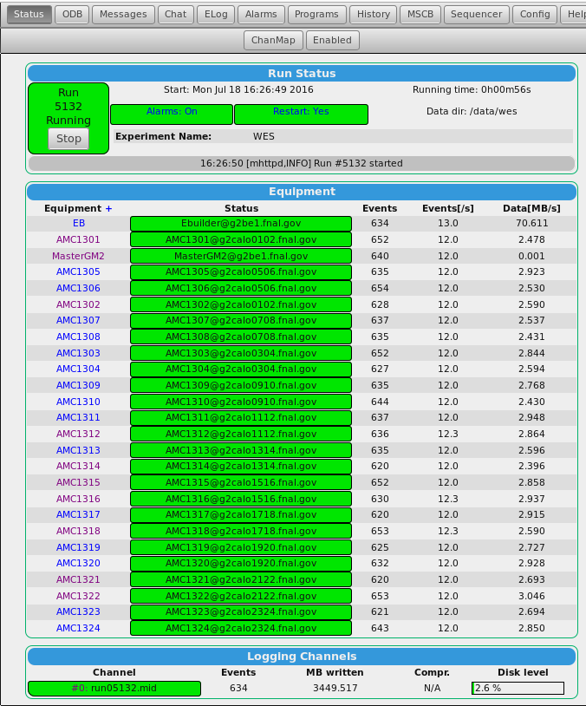
DAQ Software: MIDAS
MIDAS is a data acquisition software package developed at PSI and Triumf.
Significant experience in collaboration from multiple PSI experiments.
Includes web-interface for easy run control and experiment configuration via an online database (ODB)
Frontend code written in C/C++ with CUDA for GPU programming and IPBus libraries for communicating with µTCA electronics.
Data will be stored as MIDAS data-files, and then translated to art offline.

Slide 15
MIDAS Programs
Included with Midas:
MLogger: Writes data to Midas file.
Mserver: Coordinates Midas processes across multiple machines.
Mhttpd: Hosts a webserver for experiment control.
Online Database (ODB): Local database for control of experiment.
Custom Software:
MasterGM2 (UKY): received accelerator trigger and writes GPS timestamp into data stream.
CaloReadoutAMC13 (UKY): Reads data from AMC13 via 10 GbE, processes data in GPU using CUDA routines for T and Q methods. Also configures AMC13 via MIDAS online database and IPBus. Also reads auxiliary detectors.
TrackerReadout (UCL): Reads tracker multi-hit TDCs.
EventBuilder (UKY+UCL): Combines data fragments from multiple buffers into MIDAS events.

Slide 16
Data Format
MIDAS Run: 1 hour
MIDAS Run: 1 Hour, 120 subruns
Subrun: 2 GB
Event: 1 Fill (700 us)
GPS Timestamp
T-method
Q-method
Prescaled Raw
Pedestals
Header/Trailer
Process monitoring
Auxiliary banks
Tracker bank

Slide 17
Data Compression
We are compressing the data using the zlib libraries in each of the frontends.
The frontend compresses all banks into one compressed bank, which is unpacked later in an art input module.
We achieve a factor of 2 compression without any significant impact on the overall acquisition speed.

Slide 18
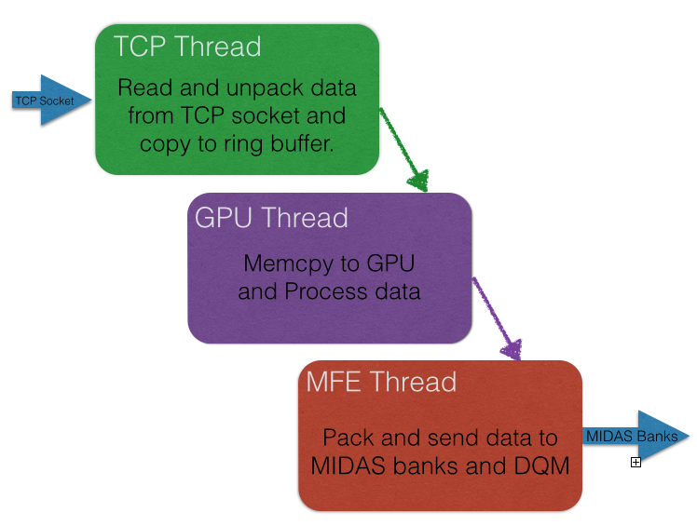
Code Structure
CPU multithreading with mutex locks to insure data integrity as it is passed through the three threads.
One thread reads and unpacks data from TCP socket.
Next thread sends data to be processed on the GPU.
Third thread packs data into Midas banks and sends it to the event builder.

Slide 19
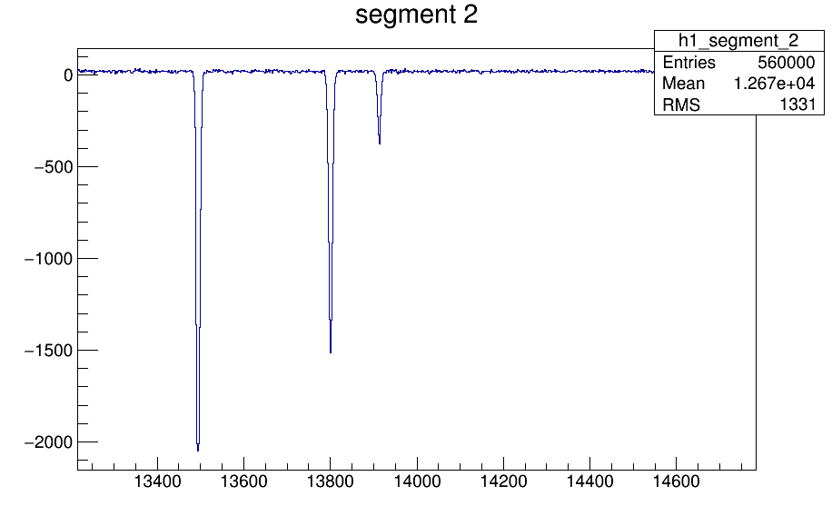
T-Method
A typical waveform will have ~180 islands.
Here we zoom in on three, which will be identified and saved by algorithms in the GPU.
Identify samples above threshold.
Extend islands
Combine islands
Save islands

Slide 20
Q-Method
Sum of 100 fills with 16x decimation.
Each fill is summed in GPU.
Tunable parameters are:
Flush rate
Time decimation
Crystal sums
Compression factor determined by tunable settings.
Pedestal subtraction is necessary to remove fill-correlated noise.
Possible solution would be logarithmic binning, but more study is needed (see talk by T. Gorringe).
Pedestals showing fill correlated noise

Slide 21
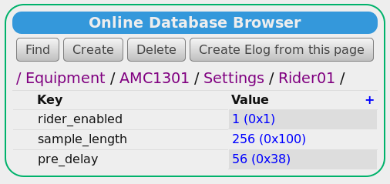
Run Control and ODB
Experiment is fully configurable via an online database
Testing custom JS pages for improved and constrained user control
Entire configuration stored for each run in json format, which will be stored in DB (see talk by D. Li)

Slide 22
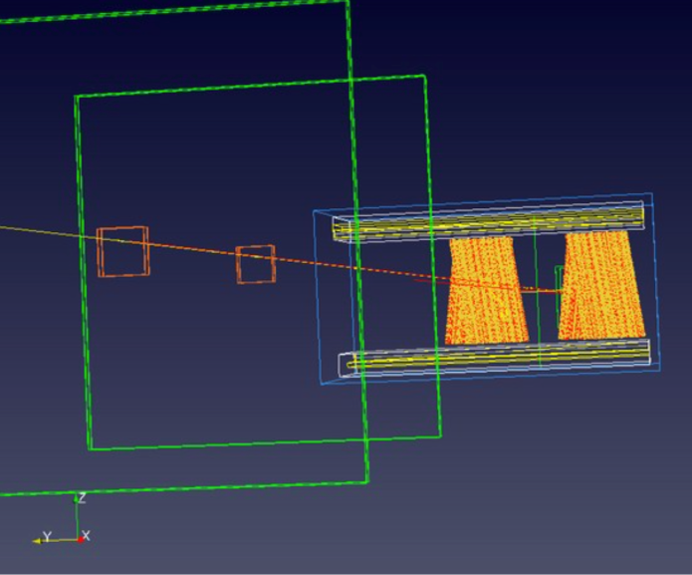
Tracker DAQ
Runs as part of the main Midas DAQ as a separate frontend.
Read out using multihit TDCs via a µTCA crate.
Rates are much lower than for the calorimeters, so data unpacking occurs offline.
See talk by J. Price today for more details.

Slide 23
Auxiliary Detectors
One uTCA crate with waveform digitizers will be used to read out auxiliary detectors such as the fiber harps, kickers, and quads.
We have built the flexibility into our main readout frontend to be able to handle multiple detector types with different acquisition methods.
System | Channels | Sample rate | Waveform length | Raw Data rate
Harp | 28 | 800 MHz | 700 us | 360 MB/s
Quads | 4 | 40 MHz | 700 us | 3 MB/s
Kicker | 6-9 | 200 MHz | 2-4 us | <1 MB/s

Slide 24
Laser Monitor
The Laser runs in two modes:
Uniform pulses sequence between muon fills – islands are chopped with FPGA.
Laser pulses during a muon fill, and pulses are chopped in the GPU.
The laser system is monitored using a µTCA crate of Riders and by custom-built 14 bit boards.
A Midas frontend is under development to read out the 14 bit board (Naples).

Slide 25
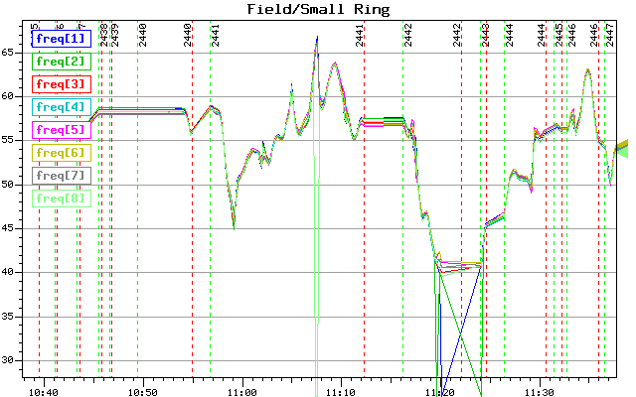
Field DAQ
Utilizes separate Midas experiment with data not tied to muon fills.
Performs both continuous B-field measurements at fixed points and records data from trolly runs.
Utilizes custom JS for online data display and Midas history for simple trendplot display.
See talk by M. Smith for more detail.

Slide 26
Slow Controls
Slow controls will use the Midas Slow Control Bus (MSCB).
It runs as a periodic Midas frontend, so it is not tied to the beam trigger.
Slow control signals are processed by an SCS3000 (pictured), and read by the MSCB program.
Data will be written to datafiles and to a Postgres database.
A Django based web display will provide trendplots based on the slow control data.
See talk by M. Eads for more detail.

Slide 27
Midas2art
We have written an art producer called midas2art.
Capable of reading Midas files or streaming data directly from the mserver (in a manner similar to NOνA).
The same art analyzers can be used online and offline.
It has been used for test beam data for the calorimeters (talk by K. Khaw) and trackers (talk by J. Price).
Utilized online in DQM system (talk tomorrow by W.G.)
MIDAS File
mserver
midas2art
gm2dataproducts
art File
Online DQM
art analyzers

Slide 28
Conclusion
The data acquisition system for muon g-2 is ready to begin commissioning, with only a few small pieces that need to be added.
Once the calorimeters and laser systems are installed, we will begin mock-production running, which will continue until the commissioning of the beam.
A wiki page and a detailed users manual are kept up to date.
Further studies of the Q-method are required to determine our total data rate to tape (see next talk by T. Gorringe), but current estimates indicate 10 PB of data over the lifetime of the experiment.

Slide 29
Backup

Slide 30
Summary
Our data acquisition system hardware for Muon g-2 is nearly complete. Still to install:
Database server -- PO placed
Laser frontend -- Quote received
IBMS frontend -- TBD
We have a working version of the DAQ code, and it is being tested and refined. Still under development are:
Q method algorithms – Testing to determine ideal configuration
Auxiliary crate readout – Testing multiple T/Q methods in single frontend.
Laser monitor readout – Prototype developed, refining readout
IBMS readout -- TBD

Slide 31
Personnel
Computing coordinator + Online Manager: W. Gohn
Online Monitoring Manager: ?
Main DAQ organization, Calorimeter processing, GPU algorithms, Auxiliary crate readout:
University of Kentucky: T. Gorringe, W. Gohn (PD), F. Hong (GS)
Tracker DAQ
University College London: M. Lancaster, R. Chislett (PD), G. Lukicov (GS)
Field DAQ
Fermilab + University of Washington: B. Kiburg (Wilson Fellow), M. Smith (GS)
Laser Monitor
Frascatti + Napoli: S. Mastroianni, N. Raha (PD)
IBMS Caen Readout
University of Washington: P. Kammel
DQM
U. Kentucky: R. Fatemi, W. Gohn (PD), L. Kelton (GS), U. Washington: A. Fienberg (GS), M. Smith (GS), UCL: R. Chislett (PD)
Paraview event display
Dubna: N. Khomutov, V. Krylov, UCL: W. Turner
Slow Controls
Northern Illinois University: M. Eads

Slide 32
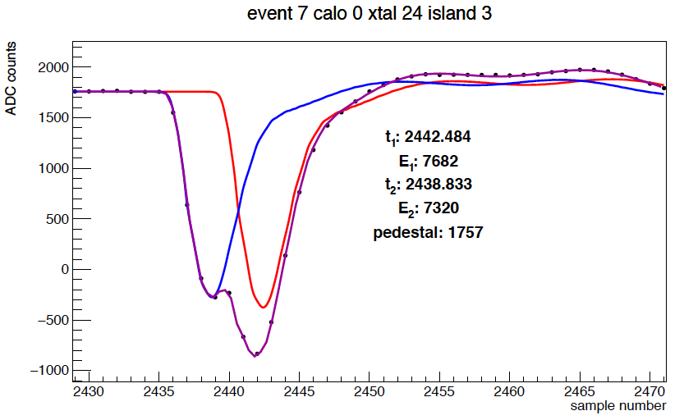
T and Q Methods
T-method
Positron events in the calorimeter are identified, sorted, and fit to obtain time and energy.
All events above an energy threshold are included.
⍵_{a} is determined from a fit to a pileup-subtracted histogram.
This was the method used in BNL E821.
Q-method
Individual positron events are not identified.
Detector current is integrated as a proxy for event energy.
No pileup correction is necessary.

Slide 33
Performance Testing
Three methods of testing the DAQ:
We wrote a simulator that runs as a Midas frontend and generates data synchronously with the master. This produces realistic looking events that can be used to test our GPU algorithms.
Rider readout. We have 420 channels of digitized data that we are processing with the DAQ, but we only have the hardware available to put pulses on 9 of those channels. This is useful for rate tests, but less useful for algorithm testing.
Laser flight simulator with calorimeters (near future), will allow us to test realistic fills in the calorimeter readout – this is the mode we will run in once the calorimeters and laser system are installed.

Slide 34
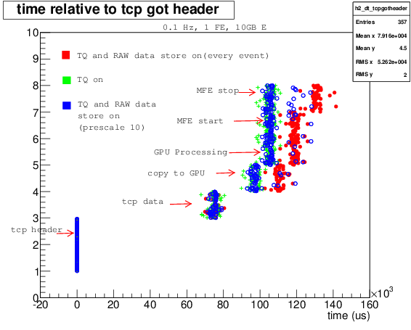
GPU Processing
CUDA kernel routines: Data is copied to GPU memory in GPU thread, and then accessed by the following functions to identify and save islands, which are copied back to the computer memory and sent to the event builder.
Function | Number of threads | Execution Time (ms)
Compute pedestals | 54 | 0.1
Determine if threshold is passed for each sample | 560k | 1.7
Add pre and post samples to each island | 560k | 0.1
Check to see if any islands have merged | 560k | 0.2
Save an array of identified islands | 560k | 0.2
Sum all waveforms | 560k | 1.2
Decimate sum | 17.5k | 0.3
Make a fill-by-fill sum of waveforms | 30M | 2.4

Slide 35
T-Method Tests
The T-method chops islands out of each waveform. We currently have four options:
Periodic trigger
Threshold on waveform sum over channels
Threshold on each channel
Pulse-shape weighted identification
Simulations showed that 4 has the lowest signal-to noise, and 2 is has such high signal to noise that it would be unreliable.
We performed tests comparing 3 and 4 using the Midas calorimeter simulator, and both perform equally well, but 3 takes about half the processing time.
The plots on the right show the number of identified islands vs the number of simulated islands for decreasing threshold.
10
20
30
40

Slide 36
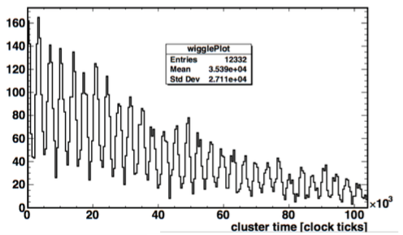
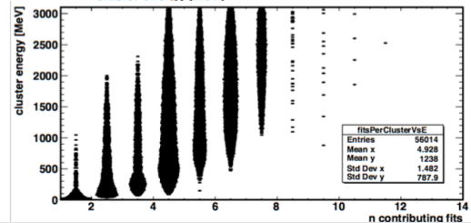
GPU Pulse Fitter
Recently we have implemented an adaptation of our template fitter into our GPU algorithms.
It works online, and returns just the fit parameters for every pulse in a fill in a Midas bank.
This data is not expected to be used for final analysis, but it will greatly increase the speed of our online and nearline analysis.
The increase to our GPU computing time is negligible (about 1 ms).

Slide 37
Pedestal variations
We see both short-time pedestal variation over a single fill, and long term pedestal drive over a period of hours. Both must be accounted for.
We have one pedestal subtraction algorithm that averaged the first N or last N samples in a fill, but we are looking to replace it with one that is more robust.
Pedestal in one channel over 250000 events.

Slide 38
Q-Method Tests
We have found that it is necessary to extract the pedestal from the Q-method data in the GPU to get rid of fill-correlated noise.
This limits the number of samples we are able to sum, because we need to see the pedestal between samples.
We are exploring options such as logarithmic binning or multi-histogramming to account for this.
Fill correlated noise

Slide 39
Rate test
The following test was used while reading out 7 uTCA crates, so 420 channels of digitized data.
We performed the test with frontend compression on and off.
The maximum rate we were able to attain was about 400 MB/s. We think this is frontend limited, so it should scale as we increase the number of crates.

Slide 40
Data Unpacking
The data from the AMC13 has to be unpacked before it is sent to the GPU.
We tested unpacking of the data in three mechanisms:
Unpacking in CPU to GPU memcpy.
Unpacking in CPU
Unpacking in GPU
It was found that the GPU unpacking is by far the fastest.

Slide 41
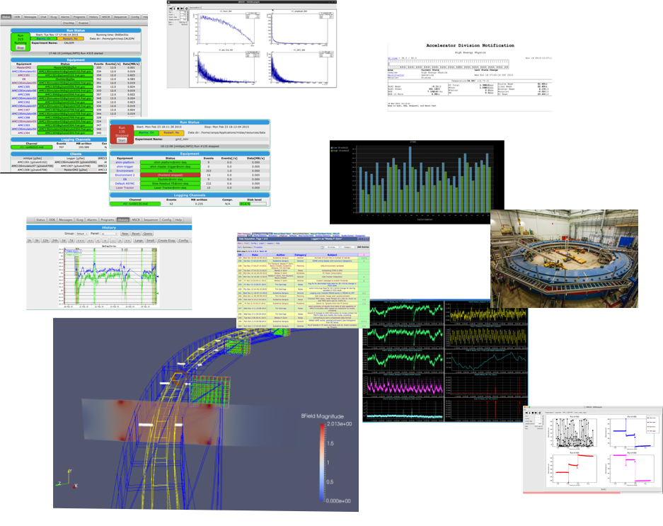
Control Room Requirements
MIDAS for detectors
MIDAS for field
DQM for detectors
DQM for field
Trend plots
Laser monitor
Rider monitor
Kicker monitor
CTAG display
Run log
Elog
Video feed
MIDAS History (for field)
High Voltage control
Nearline monitor
SiPM monitor
Run status display
Daq monitor
Free / User space
80” Paraview Event display

