Slide 1
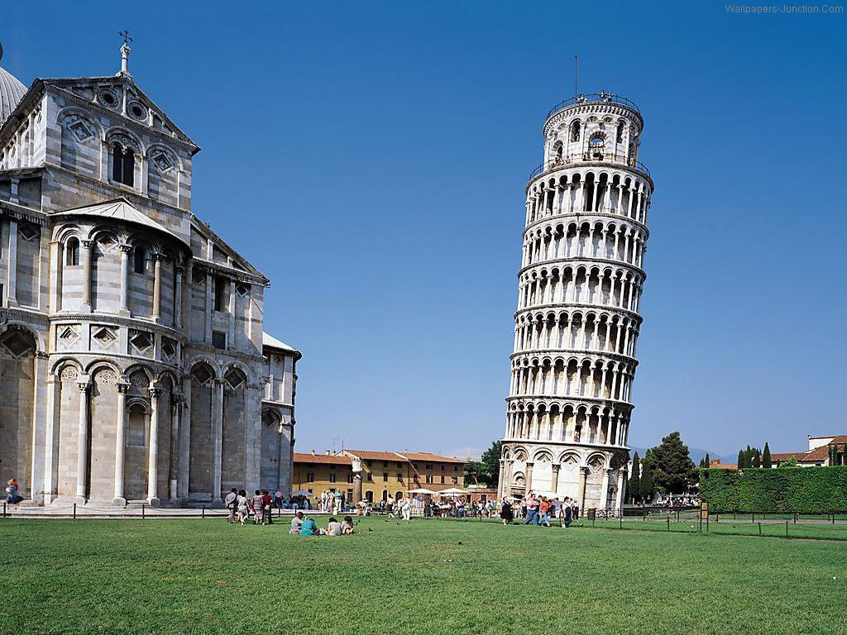
NuMI Horn 1 mis-alignment
Jim Hylen
NuMI operations meeting
11/08/2016

Slide 2
Timeline
29 September 2015: alignment/survey of horn PH1-03 (replacement for failed PH1-04; to achieve alignment, move US shaft down 0.165”, DS shaft down 0.051”)
9 October 2015: move target to work cell to allow beam scan of horn cross-hairs
18 October 2015: beam scan of horn 1 – horn in passable alignment
29 June 2016: switch horns from FHC to RHC ( to anti-neutrino mode)
29 July 2016: end of FY16 run
Shutdown work - remove target because of helium leak, switch RHC to FHC
30 October 2016: beam scan of horn – neck ~ 1/8” inch low (V-nub not visible)
Diagnose problem, horn move, 1 Nov 2016 scan see cross-hair, repair drive, realign
4 Nov 2016: final beam scan of horn before target installation; passable alignment
7 Nov 2016: final survey of Horn 1 tooling balls
Need to try to determine progression
of mis-alignment from monitoring

Slide 3
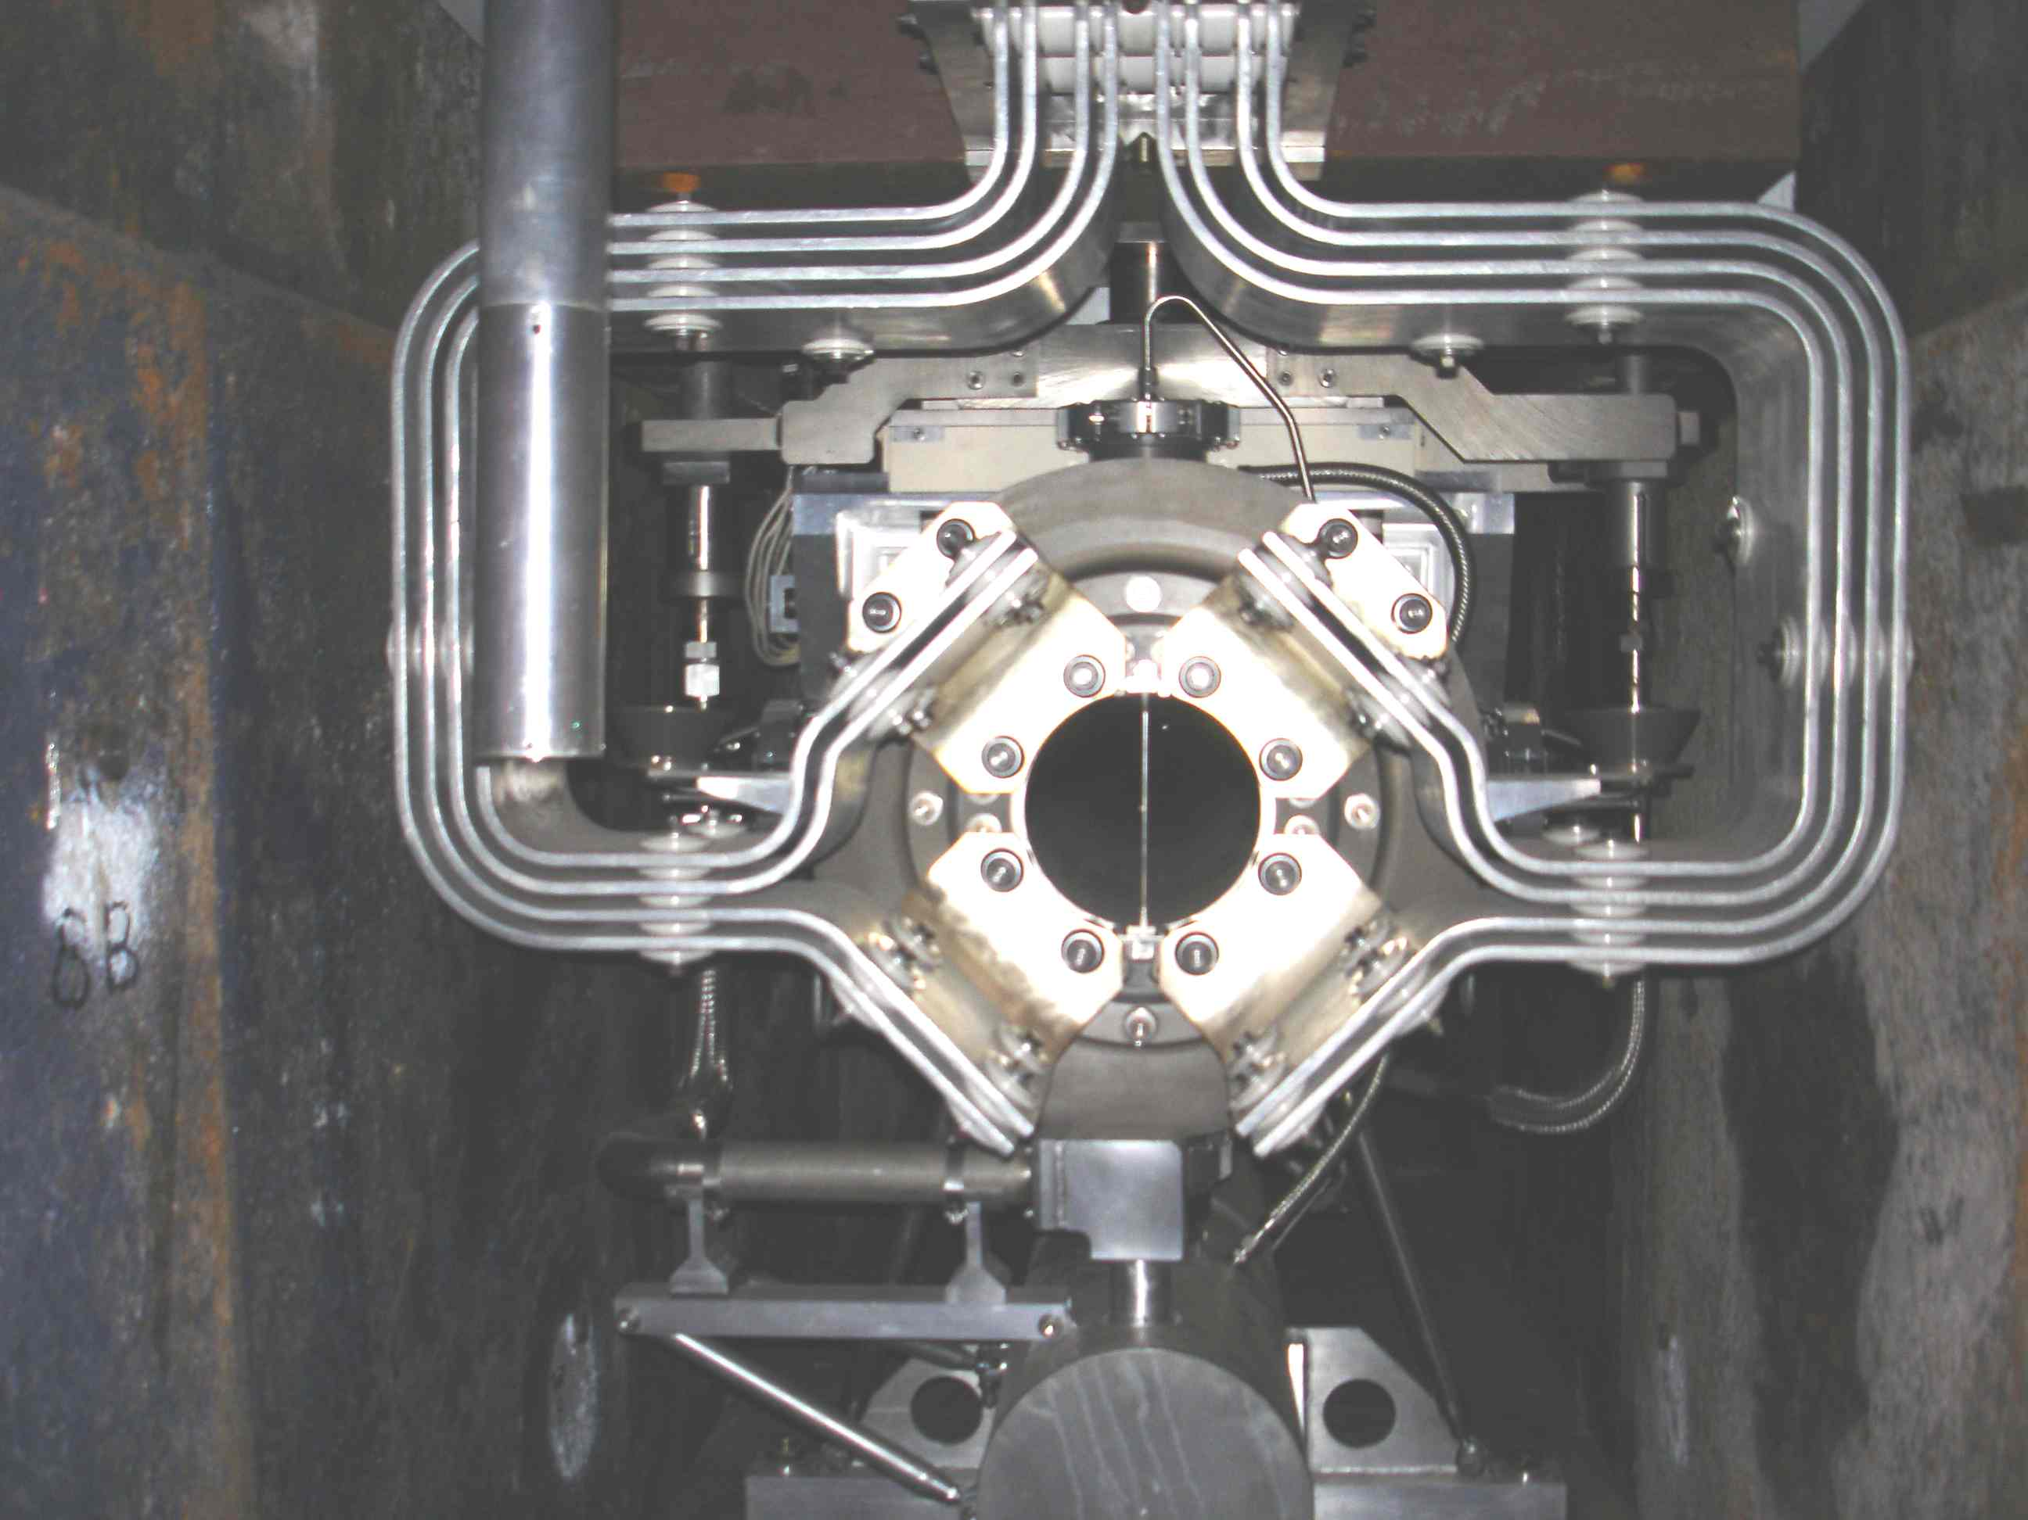
Horn cross-hair
Fin for beam
horz. alignment
Nub for beam
vert. align
Beam loss mon.
to detect beam
scatter from fin
(“cross-hair”)

Slide 4
Horn 1 on module
shafts
2016 survey found top
of downstream shaft
within 0.005” of
2015 survey
So best guess is that
entire deviation is
from upstream shaft
Horn neck
Rotation bearings
Tooling Balls for survey
Cross-hair

Slide 5
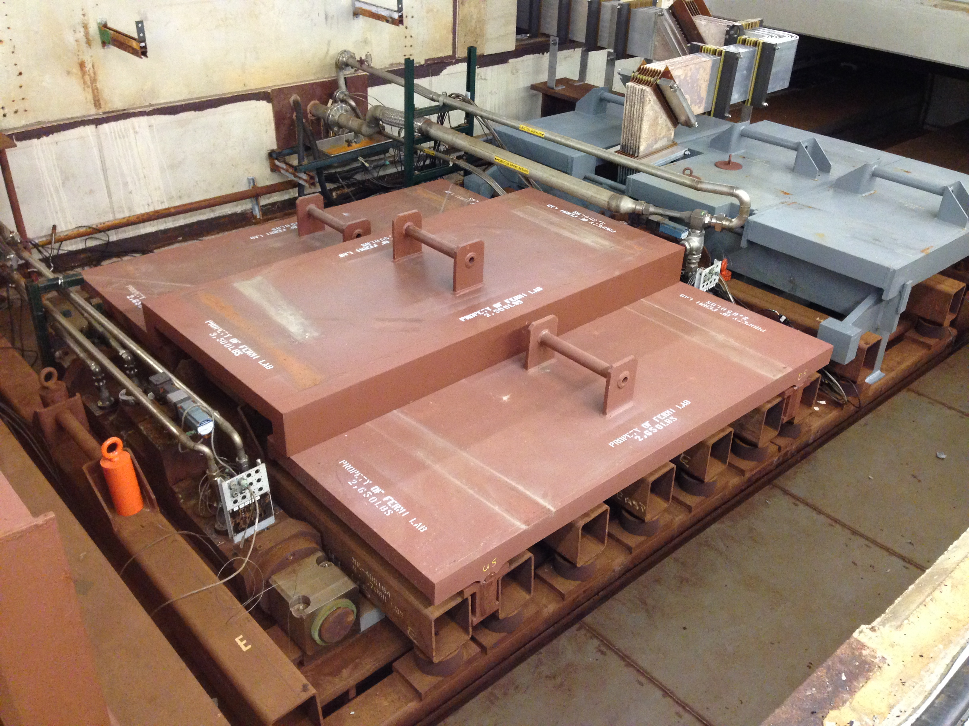
Horn Alignment Issue Specifics
Horn 1 Upstream Vertical Drive.

Slide 6
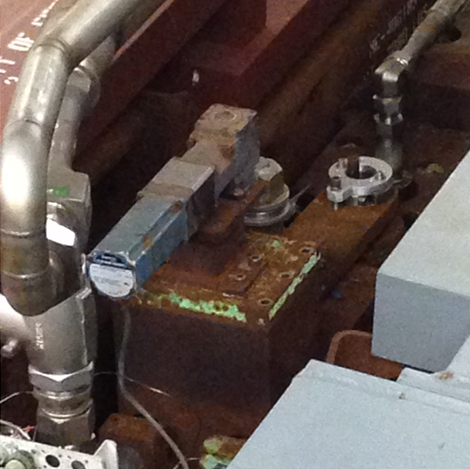
Horn Alignment Issue Specifics
Horn 1 downstream vertical drive.

Slide 7
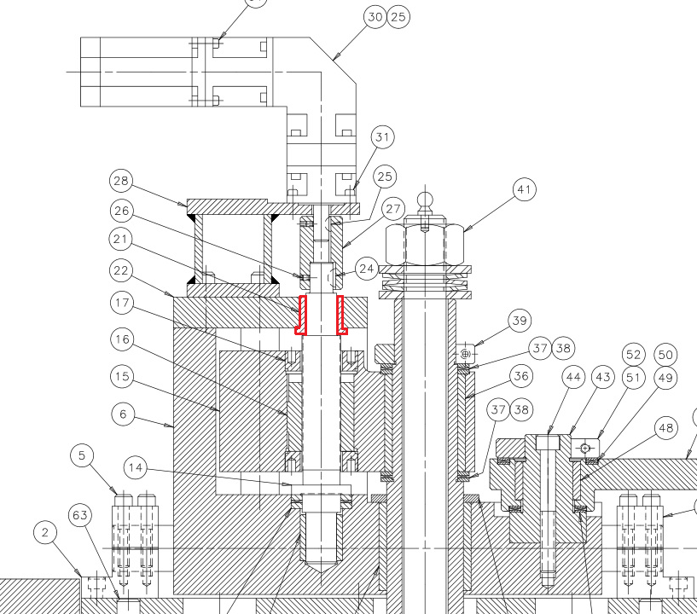
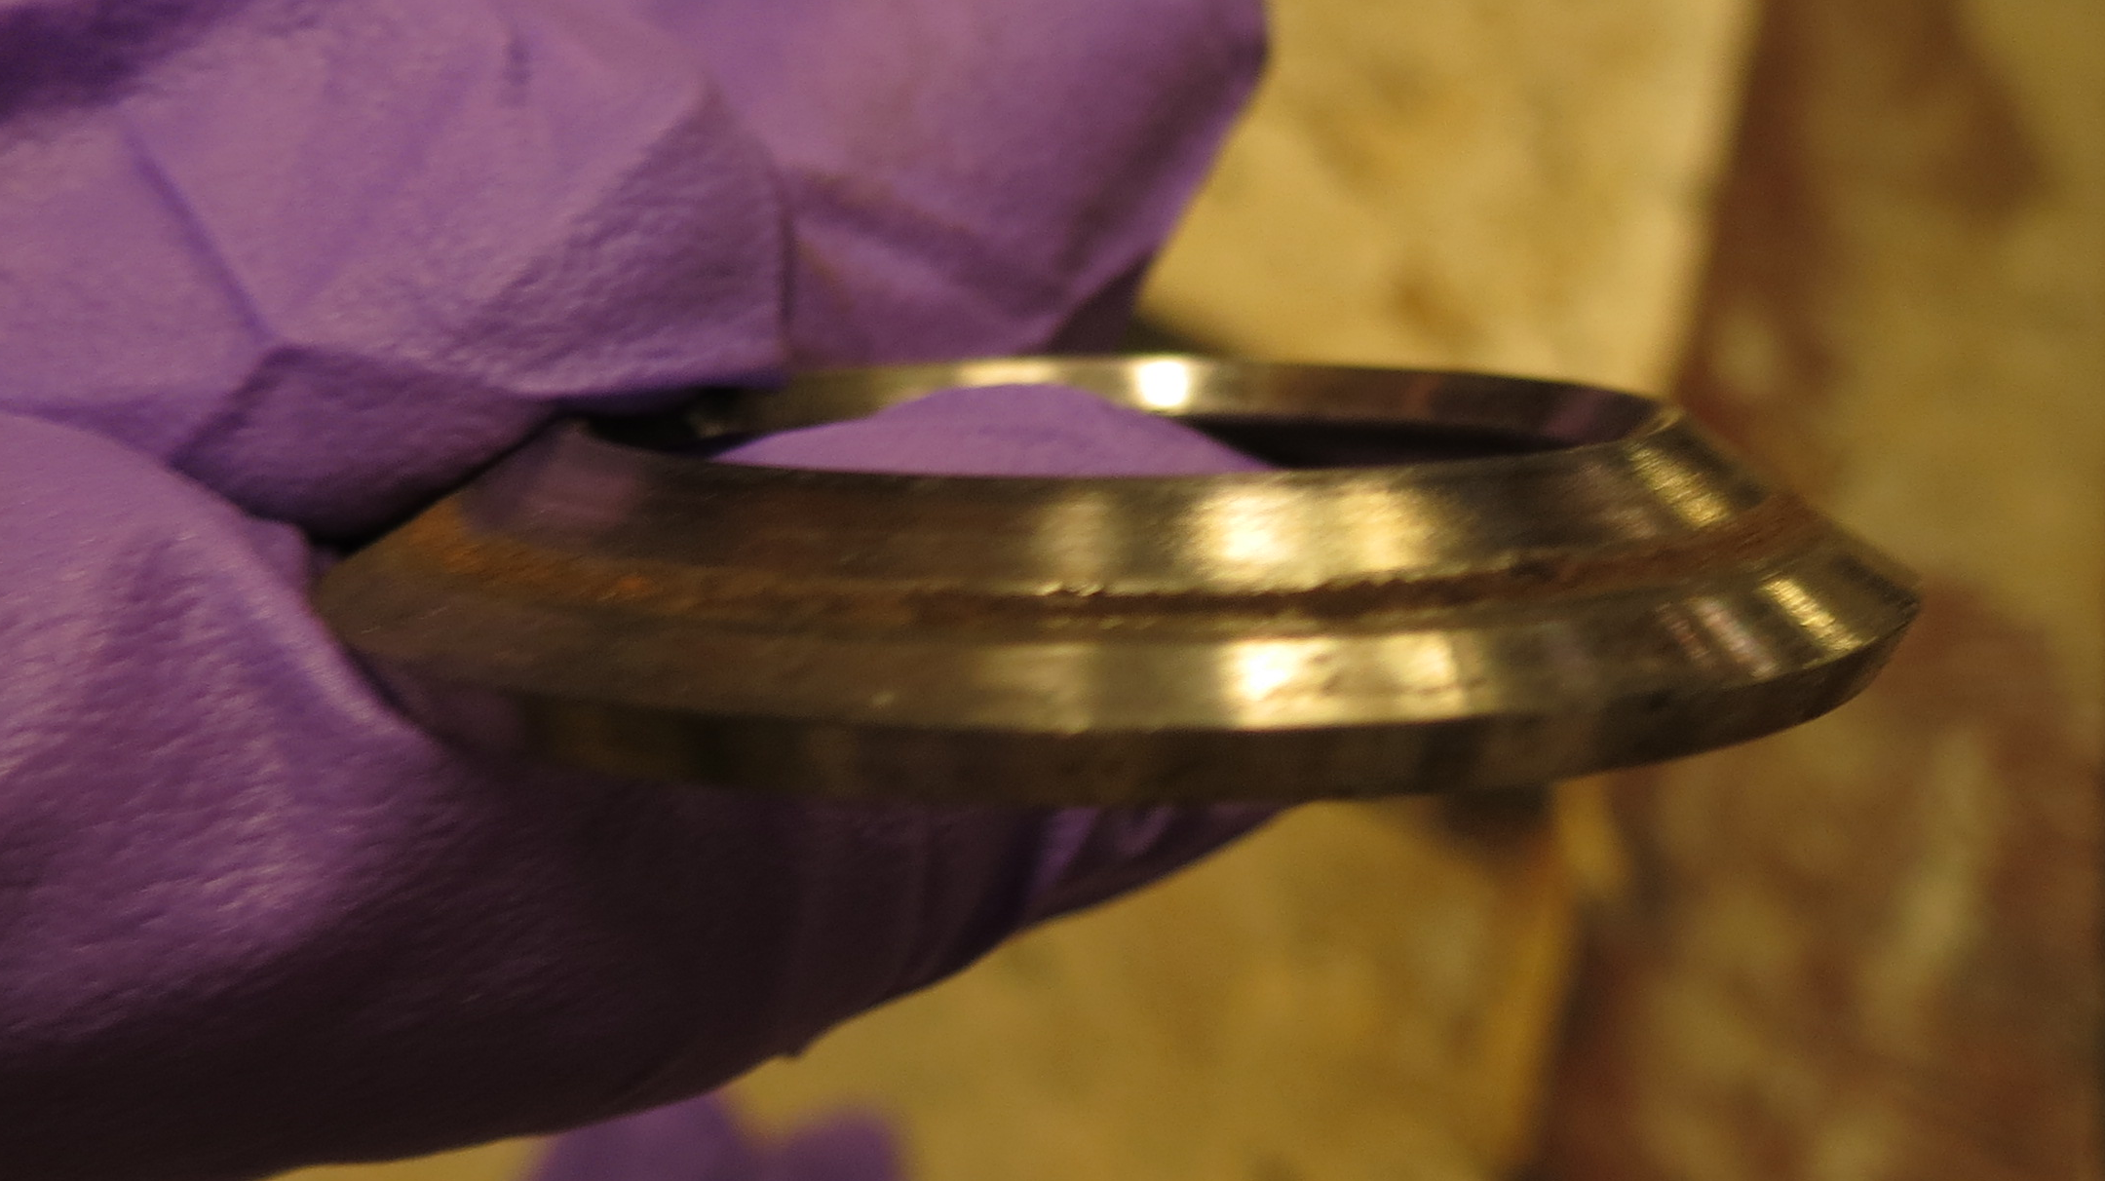
Component Failure
Drive system bushing (hard stop) found to be broken and out of position.
Motor
Main shaft to horn
There is a thrust washer
not shown in drawing.
It was warped.

Slide 8
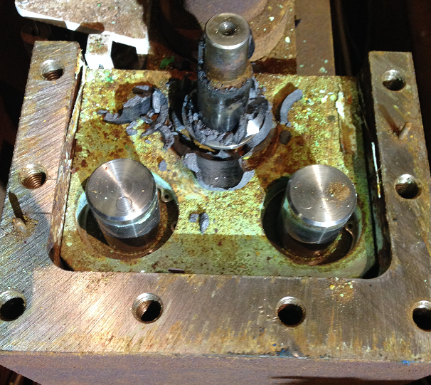
Component Failure
Pieces of bushing all over ball screw.
Found to be Graphalloy (metal impregnated graphite).
Failure was caused by corrosion induced friction of drive components, causing excessive force on the Graphalloy.

Slide 9
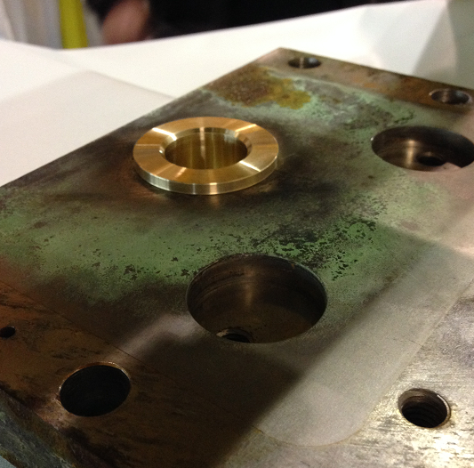
Component Repair
New bushing is corrosion resistant naval brass.
Will likely provide years of operation.

Slide 10
Scenario
The graphalloy only sees force during horn move down. In clean operation, gravity is pulling horn down, and there should be minimal force on this.
As shaft and its bushings corroded, ended up needing a lot of force to move horn down. Graphalloy broke, thrust washer bent, leaving large back-lash possible.
At end of PH1-03 installation, apparently drive was at top or close to top of this back-lash.
Speculate that vibration from horn pulsing gradually let gravity overcome the friction, and shaft sank to finally rest on the lower metal bearing.
Mechanically, the movement may have been slow, or jerky, or fairly fast on the time-scale of the FY16 run.
Would like to have Monte Carlo of the effect both in the MINOS ND and the NuMI muon monitors, to try to determine if we can get a consistent picture of when and how fast the horn sank.

Slide 11
Operation notes
Replaced the US shaft graphalloy bushing/bearing with naval brass
Replaced the DS shaft graphalloy bushing/bearing with naval brass as well
Shaft drive systems backlash now: US 0.03” to 0.04”, DS 0.02” to 0.03”
To assure that shafts are resting on the bottom bearing, went an extra 0.09” down on each shaft, and came back up to the final setting.
When we tried to move the shafts horizontally to achieve the best alignment based on the beam scan, found they are too corroded to move.
Repair would involve some months of parts acquisition, dismounting the horn from the module and strip-line block, and some weeks of work in the work cell.
Horn is within NuMI-MINOS TDR alignment tolerance, although not best achievable. Decided to put target in and proceed to get beam to experiments.

Slide 12
Size of mis-alignment (Preliminary)
Backing out Horn 1 neck move by two different methods yields it sinking by
  2.75 mm or 2.35 mm
Backing out Horn 1 cross-hair move by two estimations, it may have raised by
  0.8 mm or 1.5 mm
Upstream end of horn 1 may have sunk ~ 3.8 mm
Suggestion for initial model: rotate horn by 1.37 milli-radians around downstream rotation bushing. Upstream end moves down, downstream end moves up.
Table of stationing relative to MCZERO:

Slide 13
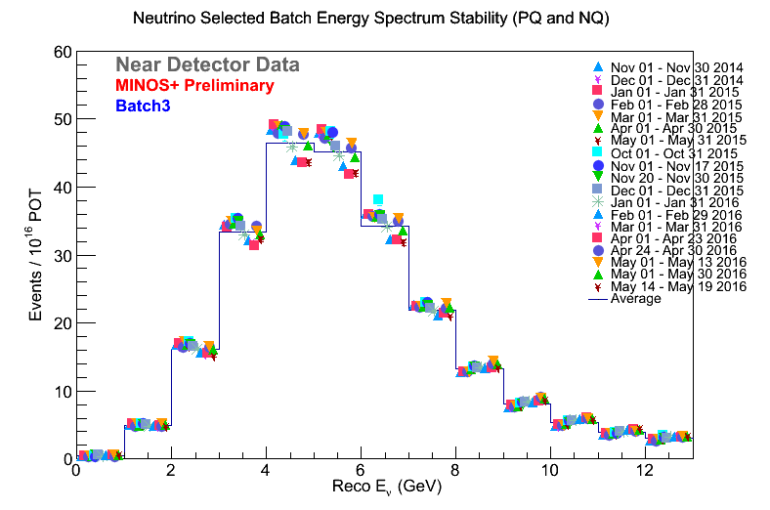
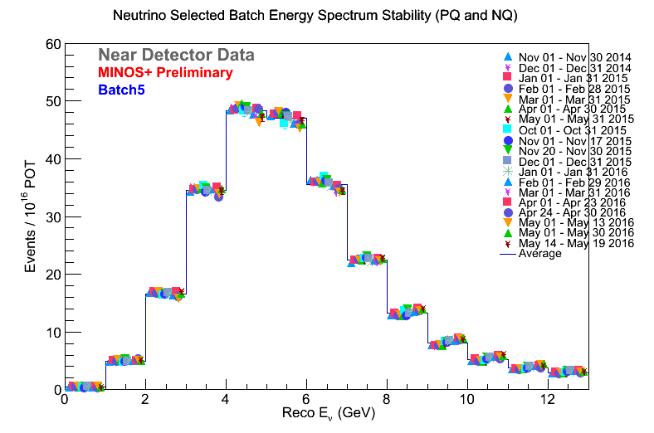
MINOS ND for FY15 & FY16 neutrino run
Is rise in HE tail connected
to horn 1 moving ?
Saw 10% dip in reconstructed Nu-CC
in slip-stacked batch –
came most of the way back when
non-slip-stacking after RR fire -
mainly reconstruction eff. !

Slide 14
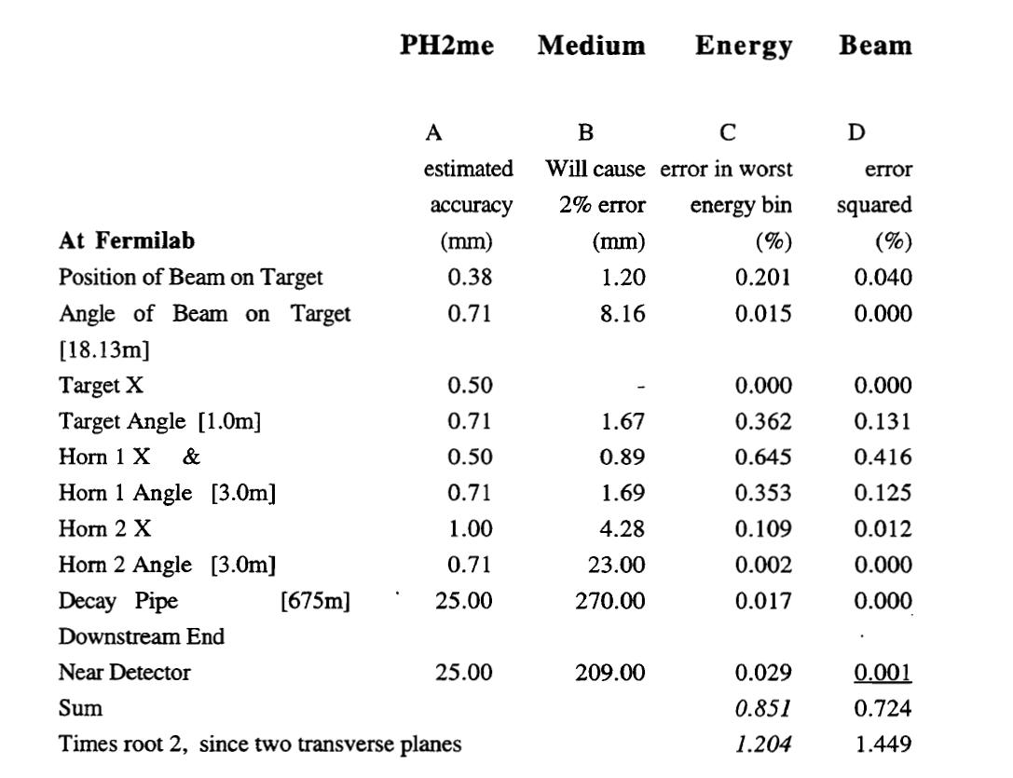
From NuMI TDR - tolerances for NuMI Far/Near

Slide 15
Summary of scan results – 1st ME Fall 2013
HORZ. | X seen |  |  | Beam Set to: | Beam Set to: | X from beam (mm)
 | 0.82 |  | H1 neck | 1.00 | 1.00 | -0.18
 | 0.63 |  | H1 fin | 1.00 | 1.00 | -0.37
 | 1.80 |  | H2 fin | 1.00 | 1.00 | 0.80
ave | 1.08
 |  |  | target | 1.00 | 1.00 | 0.0
 |  |  | Had mon |  |  | -18
VERT. | Y seen |  |  | E:VP121 | E:VPTGT | Y from beam (mm)
 | 0.47 |  | neck | 0.00 | 1.00 | 0.47
 |  |  | H1 fin
 | -1.10 |  | H2 fin | 0.00 | 1.00 | -1.10
ave n,n,h2 | -0.05
 |  |  | target | 0.00 | 1.00 | -0.2 to +0.5
 |  |  | Had mon | 0.00 | 1.00 | -15
-0.4 to + 0.4

Slide 16
Oct. 2015 Alignment Horizontal
TDR error est.
Beam setting for running
Misalignment

Slide 17
Oct. 2015 alignment Vertical
TDR error est.
Beam setting for running
Misalignment

Slide 18
DRAFT Horizontal alignment as of 7 Nov 2016
Plan to tweek autotune setting a little more.

Slide 19
DRAFT Vertical alignment as of 7 Nov 2016
Plan to tweek autotune setting a little more.

Slide 20
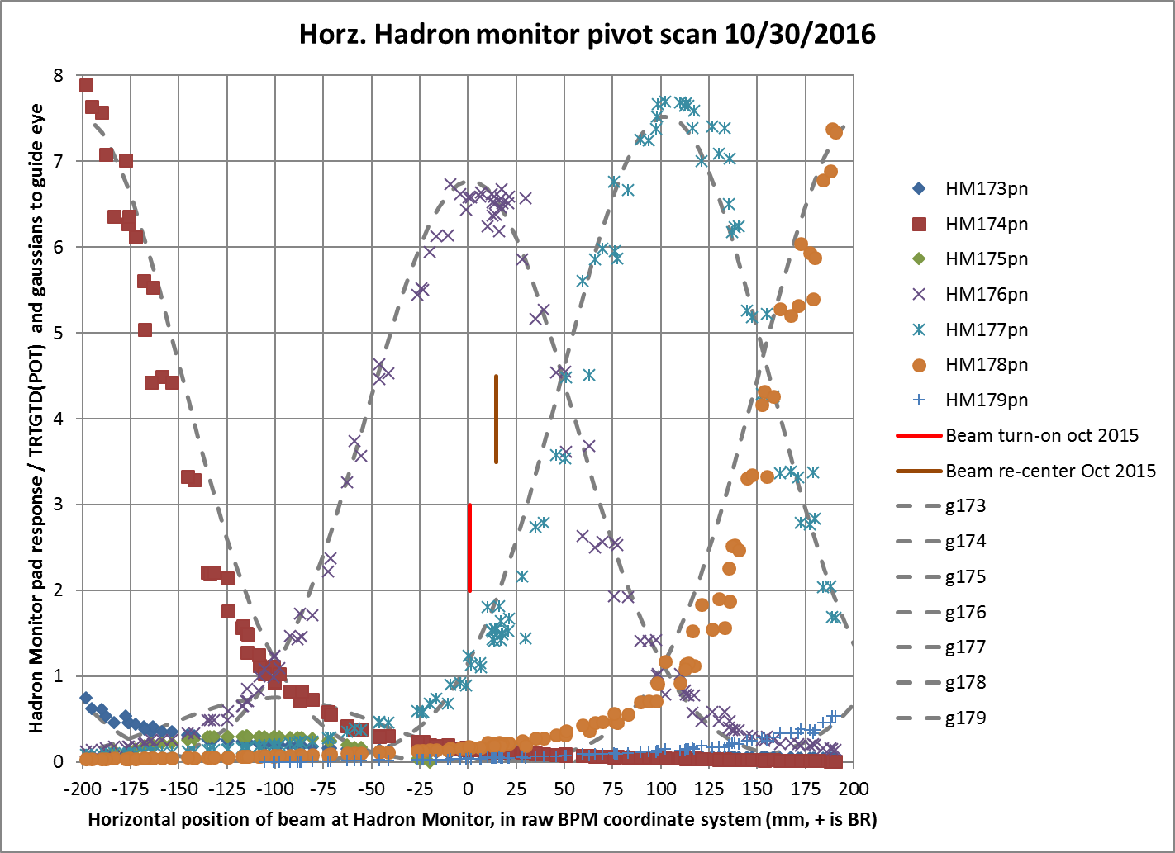
Scan of hadron monitor to get beam angle: horizontal

Slide 21
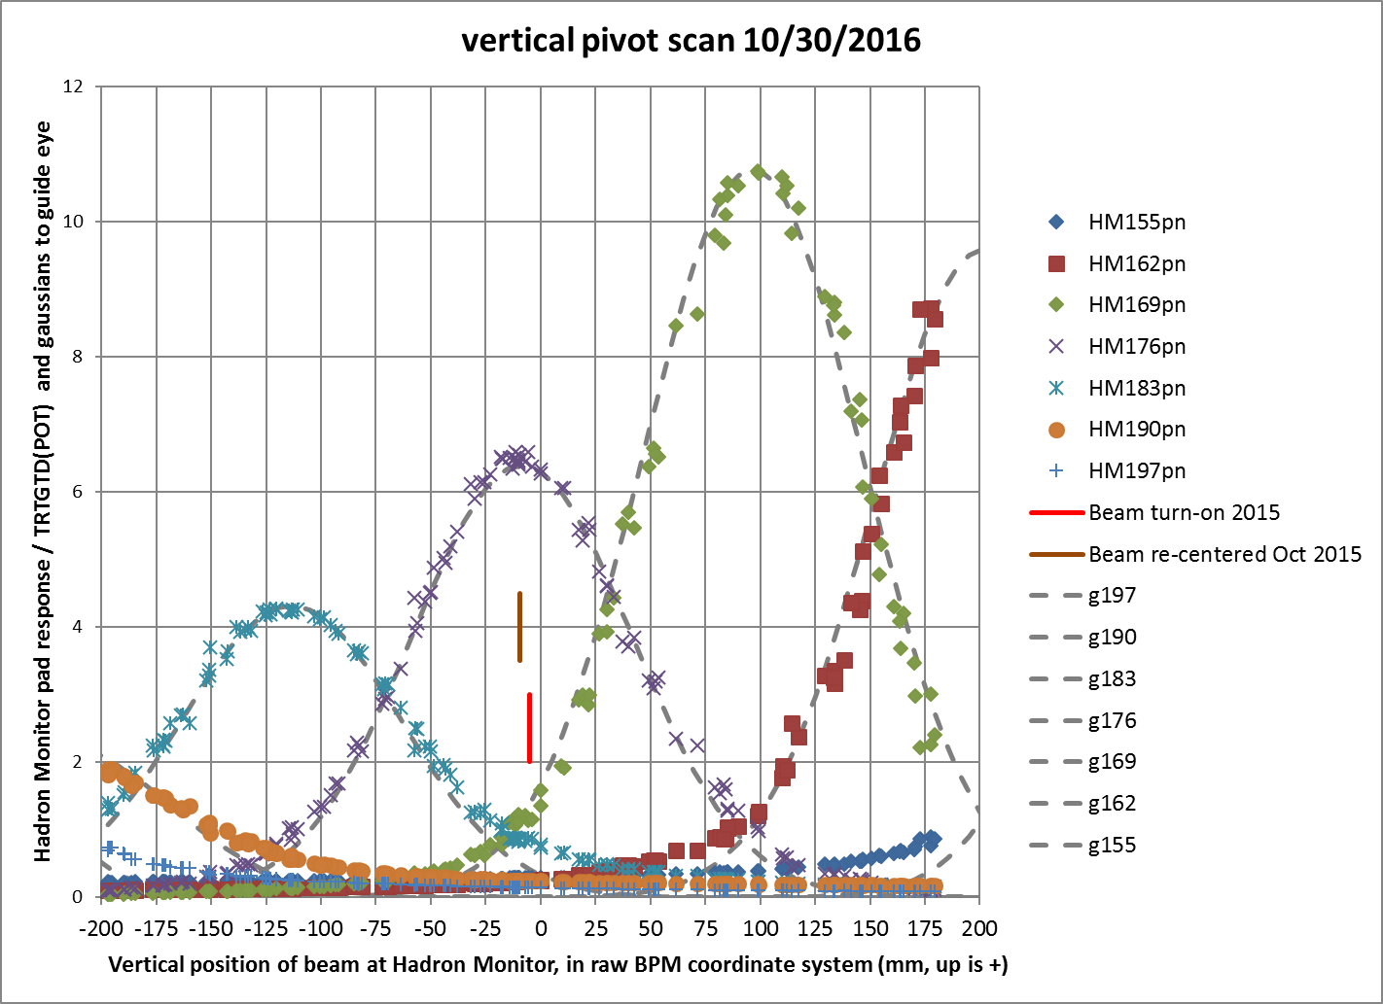
Scan of hadron monitor to get beam angle: vertical

Slide 22
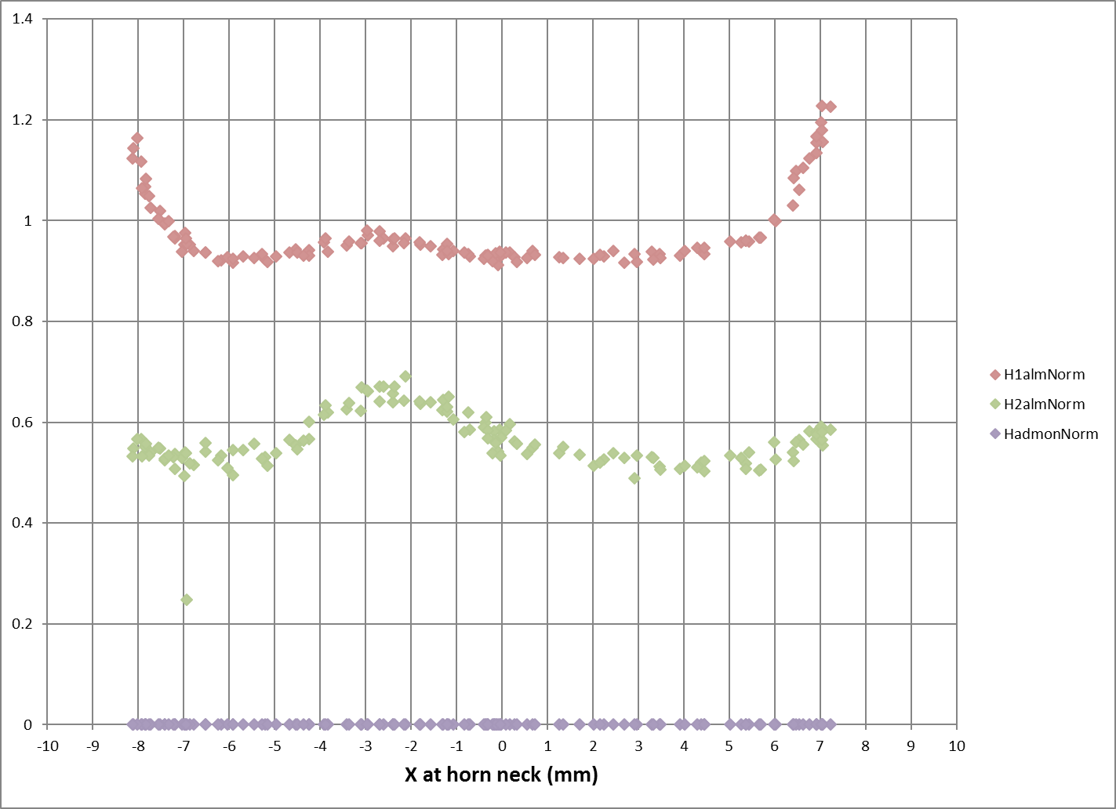
Nov 4 horn scan Horizontal; Horn 1 neck (final)

Slide 23
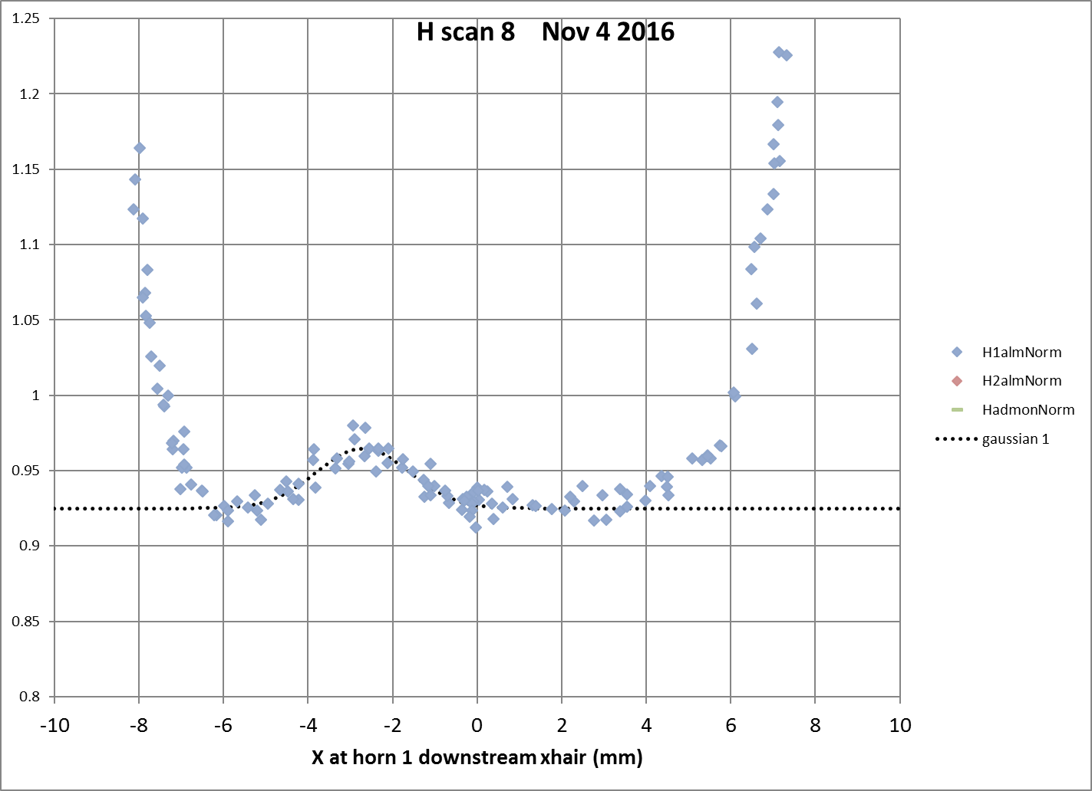
Nov 4 horn scan horizontal; Horn 1 DS fin

Slide 24
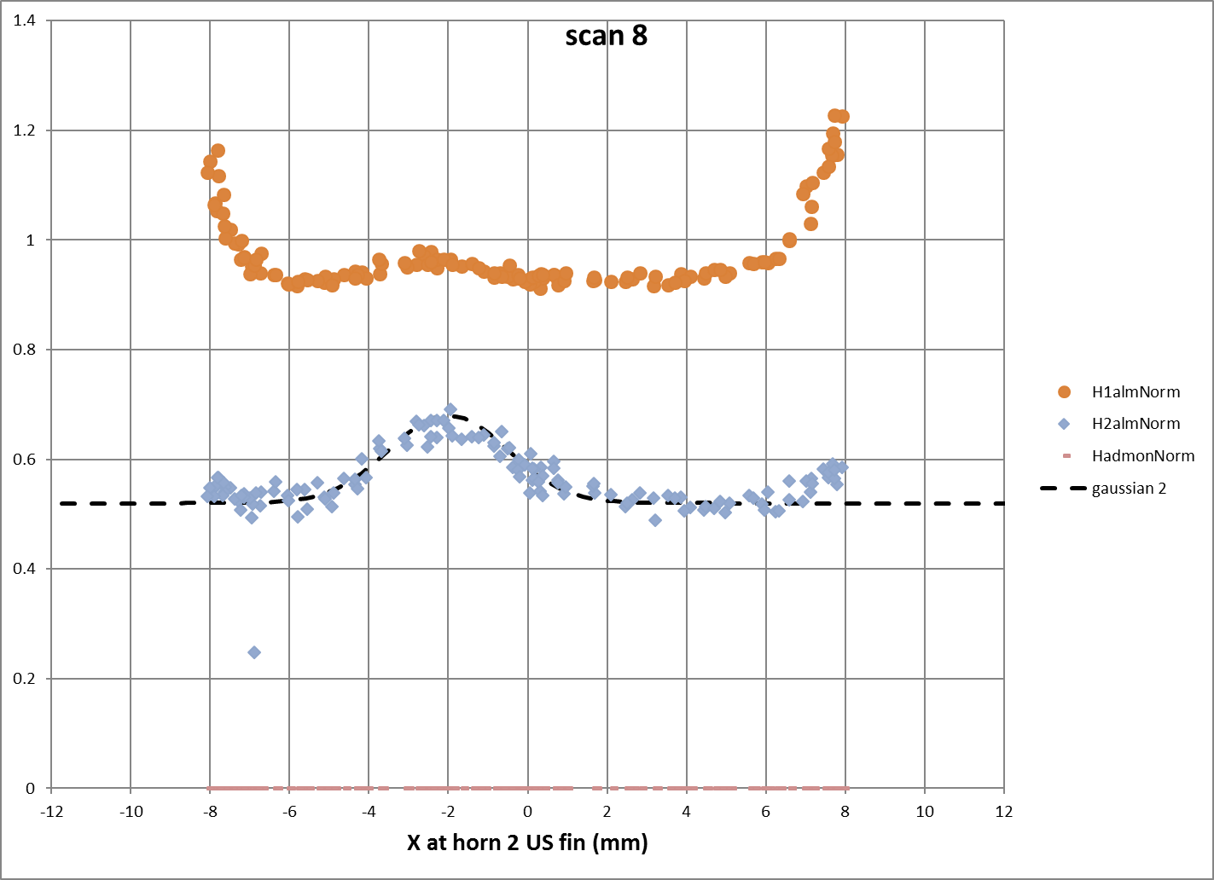
Nov 4 horn scan horizontal; Horn 2 US fin

Slide 25
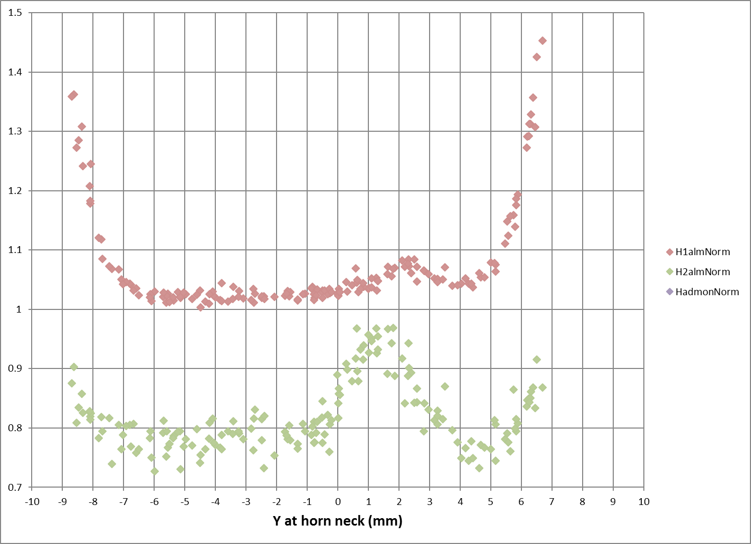
Nov 4 horn scan vertical; Horn 1 neck

Slide 26
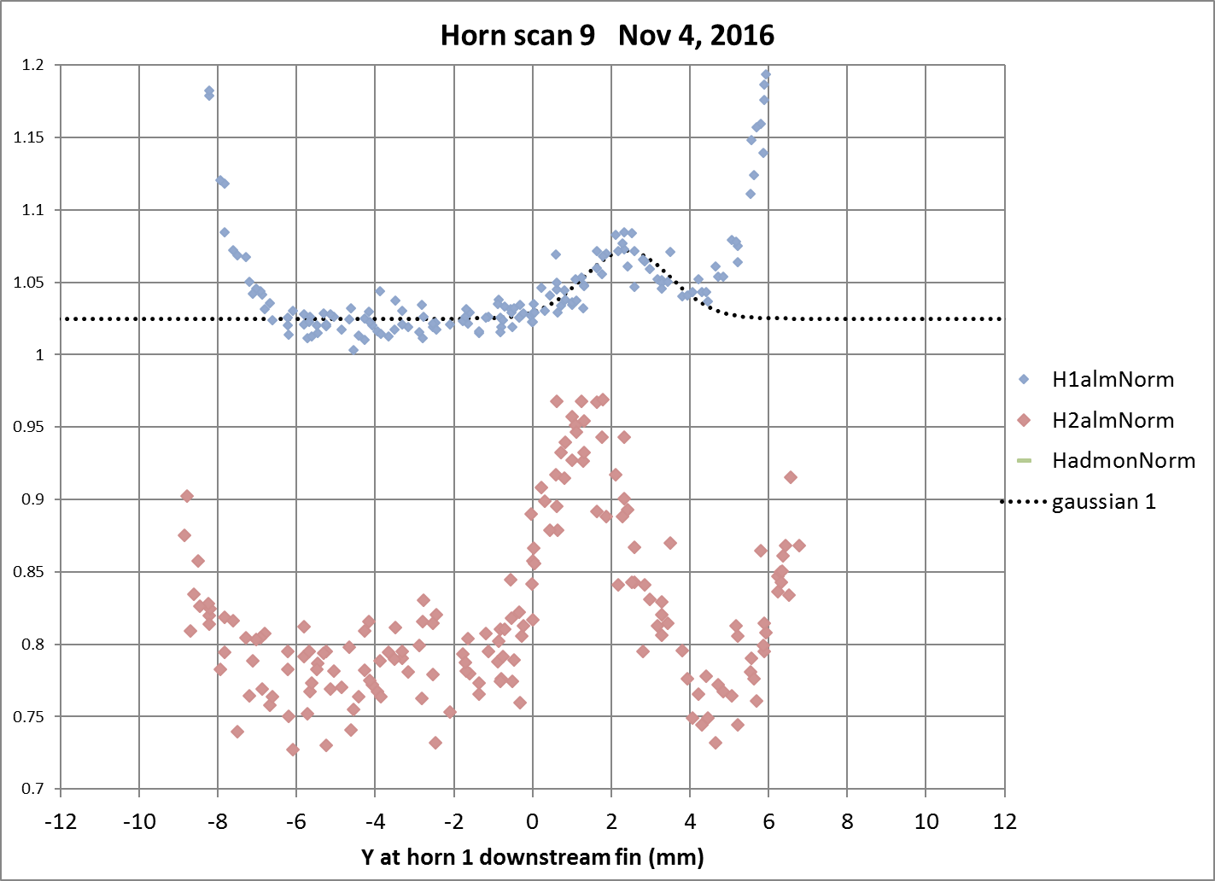
Nov 4 horn scan vertical; Horn 1 DS fin

Slide 27
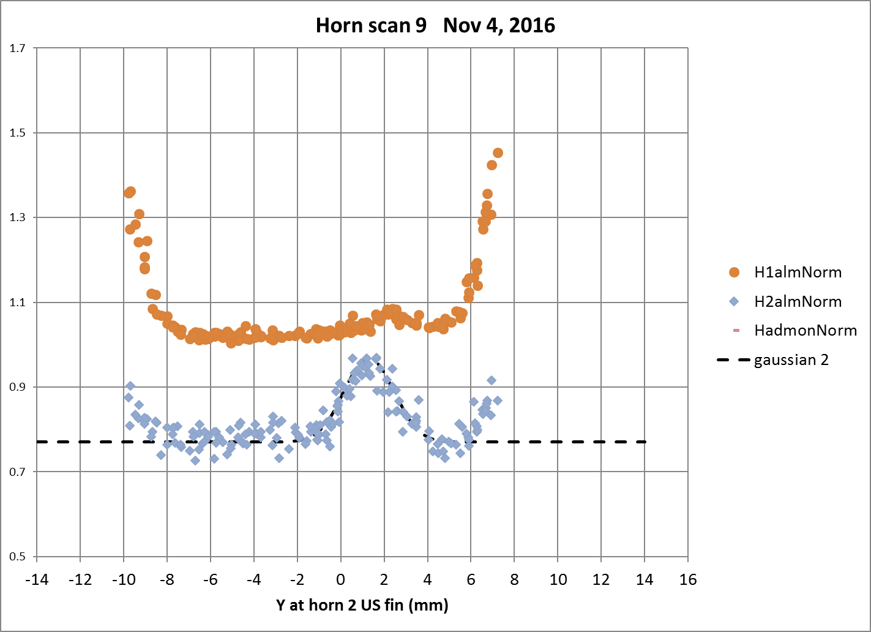
Nov 4 horn scan vertical; Horn 2 US fin

