Slide 1
Can we use R134a as Cherenkov radiator ?
Yannis & Nikos
16 Nov 2016

Slide 2
What is the index of R134a ?
Small experiment at PS on T9 beam
Hadron or electron enriched target
Two threshold Cherenkovs A and B
A can be filled with CO2
B can be filled with CO2 or R134a
Beam at + 7GeV/c, -2GeV/c, -3GeV/c
Pressure scan
Fit (n-1), Constant A, muon/e content

Slide 3
Used positive beam at 7 GeV/c @PS Zone T9
Collimator ± 5mm
Two scintillator counters = Trigger
Two Cherenkovs filled with CO2
Composition collimator wide open:
40%
p 47%
K 5%
e < 1%

Slide 4
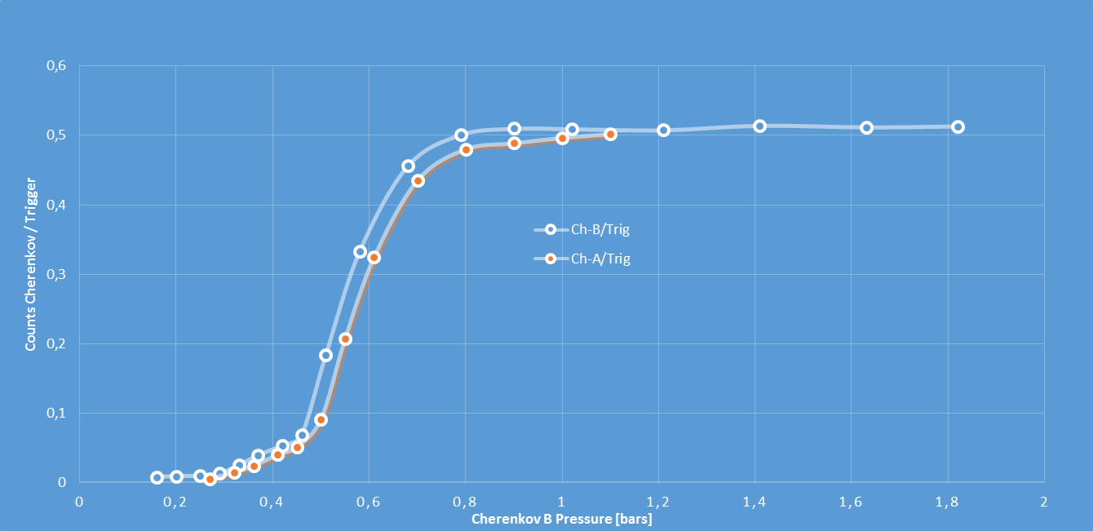
At full efficiency both Cherenkov see 50% of the beam
Pions (hadron enhanced target) and muons from π decays and elsewhere
Very few electrons
Momentum = +7GeV/c

Slide 5
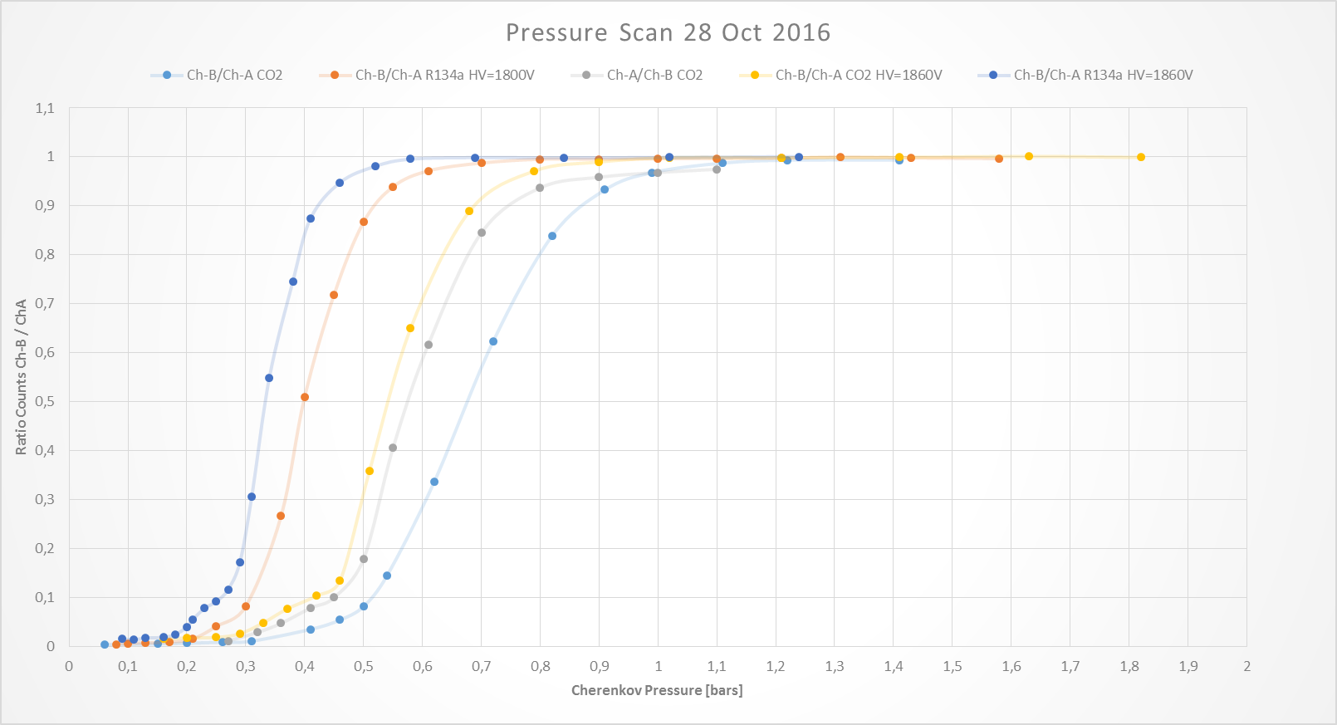
PM overall efficiency is critical for the index determination

Slide 6
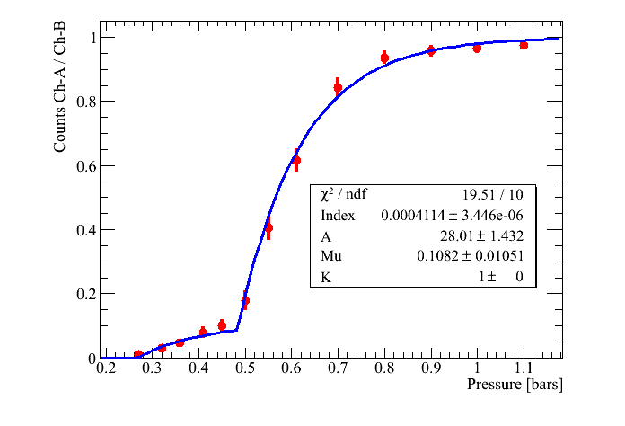
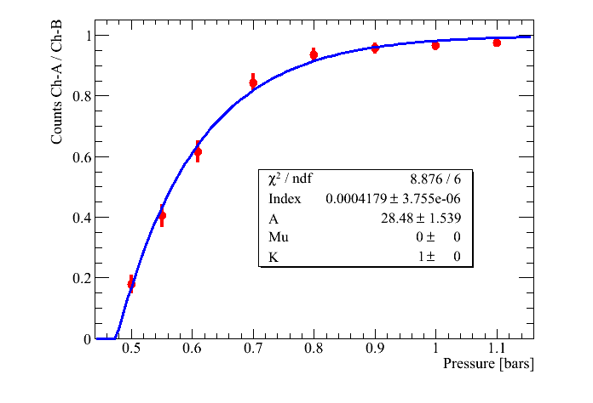
Cherenkov A filled with CO₂ and Cherenkov B filled with CO₂ @ 1.2bars
Momentum = +7GeV/c
We scan the pressure of Cherenkov A
We measure the (Index-1) CO₂ > 418 10⁻⁶
and 11% muons in the beam
μ content fixed to 0
F=Σ_{i}p_{i}exp(-KN_{phel})
Where N_{phel}= A L (n-1) (Pressure – Pressure _{Threshold} )
and Pressure _{Threshold} = m_{i}^2 / (2(n-1)p^2)

Slide 7
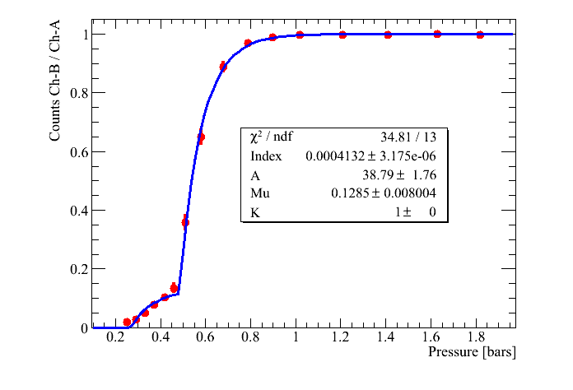
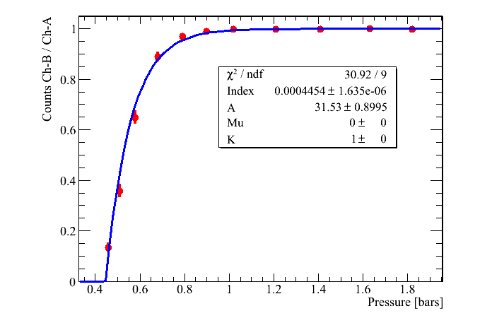
Cherenkov B filled with CO₂ and Cherenkov A filled with CO₂ @ 1.2bars
From literature n-1 = 418 10⁻⁶
We scan the pressure of Cherenkov B
We measure (Index-1) CO₂ > 414 10⁻⁶
and 13% muons in the beam
Momentum = +7GeV/c

Slide 8
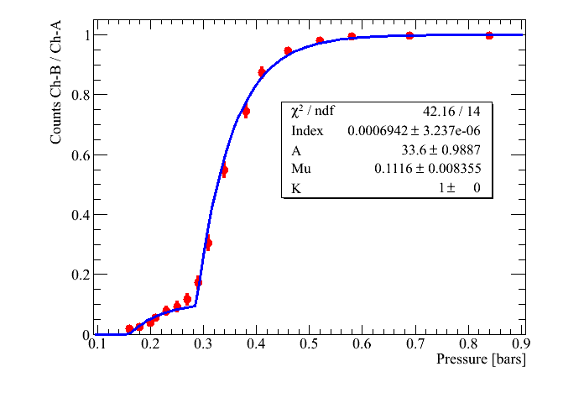
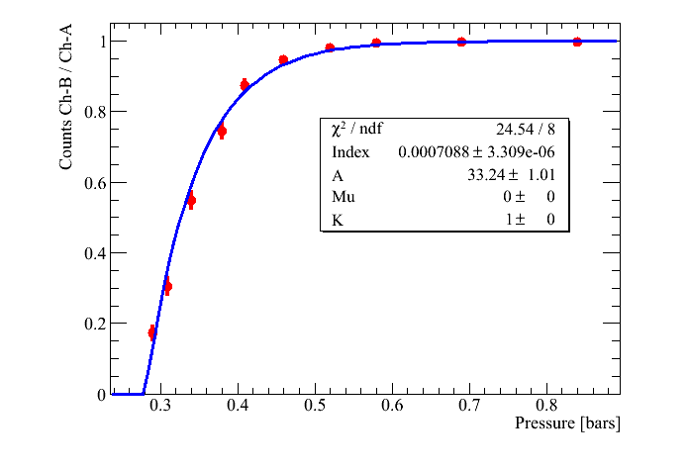
Cherenkov B filled with R134a and Cherenkov A filled with CO₂ @ 1.2bars
Momentum = +7GeV/c
(Index-1) R134a > 700 10⁻⁶
and 11% muons in the beam

Slide 9
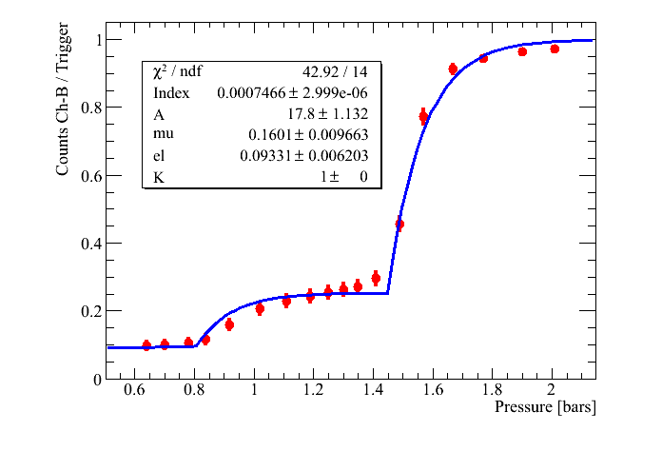
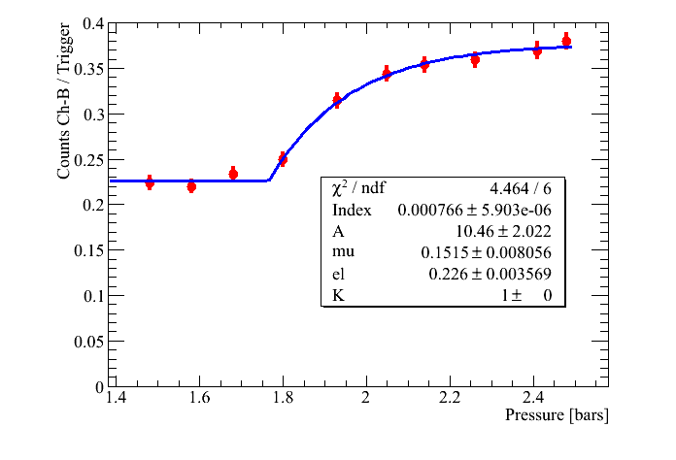
Cherenkov B filled with R134a and Cherenkov A filled with CO₂
Momentum = -3 GeV/c electrons enhanced target
Momentum = -2 GeV/c electrons enhanced target
We do not see pions
Ch-A shows 21.7% electrons
We tuned the Ch-A pressure below the μ threshold and we measure :
Nb of e = Ch-A / Trigger = 10.9% in agreement with the fit for Ch-B

Slide 10
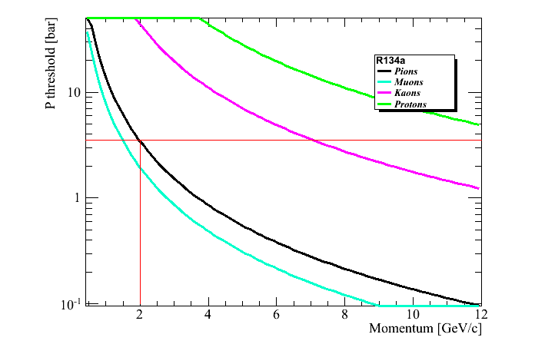
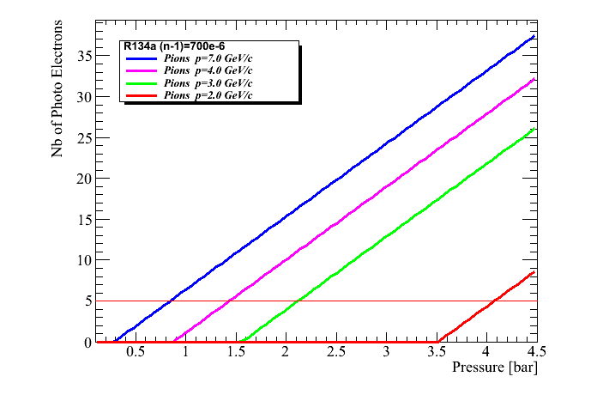
Taking for R134a (Index-1) = 700×10⁻⁶
A=32 and Cherenkov length = 200cm

Slide 11
Conclusion
For the H4 beam we need
A high pressure (p_{max}=15 bars) Cherenkov to be filled with CO₂
A low pressure (p_{max}=3 bars) Cherenkov to be filled with CO₂ or R134a
Below 3GeV/c, only a moderate TOF will save us !

