Slide 1
Technical Board Meeting,
Cathode discussion 16/11/2016
D.Autiero, A. Gendotti, L. Molina, C. Regenfus, F. Sergiampietri, A. Rubbia

Slide 2
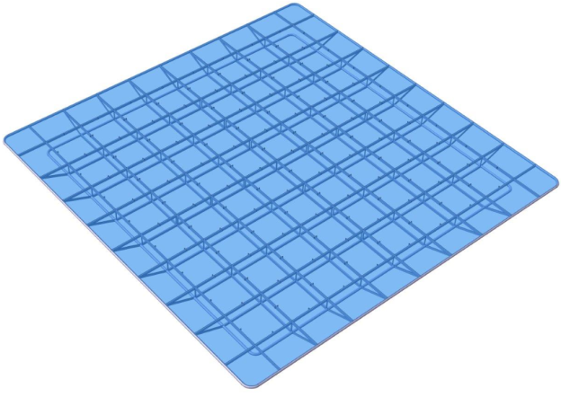
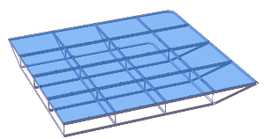
We have been working very intensively during the last year (and in particular Christian) on the R&D, tests and design of the ITO plates PMMA cathode.
All tests have been very encouraging, Adamo has developed a full integration design of this part in the detector which was foreseen to be finalized by the end of November
The cathode has been designed in 4 quarters to be assembled inside the cryostat with dimensions compatible with the standard transportation boxes and installation procedure …
Cathode sub-module
We went also through an extensive series of simulations on the PMTs position (thanks to the effort of the SB !) and evaluated their installation on the floor and the interference with the cryogenic piping

Slide 3
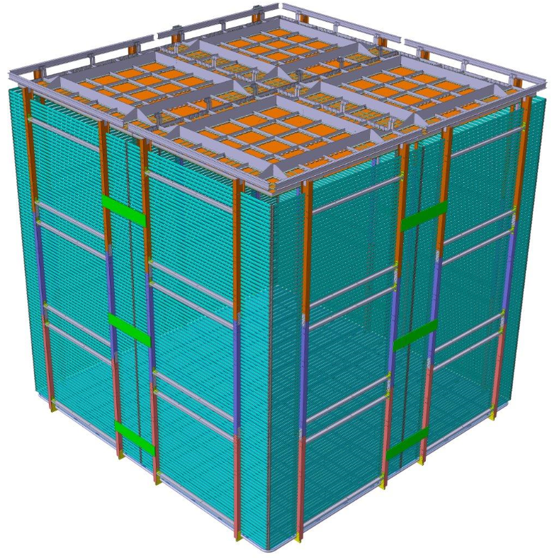
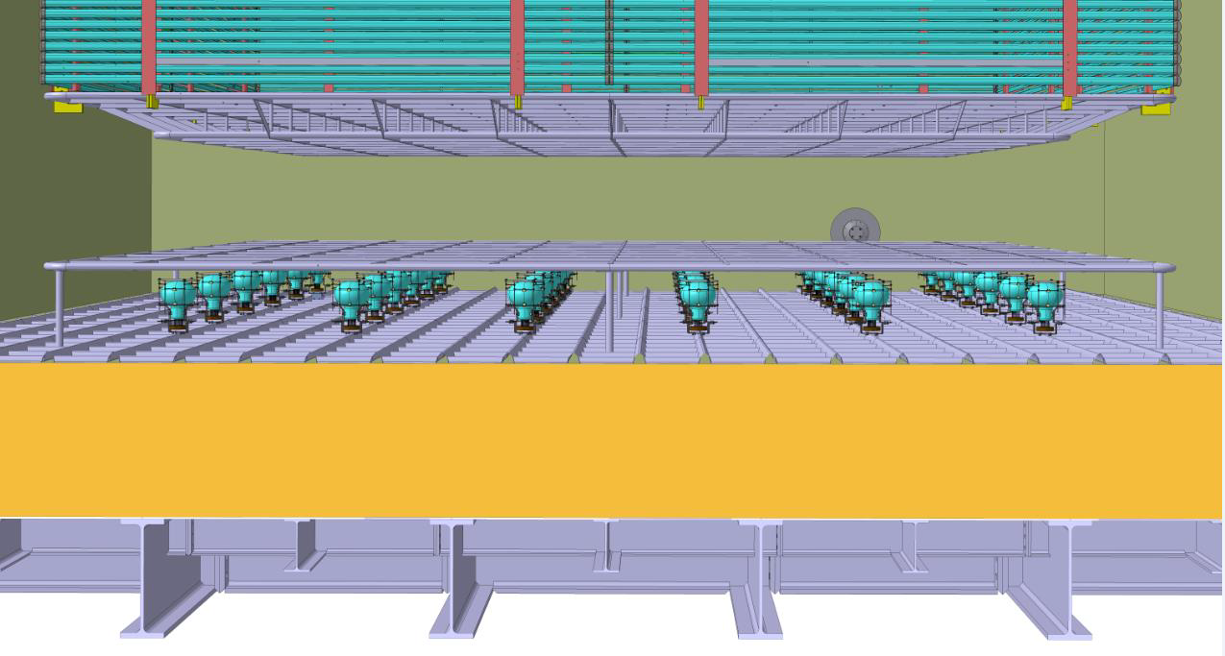

Slide 4
However …
The feedback we got from the last LBNC on the transparent cathode, although recognizing that it is a very interesting development and a promising approach, was mostly concerned about possible risks related to the 6x6x6 tight time schedule
There is still little experience on this cathode concept and on its implementation of such large size
It is not tested in the 3x1x1, neither we can provide in short time long term tests at very high voltage
By taking seriously the comments from the committee and their suggestions of retiring the maximal number of risks from the 6x6x6 design we (Andre’, Christian, dario, …) would then like to propose at this TB to reactivate the baseline original option (extensively studied in the LAGUNA/LBNO DS) of the cathode made with a mesh of pipes.
This is a safer option and goes in the line of satisfying the comments of the committees and finalizing the 6x6x6 design by the end of November.
Already immediately after the last TB we have been discussing with Adamo and Franco how to reactivate the pipe-cathode and integrate it in the general design. We have been restarting from the baseline option developed by Franco at the time of the TDR and readapting it to the present knowledges and detector design.
We have been so checking that a fallback solution was available in order to finalize the design by November. Adamo has been intensively working on the design and integration. Laura has been working on the electrostatic simulations (see next presentation)

Slide 5
Adamo should have been today presenting in more details this fallback design
Basic ideas:
Minimal changes to the structure already developed for the PMMA plates (frames of 65x65 cm) and all the related aspects on the PMT arrangement on the floor and various interferences with the cryogenic pipes (already optimized)
Replacement of the PMMA plates in this structure of small pipes to define the field, as in original TDR design by Franco
Keep installation contraints of previous structure defined for PMMA
PMTs will have to go back to original option with the TPB coated PMMA plate in front of them (like tested in 3x1x1)
While waiting for the simulations by Laura, in order to get a first idea and a conservative design we computed the field at the surface of the small pipes by using the exact field solution with are computed for multi-wire proportional chambers (wires → pipes), 2D calculation for infinite pipes length; See Laura presentation for more sophisticated simulations
Requirements (field <30 kV/cm at 600 kV). 20 mm diameter pipes satisfy this requirement given the distance of the cathode from the PMTs protection grid (70 cm)
Adamo developed a first design (evolving from Franco original design) based on these criteria: pipes of 20 mm, pitch 100 mm, already existing frame

Slide 6
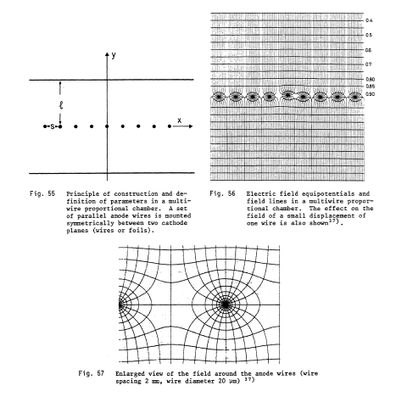
Field calculations from Sauli’s book

Slide 7
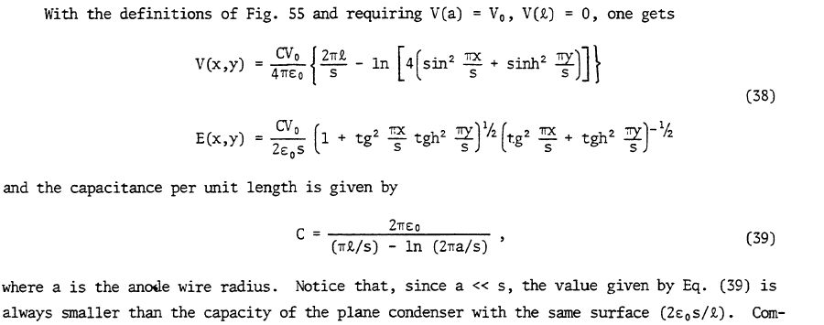

Slide 8
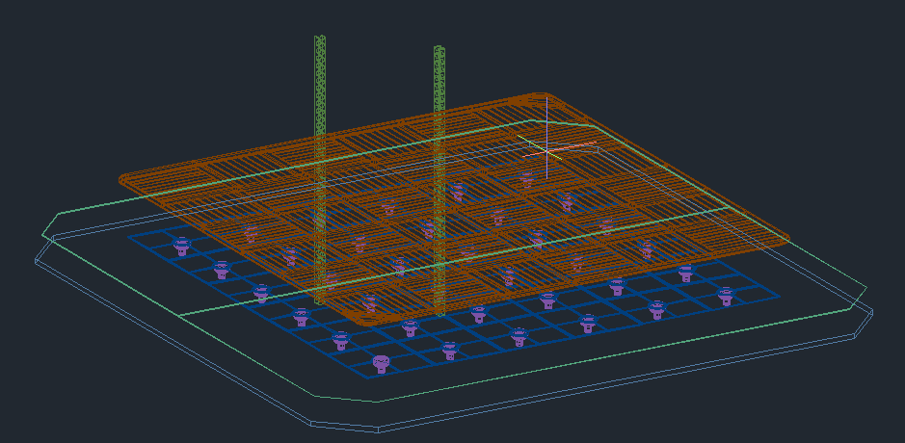
Original TDR design by Franco (alternated orientation of pipes in different frames)

Slide 9
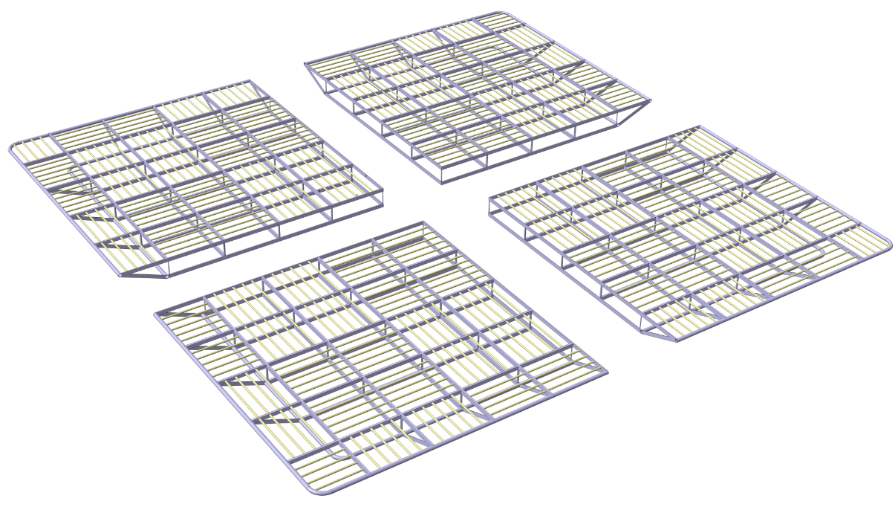
New design by Adamo:
(20 mm pipes integrated in larger structural pipes with insertion holes and external welding)

Slide 10
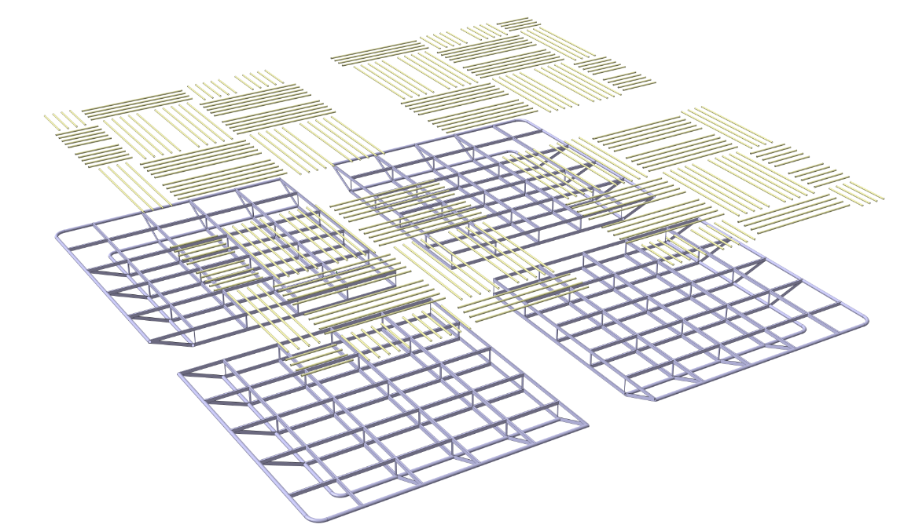
More details at the next TB where an executive design based on the fallback standard pipes solution can be perfected and provided on time with respect to the milestone deadline

