Slide 1
SCD Computing Summary
November 7th, 2016 though November 14th, 2016

Slide 2
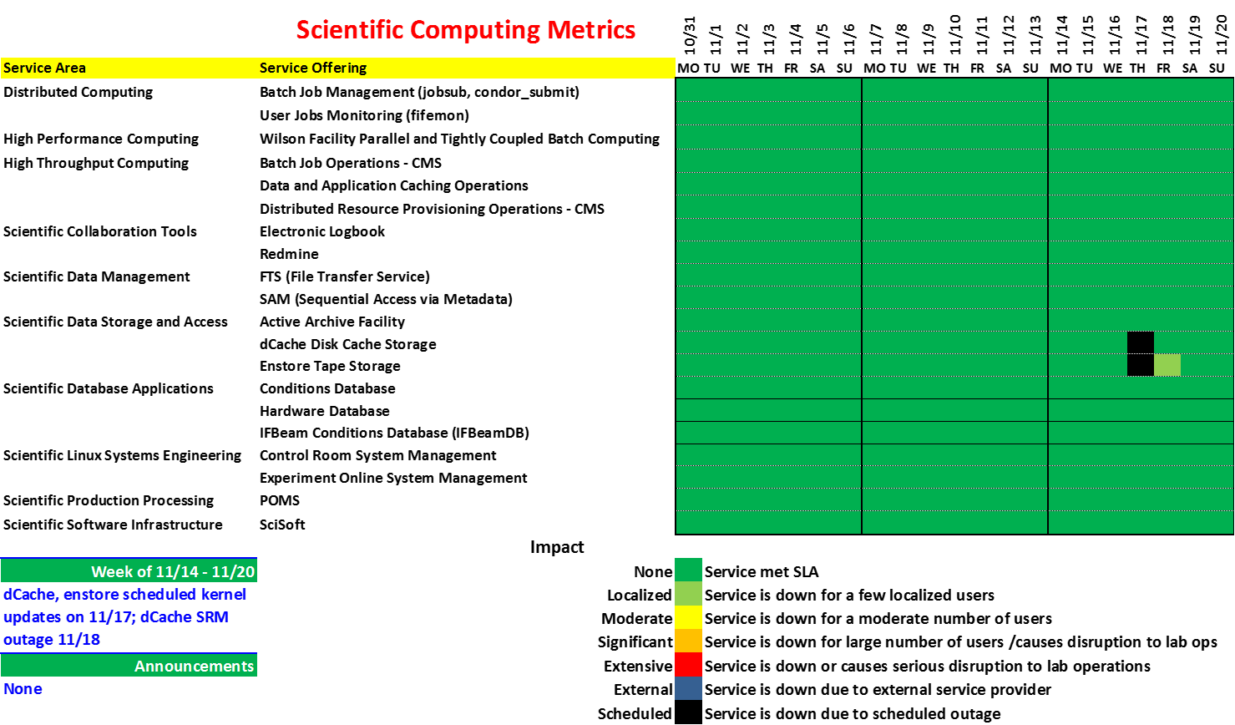

Slide 3
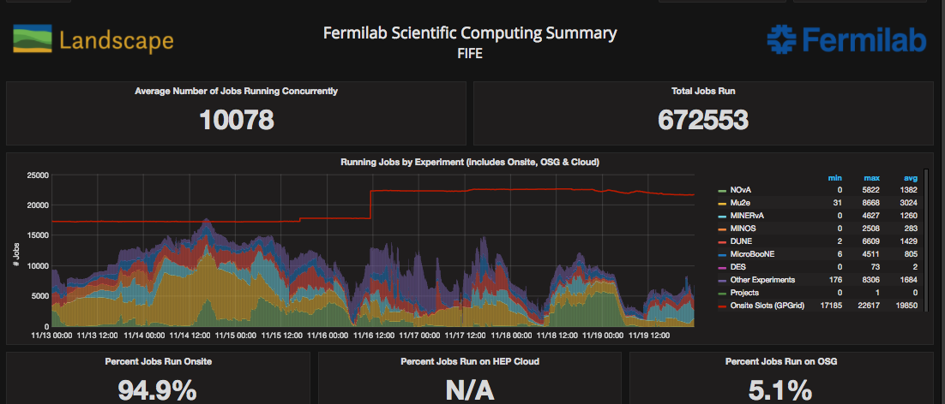
FIFE Operations
https://fifemon.fnal.gov/monitor/dashboard/db/scd-summary-fife?from=now-1w%2Fw&to=now-1w%2Fw
Note: bump mid week in available slots is deployment of new worker nodes. Will drop when out of warranty nodes are retired.

Slide 4
CMS LPC Operations
https://landscape.fnal.gov/lpc/dashboard/db/lpc-summary?from=now-1w%2Fw&to=now-1w%2Fw

Slide 5
CMS Operations
https://fifemon.fnal.gov/monitor/dashboard/db/scd-summary-cms?from=now-1w%2Fw&to=now-1w%2Fw
Note CMS successufly ran well over ½ of jobs on the cloud as part of supercomputing demo.

Slide 6
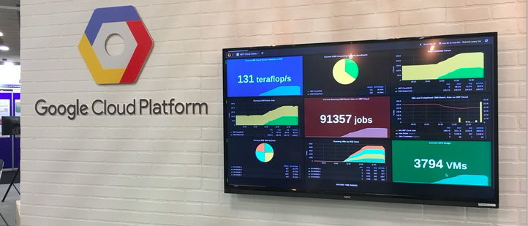
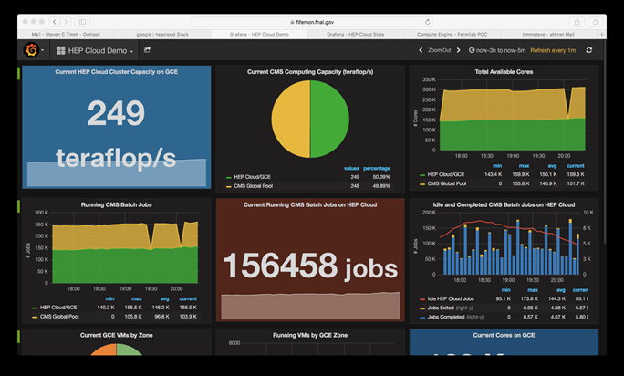
Supercomputing FY17
By last day of conference we were
running 156K simultaneous jobs
on Google cloud
Equal to world-wide CMS !

