Slide 1
Accelerator Division Status
Daniel Johnson
All Experimenters’ Meeting
21 November 2016

Slide 2
Content Slide [22pt Bold]
Bullet points are optional. If preferred, only first level bullets can be used or bullets can be set to “NONE.” [18pt Regular]
First level bullet [18pt Regular]
Second level bullet [16pt Regular]
Third level bullet [15pt Regular]
Fourth level bullet [14pt Regular]
Fifth level bullet [14pt Regular]

Slide 3
Accelerator Operations Summary
From: November 14, 2016 (0000 hours)
To: November 21, 2016 (0000 hours)
Calendar Week # 46
NuMI Weekly Integrated Intensity 8.35 E18 protons
Beam Hours To NuMI 140.6 hours
BNB Weekly Integrated Intensity 1.38 E19 protons
Beam Hours To BNB 157.5 hours
NMuon Weekly Integrated Intensity 4.79 E13 protons
Beam Hours To NMuon 4.2 hours
MTest Weekly Integrated Intensity 3.54 E11 protons
Beam Hours To MTest 0.9 hours
MCenter Weekly Integrated Intensity 0.00 E12 protons
Beam Hours To MCenter 0.0 hours

Slide 4
NuMI Operation

Slide 5
BNB Operation

Slide 6
Content and Caption Slide [22pt Bold]
Click to add caption text [13pt Bold]
First level bullet [18pt Reg]
Second level bullet [16pt]
Third level bullet [15pt]
Fourth level bullet [14pt]
Fifth level bullet [14pt]

Slide 7
Complex Status
LINAC
Running well
Booster
Running well
~4.8 E12 p/p
MI/RR
Recycler startup
NuMI
Running at ~320 kW
Booster Neutrino Beamline (BNB)
Running well
Switchyard
SeaQuest beam when requested
Meson Test instrumentation run
General
No plans for access

Slide 8
November 2016

Slide 9
MI-12 Communication Duct
Damaged on 10/24/16
Protected from further damage
Able to run experiments now
Provides timing/date to Neutrino Experiments
Also safety & fire systems
Working on possible solutions
Status meeting this week

Slide 10
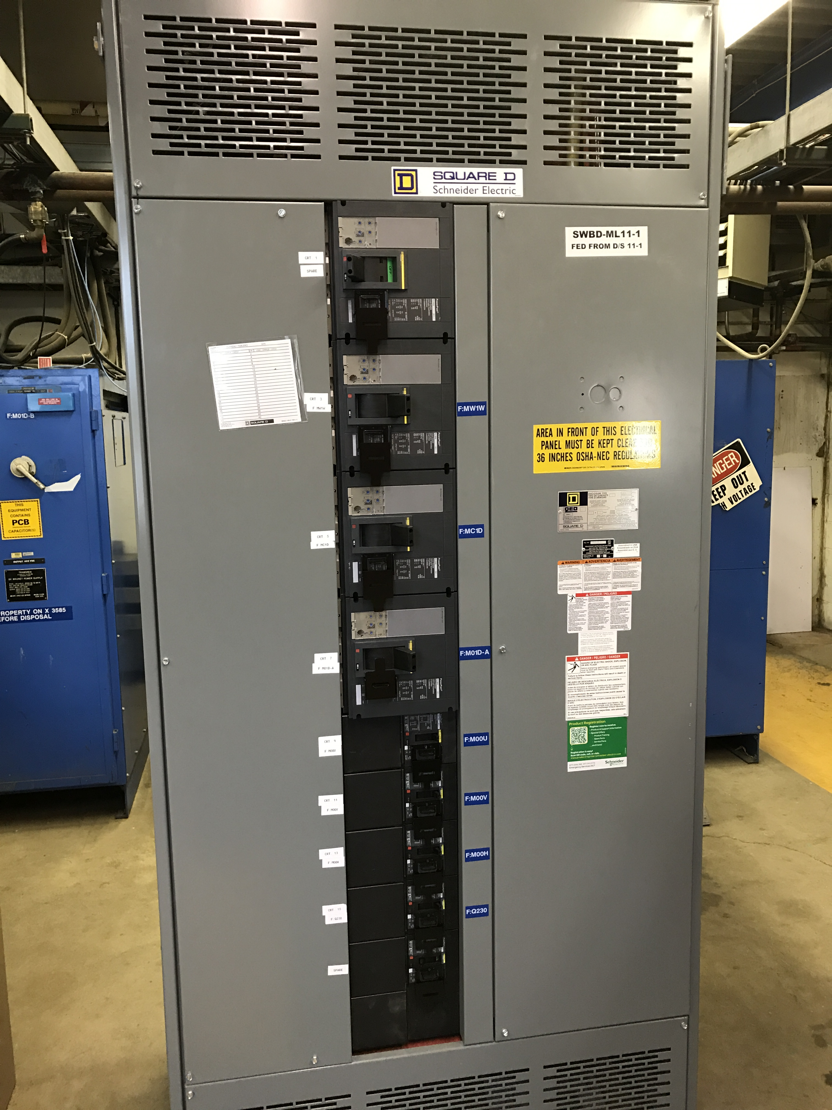
MS1 Bus Failure
All power supplies cabled into breaker panel
Work completed

Slide 11
PIP-II Injector Test & FAST Status
PIP-II Injector Test
CW RFQ operation startup
Performing 24 hour operation test on Tuesday, November 22nd
Beam scans and studies
CW studies
Collecting data
FAST
No gun operation
Shutdown for 300 MeV upgrade
Cave Roof Block Installation complete
Begin magnet and stand installation

Slide 12
CMTS1 Status
LCLSII Prototype Cryo Module
Cryo
Cryo safety walkthrough complete
Cryostat vacuum pumpdown
Cooldown in late November/early December
Accomplishments
Welding completed
Cryo safety walkthrough
Plan for the week
Cooldown and extended testing to follow into (January 2017)

Slide 13
ICW Reduction
Looking at measuring flows on systems
Stakeholders impacted
AD, TD, PPD, CD, FESS
Need to establish new Casey’s Pond West Strainer Vault
Everybody working on priority projects
Will be difficult to line up downtime schedules
Reducing flow will be painful
Estimate two week reduction for work
Performing measurements in late November
Planning on early 2017 (January)
Will know more after November measurements
2 week reduction period
Should not impact most experiments
Will impact experiments/projects with cryogenic operation

Slide 14
January 2017

Slide 15
Schedules and Links
Schedule can be accessed from the Operations Department Home Page
Schedules -> Operations Schedule
Direct link to schedule
http://www-ad.fnal.gov/ops/schedule.html

Slide 16
Collaborations / Partnerships / Members [22pt Bold]

