Slide 1
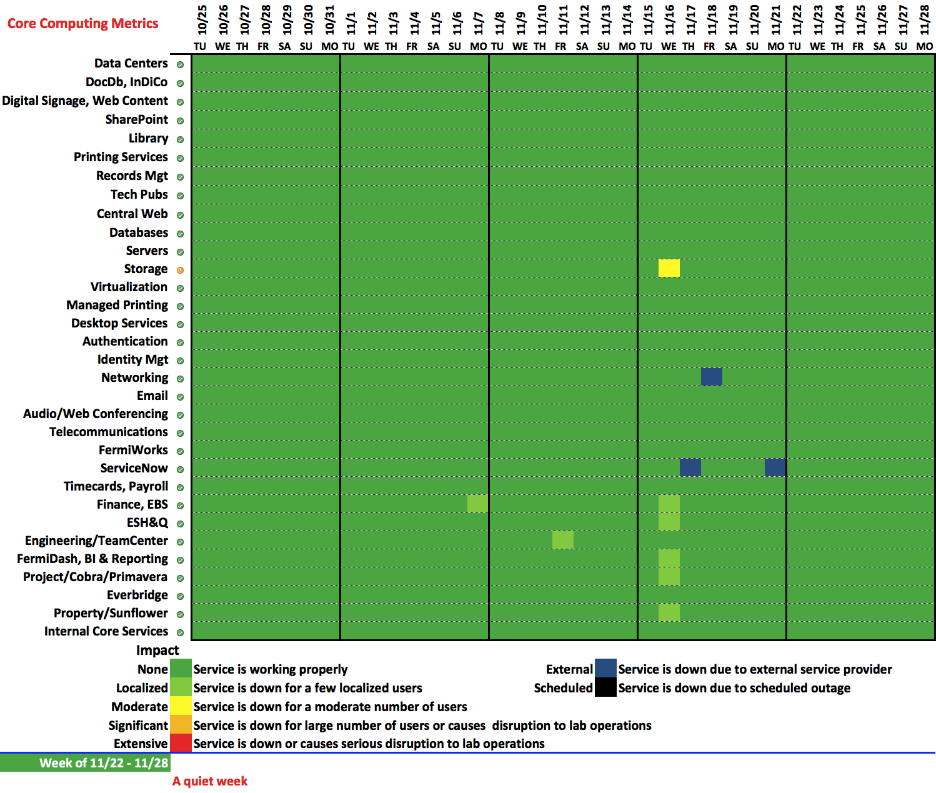

Slide 2
Announcements
We have started the process to eliminate toll-free calling for all audio/web conferencing (i.e. Readytalk calls)
Pilot with business staff and experimenters has been successful
Req in procurement, expect Feb-May rollout.
Electronic Travel Approvals and Expense Voucher Application is being rolled out at the lab, a few D/S at a time.
Full rollout expected by end of January
Details, including manual, rollout schedule, and training schedule is available at
https://fermipoint.fnal.gov/service/TravelSystem/SitePages/How%20to%20Use%20the%20New%20Travel%20System.aspx

