Slide 1
Accelerator Division Status
Duane Newhart
All Experimenters’ Meeting
28 November 2016

Slide 2
Content Slide [22pt Bold]
Bullet points are optional. If preferred, only first level bullets can be used or bullets can be set to “NONE.” [18pt Regular]
First level bullet [18pt Regular]
  Second level bullet [16pt Regular]
    Third level bullet [15pt Regular]
      Fourth level bullet [14pt Regular]
        Fifth level bullet [14pt Regular]

Slide 3
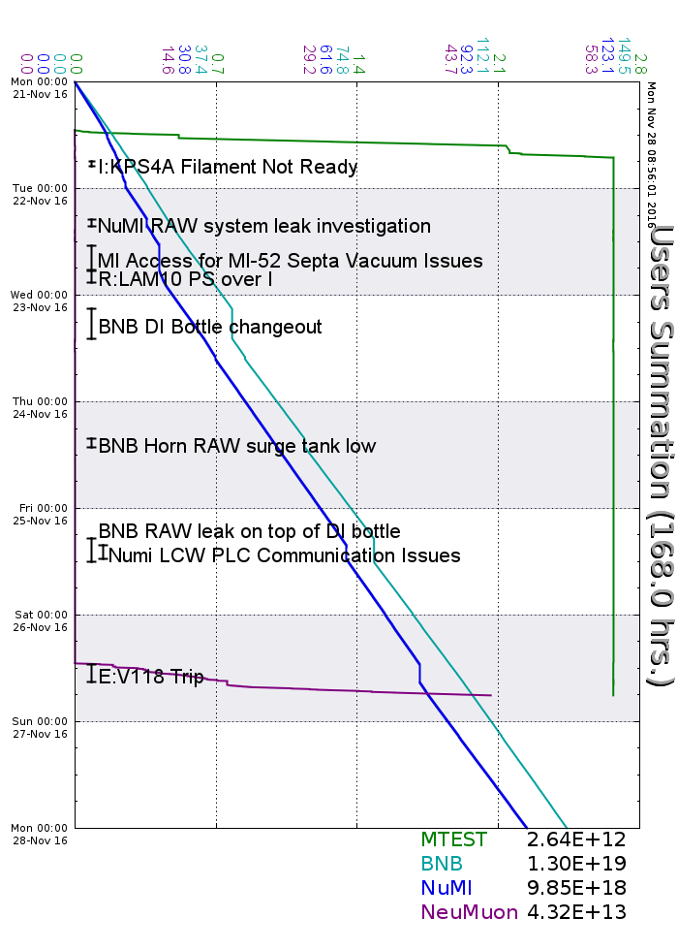
Accelerator Operations Summary
From: November 21, 2016 (0000 hours)
To: November 28, 2016 (0000 hours)
Calendar Week # 46
NuMI Weekly Integrated Intensity 9.85 E18 protons
Beam Hours To NuMI 148.6 hours
BNB Weekly Integrated Intensity 1.30 E19 protons
Beam Hours To BNB 151.6 hours
NMuon Weekly Integrated Intensity 4.32 E13 protons
Beam Hours To NMuon 4.7 hours
MTest Weekly Integrated Intensity 2.61 E12 protons
Beam Hours To MTest 3.4 hours
MCenter Weekly Integrated Intensity 0.00 E12 protons
Beam Hours To MCenter 0.0 hours

Slide 4
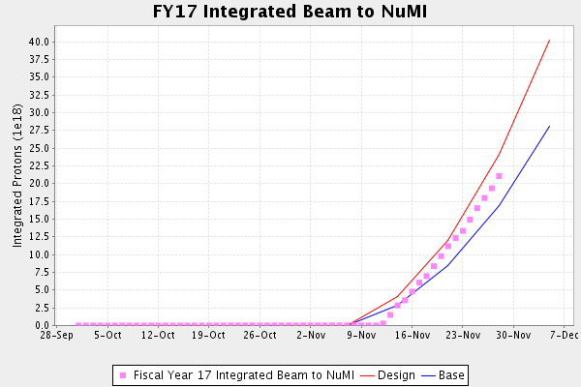
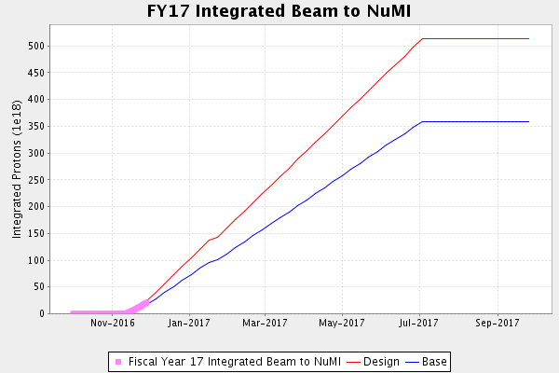
NuMI Operation

Slide 5
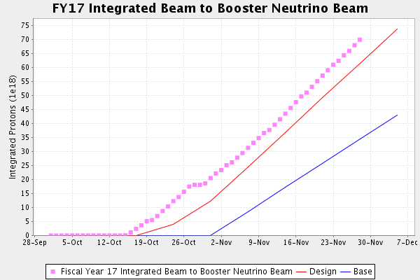
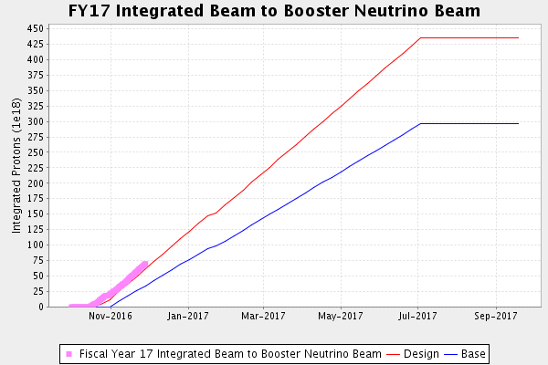
BNB Operation

Slide 6
Content and Caption Slide [22pt Bold]
Click to add caption text
[13pt Bold]
First level bullet [18pt Reg]
  Second level bullet [16pt]
    Third level bullet [15pt]
      Fourth level bullet [14pt]
        Fifth level bullet [14pt]

Slide 7
Complex Status
LINAC
  Running well
Booster
  Running well
  ~4.8 E12 p/p
MI/RR
  Recycler startup
  MI52 extraction septum sparking last week, but have a work around
NuMI
  Running at ~340- 350 kW
  V118 regulation returned to analogue regulation (no bulb)
Booster Neutrino Beamline (BNB)
  Running well
Switchyard
  SeaQuest beam when requested
    Continue tuning beam size
  Meson Test instrumentation run
    Experiment install tomorrow
General
  No plans for access

Slide 8
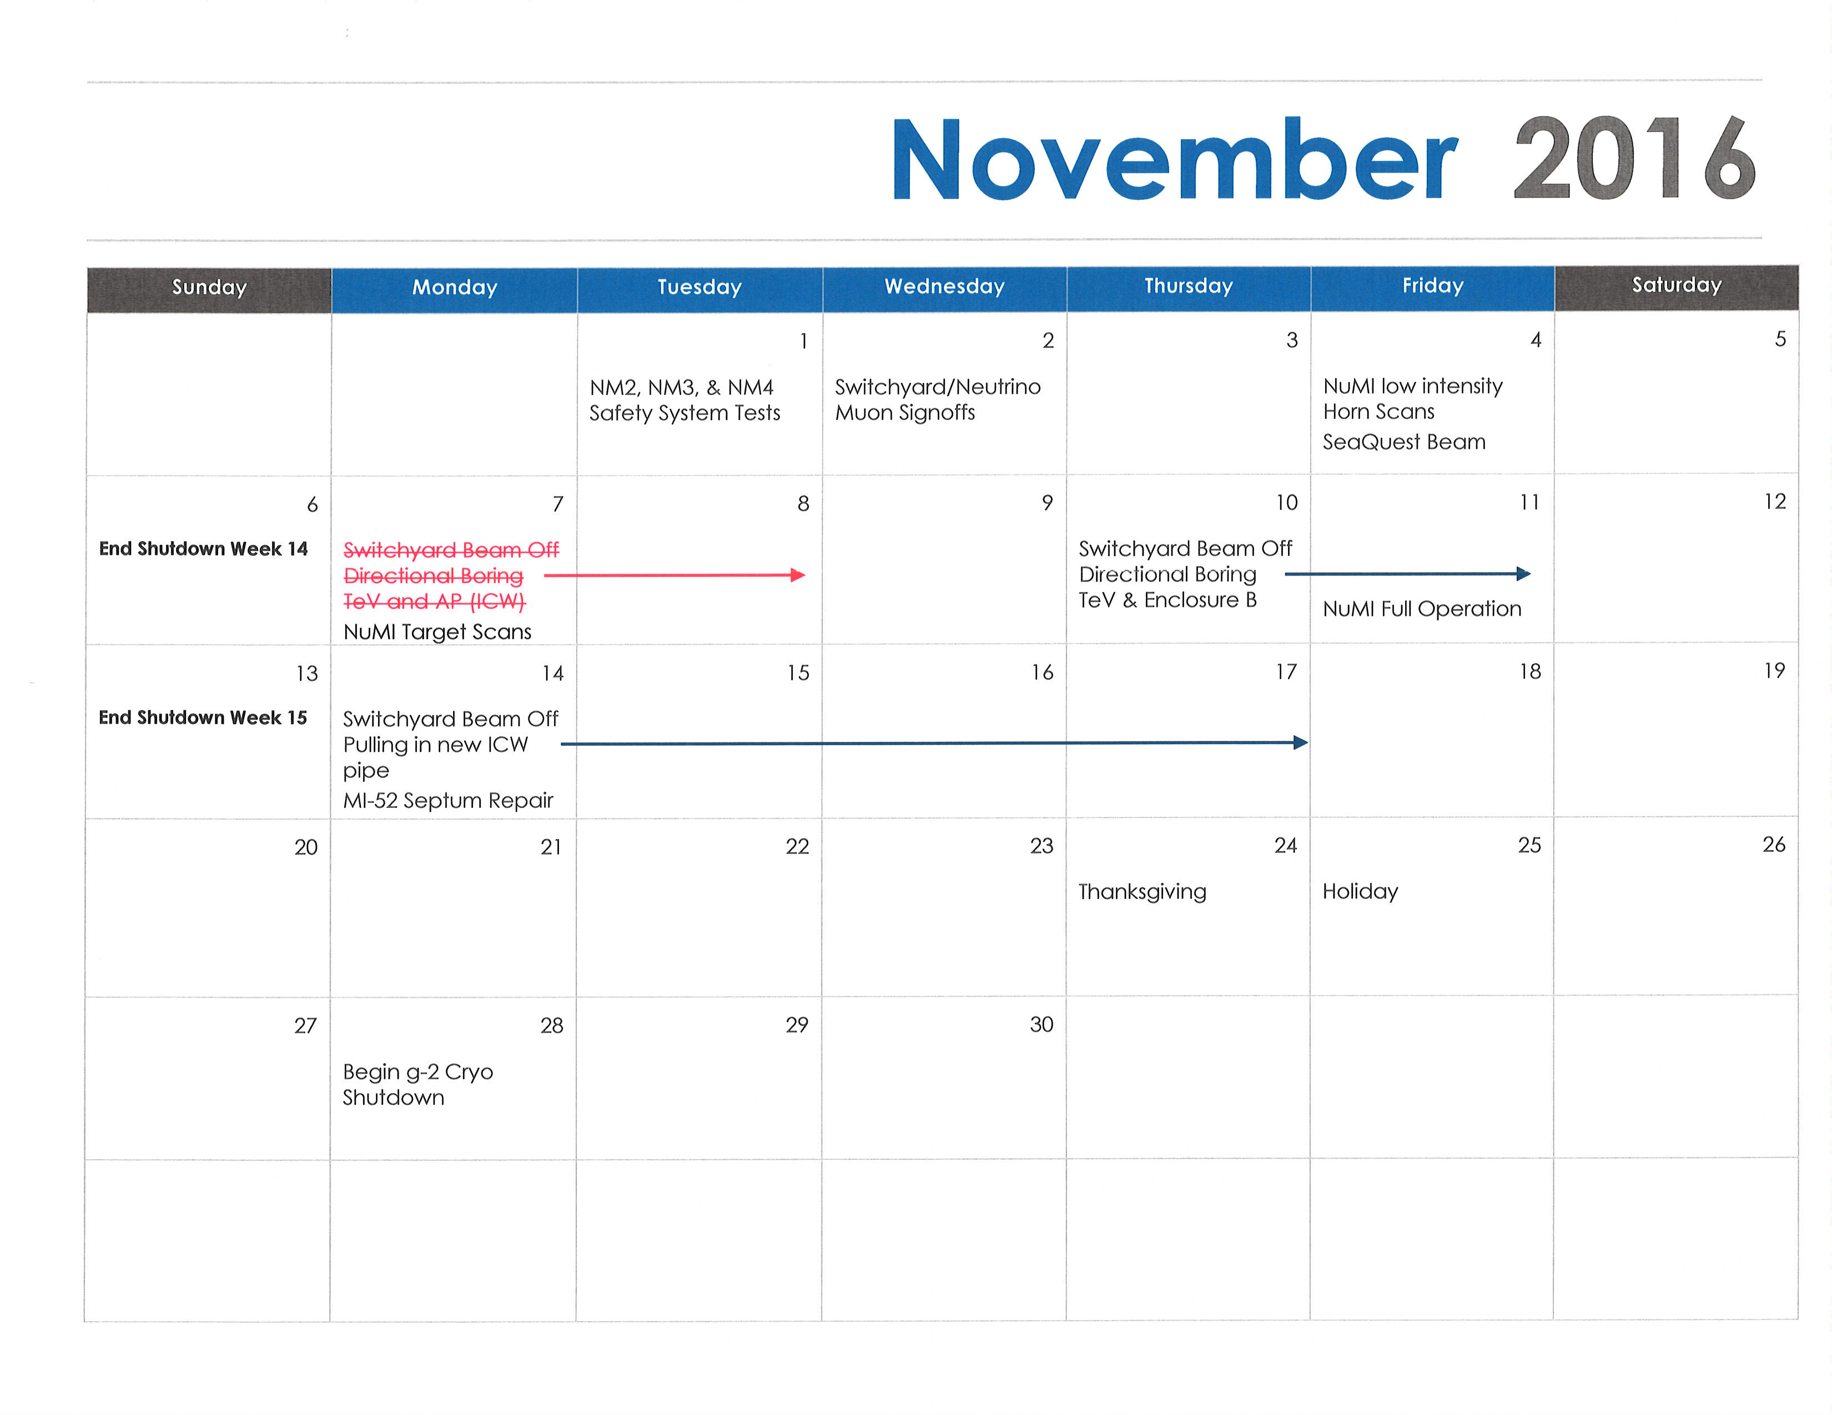
November 2016

Slide 9
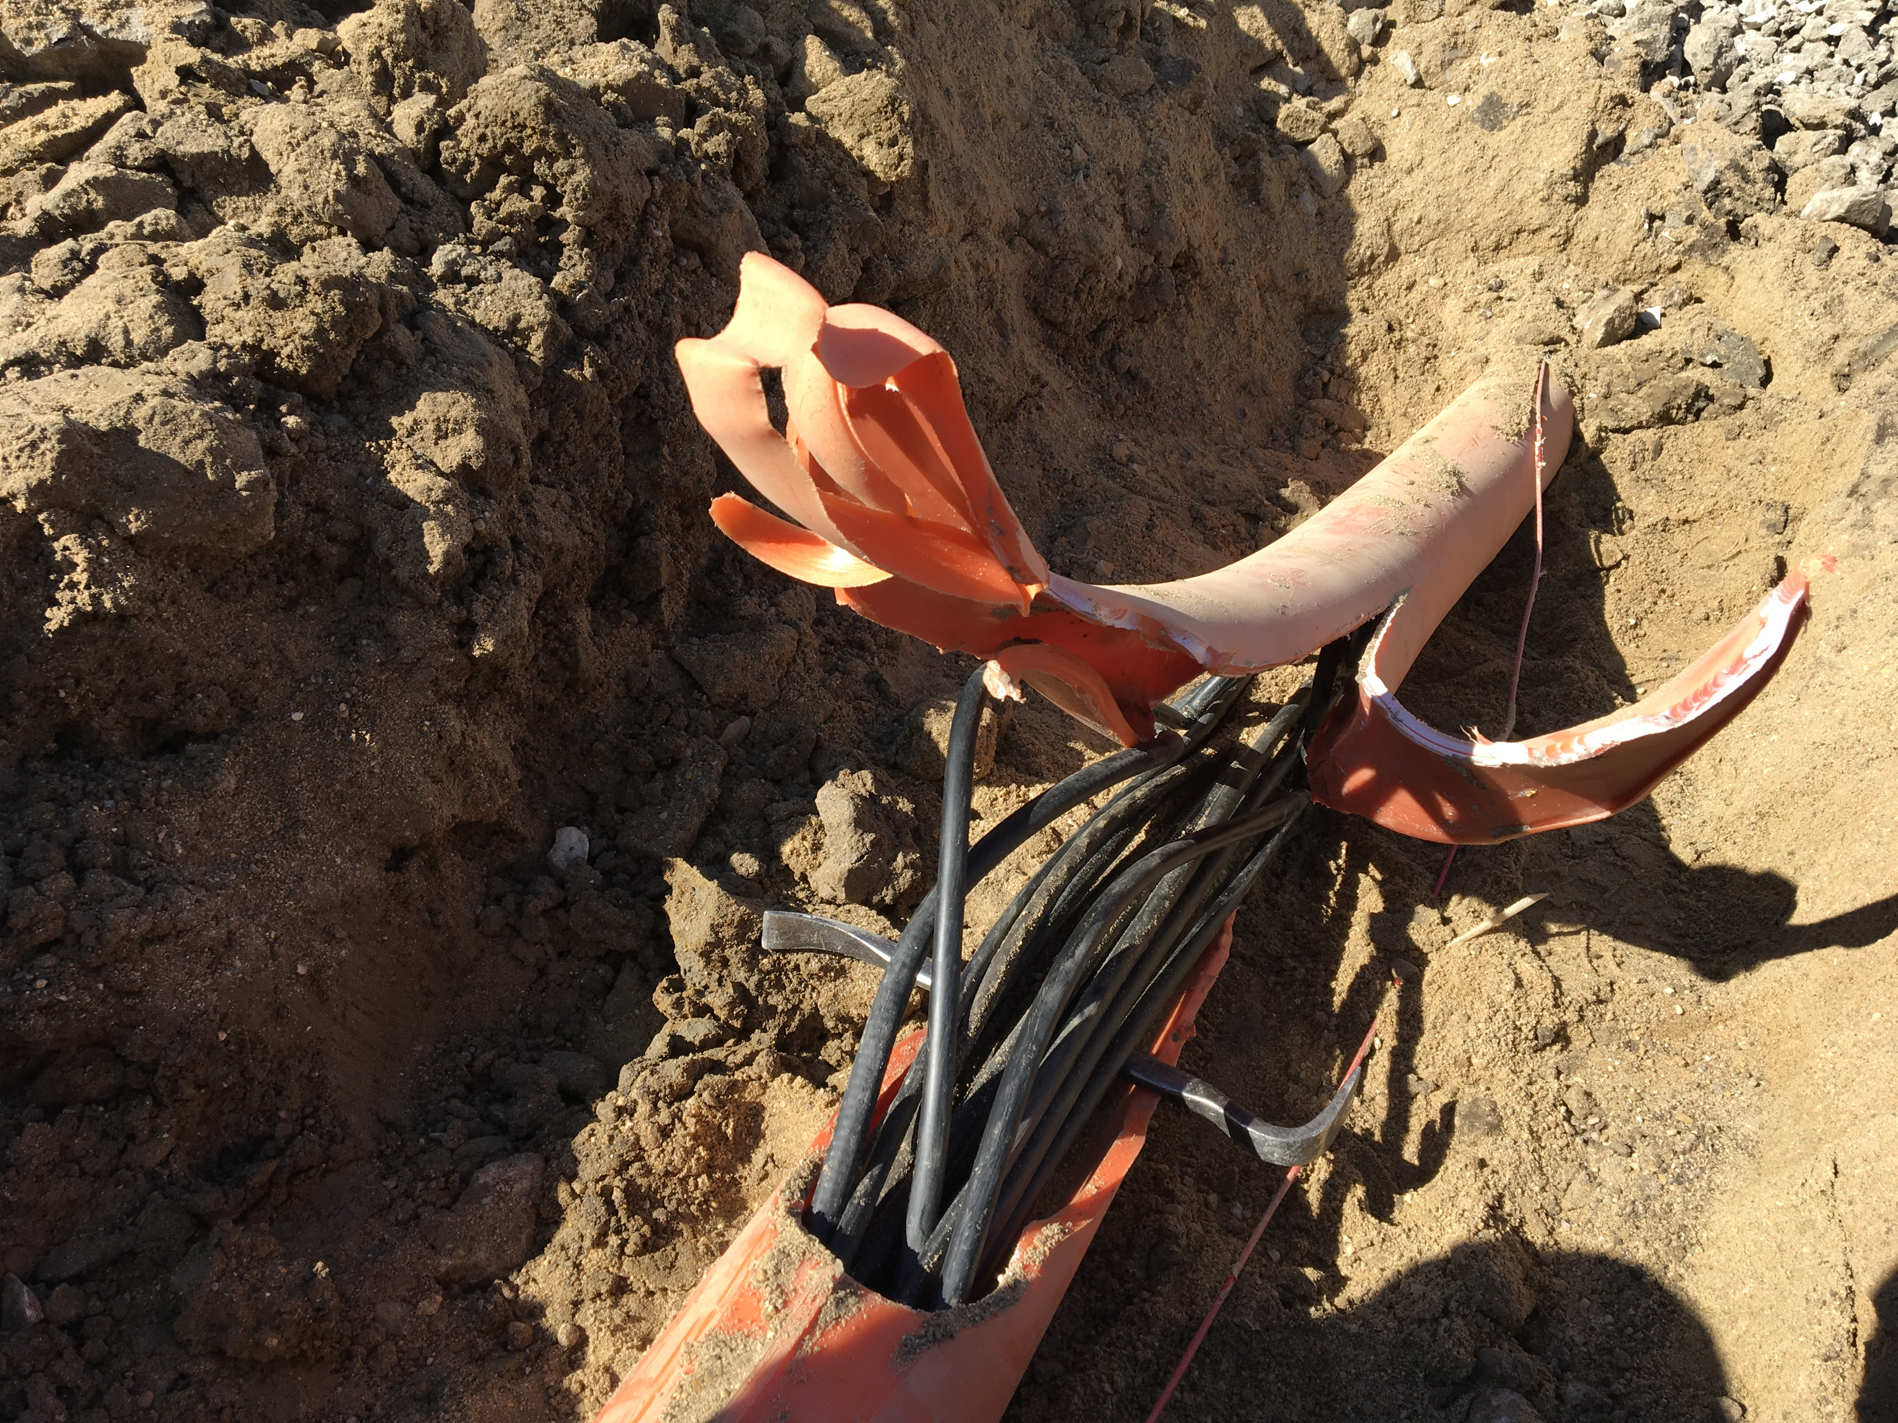
MI-12 Communication Duct
Summary from Wed 23rd Meeting
Emergency Repair Plan In Place
  Need 2 hour notification
  Vendor has cable
New Communications Duct Plan
  Targeting communications duct completion by January
    A portion of new duct has been installed
    Plans for routing remainder of new duct underway
  Expect cable delivery in mid-January
  Hope to move to new cable in January/February
  Try to coordinate downtime with Master SubStation outages
Damaged on 10/24/16
Protected from further damage
Able to run experiments now
Provides timing/date to Neutrino Experiments
Also safety & fire systems
Working on possible solutions

Slide 10
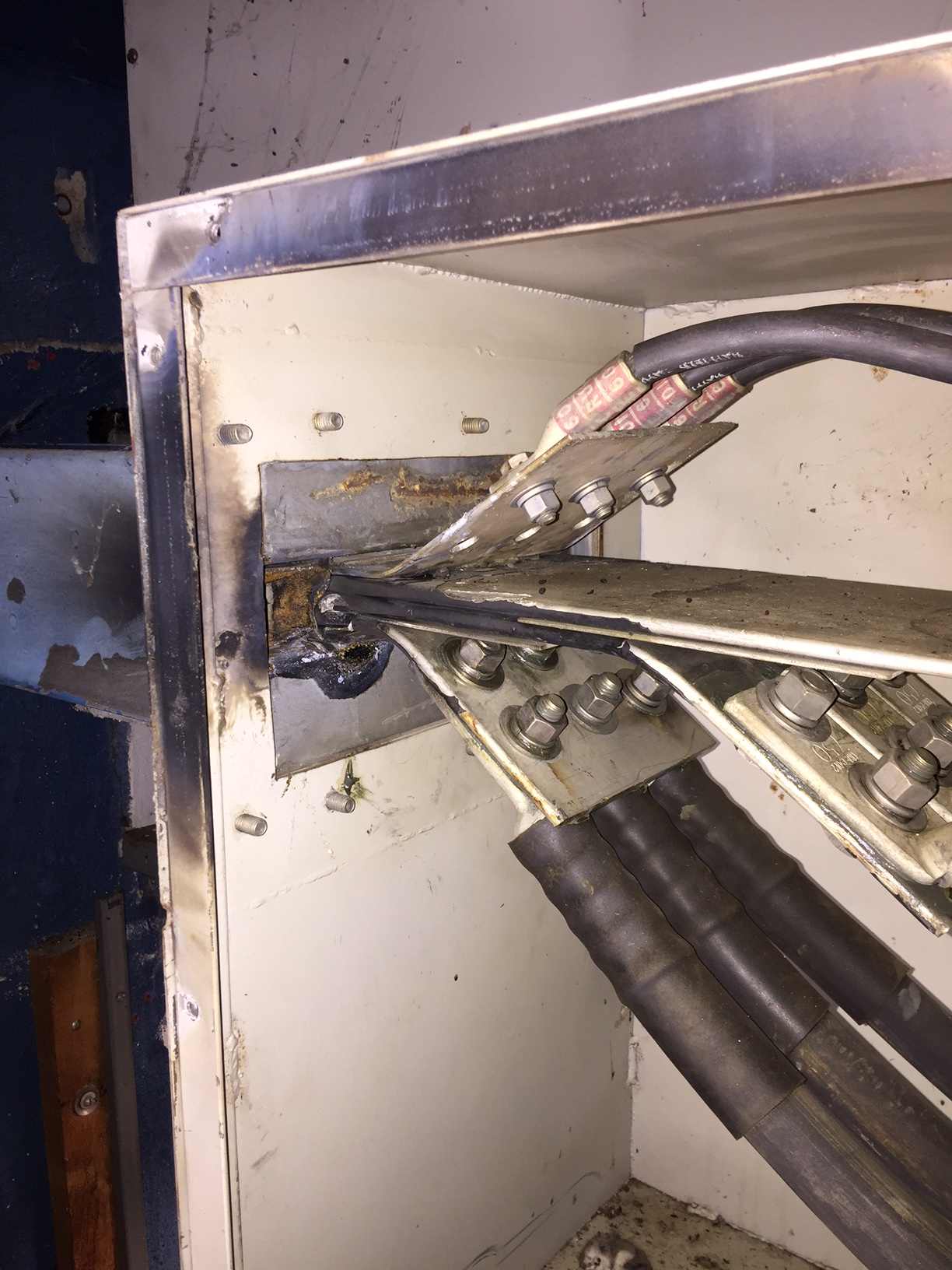
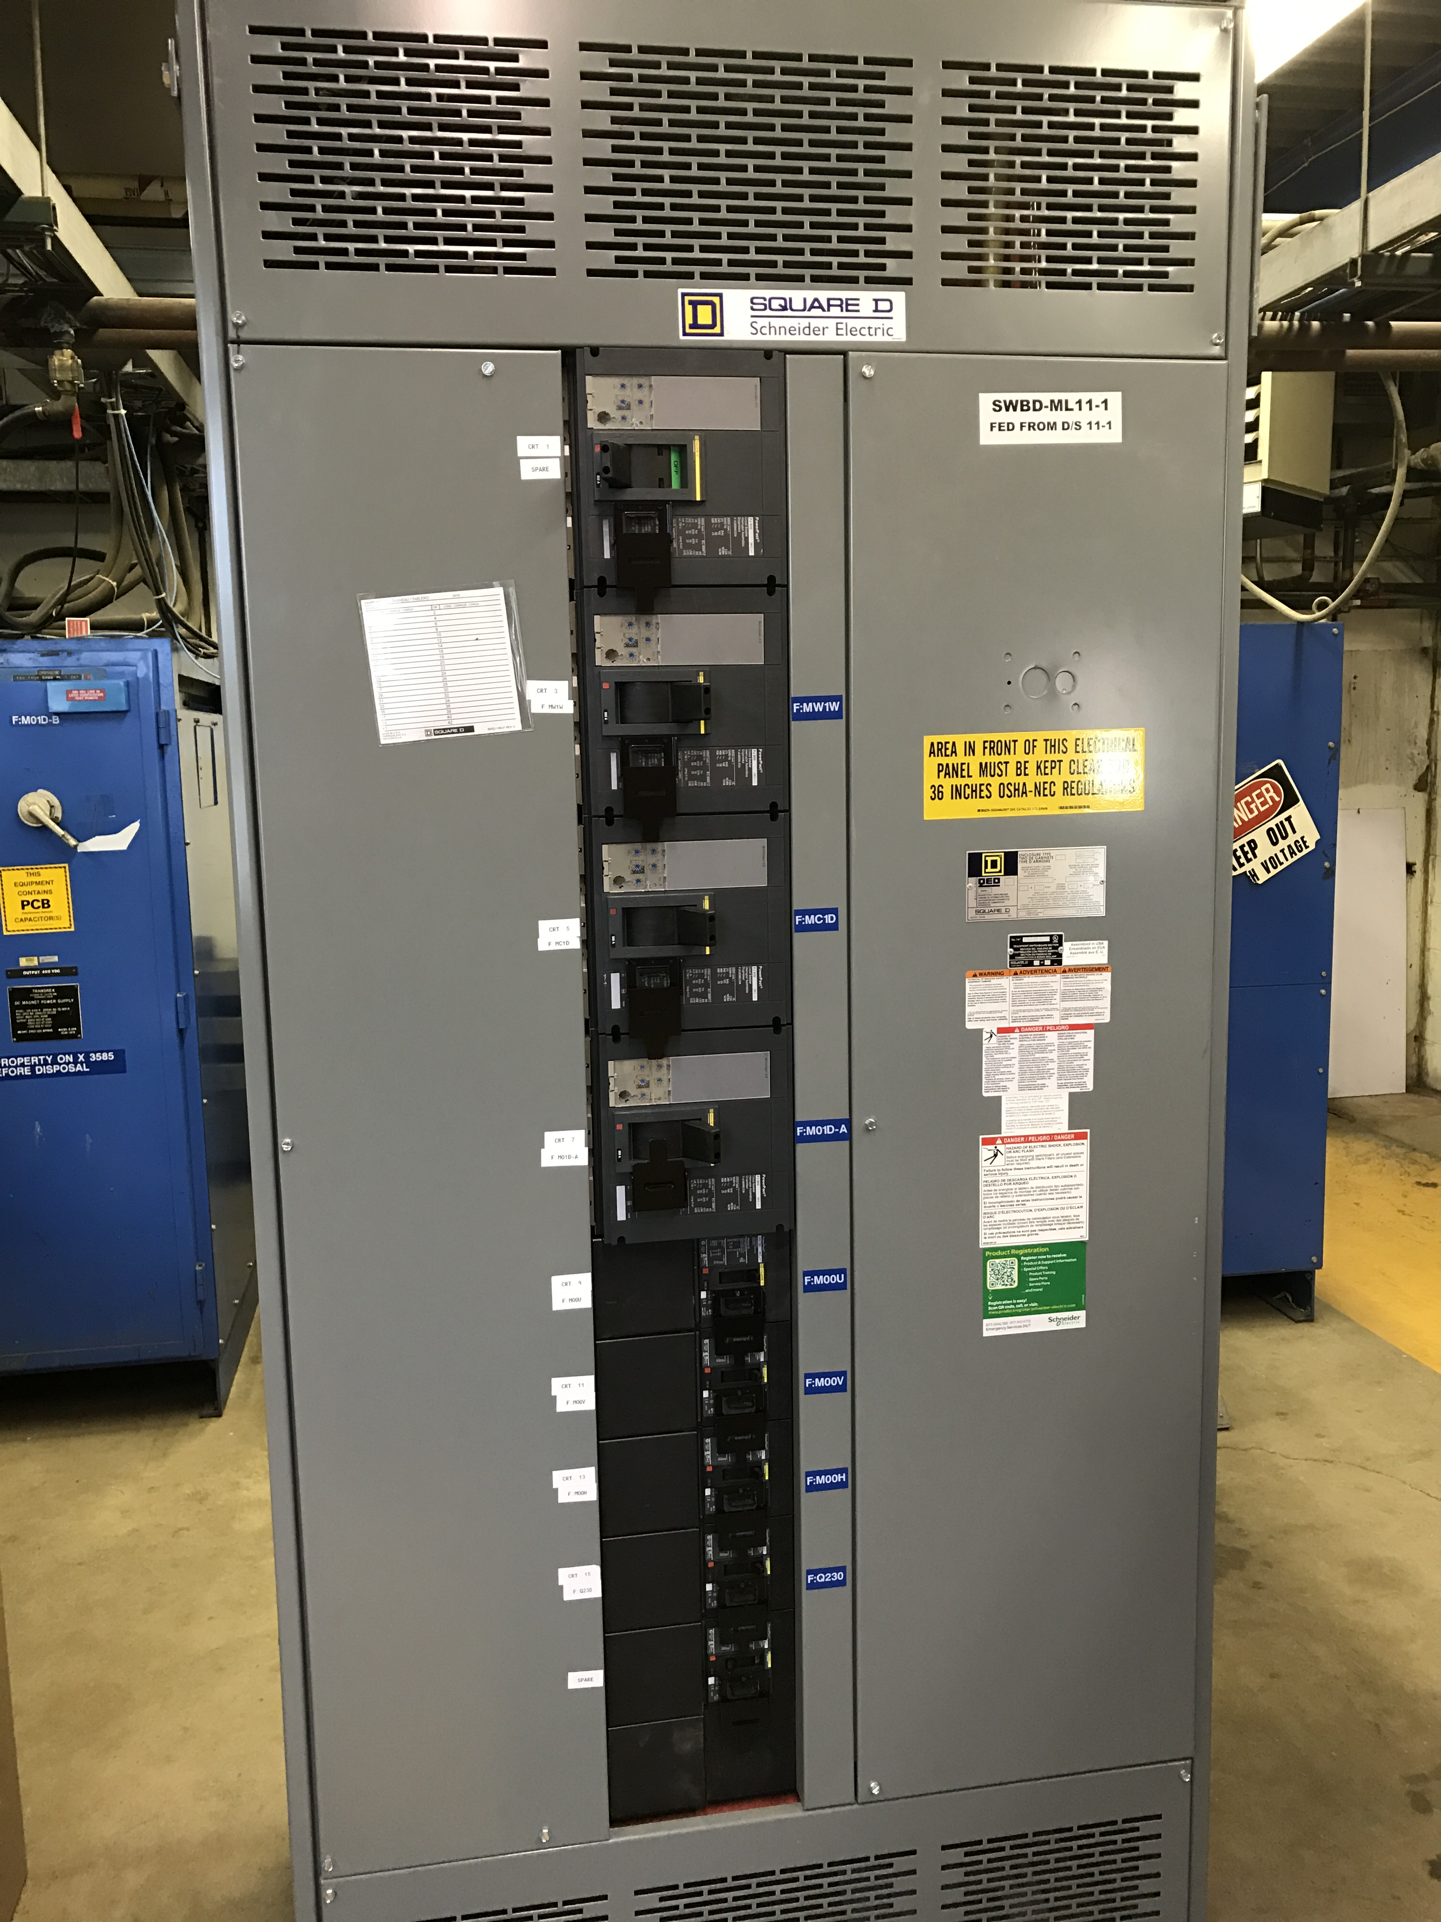
MS1 Bus Failure
All power supplies cabled into breaker panel
Work completed

Slide 11
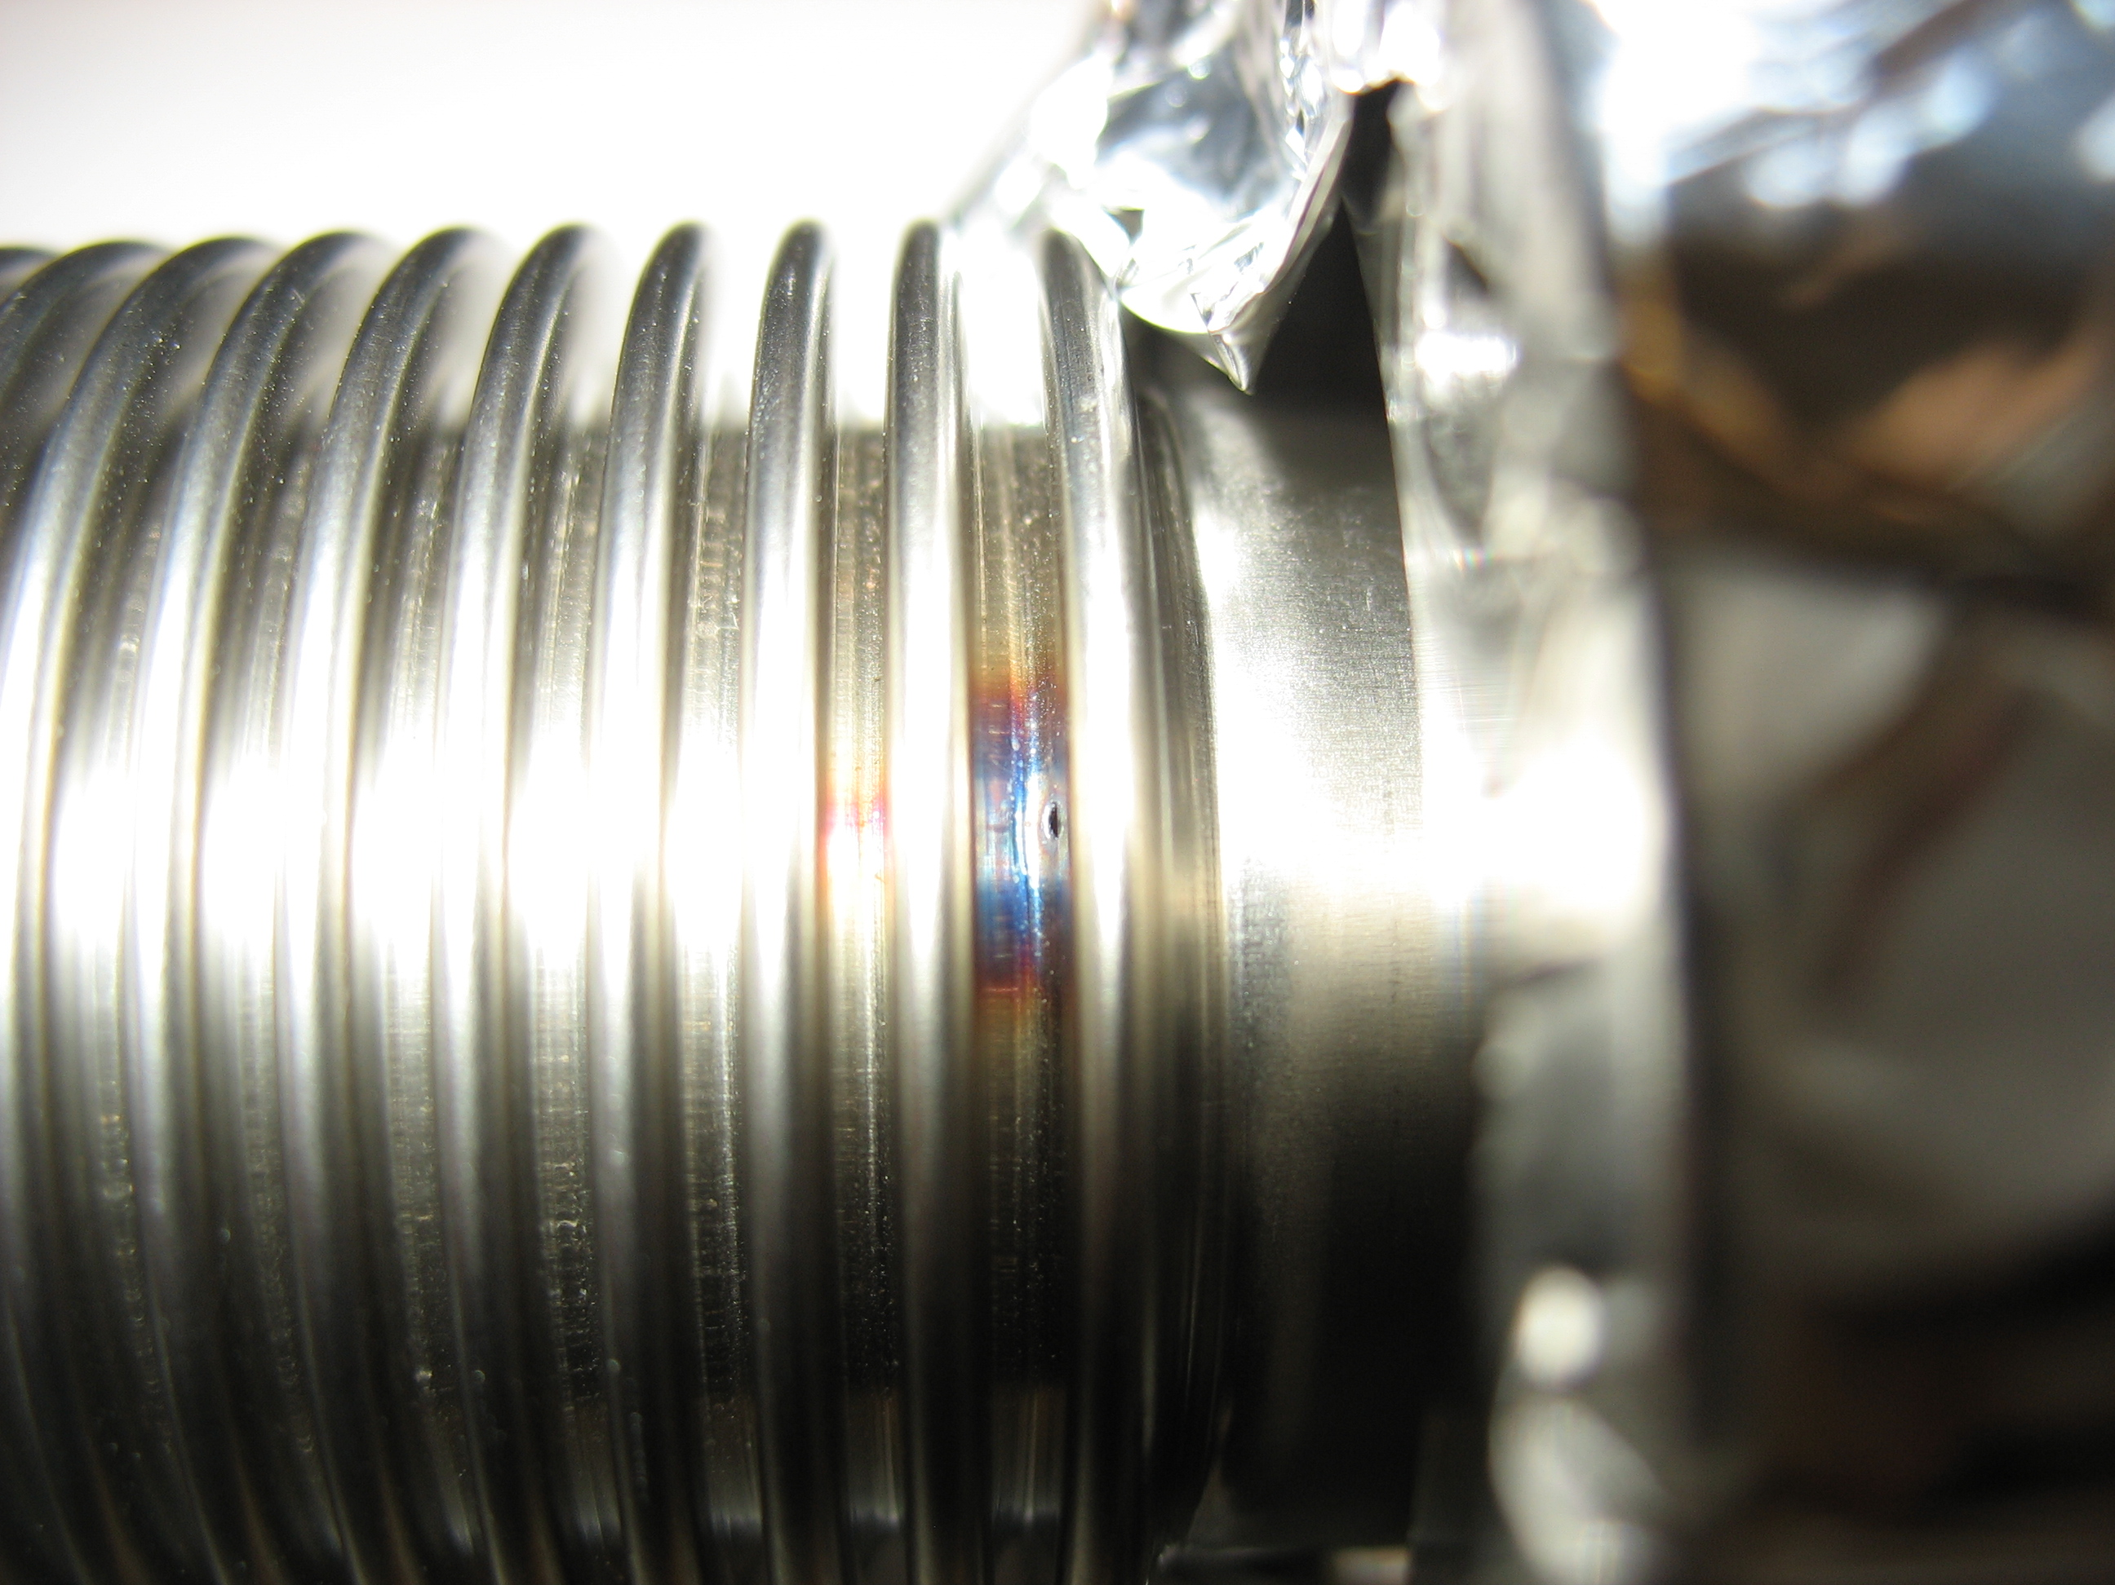
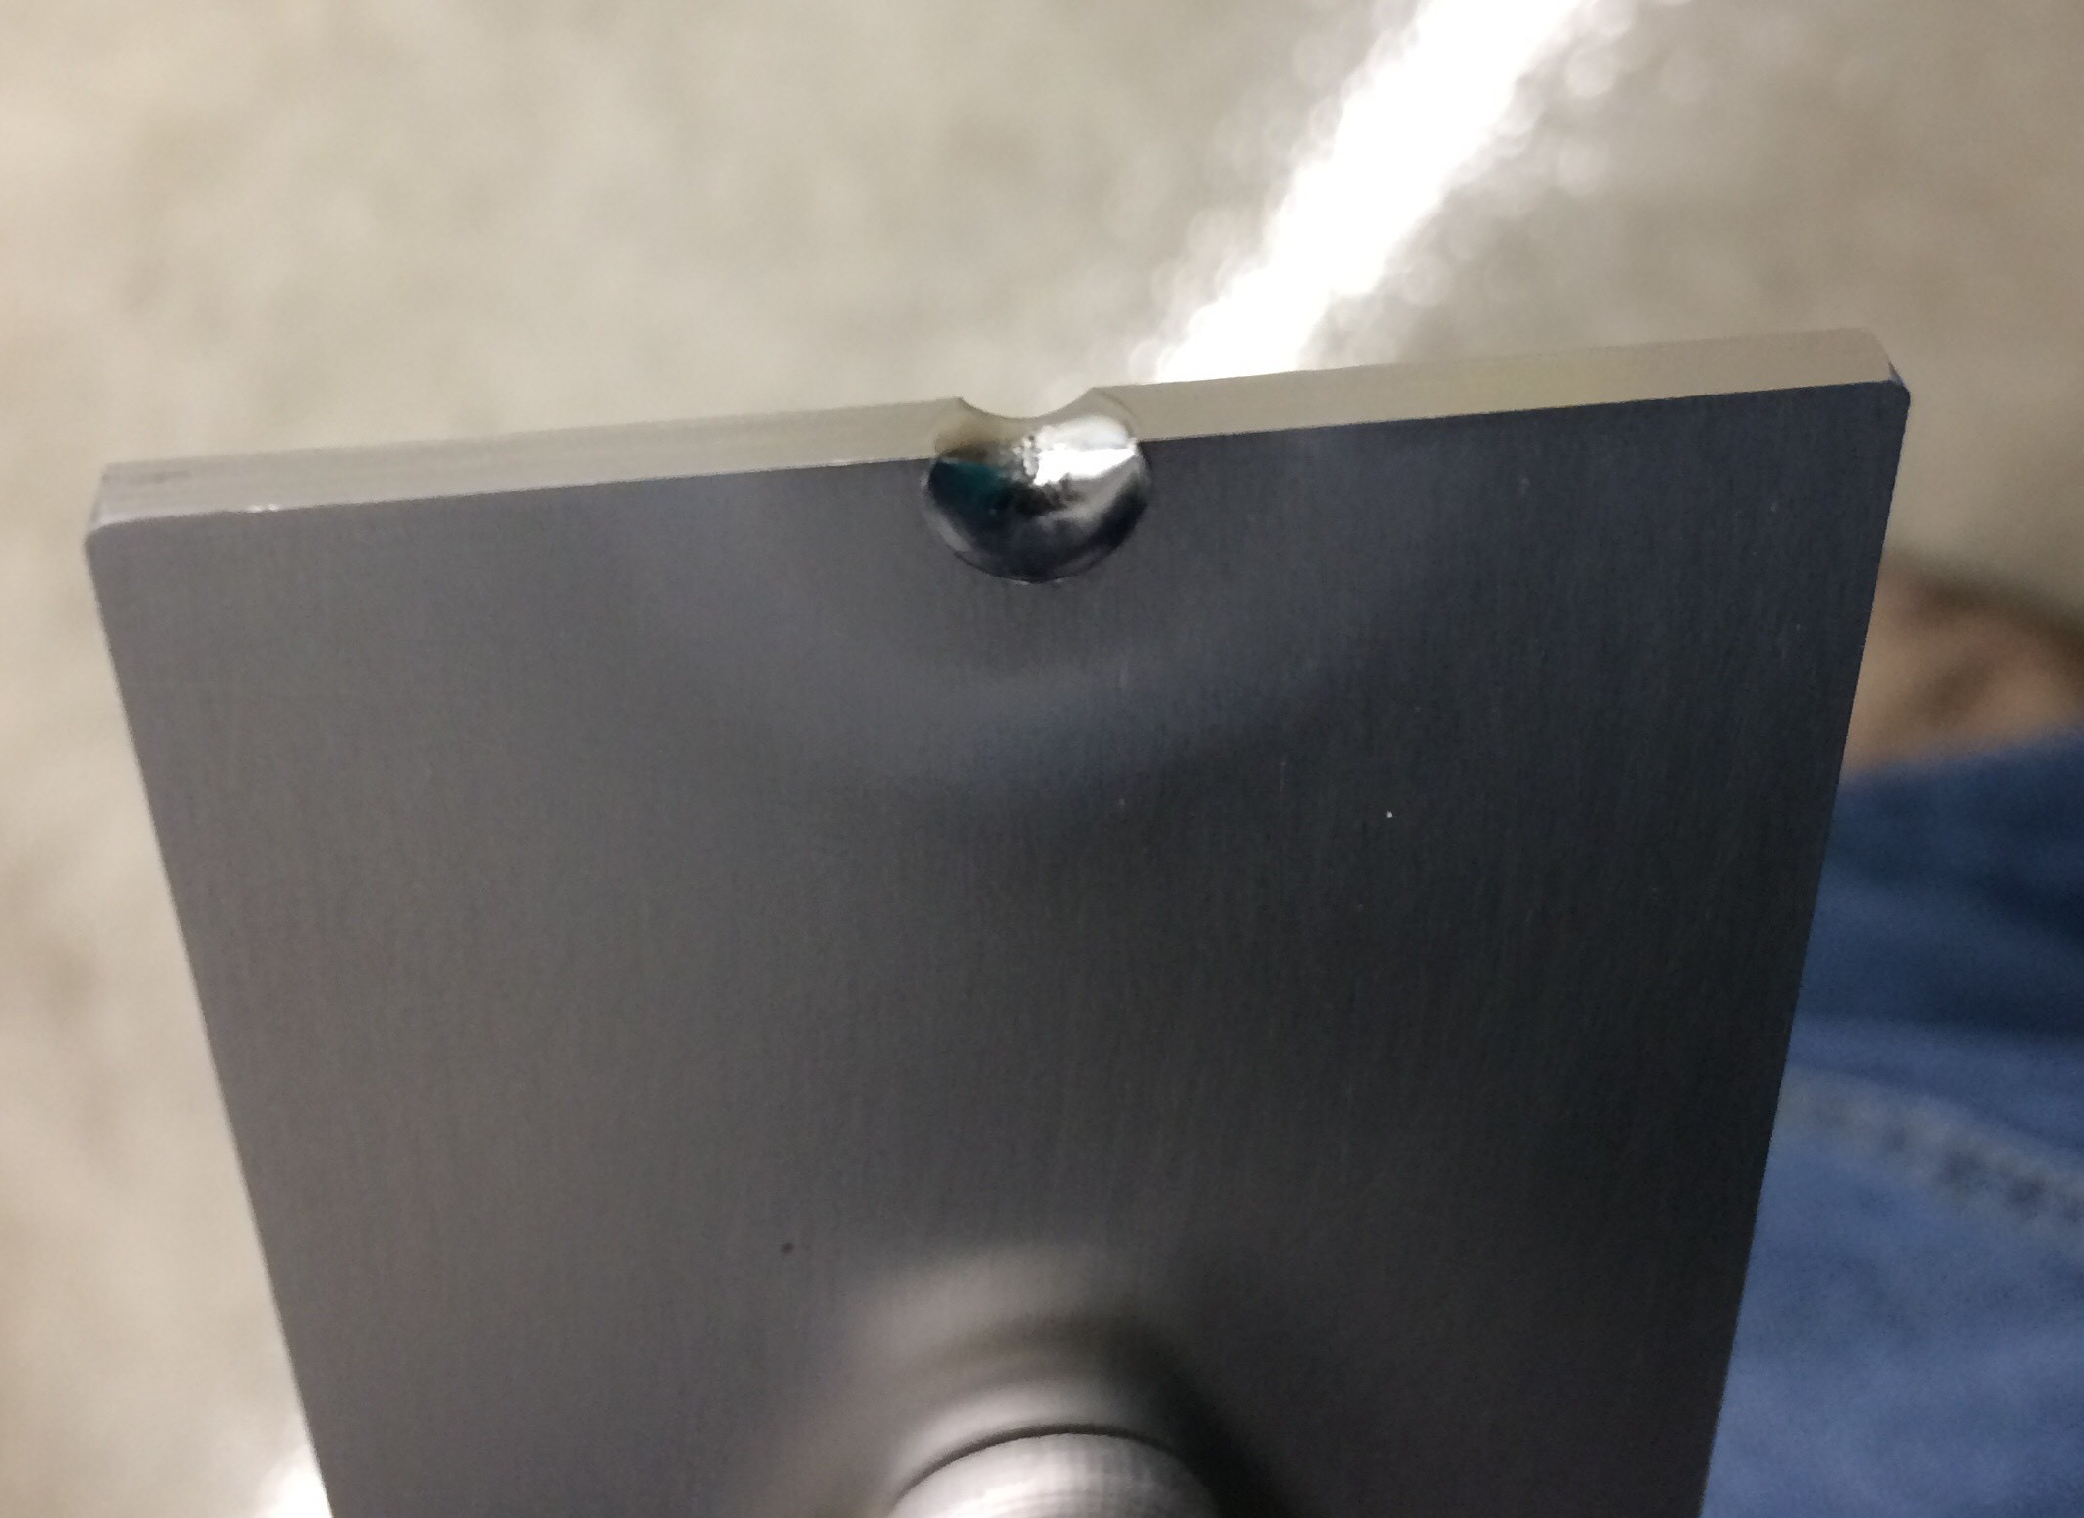
PIP-II Injector Test & FAST Status
PIP-II Injector Test
  During studies on Wed. 23rd
    Vacuum went to atmosphere
    Beam punched a hole in a bellows
    Investigating cause of the beam excursion
    Bellows and damaged collimator replaced and pumping down today
FAST
  No gun operation
  Shutdown for 300 MeV upgrade
  Cave Roof Block Installation complete
  Begin magnet and stand installation

Slide 12
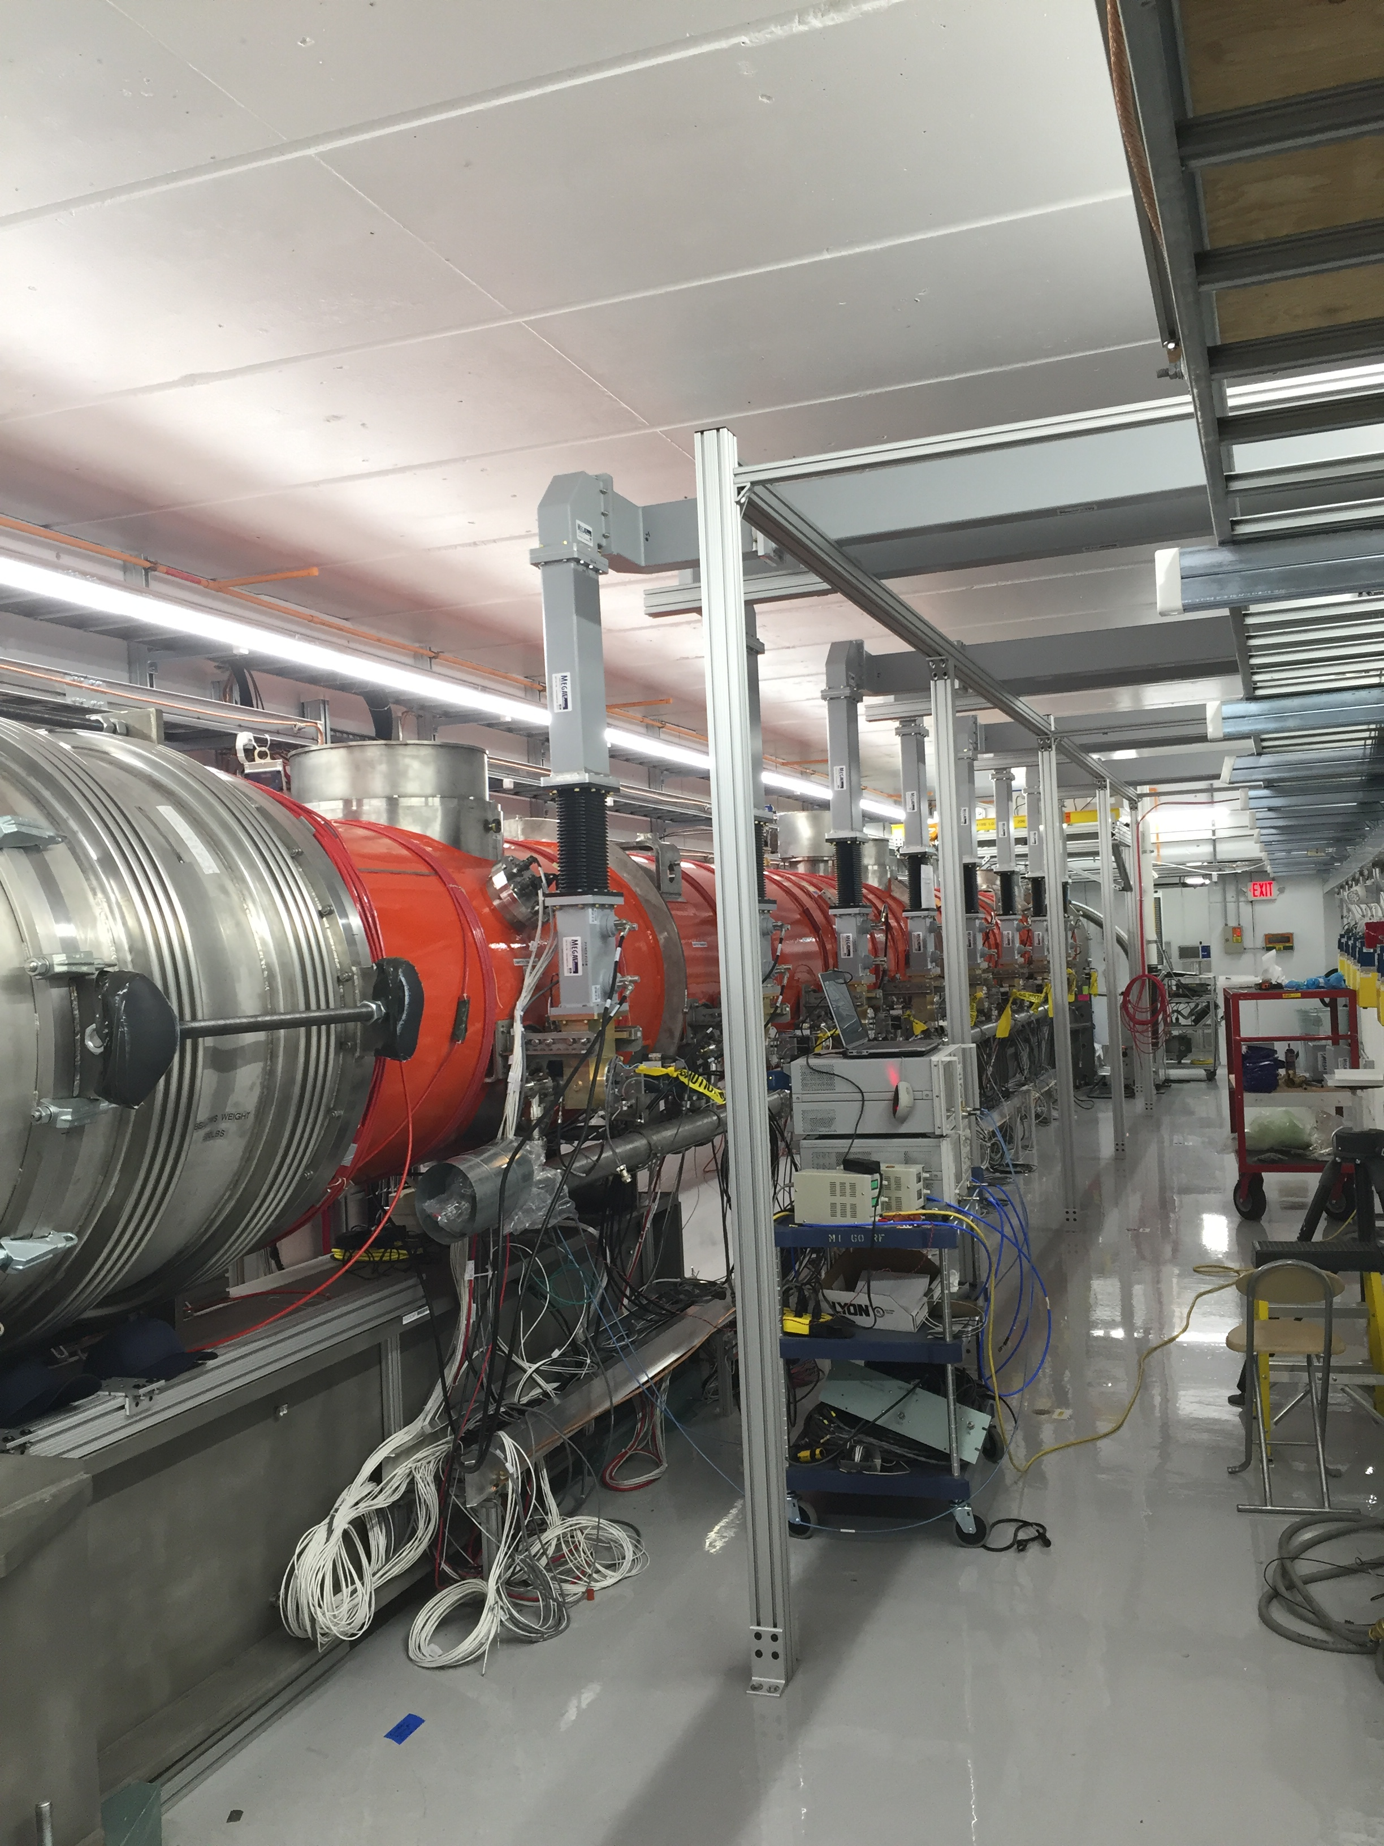
CMTS1 Status
LCLSII Prototype Cryo Module
  Cryo
    Cryo mechanical work complete
    Awaiting Review Committee approvals for cooldown
    Cooldown in late November/early December
  Accomplishments
    Attempt to repair leaking instrumentation port completed, leak check underway
    Faraday cup lead shielding supports built, leak bricks in-hand
  Plan for the week
    Installation of lead shielding around Faraday Cups
  Begin Cooldown and extended testing to follow into (January 2017)

Slide 13
ICW Reduction
Looking at measuring flows on systems
  Stakeholders impacted
    AD, TD, PPD, CD, FESS
      Need to establish new Casey’s Pond West Strainer Vault
      Everybody working on priority projects
        Will be difficult to line up downtime schedules
      Reducing flow will be painful
      Estimate two week reduction for work
      Performing measurements in late November
  Planning on early 2017 (January)
    Will know more after November measurements
    2 week reduction period
    Should not impact most experiments
    Will impact experiments/projects with cryogenic operation

Slide 14
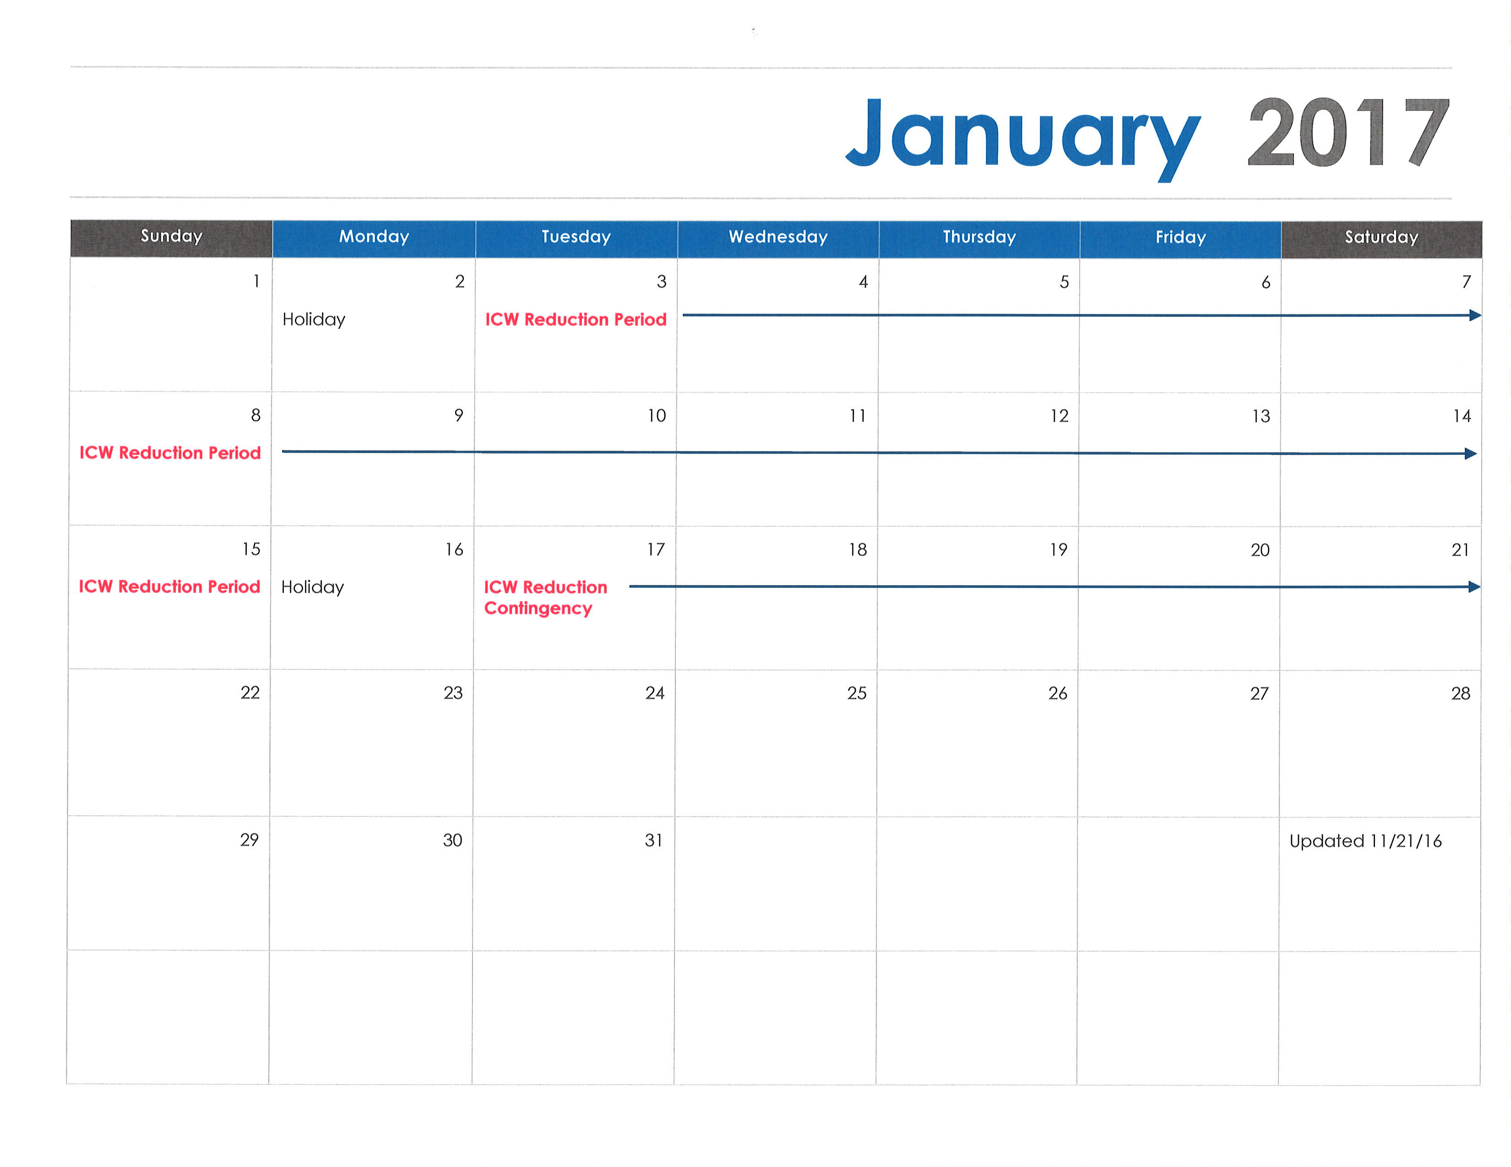
January 2017

Slide 15
Schedules and Links
Schedule can be accessed from the Operations Department Home Page
  Schedules -> Operations Schedule
Direct link to schedule
  http://www-ad.fnal.gov/ops/schedule.html

Slide 16














Collaborations / Partnerships / Members [22pt Bold]

