Slide 1
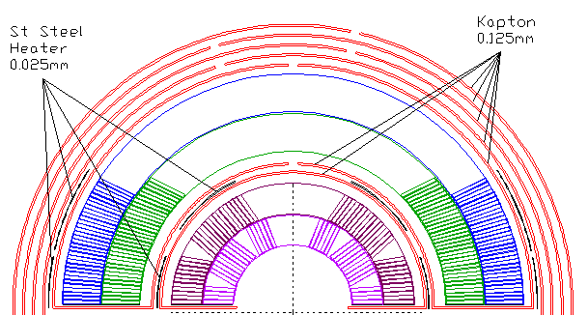
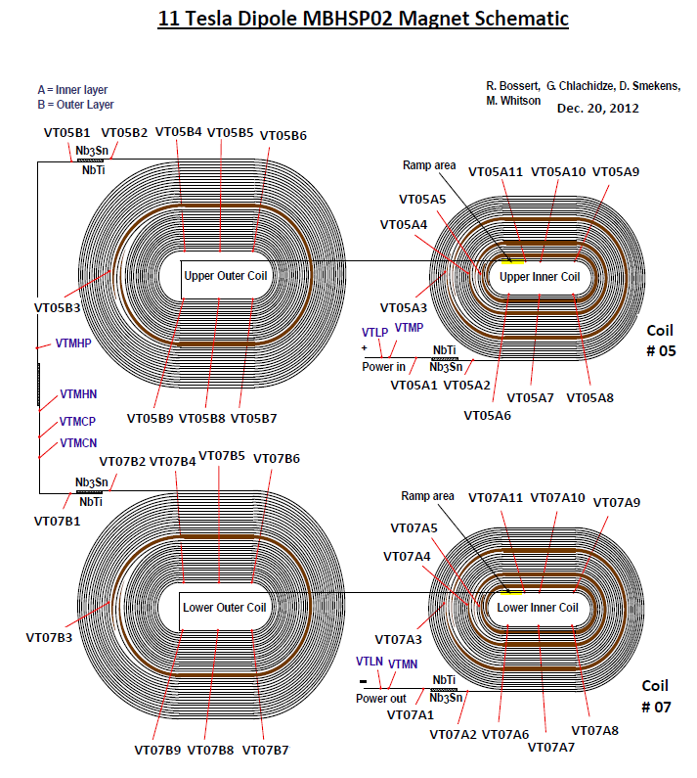
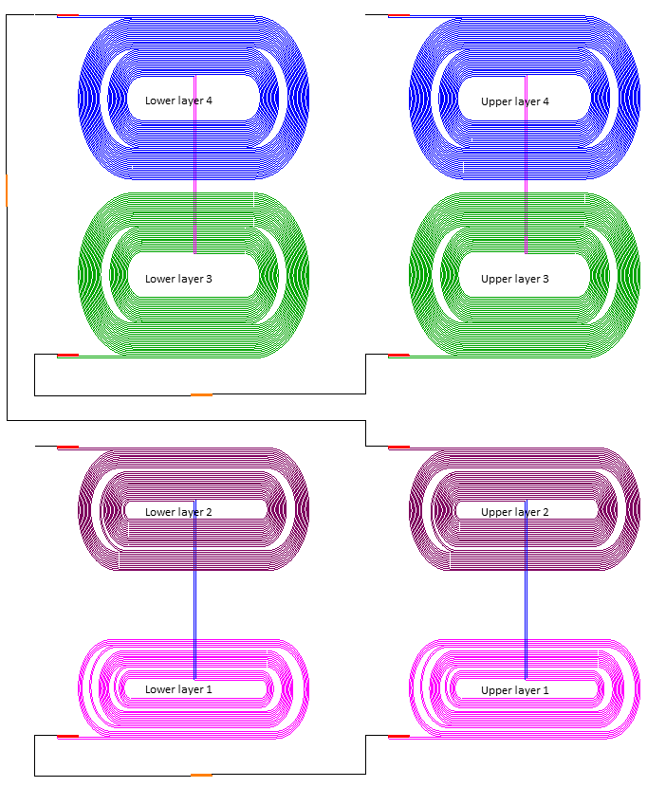
Voltage taps and heaters for 15 T
heaters
Layers 1 and 2 resemble the structure of a two-layer magnet
To be instrumented in a similar to past magnets way
Voltage tabs at the inner- and outer-most surfaces of the structure
Heaters at the outer-most surface
Layer 4 resembles the outer layer of a two-layer magnet (or layer 2 in our case)
To be instrumented in a similar to past magnets way
Voltage tabs and heaters at the outside surface
Layer 3 is very different from past
Limited number of voltage taps to be instrumented
insulation
{
Layers: 4 3 2 1
Very similar
11 T
4
3
2
1
15 T
similar

Slide 2
Voltage taps for 15 T
C7
C4
C6
C5
L3 (from above)
C3
L3 inner surface (from below)
C6
C3
C4
C5
C7

Slide 3
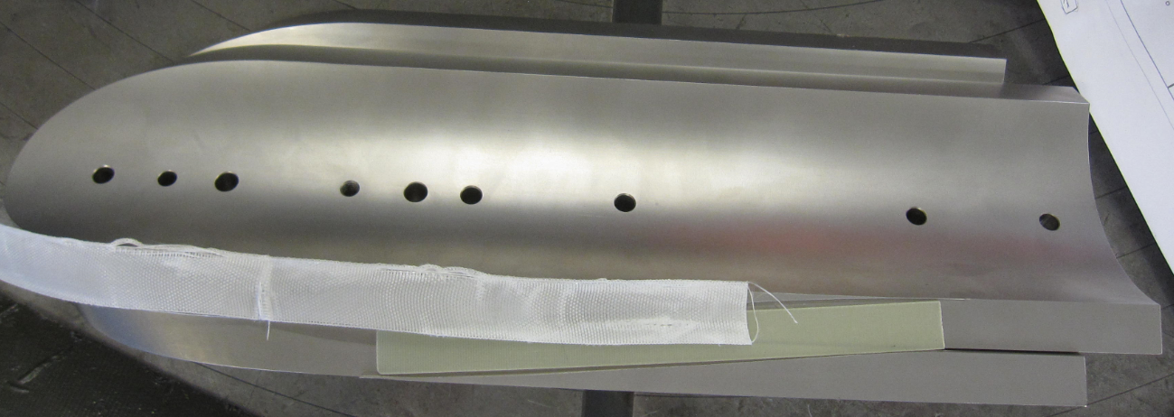
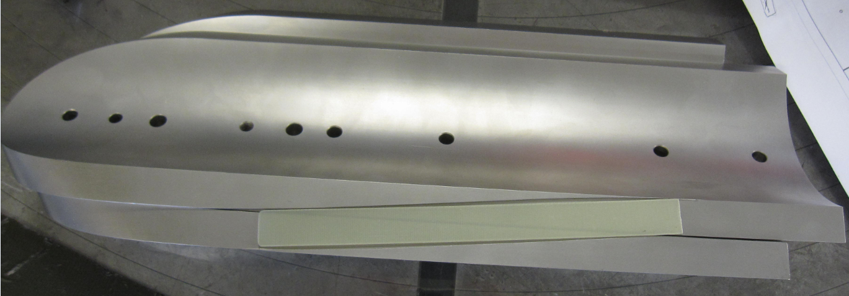
Voltage taps for 15 T
C4
Voltage taps in this area look risky
C7
L3 inner surface (from below)
C3
C4
C5
C6
C7
This whole area is the ramp up – better to be avoided

Slide 4
Voltage taps for 15 T
D4
D3
D7
L4 (from above)
D6
D5
D4
D7
L4 outer surface (from above)
D3
D6
D5

Slide 5
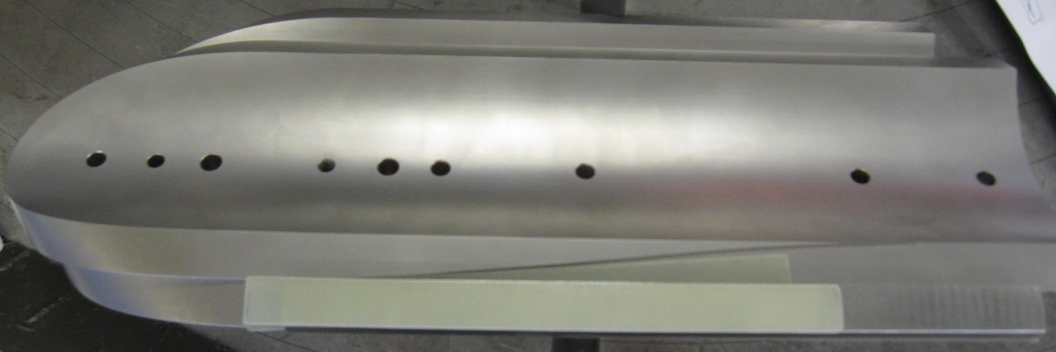
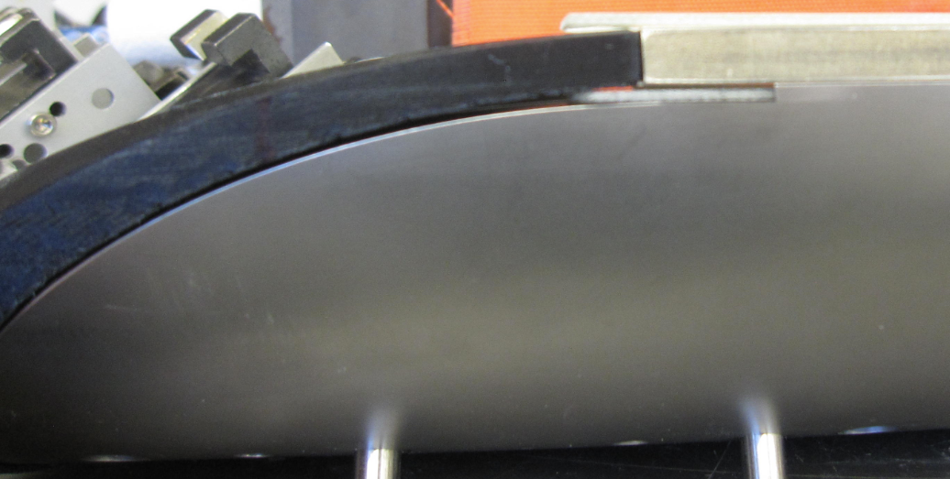
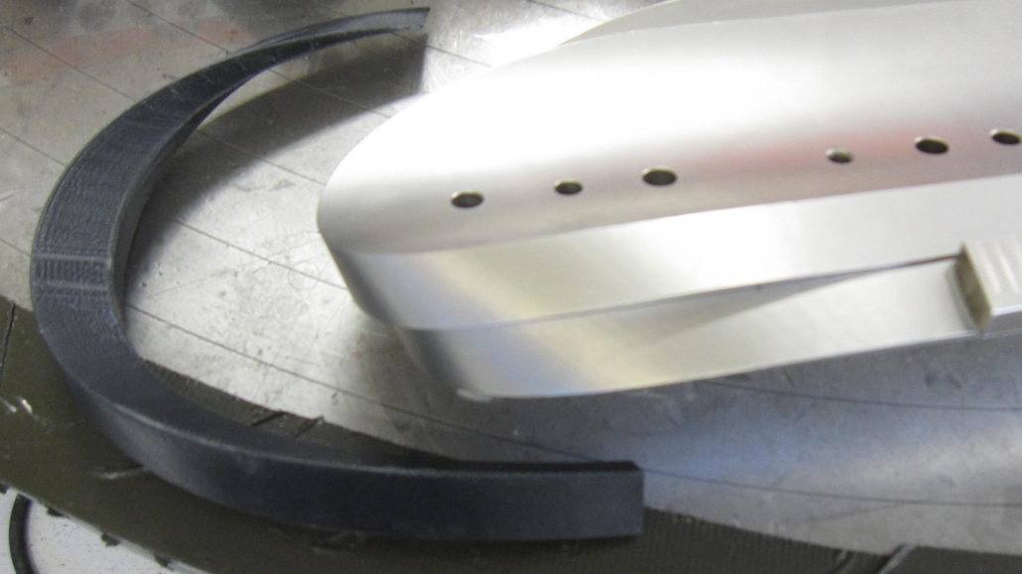
Voltage taps for 15 T
D4
D7
D4
D7
L4 outer surface (from above)
D3
D6
D5
This area to be avoided (actual metal piece)

Slide 6
L4 alternatives
Includes non-trivial non-pole (part) turn:
D5
D3
D4
Misses part of the pole turn:
D5
D4
D3
D6
D5

Slide 7
Examples (QXF)

Slide 8
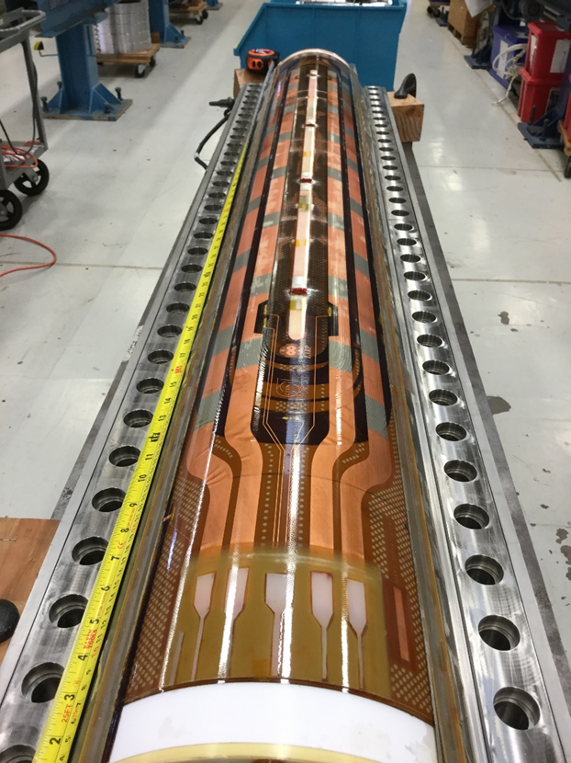
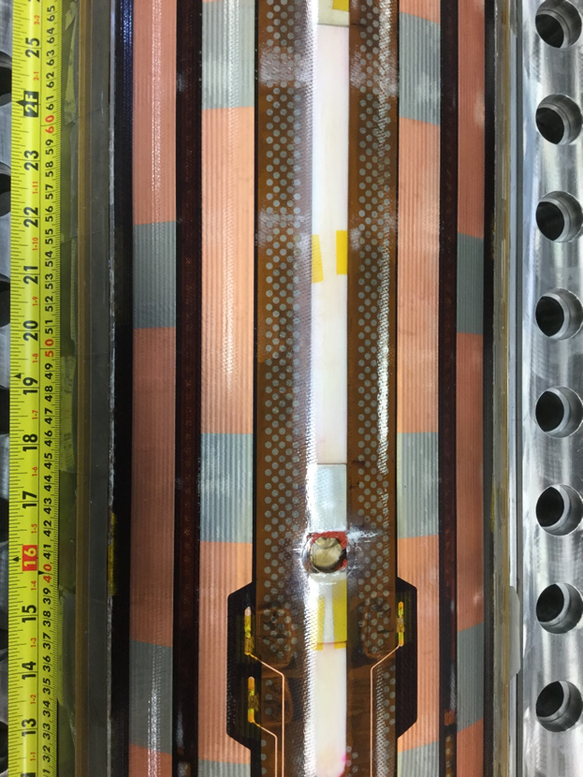
Examples (QXF)

Slide 9
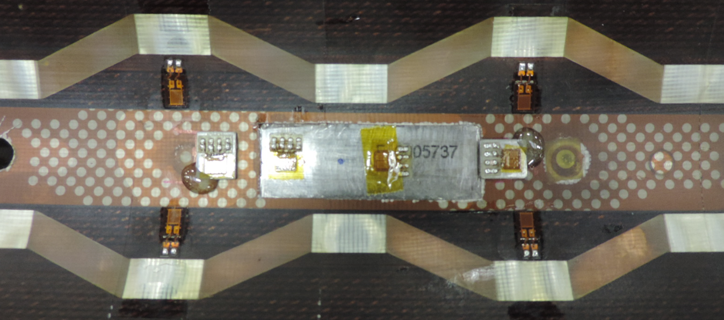
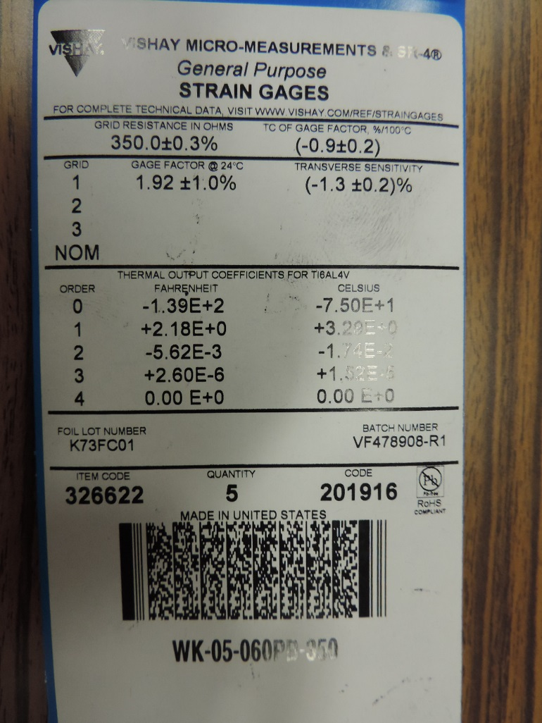
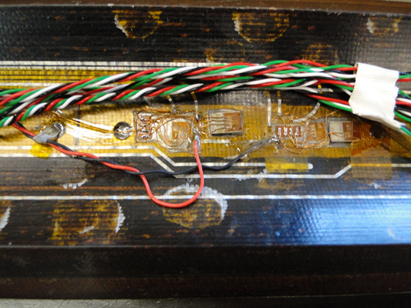
Stain gauges for the pole
No “pockets” in the pole for the first winding
(may use pockets in isolation?)
May have to abandon them for now
No space for twisted pair wires
It will be full bridge
configuration
Full bridge SG on the pole

