Slide 1
Chirality and Neutrinos
E Conley¹, D Jena², J Norris³, O Volcy⁴
The Problem:
Explain the difference between what we call neutrinos and antineutrinos in the Dirac and Majorana cases, clarifying the role of chirality in weak interactions and the difference between chirality and helicity.
Our Solution:
Chirality vs. Helicity
Chirality’s role in the weak interaction
Dirac vs Majorana Neutrinos--English
Dirac vs Majorana Neutrinos--Mathematics
Spinor Formalism
Dirac Formalism
Majorana Formalism
¹ Duke University, ² Fermi National Lab, ³ Idaho State University, ⁴ Laboratoire Leprince-Ringuet

Slide 2
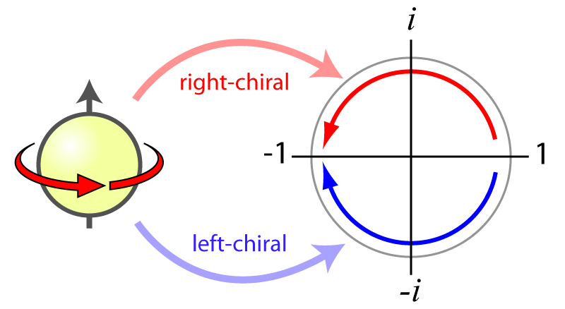
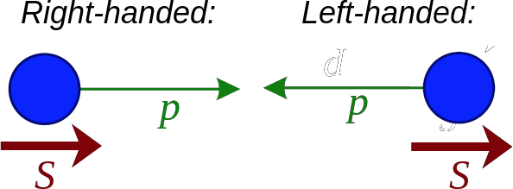
Chirality vs. Helicity
Chirality
Inherent quantum mechanical property
Lorentz invariant
Commutes with Hamiltonian for massless particles
Helicity
Projection of particle’s spin onto momentum
Lorentz invariant for massless particle
Commutes with Hamiltonian → conserved
F. Tanedo, “Helicity, Chirality, Mass, and the Higgs”, Quantum Diaries
https://en.wikipedia.org/wiki/Chirality_(physics)
(modified)
For a massless particle, chirality and helicity coincide.
Notes:
Chirality: how wavefunction behaves when the particle is rotated

Slide 3
Weak Interaction and Chirality
Charged current:
Left-handed chiral projection operator:
Charged weak interaction only couples left-handed chiral particles (or right-handed chiral antiparticles)
Neutrinos only made in weak interactions → all created as left-handed chiral particles
Probability of generating right-handed helicity neutrino:
Almost impossible
Since neutrino mass very small, helicity ~ chirality
Notes:
The charged current for the weak interaction contains the left-handed chiral projection operator
This isn’t to say that right-handed helicity neutrinos cannot be created; however, since the probability of this generation is dependent upon the mass (derivation not shown here), the odds of generating right-handed helicity neutrinos is almost impossible.
The meaning of the symbols in the CC equation will be explained shortly.

Slide 4
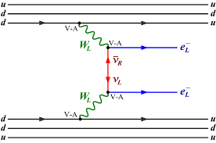
Dirac vs. Majorana Neutrinos--English
(with a picture)
In short, neutrinos and antineutrinos of the same flavor (e, µ, τ) are different particles if neutrinos are Dirac particles; if neutrinos are Majorana particles, then for a given flavor, the neutrino and antineutrino are the same particle.
As a result, neutrinoless double-β
(0𝝂ββ) decay:
is possible for Majorana neutrinos, but not for Dirac neutrinos. Thus, observation of 0𝝂ββ decay would demonstrate that neutrinos are Majorana particles.
Arnold, R. et al., Eur.Phys.J. C70 (2010) 927-943

Slide 5
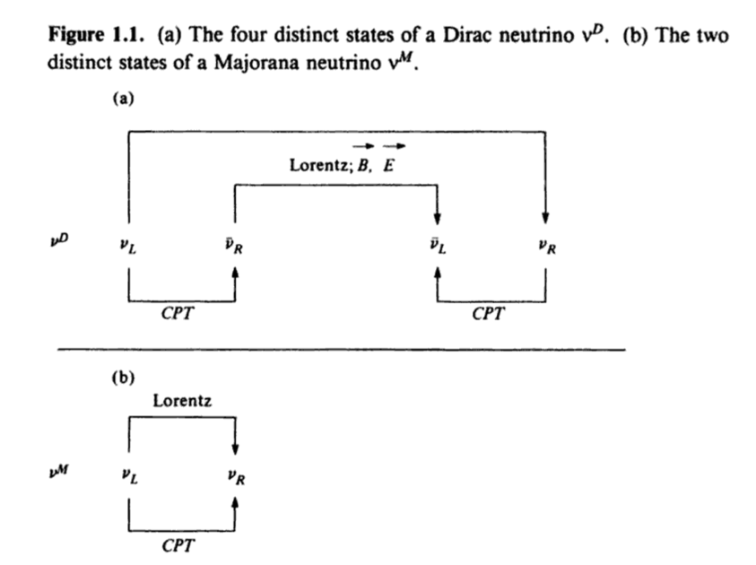
Helicity States for Dirac and Majorana Neutrinos
F. Boehm and P. Vogel. Physics of Massive Neutrinos. 2nd ed., Cambridge University Press, 1992
Notes:
Figure is from a textbook co-written by Vogel. Arrows can go either way; for example, performing a Lorentz boost on a Dirac left-handed antineutrino brings it to a right-handed antineutrino (although the arrow only shows the one direction). This diagram is a visual indicator that Dirac neutrino states have four degrees of freedom, while Majorana neutrino states have two degrees of freedom.

Slide 6
Spinor Formalism
Klein Gordon equation:
We use the Pauli matrices:
The Dirac matrices are defined as:
is the Dirac adjoint adjoint of the spinor
is the Chirality observable in the Dirac formalism
Notes:
When solving the Klein-Gordon equation, we find 2 solutions, one with positive and one with negative energies. But the negative energy solution have a negative probability density.
To solve this issue, we factorize the Klein-Gordon into two first-order equations.
This factorisation and an analysis on the coefficients makes the Dirac 4-matrices appear, as well as 4-dimension objects called Dirac-spinors.

Slide 7
Dirac Formalism - Part 1
By breaking the electroweak Lagrangian into a free Lagrangian and an electroweak interaction Lagrangian we can see:
The right-handed fermions and left-handed anti-fermions only propagate and do not interact via the weak interaction
The neutrinos and anti-neutrinos are electrically neutral and not coloured, and thus do not interact via electromagnetism nor strong interaction
Thus the right-handed neutrinos and left-handed anti-neutrinos exclusively propagate
Notes:
In this Lagrangian :
-the mass terms have been omitted because it breaks the electroweak-symmetry. Adding the couplings to the Higgs field would correct this.
-the coupling to the electromagnetic field has been omitted since we are only interested in the electro-weak phenomenology, but it should of course be considered if calculating propagators or decay channels

Slide 8
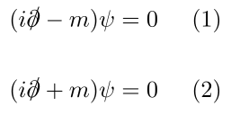
Dirac Formalism - Part 2
Spinors are solutions to (1) and the anti-spinors to (2). Hence, they are a free-basis for the Klein-Gordon equation.
takes a spinor ↔ an anti-spinor
The interaction Lagrangian is invariant under electroweak gauge symmetry group SU(2)
Furthermore, we see that only left-handed particles and right-handed anti-particles are involved in the electroweak interaction.
Notes:
(1) and (2) mean neutrinos and antineutrinos are represented by different fields.
There is no repetition in our Lagrangian--WORDING/MEANING

Slide 9
Majorana Formalism - Part 1
Dirac and Majorana spinor fields are defined with Weyl formalism:
By breaking down the electroweak Lagrangian into a free Lagrangian and an electroweak interaction Lagrangian we can see:
The right-handed Dirac-fermions and left-handed Dirac-anti-fermions only propagate and do not interact via weak interaction
The neutrino field is neutral and not coloured, thus do not interact via electromagnetism nor strong interaction
Notes:
Once again, no electronic coupling terms in the Lagrangian
-The mass terms for the Dirac fermions are to be added with the Higgs coupling. However it is different for the Majorana neutrinos who cannot produce a mass as Dirac fermions
-There are 2 different types of gamma matrices here. The ones labeled with a sign mix the electroweak doublet fields with
each other (neutrinos and electrons) while the one with the numbers couple the fields with the electroweak bosonic fields

Slide 10
Majorana Formalism - Part 2
There is no sterile neutrino in this formalism.
All the fields, independently of their handedness are coupled to the electroweak boson fields.
The electron and positron are coupled to the same field by the electroweak symmetry. That means neutrinos and anti-neutrinos are represented by the same field.
A charge conjugation leaves the neutrino field unchanged, which proves that neutrinos and antineutrinos are the same particle:
The interaction lagrangian is invariant by the electroweak gauge symmetry group
Furthermore, we see that only left-handed Dirac-particles, the right-handed Dirac-antiparticles and the Majorana neutral particle are involved in the electroweak interaction.

Slide 11
Conclusions
Chirality is a fundamental property of a particle whereas helicity is frame-dependent
Dirac neutrinos and anti-neutrinos are distinct particles
Majorana neutrinos and anti-neutrinos are not distinct particles

